Slide 1
Design of Physically Grounded Communication System
実世界コミュニケーション特論
Michita Imai
今井 倫太

Slide 2
4 Communication System in Real World and Focus of Attention
Dialogue system with a robot
  Disambiguation with sensor information
Logical framework between verbal expressions and nonverbal information (situations)
Focus of attention
  Recognizing situations with focus of attention for a dialogue

Slide 3
4.1 Dialogue system using sensor information:
Linta-I
Dialogue system for a real world robot
  Sensor Information

Slide 4
4.1.2 Dialogue in Real World
Person’s utterance is generated referring to a current situation or context.
They omit obvious information from their utterances.
  Close!
  A robot must use real world information to interpret it.

Slide 5
4.1.3 Ambiguity in Dialogue System
Linta-I
Linta-I tries to interpret user’s command which has incomplete expression, with sensor information.

Slide 6
4.1.3 Ambiguity in Dialogue System
Recognized
text
Structure
of text
Semantics
of text
Verbal
command
Speech
Recognition
Parsing
Interpretation
Situation and Context

Slide 7
4.1.3 Ambiguity in Dialogue System
Verbal
command
Recognized
text
Structure
of text
Semantics
of text
Ambiguity at Speech Recognition
Ambiguity at Parsing
Ambiguity at Interpretation
Speech
Recognition
Parsing
Interpretation
Situation and Context

Slide 8
4.1.4 Example of Interaction
U: Go forwad!
R: Should I go forward?
U: Yes.
R: I see. I proceed.
U: Stop!
R: Yes. I will stop.

Slide 9
4.1.4 Example of Interaction
U: Go!
R: Which direction should I go?
U: Right!
R: I cannot proceed to right.

Slide 10
4.1.4 Example of Interaction
U: Go forward!
R: I see. I proceed.
U: Wrong!
R: What is wrong?
U:Proceeding.
R:Yes. I will stop.

Slide 11
4.1.4 Example of Interaction
U: Go forward!
R: I see. I proceed.
U: Wrong!
R: Do you mention that proceeding is wrong?
U: Yes.
R. I see. I will stop.

Slide 12
4.1.4 Example of Interaction
U: Go forward!
R: I see. I proceed.
U: Wrong!
R. I see. I will stop.

Slide 13
4.1.5 Structure of Linta-I
Hardware structure

Slide 14
4.1.5 Structure of Linta-I
Speech
Recognition
Natural Language Processing
Action Generation
Words
Words
Response
message
Main Program
Sensor data
Robot state
Command
Response
message
US sensors
Speech
Synthesis
Robot

Slide 15
4.1.6 Natural Language Processing
DCG (Definite Clause Grammars)
Case Frame
Ex. Go forward!
  [proceed, [agent [robot]], [goal, [forward]], [source, X], [adv, Y]]

Slide 16
4.1.6 Natural Language Processing
Interpretation
DB
Speech recognition
Verbal
command
Real World
Parsing
Sensor
information
Context
Current
robot
action
Case frame
Condition 1
Condition 2
Robot action
Response utterance

Slide 17
4.1.7 Knowledge of Linta-I
Robot action
  Go forward
  Turn right
  Turn left
  Go Backward
  Stop
Object

Slide 18
4.1.7 Knowledge of Linta-I
Knowledge Frame
attribute
  safety
  distance
  robot_action
attribute | value
safety | danger warning normal safety
distance | 0 - 250 cm
robot_action | running no_running

Slide 19
4.1.7 Knowledge of Linta-I
Sensor Information
safety
normal
warning
danger
15cm
100cm
200cm

Slide 20
4.1.8 Example of interpretation
[proceed, [agent, [robot]], [direction, [front]], [adv]]
action: go_forwad
speak: [ok]
I see. I proceed.
front_sensor_output
state_of_robot

Slide 21
4.1.9 Constraints on decision
Wrong!
  [reject, [object A]]
Go forward!
  [proceed, [agent, [robot]], [direction, [front]], [adv]]

Slide 22
4.1.10 Response utterance
[where]
  Where should I go?
[yes_no, [proceed, X]]
  Do I go toward X?
[yes_no, [subject, X]]
  Do you mention X?
[what_object, X]
  What is X?

Slide 23
Linta-I

Slide 24
4.2 Logical framework between verbal expressions and nonverbal information

Slide 25
4.2.1 Situation and Attitude
Theory of meaning of situated expression
  Jon Barwise and John Perry, 1983
  The meaning changes according to a current situation.
Relation between verbal expression and situations.

Slide 26
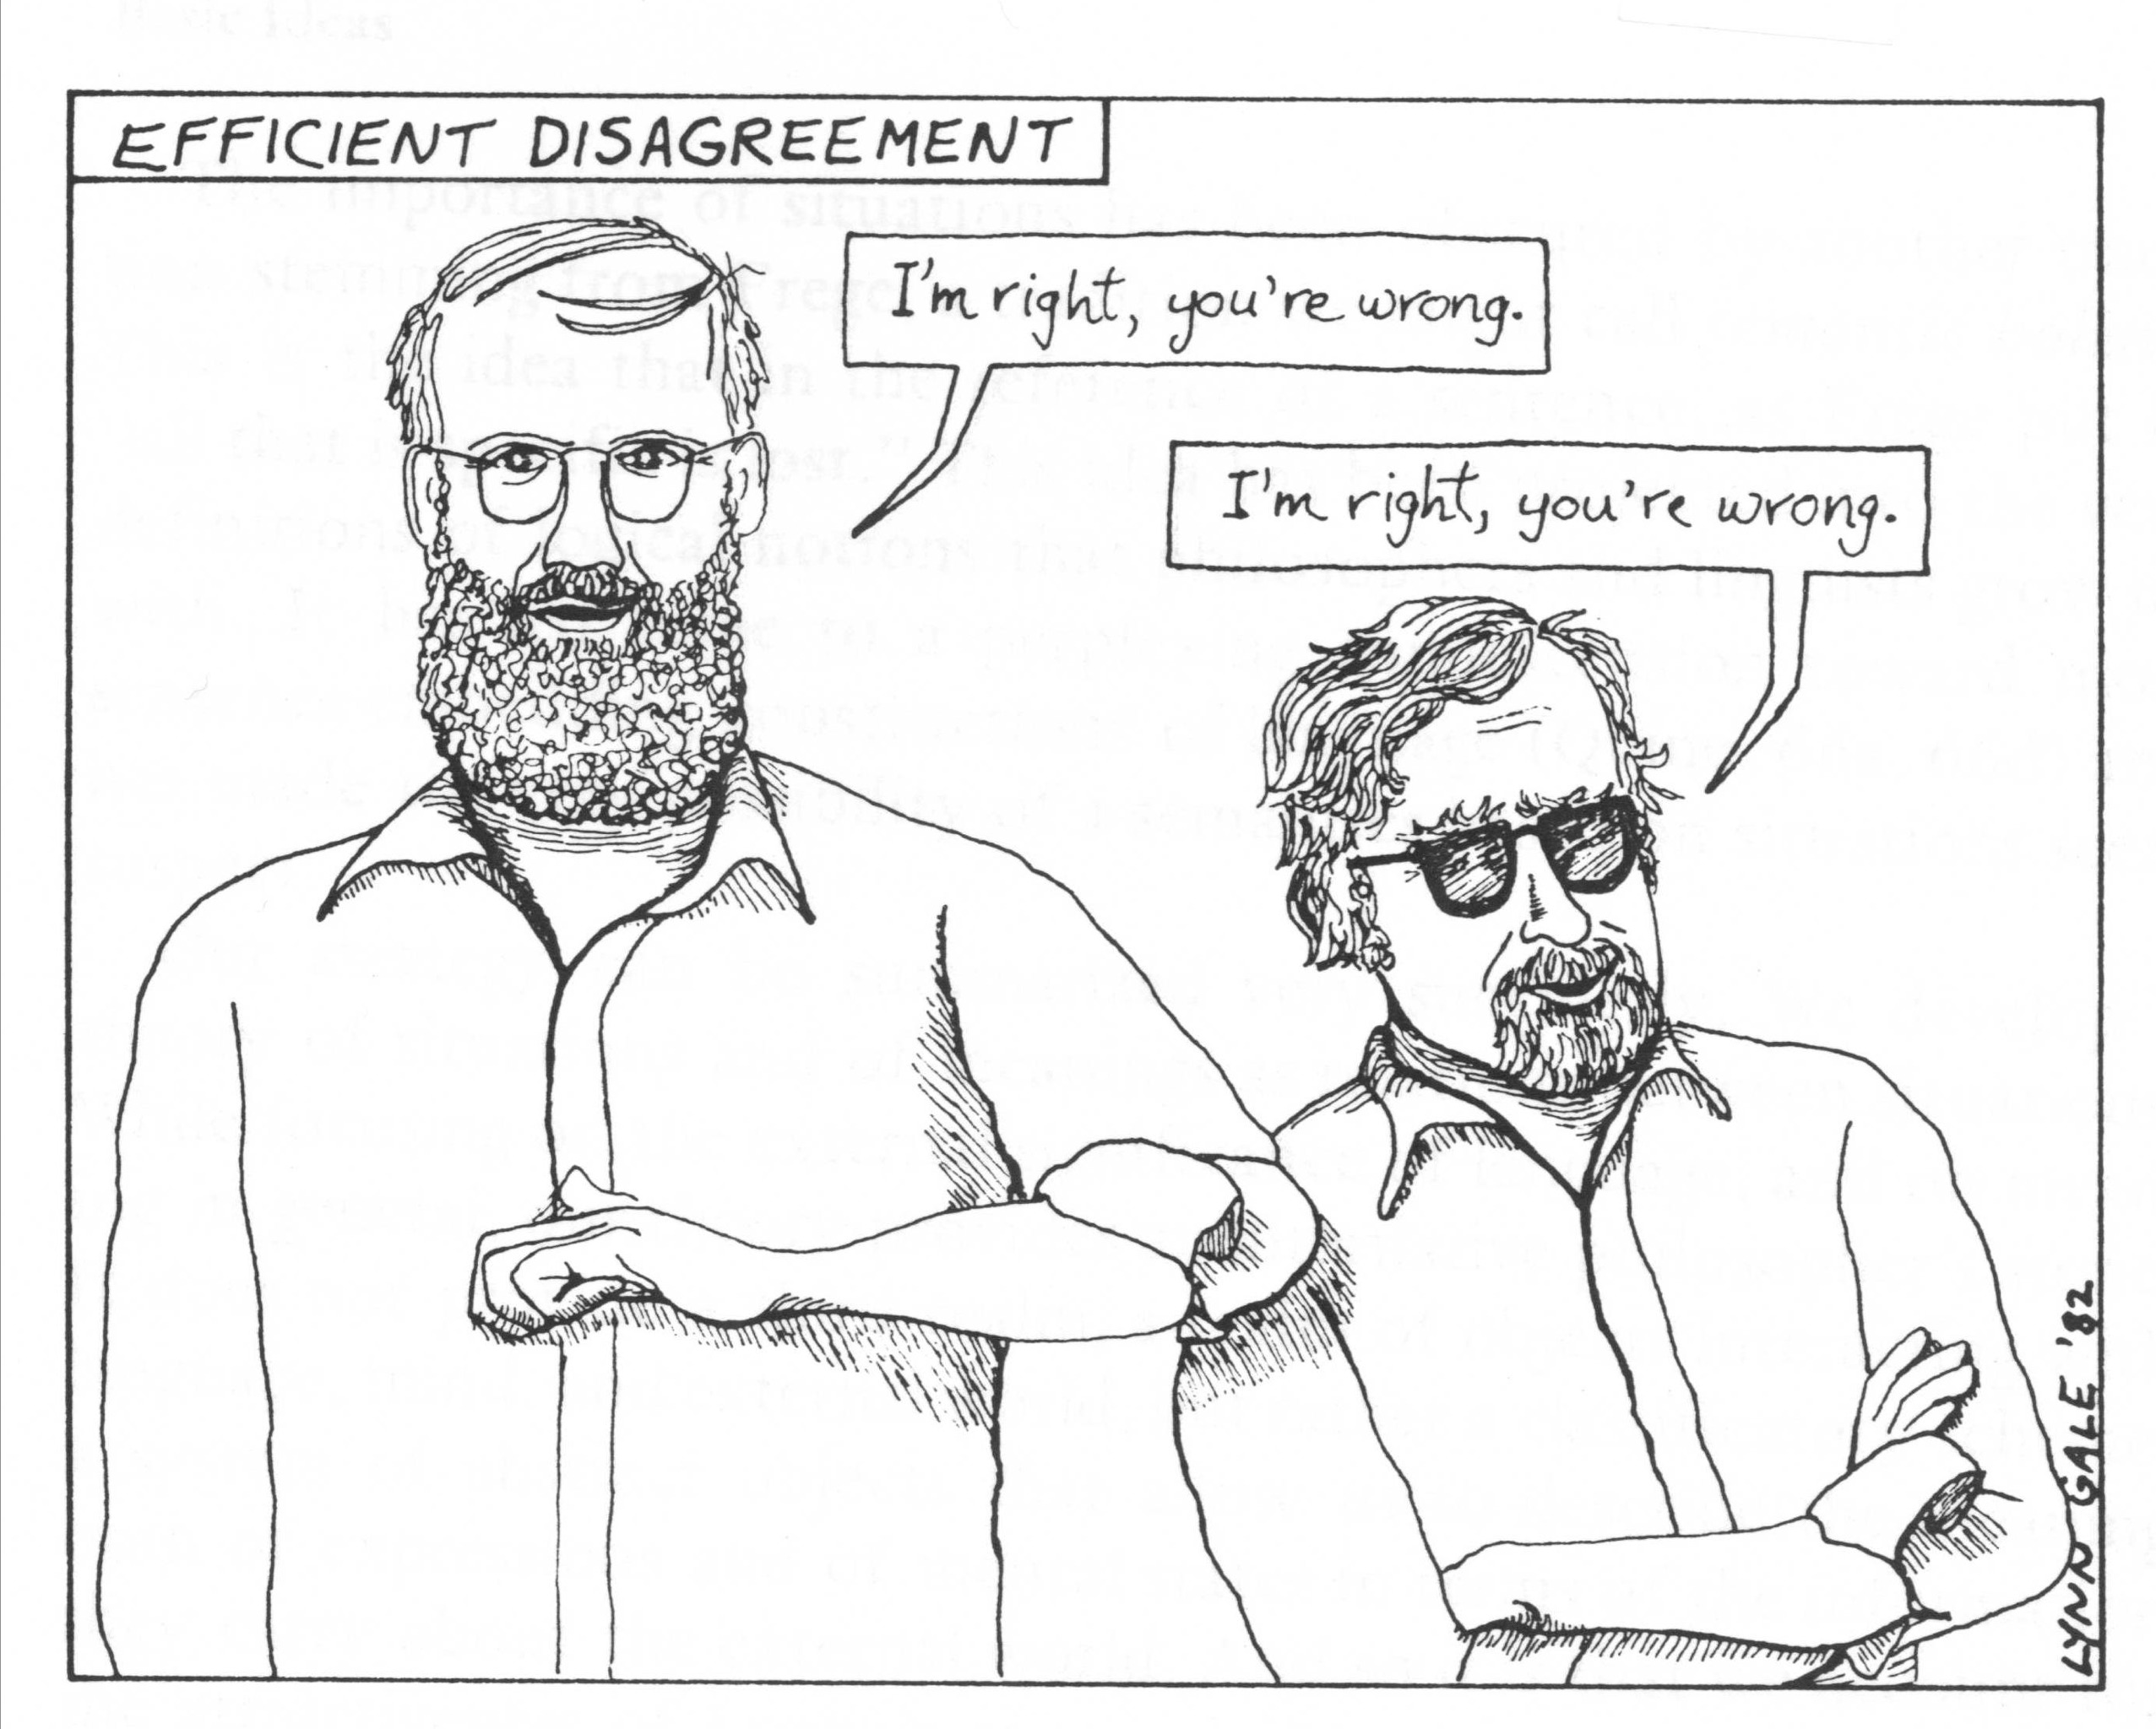
4.2.2 Situated Expression
I’m right, you’re wrong.

Slide 27
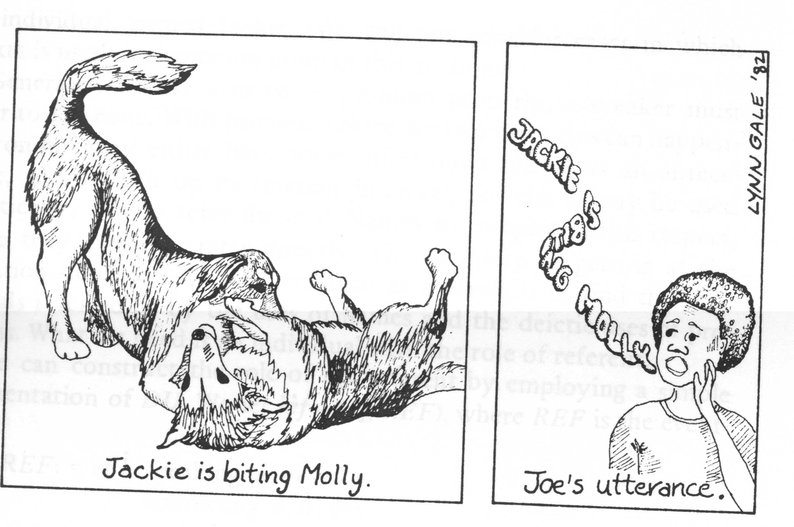
4.2.2 Situated Expression
Jackie is biting Molly.

Slide 28
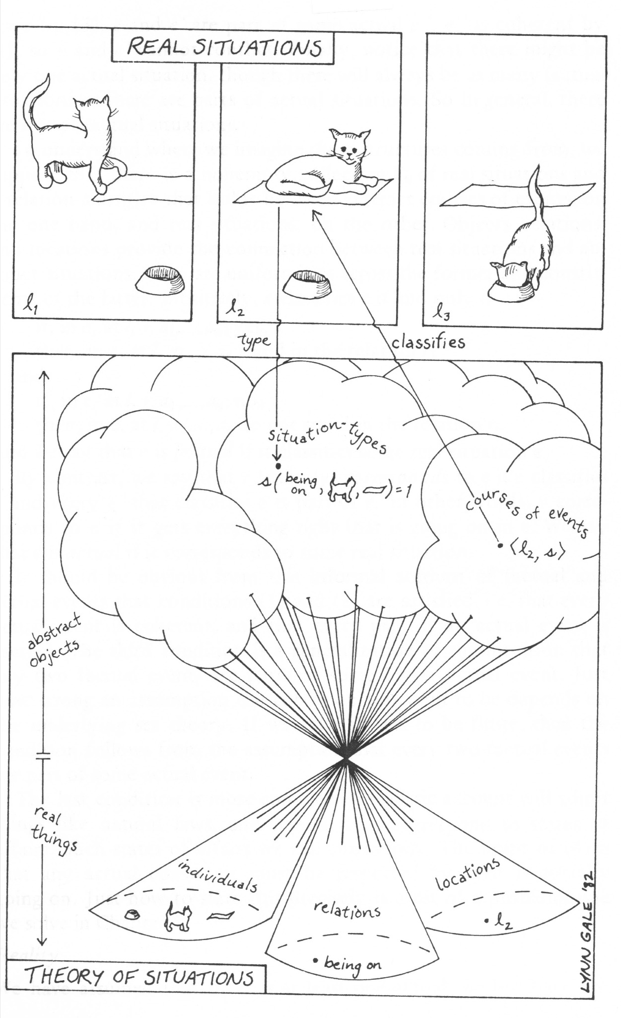
4.2.3 Relation between Physical event and Logical from

Slide 29
4.2.4 Logical From
u[[I AM SITTING]]e
  u denotes a discourse situation; who is speaking, when and where, what words are being uttered, and to whom.
  e denotes a recognized/described situation; what events occur and where.
  in u: at l: speaks, a; yes
  in e: at l: sits, a; yes

Slide 30
4.2.4 Logical Form
u[[I AM SITTING]]e
  in u:
  at l: speaks, a; yes
  referring-to,Miss a,
  I,a;yes
in e:
at l: sits, a; yes
I am sitting.
Miss a

Slide 31
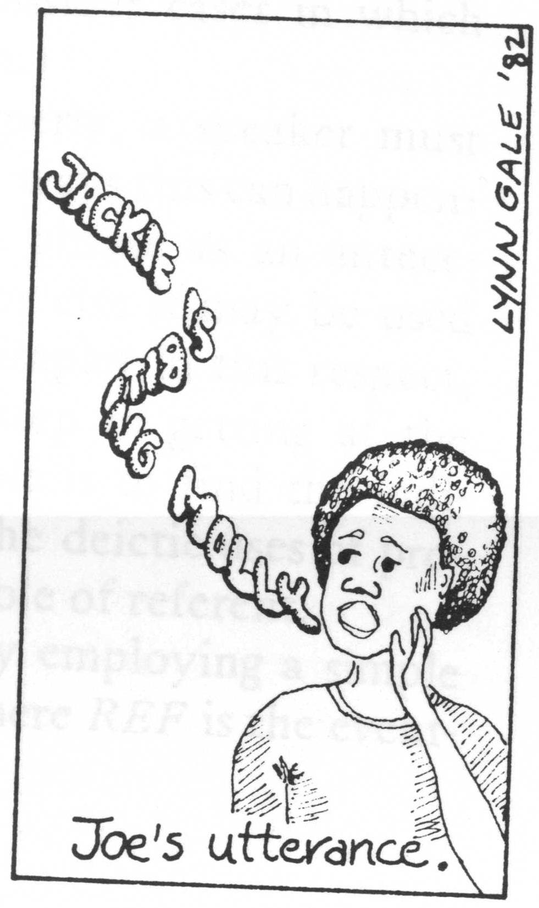
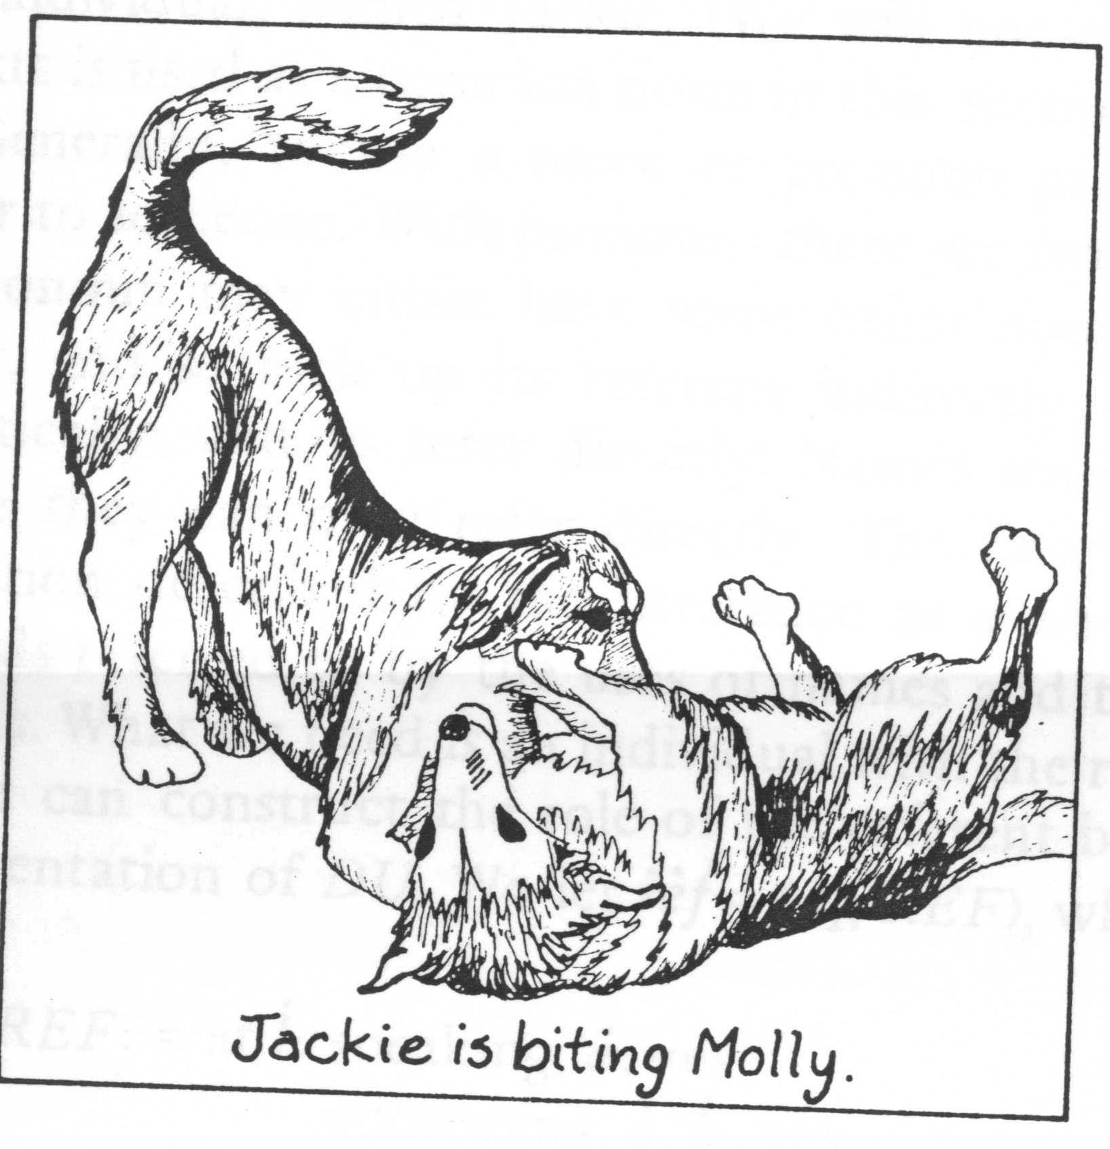
4.2.4 Logical Form
Jackie is Jonny’s dog.
Molly is Joe’s dog.
at l1
at l2
at l1:
speaking, Joe; yes
addressing, Joe, Jonny; yes
referring-to, Joe, JACKIE, Jackie;yes
referring-to, Joe, MOLLY, Molly;yes
at l2:
biting, Jackie,
Molly, yes
u[[Jackie is biting Molly]]e

Slide 32
4.2.4 Logical Form
Jackie is Jonny’s dog.
Jonny is unfamiliar to Molly.
at l1
at l2
at l1:
speaking, Joe; yes
addressing, Joe, Jonny; yes
referring-to, Joe, JACKIE, Jackie;yes
referring-to, Joe, MOLLY, b;yes
at l2:
biting, Jackie,
b, yes
u[[Jackie is biting Molly]]e

Slide 33
4.2.4 Logical Form
Mr. A
right
Mr. B
wrong
at l1:
speaking, A; yes
addressing, A, B; yes
referring-to, A, I, A;yes
referring-to, A, YOU, B;yes
at l1:
right,A;yes
wrong,B;yes
u[[I am right. You are wrong.]]e

Slide 34
4.2.4 Logical Form
Mr. A
wrong
Mr. B
right
at l1:
speaking, B; yes
addressing, B, A; yes
referring-to, B, I, B;yes
referring-to, B, YOU, A;yes
at l1:
right,B;yes
wrong,A;yes
u[[I am right. You are wrong.]]e

Slide 35
4.2.5 Applications for Actual System
How to recognize a situation
How to select relevant information
  The selected information forms a discourse situation.
Robot must recognize relevant situation from sensor data.

Slide 36
4.3.1 Requirement of Focus of Attention
Natural Language and Situated Expression
  Situated logical expression introduced by Situation and Attitude
Focus of Attention
  Select relevant information from sensor information
  Construct relationship between situation and language

Slide 37
4.3.1 Requirement of Focus of Attention
Application of situated expression for Actual System like Linta
  how to recognize a situation
  how to select relevant information for the expression
Attention for Communication System: the selected information forms a discourse situation.
Robot must recognize relevant situation from sensor data.

Slide 38
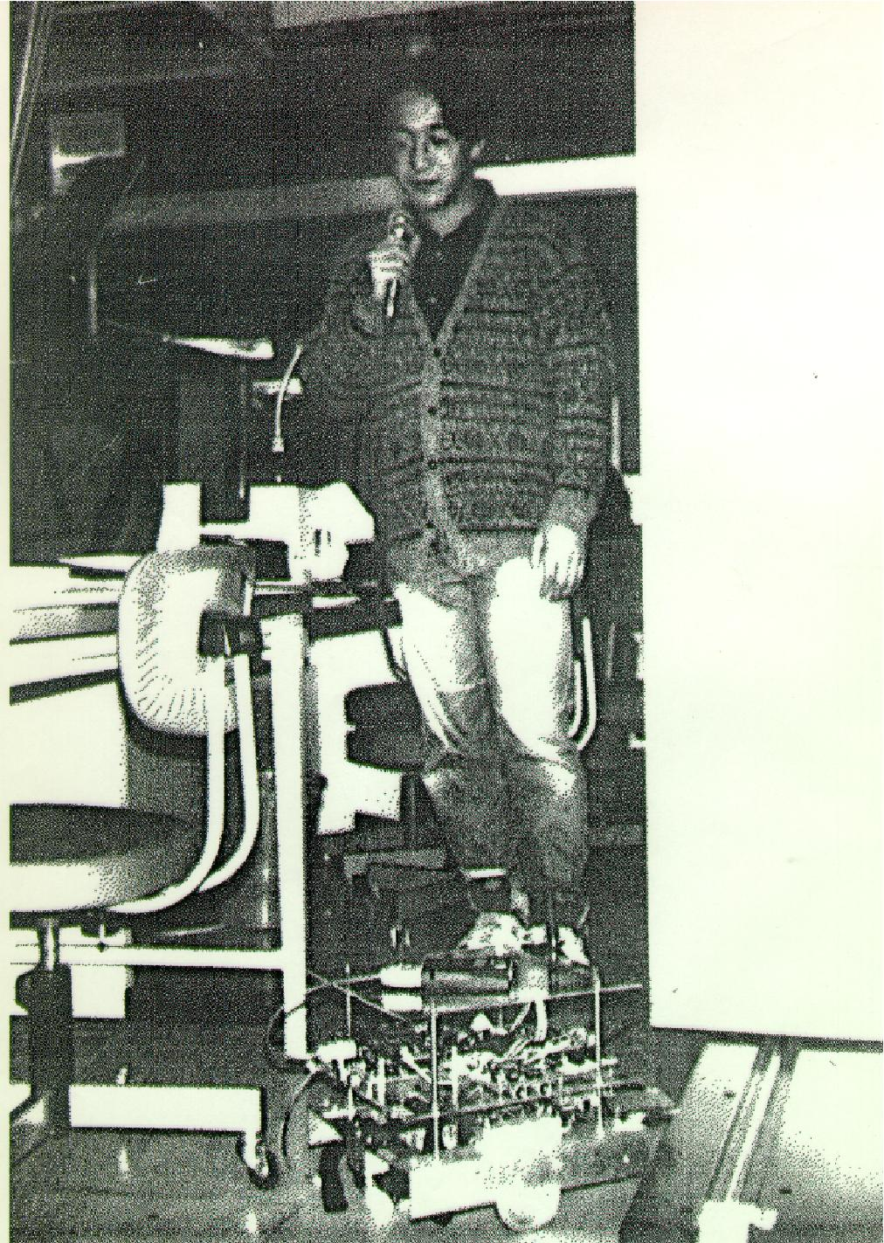
4.3.2 Application for Actual System
Wrong!
at l1:
speaking, Michita; yes
addressing, Michita, Linta; yes
at l2:
wrong, a; yes
u[[wrong!]]e

Slide 39
4.3.2 Application for Actual System
Wrong!
at l1:
speaking, Michita; yes
addressing, Michita, Linta; yes
referring-to, Michita,,obstacle;yes
referring-to,Michita,,proceeding;yes
at l2:
wrong, proceeding;
yes
u[[wrong!]]e

Slide 40
4.3.2 Application for Actual System
Wrong!
at l1:
speaking, Michita; yes
addressing, Michita, Linta; yes
looking-at, Michita,obstacle;yes
referring-to,Michita,dangerous situation,
proceeding forward;yes
at l2:
wrong, proceeding
forward; yes
Selection of relevant
information
u[[wrong!]]e

Slide 41
4.3.3 Attention Mechanism
Attention Mechanism
  To select sensor data to recognize current situation
Strategy of the selection
  Context
  Action

Slide 42
4.3.3 Attention Mechanism
Dialogue system Linta-II with Attention Mechanism
Attention mechanism selects sensor information relevant to current human robot interaction
  Top-down attention: selects sensor data related to a current robot action or plan
  Bottom-up attention: selects sensor data in response to an event around a robot.
Decrease of the use of constraints
Easy to design the system

Slide 43
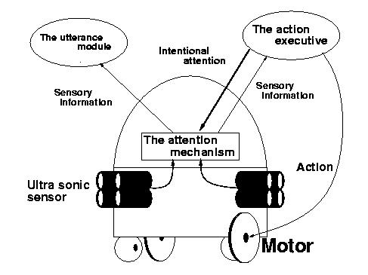
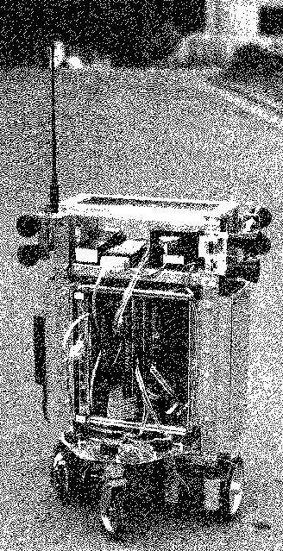
4.3.4 Linta-II

Slide 44
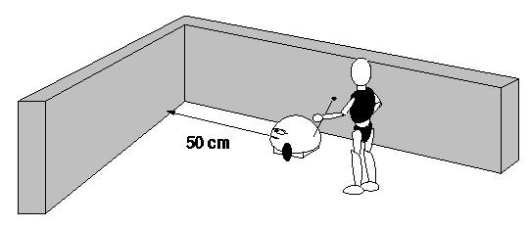
4.3.4 Linta-II
Utterance Example
Ex. 1.a User: “What’s next?”
ASPIRE: “We cannot proceed toward front direction soon.”
Ex. 1.b User: “What’s next?”
ASPIRE: “We cannot turn right.”
Ex. ASPIRE: “I’m surprised!”

Slide 45
4.3.4 Linta-II
Utterance Example
Ex. 1.a User: “What’s next?”
ASPIRE: “We cannot proceed toward front direction soon.”
Ex. 1.b User: “What’s next?”
ASPIRE: “We cannot turn right.”
Ex. ASPIRE: “I’m surprised!”
Top-down attention
by a robot’s action
Top-down attention
by a planner
Bottom-up attention
by a change in an environment

Slide 46
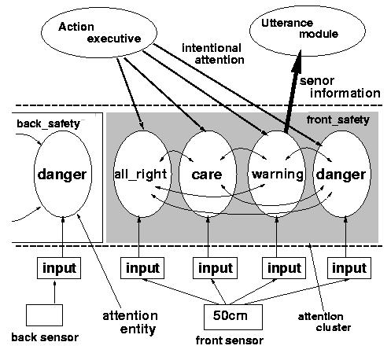
4.3.5 Attention Mechanism of Linta-II

Slide 47
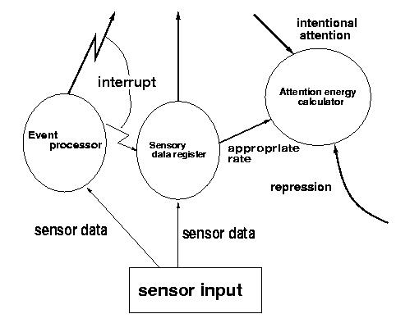
4.3.5 Attention Mechanism of Linta-II
Attention Entities

Slide 48
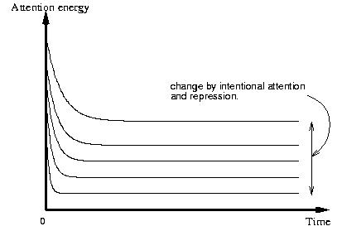
4.3.5 Attention Mechanism of Linta-II Attention Energy

Slide 49
Attention Mechanism

Slide 50
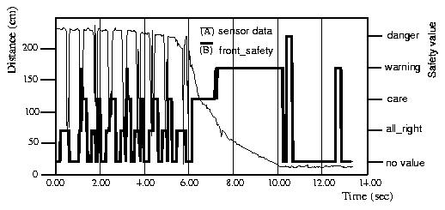
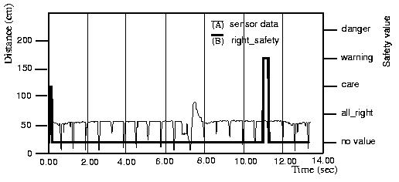
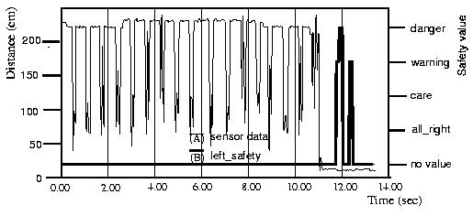
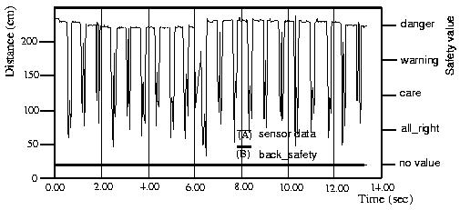
4.3.6 Example
Top-down attention
from front moving
Top-down attention
from planner
F
R
“We cannot proceed toward front
direction soon.”
“We cannot turn right.”
Bottom-up attention
L
B
“I’m surprised!”

Slide 51
4.3.7 Conclusion of Linta-II
Linta-II employs attention mechanism to obtain a situation for utterance generation.
Attention mechanism: Top-down attention and Bottom-up attention
  Extract situated meaning under the attention
A system designer can develop a dialogue system and an action system independently. These are connected through the attention mechanism.
Problem
  Robot obtains the situation selfishly.

