Slide 1

Voila !
There are Somethings you Can’t Google!!

Slide 2
Group Members -
Siddhant Shah
Ajay Sharma G S
Aman Khandelwal
Rahul Saha
Aravind Vobbilisetty

Slide 3
Objectives
The Idea Behind the project is to develop a website which can be used by the people to ask their queries about Food, Computer Games and Programming Languages and get their respective answers from Other users.
The project aims to create a discussion forum and an open environment where people can answer as well as ask questions which will help to learn and grow together.

Slide 4
Work Accomplished
Back End - Ajay , Aman and Aravind
(Database Tables for Storing Data ,Creating login and register page ,Posting a Question , Add a Reply , etc.)
Front End - Siddhant , Rahul
(User Interface , Layout Design , Linking Subsequent Pages etc.)

Slide 5
Technologies Being Used
Our Project Voila! Is mainly created from –
MySQL
PHP
HTML
CSS
Wamp Server

Slide 6
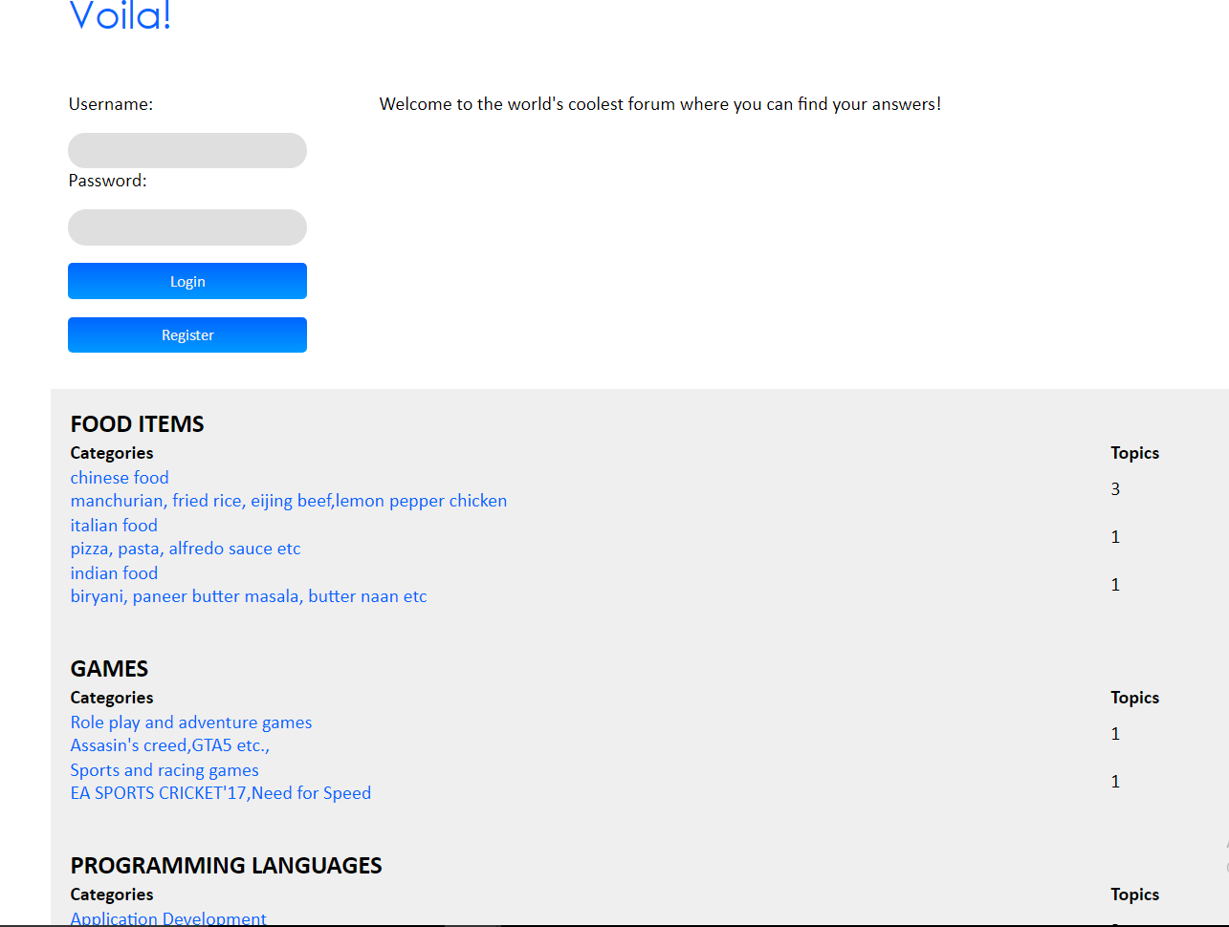
Glimpse Of the Website -

Slide 7
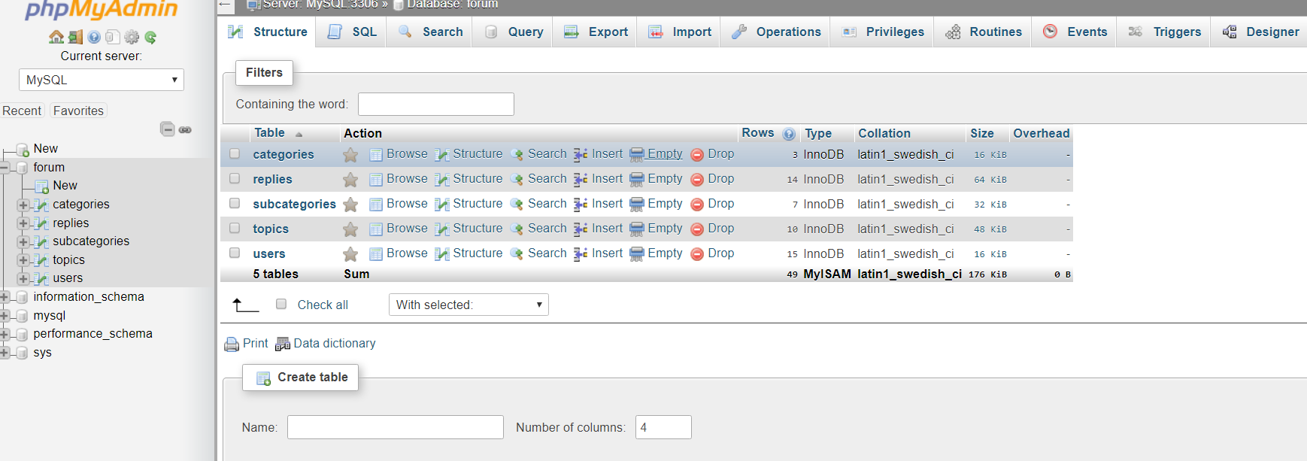
Database Tables

Slide 8
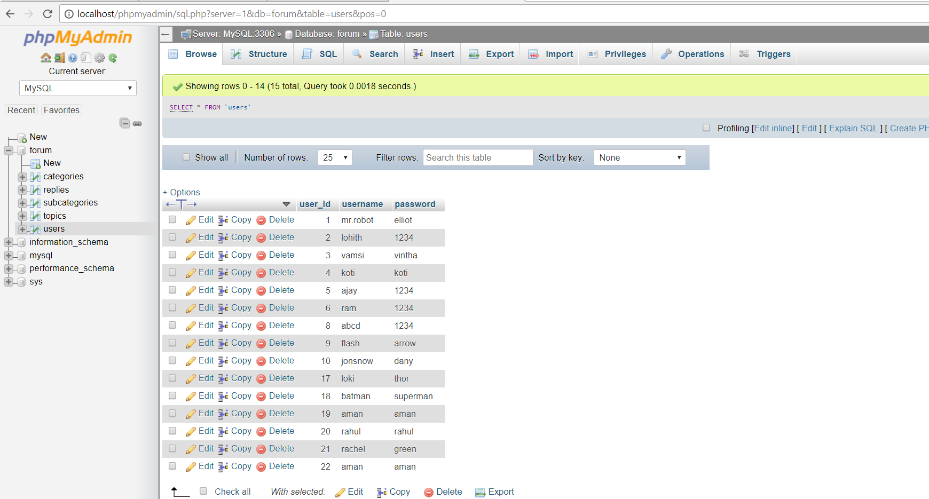
Storage of Users

Slide 9
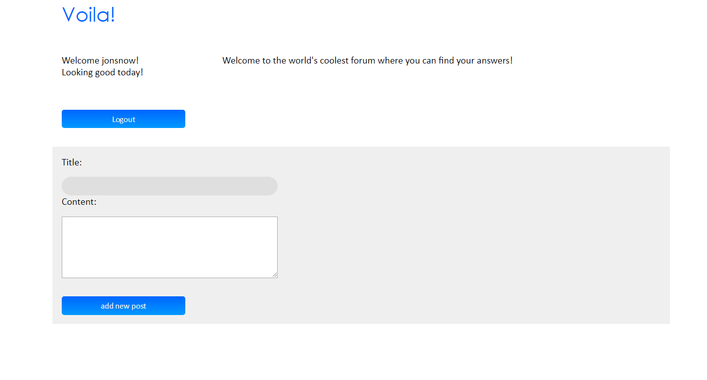
Posting a Query!

Slide 10
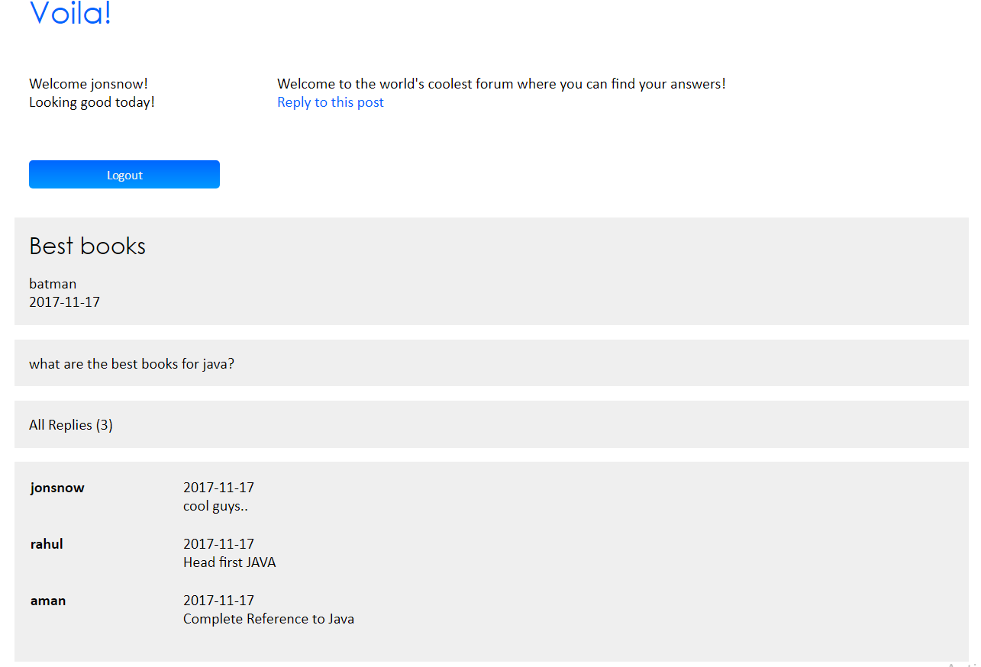
Replies

Slide 11
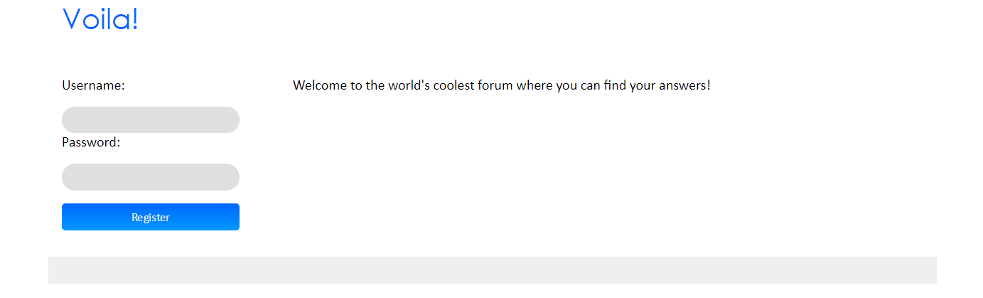
So How Do We Start??
Start by setting your Profile.
Just Register and look Its done!!

Slide 12
Still Miles to Go -
Creating an AI Bot using AIML which can answer your query both instantly and Accurately.
Creating more Categories such as technology, politics, sport , etc. and attract more users.
Enhance to a more user friendly platform similar to Quora
Adding Login via Facebook, Twitter And Gmail using Google API

Slide 13
We would like to take this opportunity and Thank Mr. Vijayant Pawar Sir who guided us in this project and helped us in every possible way in completing this project.

Slide 14
THANK YOU

