Slide 1
O2O (Offline to Online) Model
O2O model aims to predict the likelihood of an offline customer to shop online, and hence to classify customers based on their propensity scores- thereby optimising the return on investment for SMS campaigns.
Objective & Overview
Data Sources
Model Framework
Model Evaluation & Results
Future Scope

Slide 2
Model Framework
Independent Variables
TRIPS_12M
UNITS_12M
REVENUE_AED_12M
REVENUE_AED_SALE_12M
CLASSIFICATION MODEL
Logistic
XG Boost
Random Forest
INVOICES_SALE_12M
RFM_SGMNT
Propensity Scores
PROMO_SGMNT
INCOME RANGE
GENDER
RECENCY_CNCPT_12
ACTIVE_TIME_12
AVG_UNIT_PER_TRIP
VINTAGE_CNCPT_12
DEPENDENT VARIABLES
O2O FLAG
Transactional Variables
Non- Transactional Variables
Engineered Features
Objective & Overview
Model Framework
Model Evaluation & Results
Future Scope
Objective & Overview
Data Sources
Data Sources

Slide 3
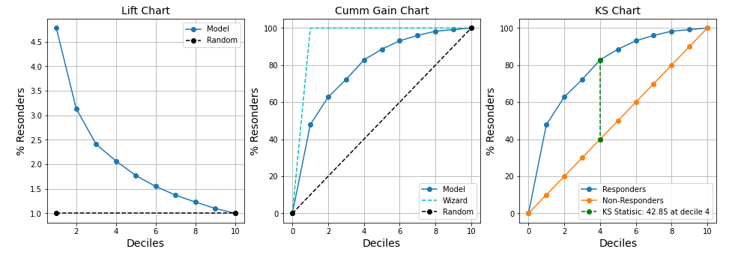
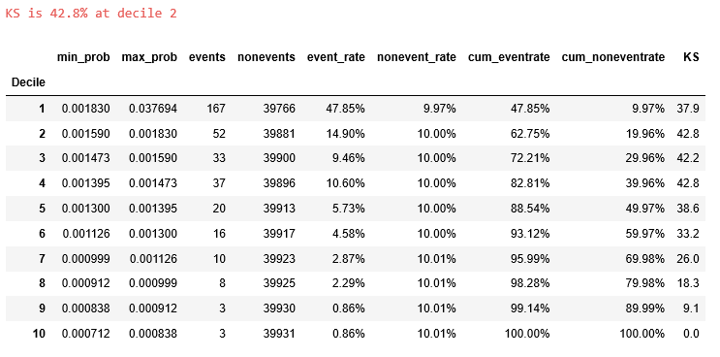
Model Evaluation & Results: For December Conversions (Old Results)
O2O Model Validation Results for Dec’20
Objective & Overview
Data Sources
Model Framework
Model Evaluation & Results
Future Scope

Slide 4
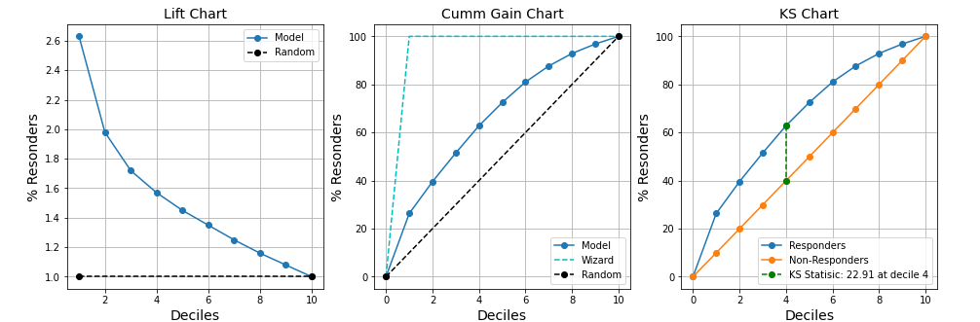
Model Evaluation & Results: For December Conversions
O2O Model accuracy for DEC’20 with 6 Months Base (01 Jun’20 to 30 Nov’20)
 | min prob | max prob | events | non events | event rate | non event rate | cum event rate | cum non event rate | KS
Decile
1 | 0.007468 | 0.025104 | 506 | 52403 | 25.15% | 9.94% | 25.15% | 9.94% | 15.2
2 | 0.006441 | 0.007468 | 280 | 52628 | 13.92% | 9.98% | 39.07% | 19.93% | 19.1
3 | 0.005690 | 0.006441 | 240 | 52668 | 11.93% | 9.99% | 50.99% | 29.92% | 21.1
4 | 0.005026 | 0.005689 | 206 | 52703 | 10.24% | 10.00% | 61.23% | 39.92% | 21.3
5 | 0.004467 | 0.005026 | 204 | 52704 | 10.14% | 10.00% | 71.37% | 49.92% | 21.5
6 | 0.004035 | 0.004467 | 169 | 52739 | 8.40% | 10.01% | 79.77% | 59.92% | 19.8
7 | 0.003677 | 0.004035 | 136 | 52773 | 6.76% | 10.01% | 86.53% | 69.94% | 16.6
8 | 0.003430 | 0.003677 | 129 | 52779 | 6.41% | 10.01% | 92.94% | 79.95% | 13.0
9 | 0.003203 | 0.003430 | 76 | 52832 | 3.78% | 10.02% | 96.72% | 89.97% | 6.7
10 | 0.002870 | 0.003203 | 66 | 52843 | 3.28% | 10.03% | 100.00% | 100.00% | 0.0
Objective & Overview
Data Sources
Model Framework
Model Evaluation & Results
Future Scope

Slide 5
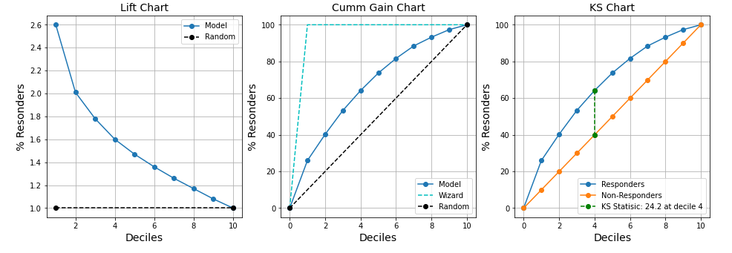
Model Evaluation & Results: For December Conversions
O2O Model accuracy for DEC’20 with 1 Year Base (01 Dec’19 to 30 Nov’20)
 | min prob | max prob | events | non events | event rate | non event rate | cum event rate | cum non event rate | KS
Decile
1 | 0.006758 | 0.025566 | 865 | 102763 | 25.95% | 9.95% | 25.95% | 9.95% | 16.0
2 | 0.005364 | 0.006758 | 476 | 103151 | 14.28% | 9.99% | 40.23% | 19.93% | 20.3
3 | 0.004498 | 0.005364 | 434 | 103194 | 13.02% | 9.99% | 53.26% | 29.93% | 23.3
4 | 0.004067 | 0.004498 | 362 | 103265 | 10.86% | 10.00% | 64.12% | 39.92% | 24.2
5 | 0.003797 | 0.004067 | 318 | 103309 | 9.54% | 10.00% | 73.66% | 49.92% | 23.7
6 | 0.003630 | 0.003797 | 266 | 103362 | 7.98% | 10.01% | 81.64% | 59.93% | 21.7
7 | 0.003491 | 0.003630 | 227 | 103399 | 6.81% | 10.01% | 88.45% | 69.94% | 18.5
8 | 0.003345 | 0.003491 | 159 | 103465 | 4.77% | 10.02% | 93.22% | 79.96% | 13.3
9 | 0.003183 | 0.003345 | 137 | 103495 | 4.11% | 10.02% | 97.33% | 89.98% | 7.4
10 | 0.002870 | 0.003183 | 89 | 103539 | 2.67% | 10.02% | 100.00% | 100.00% | 0.0
Objective & Overview
Data Sources
Model Framework
Model Evaluation & Results
Future Scope

Slide 6
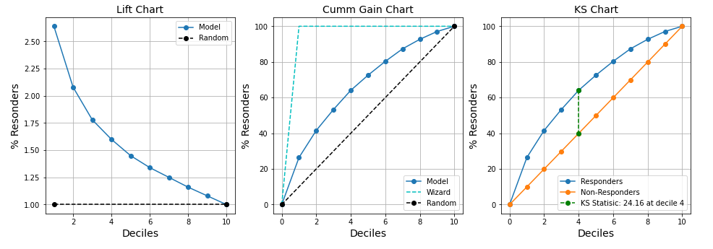
Model Evaluation & Results: For January Conversions
O2O Model accuracy for JAN’21 with 1 Year Base (01 Jan’20 to 31 Dec’20)
 | min prob | max prob | events | non events | event rate | non event rate | cum event rate | cum non event rate | KS
Decile
1 | 0.004848 | 0.019269 | 988 | 97330 | 26.40% | 9.94% | 26.40% | 9.94% | 16.5
2 | 0.004015 | 0.004848 | 568 | 97750 | 15.17% | 9.98% | 41.57% | 19.92% | 21.7
3 | 0.003437 | 0.004015 | 441 | 97877 | 11.78% | 9.99% | 53.35% | 29.91% | 23.4
4 | 0.003081 | 0.003437 | 401 | 97917 | 10.71% | 10.00% | 64.07% | 39.91% | 24.2
5 | 0.002839 | 0.003081 | 318 | 98000 | 8.50% | 10.01% | 72.56% | 49.91% | 22.6
6 | 0.002680 | 0.002839 | 290 | 98028 | 7.75% | 10.01% | 80.31% | 59.92% | 20.4
7 | 0.002565 | 0.002680 | 263 | 98055 | 7.03% | 10.01% | 87.34% | 69.93% | 17.4
8 | 0.002465 | 0.002565 | 200 | 98118 | 5.34% | 10.02% | 92.68% | 79.95% | 12.7
9 | 0.002362 | 0.002465 | 164 | 98154 | 4.38% | 10.02% | 97.06% | 89.97% | 7.1
10 | 0.002129 | 0.002362 | 110 | 98208 | 2.94% | 10.03% | 100.00% | 100.00% | 0.0
Objective & Overview
Data Sources
Model Framework
Model Evaluation & Results
Future Scope

Slide 7
Future Scope
1. Can Introduce Campaign Cost Analysis
Add previous evaluation data for measurement and comparison
Change Platform to simple responsive WebApp
Any other ideas…
Assume,
Average campaign cost per customer is Rs. 10/-
Revenue per conversion is Rs. 150/-
The campaign will be profitable only if our campaign conversion is above 6.7% (=10/150).
Decile (Rank) | # Customers | # Responders | # Non-Resp. | % Resp. Rate | Campaign Cost | Revenue | Profit
1 | 1,000 | 295 | 705 | 29.50% | 1000*10 =10000 | 295*150=44250 | 34250
2 | 1,000 | 176 | 824 | 17.60% | 10000 | 26400 | 16400
3 | 1,000 | 115 | 885 | 11.50% | 10000 | 17250 | 7250
4 | 1,000 | 75 | 925 | 7.50% | 10000 | 11250 | 1250
5 | 1,000 | 35 | 965 | 3.50% | 10000 | 5250 | -4750
6 | 1,000 | 30 | 970 | 3.00% | 10000 | 4500 | -5500
7 | 1,000 | 23 | 977 | 2.30% | 10000 | 3450 | -6550
8 | 1,000 | 18 | 982 | 1.80% | 10000 | 2700 | -7300
9 | 1,000 | 13 | 987 | 1.30% | 10000 | 1950 | -8050
10 | 1,000 | 7 | 993 | 0.70% | 10000 | 1050 | -8950
Total | 10,000 | 787 | 9,213 | 7.87% | 100000 | 118050 | 18050
Objective & Overview
Data Sources
Model Framework
Model Evaluation & Results
Future Scope

