Slide 1
Akash P – Aspiring Software Developer
MCA Student | Passionate about Tech, Development & Innovation
Let's Build Together

Slide 2
About Me
• MCA student with strong interest in full-stack development and machine learning
• Passionate about building impactful, user-focused digital solutions
• Open to challenging roles to grow and contribute to meaningful projects

Slide 3
Skills
Languages & Frameworks: Python, Java, JavaScript, ReactJS, HTML/CSS
Databases & Tools: MySQL, MongoDB
Other Skills: Machine Learning, Data Management, Adobe XD, Notion, Trello

Slide 4
Project 1 – Movie Recommendation Engine
• Built a movie recommendation system using Cosine Similarity
• Focused on user personalization and evaluation metrics
• Visualized results with clarity and explained performance

Slide 5
Project 2 – Student Information System
• Developed using Java Swing for GUI + MySQL for backend
• Full CRUD operations and secure login
• Emphasized data validation and backend integration

Slide 6
Project 3 – Web-Based Resource Management Portal
• Built with HTML, CSS, Bootstrap
• Clean admin dashboard + notification system
• Fully responsive design for cross-device access

Slide 7
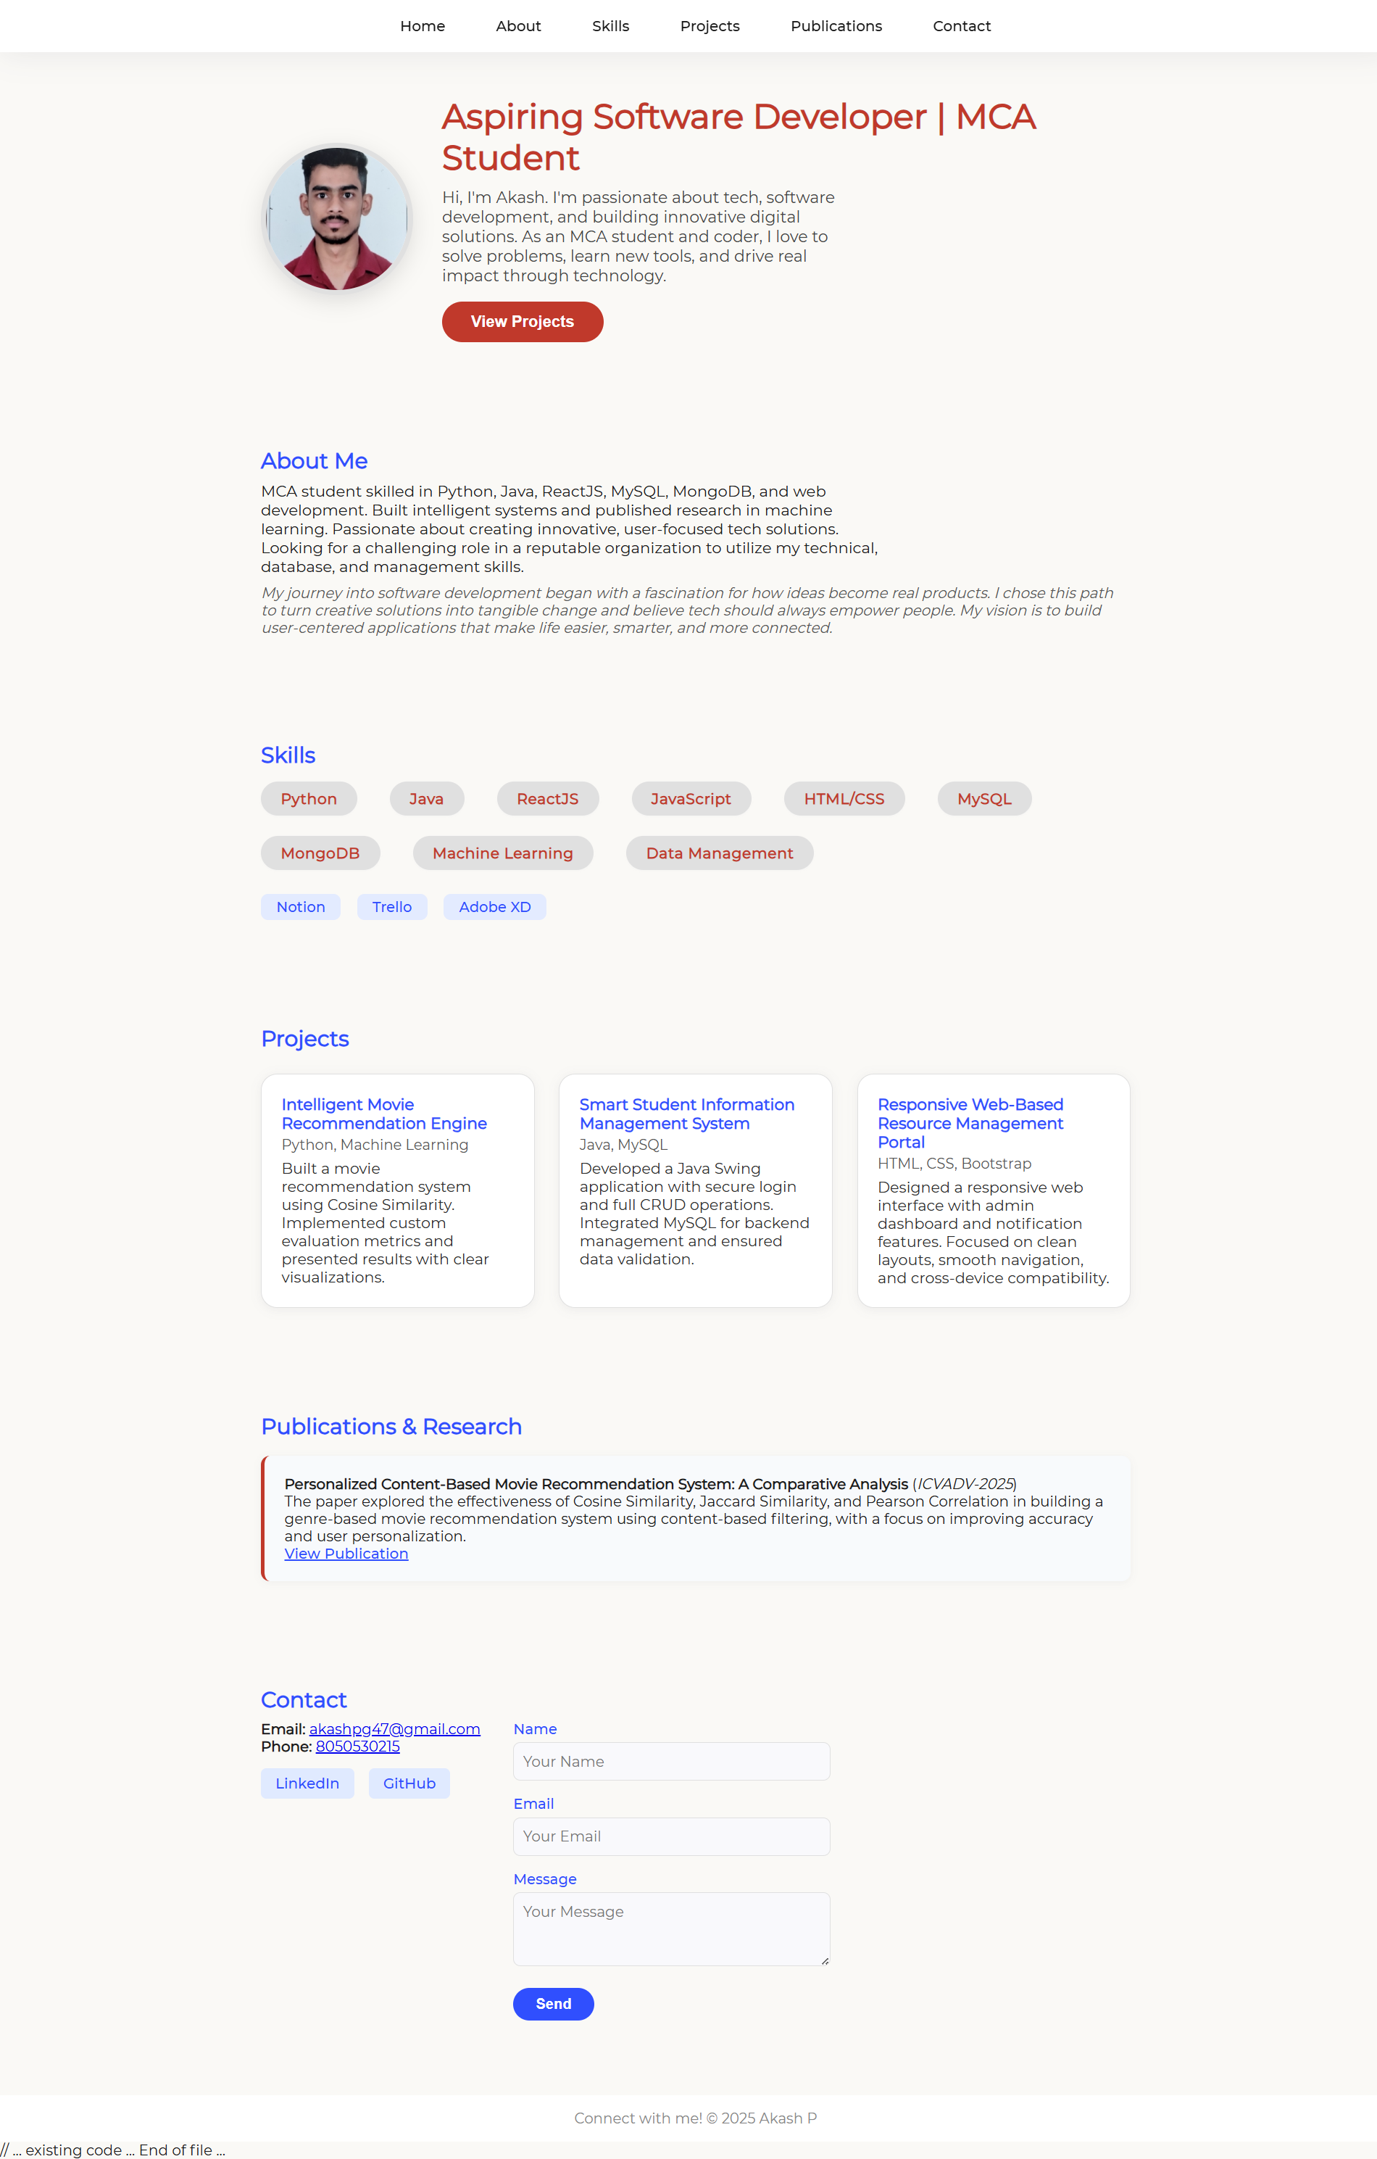
Aspiring Software Developer | MCA Student
Hi, I'm Akash. I'm an MCA student with a passion for software development and building digital solutions. I enjoy solving problems, learning new tools, and creating user-friendly applications using technologies like Python, Java, ReactJS, and more.

Slide 8
Research Publication
Title: Personalized Content-Based Movie Recommendation System
• Presented at ICVAD-2023
• Compared Cosine, Jaccard, Pearson similarity
• Focused on accuracy, personalization, and genre filtering

Slide 9
Contact Information
Email: akashpc947@gmail.com
Phone: 8050502915
Links: GitHub, LinkedIn
Encourage audience to connect or collaborate

Slide 10
Message / Feedback Form
Embedded form for name, email, and message
Call to action: “Let’s connect and build something great together!”

Slide 11
Thank You

