Slide 1
ASK, FSK, PSK COMPARITIVE STUDY
GANDHAM SAI RAM PAVAN – AM.EN.U4.AIE20125
KUCHARLAPATI AKASH VARMA - AM.EN.U4.AIE20141
N.MONEESH - AM.EN.U4.AIE20150
SANDEEP NEEMKAR - AM.EN.U4.AIE20163
GROUP 15

Slide 2
OVERVIEW
Types of signals
Modulation techniques
Amplitude shift keying, frequency shift keying, phase shift keying
Their simulation results
Comparison between ask, fsk, psk

Slide 3
OBJECTIVE
A signal is an electrical or electromagnetic current that is used for carrying data from one device or network to another and there 2 types of signals they are analog and digital
Digital signal is a signal that represents data as a sequence of discrete values.
Digital Modulation provides more information capacity, high data security, quicker system availability with great quality communication. Hence, digital modulation techniques have a greater demand, for their capacity to convey larger amounts of data than analog modulation techniques
There are three types of digital modulation, and they are: Amplitude shift key (ASK) Frequency shift key (FSK) Phase shift key (PSK)

Slide 4
BLOCK DIAGRAM
Ask modulation: Ask demodulation:

Slide 5
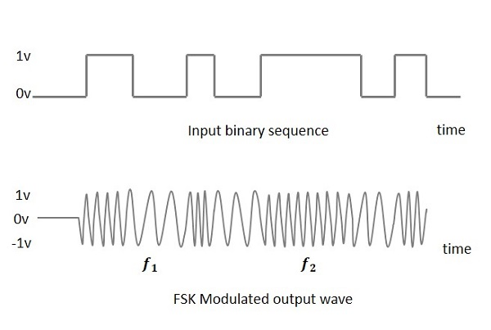
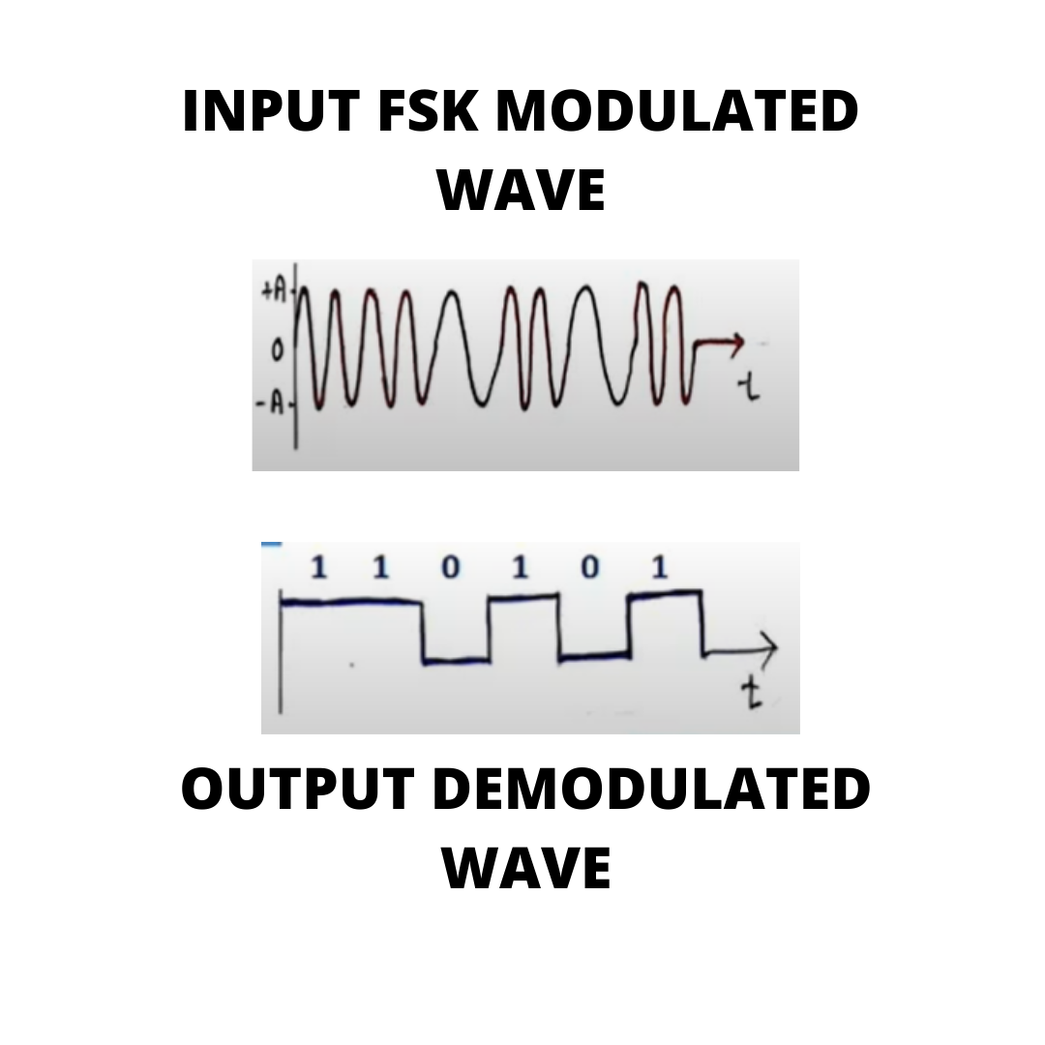
BLOCK DIAGRAM
Fsk modulation: Fsk demodulation:

Slide 6
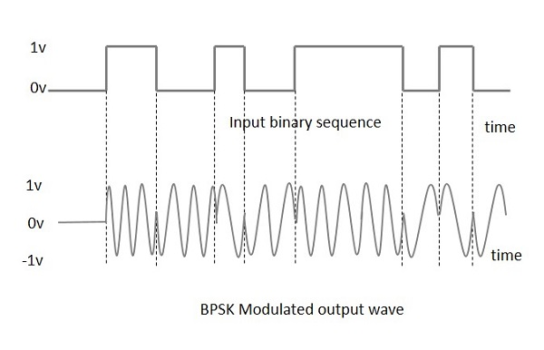
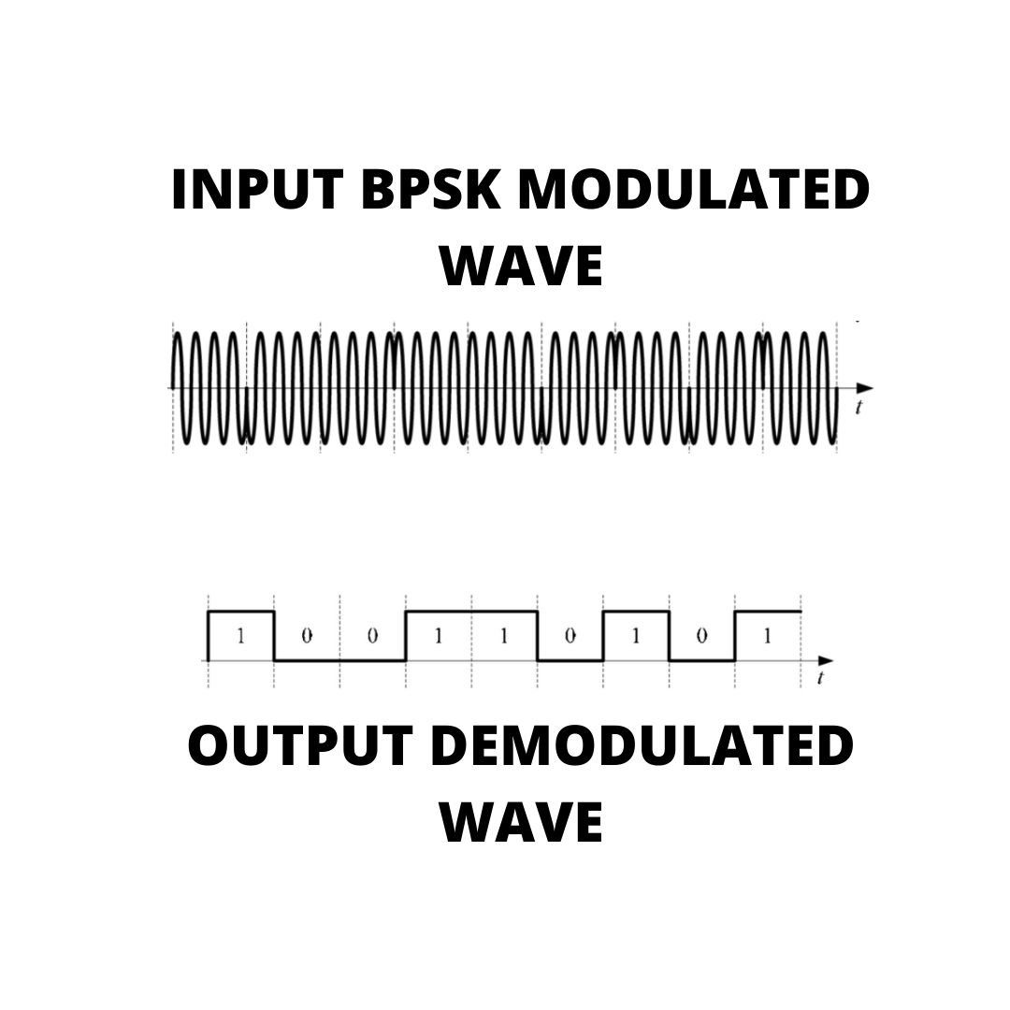
BLOCK DIAGRAM
Bpsk modulation: Bpsk demodulation:

Slide 7
SIMULATION RESULTS
ASK: FSK: BPSK:

Slide 8
INFERENCES
First we will give the input binary code in a form of array
And then we will convert the input binary in to discrete wave form
And the discrete wave form will be the input for the modulation process and it will produce the continuous wave form(which is modulated)
And the continuous wave form(modulated wave) will be the input for the demodulation process and it will produce the discrete wave form(which is demodulated)
And if the first digital waveform is same as demodulated waveform then we can say that our code is efficient.
This process is same for all digital modulation techniques that are mentioned above.

Slide 9
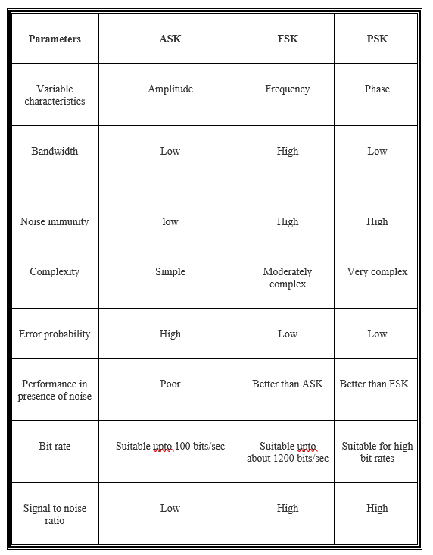
CONCLUSION

Slide 10
REFERENCES
Encyclopædia Britannica, Encyclopædia Britannica, Inc., www.britannica.com/technology/digital-signal-modulation.
Cadence System Analysis, et al. “Types of Digital Modulation.” Cadence, 5 Oct. 2021, resources.system-analysis.cadence.com/blog/msa2021-types-of-digital-modulation.
“Principles of Modulation and Digital Transmission.” Optical Bit Error Rate, 2009, doi:10.1109/9780470545430.ch1.
Digital Modulation - MATLAB &amp; Simulink - MathWorks India, in.mathworks.com/help/comm/ug/digital-modulation.html.
Smillie, Grahame. “Digital Modulation Techniques.” Analogue and Digital Communication Techniques, 1999, pp. 59–96

