Slide 1


FAKE CREDIT CARD DETECTION
GROUP 5
GANDHAM SAI RAM PAVAN – AM.EN.U4.AIE20125
JITHIN JOHN - AM.EN.U4.AIE20135
KUCHARLAPATI AKASH VARMA - AM.EN.U4.AIE20141
N.MONEESH - AM.EN.U4.AIE20150

Slide 2



INTRODUCTION
Nowadays because of outbreak of COVID-19 all purchases have become online so many are using online mode of transactions to avoid the spread of COVID-19 so the many people will be using credit card transactions nowadays
There are a number of reasons why customers are gradually phasing out debit card transactions and switching to credit card purchases, especially in developing countries like India. Here's why:
Profitable cashback and bonus points can be used on all credit card purchases. In general, banking institutions do not offer debit cards.
We offer additional discounts on transactions by linking your credit card to our online and offline stores, especially during holidays such as Diwali, Eid and Christmas.
Immediate needs (e.g. medical crises, life events, etc.) can be met quickly instead of having a sufficient account balance. Most credit cards have an EMI alternative with no interest rate.

Slide 3


INTRODUCTION
A strong credit history contributes to a good CIBIL score, allowing customers to obtain superior and competitive interest rates on long-term claims such as home or car loans.
Cyber attackers, on the other hand, take use of these qualities. To address this issue, we require a system that can cancel a transaction if it detects something strange.
Here, a system that can follow the pattern of all transactions is required, and if any pattern is aberrant, the transaction should be cancelled.
We now have a plethora of machine learning techniques at our disposal to assist us in classifying irregular transactions. The sole prerequisite is previous data and an appropriate algorithm that can better match our data.
So the problem is to identify fraudulent credit card transactions so that credit card firms' consumers are not charged for products they did not purchase.

Slide 4


BACKGROUND STUDY
Although various supervised and semi-supervised machine learning techniques are used to detect fraud, our aim is to have three major issues with card fraud recording: serious class imbalances, labelled.
Inclusion of samples and unlabelled samples, and numerous transactions.
To detect rogue transactions in real-time datasets, use monitored machine learning techniques such as decision tree, naive Bayes classification, least square regression, logistic regression, and SVM.
Two approaches are used in Random Forest to train aspects of normal and abnormal transaction behaviour. There are two types: random tree-based random forests and CART-based random forests.

Slide 5
BACKGROUND STUDY
Random forests produce good results with small datasets, but there are certain problems when dealing with imbalanced data.
The random forest algorithm itself needs to be improved.For highly biased credit card fraud data, logistic regression, K Nearest Neighbor, and Nave Bayes performance will be investigated to investigate meta-classifiers and meta-revenue methods when dealing with significantly imbalanced credit card fraud data.

Slide 6

PROBLEMS
After realizing the seriousness of the fraud crisis, the next logical question is how to avoid this scam and its damage to the economy as a whole, especially customer sentiment and trust in financial institutions. We'll also look at some of the current challenges we face when dealing with credit card theft. The main barriers to credit card fraud detection include:
Huge amounts of data are collected every day, and models must be fast enough to respond to fraud in real time.
The disproportionate data means that most transactions (99.8%) are not fraudulent, making it very difficult to detect fraudulent transactions.

Slide 7

PROBLEMS
Data is usually confidential, so data availability.
Misclassified data can also be a major problem, as not all fraudulent transactions are detected and reported.
The scammers used adaptive tactics against the model.
It can take a long time for a transaction to develop a high-fidelity model, but the algorithm takes less time to determine whether the feedback is real or not. This issue occurs in a real-time environment.

Slide 8
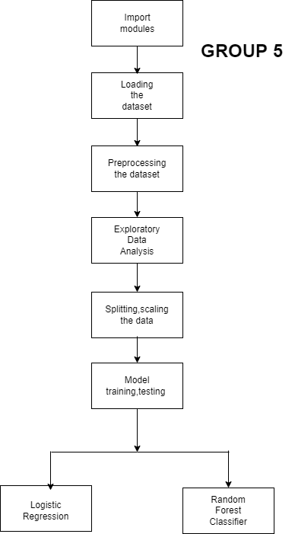

SOLUTION APPROACH

Slide 9

DATASET
Data set includes credit card transactions performed by European cardholders in September 2013.
This dataset contains 492 frauds out of 284,807 transactions that happened over the course of two days.
The data set is significantly imbalanced, with positive transactions accounting for 0.172 percent of all transactions.
The answer variable is called 'Class,' and it has a value of 1 if there is fraudulent, 0 otherwise.

Slide 10


IMPLEMENTATION
First we will import all the basic libraries which will be used in the program. They are pandas, numpy, seaborn, matplotlib, sklearn and warnings.
After that we have to load the dataset here it is a csv file. 1st column is timestamp and the remaining columns are PCA values which will be in the range of -2 to 2.
For the data preprocessing we have to check whether the data set contains null values or not.
Mainly the values of amount and timestamp are very huge. Other than the amount and timestamp remaining all are in uniform distribution.
So we should transform the amount and timestamp so that there could be easy comparison between all the values so here we are using standard scaler transformation.

Slide 11
IMPLEMENTATION
Correlation matrix
We will drop all the unnecessary columns so that only required data will be there in the file.
For any model first we have to split the data set into training and testing. Here in our code we are using sklearn to split.
Here in our code we are using logistic regression and random forest classifier.
So after the testing of the data we will get accuracy, presion,and f1 score.
CODE LINK: GITHUB

Slide 12

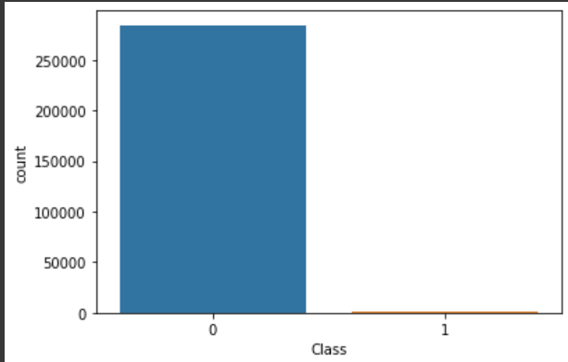
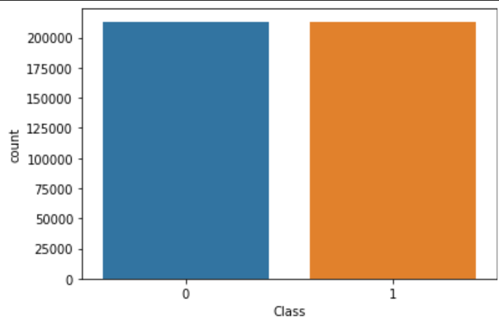


OBSERVATIONS
The plot for exploring class:
After balancing we find that the model can equal weightage for both fraudulent and non fraudulent class.
From the above we can see that the fraud line class is very low. If we leave it like this the results will be not clear. So, we’ll do balancing.

Slide 13
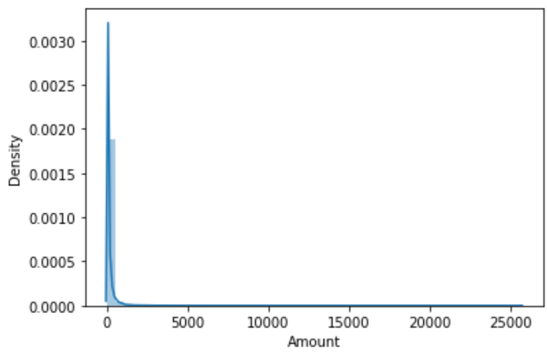
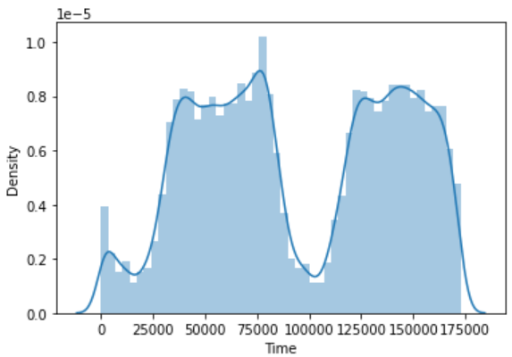
OBSERVATIONS
Here also it is not distributed uniformly and maximum things lie between 0 and 5000€.
The above is time column and it is not distributed and the ranges are also very huge.

Slide 14
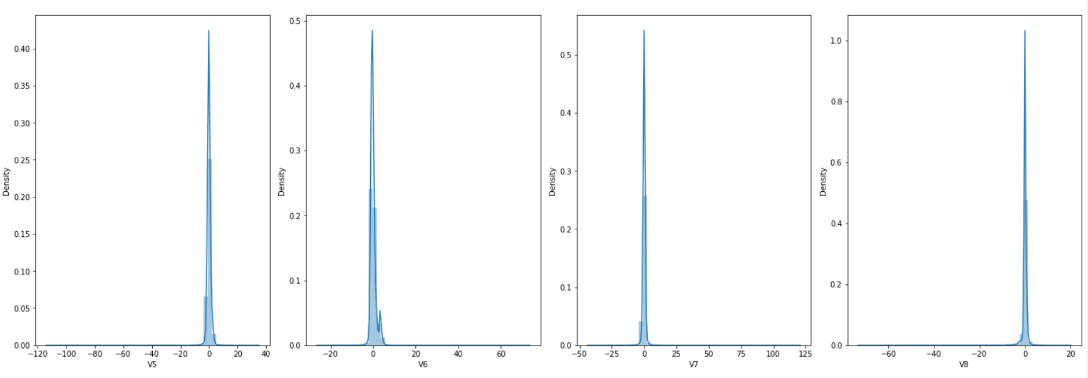
OBSERVATIONS
FEATURES OF DATASET(PCA) ARE UNIFORMLY DISTRIBUTED

Slide 15
OBSERVATIONS
Before balancing the F1 score of :
Logistic regression :0.7196
Random Forest :0.8416
Here the is not much difference.
But after balancing the F1 score of :
Logistic regression : 0.1123
Random Forest : 0.8398
So, after balancing we can see that F1 score of logistic regression is very low.
We must give equal weightage to all classes, the balanced will give more accuracy.
But for that logistic regression is not accurate. So, we can conclude that random forest is better than logistic regression.

Slide 16


REFERENCES
A John Richard, D. Kho, Larry A. Vea, “Credit Card Fraud Detection Based on Transaction Behaviour”, 2017 IEEE Region 10 Conference (TENCON), Malaysia, November 5-8, 2017.
Massimiliano Zanin, Miguel Romance, Regino Criado, and SantiagoMoral, “Credit Card Fraud Detection through Parenclitic Network Analysis”, Hindawi Complexity Volume 2018, Article ID 5764370.
ULB (2018), Kaggle, “Machine Learning Group-Credit Card Fraud Detection”
S P Maniraj and Aditya Saini, “Credit Card Fraud Detection using Machine Learning and Data Science”, International Journal of Engineering Research & Technology (IJERT), Vol. 8 Issue 09, September-2019.
Suman, GJUS&T Hisar HCE, Sonepat, “Survey Paper on Credit Card Fraud Detection”, International Journal of Advanced Research in Computer Engineering & Technology (IJARCET) Volume 3 Issue 3, March 2016. Pages 237–243, https://doi.org/10.1093/ijlct/ctt041

Slide 17


