Slide 1


IMAGE COLORIZATION
GROUP 14
KUCHARLAPATI AKASH VARMA - AM.EN.U4AIE20141 N.MONEESH - AM.EN.U4AIE20150
SANDEEP NEEMKAR - AM.EN.U4AIE20163 GANDHAM SAI RAM PAVAN - AM.EN.U4AIE20125 VANAPALA BHARATH CHANDRA VARMA - AM.EN.U4AIE20172
KUCHARLAPATI AKASH VARMA - AM.EN.U4AIE20141 N.MONEESH - AM.EN.U4AIE20150
SANDEEP NEEMKAR - AM.EN.U4AIE20163 GANDHAM SAI RAM PAVAN - AM.EN.U4AIE20125 VANAPALA BHARATH CHANDRA VARMA - AM.EN.U4AIE20172

Slide 2

PROBLEM-STATEMENT
Image colorization is a process of adding colors to the gray scale image. This colorization technique is commonly used in picture editing and research illustrations.
A small portion of an image grouped together into blocks is called a patch of the image. Due to the smaller size of the patch many image processing algorithms such as colorization are easily operated on the patches rather than working on the whole image itself.
We have used an image colorization dataset which is called as NCDataset , It contains set of color, gray scale images.
In this project we are implementing image colorization with the images taken from above dataset with the method Patch based discussed above.
Then we are checking the accuracy of our output image with color images which are given in the dataset
MSE, PSNR are the evaluation metrics we are using.

Slide 3

METHODS
First the target grayscale image and reference color image are selected via clicking the GUI buttons.
These two images are then converted to the YCbCr plane and the Luminance (Y) component plane is taken.
For every pixel of the target grayscale image, its luminance component is subtracted from the luminance plane of reference color image.
For the closest matching value of the reference luminance plane, we transfer its chromatic components to the target grayscale pixel. At the end resulting in colorization of grayscale image.

Slide 4
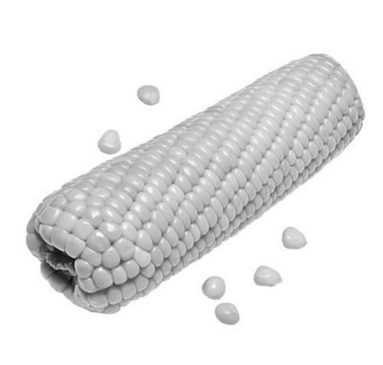
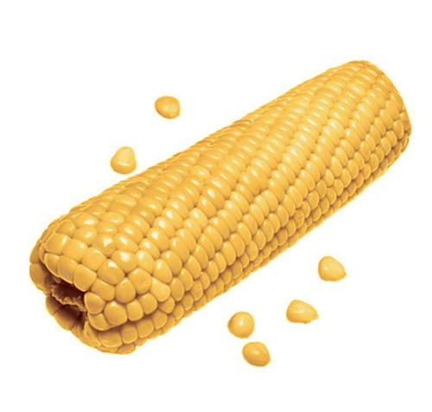
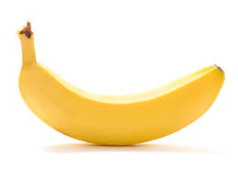

RESULTS AND DISCUSSIONS
INPUT COLOR PALETTE OUTPUT

Slide 5

REFERENCES
Shariatnia, Moein. “Colorizing Black amp; White Images with UNetand Conditional Gan-A Tutorial.” Medium, Towards Data Science,18 Nov. 2020, https://towardsdatascience.com/colorizing-black-whiteimages-with-u-net-and-conditional-gan-a-tutorial-81b2df111cd8.
“Patch-Based Image Colorization.” IEEE Xplore,https://ieeexplore.ieee.org/document/6460810?arnumber=6460810.
(PDF) Image Coloring Techniques and Applications.https://www.researchgate.net/publication/215869739 Coloring Techniques and Applications.
“Colorful Image Colorization.” Colorful Image Colorization,https://richzhang.github.io/colorization/.
Pierre, Fabien, et al. “Luminance-Chrominance Model for Image Colorization.”HAL Open Science, 25 July 2014, https://hal.archivesouvertes.fr/hal-01051308.

Slide 6




