Slide 1


MOBILE CONTOL ROBOT
GROUP 10
N.MONEESH - AM.EN.U4AIE20150
KUCHARLAPATI AKASH VARMA - AM.EN.U4AIE20141
GUDLA DINESH REDDY - AM.EN.U4AIE20130
GANDHAM SAI RAM PAVAN - AM.EN.U4AIE20125

Slide 2

TABLE OF CONTENTS
01
03
02
INTRODUCTION
HARDWARE IMPLEMENTATION
COMPONENTS USED
SOFTWARE IMPLEMENTATION
04

Slide 3


INTRODUCTION
Robot is an autonomous machine capable of sensing its environment, carrying out computations to make decisions, and performing actions in the real world.
Ros acronym for ‘Robot Operating System’ is an open-source, meta-operating system for a robot.
The main intention behind building the ROS framework is to become a generic software framework for robots.
Even though there was robotics research happening before ROS, most of the software was exclusive to their own robots. Their software may be open source, but it is very difficult to reuse.
We did mobile control robot in this project we control our robot actions by our mobile, in this we have used a android phone.

Slide 4
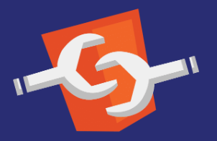

COMPONENTS USED
PowerBank
Soldering equipment
Male, female wires
Ubuntu
ROS Noetic
Android phone
Raspberry Pi 4
Motor Driver
Motors
Wheels
9V Batteries

Slide 5
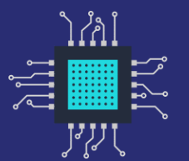


HARDWARE IMPLEMENTATION
Starting off, a skeletal body for the robot was made. Later wheels and DC motors (for each wheel) were added.
The motors were further connected to the L298N Motor driver.
Power was provided to the motor driver in order to function the motors by using 9 watt batteries.
A Raspberry Pi ( Model 4) was connected to the motor driver (to gpio pins) by using ‘female-female’ cables, ‘male-female’ cables.
Power is provided to raspberrypi by using a power bank.

Slide 6


SOFTWARE IMPLEMENTATION
As we know in this project we use an android for operating our robot.
We should have an application preinstalled in our phone and our phone should a android phone for this project
The application's name is Raspcontrol. You can also search on Google Play Store for it.
Here is the procedure to connect your Android phone to a ROS environment:

Slide 7
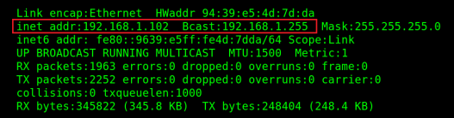

SOFTWARE IMPLEMENTATION
Initially, you have to connect both your PC and Android device to a local Wi-Fi network in which each device can communicate with each other using IP addresses.
As After connecting to the same network, you have to entre the ip address and the port address and the hostname.
You can also note the IP address of the PC by entering the command ifconfig.
After connecting First we should open the raspberry pi software then open preferences tab then we should navigate to interference then we should enable the ssh.

Slide 8
SOFTWARE IMPLEMENTATION
Then we will get many options that are useful to control our raspberry.
GPIO pins (and power pins) are utilised to control and communicate with other components.
Whether it’s turning off a switch, or turning on an LED, With the RaspConnect App you can remotely control every single GPIO (General Purpose Input and Output) Pin .
This application also enables you to access the Raspberry Pi Console
The commands are single-click buttons that will write whatever string of text you decide straight into the Shell and run it.

Slide 9

SOFTWARE IMPLEMENTATION
This is a great way to quickly run Python scripts that you have created.
Technical details like CPU, RAM, and Disk Monitoring can also be viewed.
Every single application running and how much brainpower it is taking up on your Raspberry Pi can also be seen.
It is also easy to access, modify and take information out of the Raspberry Pi utilising the File Manager options.
You can even transfer data to your phone seamlessly.
We can reboot or shutdown the raspberry pi by our application.

Slide 10
SOFTWARE IMPLEMENTATION
We need to write a python code to run the motor drive.
In the code we’ll assign motor drive pins to raspberry pi and in the same way we’ll connect that in hardware.
In the code we need to run a while loop to start all the GPIO pins.
So, based on the input by user we’ll keep some if else cases such that in each respective case we’ll correspondingly change the outputs of the GPIO to HIGH or LOW.
In this way the code works.
Open ssh connect in the app.
Navigate to the code directory from code.
Run the python code.

Slide 11




