Slide 1



Analyzing Twitter Data using Hive, Spark
GROUP-9
N.MONEESH - AM.EN.U4AIE20150
KUCHARLAPATI AKASH VARMA - AM.EN.U4AIE20141
JITHIN JOHN - AM.EN.U4AIE20135
GANDHAM SAI RAM PAVAN - AM.EN.U4AIE20125

Slide 2




INTRODUCTION
The term ‘Big Data’ is used for collections of large datasets that include huge volume, high velocity, and a variety of data that is increasing day by day
Companies can understand client behaviour, change their marketing strategies
Gain competitive advantage over its competitors by analysing these massive volume of data.
In a week Twitter can generate 1TB of text data in the form of tweets.

Slide 3
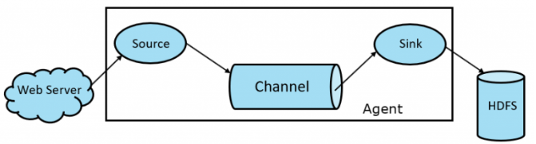

INTRODUCTION
APACHE FLUME:

Slide 4

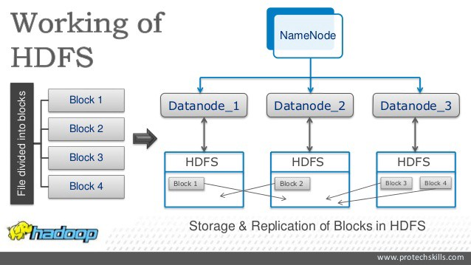

INTRODUCTION
HADOOP DISTRIBUTED FILE SYSTEM (HDFS):

Slide 5


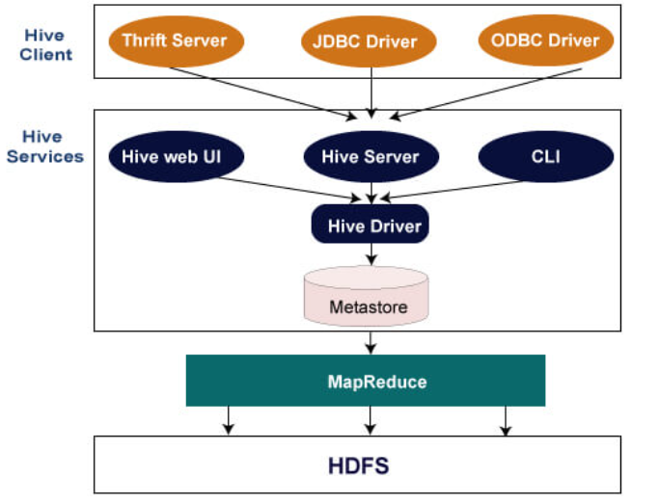
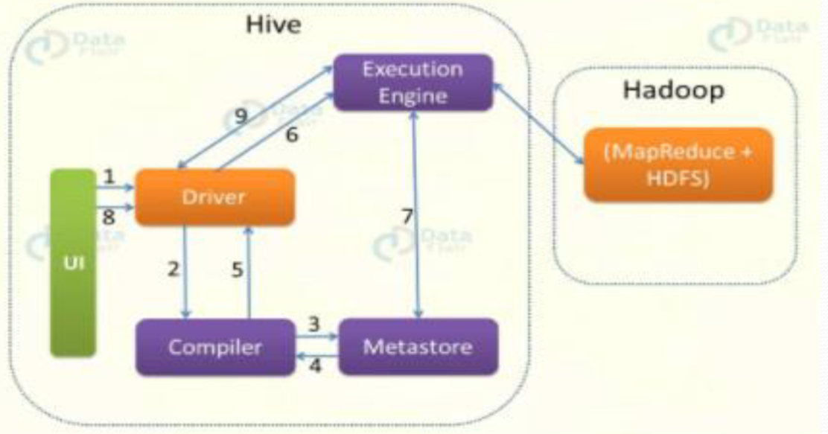
INTRODUCTION
HIVE:

Slide 6

INTRODUCTION
SPARK:

Slide 7


RELATED WORKS
Research paper on "Real-time Twitter data analysis using Hadoop ecosystem“.
Research paper on "Sentiment Analysis on Twitter Data Using Apache Flume and Hive" .
Research paper on "Big Data Emerging Technologies: A CaseStudy with Analyzing Twitter Data using Apache Hive" .
Research paper on "Social Media based Sentimental Analysis using Hive and Flume “.

Slide 8
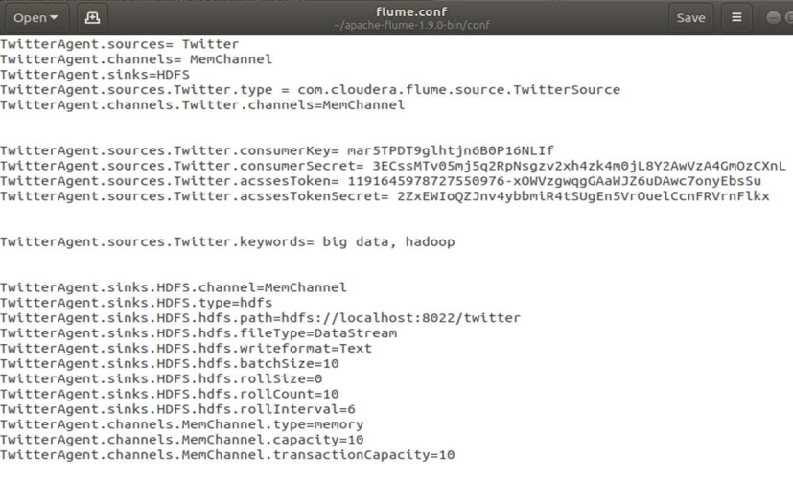
METHODOLOGY
FLUME:

Slide 9


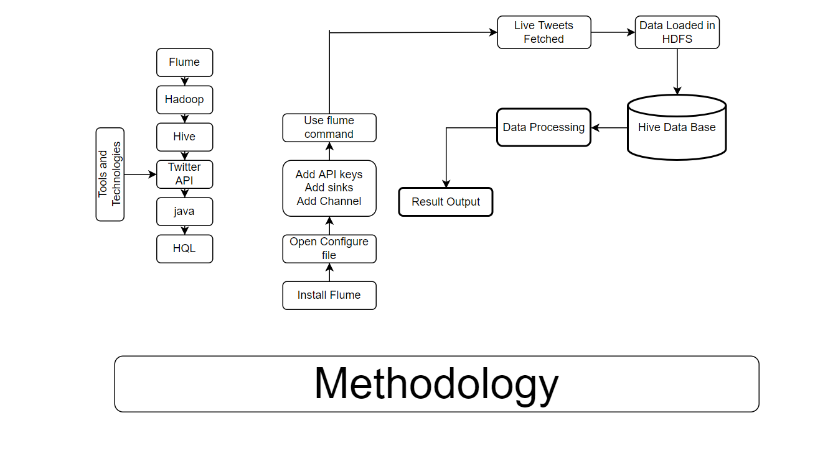
METHODOLOGY
USING HIVE:

Slide 10

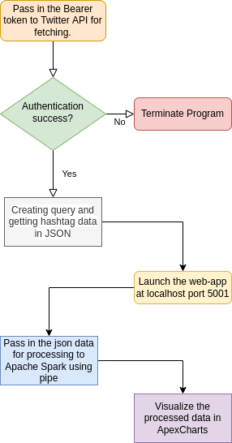
METHODOLOGY
USING SPARK:

Slide 11


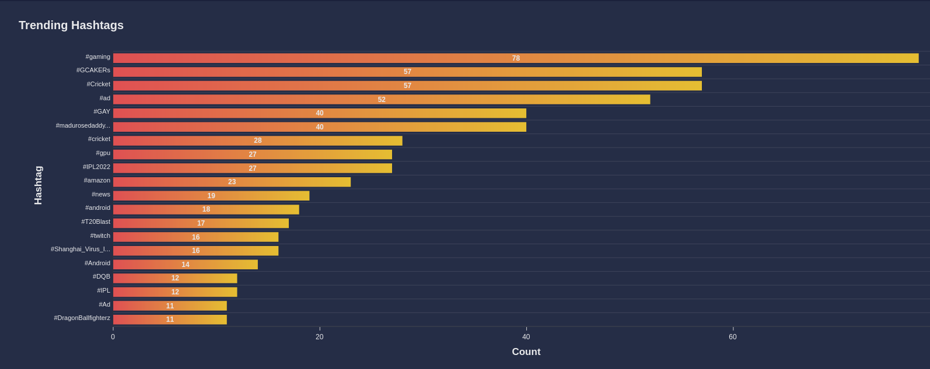
RESULTS

Slide 12
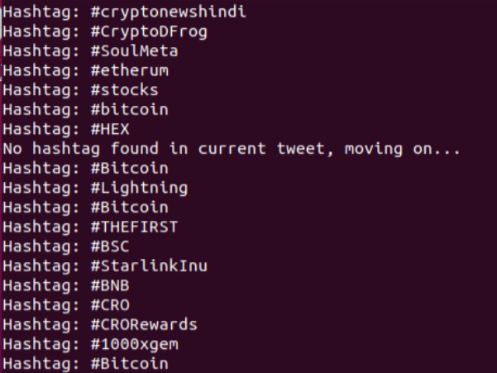
RESULTS

Slide 13




