Slide 1
VIRTUAL MEMORY MANAGEMENT SYSTEM
GROUP 13
GANDHAM SAI RAM PAVAN – AM.EN.U4.AIE20125
JITHIN JOHN - AM.EN.U4.AIE20135
KUCHARLAPATI AKASH VARMA - AM.EN.U4.AIE20141
N.MONEESH - AM.EN.U4.AIE20150

Slide 2
INTRODUCTION
The process that is now running must be loaded into main memory.
This demands storing the program's whole logical address space in physical memory.
Because physical memory is finite, the size of a program is bound by the size of physical memory.
As a result, we'll need to employ strategies that allow us to run the program without using up all the logical address space.

Slide 3
VIRTUAL MEMORY
Virtual Memory is a storage scheme that provides user an illusion of having a very big main memory.
This is done by treating a part of secondary memory as the main memory . In this scheme, User can load the bigger size processes than the available main memory by having the illusion that the memory is available to load the process.
Instead of loading one big process in the main memory, the Operating System loads the different parts of more than one process in the main memory.
By doing this, the degree of multiprogramming will be increased and therefore, the CPU utilization will also be increased.

Slide 4
VM IMPLEMENTATION
Virtual memory can be implemented by demand paging
Demand paging :
The pager guesses which pages will be used when a process is swapped in before it is swapped out again.
Instead of loading an entire process into memory, the pager loads only the pages that are required. As a result, it avoids reading into memory pages that will never be used, reducing swap time and physical memory requirements.

Slide 5
VALID,INVALID PAGES
The valid-invalid bit is used to distinguish between pages that are in main memory and pages that are on the disc.
When the page is in memory, this bit is set to "valid," while it is set to "invalid" when the page is either not valid or valid but on the disc.
A page fault will occur if the process tries to access a page that is not in main memory.

Slide 6
PAGE FAULT
As if it were a mistake, the page fault dominates. If a software tries to access a chunk of memory that does not exist in physical memory (main memory), a page fault will occur.
The fault instructs the operating system to trace all data into virtual memory management and then relocate it from secondary memory, such as a hard disc, to the system's primary memory.

Slide 7
HANDLING PAGE FAULTS
However, if the appropriate page isn't put into memory, a page fault trap occurs. Now, in order to handle the page fault, you must follow these procedures.
To begin, examine the main memory address requests and validate that they are genuine.
The procedure will be ended if the reference becomes invalid; else, the page will be paged in.
The free frame is then found using the Free-frame list.

Slide 8
HANDLING PAGE FAULTS
Disk operations will now be scheduled to get the required page from disc.
When the I/O operation is completed, the process's page table will be updated with a new frame number and the invalid bit will be changed. This is now a legitimate page reference.
If a page fault is discovered later, restart these procedures from the beginning.

Slide 9
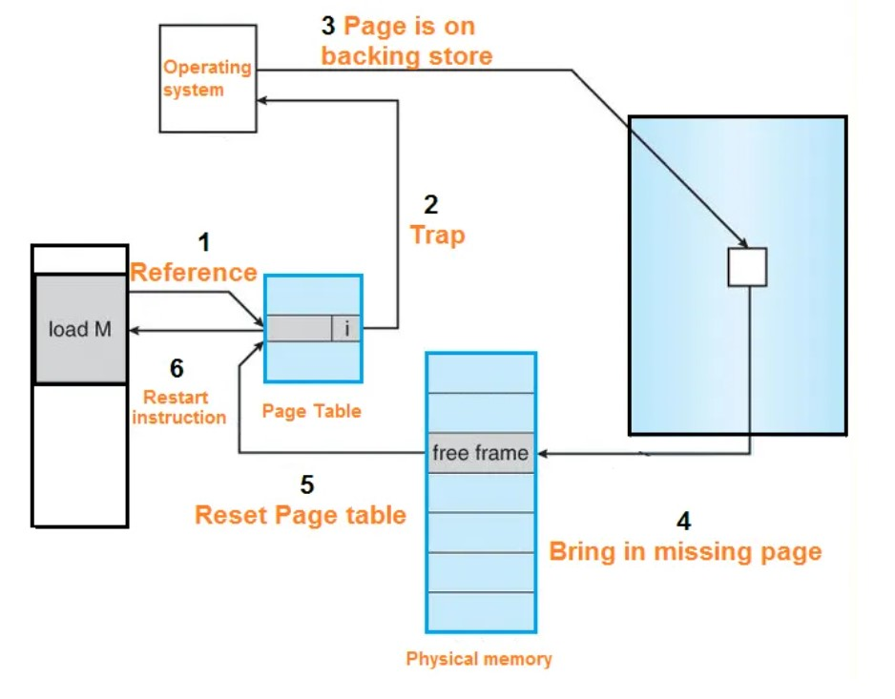
HANDLING PAGE FAULTS (CONT)

Slide 10
TERMINOLOGY FOR PAGE FAULTS
Page Hit - When the CPU attempts to obtain a page from main memory and that page already exists in main memory (RAM)
Page Miss - When a required page does not exist in the RAM
Page Fault Rate - The rate at which threads locate a page fault in memory .The Page Fault Rate is expressed in seconds.
Page Fault Time - The time it takes to collect a page from secondary memory plus the time it takes to recover the page from RAM after it has been loaded.

Slide 11
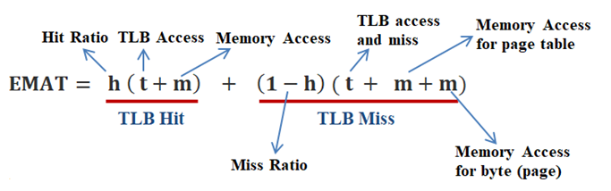
Performance of Demand Paging:
It is evaluated by effective memory access time

Slide 12
PAGE REPLACEMENT ALGORITHMS
When a page of memory needs to be allocated, the Operating System uses page replacement algorithms to determine which memory pages to swap out and write to disc.
When a page fault occurs and a free page cannot be used for allocation purposes due to the fact that pages are not available or the number of free pages is less than the number of required pages, paging occurs.
And basically there are 2 algorithms which are mostly used they are FIFO , LRU

Slide 13
FIRST IN FIRST OUT (FIFO)
The simplest page replacement algorithm is First In First Out (FIFO). The operating system uses this algorithm to maintain track of all pages in memory in a queue, with the oldest page at the top. When a page has to be replaced, the first page in the queue is chosen for replacement.
Belady's anomaly - Belady's anomaly shows that increasing the number of page frames while employing the First in First Out (FIFO) page replacement mechanism can result in additional page faults.

Slide 14
LEAST-RECENTLY-USED (LRU)
In LRU, replace the page that has not been used for the longest period of time.
The implementation of LRU replacement requires substantial hardware assistance to determine an order for the frames defined by the time of last use.

Slide 15
ADVANTAGES, DISADVANTAGES
Advantages of Virtual Memory:
Virtual memory is easy and cheaper to use.
That brings in the request.
It supplies an environment-friendly swapping.
It allows the facility to run more than 1 goal same time.
With virtual memory, we can perform mass targets with much less RAM.
Disadvantages of Virtual Memory:
Others will be admitted promptly.
Due to massive get, right-of-way to time functions run more slowly.
It has high complexity.
It takes longer to switch back and forth between processes.
General expenditure on exchange.

Slide 16
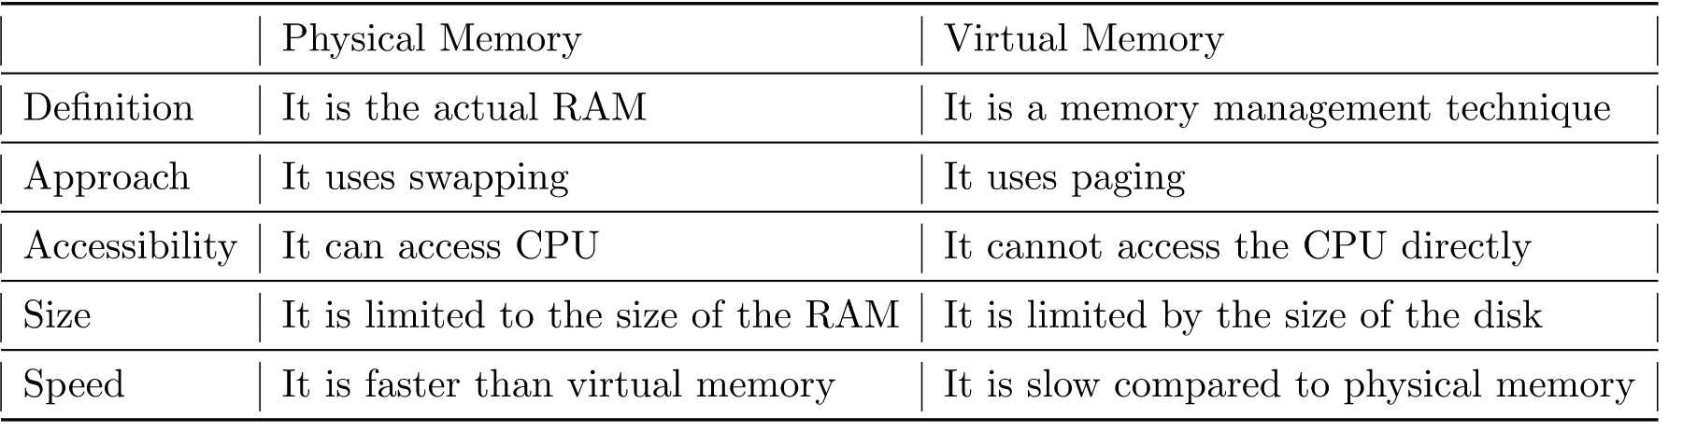
VIRTUAL,PHYSICAL MEMORY

Slide 17
CONCLUSION
Virtual memory creates the illusion of a wide address space, thus removing the constraints imposed by real memory's limited capacity.
As a result, regardless of the quantity of actual memory installed in a system, both system and user program can provide the needed functionality.
Virtual memory's biggest downside is the complicated hardware and software required to support it.
Virtual-memory operating systems have more space and temporal complications than their real-memory equivalents.
The administration of file-map tables and the use of a large virtual-address space contribute to a significant increase in table fragmentation.

Slide 18
REFERENCES
Cicnavi (2010). “What is Virtual Memory and why do we need it?” Available fromwww.utilizewindow.com.
John Papiewski (2018). “The Concept of Virtual Memory in Computer Architecture. Available From www.smallbuisness.chron.com/Concept-Virtual-memory.
Jacob Queen (2018). “Why is Virtual Memory Important?” Available fromwww.techwalla.com/articles/why-is-virtual-memory-important.
Geeks for Geeks(n.d). “Page Replacement Algorithms”. Available from www.geeksforgeeks.org/operating-system-page-replacement-algorithm.
Operating Systems Study Guide (2015). “Page faults”. Available from faculty.salima.k-state.edu.

Slide 19
THANK YOU!

