Slide 1
Requirement Analysis
2.1 Feasibility Study
The feasibility study includes consideration of all the possible ways to provide a solution to the given problem. The proposed solution should satisfy all the user requirements and should be flexible enough so that future changes can be easily done based on the future upcoming requirements.

Slide 2
I. Economical Feasibility:
This is a very important aspect to be considered while developing a project. We decided on the technology based on the minimum possible cost factor.
AI hardware and software cost has to be borne by our team.
Overall we have estimated that the benefits the organization is going to receive from the proposed system will surely overcome the initial costs and the later on running cost for the system.
II. Technical Feasibility:
This included the study of function, performance, and constraints that may affect the ability to achieve an acceptable system. For this feasibility study. We studied complete functionality to be provided in the system, as described in the System Requirement Specification (SRS). and checked if everything was possible using a different type of frontend and backend platforms.
III. Operational Feasibility:
No doubt the proposed system is fully GUI based that is very user friendly and all inputs to be taken all self-explanatory even to a layman.

Slide 3
Software Required Specification Document

Slide 4

REQUIREMENTS :--
HARDWARE:
Intel i3 5th gen or higher, Amd a6 or higher
2 GB or more of Hard Disk/SSD
1 Gb or more of DDR2 or later Ram
Webcam or Front Facing Camera.
Network Card for internet connection
SOFTWARE:
Languages : Python, JavaScript
Design : Figma, Notion
Development Environment : Vscode, PyCharm
Backend : MongoDB
ML/Computer Vision Frameworks And Libraries : Tensorflow, Numpy, Pandas, OpenCV
Other frameworks : Electron/PyQt

Slide 5
Functional requirements
This project requires dataset for generating questions and answers.
Based on this dataset the software will generate questions using NLP (Using Python and its libraries).
Its User Interface design presents a seamless blend of visual design, interaction design, and information architecture.
Automatic evaluation of result also reduces effort of teacher to manually evaluate them.
Stores result of all students in database for future use.

Slide 6
Non functional requirements
User Satisfaction: - The system is such that it stands up to the user expectations.
Response Time: - The response of all the operation is good. This has been made possible by careful programming.
Error Handling: - Response to user errors and undesired situations has been taken care of to ensure that the system operates without halting.
Safety and Robustness: - The system is able to avoid or tackle disastrous action. In other words, it should be foul proof. The system safeguards against undesired events, without human intervention.
User friendliness: - The system is easy to learn and understand. A native user can also use the system effectively, without any difficulties.

Slide 7

System Design / Architecture

Slide 8


Essential Modules of Project
User Interface Module | Is the module user directly interacts with.
NLP Module | This module is acting as backbone for project. Keyword extraction is done using various processes like tokenization , morphology , part of speech tagging , distributional similarity , chunking , name entity recognition.
Database Module | All students records will be saved in database.

Slide 9
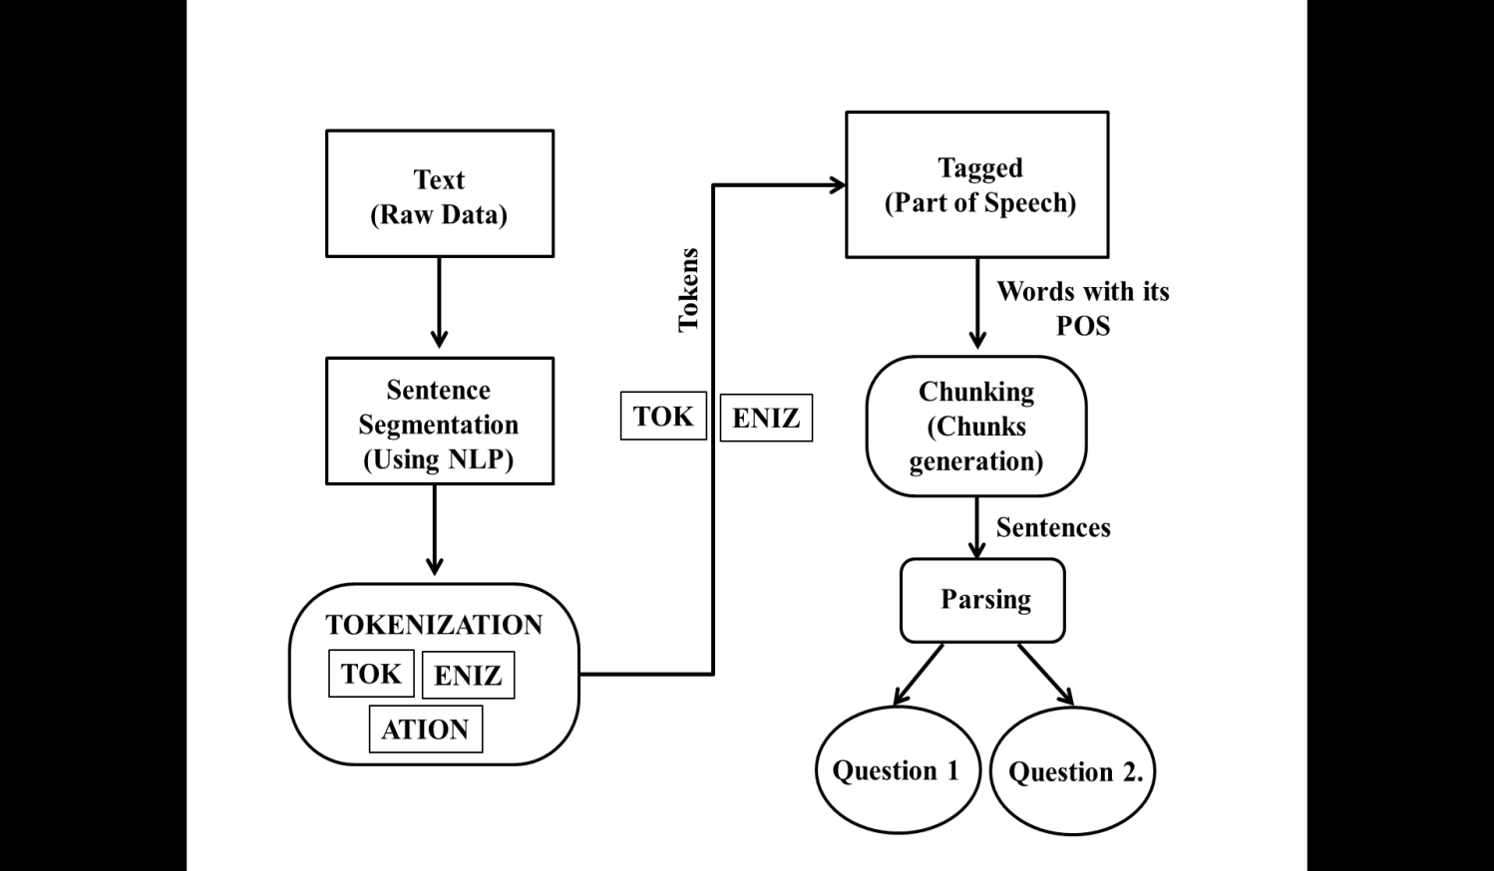
System Design and Architecture

Slide 10
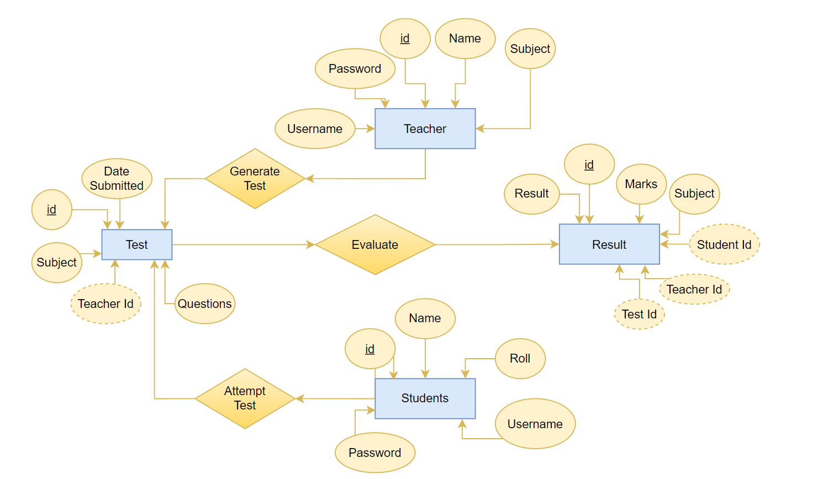
ER DIAGRAM

Slide 11
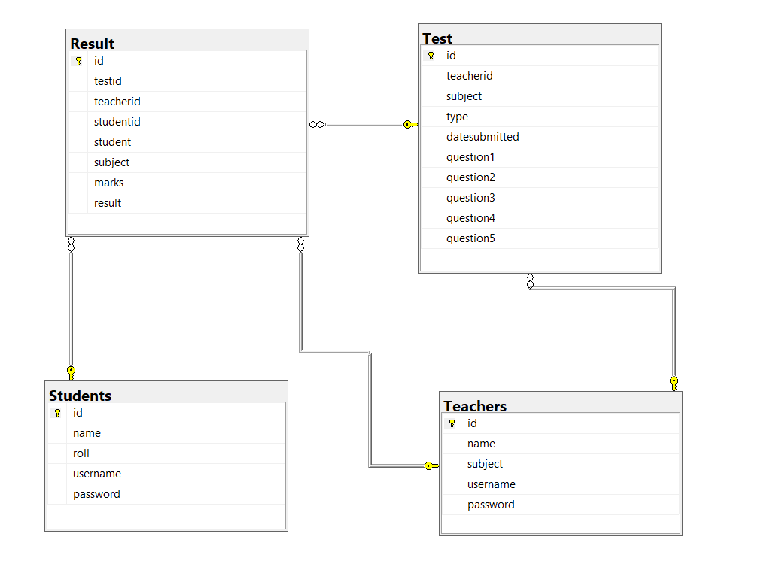
TABLE STRUCTURE

Slide 12
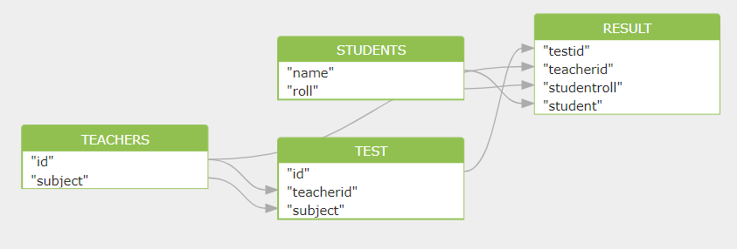
DATA FLOW DIAGRAM

Slide 13
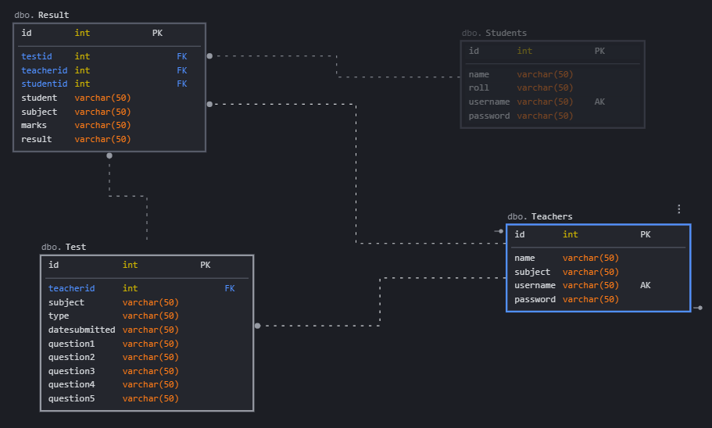
DATABASE DIAGRAM

Slide 14
[Chapter-4] Development, Implementation and Testing
4.1 Introduction to development environment (Front End and Back End)

Slide 15





Development environment
Front End
HTML
CSS
Bootstrap
JavaScript
Back End
Flask
Python
SQLite

Slide 16
Other supporting languages or tools
NLTK
Numpy
Pandas
Scikit – Learn
JSON
Jquery

Slide 17
4.3 Implementation of the problem (Use pseudo-codes, algorithms, figures, and tables) -Each Figure must be numbered, Description and discussion of pseudo-codes, algorithms, figures, and tables must be provided in the text – Exclude the screenshots of the projects.

Slide 18
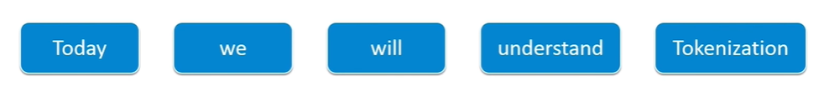
Pseudocode of tokenization
Define : List of unwanted_character
Define : String_article
For i=1 to number_of_character in String Article
If (String_article[i]==“unwanted character”)
Remove String_article[i];
End If
End For
String_split (String_article)

Slide 19
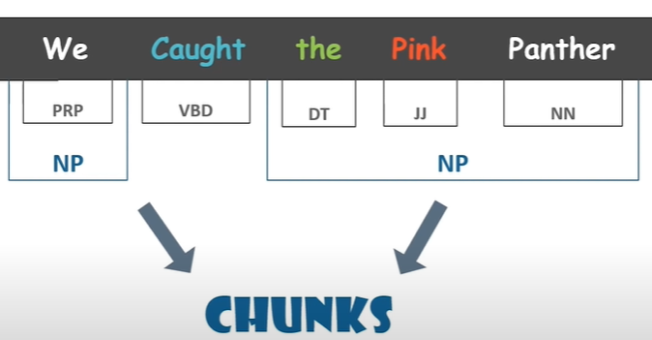
Pseudocode of Keyword extraction
sort sentences by weignt
while (desiredSumLength is not met and there are unused sentences)
for (all sentences x )
if (sentence x not already in summary)
if (segment of sentece x has the lowest or equally low use)
set sum_sentence = x
break out of for loop
end if
end if
end for
add sum_sentence to the summary
record sum_sentence as having been used
increment sum_sentence's segment use
increment currentSumLength
end while

Slide 20
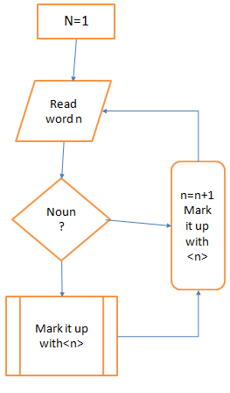
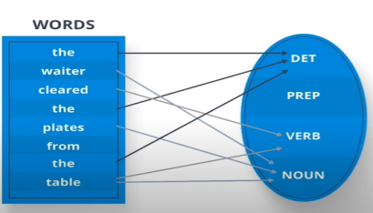
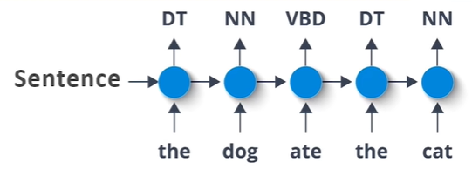
Part of speech tagging
Algorithm Noun<n>
for each word in the list n >= 1do
if the word=noun then mark it up with <n>
else mark it up with <a>
return <n>

