Slide 1






Introduction
What is Test?
A test or examination is an educational assessment intended to measure a test taker's knowledge and skill. Exam is conducted for a job or for a college or examination in schools.

Slide 2

Traditional Method of Test
Pen-paper based exam the verification of answers and result processing.
Teacher sets question paper.
A physical Infrastructure for conducting examination.
The manual checking process.
The manual result formulation

Slide 3

Modern Method of Examination
Modern Method includes an on-line test simulator is to take examination
Online creation of question Paper.
PC or Mobile to attempt Examination.
Answer evaluation by exact answer matching.
Automated result formulation .

Slide 4


Our Approach?
Our Approach, it is further extension to modern method of examination by using Artificial intelligence and Natural Language Processing.
Automatic Question and Answer generation.
Random Distribution of Questions.
Automated answer evaluation by AI.
Automated result formulation.

Slide 5

Background Study
Offline System
In the offline examination system relies on manual work from printing to transporting the paper to the examination hall, then invigilation and the most tedious task of checking the answer sheets which is a huge mess for any examiner which sometimes leads to resource loss. Also, we hear news about paper leaks and answer sheets being lost in the transporting process.

Slide 6



Online System
The online examination system does not features descriptive question. They are good at evaluating the answers but they have little to no scope for the descriptive ones and the analysis is not well implemented to get meaningful results. Even the most famous of them just have a simple system of storing the correct options in the database and just matching the correct option with it to calculate the result.

Slide 7
Requirement Analysis
Feasibility Study:
The feasibility study includes consideration of all the possible ways to provide a solution to the given problem. The proposed solution should satisfy all the user requirements and should be flexible enough so that future changes can be easily done based on the future upcoming requirements.

Slide 8
I. Economical Feasibility:
This is a very important aspect to be considered while developing a project. We decided on the technology based on the minimum possible cost factor.
AI hardware and software cost has to be borne by our team.
II. Technical Feasibility:
This included the study of function, performance, and constraints that may affect the ability to achieve an acceptable system. For this feasibility study. We studied complete functionality to be provided in the system, as described in the System Requirement Specification (SRS). and checked if everything was possible using a different type of frontend and backend platforms.
III. Operational Feasibility:
No doubt the proposed system is fully GUI based that is very user friendly and all inputs to be taken all self-explanatory even to a layman.

Slide 9
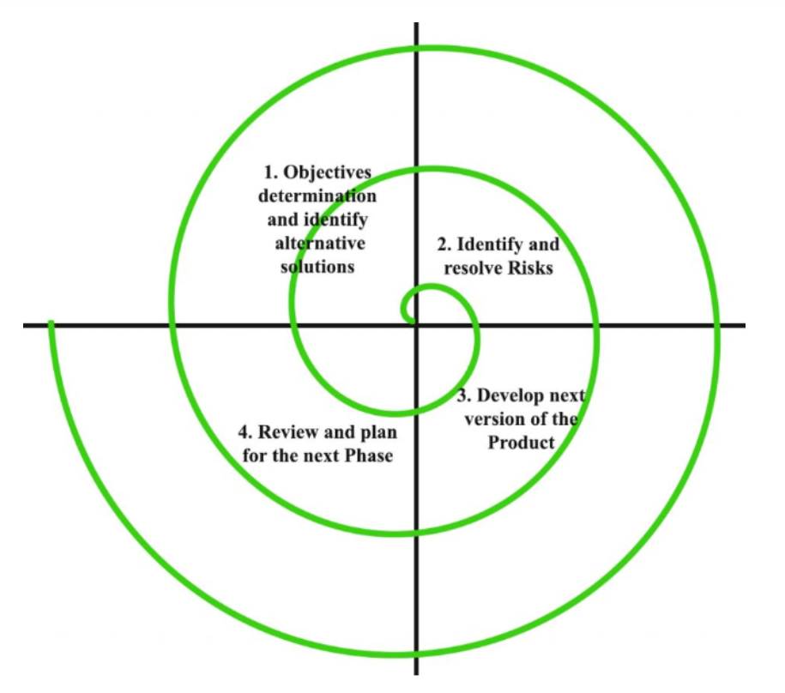
Software Development Life Cycle

Slide 10
Functional requirements
This project requires dataset for generating questions and answers.
Based on this dataset the software will generate questions using NLP (Using Python and its libraries).
Its User Interface design presents a seamless blend of visual design, interaction design, and information architecture.
Automatic evaluation of result also reduces effort of teacher to manually evaluate them.
Stores result of all students in database for future use.

Slide 11
Non functional requirements
User Satisfaction: - The system is such that it stands up to the user expectations.
Response Time: - The response of all the operation is good. This has been made possible by careful programming.
Error Handling: - Response to user errors and undesired situations has been taken care of to ensure that the system operates without halting.
Safety and Robustness: - The system is able to avoid or tackle disastrous action. In other words, it should be foul proof. The system safeguards against undesired events, without human intervention.
User friendliness: - The system is easy to learn and understand. A native user can also use the system effectively, without any difficulties.

Slide 12

REQUIREMENTS :-
HARDWARE:
Intel i3 5th gen or higher, Amd a6 or higher
2 GB or more of Hard Disk/SSD
1 Gb or more of DDR2 or later Ram
Network Card for internet connection
SOFTWARE:
Languages : HTML, CSS, Bootstrap, JavaScript
Development Environment : Vscode
Backend : Flask, Python
Database: SQLite
Other frameworks : JQuery, Numpy, Pandas, JSON, NLTK

Slide 13

System Design / Architecture

Slide 14
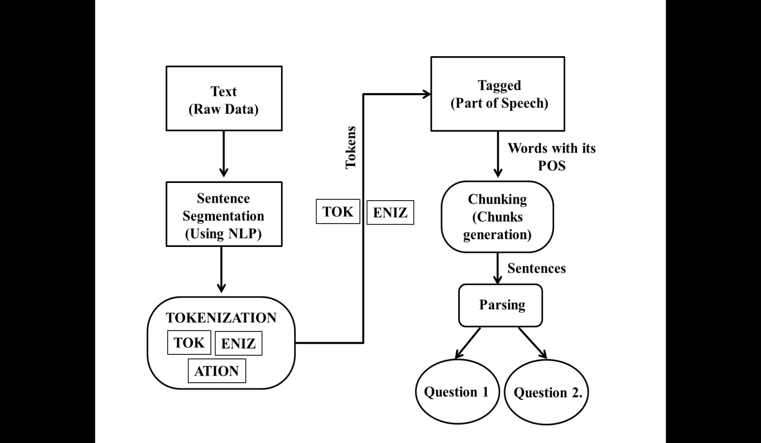
System Design and Architecture

Slide 15
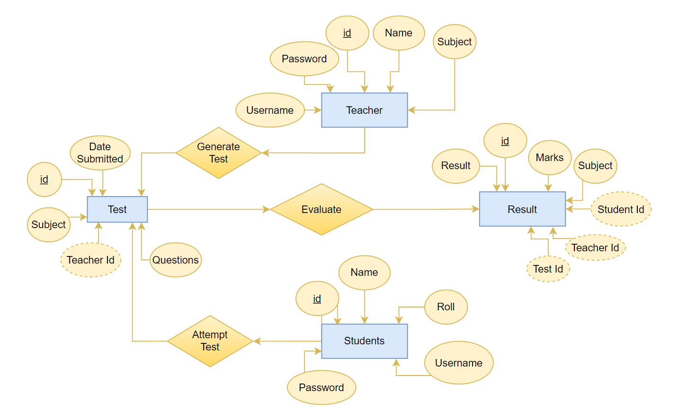
ER DIAGRAM

Slide 16
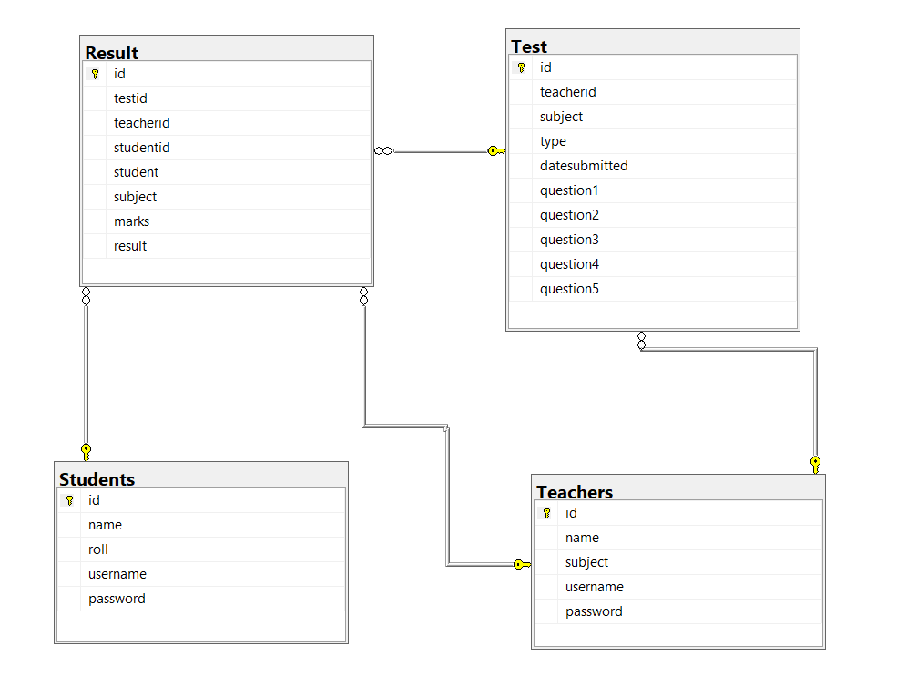
TABLE STRUCTURE

Slide 17
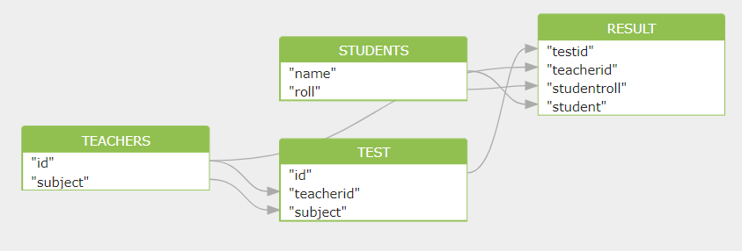
DATA FLOW DIAGRAM

Slide 18
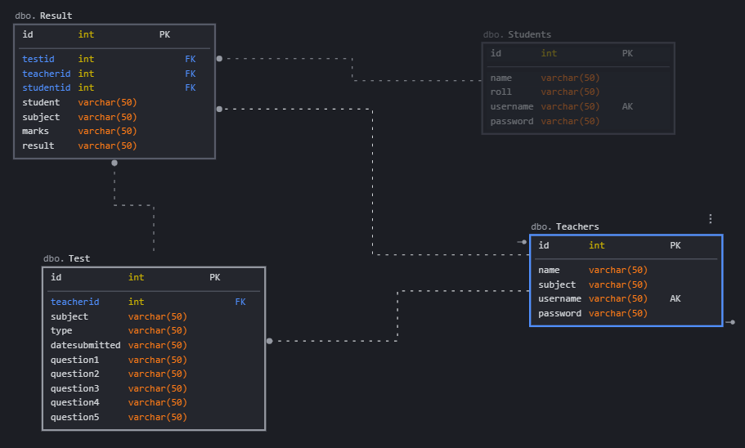
DATABASE DIAGRAM

Slide 19





Implementation & Testing
Development environment
Front End
HTML
CSS
Bootstrap
JavaScript
Back End
Flask
Python
SQLite

Slide 20
Other supporting languages or tools
NLTK
Numpy
Pandas
Scikit – Learn
JSON
Jquery

Slide 21
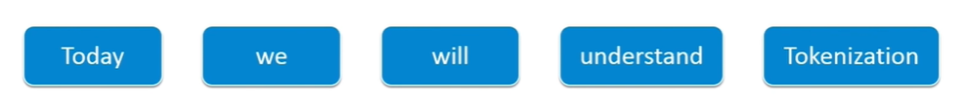
Pseudocode of tokenization
Define : List of unwanted_character
Define : String_article
For i=1 to number_of_character in String Article
If (String_article[i]==“unwanted character”)
Remove String_article[i];
End If
End For
String_split (String_article)

Slide 22
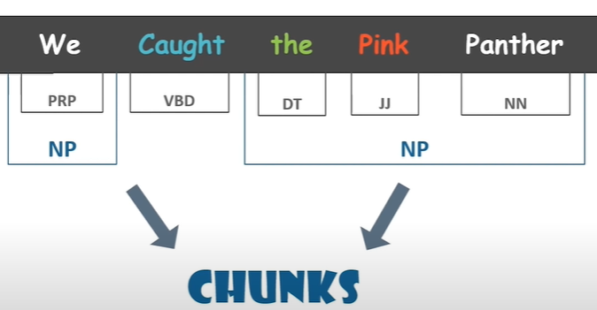
Pseudocode of Keyword extraction
sort sentences by weignt
while (desiredSumLength is not met and there are unused sentences)
for (all sentences x )
if (sentence x not already in summary)
if (segment of sentece x has the lowest or equally low use)
set sum_sentence = x
break out of for loop
end if
end if
end for
add sum_sentence to the summary
record sum_sentence as having been used
increment sum_sentence's segment use
increment currentSumLength
end while

Slide 23
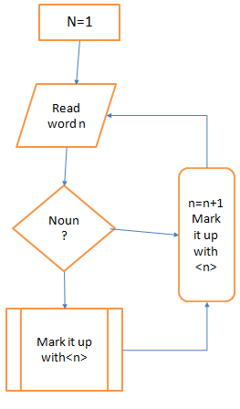
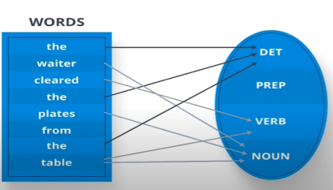
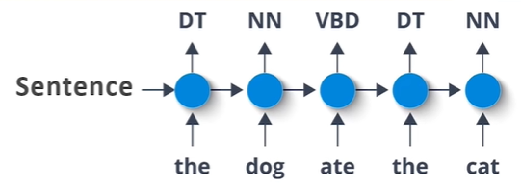
Part of speech tagging
Algorithm Noun<n>
for each word in the list n >= 1do
if the word=noun then mark it up with <n>
else mark it up with <a>
return <n>

Slide 24
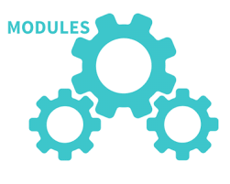

Results and Discussions
User Interface Module | Is the module user directly interacts with.
NLP Module | This module is acting as backbone for project. Keyword extraction is done using various processes like tokenization , morphology , part of speech tagging , distributional similarity , chunking , name entity recognition.
Database Module | All students records will be saved in database.

Slide 25







User Login Portal
Teacher Login
Student Login
Provides Raw data
Attempt
Exam
Result
Result

Slide 26




Maintaining Student Record
Teacher Login
Student Evaluated Result
Student Login

Slide 27
Conclusion
Our project is only a humble venture to satisfy the needs of educational institutes to manage their Test-taking task conveniently. Several user-friendly coding has also been adopted. This package shall prove to be a powerful package in satisfying all the requirements of the educational institutes. The manual question generation takes much time and labor. Therefore, automatic question generation from learning resources is the primary task of an automated assessment system.
This project presents a survey of automatic question generation and assessment strategies from textual learning resources. The purpose of this project is to summarize the state-of-the-art techniques for generating questions and evaluating their answers automatically.

Slide 28
Future Scope
Nowadays the fastest developing field in NLP is one of the quickest developing fields from recent years. By the evolution of the period, its significance will increase day by day because online data is present in an enormous amount due to digitalization. Extracting useful information from text has a long way to go. By developing the benefit of connecting content mining to other fields such as machine learning, perception, normal dialect preparing, it could be conceivable to sketch more effective and helpful content mining frameworks. Few advancements that can be added are:
Difficulty level of the question can be improved in the advance version of this project in future.
User interface can be enhanced.
Grammatically errors can be improved.

Slide 29
References
[1]
Indrashis Das, Bharat Sharma, Manjusha Pandey and Siddhart S. Rautaray“An Examination System Automation Using Natural Language Processing”, Fourth International Conference on Communication and Electronics Systems, 978-1-7281-1261-9,2019
Cristley, “Natural Language Processing (NLP) Tutorial with Python & NLTK”, freeCodeCamp.org, 2018 (https://www.youtube.com/watch?v=X2vAabgKiuM)
Catherine Henry, “Natural Language Processing (NLP): Automatic generation of questions and answers from Wikipedia”, Clearwater DevCon - Clearwater Analytics,2017 (https://www.youtube.com/watch?v=3vRZ6dBPL2A)
Zolzaya Luvsandorj , “Introduction to NLP : Preprocessing text in Python”, Towards Data Science, 2020 (https://towardsdatascience.com/introduction-to-nlp-part-1-preprocessing-text-in-python-8f007d44ca96)
B. Kaur, and S. Jain “Keyword extraction using machine learning approaches”, IEEE 3rd International Conference on Advances in Computing, Communication & Automation (ICACCA) (Fall), 2017
[2]
[3]
[4]
[5]

