Slide 1
VIT VELLORE / PROJECT PRESENTATION
Campus
Helpdesk
AI answers with sources.
Staff support in the same conversation.
25 October 2026
CAMPUS HELPDESK
01
Notes:
Opening, 15 seconds. Introduce an independent academic project combining source-backed AI and human support. Use this order: problem, idea, implementation, short demonstration, limitations, future scope. Suggested duration is 7 to 8 minutes including the demo.
Evidence: README.md, Project owner completion confirmation. Presentation date: 25 October 2026. Two-account login, saved conversations and live staff chat are complete and verified according to the project owner’s confirmation on 25 October 2026. This document revision does not claim a new independent test of the teammate’s build.

Slide 2
01 PROBLEM
Finding the right campus information
A student has
a question.
Information is spread out
Relevant details sit across university pages, policy PDFs and different offices.
Hostel booking. Library rules.
Academic procedures.
Some answers need staff
Unclear details and personal requests need a human response.
CAMPUS HELPDESK
02
Notes:
30 seconds. Describe the information-discovery problem as the motivation, not as a measured survey result. Public source search helps students find guidance, and staff handle cases the collection cannot answer.
Evidence: README.md, reports/official-dataset.md. Presentation date: 25 October 2026. Two-account login, saved conversations and live staff chat are complete and verified according to the project owner’s confirmation on 25 October 2026. This document revision does not claim a new independent test of the teammate’s build.

Slide 3
02 IDEA
One place for campus questions
Ask naturally.
Check the source.
Continue with staff.
The student confirms before a conversation goes to staff.
CAMPUS HELPDESK
03
Notes:
25 seconds. Explain the idea before the technology: a question interface with inspectable university evidence and a consent-based path into live human support. This is the functional project outcome confirmed by the team. No measured response-time or workload improvement is claimed.
Evidence: README.md, Project owner completion confirmation. Presentation date: 25 October 2026. Two-account login, saved conversations and live staff chat are complete and verified according to the project owner’s confirmation on 25 October 2026. This document revision does not claim a new independent test of the teammate’s build.

Slide 4
03 HOW IT WORKS
The student-to-staff journey
01
Ask
Sign in and ask a campus question.
02
Get an AI answer
Retrieve public sources and show citations.
03
Confirm a handoff
Save the request and pause AI replies.
04
Chat with staff
Staff takes over, replies and resolves the chat.
CAMPUS HELPDESK
04
Notes:
40 seconds. Distinguish an AI answer from a staff reply. Staff only sees confirmed handoffs. While the student waits and while staff is active, AI remains paused. Resolution closes the composer, with explicit reopening or a separate new AI conversation available.
Evidence: User-supplied two-account and live-chat specification, Project owner completion confirmation. Presentation date: 25 October 2026. Two-account login, saved conversations and live staff chat are complete and verified according to the project owner’s confirmation on 25 October 2026. This document revision does not claim a new independent test of the teammate’s build.

Slide 5
04 IMPLEMENTATION
The system behind the conversation
Interface
Application
React and TypeScript
Student chat and staff workspace
FastAPI and Python
Login, conversations and handoff logic
Knowledge and storage
AI and live delivery
Neon PostgreSQL with pgvector
Sources, history, tickets and vector search
OpenRouter for grounded answers
WebSockets for message and status updates
CAMPUS HELPDESK
05
Notes:
35 seconds. Keep the explanation at component level. Retrieval-augmented generation finds relevant source passages before model generation. HTTP handles authenticated sends and WebSockets carry committed updates. Neon remains authoritative. These describe the supplied design and the team-confirmed completed extension, not independently reviewed endpoint names.
Evidence: README.md, User-supplied specification, Project owner completion confirmation. Presentation date: 25 October 2026. Two-account login, saved conversations and live staff chat are complete and verified according to the project owner’s confirmation on 25 October 2026. This document revision does not claim a new independent test of the teammate’s build.

Slide 6
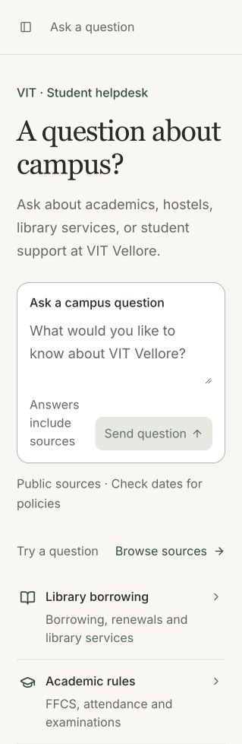
04 IMPLEMENTATION
Source-backed AI assistance
Public VIT Vellore
information
Academics, library, hostels and student services
Inspect the passage and original source.
Follow up without repeating the topic.
CAMPUS HELPDESK
06
Notes:
30 seconds. The corpus uses public Vellore pages and PDFs. Cite actual passages, preserve policy dates and programme scope, and use stored history for follow-ups. Screenshot is an earlier actual question-screen capture, not evidence of the updated account or staff-chat screens. Do not treat retrieval dates as a guarantee of current policy.
Evidence: knowledge/official/manifest.json, reports/official-dataset.md, backend/app/retrieval.py. Presentation date: 25 October 2026. Two-account login, saved conversations and live staff chat are complete and verified according to the project owner’s confirmation on 25 October 2026. This document revision does not claim a new independent test of the teammate’s build.

Slide 7
04 IMPLEMENTATION / COMPLETE
Two accounts, with saved conversations
Student
Staff
Ask the AI assistant
Start or resume a conversation
Return to history after signing in
Open confirmed support requests
Read the conversation context
Take over and reply live
One shared login screen opens the workspace for each role.
CAMPUS HELPDESK
07
Notes:
35 seconds. Exactly two fixed accounts, one student and one staff. Login sessions and conversations are distinct. Students see their own chats, while staff accesses confirmed handoffs. This feature set is complete and verified per the owner. Do not describe it as proposed. No registration or password-reset system is included in this version.
Evidence: User-supplied specification, Project owner completion confirmation. Presentation date: 25 October 2026. Two-account login, saved conversations and live staff chat are complete and verified according to the project owner’s confirmation on 25 October 2026. This document revision does not claim a new independent test of the teammate’s build.

Slide 8
05 DEMONSTRATION
A short end-to-end demonstration
01
Ask and inspect
Student asks an FFCS question and opens its source.
02
Resume a saved chat
Sign back in and reopen the conversation history.
03
Confirm staff help
Request a handoff and show the waiting state.
04
Reply as staff
Staff starts chat, sends a reply, then resolves it.
CAMPUS HELPDESK
08
Notes:
About 2 to 3 minutes. Use separate student and staff browser sessions, prepared before speaking. Never project credentials. Student asks “What choices does FFCS give students?” and opens a citation. Show a saved chat after re-login, using prepared history if time is short. Student explicitly confirms a staff handoff for the selected question, creating or reusing a real demo ticket. Verify AI pauses and the waiting state appears. In the staff session select Start chat, send a brief real reply and show it arriving for the student. Resolve and show the closed composer. This is a demo runbook, not a claim that this exact sequence ran during artifact preparation. If unavailable, describe the team-verified flow honestly rather than simulating successful replies.
Evidence: User-supplied specification, Project owner completion confirmation. Presentation date: 25 October 2026. Two-account login, saved conversations and live staff chat are complete and verified according to the project owner’s confirmation on 25 October 2026. This document revision does not claim a new independent test of the teammate’s build.

Slide 9
06 SCOPE AND LIMITATIONS
Public guidance with human support
What the project supports
What still needs care
Public campus questions
Saved conversation history
Live staff support after consent
Private VTOP data remains unavailable
Policies vary by programme and year
Staff availability affects waiting time
Source inspection and staff review remain important for critical decisions.
CAMPUS HELPDESK
09
Notes:
30 seconds. Two fixed accounts are a demonstration scope, not an institution-wide account system. Public source grounding does not make every generated claim correct. OCR and stale policy risks remain. Multi-worker real-time scaling and institution-level identity are future rollout concerns.
Evidence: reports/official-dataset.md, User-supplied specification, Project owner completion confirmation. Presentation date: 25 October 2026. Two-account login, saved conversations and live staff chat are complete and verified according to the project owner’s confirmation on 25 October 2026. This document revision does not claim a new independent test of the teammate’s build.

Slide 10
07 FUTURE SCOPE
Beyond the two-account version
Broader campus rollout
Source maintenance
More users and departments
Scalable staff routing and deployment
Scheduled refresh of official material
Review changes before publishing
University integration
Institutional readiness
Institutional sign-in
Approved, scoped access to university systems
Privacy and retention policies
Staff review and wider accessibility checks
CAMPUS HELPDESK
10
Notes:
35 seconds. Only this slide describes future work. The two accounts, history and live chat are already complete per owner confirmation. Broader rollout, scheduled source refresh and institutional integration are beyond that delivered scope. Private-system access requires institutional authorization and privacy controls. No delivery dates are promised.
Evidence: Project owner future-scope instruction, README.md. Presentation date: 25 October 2026. Two-account login, saved conversations and live staff chat are complete and verified according to the project owner’s confirmation on 25 October 2026. This document revision does not claim a new independent test of the teammate’s build.

Slide 11
08 CONCLUSION
AI guidance with a human continuation
Implemented
Cited answers, saved chats
and live staff support
Future scope
Broader rollout and
university integration
Questions
CAMPUS HELPDESK
11
Notes:
15 seconds. Close with the clear split: working source-backed AI, account history and live staff continuation, followed by future institutional rollout. The project is an independent academic prototype, without a claim of university endorsement.
Evidence: Project owner completion confirmation, Project owner future-scope instruction. Presentation date: 25 October 2026. Two-account login, saved conversations and live staff chat are complete and verified according to the project owner’s confirmation on 25 October 2026. This document revision does not claim a new independent test of the teammate’s build.

