Slide 1
PROJECT PRESENTATION
Campus Helpdesk
Source-backed student support
for VIT Vellore
26 October 2026
Independent academic prototype
CAMPUS HELPDESK / 01
Notes:
Opening, 20 seconds. Introduce a working web prototype that answers public campus questions with inspectable sources and asks for consent before creating a staff ticket. It is independent of VIT. Suggested total: 7 minutes, including a 2-minute live demonstration.
Project evidence: README.md. Repository: imakshat27/campus-helpdesk. Prepared 25 October 2026 for presentation on 26 October 2026.

Slide 2
01 PROBLEM AND SCOPE
Student questions and project scope
01
Problem
Campus information spans web pages, policy PDFs and different offices.
02
Objective
Provide one question interface with evidence students can inspect.
03
Boundary
Public Vellore information. Personal VTOP records remain unavailable.
CAMPUS HELPDESK / 02
Notes:
40 seconds. Explain the information-finding problem as the design motivation, not a measured survey result. The project does not access private attendance, personal timetables or live allocations. Roadmap: scope, implementation, demonstration, evidence and future work.
Project evidence: README.md, reports/official-dataset.md. Repository: imakshat27/campus-helpdesk. Prepared 25 October 2026 for presentation on 26 October 2026.

Slide 3
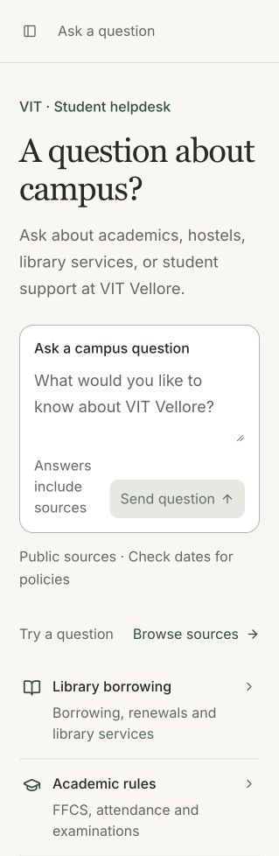
02 IMPLEMENTED SYSTEM
Implemented features
Student workspace
Cited chat answers and source inspection
Conversation follow-ups and topic returns
Searchable official-source knowledge base
Staff workflow
Explicit ticket consent, protected queue,
resolve and reopen actions
CAMPUS HELPDESK / 03
Notes:
40 seconds. These capabilities exist in the source code. Screenshot: actual deployed home screen captured 25 October 2026, with no generated answers or fabricated queue. Staff access uses configured HTTP Basic credentials. No student account system exists.
Project evidence: frontend/src/App.tsx, backend/app/main.py, backend/app/schemas.py. Repository: imakshat27/campus-helpdesk. Prepared 25 October 2026 for presentation on 26 October 2026.

Slide 4
02 IMPLEMENTED SYSTEM
Architecture and answer flow
01
React interface / Vercel
Student chat, knowledge browser and staff workspace
02
FastAPI backend / Render
History resolution, hybrid retrieval, OpenRouter generation and validation
03
Neon PostgreSQL with pgvector
Approved documents, 384-dimensional vectors, conversations and tickets
CAMPUS HELPDESK / 04
Notes:
45 seconds. A question reaches FastAPI. For follow-ups, the resolver uses actual stored history to form a search query. Retrieval combines vector similarity and keyword matching. OpenRouter generates structured output from passages. The server validates citation IDs before returning source cards. Alembic manages schema changes. Frontend and backend have separate deployment configurations.
Project evidence: backend/app/main.py, backend/app/retrieval.py, backend/app/llm.py, backend/app/models.py, DEPLOYMENT.md. Repository: imakshat27/campus-helpdesk. Prepared 25 October 2026 for presentation on 26 October 2026.

Slide 5
02 IMPLEMENTED SYSTEM
Official knowledge and source boundaries
50
1,073
968
public source documents
searchable passages
extractive Q&A records
Public VIT Vellore HTML and PDFs, imported 24 October 2026
Original URLs and retrieval dates stay visible. Programme and policy-year scope matter.
Q&A extracts are section records, not 968 independently reviewed FAQs.
CAMPUS HELPDESK / 05
Notes:
35 seconds. Counts come from the recorded official-dataset validation, not a fresh database recount in this artifact task. Ingestion uses allowlisted URLs, heading/page-aware splitting and OCR where needed. Refresh is manual. Official mode excludes the fictional sample corpus. Publication dates may differ from download dates.
Project evidence: reports/official-dataset.md, knowledge/official/manifest.json, backend/app/import_official.py, backend/app/seed.py. Repository: imakshat27/campus-helpdesk. Prepared 25 October 2026 for presentation on 26 October 2026.

Slide 6
03 SHORT DEMONSTRATION
Two-minute live demonstration
00:00
Ask
What choices does FFCS give students?
00:30
Inspect
Open the citation and original source.
01:00
Follow up
What choices does it give me?
01:30
Handle a gap
What is my personal attendance percentage today?
CAMPUS HELPDESK / 06
Notes:
Demo instructions. Open https://campus-helpdesk-rho.vercel.app before presenting. The backend may need time to wake. Start a new conversation. Ask the FFCS question, open its source, then use the pronoun follow-up in this same conversation. Ask the private attendance question and show the consent offer. Choose No thanks: this demonstration stops before saving a ticket. The exact demo sequence is proposed for the presentation, not a new test result. If a request fails, show the recorded examples on the next slide and label them as recorded. Never claim a failed save succeeded. A full optional staff demonstration requires explicit consent to create one real demo ticket.
Project evidence: reports/official-live-evaluation.md, reports/official-context-and-consent.md, DEPLOYMENT.md. Repository: imakshat27/campus-helpdesk. Prepared 25 October 2026 for presentation on 26 October 2026.

Slide 7
03 SHORT DEMONSTRATION
Recorded behavior examples
A
Supported question
FFCS choices: the recorded answer lists course order, time slots and course load.
B
Ambiguous question
“When does the lab open?” returns “Which lab do you mean?”
C
Private information
Personal attendance returns a staff-confirmation offer with no saved ticket.
CAMPUS HELPDESK / 07
Notes:
30 seconds, or use as the demo fallback. These paraphrase the recorded official live evaluation. They are not screenshots or a fresh live run. The evaluator recorded eight supported responses, two clarifications and two unsupported outcomes. Do not present the examples as proof of universal answer accuracy.
Project evidence: reports/official-live-evaluation.md. Repository: imakshat27/campus-helpdesk. Prepared 25 October 2026 for presentation on 26 October 2026.

Slide 8
04 EVALUATION
Verification evidence and its limits
77 backend tests
Current isolated regression suite
18 frontend tests
Current UI/API component suite
30 / 30 retrieval checks
Expected source family in top eight
12 / 12 live checks
Recorded outcome and source-family checks
Recorded consent regression: eight turns, one ticket only after confirmation.
These checks do not establish universal factual accuracy.
CAMPUS HELPDESK / 08
Notes:
45 seconds. Isolated test counts and production build were rerun during preparation. Retrieval and live model figures come from existing reports, not new paid calls for this presentation. The consent regression intentionally created one demo ticket after affirmative consent. Automatic source-family checks do not verify every sentence. Earlier failed live iterations remain documented.
Project evidence: reports/official-retrieval.md, reports/official-live-evaluation.md, reports/official-context-and-consent.md, reports/unsupported-citation-fix.md, backend/tests, frontend/src/App.test.tsx. Repository: imakshat27/campus-helpdesk. Prepared 25 October 2026 for presentation on 26 October 2026.

Slide 9
04 EVALUATION
Implemented safeguards and current limits
Implemented
Current limits
Approved-source retrieval
Citation-ID validation and bounded repair
History-based follow-up resolution
Message-specific ticket confirmation
Visible service and persistence errors
Bounded conversation memory
Manual source refresh and OCR risk
No student identity or private records
No staff replies or notifications
Latest hosted fix verification pending
CAMPUS HELPDESK / 09
Notes:
40 seconds. Citation validity proves provenance, not that every generated claim is entailed. Conversation handles are UUIDs without student authentication, so the prototype is unsuitable for sensitive student records. The unsupported-answer fix passed local checks but its hosted behavior still needs verification after deployment. Viewing the home screen today does not close that gap.
Project evidence: README.md, reports/official-dataset.md, reports/unsupported-citation-fix.md, DEPLOYMENT.md. Repository: imakshat27/campus-helpdesk. Prepared 25 October 2026 for presentation on 26 October 2026.

Slide 10
05 FUTURE WORK
Proposed next steps
01
Before a campus pilot
Verify hosted flows, review sources with staff, add request limits and retention rules.
02
Identity and communication
Institutional SSO, role-based access, staff replies and student notifications.
03
Knowledge and evaluation
Scheduled refresh, source-change review and a human-labelled answer benchmark.
CAMPUS HELPDESK / 10
Notes:
35 seconds. All items on this slide are proposed. They are not complete. Private VTOP integration would additionally require institutional approval, scoped access and privacy controls. Avoid promising a timeline without staffing or approval.
Project evidence: README.md, DEPLOYMENT.md, reports/official-dataset.md. Repository: imakshat27/campus-helpdesk. Prepared 25 October 2026 for presentation on 26 October 2026.

Slide 11
05 CLOSE
Project outcome
A working prototype for public campus questions,
with inspectable sources and consent-based
staff routing.
Next milestone: a verified, staff-reviewed pilot
Questions
CAMPUS HELPDESK / 11
Notes:
20 seconds. Close by separating the implemented prototype from the future campus pilot. The project demonstrates the complete public-information question path and staff ticket queue. It makes no claim of official VIT endorsement or production readiness.
Project evidence: README.md, DEPLOYMENT.md. Repository: imakshat27/campus-helpdesk. Prepared 25 October 2026 for presentation on 26 October 2026.

