Slide 1
CS 245: Database System Principles
Notes 08: Failure Recovery
Hector Garcia-Molina
CS 245
Notes 08

Slide 2
PART II
Crash recovery (2 lectures) Ch.17[17]
Concurrency control (3 lectures) Ch.18[18]
Transaction processing (2 lects) Ch.19[19]
Information integration (1 lect) Ch.20[21,22]
CS 245
Notes 08

Slide 3
Integrity or correctness of data
Would like data to be “accurate” or “correct” at all times
EMP
Name
Age
White
Green
Gray
52
3421
1
CS 245
Notes 08

Slide 4
Integrity or consistency constraints
Predicates data must satisfy
Examples:
  - x is key of relation R
  - x → y holds in R
  - Domain(x) = {Red, Blue, Green}
  − α is valid index for attribute x of R
  - no employee should make more than twice the average salary
CS 245
Notes 08

Slide 5
Definition:
Consistent state: satisfies all constraints
Consistent DB: DB in consistent state
CS 245
Notes 08

Slide 6
Constraints (as we use here) may not capture “full correctness”
Example 1 Transaction constraints
When salary is updated,
new salary > old salary
When account record is deleted,
balance = 0
CS 245
Notes 08

Slide 7
Note: could be “emulated” by simple constraints, e.g.,
account
Acct #
….
balance
deleted?
CS 245
Notes 08

Slide 8
Constraints (as we use here) may not capture “full correctness”
Example 2 Database should reflect real world
Reality
DB
CS 245
Notes 08

Slide 9
in any case, continue with constraints...
Observation: DB cannot be consistent always!
Example: a1 + a2 +…. an = TOT (constraint)
Deposit $100 in a2: a2 ← a2 + 100
TOT ← TOT + 100
CS 245
Notes 08

Slide 10
Example: a1 + a2 +…. an = TOT (constraint)
Deposit $100 in a2: a2 ← a2 + 100
TOT ← TOT + 100
a2
TOT
.
.
.
.
.
.
50
150
150
.
.
.
.
.
.
1000
1000
1100
CS 245
Notes 08

Slide 11
Transaction: collection of actions that preserve consistency
Consistent DB
Consistent DB’
T
CS 245
Notes 08

Slide 12
Big assumption:
If T starts with consistent state +
T executes in isolation
⇒ T leaves consistent state
CS 245
Notes 08

Slide 13
Correctness (informally)
If we stop running transactions, DB left consistent
Each transaction sees a consistent DB
CS 245
Notes 08

Slide 14
How can constraints be violated?
Transaction bug
DBMS bug
Hardware failure
e.g., disk crash alters balance of account
Data sharing
e.g.: T1: give 10% raise to programmers T2: change programmers ⇒ systems analysts
CS 245
Notes 08

Slide 15
How can we prevent/fix violations?
Chapter 8[17]: due to failures only
Chapter 9[18]: due to data sharing only
Chapter 10[19]: due to failures and sharing
CS 245
Notes 08

Slide 16
Will not consider:
How to write correct transactions
How to write correct DBMS
Constraint checking & repair
That is, solutions studied here do not need
to know constraints
CS 245
Notes 08

Slide 17
Chapter 8[17]: Recovery
First order of business: Failure Model
CS 245
Notes 08

Slide 18
Events Desired
Undesired Expected
Unexpected
CS 245
Notes 08

Slide 19
Our failure model
processor
memory disk
CPU
D
M
CS 245
Notes 08

Slide 20
Desired events: see product manuals….
Undesired expected events:
System crash
- memory lost
- cpu halts, resets
CS 245
Notes 08

Slide 21
Desired events: see product manuals….
Undesired expected events:
System crash
- memory lost
- cpu halts, resets
that’s it!!
Undesired Unexpected: Everything else!
CS 245
Notes 08

Slide 22
Undesired Unexpected: Everything else!
Examples:
Disk data is lost
Memory lost without CPU halt
CPU implodes wiping out universe….
CS 245
Notes 08

Slide 23
Is this model reasonable?
Approach: Add low level checks + redundancy to increase
probability model holds
E.g., Replicate disk storage (stable store)
Memory parity
CPU checks
CS 245
Notes 08

Slide 24
Second order of business:
Storage hierarchy
x
x
Memory Disk
CS 245
Notes 08

Slide 25
Operations:
Input (x): block containing x → memory
Output (x): block containing x → disk
CS 245
Notes 08

Slide 26
Operations:
Input (x): block containing x → memory
Output (x): block containing x → disk
Read (x,t): do input(x) if necessary t ← value of x in block
Write (x,t): do input(x) if necessary value of x in block ← t
CS 245
Notes 08

Slide 27
Key problem Unfinished transaction
Example Constraint: A=B
T1: A ← A × 2
B ← B × 2
CS 245
Notes 08

Slide 28
T1: Read (A,t); t ← t×2
Write (A,t);
Read (B,t); t ← t×2
Write (B,t);
Output (A);
Output (B);
A: 8
B: 8
A: 8
B: 8
memory
disk
CS 245
Notes 08

Slide 29
T1: Read (A,t); t ← t×2
Write (A,t);
Read (B,t); t ← t×2
Write (B,t);
Output (A);
Output (B);
A: 8
B: 8
A: 8
B: 8
16
16
memory
disk
CS 245
Notes 08

Slide 30
T1: Read (A,t); t ← t×2
Write (A,t);
Read (B,t); t ← t×2
Write (B,t);
Output (A);
Output (B);
failure!
A: 8
B: 8
A: 8
B: 8
16
16
16
memory
disk
CS 245
Notes 08

Slide 31
Need atomicity: execute all actions of a transaction or none at all
CS 245
Notes 08

Slide 32
One solution: undo logging (immediate
modification)
due to: Hansel and Gretel, 1812 AD
CS 245
Notes 08

Slide 33
One solution: undo logging (immediate
modification)
due to: Hansel and Gretel, 1812 AD
Improved in 1813 AD to durable
undo logging
CS 245
Notes 08

Slide 34
Undo logging (Immediate modification)
T1: Read (A,t); t ← t×2 A=B
Write (A,t);
Read (B,t); t ← t×2
Write (B,t);
Output (A);
Output (B);
A:8
B:8
A:8
B:8
memory
disk
log
CS 245
Notes 08

Slide 35
Undo logging (Immediate modification)
T1: Read (A,t); t ← t×2 A=B
Write (A,t);
Read (B,t); t ← t×2
Write (B,t);
Output (A);
Output (B);
<T1, start>
<T1, A, 8>
A:8
B:8
A:8
B:8
16
16
memory
disk
log
CS 245
Notes 08

Slide 36
Undo logging (Immediate modification)
T1: Read (A,t); t ← t×2 A=B
Write (A,t);
Read (B,t); t ← t×2
Write (B,t);
Output (A);
Output (B);
<T1, start>
<T1, A, 8>
A:8
B:8
A:8
B:8
16
16
16
<T1, B, 8>
memory
disk
log
CS 245
Notes 08

Slide 37
Undo logging (Immediate modification)
T1: Read (A,t); t ← t×2 A=B
Write (A,t);
Read (B,t); t ← t×2
Write (B,t);
Output (A);
Output (B);
<T1, start>
<T1, A, 8>
A:8
B:8
A:8
B:8
16
16
16
<T1, B, 8>
16
memory
disk
log
CS 245
Notes 08

Slide 38
Undo logging (Immediate modification)
T1: Read (A,t); t ← t×2 A=B
Write (A,t);
Read (B,t); t ← t×2
Write (B,t);
Output (A);
Output (B);
<T1, start>
<T1, A, 8>
A:8
B:8
A:8
B:8
16
16
16
<T1, B, 8>
16
<T1, commit>
memory
disk
log
CS 245
Notes 08

Slide 39
One “complication”
Log is first written in memory
Not written to disk on every action
memory
DB
Log
A: 8
B: 8
A: 8 16
B: 8 16
Log:
<T1,start>
<T1, A, 8>
<T1, B, 8>
CS 245
Notes 08

Slide 40
One “complication”
Log is first written in memory
Not written to disk on every action
memory
DB
Log
A: 8
B: 8
16
A: 8 16
B: 8 16
Log:
<T1,start>
<T1, A, 8>
<T1, B, 8>
BAD STATE
# 1
CS 245
Notes 08

Slide 41
One “complication”
Log is first written in memory
Not written to disk on every action
memory
DB
Log
A: 8
B: 8
16
A: 8 16
B: 8 16
Log:
<T1,start>
<T1, A, 8>
<T1, B, 8>
<T1, commit>
BAD STATE
# 2
...
<T1, B, 8>
<T1, commit>
CS 245
Notes 08

Slide 42
Undo logging rules
(1) For every action generate undo log record (containing old value)
(2) Before x is modified on disk, log records pertaining to x must be
on disk (write ahead logging: WAL)
(3) Before commit is flushed to log, all writes of transaction must be
reflected on disk
CS 245
Notes 08

Slide 43
Recovery rules: Undo logging
For every Ti with <Ti, start> in log: - If <Ti,commit> or <Ti,abort>
in log, do nothing
- Else For all <Ti, X, v> in log:
write (X, v)
output (X )
Write <Ti, abort> to log
CS 245
Notes 08

Slide 44
Recovery rules: Undo logging
For every Ti with <Ti, start> in log: - If <Ti,commit> or <Ti,abort>
in log, do nothing
- Else For all <Ti, X, v> in log:
write (X, v)
output (X )
Write <Ti, abort> to log
☒IS THIS CORRECT??
CS 245
Notes 08

Slide 45
Recovery rules: Undo logging
(1) Let S = set of transactions with <Ti, start> in log, but no
<Ti, commit> (or <Ti, abort>) record in log
(2) For each <Ti, X, v> in log,
in reverse order (latest → earliest) do:
- if Ti ∈ S then - write (X, v)
- output (X)
(3) For each Ti ∈ S do
- write <Ti, abort> to log
CS 245
Notes 08

Slide 46
Question
Can writes of <Ti, abort> records
be done in any order (in Step 3)?
  Example: T1 and T2 both write A
  T1 executed before T2
  T1 and T2 both rolled-back
  <T1, abort> written but NOT <T2, abort>?
  <T2, abort> written but NOT <T1, abort>?
T1 write A
time/log
T2 write A
CS 245
Notes 08

Slide 47
What if failure during recovery?
No problem!  Undo idempotent
CS 245
Notes 08

Slide 48
To discuss:
Redo logging
Undo/redo logging, why both?
Real world actions
Checkpoints
Media failures
CS 245
Notes 08

Slide 49
Order of Redo Matters
Since several committed transactions may have written new values for the same database element X
So during a redo recovery, we scan the log from earliest to latest.
For undo recovery, we required that the log be scanned from latest to earliest.
Thus, the final value of X will be the value that it had before any of the incomplete transactions changed it.
CS 245
Notes 08

Slide 50


Redo Logging
First send Gretel up with no rope,
then Hansel goes up safely with rope!
CS 245
Notes 08

Slide 51
Redo logging (deferred modification)
T1: Read(A,t); t t×2; write (A,t);
Read(B,t); t t×2; write (B,t);
Output(A); Output(B)
A: 8
B: 8
A: 8
B: 8
memory
DB
LOG
CS 245
Notes 08

Slide 52
Redo logging (deferred modification)
T1: Read(A,t); t t×2; write (A,t);
Read(B,t); t t×2; write (B,t);
Output(A); Output(B)
<T1, start>
<T1, A, 16>
<T1, B, 16>
<T1, commit>
A: 8
B: 8
A: 8
B: 8
16
16
memory
DB
LOG
CS 245
Notes 08

Slide 53
Redo logging (deferred modification)
T1: Read(A,t); t t×2; write (A,t);
Read(B,t); t t×2; write (B,t);
Output(A); Output(B)
<T1, start>
<T1, A, 16>
<T1, B, 16>
<T1, commit>
A: 8
B: 8
output
A: 8
B: 8
16
16
16
16
memory
DB
LOG
CS 245
Notes 08

Slide 54
Redo logging (deferred modification)
T1: Read(A,t); t t×2; write (A,t);
Read(B,t); t t×2; write (B,t);
Output(A); Output(B)
<T1, start>
<T1, A, 16>
<T1, B, 16>
<T1, commit>
A: 8
B: 8
output
A: 8
B: 8
16
16
16
16
<T1, end>
memory
DB
LOG
CS 245
Notes 08

Slide 55
Redo logging rules
(1) For every action, generate redo log
record (containing new value)
(2) Before X is modified on disk (DB), all log records for transaction that modified X (including commit) must
be on disk
(3) Flush log at commit
(4) Write END record after DB updates
flushed to disk
CS 245
Notes 08

Slide 56
Recovery rules: Redo logging
For every Ti with <Ti, commit> in log:
  For all <Ti, X, v> in log:
  Write(X, v)
  Output(X)
CS 245
Notes 08

Slide 57
Recovery rules: Redo logging
For every Ti with <Ti, commit> in log:
  For all <Ti, X, v> in log:
  Write(X, v)
  Output(X)
☒IS THIS CORRECT??
CS 245
Notes 08

Slide 58
Recovery rules: Redo logging
(1) Let S = set of transactions with
<Ti, commit> (and no <Ti, end>) in log
(2) For each <Ti, X, v> in log, in forward
order (earliest → latest) do:
- if Ti ∈ S then Write(X, v)
Output(X)
(3) For each Ti ∈ S, write <Ti, end>
CS 245
Notes 08

Slide 59
Combining <Ti, end> Records
Want to delay DB flushes for hot objects
Actions:
write X
output X
write X
output X
write X
output X
write X
output X
Say X is branch balance:
T1: ... update X...
T2: ... update X...
T3: ... update X...
T4: ... update X...
CS 245
Notes 08

Slide 60
Combining <Ti, end> Records
Want to delay DB flushes for hot objects
Actions:
write X
output X
write X
output X
write X
output X
write X
output X
Say X is branch balance:
T1: ... update X...
T2: ... update X...
T3: ... update X...
T4: ... update X...
combined <end> (checkpoint)
CS 245
Notes 08

Slide 61
Solution: Checkpoint
no <ti, end> actions>
simple checkpoint
Periodically:
(1) Do not accept new transactions
(2) Wait until all transactions finish
(3) Flush all log records to disk (log)
(4) Flush all buffers to disk (DB) (do not discard buffers)
(5) Write “checkpoint” record on disk (log)
(6) Resume transaction processing
CS 245
Notes 08

Slide 62
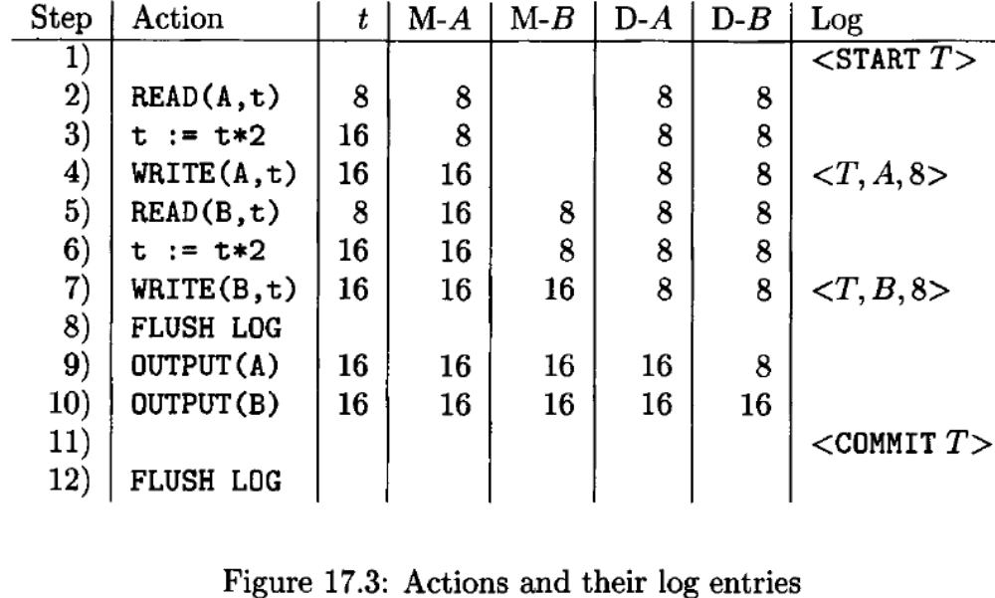
CS 245
Notes 08

Slide 63
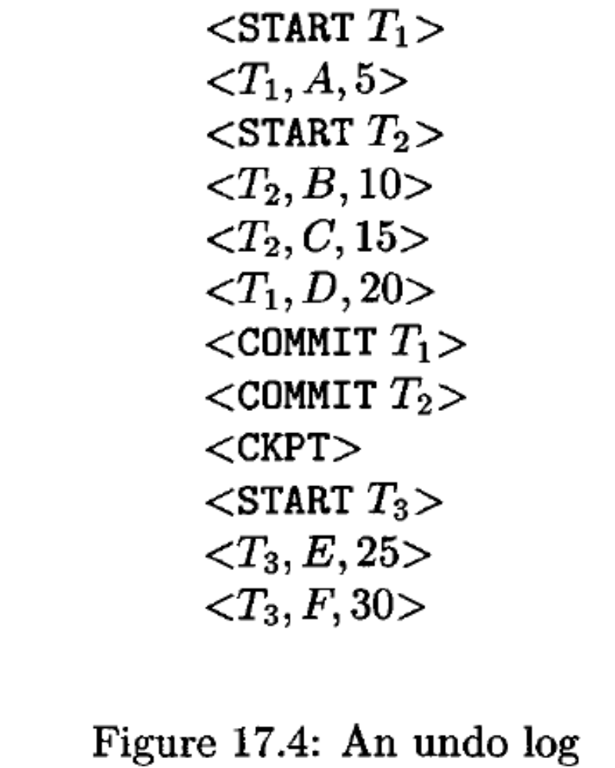
CS 245
Notes 08

Slide 64
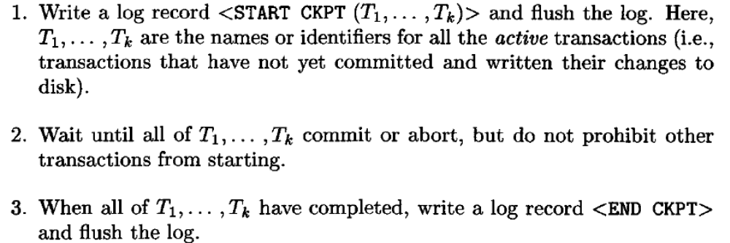
CS 245
Notes 08

Slide 65
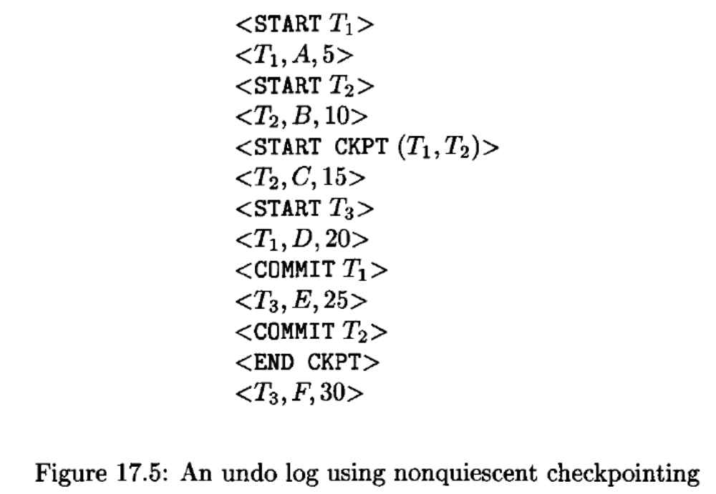
CS 245
Notes 08

Slide 66
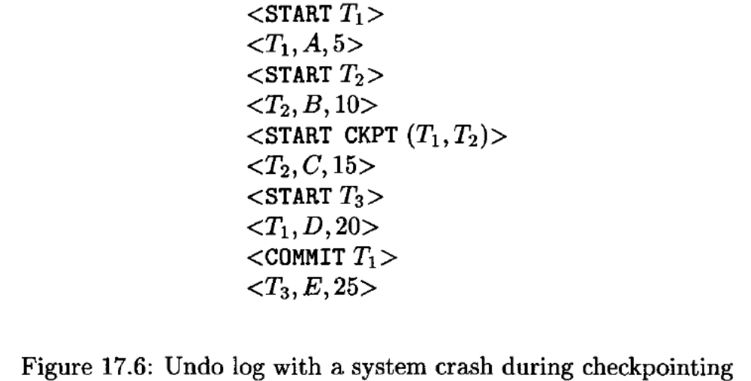
CS 245
Notes 08

Slide 67
Undo logging has a potential problem that we cannot commit a transaction without first writing all its changed data to disk
we can save disk I/O ’s if we let changes to the database reside only in main memory for a while
The requirement for immediate backup of database elements to disk can be avoided
undo logging cancels the effect of incomplete transactions and ignores committed ones during recovery,
CS 245
Notes 08

Slide 68
redo logging ignores incomplete transactions and repeats the changes made by committed transactions
undo logging requires us to write changed database elements to disk before the COMMIT log record reaches disk,
redo logging requires that the COMMIT record appear on disk before any changed values reach disk
the order in which material associated with one transaction gets written to disk
1. The log records indicating changed database elements.
2. The COMMIT log record.
3. The changed database elements themselves.
CS 245
Notes 08

Slide 69
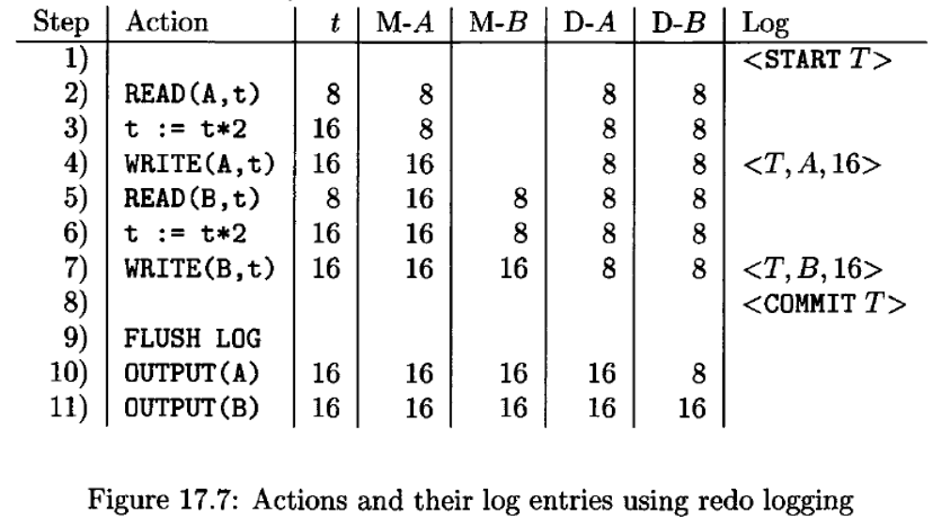
CS 245
Notes 08

Slide 70
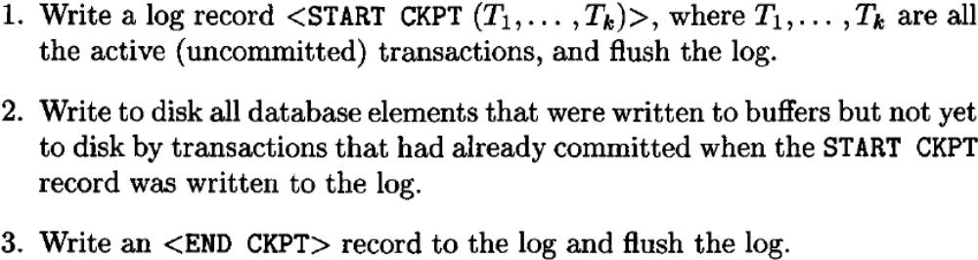
CS 245
Notes 08

Slide 71
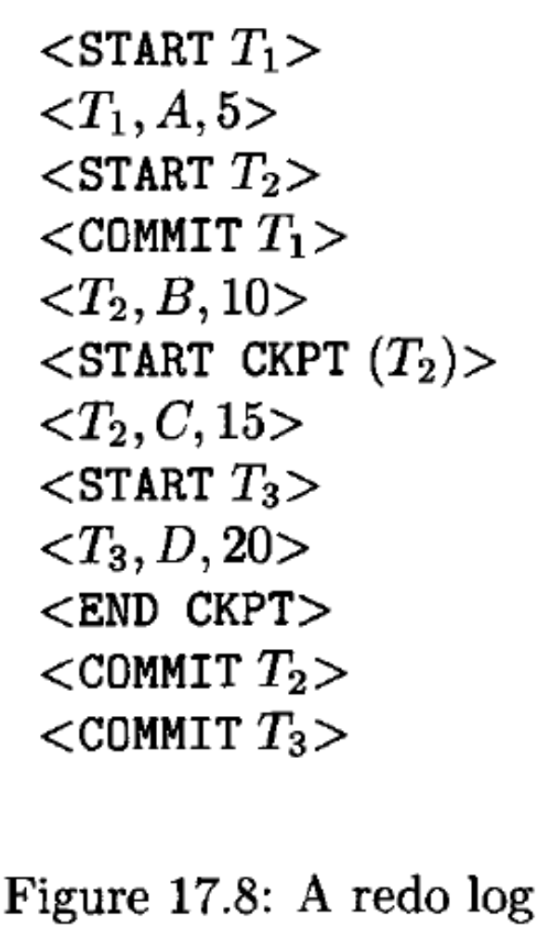
CS 245
Notes 08

Slide 72

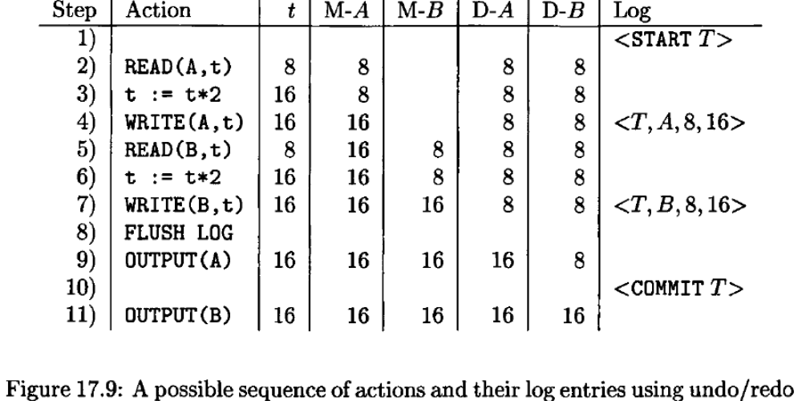
CS 245
Notes 08

Slide 73
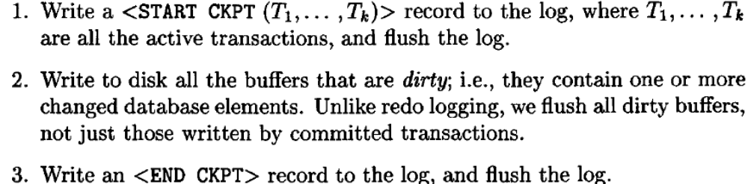
CS 245
Notes 08

Slide 74
The undo/redo recovery policy is:
Redo all the committed transactions in the order earliest-first
2. Undo all the incomplete transactions in the order latest-first.
CS 245
Notes 08

Slide 75
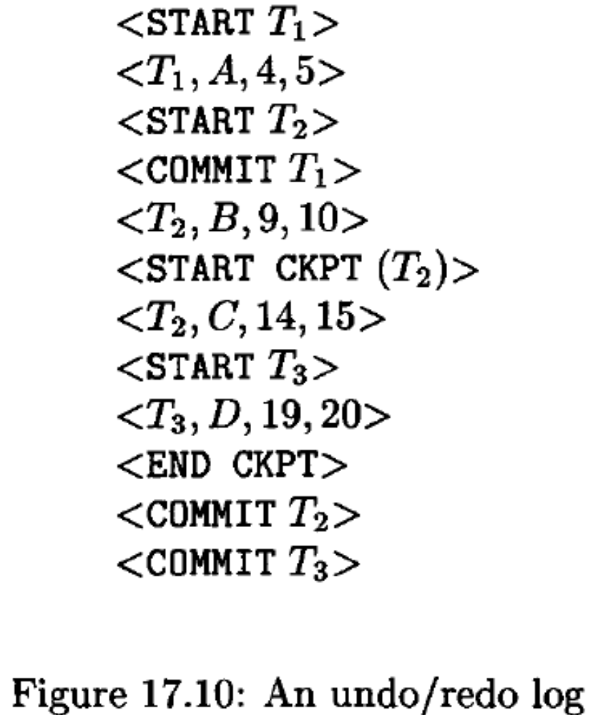
CS 245
Notes 08

Slide 76
Example: what to do at recovery?
Redo log (disk):
<T1,A,16>
<T1,commit>
Checkpoint
<T2,B,17>
<T2,commit>
<T3,C,21>
Crash
...
...
...
...
...
...
CS 245
Notes 08

Slide 77
Key drawbacks:
Undo logging: cannot bring backup DB copies up to date
Redo logging: need to keep all modified blocks in memory until commit
CS 245
Notes 08

Slide 78
Solution: undo/redo logging!
Update ⇒ <Ti, Xid, New X val, Old X val>
page X
CS 245
Notes 08

Slide 79
Rules
Page X can be flushed before or after Ti commit
Log record flushed before corresponding updated page (WAL)
Flush at commit (log only)
CS 245
Notes 08

Slide 80
Example: Undo/Redo logging what to do at recovery?
log (disk):
<checkpoint>
<T1, A, 10, 15>
<T1, B, 20, 23>
<T1, commit>
<T2, C, 30, 38>
<T2, D, 40, 41>
Crash
...
...
...
...
...
...
CS 245
Notes 08

