Slide 1
CS 245: Database System Principles
Notes 7: Query Optimization
Hector Garcia-Molina
CS 245
Notes 7

Slide 2
Query Optimization
--> Generating and comparing plans
Query
Generate Plans
Pruning x x
Estimate Cost
Cost
Select
Pick Min
CS 245
Notes 7

Slide 3
To generate plans consider:
Transforming relational algebra expression
        (e.g. order of joins)
Use of existing indexes
Building indexes or sorting on the fly
CS 245
Notes 7

Slide 4
Implementation details:
e.g. - Join algorithm
- Memory management
- Parallel processing
CS 245
Notes 7

Slide 5
Estimating IOs:
Count # of disk blocks that must be read (or written) to execute query plan
CS 245
Notes 7

Slide 6
To estimate costs, we may have additional parameters:
B(R) = # of blocks containing R tuples
f(R) = max # of tuples of R per block
M = # memory blocks available
CS 245
Notes 7

Slide 7
To estimate costs, we may have additional parameters:
B(R) = # of blocks containing R tuples
f(R) = max # of tuples of R per block
M = # memory blocks available
HT(i) = # levels in index i
LB(i) = # of leaf blocks in index i
CS 245
Notes 7

Slide 8
Clustering index
Index that allows tuples to be read in an order that corresponds to physical order
A
10
15
A
index
17
19
35
37
CS 245
Notes 7

Slide 9
Notions of clustering
Clustered file organization
…..
Clustered relation
…..
Clustering index
R1 R2 S1 S2
R3 R4 S3 S4
R1 R2 R3 R4
R5 R5 R7 R8
CS 245
Notes 7

Slide 10
Example R1 R2 over common attribute C
T(R1) = 10,000
T(R2) = 5,000
S(R1) = S(R2) = 1/10 block
Memory available = 101 blocks
CS 245
Notes 7

Slide 11
Example R1 R2 over common attribute C
T(R1) = 10,000
T(R2) = 5,000
S(R1) = S(R2) = 1/10 block
Memory available = 101 blocks
→ Metric: # of IOs
(ignoring writing of result)
CS 245
Notes 7

Slide 12
Caution!
This may not be the best way to compare
ignoring CPU costs
ignoring timing
ignoring double buffering requirements
CS 245
Notes 7

Slide 13
Options
Transformations: R1 R2, R2 R1
Join algorithms:
  Iteration (nested loops)
  Merge join
  Join with index
  Hash join
CS 245
Notes 7

Slide 14
Iteration join (conceptually)
for each r ∈ R1 do
for each s ∈ R2 do
if r.C = s.C then output r,s pair
CS 245
Notes 7

Slide 15
Example
i R1{i}.C R2{j}.C j
1 10 5 1
2 20 20 2
3 20 20 3
4 30 30 4
5 40 30 5
50 6
52 7
CS 245
Notes 7

Slide 16
Merge join (conceptually)
  (1) if R1 and R2 not sorted, sort them
  (2) i ← 1; j ← 1;
  While (i ≤ T(R1)) ∧ (j ≤ T(R2)) do
  if R1{ i }.C = R2{ j }.C then outputTuples
  else if R1{ i }.C > R2{ j }.C then j ← j+1
  else if R1{ i }.C < R2{ j }.C then i ← i+1
CS 245
Notes 7

Slide 17
Procedure Output-Tuples
While (R1{ i }.C = R2{ j }.C) ∧ (i ≤ T(R1)) do
[jj ← j;
while (R1{ i }.C = R2{ jj }.C) ∧ (jj ≤ T(R2)) do
[output pair R1{ i }, R2{ jj };
jj ← jj+1 ]
i ← i+1 ]
CS 245
Notes 7

Slide 18
Example
i R1{i}.C R2{j}.C j
1 10 5 1
2 20 20 2
3 20 20 3
4 30 30 4
5 40 30 5
50 6
52 7
CS 245
Notes 7

Slide 19
Join with index (Conceptually)
For each r ∈ R1 do
[ Z ← index (R2, C, r.C)
for each s ∈ Z do
output r,s pair]
Assume R2.C index
Note: Z ← index(rel, attr, value)
then Z = set of rel tuples with attr = value
CS 245
Notes 7

Slide 20
Hash join (conceptual)
  Hash function h, range 0 → k
  Buckets for R1: G0, G1, ... Gk
  Buckets for R2: H0, H1, ... Hk
CS 245
Notes 7

Slide 21
Factors that affect performance
(1) Tuples of relation stored
physically together?
(2) Relations sorted by join attribute?
(3) Indexes exist?
CS 245
Notes 7

Slide 22
Example 1(a) Iteration Join R1 R2
Relations not contiguous
Recall T(R1) = 10,000 T(R2) = 5,000
S(R1) = S(R2) =1/10 block
MEM=101 blocks
CS 245
Notes 7

Slide 23
Example 1(a) Iteration Join R1 R2
Relations not contiguous
Recall T(R1) = 10,000 T(R2) = 5,000
S(R1) = S(R2) =1/10 block
MEM=101 blocks
Cost: for each R1 tuple:
[Read tuple of R1+ Read R2]
Total =10,000 [1+5000]=50,010,000 IOs
CS 245
Notes 7

Slide 24
Can we do better?
CS 245
Notes 7

Slide 25
Can we do better?
Use our memory
(1) Read 100 blocks of R1
(2) Read all of R2 (using 1 block) + join
(3) Repeat until done
CS 245
Notes 7

Slide 26
Cost: for each R1 chunk:
Read chunk: 1000 IOs
Read R2: 5000 IOs
6000
CS 245
Notes 7

Slide 27
Cost: for each R1 chunk:
Read chunk: 1000 IOs
Read R2: 5000 IOs
6000
Total = 10,000 x 6000 = 60,000 IOs
1,000
CS 245
Notes 7

Slide 28
Can we do better?
CS 245
Notes 7

Slide 29
Can we do better?
 Reverse join order: R2 R1
Total = 5000 x (1000 + 10,000) =
1000
5 x 11,000 = 55,000 IOs
CS 245
Notes 7

Slide 30
Example 1(b) Iteration Join R2 R1
Relations contiguous
CS 245
Notes 7

Slide 31
Example 1(b) Iteration Join R2 R1
Relations contiguous
Cost
For each R2 chunk:
Read chunk: 100 IOs
Read R1: 1000 IOs
1,100
Total= 5 chunks x 1,100 = 5,500 IOs
CS 245
Notes 7

Slide 32
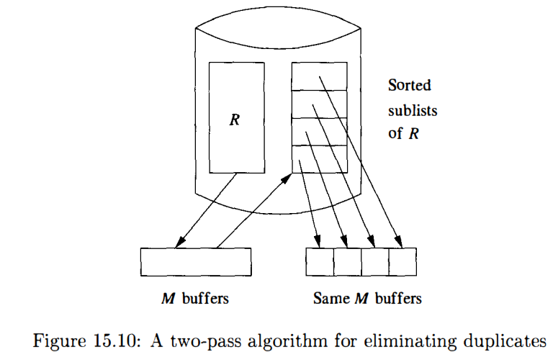
Two-Pass Algorithms Based on Sorting
CS 245
Notes 7

Slide 33
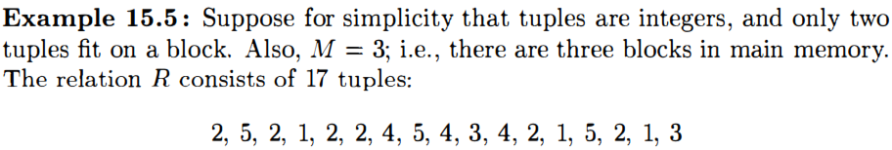
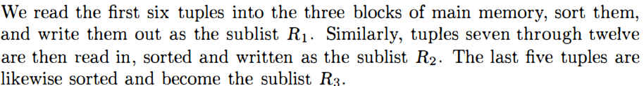
Two-Pass Algorithms Based on Sorting
CS 245
Notes 7

Slide 34
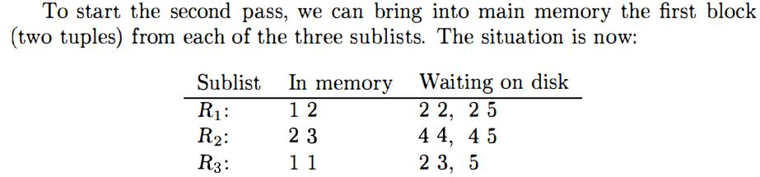
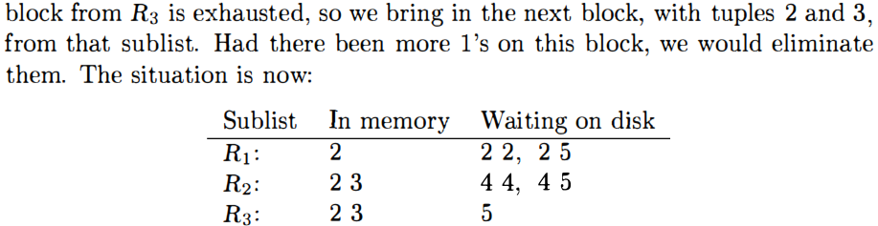
Two-Pass Algorithms Based on Sorting
CS 245
Notes 7

Slide 35
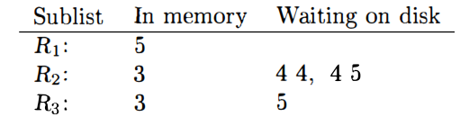
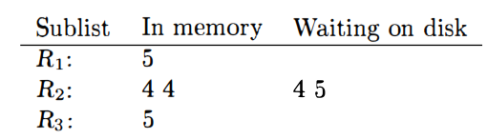
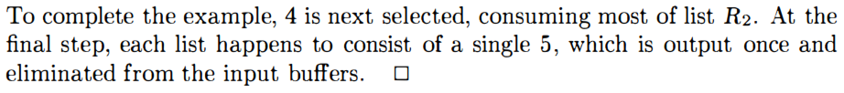
Two-Pass Algorithms Based on Sorting
CS 245
Notes 7

Slide 36
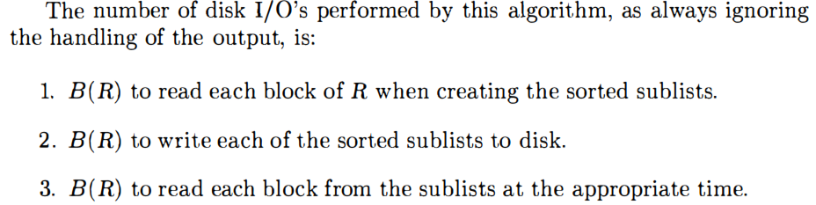
Two-Pass Algorithms Based on Sorting
CS 245
Notes 7

Slide 37
Example 1(c) Merge Join
Both R1, R2 ordered by C; relations contiguous
Memory
…..
R1
R1
R2
…..
R2
CS 245
Notes 7

Slide 38
Example 1(c) Merge Join
Both R1, R2 ordered by C; relations contiguous
Memory
…..
R1
R1
R2
…..
R2
Total cost: Read R1 cost + read R2 cost
= 1000 + 500 = 1,500 IOs
CS 245
Notes 7

Slide 39
Example 1(d) Merge Join
R1, R2 not ordered, but contiguous
--> Need to sort R1, R2 first…. HOW?
CS 245
Notes 7

Slide 40
One way to sort: Merge Sort
(i) For each 100 blk chunk of R:
- Read chunk
- Sort in memory
- Write to disk
sorted
chunks
Memory
R1
...
R2
CS 245
Notes 7

Slide 41
(ii) Read all chunks + merge + write out
Sorted file Memory Sorted
Chunks
...
...
CS 245
Notes 7

Slide 42
Cost: Sort
Each tuple is read,written,
read, written
so...
Sort cost R1: 4 x 1,000 = 4,000
Sort cost R2: 4 x 500 = 2,000
CS 245
Notes 7

Slide 43
Example 1(d) Merge Join (continued)
R1,R2 contiguous, but unordered
Total cost = sort cost + join cost
= 6,000 + 1,500 = 7,500 IOs
CS 245
Notes 7

Slide 44
Example 1(d) Merge Join (continued)
R1,R2 contiguous, but unordered
Total cost = sort cost + join cost
= 6,000 + 1,500 = 7,500 IOs
But: Iteration cost = 5,500
so merge join does not pay off!
CS 245
Notes 7

Slide 45
But say R1 = 10,000 blocks contiguous
R2 = 5,000 blocks not ordered
Iterate: 5000 x (100+10,000) = 50 x 10,100
100
= 505,000 IOs
Merge join: 5(10,000+5,000) = 75,000 IOs
Merge Join (with sort) WINS!
CS 245
Notes 7

Slide 46
How much memory do we need for merge sort?
E.g: Say I have 10 memory blocks
10
100 chunks ⇒ to merge, need
100 blocks!
R1
...
CS 245
Notes 7

Slide 47
In general:
Say k blocks in memory
x blocks for relation sort
# chunks = (x/k) size of chunk = k
CS 245
Notes 7

Slide 48
In general:
Say k blocks in memory
x blocks for relation sort
# chunks = (x/k) size of chunk = k
# chunks < buffers available for merge
CS 245
Notes 7

Slide 49
In general:
Say k blocks in memory
x blocks for relation sort
# chunks = (x/k) size of chunk = k
# chunks < buffers available for merge
so... (x/k) ≤ k
or k² ≥ x or k ≥ √x
CS 245
Notes 7

Slide 50
In our example
R1 is 1000 blocks, k ≥ 31.62
R2 is 500 blocks, k ≥ 22.36
Need at least 32 buffers
CS 245
Notes 7

Slide 51
Can we improve on merge join?
Hint: do we really need the fully sorted files?
R1
Join?
R2
sorted runs
CS 245
Notes 7

Slide 52
Cost of improved merge join:
C = Read R1 + write R1 into runs
+ read R2 + write R2 into runs
+ join
= 2000 + 1000 + 1500 = 4500
--> Memory requirement?
CS 245
Notes 7

Slide 53
Example 1(e) Index Join
Assume R1.C index exists; 2 levels
Assume R2 contiguous, unordered
Assume R1.C index fits in memory
CS 245
Notes 7

Slide 54
Cost: Reads: 500 IOs
for each R2 tuple:
- probe index - free
- if match, read R1 tuple: 1 IO
CS 245
Notes 7

Slide 55
What is expected # of matching tuples?
(a) say R1.C is key, R2.C is foreign key
then expect = 1
(b) say V(R1,C) = 5000, T(R1) = 10,000
with uniform assumption
expect = 10,000/5,000 = 2
CS 245
Notes 7

Slide 56
What is expected # of matching tuples?
(c) Say DOM(R1, C)=1,000,000
T(R1) = 10,000
with alternate assumption
Expect = 10,000 = 1
1,000,000 100
CS 245
Notes 7

Slide 57
Total cost with index join
(a) Total cost = 500+5000(1)1 = 5,500
(b) Total cost = 500+5000(2)1 = 10,500
(c) Total cost = 500+5000(1/100)1=550
CS 245
Notes 7

Slide 58
What if index does not fit in memory?
Example: say R1.C index is 201 blocks
Keep root + 99 leaf nodes in memory
Expected cost of each probe is
E = (0)99 + (1)101 ≈ 0.5
200 200
CS 245
Notes 7

Slide 59
Total cost (including probes)
= 500+5000 [Probe + get records]
= 500+5000 [0.5+2] uniform assumption
= 500+12,500 = 13,000 (case b)
CS 245
Notes 7

Slide 60
Total cost (including probes)
= 500+5000 [Probe + get records]
= 500+5000 [0.5+2] uniform assumption
= 500+12,500 = 13,000 (case b)
For case (c):
= 500+5000[0.5 × 1 + (1/100) × 1]
= 500+2500+50 = 3050 IOs
CS 245
Notes 7

Slide 61
So far
Iterate R2 R1 55,000 (best)
Merge Join _______
Sort+ Merge Join _______
R1.C Index _______
R2.C Index _______
Iterate R2 R1 5500
Merge join 1500
Sort+Merge Join 7500 → 4500
R1.C Index 5500 → 3050 → 550
R2.C Index ________
not
contiguous
contiguous
CS 245
Notes 7

Slide 62
Hash join (conceptual)
  Hash function h, range 0 → k
  Buckets for R1: G0, G1, ... Gk
  Buckets for R2: H0, H1, ... Hk
Algorithm
(1) Hash R1 tuples into G buckets
(2) Hash R2 tuples into H buckets
(3) For i = 0 to k do
match tuples in Gi, Hi buckets
CS 245
Notes 7

Slide 63
Simple example hash: even/odd
R1 R2 Buckets
2 5 Even
4 4 R1 R2
3 12 Odd:
5 3
8 13
9 8
11
14
2 4 8
4 12 8 14
3 5 9
5 3 13 11
CS 245
Notes 7

Slide 64
Example 1(f) Hash Join
R1, R2 contiguous (un-ordered)
→ Use 100 buckets
→ Read R1, hash, + write buckets
R1 →
100
...
...
10 blocks
CS 245
Notes 7

Slide 65
-> Same for R2
-> Read one R1 bucket; build memory hash table
-> Read corresponding R2 bucket + hash probe
R1
R2
R1
...
...
memory
 Then repeat for all buckets
CS 245
Notes 7

Slide 66
Cost:
“Bucketize:” Read R1 + write
Read R2 + write
Join: Read R1, R2
Total cost = 3 x [1000+500] = 4500
CS 245
Notes 7

Slide 67
Cost:
“Bucketize:” Read R1 + write
Read R2 + write
Join: Read R1, R2
Total cost = 3 x [1000+500] = 4500
Note: this is an approximation since
buckets will vary in size and
we have to round up to blocks
CS 245
Notes 7

Slide 68
Minimum memory requirements:
Size of R1 bucket = (x/k)
k = number of memory buffers
x = number of R1 blocks
So... (x/k) < k
k > √x need: k+1 total memory
buffers
CS 245
Notes 7

Slide 69
Trick: keep some buckets in memory
E.g., k’=33 R1 buckets = 31 blocks
keep 2 in memory
memory
in
G0
R1
31
G1
33-2=31
...
called hybrid hash-join
CS 245
Notes 7

Slide 70
Trick: keep some buckets in memory
E.g., k’=33 R1 buckets = 31 blocks
keep 2 in memory
memory
Memory use:
G0 31 buffers
G1 31 buffers
Output 33-2 buffers
R1 input 1
Total 94 buffers
6 buffers to spare!!
in
G0
R1
31
G1
31 Buckets, one block each
33-2=31
...
called hybrid hash-join
CS 245
Notes 7

Slide 71
Next: Bucketize R2
  R2 buckets =500/33= 16 blocks
  Two of the R2 buckets joined immediately with G0,G1
memory
R2 buckets
R1 buckets
in
G0
R2
16
31
G1
31 Buckets, one block each
33-2=31
33-2=31
...
...
CS 245
Notes 7

Slide 72
Finally: Join remaining buckets
  for each bucket pair:
    read one of the buckets into memory
    join with second bucket
memory
one full R2
bucket
R2 buckets
R1 buckets
out
ans
Hi
16
31
one R1
buffer
33-2=31
33-2=31
...
...
CS 245
Notes 7

Slide 73
Cost
Bucketize R1 = 1000+31×31=1961
To bucketize R2, only write 31 buckets: so, cost = 500+31×16=996
To compare join (2 buckets already done) read 31×31+31×16=1457
Total cost = 1961+996+1457 = 4414
CS 245
Notes 7

Slide 74
Hybrid Hash-Join
Example 15.10 : Consider the problem of Example 15.4, where we had to join relations R and S, of 1000 and 500 blocks, respectively, using M = 101. If we use a hybrid hash-join, then we want k, the number of buckets, to be about 500/ 101. Suppose we pick k = 5 .

Slide 75
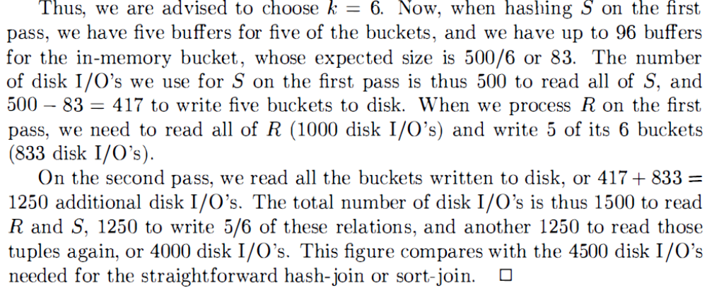
Hybrid Hash-Join

Slide 76
How many buckets in memory?
memory
memory
in
G0
in
G0
R1
R1
G1
?
OR...
 See textbook for answer...
CS 245
Notes 7

Slide 77
Another hash join trick:
Only write into buckets <val,ptr> pairs
When we get a match in join phase, must fetch tuples
CS 245
Notes 7

Slide 78
To illustrate cost computation, assume:
  100 <val,ptr> pairs/block
  expected number of result tuples is 100
CS 245
Notes 7

Slide 79
To illustrate cost computation, assume:
  100 <val,ptr> pairs/block
  expected number of result tuples is 100
Build hash table for R2 in memory 5000 tuples → 5000/100 = 50 blocks
Read R1 and match
Read ~ 100 R2 tuples
CS 245
Notes 7

Slide 80
To illustrate cost computation, assume:
  100 <val,ptr> pairs/block
  expected number of result tuples is 100
Build hash table for R2 in memory 5000 tuples → 5000/100 = 50 blocks
Read R1 and match
Read ~ 100 R2 tuples
Total cost = Read R2: 500
Read R1: 1000
Get tuples: 100
1600
CS 245
Notes 7

Slide 81
So far:
Iterate 5500
Merge join 1500
Sort+merge joint 7500
R1.C index 5500 → 550
R2.C index _____
Build R.C index _____
Build S.C index _____
Hash join 4500+
with trick,R1 first 4414
with trick,R2 first _____
Hash join, pointers 1600
contiguous
CS 245
Notes 7

Slide 82
Summary
Iteration ok for “small” relations (relative to memory size)
For equi-join, where relations not sorted and no indexes exist, hash join usually best
CS 245
Notes 7

Slide 83
Sort + merge join good for non-equi-join (e.g., R1.C > R2.C)
If relations already sorted, use merge join
If index exists, it could be useful
(depends on expected result size)
CS 245
Notes 7

Slide 84
Join strategies for parallel processors
Later on….
CS 245
Notes 7

Slide 85
Chapter 16 [16] summary
Relational algebra level
Detailed query plan level
  Estimate costs
  Generate plans
    Join algorithms
  Compare costs
CS 245
Notes 7

