Slide 1
Query Execution

Slide 2
Where are we?
File organizations: sorted, hashed, heaps.
Indexes: hash index, B+-tree
Indexes can be clustered or not.
Data can be stored in the index or not.
Hence, when we access a relation, we can either scan or go through an index:
  Called an access path.

Slide 3
Current Issues in Indexing
Multi-dimensional indexing:
  how do we index regions in space?
  Document collections?
  Multi-dimensional sales data
  How do we support nearest neighbor queries?
Indexing is still a hot and unsolved problem!

Slide 4
Query Execution
User/
Application
Query
update
Query compiler
Query execution
plan
Execution engine
Record, index
requests
Index/record mgr.
Page
commands
Buffer manager
Read/write
pages
Storage manager
storage

Slide 5
Query Execution Plans
SELECT P.buyer
FROM Purchase P, Person Q
WHERE P.buyer=Q.name AND
Q.city=‘seattle’ AND
Q.phone > ‘5430000’
buyer
σ
City=‘seattle’
phone>’5430000’
Query Plan:
logical tree
implementation choice at every node
scheduling of operations.
Buyer=name
(Simple Nested Loops)
Purchase
Person
(Table scan)
(Index scan)
Some operators are from relational
algebra, and others (e.g., scan, group)
are not.

Slide 6
The Leaves of the Plan: Scans
Table scan: iterate through the records of the relation.
Index scan: go to the index, from there get the records in the file (when would this be better?)
Sorted scan: produce the relation in order. Implementation depends on relation size.

Slide 7
How do we combine Operations?
The iterator model. Each operation is implemented by 3 functions:
  Open: sets up the data structures and performs initializations
  GetNext: returns the the next tuple of the result.
  Close: ends the operations. Cleans up the data structures.
Enables pipelining!
Contrast with data-driven materialize model.
Sometimes it’s the same (e.g., sorted scan).

Slide 8

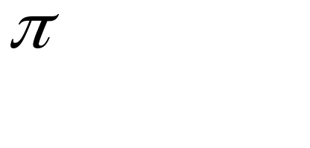

Implementing Relational Operations
We will consider how to implement:
  Selection ( ) Selects a subset of rows from relation.
  Projection ( ) Deletes unwanted columns from relation.
  Join ( ) Allows us to combine two relations.
  Set-difference Tuples in reln. 1, but not in reln. 2.
  Union Tuples in reln. 1 and in reln. 2.
  Aggregation (SUM, MIN, etc.) and GROUP BY
Notes:
3

Slide 9
Schema for Examples
Purchase (buyer:string, seller: string, product: integer),
Person (name:string, city:string, phone: integer)
Purchase:
  Each tuple is 40 bytes long, 100 tuples per page, 1000 pages (i.e., 100,000 tuples, 4MB for the entire relation).
Person:
  Each tuple is 50 bytes long, 80 tuples per page, 500 pages (i.e, 40,000 tuples, 2MB for the entire relation).
Notes:
4

Slide 10

Simple Selections
SELECT *
FROM Person R
WHERE R.phone < ‘543%’
Of the form
With no index, unsorted: Must essentially scan the whole relation; cost is M (#pages in R).
With an index on selection attribute: Use index to find qualifying data entries, then retrieve corresponding data records. (Hash index useful only for equality selections.)
Result size estimation:
(Size of R) * reduction factor.
More on this later.
Notes:
11

Slide 11
Using an Index for Selections
Cost depends on #qualifying tuples, and clustering.
  Cost of finding qualifying data entries (typically small) plus cost of retrieving records.
  In example, assuming uniform distribution of phones, about 54% of tuples qualify (250 pages, 20000 tuples). With a clustered index, cost is little more than 250 I/Os
Notes:
12

Slide 12
Two Approaches to General Selections
First approach: Find the most selective access path, retrieve tuples using it, and apply any remaining terms that don’t match the index:
  Most selective access path: An index or file scan that we estimate will require the fewest page I/Os.
  Consider city=“seattle AND phone<“543%” :
    A hash index on city can be used; then, phone<“543%” must be checked for each retrieved tuple.
    Similarly, a b-tree index on phone could be used; city=“seattle” must then be checked.
Notes:
14

Slide 13
Intersection of Rids
Second approach
  Get sets of rids of data records using each matching index.
  Then intersect these sets of rids.
  Retrieve the records and apply any remaining terms.
Notes:
15

Slide 14
Implementing Projection
SELECT DISTINCT
R.name,
R.phone
FROM Person R
Two parts:
(1) remove unwanted attributes,
(2) remove duplicates from the result.
Refinements to duplicate removal:
  If an index on a relation contains all wanted attributes, then we can do an index-only scan.
  If the index contains a subset of the wanted attributes, you can remove duplicates locally.

Slide 15

Equality Joins With One Join Column
SELECT *
FROM Person R, Purchase S
WHERE R.name=S.buyer
R S is a common operation. The cross product is too large. Hence, performing R S and then a selection is too inefficient.
Assume: M pages in R, p_{R} tuples per page, N pages in S, p_{S} tuples per page.
  In our examples, R is Person and S is Purchase.
Cost metric: # of I/Os. We will ignore output costs.
Notes:
5

Slide 16
Discussion
How would you implement join?

Slide 17
Simple Nested Loops Join
For each tuple r in R do
for each tuple s in S do
if r_{i} == s_{j} then add <r, s> to result
For each tuple in the outer relation R, we scan the entire inner relation S.
  Cost: M + (p_{R} * M) * N = 1000 + 100*1000*500 I/Os: 140 hours!
Page-oriented Nested Loops join: For each page of R, get each page of S, and write out matching pairs of tuples <r, s>, where r is in R-page and S is in S-page.
  Cost: M + M*N = 1000 + 1000*500 (1.4 hours)
Notes:
6

Slide 18
Index Nested Loops Join
foreach tuple r in R do
foreach tuple s in S where r_{i} == s_{j} do
add <r, s> to result
If there is an index on the join column of one relation (say S), can make it the inner.
  Cost: M + ( (M*p_{R}) * cost of finding matching S tuples)
For each R tuple, cost of probing S index is about 1.2 for hash index, 2-4 for B+ tree. Cost of then finding S tuples depends on clustering.
  Clustered index: 1 I/O (typical), unclustered: up to 1 I/O per matching S tuple.

Slide 19
Examples of Index Nested Loops
Hash-index on name of Person (as inner):
    Scan Purchase: 1000 page I/Os, 100*1000 tuples.
    For each Person tuple: 1.2 I/Os to get data entry in index, plus 1 I/O to get (the exactly one) matching Person tuple. Total: 220,000 I/Os. (36 minutes)
Hash-index on buyer of Purchase (as inner):
    Scan Person: 500 page I/Os, 80*500 tuples.
    For each Person tuple: 1.2 I/Os to find index page with data entries, plus cost of retrieving matching Purchase tuples. Assuming uniform distribution, 2.5 purchases per buyer (100,000 / 40,000). Cost of retrieving them is 1 or 2.5 I/Os depending on clustering.
Notes:
8

Slide 20
Block Nested Loops Join
Use one page as an input buffer for scanning the inner S, one page as the output buffer, and use all remaining pages to hold ``block’’ of outer R.
  For each matching tuple r in R-block, s in S-page, add <r, s> to result. Then read next R-block, scan S, etc.
R & S
Join Result
Hash table for block of R
(k < B-1 pages)
. . .
. . .
. . .
Input buffer for S
Output buffer
Notes:
9

Slide 21
Sort-Merge Join (R S)
i=j
Sort R and S on the join column, then scan them to do a ``merge’’ on the join column.
  Advance scan of R until current R-tuple >= current S tuple, then advance scan of S until current S-tuple >= current R tuple; do this until current R tuple = current S tuple.
  At this point, all R tuples with same value and all S tuples with same value match; output <r, s> for all pairs of such tuples.
  Then resume scanning R and S.
Notes:
11

Slide 22
Cost of Sort-Merge Join
R is scanned once; each S group is scanned once per matching R tuple.
Cost: M log M + N log N + (M+N)
  The cost of scanning, M+N, could be M*N (unlikely!)
With 35, 100 or 300 buffer pages, both Person and Purchase can be sorted in 2 passes; total: 7500. (75 seconds).

Slide 23
Hash-Join
Original
Relation
OUTPUT
Partitions
1
Partition both relations using hash fn h1: R tuples in partition i will only match S tuples in partition i.
(if partition is bigger than B-2, do it again)
1
INPUT
2
hash
function
h1
2
. . .
B-1
B-1
Disk
B main memory buffers
Disk
Partitions
of R & S
Join Result
Read in a partition of R, hash it using h2. Scan matching partition of S, search for matches.
Hash table for partition
Ri (k < B-1 pages)
hash
fn
h2
h2
Input buffer
for Si
Output
buffer
Disk
B main memory buffers
Disk
Notes:
14

Slide 24
Cost of Hash-Join
In partitioning phase, read+write both relations; 2(M+N). In matching phase, read both relations; M+N I/Os.
In our running example, this is a total of 4500 I/Os. (45 seconds!)
Sort-Merge Join vs. Hash Join:
  Given a minimum amount of memory both have a cost of 3(M+N) I/Os. Hash Join superior on this count if relation sizes differ greatly. Also, Hash Join shown to be highly parallelizable.
  Sort-Merge less sensitive to data skew; result is sorted.
Notes:
16

Slide 25
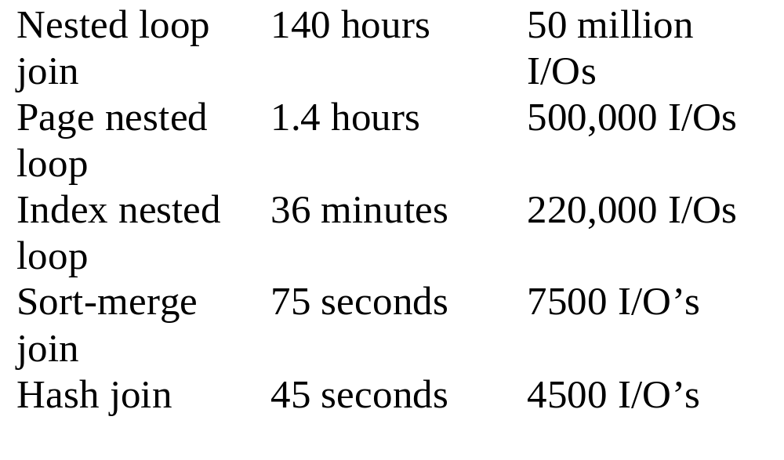
How are we doing?

Slide 26
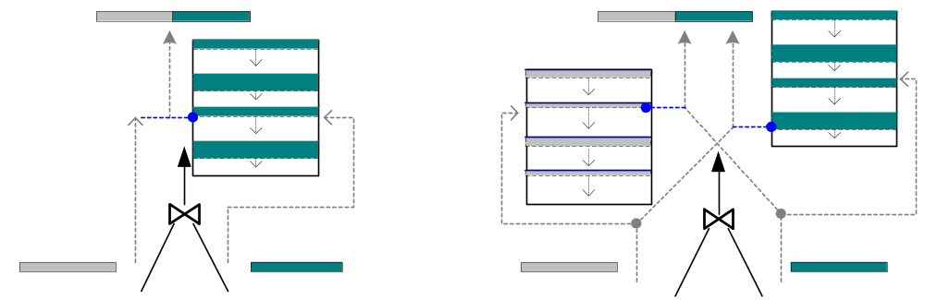
Double Pipelined Join (Tukwila)
Hash Join
  Partially pipelined: no output until inner read
  Asymmetric (inner vs. outer) — optimization requires source behavior knowledge
Double Pipelined Hash Join
  Outputs data immediately
  Symmetric — requires less source knowledge to optimize
Notes:
DPJoin picture
Cite Wilschut 91 PDIS
Mention that we use multithreading to achieve same effect

