Slide 1

Analysis of Algorithms
CS 477/677
Graphs
Instructor: George Bebis
Appendix B4, Appendix B5.1
Chapter 22

Slide 2
Graphs
Definition = a set of nodes (vertices) with edges (links) between them.
G = (V, E) - graph
V = set of vertices ⎜V ⎜= n
E = set of edges ⎜E ⎜= m
  Binary relation on V
  Subset of V x V ={(u,v): u ∈V, v ∈V}
1
2
3
4

Slide 3
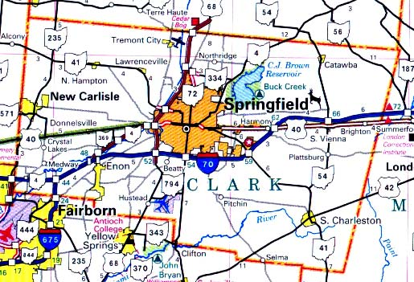


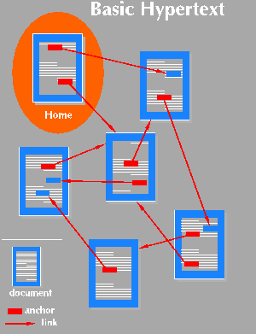

Applications
Applications that involve not only a set of items, but also the connections between them
Maps
Schedules
Computer networks
Hypertext
Circuits

Slide 4
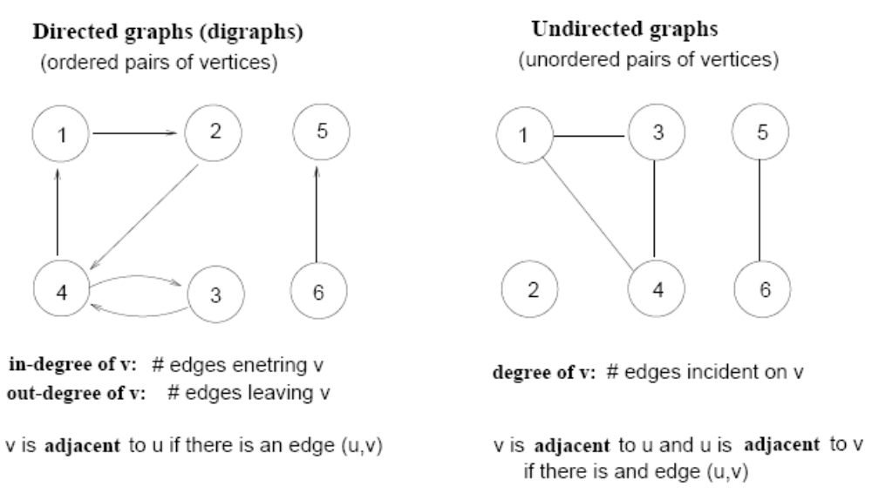
Terminology
Directed vs Undirected graphs

Slide 5
Terminology (cont’d)
Complete graph
  A graph with an edge between each pair of vertices
Subgraph
  A graph (V’, E’) such that V’⊆V and E’⊆E
Path from v to w
  A sequence of vertices <v₀, v₁, …, v_{k}> such that v₀=v and v_{k}=w
Length of a path
  Number of edges in the path
1
2
3
4
path from v₁ to v₄
<v₁, v₂, v₄>

Slide 6
Terminology (cont’d)
w is reachable from v
  If there is a path from v to w
Simple path
  All the vertices in the path are distinct
Cycles
  A path <v₀, v₁, …, v_{k}> forms a cycle if v₀=v_{k} and k≥2
Acyclic graph
  A graph without any cycles
1
2
3
4
cycle from v₁ to v₁
<v₁, v₂, v₃,v₁>

Slide 7
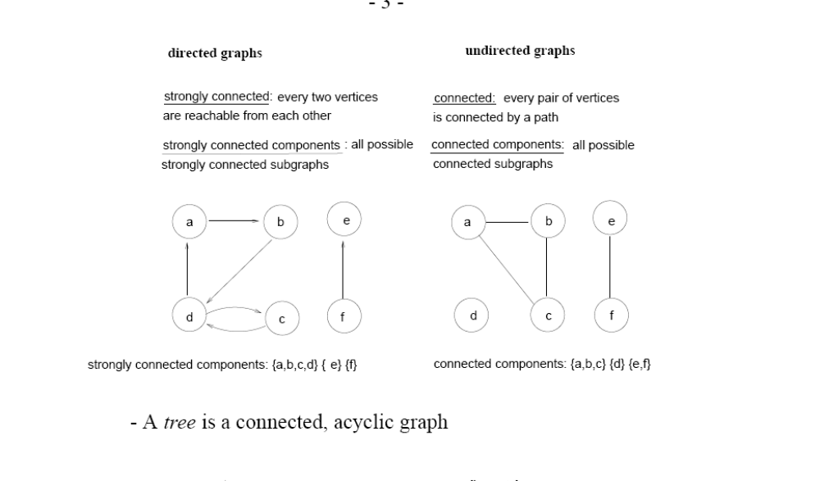
Terminology (cont’d)
Connected and Strongly Connected

Slide 8
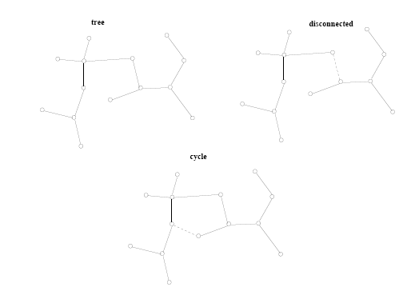
Terminology (cont’d)
A tree is a connected, acyclic undirected graph

Slide 9
Terminology (cont’d)
A bipartite graph is an undirected graph
G = (V, E) in which V = V₁ + V₂ and there are edges only between vertices in V₁ and V₂
V₁
V₂
1
2
9
4
8
3
6
7
4

Slide 10
Graph Representation
Adjacency list representation of G = (V, E)
  An array of ⎜V ⎜lists, one for each vertex in V
  Each list Adj[u] contains all the vertices v that are adjacent to u (i.e., there is an edge from u to v)
  Can be used for both directed and undirected graphs
1
2
5 | /
1
2
2
1
5
3
4 | /
3
3
2
4
5
4
4
2
5
3 | /
5
4
1
2
Undirected graph

Slide 11
Properties of Adjacency-List Representation
Sum of “lengths” of all adjacency lists
  Directed graph:
    edge (u, v) appears only once (i.e., in the
    list of u)
  Undirected graph:
    edge (u, v) appears twice (i.e., in the lists of
    both u and v)
1
2
⎜E ⎜
3
4
Directed graph
1
2
2 ⎜E ⎜
3
5
4
Undirected graph

Slide 12
Properties of Adjacency-List Representation
Memory required
  Θ(V + E)
Preferred when
  The graph is sparse: ⎜E ⎜ << ⎜V ⎜²
  We need to quickly determine the nodes adjacent to a given node.
Disadvantage
  No quick way to determine whether there is an edge between node u and v
Time to determine if (u, v) ∈ E:
  O(degree(u))
Time to list all vertices adjacent to u:
  Θ(degree(u))
1
2
3
5
4
Undirected graph
1
2
3
4
Directed graph

Slide 13
Graph Representation
Adjacency matrix representation of G = (V, E)
  Assume vertices are numbered 1, 2, … ⎜V ⎜
  The representation consists of a matrix A _{⎜V ⎜x ⎜V ⎜}:
  a_{ij} = 1 if (i, j) ∈ E
  0 otherwise
1
2
3
4
5
1
0
1
0
0
1
For undirected graphs, matrix A is symmetric:
a_{ij} = a_{ji}
A = A^{T}
1
2
3
2
1
0
1
1
1
5
4
3
0
1
0
1
0
4
0
1
1
0
1
Undirected graph
5
1
1
0
1
0

Slide 14
Properties of Adjacency Matrix Representation
Memory required
  Θ(V²), independent on the number of edges in G
Preferred when
  The graph is dense: ⎜E ⎜is close to ⎜V ⎜²
  We need to quickly determine if there is
  an edge between two vertices
Time to determine if (u, v) ∈ E:
  Θ(1)
Disadvantage
  No quick way to determine the vertices
  adjacent to another vertex
Time to list all vertices adjacent to u:
  Θ(V)
1
2
3
5
4
Undirected graph
1
2
3
4
Directed graph

Slide 15
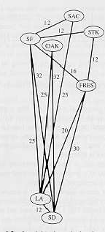
Weighted Graphs
Graphs for which each edge has an associated weight w(u, v)
w: E → R, weight function
Storing the weights of a graph
  Adjacency list:
    Store w(u,v) along with vertex v in
    u’s adjacency list
  Adjacency matrix:
    Store w(u, v) at location (u, v) in the matrix

Slide 16
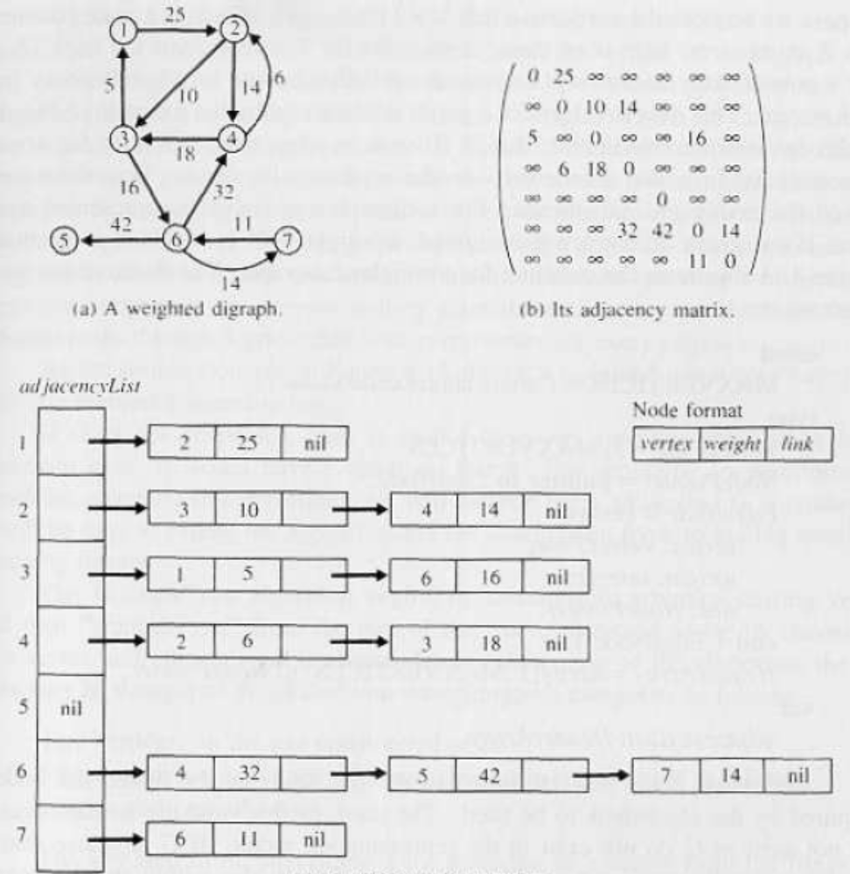
Weighted Graphs

Slide 17
Problem 1
(Exercise 22.1-1, page 530) Given an adjacency-list representation, how long does it take to compute the out-degree of every vertex?
  For each vertex u, search Adj[u] → Θ(E)
1
2
5 | /
2
1
5
3
4 | /
3
2
4
4
2
5
3 | /
5
4
1
2

Slide 18
Problem 1
How long does it take to compute the in-degree of every vertex?
  For each vertex u,
  search entire list of edges → Θ(VE)
1
2
5 | /
2
1
5
3
4 | /
3
2
4
4
2
5
3 | /
5
4
1
2

Slide 19
Problem 2
(Exercise 22.1-3, page 530) The transpose of a graph G=(V,E) is the graph G^{T}=(V,E^{T}), where E^{T}={(v,u)єV x V: (u,v) є E}. Thus, G^{T} is G with all edges reversed.
Describe an efficient algorithm for computing G^{T} from G, both for the adjacency-list and adjacency-matrix representations of G.
Analyze the running time of each algorithm.

Slide 20
Problem 2 (cont’d)
Adjacency matrix
for (i=1; i<=V; i++)
for(j=i+1; j<=V; j++)
if(A[i][j] && !A[j][i]) {
A[i][j]=0;
A[j][i]=1;
}
O(V²) complexity
1
2
3
4
5
1
0
1
0
0
1
2
0
0
0
1
1
3
0
1
0
0
0
4
0
1
1
0
1
5
0
0
0
1
0

Slide 21
Problem 2 (cont’d)
Adjacency list
Allocate V list pointers for G^{T} (Adj’[])
for(i=1; i<=V, i++)
for every vertex v in Adj[i]
add vertex i to Adj’[v]
O(V)
O(E)
1
2
5 | /
Total time: O(V+E)
2
1
5
3
4 | /
3
2
4
4
2
5
3 | /
5
4
1
2

Slide 22
Problem 3
(Exercise 22.1-6, page 530) When adjacency-matrix representation is used, most graph algorithms require time Ω(V²), but there are some exceptions. Show that determining whether a directed graph G contains a universal sink – a vertex of in-degree |V|-1 and out-degree 0 – an be determined in time O(V).
Example

Slide 23
Problem 3 (cont.)
1
2
3
4
5
1
1
0
0
0
1
0
3
4
2
1
0
0
1
0
2
5
3
1
0
0
1
0
4
0
0
0
0
0
5
0
0
0
1
0

Slide 24
Problem 3 (cont.)
How many sinks could a graph have?
  0 or 1
How can we determine whether a given vertex u is a universal sink?
  The u-row must contain 0’s only
  The u-column must contain 1’s only
  A[u][u]=0
How long would it take to determine whether a given vertex u is a universal sink?
  O(V) time

Slide 25
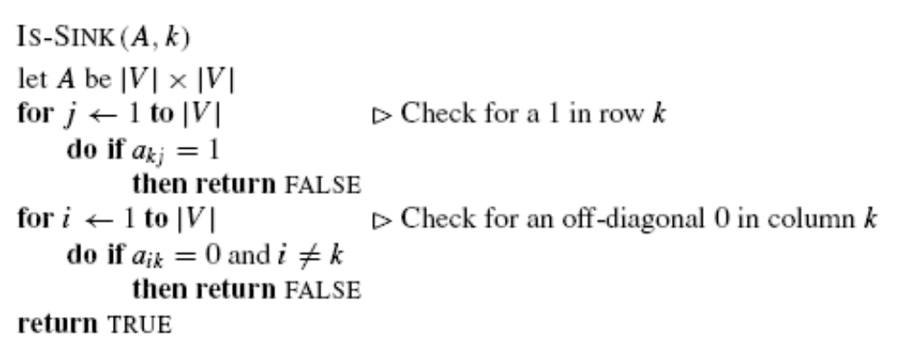
Problem 3 (cont.)
How long would it take to determine whether a given
graph contains a universal sink if you were to check
every single vertex in the graph?
- O(V²)

Slide 26
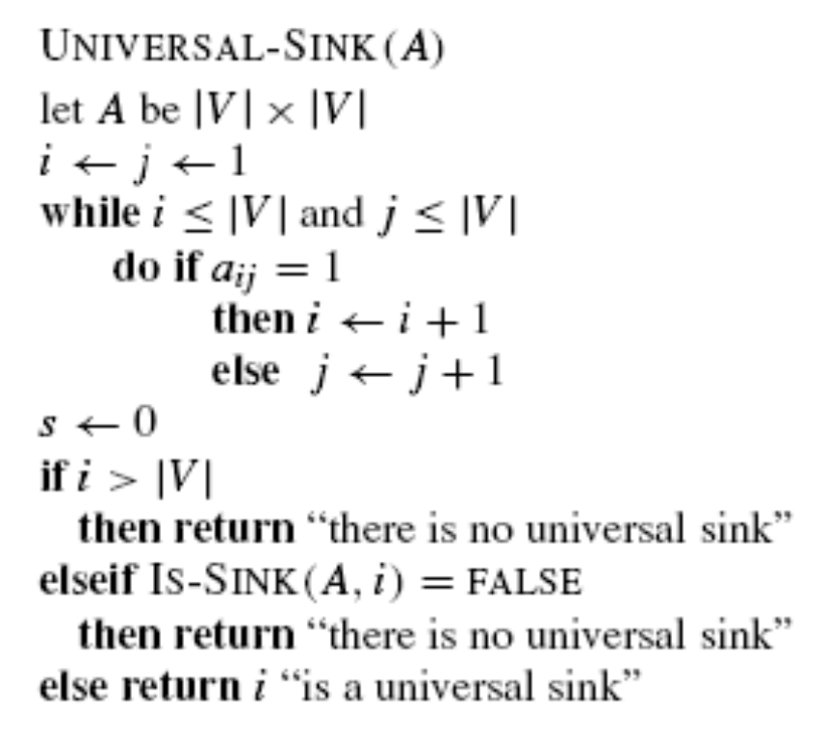
Problem 3 (cont.)
Can you come up with a O(V) algorithm?
Observations
  If A[u][v]=1, then u cannot be a universal sink
  If A[u][v]=0, then v cannot be a universal sink

Slide 27
Problem 3 (cont.)
v₁ v₂ v₃ v₄ v₅
v₁
v₂
v₁
v₂
v₃
v₄
v₅
0 1 1 1 1
0 0 0 1 1
0 1 0 1 1
0 0 0 0 1
0 0 0 0 0
v₃
v₄
v₅
Loop terminates when i>|V| or j>|V|
Upon termination, the only vertex that could be a sink is i
  If i > |V|, there is no sink
  If i < |V|, then j>|V|
  * vertices k where 1 ≤ k < i can not be sinks
    * vertices k where i < k ≤ |V| can not be sinks

