Slide 1
Analysis of Algorithms
CS 477/677
Midterm Exam Review
Instructor: George Bebis

Slide 2
General Advice for Study
Understand how the algorithms are working
  Work through the examples we did in class
  “Narrate” for yourselves the main steps of the algorithms in a few sentences
Know when or for what problems the algorithms are applicable
Do not memorize algorithms

Slide 3
Asymptotic notations
A way to describe behavior of functions in the limit
  Abstracts away low-order terms and constant factors
  How we indicate running times of algorithms
  Describe the running time of an algorithm as n goes to ∝
O notation: asymptotic “less than”: f(n) “≤” g(n)
Ω notation: asymptotic “greater than”: f(n) “≥” g(n)
Θ notation: asymptotic “equality”: f(n) “=” g(n)

Slide 4

Exercise
Order the following 6 functions in increasing order of their growth rates:
  nlog n, log²n, n², 2^{n}, , n.
  log²n
  n
  nlogn
  n²
  2^{n}

Slide 5
Running Time Analysis
Algorithm Loop1(n)
  p=1
  for i = 1 to 2n
    p = p*i
Algorithm Loop2(n)
p=1
for i = 1 to n²
p = p*i
O(n)
O(n²)

Slide 6
Running Time Analysis
Algorithm Loop3(n)
s=0
for i = 1 to n
for j = 1 to i
s = s + I
O(n²)

Slide 7
Recurrences
Def.: Recurrence = an equation or inequality that describes a function in terms of its value on smaller inputs, and one or more base cases
Recurrences arise when an algorithm contains recursive calls to itself
Methods for solving recurrences
  Substitution method
  Iteration method
  Recursion tree method
  Master method
Unless explicitly stated choose the simplest method for solving recurrences

Slide 8
Analyzing Divide and Conquer Algorithms
The recurrence is based on the three steps of the paradigm:
  T(n) – running time on a problem of size n
  Divide the problem into a subproblems, each of size n/b:
  Conquer (solve) the subproblems
  Combine the solutions
Θ(1) if n ≤ c
T(n) =
takes D(n)
aT(n/b)
C(n)
aT(n/b) + D(n) + C(n) otherwise

Slide 9
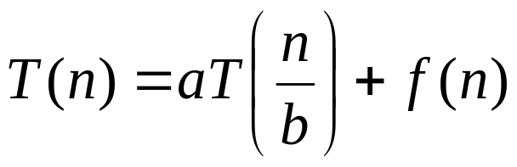
Master’s method
Used for solving recurrences of the form:
where, a ≥ 1, b > 1, and f(n) > 0
Compare f(n) with n^{log}_{b}ª:
Case 1: if f(n) = O(n^{log}_{b}^{a - ε}) for some ε > 0, then: T(n) = Θ(n^{log}_{b}ª)
Case 2: if f(n) = Θ(n^{log}_{b}ª), then: T(n) = Θ(n^{log}_{b}ª lgn)
Case 3: if f(n) = Ω(n^{log}_{b}^{a +ε}) for some ε > 0, and if
af(n/b) ≤ cf(n) for some c < 1 and all sufficiently large n, then:
T(n) = Θ(f(n))
regularity condition

Slide 10
Sorting
Insertion sort
  Design approach:
  Sorts in place:
  Best case:
  Worst case:
Bubble Sort
  Design approach:
  Sorts in place:
  Running time:
incremental
Yes
Θ(n)
Θ(n²)
incremental
Yes
Θ(n²)

Slide 11


Analysis of Insertion Sort
INSERTION-SORT(A)
for j ← 2 to n
do key ← A[ j ]
Insert A[ j ] into the sorted sequence A[1 . . j -1]
i ← j - 1
while i > 0 and A[i] > key
do A[i + 1] ← A[i]
i ← i – 1
A[i + 1] ← key
cost times
c₁ n
c₂ n-1
0 n-1
c₄ n-1
c₅
c₆
c₇
c₈ n-1
≈ n²/2 comparisons
≈ n²/2 exchanges

Slide 12




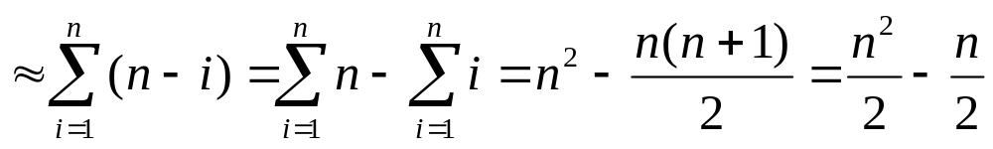
Analysis of Bubble-Sort
Alg.: BUBBLESORT(A)
for i ← 1 to length[A]
do for j ← length[A] downto i + 1
do if A[j] < A[j -1]
then exchange A[j] ↔ A[j-1]
Comparisons: ≈ n²/2
Exchanges: ≈ n²/2
T(n) =
c₁(n+1) +
c₂
c₃
c₄
= Θ(n) +
(c₂ + c₂ + c₄)
T(n) = Θ(n²)

Slide 13
Sorting
Selection sort
  Design approach:
  Sorts in place:
  Running time:
Merge Sort
  Design approach:
  Sorts in place:
  Running time:
incremental
Yes
Θ(n²)
divide and conquer
No
Θ(nlgn)

Slide 14


Analysis of Selection Sort
Alg.: SELECTION-SORT(A)
n ← length[A]
for j ← 1 to n - 1
do smallest ← j
for i ← j + 1 to n
do if A[i] < A[smallest]
then smallest ← i
exchange A[j] ↔ A[smallest]
cost times
c₁ 1
c₂ n
c₃ n-1
c₄
c₅
c₆
c₇ n-1
n²/2
comparisons
n
exchanges

Slide 15
MERGE-SORT Running Time
Divide:
  compute q as the average of p and r: D(n) = Θ(1)
Conquer:
  recursively solve 2 subproblems, each of size n/2 ⇒ 2T (n/2)
Combine:
  MERGE on an n-element subarray takes Θ(n) time ⇒ C(n) = Θ(n)
Θ(1) if n =1
T(n) = 2T(n/2) + Θ(n) if n > 1

Slide 16
Quicksort
Quicksort
  Idea:
  Design approach:
  Sorts in place:
  Best case:
  Worst case:
Partition
  Running time
Randomized Quicksort
Partition the array A into 2 subarrays A[p..q] and A[q+1..r], such that each element of A[p..q] is smaller than or equal to each element in A[q+1..r]. Then sort the subarrays recursively.
Divide and conquer
Yes
Θ(nlgn)
Θ(n²)
Θ(n)
Θ(nlgn) – on average
Θ(n²) – in the worst case

Slide 17
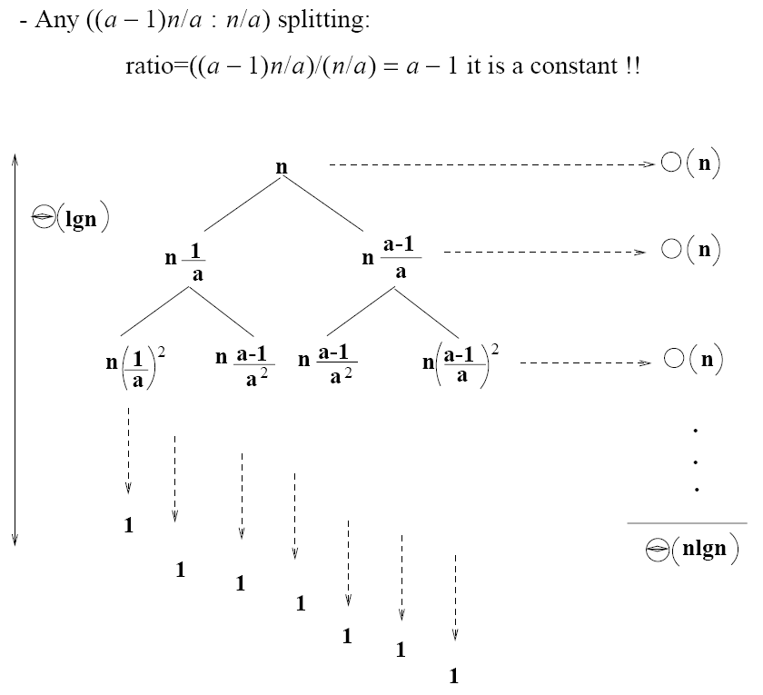
Analysis of Quicksort

Slide 18
The Heap Data Structure
Def: A heap is a nearly complete binary tree with the following two properties:
  Structural property: all levels are full, except possibly the last one, which is filled from left to right
  Order (heap) property: for any node x
  Parent(x) ≥ x
8
7
4
5
2
Heap

Slide 19
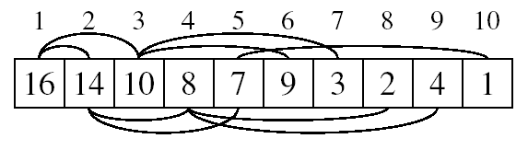
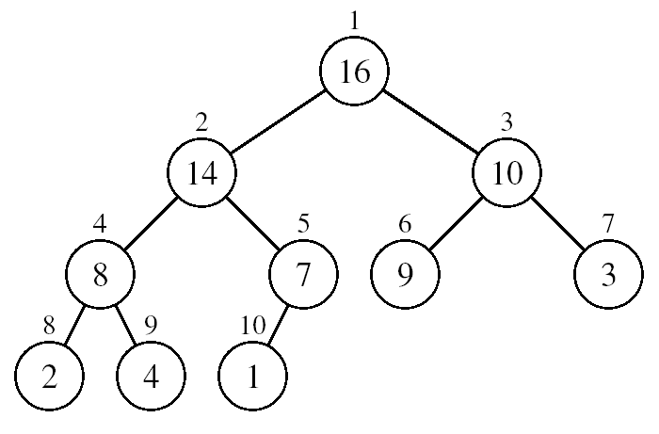
Array Representation of Heaps
A heap can be stored as an array A.
  Root of tree is A[1]
  Parent of A[i] = A[ ⎣i/2⎦ ]
  Left child of A[i] = A[2i]
  Right child of A[i] = A[2i + 1]
  Heapsize[A] ≤ length[A]
The elements in the subarray A[(⎣n/2⎦+1) .. n] are leaves
The root is the max/min element of the heap
A heap is a binary tree that is filled in order

Slide 20
Operations on Heaps
(useful for sorting and priority queues)
  MAX-HEAPIFY O(lgn)
  BUILD-MAX-HEAP O(n)
  HEAP-SORT O(nlgn)
  MAX-HEAP-INSERT O(lgn)
  HEAP-EXTRACT-MAX O(lgn)
  HEAP-INCREASE-KEY O(lgn)
  HEAP-MAXIMUM O(1)
  You should be able to show how these algorithms perform on a given heap, and tell their running time

Slide 21
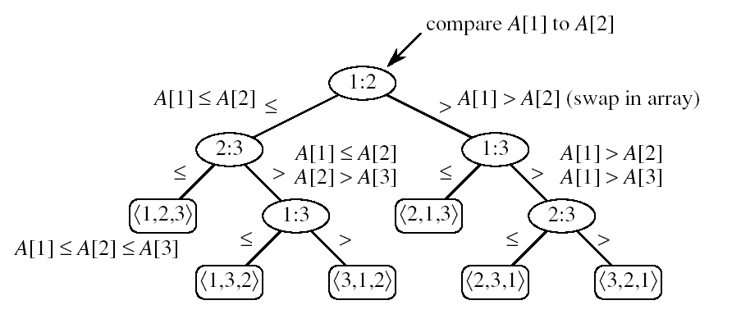
Lower Bound for Comparison Sorts
Theorem: Any comparison sort algorithm requires Ω(nlgn) comparisons in the worst case.
Proof: How many leaves does the tree have?
  At least n! (each of the n! permutations if the input appears as some leaf) ⇒ n!
  At most 2^{h} leaves
⇒ n! ≤ 2^{h}
⇒ h ≥ lg(n!) = Ω(nlgn)
h
leaves

Slide 22
Linear Time Sorting
We can achieve a better running time for sorting if we can make certain assumptions on the input data:
  Counting sort:
    Each of the n input elements is an integer in the
    range [0 ... r]
    r=O(n)

Slide 23
Analysis of Counting Sort
  Alg.: COUNTING-SORT(A, B, n, k)
  for i ← 0 to r
  do C[ i ] ← 0
  for j ← 1 to n
  do C[A[ j ]] ← C[A[ j ]] + 1
  C[i] contains the number of elements equal to i
  for i ← 1 to r
  do C[ i ] ← C[ i ] + C[i -1]
  C[i] contains the number of elements ≤ i
  for j ← n downto 1
  do B[C[A[ j ]]] ← A[ j ]
  C[A[ j ]] ← C[A[ j ]] - 1
Θ(r)
Θ(n)
Θ(r)
Θ(n)
Overall time: Θ(n + r)

Slide 24


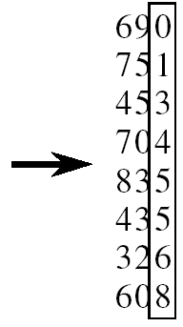
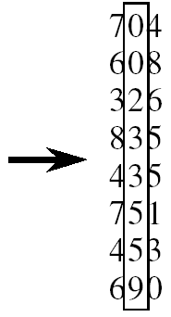
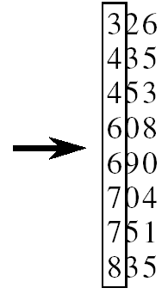
RADIX-SORT
Alg.: RADIX-SORT(A, d)
for i ← 1 to d
do use a stable sort to sort array A on digit i
1 is the lowest order digit, d is the highest-order digit
Θ(d(n+k))

Slide 25
Analysis of Bucket Sort
Alg.: BUCKET-SORT(A, n)
for i ← 1 to n
do insert A[i] into list B[⎣nA[i]⎦]
for i ← 0 to n - 1
do sort list B[i] with quicksort sort
concatenate lists B[0], B[1], . . . , B[n -1] together in order
return the concatenated lists
O(n)
Θ(n)
O(n)
Θ(n)

