Slide 1


Start
V
II
IV
I
Spelling bee
1pt
I
III
II
Trivia
1pt
II
IV
V
III
Yes, I have done that
1pt
III
V
V
I
IV
Jan-ken
2pts
IV
V
Stare down battle
2pts
V
VI
II
III
IV
VI
Challenge accepted!
3pts
2pts

Slide 2
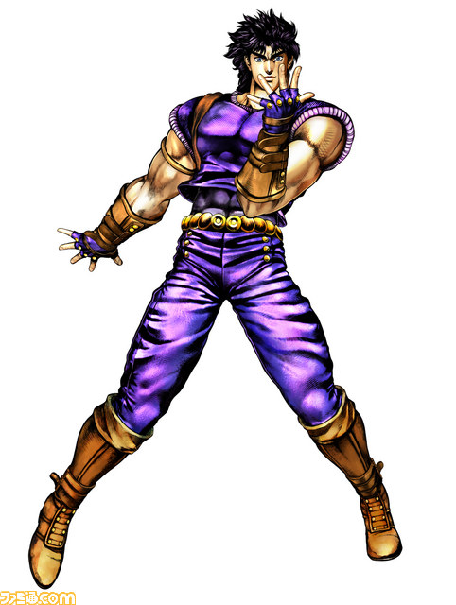

Slide 3
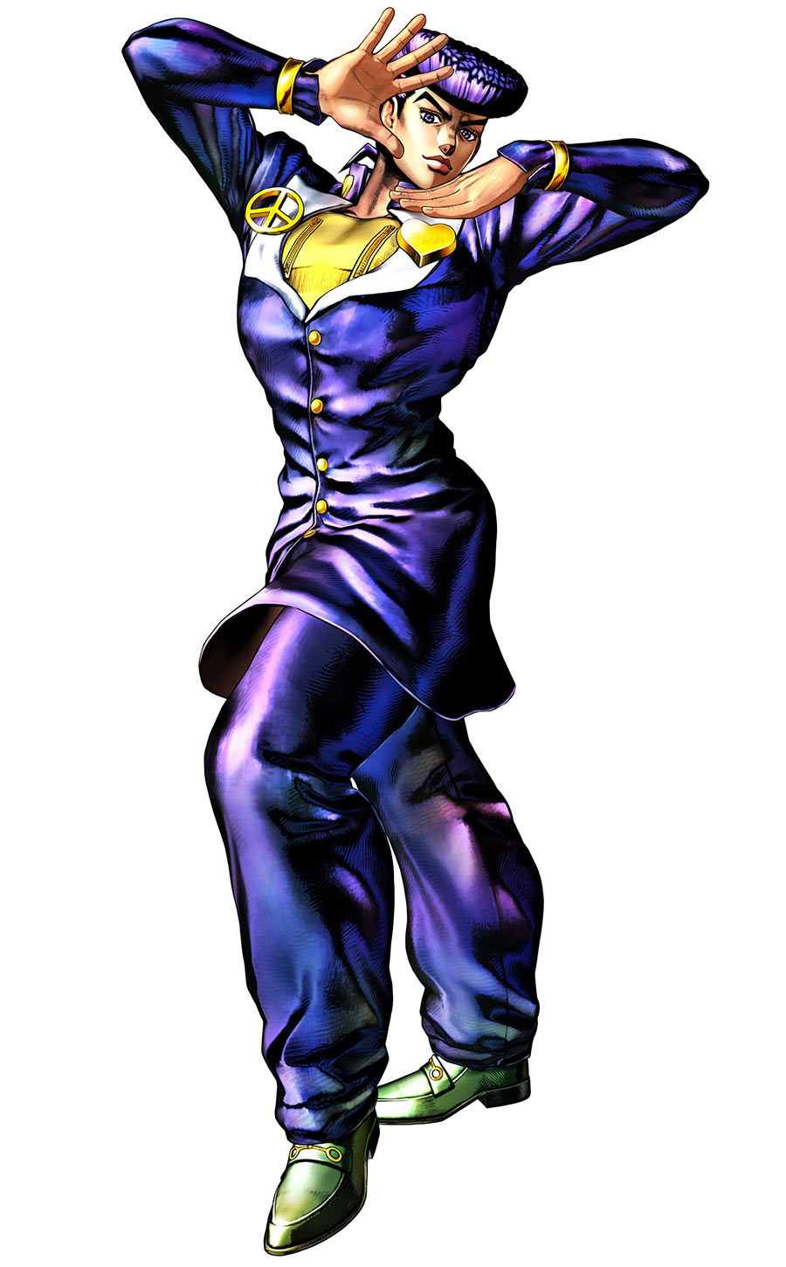

Slide 4
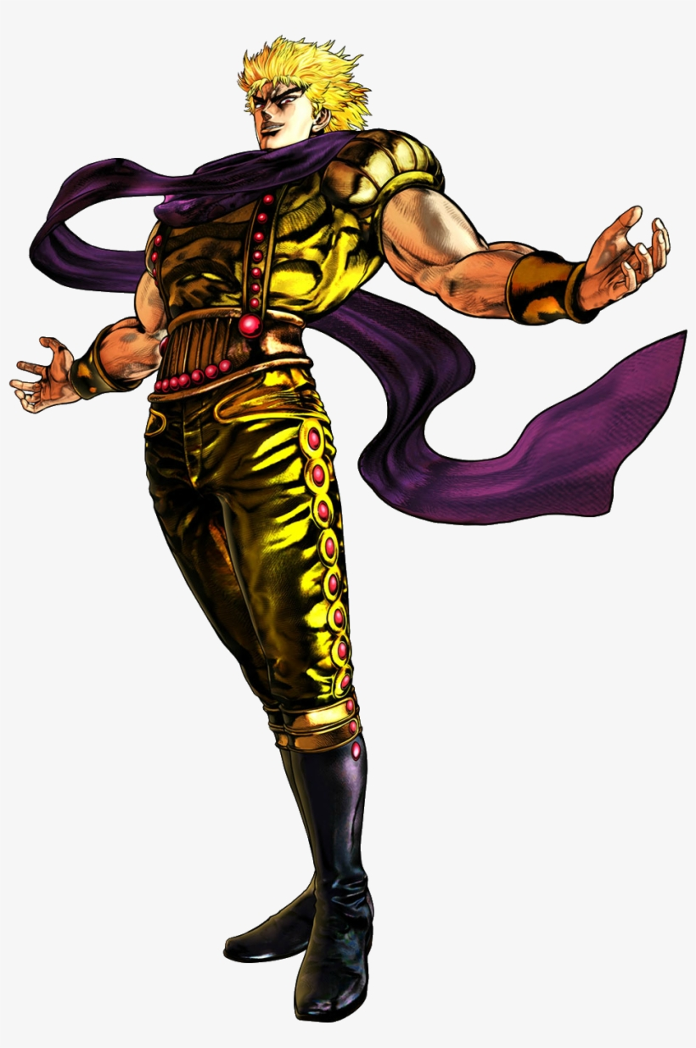

Slide 5
