Slide 1
Lynxx
DIT Bus Delays Investigation

Slide 2
Data
GTFS | Addinsights (DIT)
GTFSr – realtime Trip Updates arrival time delay information per stop, per trip. Route, start date of trip, stop sequence Vehicle Positions route and trip details, vehicle location, bearing, speed at a certain time GTFS – static Routes Stops and Stop Times trip, arrival and departure times, stop sequence of trip, distance of shape travelled up to stop Transfers Trips routes, service days of week, shapes | Incidents time, link, type (congestion, collision, works, event, burst water, hazard) Links start and end with sites, length, geometry Sites locations Holidays Cameras locations Link Stats 1 hr or 5 min travel time and detection stats per link Link Congestion Stats 30 second stats per link of (among others) travel time, delay, speed, congestion, density Probes origin and destination times and sites, time from link start to end, time and sites seen Site Stats 5 minute stats per site of number of probes (raw and unique), average time in range

Slide 3
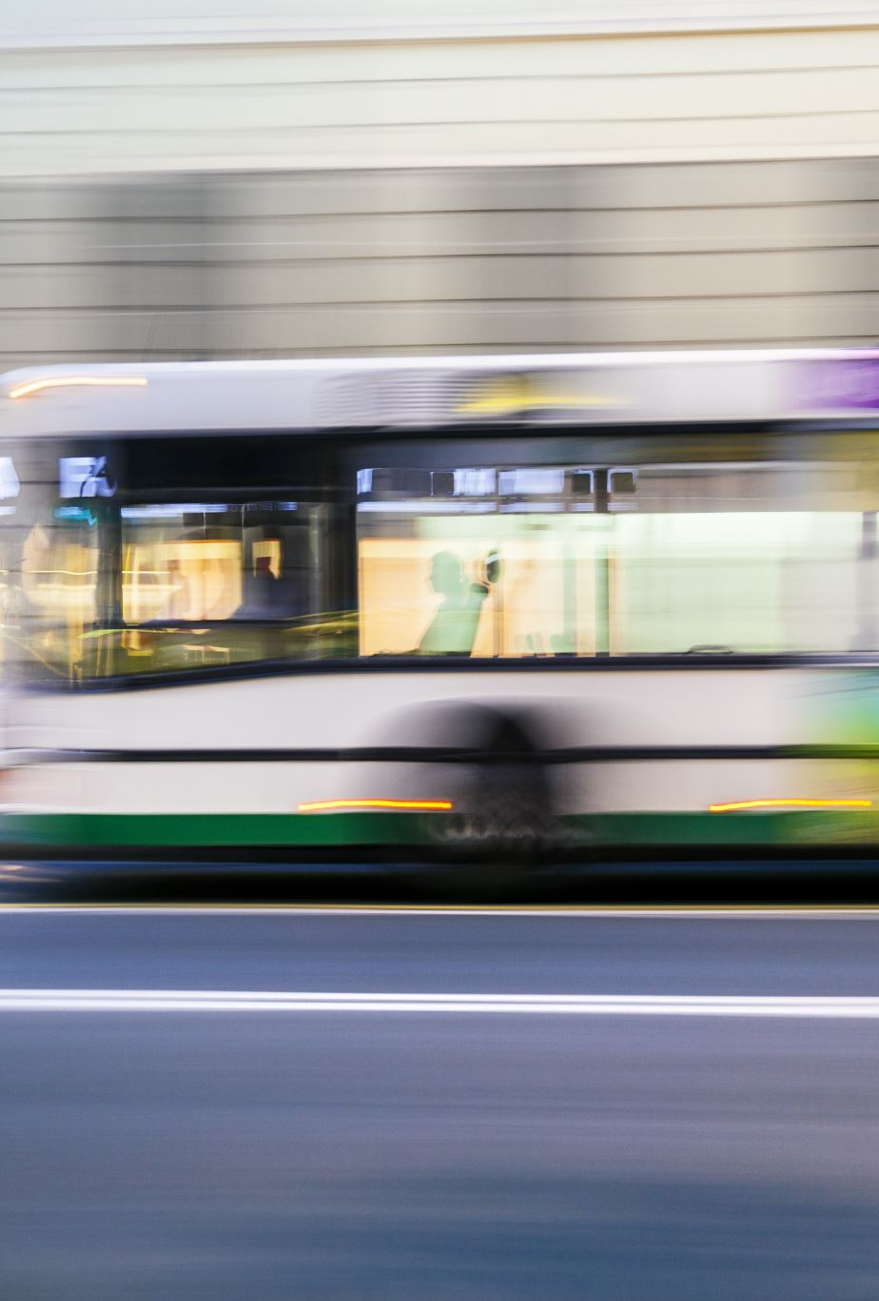
Question
Use delays from GTFS-R (trip updates) and investigate to what extent these can be explained by congestion or slow travel speeds observed in the addinsight data. It would be interesting to perhaps make two groups: (1) intersections with and (2) without bus lanes.

Slide 4
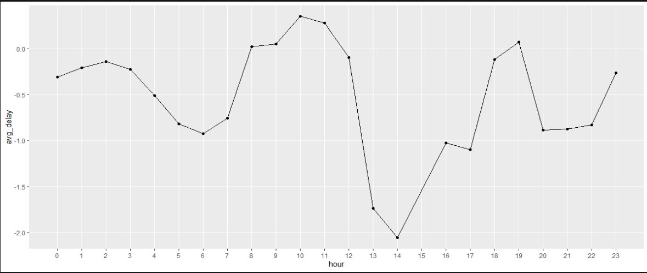
Average Delay per Hour

Slide 5

Methodology - Routes
Arrived at top 5 routes with highest average delays over the month
2 Constraints:
removed delays over 40 mins (exceptions)
Number of trips per route above minimum of mean or median of number of trips per all routes (exclude less frequent trips)
For each of the routes identified, extract hour of the day that has the highest average delay over the month
Same number of trips constraint above
For each route-hour combination identified, get the trip_id and the specific occurrence of the trip_id with the highest number of stops (more data to work with)
Average delay per route identified is approximately 1 minute
Average delay per route identified in specific hour is between 1.7 to 3.7 minutes

Slide 6
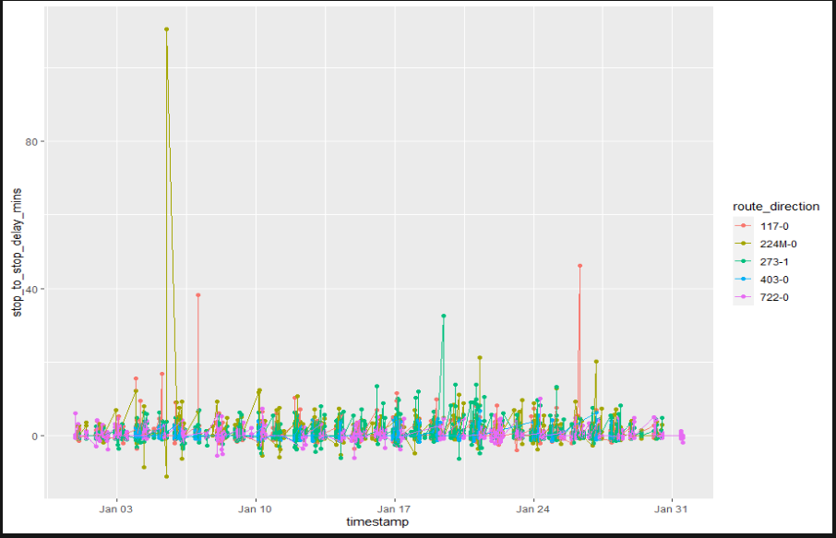

Slide 7
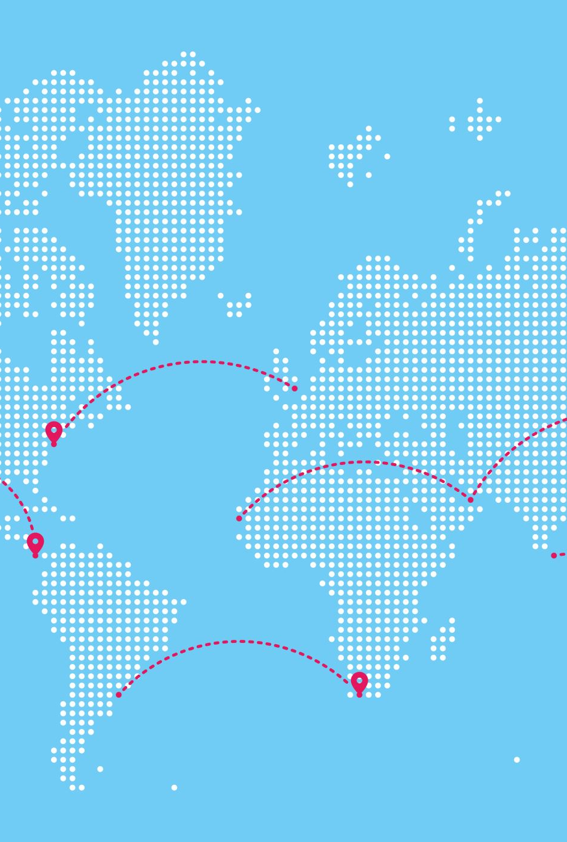
Methodology - Sites
For any – or all – routes, calculate the haversine distance between each of that route’s stops and each site. If the distance is less than 300m, keep the site, otherwise disregard
Show map to visualise

Slide 8
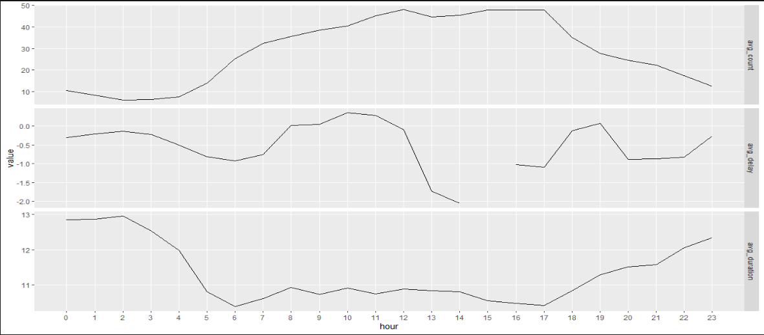
Sites Stats vs Delay

Slide 9

Findings
Routes with the highest delays have highest delays very late at night
No link between congestion and delays (so far)

Slide 10
Possible Analysis Modifications
Limit times to morning and afternoon rush hours (6-10am, 3-7pm). Exclude weekends?
Use top 5 highest average delays per route per hour over the month – occur between 2 and 10am with average delay between 3.6 and 4.6 minutes (before time limitation implemented)
Try to use link congestion stats instead of sites congestion stats – potentially more accurate in terms of congestion area and route matching
Use larger sample of January data or use other/additional month(s) (size considerations)

Slide 11
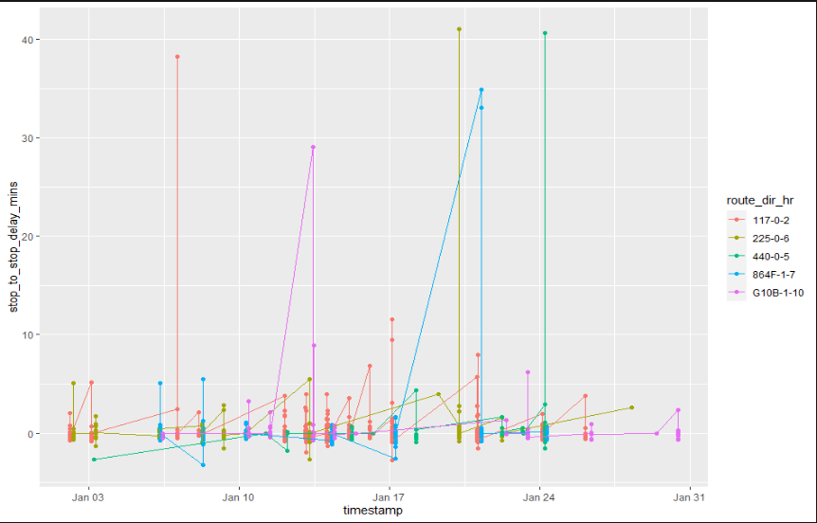

Slide 12
Additional Questions
Compare bus travel speeds observed in GTFS-R (vehicle positions) with the travel speed profiles in the addinsight data and analyse how well these overlap. Again, there could be an interesting split between road segments with and without bus lanes.
How much do incidents impact bus delays, congestion?
Where are big bottlenecks in routes (stops, sites), in terms of bus delays and/or congestion?
Do delays occur in mainly a couple of stops or are they more distributed along the route?
Are bottlenecks regular or due to some other factor such as incidents?
Holidays effect on bus delays, incidents, congestion
Cameras effects on congestion, bus delays, incidents
Do delays occur even with high bus speeds? If so, might indicate timetable too restrictive

