Slide 1

DIT Bus Times vs Road Congestion
Ibrahim Al-Hindi
15/09/2022

Slide 2
Objective
Use DIT AddInsights data and GTFS/GTFS-R data to evaluate the extent of the relationship between trip times and road congestion for a given segment(s) of road. This can indicate the robustness of the bus transport infrastructure to high levels of congestion.

Slide 3
Data Sources
DIT AddInsights
Traffic information collected through bluetooth probes, which take count of bluetooth-equipped motor vehicle numbers in a particular area and time, therefore producing a metric for congestion. A tagged vehicle is assigned an id number for the day and is tracked by getting tagged by other probes on that day
GTFS
Static transit information including stops, stops times, routes, trips, calendar dates, and transfers
GTFS-R
Realtime trip updates consisting of:
Trip updates: provides predicted arrival time for upcoming stops on the trip as of the update timestamp
Vehicle positions: provides the trip’s vehicle position (lat, lon), bearing and speed at a given update timestamp

Slide 4
AddInsights

Slide 5
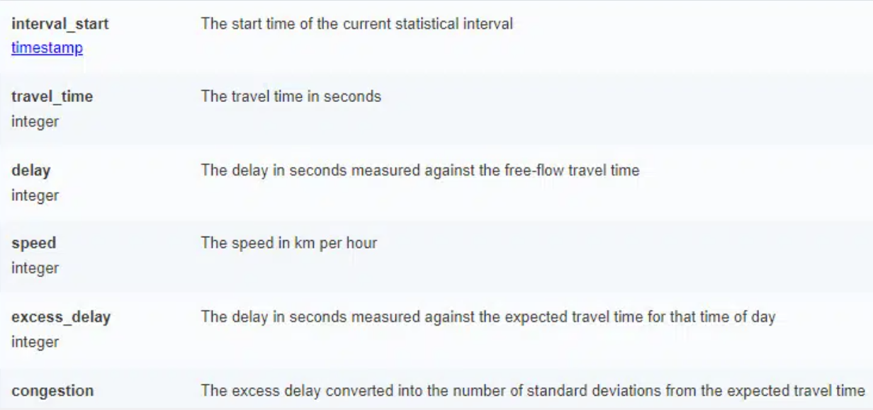

Slide 6
GTFS and GTFS-R

Slide 7
Analysis Metrics
Road congestion
Primary – using links data. Due to having more congestion metrics and segregated by direction
Secondary – using sites data. Vehicle counts per site
Bus travel time
the time taken between the first and last stops across the segment. This removes the possibility that we are measuring how accurately the schedule predicts and/or buffers for congestion

Slide 8
Scope
Time Dimensions
Per the morning peak (6am to 10am) and evening peak (3pm to 7pm)
Aggregation level(s). For example, 15-minute aggregates, hourly aggregates, …
By day of the week
Location Dimensions
Segment of a road
A link
Bus stop or pair of stops
Intersection
Towards or away from the city, or both
With or without bus lanes
North-South/East-West

Slide 9
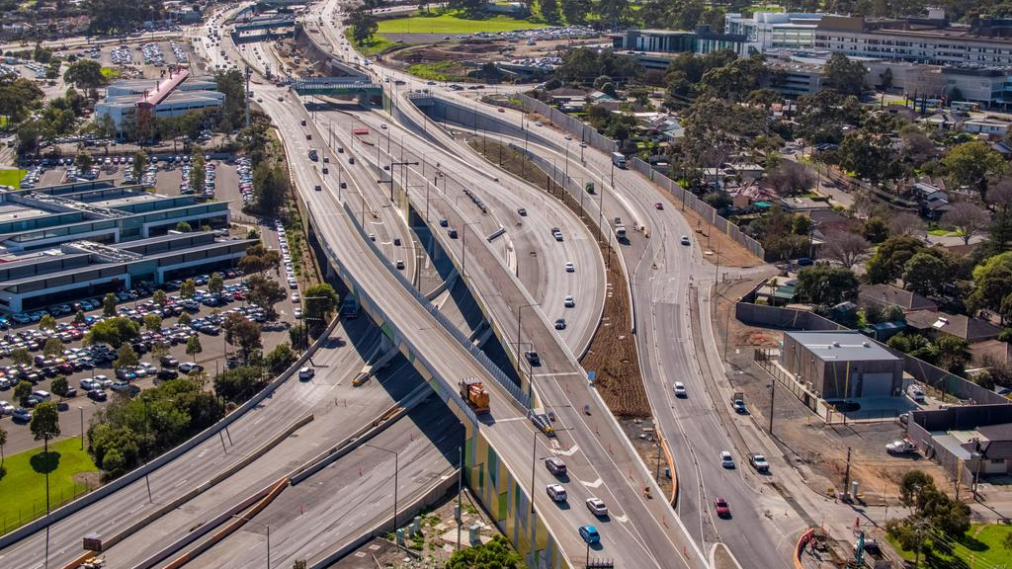
South Road

Slide 10
Analysis Parameters
Limit analysis to a period of interest. For example, March 2022
Disregard weekends and public holidays within that period
Analysis to be conducted on time-aggregated statistics applied equally to both road congestion and bus travel time. For example, 15-minute aggregates
Limit analysis to segment(s) identified
Export list of routes, stops and links id’s on the segment using Tableau

Slide 11
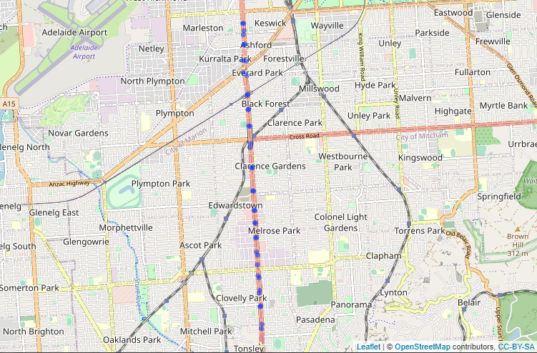
Stops

Slide 12
Calculating Bus Travel Time
Get routes’ trips updates from database. Filter to the stops on the segment only
Identify and keep trips with most occurring start and end bus stop pairs by number of trips on the segment
Calculate the travel time between each pair of stops on the trip. For error detection (lots of errors) and further analysis options such as average speed
Calculate the travel time between the first and last bus stops on the segment for each trip
Calculate the average travel time of all trips per time aggregate across the entire period, the basis of aggregation is the trip start time (the arrival time of the first stop on the segment). For example, all trips that start between 7am and 7:15am across March 2022

Slide 13
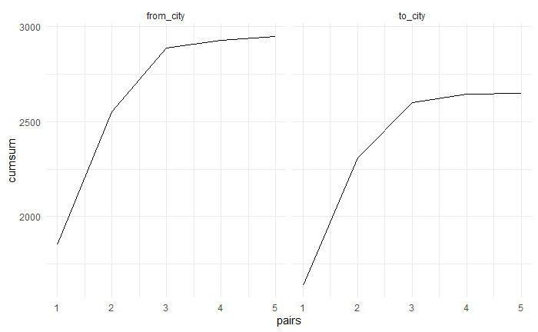
Identify most occurring start and end bus stop pairs on the segment

Slide 14
Trip Updates Errors
All updates for the trip have large delays. Most likely an error due to retrospectively entering the information at a later time
A stop has a sudden large predicted delay resulting in a much larger arrival time than that of the following stop
A stop has an arrival time later than following stops and the timestamp is earlier
A stop's arrival time is earlier than previous stops and the timestamp is earlier
A stop's arrival time is earlier than the previous stop but they both have the same timestamp
Two consecutive stops have identical arrival times but with different timestamps
Two consecutive stops have identical arrival times and timestamps
Many stops on the same trip have the same arrival time. Likely due to retrospective entry error

Slide 15
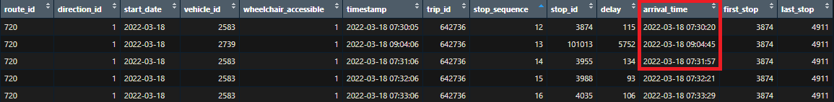
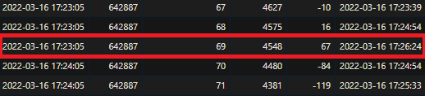
Sudden large delay
Stop has an arrival time later than following stops and the timestamp is earlier

Slide 16
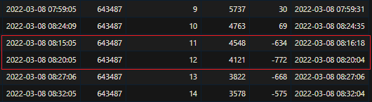
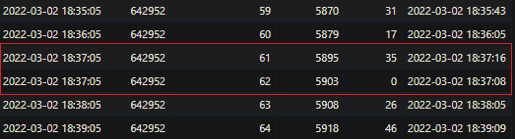
Stop's arrival time is earlier than previous stops and the timestamp is older
Stop’s arrival time is earlier than the previous stop but they both have the same timestamp

Slide 17


Two consecutive stops have identical arrival times but with different timestamps
Two consecutive stops have identical arrival times and timestamps

Slide 18
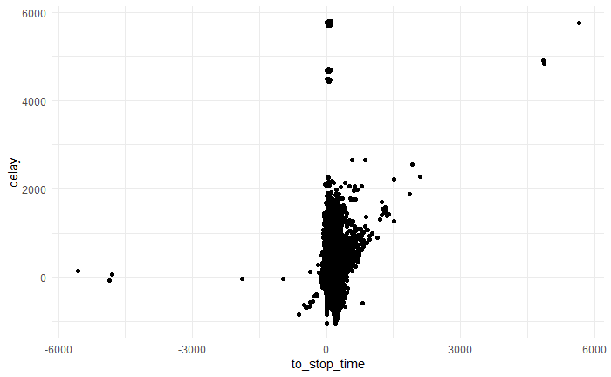
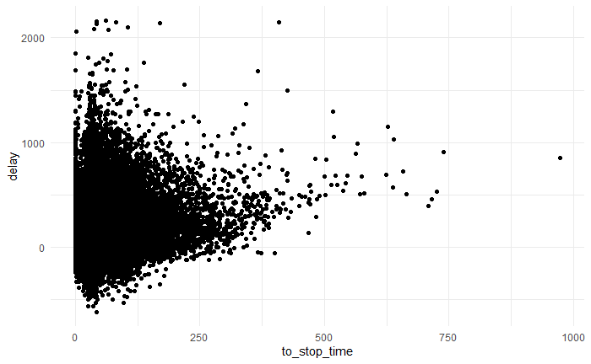
Before
After

Slide 19
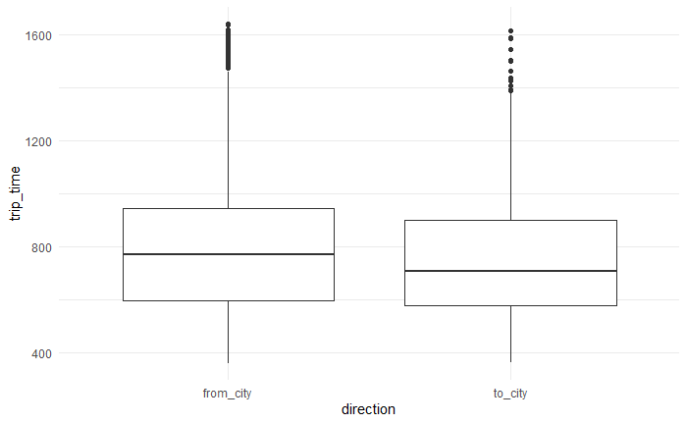
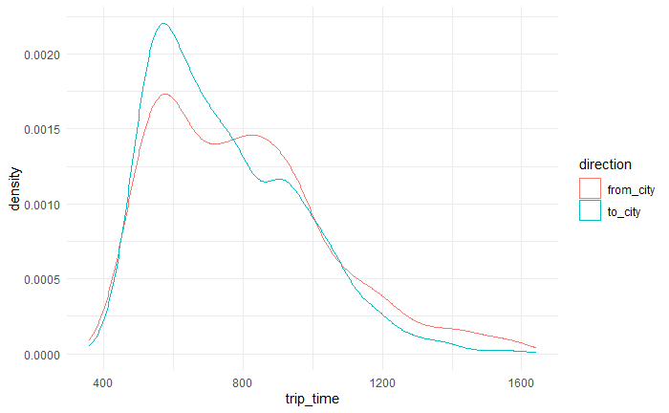
Trip Time Plots

Slide 20
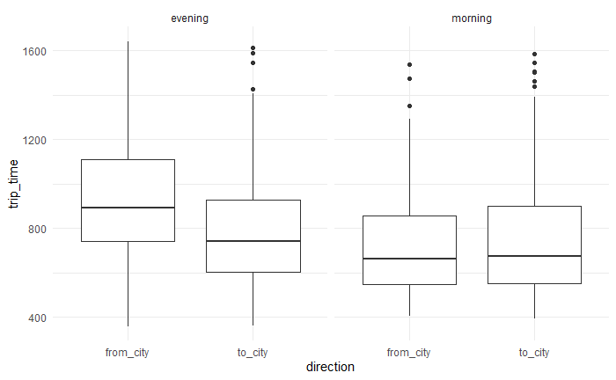
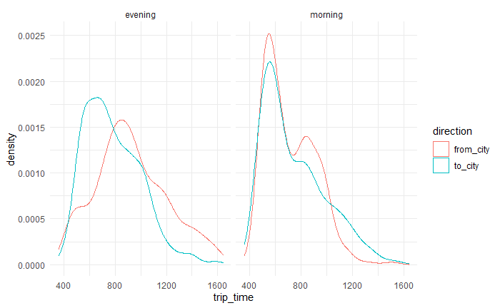
Peaks Trip Time Plots

Slide 21
Calculating Road Congestion Using Links
Identify sequence of non-overlapping links that compose the segment AND have stats in database
Calculate the average congestion per link per aggregated time across the entire period to potentially identify traffic bottlenecks within a segment in further analysis. Different metrics can be used to calculate congestion
Calculate the average congestion of all the links within a segment per aggregated time across the entire period, to produce the average congestion across the entire segment. Different metrics can be used to calculate congestion

Slide 22
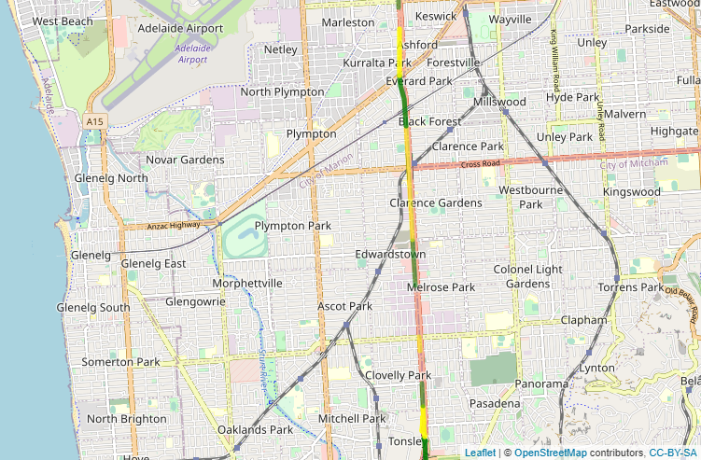

Slide 23
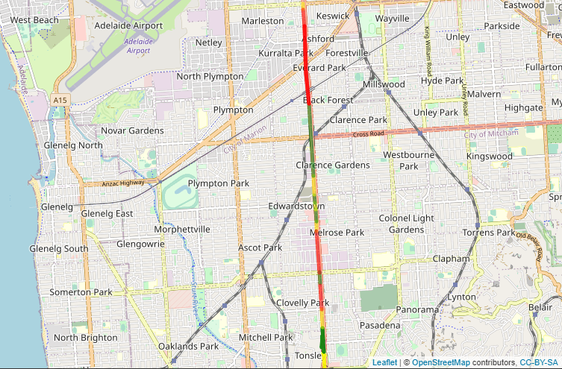

Slide 24
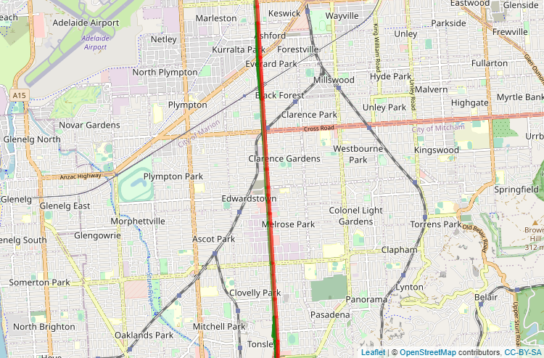

Slide 25
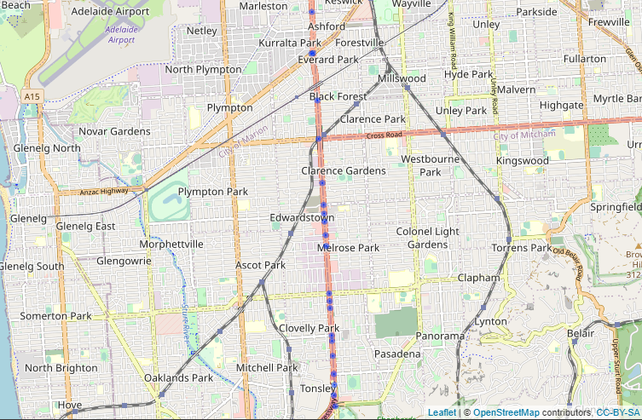
Calculating Road Congestion Using Sites
Use Google maps to determine edge coordinates of the segment, extract sites within the coordinates
Get site stats from database
Same calculation steps as when using links, however the resulting congestion is measured as the number of vehicles and average time spent by a vehicle in the sites contained within a segment and time aggregate across the period under analysis

Slide 26
Comparison Between Bus Travel Time and Congestion
The relationship between road congestion and bus travel times will be determined by analysing the variation in bus travel times compared with the variation in congestion levels. Visualisation will be used to examine the relationship per time aggregate. Specific aspects may be highlighted according to the dimensions desired, for example separate visualisations can be constructed according to the direction towards or away from the city, as well the relationship during morning and evening peak hours.

Slide 27
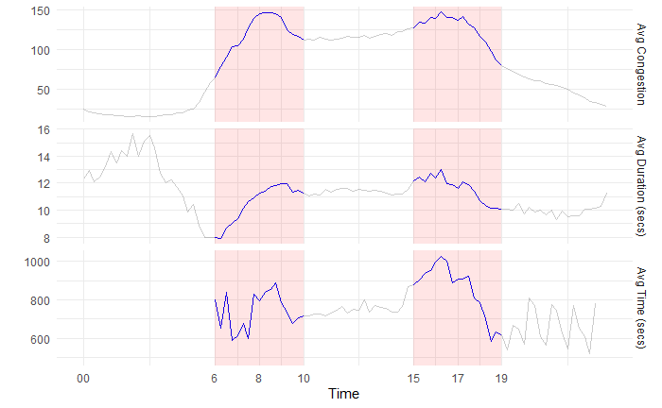
Time vs Sites (15 mins)

Slide 28
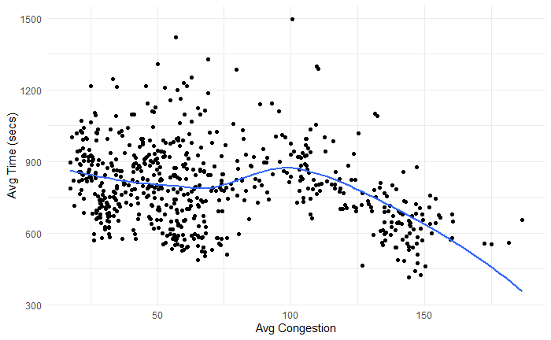
Time vs Sites Scatter (15 mins)

Slide 29
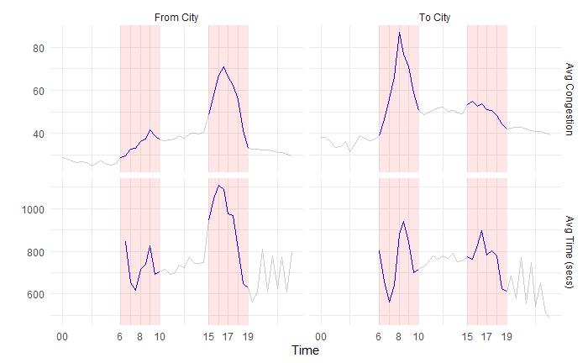
Time vs Links Travel Time (30 mins)

Slide 30
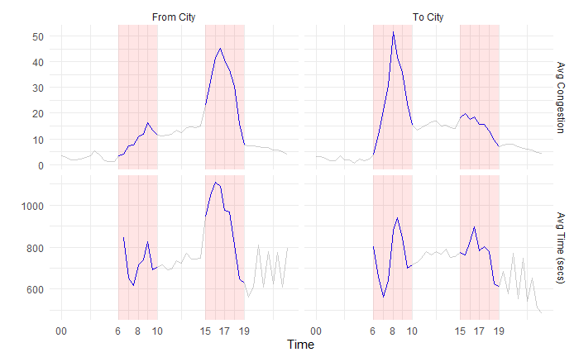
Time vs Links Delay (30 mins)

Slide 31
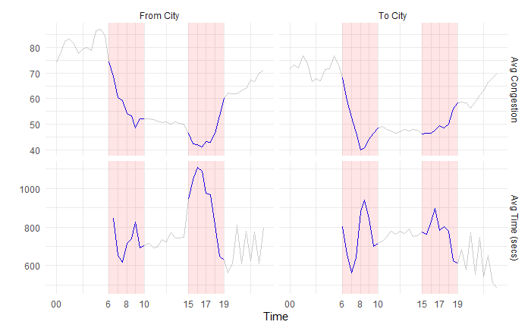
Time vs Links Speed (30 mins)

Slide 32
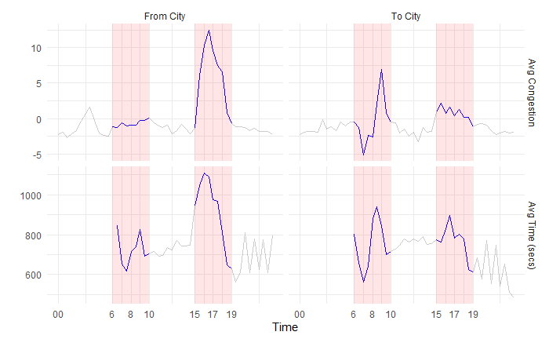
Time vs Links Excess Delay (30 mins)

Slide 33
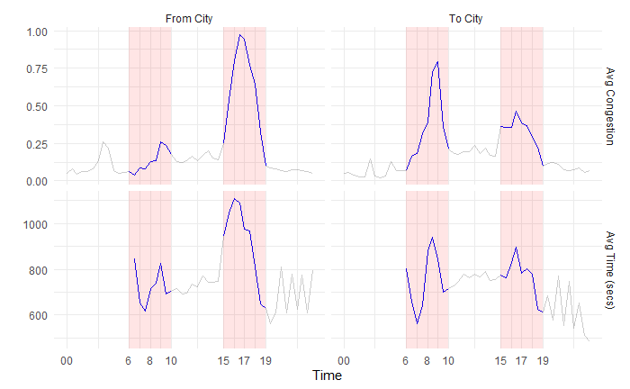
Time vs Links Congestion (30 mins)

Slide 34
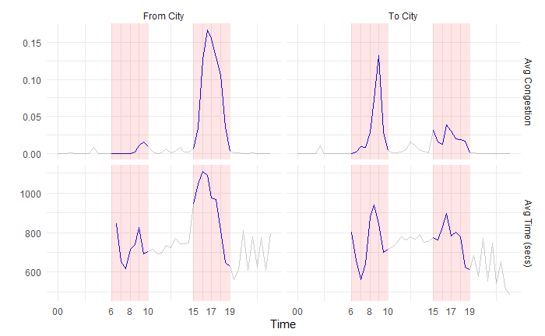
Time vs Links Score (30 mins)

Slide 35
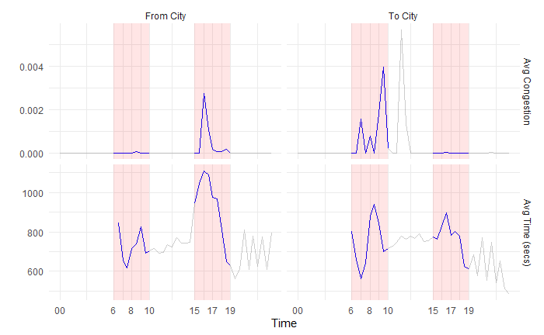
Time vs Links Flow Restriction Score (30 mins)

Slide 36
Conclusion
The figures show that average trip times increase along with congestion during the evening peak when leaving the city. Average trip times also increase in the morning towards the city, albeit to a much lesser extent

Slide 37
Moving Forward
Use average speed of the trip as a measure of robustness
Identify days where the trip time and/or congestion was much higher than the average/median of the other days during peak hours
Performing the analysis on the same segment from previous months to highlight possible trends. This can identify areas where the congestion effect on bus travel times is accelerating at a higher pace
Narrow the time or area scopes to produce outcomes of higher granularity
Identify bottlenecks in segments in terms of travel time and/or congestion
Do travel times and/or congestion occur in specific areas or are they more distributed along the segments?

