Slide 1


Projuct Presentation
HW SW Co-Design
Presented by :
Tal Schneider
Almog As

Slide 2
Chosen Benchmarks
nbody
pyflate
01
02
Computer problem
N-body gravity simulation
5.4M float operations per call
Data fits fully in L1 cache
Data-Movement Problem
Pure-Python bzip2 decode
127K page faults per run
35x higher cache miss rate
>
>
>
>
>
>

Slide 3



METHODOLOGY
Test Environment
Host CPU
Guest OS
Interpreter
Intel Xeon E5-2630 v3
Ubuntu 22.04 LTS (KVM)
CPython 3.10.12 (Debug)

Slide 4


METHODOLOGY
Fixed-Work Measurment
The Problem
Our Fix
Default harness runs 27 processes.
Created 15.9% instruction overcount.
Single worker process locked flags.
Exact same work across variants.

Slide 5
METHODOLOGY
PMU & Debug Corrections
Virtual PMU Limitations
Lacks sampling interrupts. Required explicit event profiling.
DWARF Unwinding
Frame pointers fail on -Og builds. DWARF used instead.
Debug Allocator Noise
Excluded 18.3% profile artifacts from pyflate baseline.

Slide 6

NBODY BENCHMARK
nbody Overview
>
>
>
>
20,000 timesteps per call.
5.4 M float operations per call.
Pure CPython generic flaot obkects.
In-place list sequence writes.
Five-body gravitational simulation of the sun and four gas giants.

Slide 7
NBODY BENCHMARK
Instruction Bound Workload
477
2.9G
2.54
Milliseconds per call
Instructions per call
Instructions per cycle

Slide 8
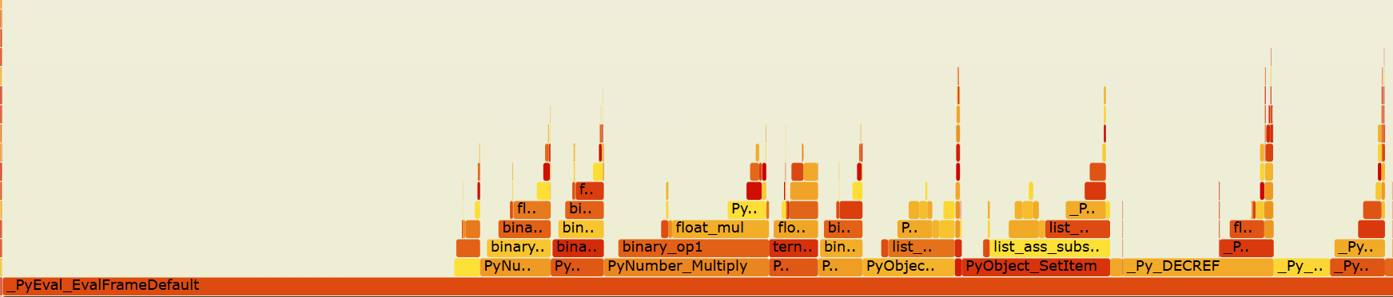
NBODY BENCHMARK
Overhead Dominated
88.9%
47.1%
12.8%
12.6%
11.1%
Interpreter dispatch:
Sequence element access:
Float boxing:
REAL float arithmetic:
Spent managing heap objects

Slide 9
NBODY OPT1
Hoist Indexed Reads
Before
After
v1[0] -= dx * b2m
v1[1] -= dy * b2m
v1[2] -= dz * b2m
v1x, v1y, v1z = v1
v1[0] = v1x - dx * b2m
.....
Repeated generic sequence protocols
Unpacked to local variables

Slide 10
NBODY OPT1 REASULTS
Sequence Work Halved
-10.3%
-8.5%
-53%
Time per call
Instructions per call
Sequence operations

Slide 11

NBODY OPT2
Math Reassociation
Before
Generic exponentiation operator
After
Replaced with math.sqrt()

Slide 12

NBODY OPT2 REASULTS
+3.7%
A Measured Regression
Math saved 0.059G instructions.
Python function dispatch cost 0.166G.
The path to a cheaper operation can cost more than the operation itself.

Slide 13
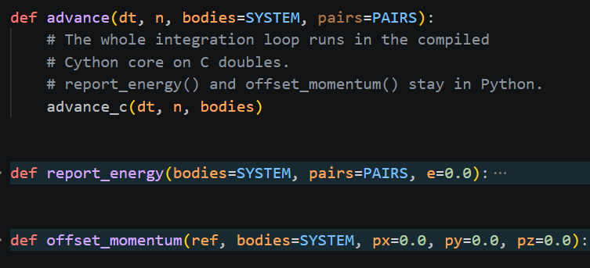
NBODY OPT3
Cython Typed Core
Typed Arrays
Values live unboxed in registers.
Compile-Time Types
Zero Python interpreter dispatch in the hot loop.
Identical Semantics
Final energy output bit-exact.

Slide 14
NBODY OPT3 REASULTS
Interpreter Bypassed
99.2%
125x
147x
Runtime Reduction
Faster overall
Fewer instructions
Required linear intercept calculation to remove 37% startup noise

Slide 15
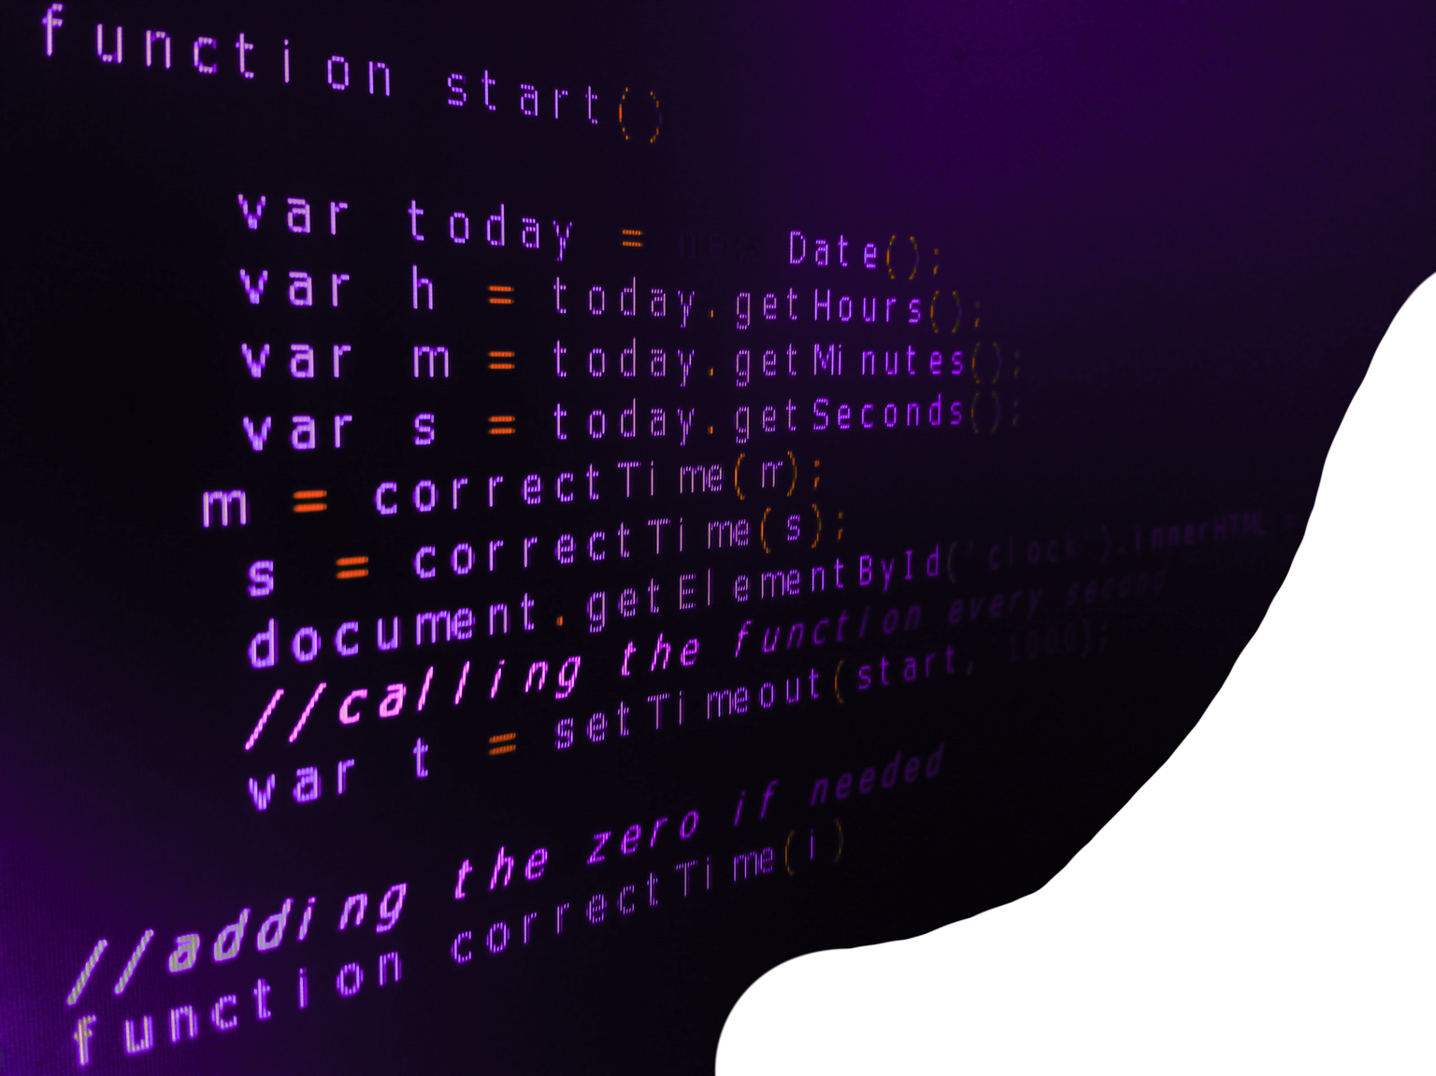
PYFLATE BENCHMARK
pyflate Overview
>
>
>
>
89,837 MTF operations per call.
145-entry Python list mutation.
Fixed MD5 digest verification.
Data-movement bound algorithm.
Pure-Python bzip2 decompression workload.

Slide 16
PYFLATE BENCHMARK
Memory Bound Workload
3.14
16.6G
127k
Seconds per call
Instructions per call
Page fault per run

Slide 17
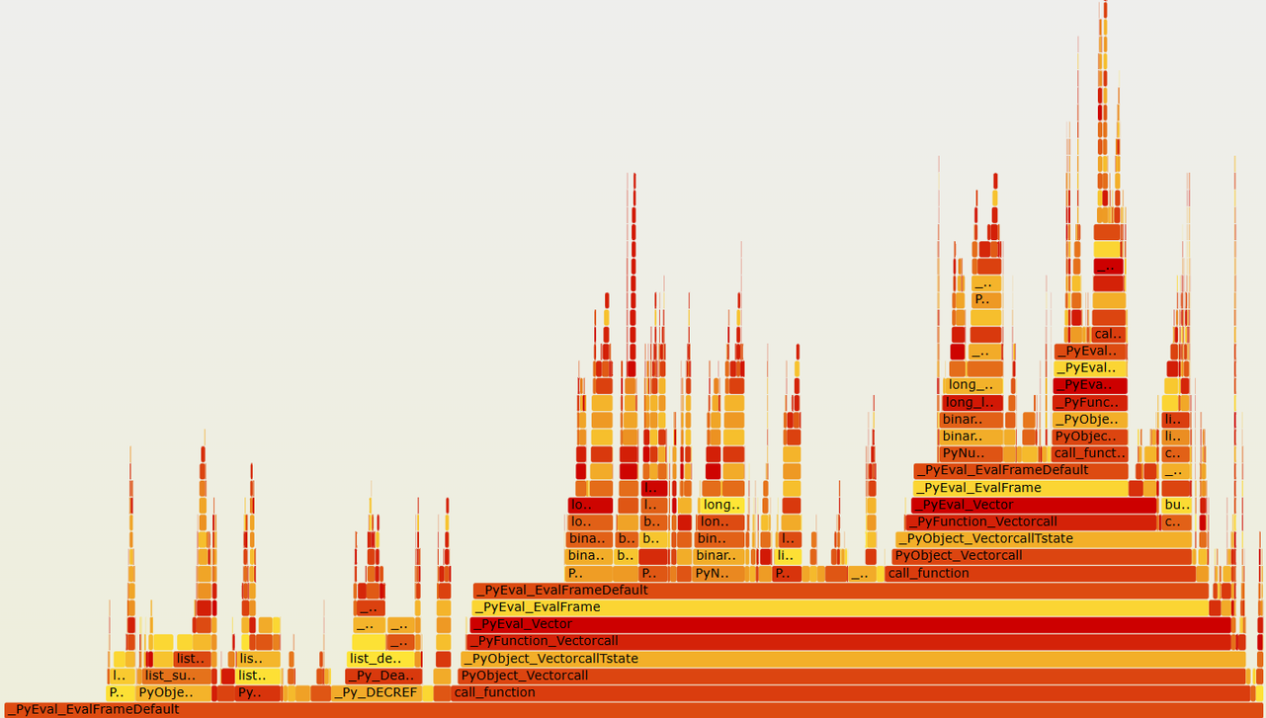
PYFLATE BENCHMARK
MTF List Churn
List slicing, concatenation, and deallocation completely dominate the python execution path.
29.4%
18.3%
12.2%
11.7%
Interpreter dispatch:
Debug-build allocator (excluded):
Function call machinery:
List & slice ops (MTF):

Slide 18



PYFLATE BENCHMARK
The MTF Bottleneck
21,400
3 List Slices
2 Concatenations
5 Heap Allocations
Instructions per byte

Slide 19


PYFLATE OPT1
In-Place MTF
Before
Complete list rebuild
After
Two internal memmoves

Slide 20
PYFLATE OPT1 REASULTS
Stage Cost Collapsed
-12.7%
-72%
0
Time per call
MTF stage operations
Heap allocations

Slide 21
PYFLATE OPT2
Linear Search
Table-Driven Huffman Decode
Slow interpreted loop
Grouped symbols by code length.
Heap Lookup
Replaced linear scan loop with one dict lookup per length.
Direct length mapping

Slide 22
PYFLATE OPT2 REASULTS
The Real Mechanism
-16.2%
Unexpected Attribution
Dict lookups actually increased
92% gain from eliminating the interpreter loop
Cumulative speedup

Slide 23

HARDWARE PROPOSAL
Move-To-Front Unit
Fixed Working Set
256 bytes resident. Zero memory traffic.
High Utilization
Runs 89,837 times per call.
Software Proven
Opt1 proved stage value.

Slide 24
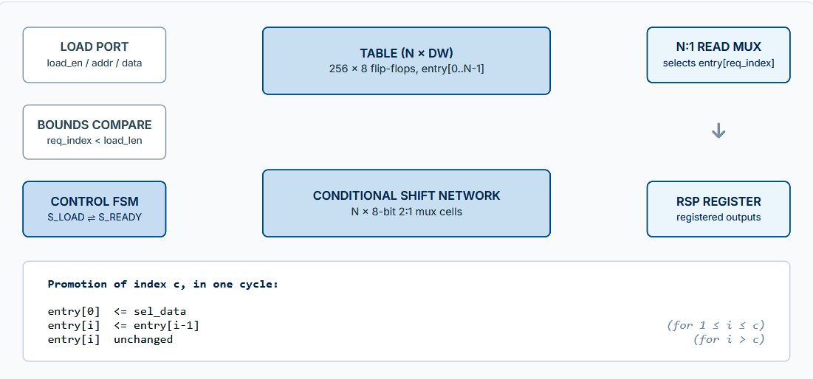
HARDWARE PROPOSAL
mtf_unit: Single-Cycle Parallel Shift

Slide 25
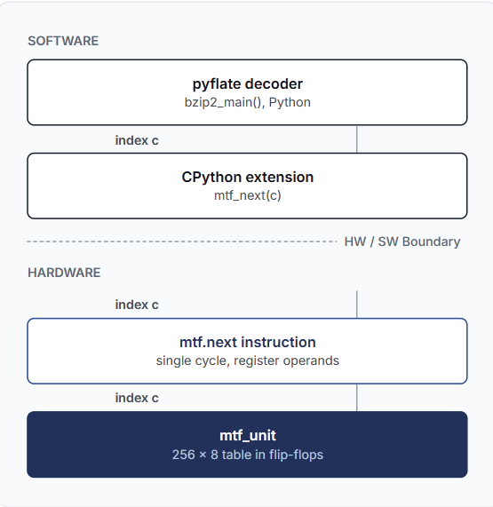
SOFTWARE INTEGRATION
Flow & Interfaces
ISA Extension
1 cycle execution (~5 ns).
Custom instruction (e.g. RISC-V custom-0).
Memory Mapped
Two bus round trips (~100-200 ns).
32-bit AXI4-Lite slave.

Slide 26



HARDWARE TRADE-OFFS
Energy vs. Power
Peak Power
Energy Per Op
Silicon Area
Increases during operation
Collapses by orders of magnitude
Minimal cost for high impact

Slide 27
The Amdahl Reality
1,294x
Zero mismatches across 89,837 operations.
Accelerating a stage 1,294x yields a modest global limit.
MTF Stage Speedup
1.23x
Global Benchmark Limit

Slide 28
PROJECT CONCLUSIONS
The Value of Profiling
pyflate
The HW/SW Lesson
nbody
Only 11.1% of runtime is the arithmetic the algorithm requires.
539 interpreter instructions per float operation vs. 3.66 in C.
Opt3 proved removing interpretation yields 125x speedup.
A data-movement workload (35x nbody's LLC miss rate).
MTF stage costs ≈21,400 instructions to move one byte.
Opt2 showed removing an interpreted search loop beat dictionary speedups.
An accelerator making its target 1,294x faster only speeds up pyflate by 1.23x.
The useful result is not just target speed, but how much total runtime it removes.

Slide 29
Big Thanks!
Questions?

