Slide 1
MWL lab meeting
Greg
9/9/2013

Slide 2
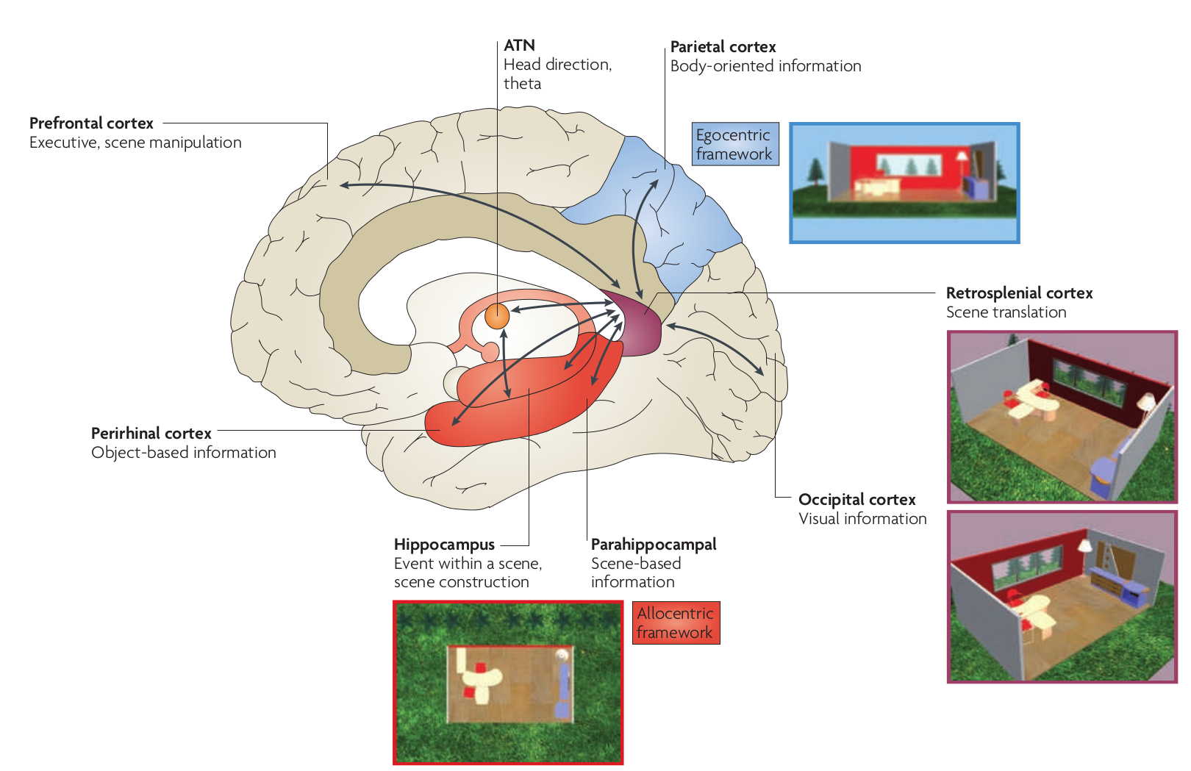
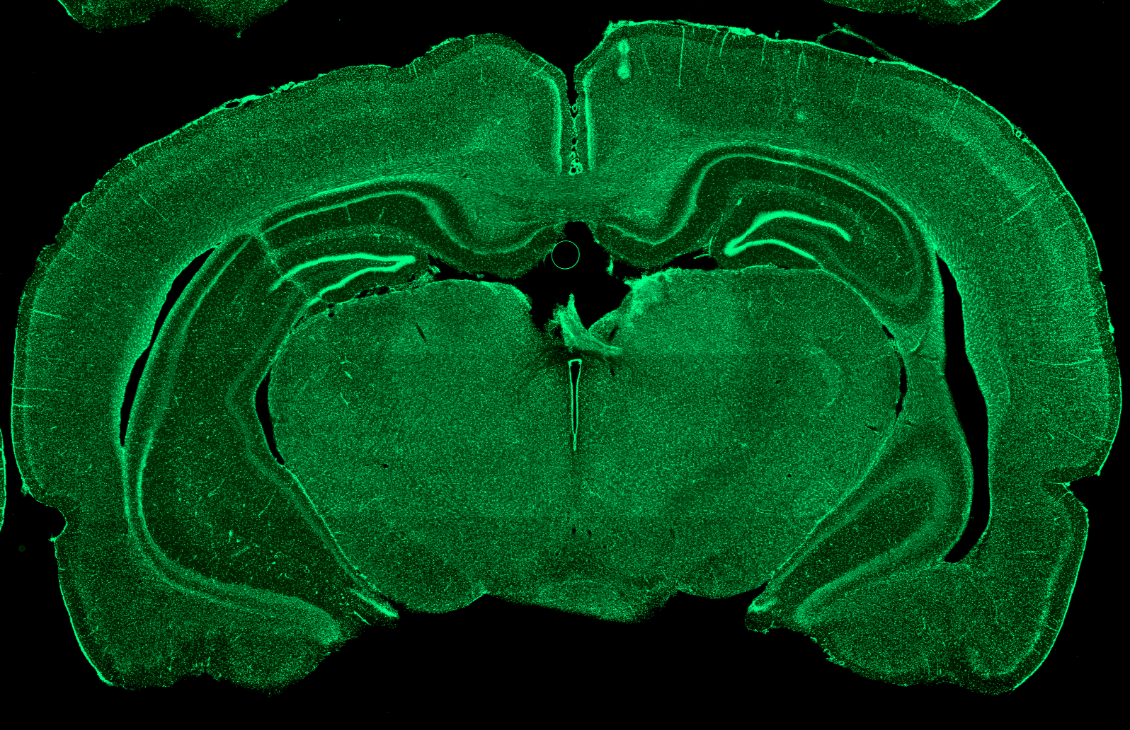
RSC:
-Anatomy
Connected with
HPC,
AD,
ACC, PFC, Parietal, V2 cortex
Granular layer: more AD Thalamus
Dysgranular layer: more Parietal
-Human lesions / fMRI
Episodic memory
Orienting wrt landmarks
Speech production/comprehension
Imagination
-Rodent lesions
Navigational memory
-Rodent recordings
10% head direction cells
Many conjunctive direction-velocity,
Or hard to classify

Slide 3
Ripple bursts
How are they organized in time
How closely does MUA follow
How rhythmic are ripples in a burst
Do ripples modulate activity in retrosplenial cortex
Do bursts modulate it differently than ripples alone

Slide 4
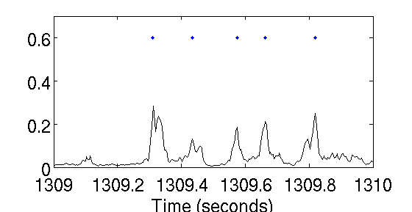
Ripple Bursts
Labeling ripples (LFP)
  Mean envelope > 100 µV
  Cutoff window at 50 µV
  At least 30 mS long
  Split in two if local minimum < 75 µV

Slide 5
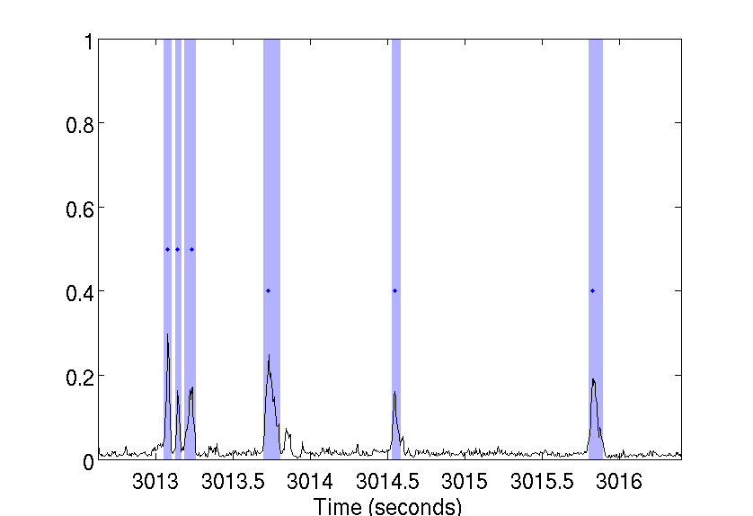
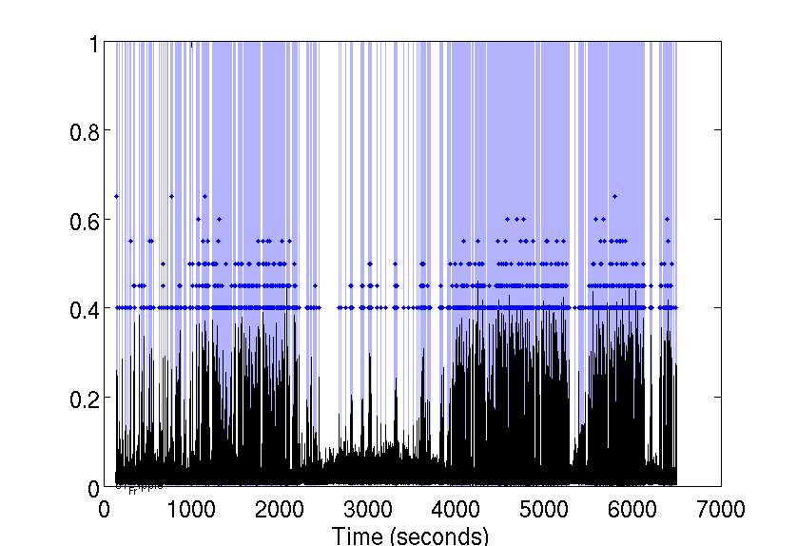
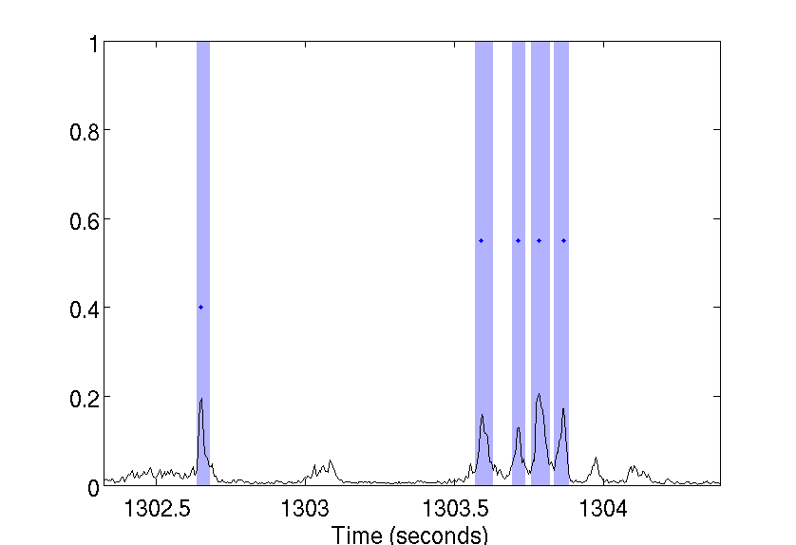
Ripple Bursts
Labeling Ripple Bursts
  Ripples with peaks < 250 mS apart are a ripple burst
Run
(Reward)
SWS
Sleep box
Track
Sleep box

Slide 6
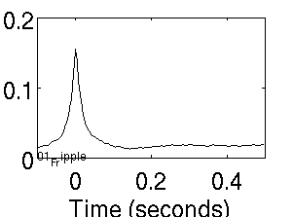
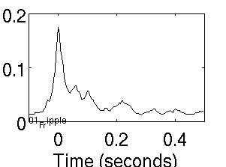
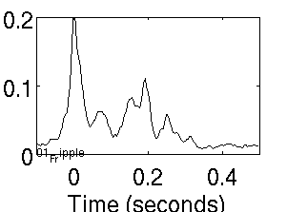
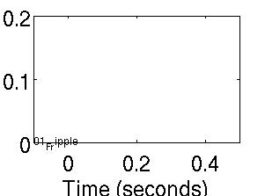
Bursts x-corr ripple LFP envelope
Singles
76%
Doubles
18%
Triples
5%
Quads
Run (Reward)

Slide 7
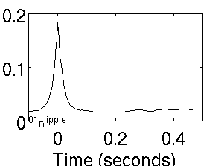
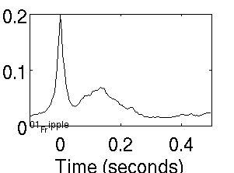
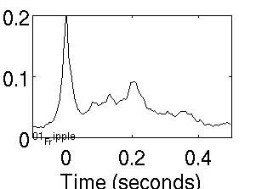
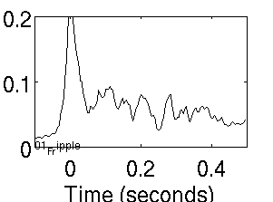
Bursts x-corr ripple LFP envelope
Singles
72%
Doubles
19%
Triples
6%
Quads
2%
SWS (Pre-sleep)

Slide 8
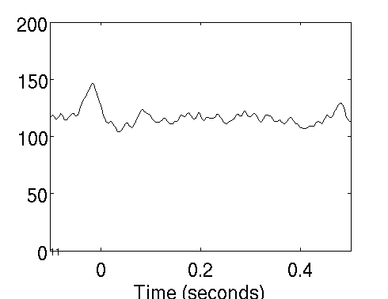
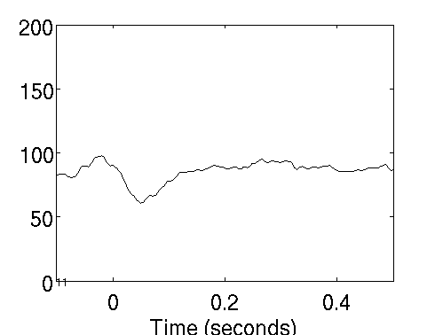
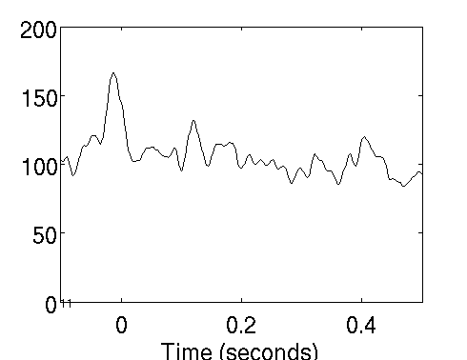
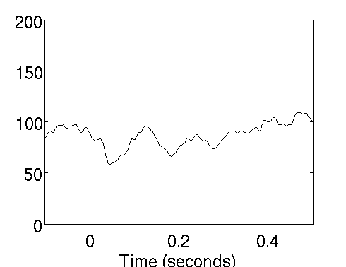
Relation to RSC MUA
Single
Single
Double
Double
Run (Reward)
SWS

Slide 9
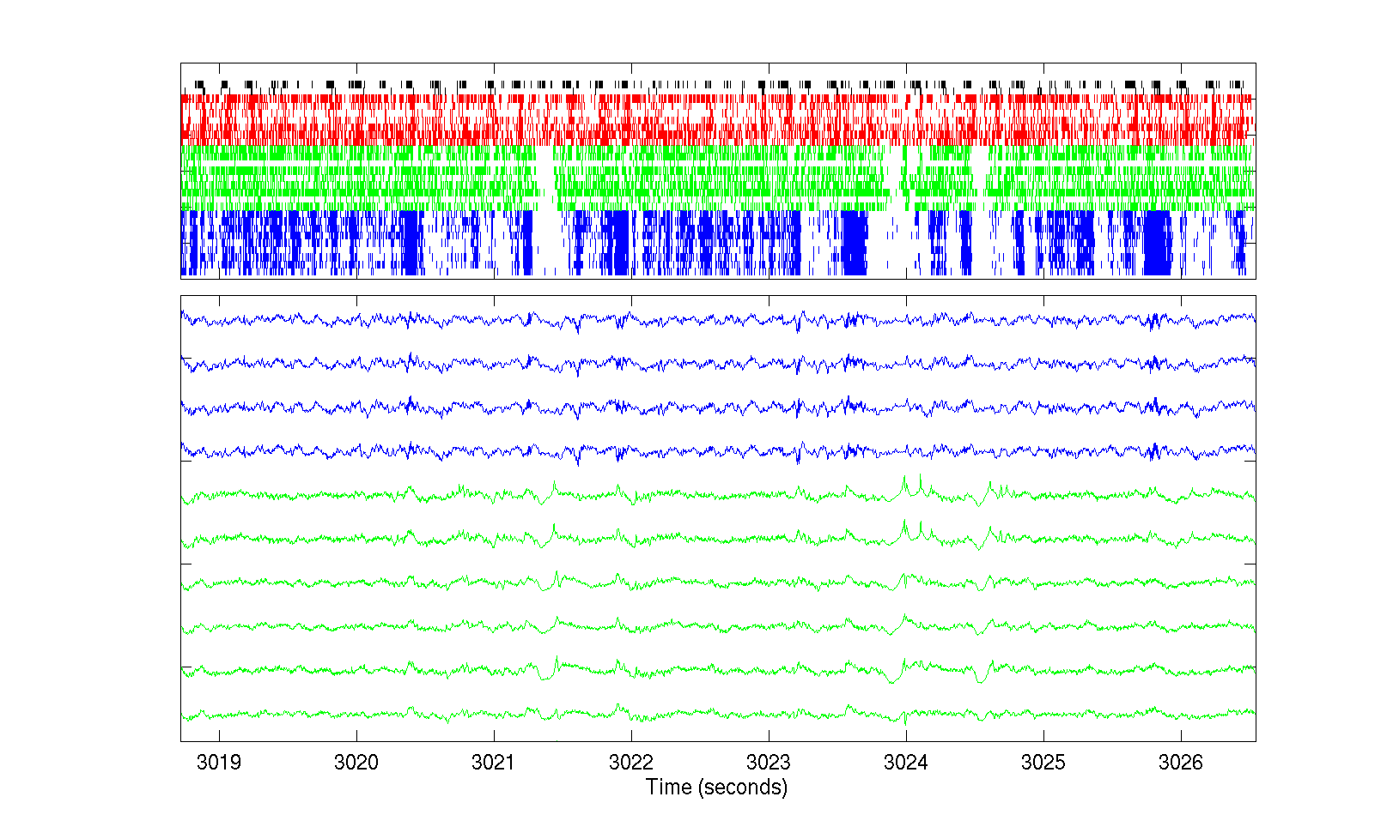
Track large reward
RSC
HPC
RSC
HPC
1 sec

Slide 10
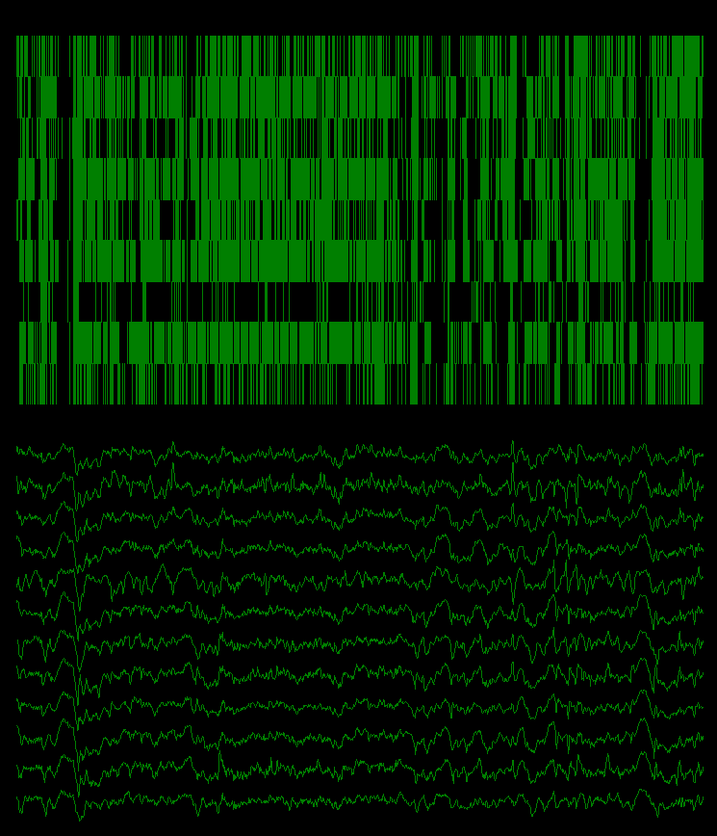
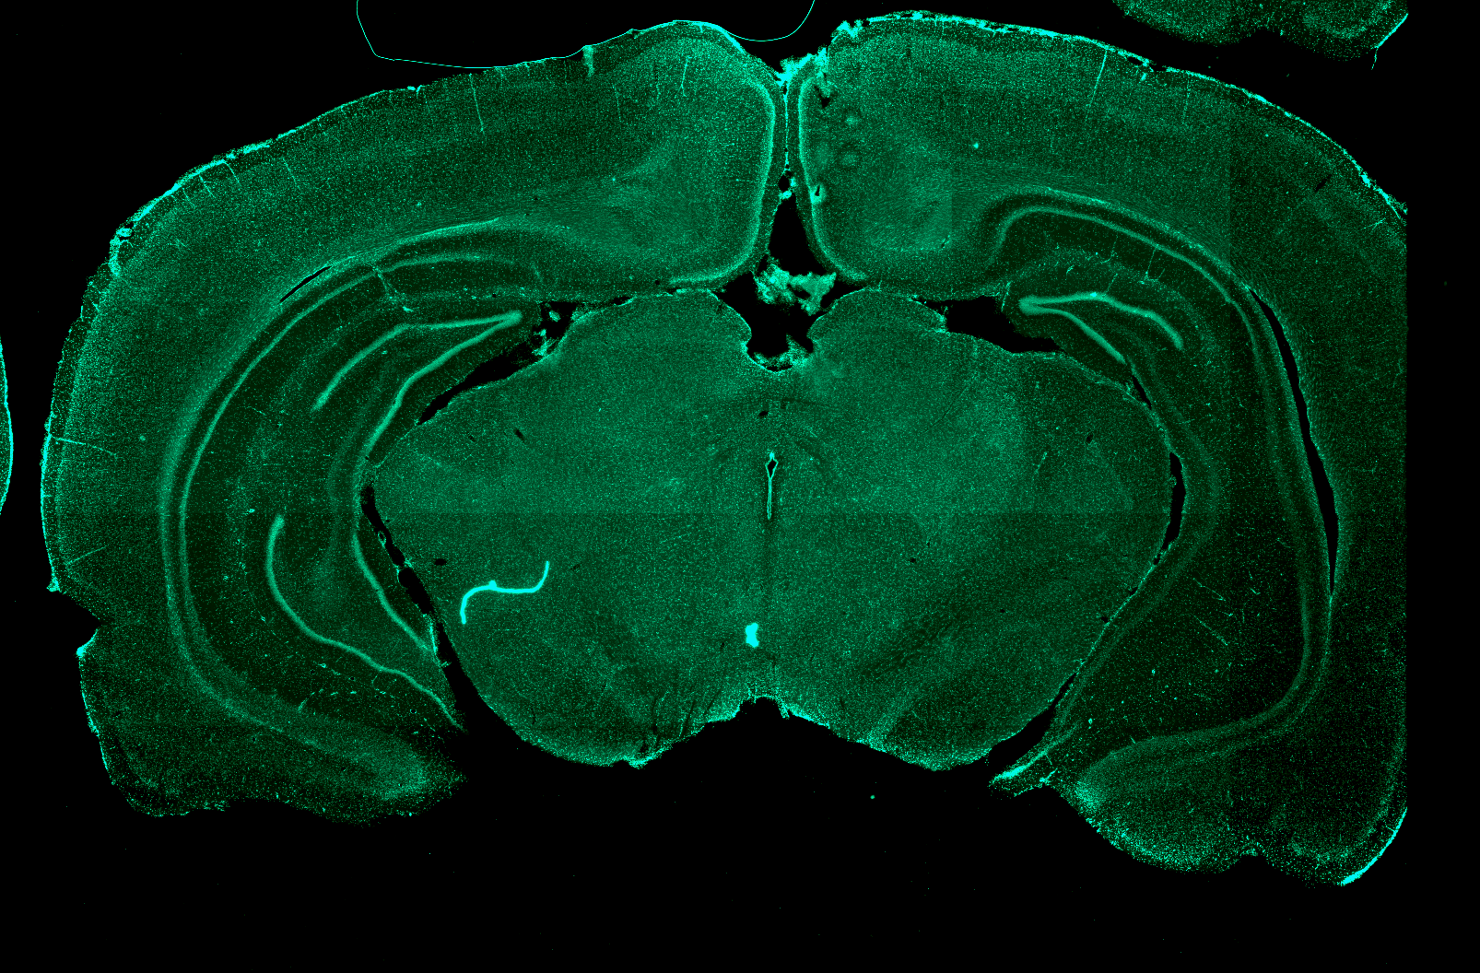
Tetrodes in granular and dysgranular
Retrosplenial cortex
1mm
1 sec

Slide 11
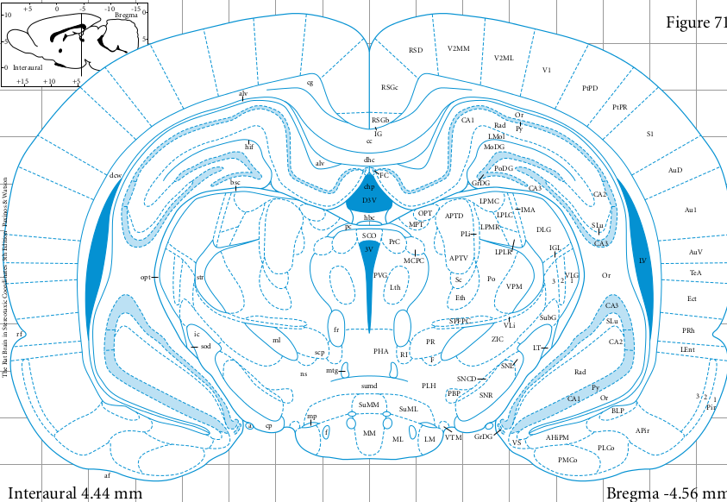
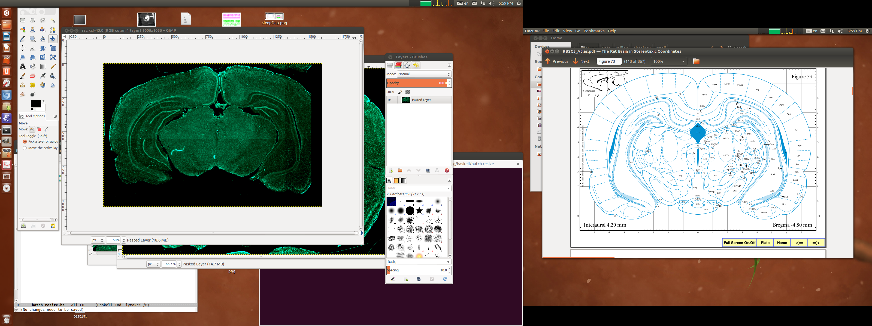
Tetrodes in granular and dysgranular
Retrosplenial cortex
1mm
1 sec

