Slide 1
ArtE
Almost a real-time electrophysiology system
Greg Hale
imalsogreg@gmail.com
Brain Lunch
Feb 10, 2014
github.com/ImAlsoGreg/arte-ephys

Slide 2
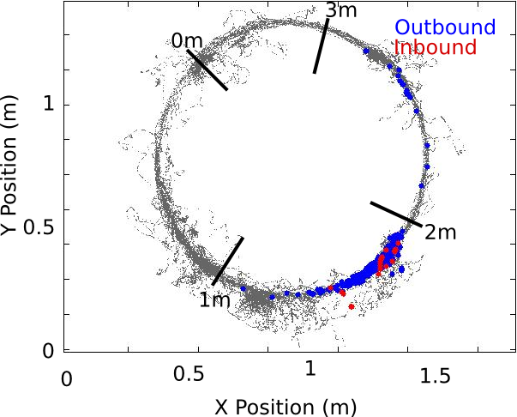
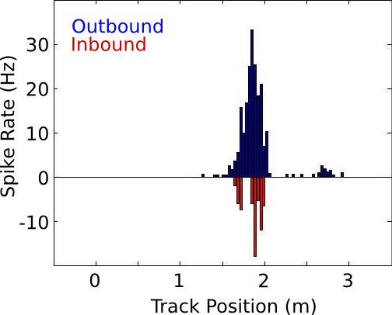
Place cell ensemble recordings
Freely moving hippocampal physiology

Slide 3
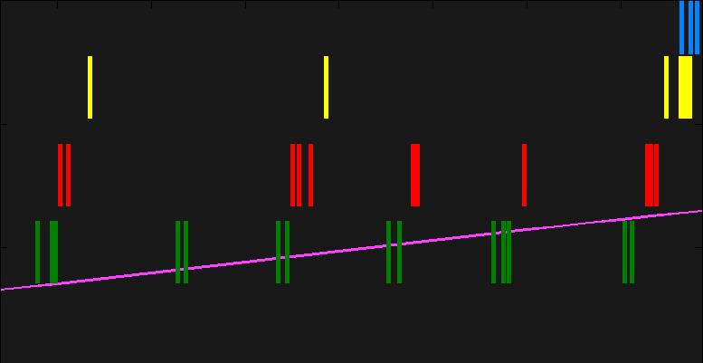
Place cell ensemble recordings
Explore population coding
Cell 4
Cell 3
Cell 2
Cell 1
Rat Position
100 ms
Time

Slide 4
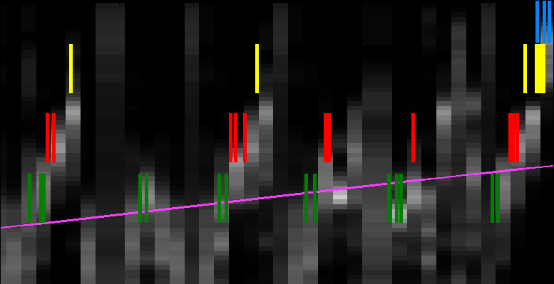
Place cell ensemble recordings
Explore population coding
Cell 4
Cell 3
Cell 2
Cell 1
Rat Position
100 ms
100 ms
Time
Position reconstruction / Bayesian stimulus decoding

Slide 5
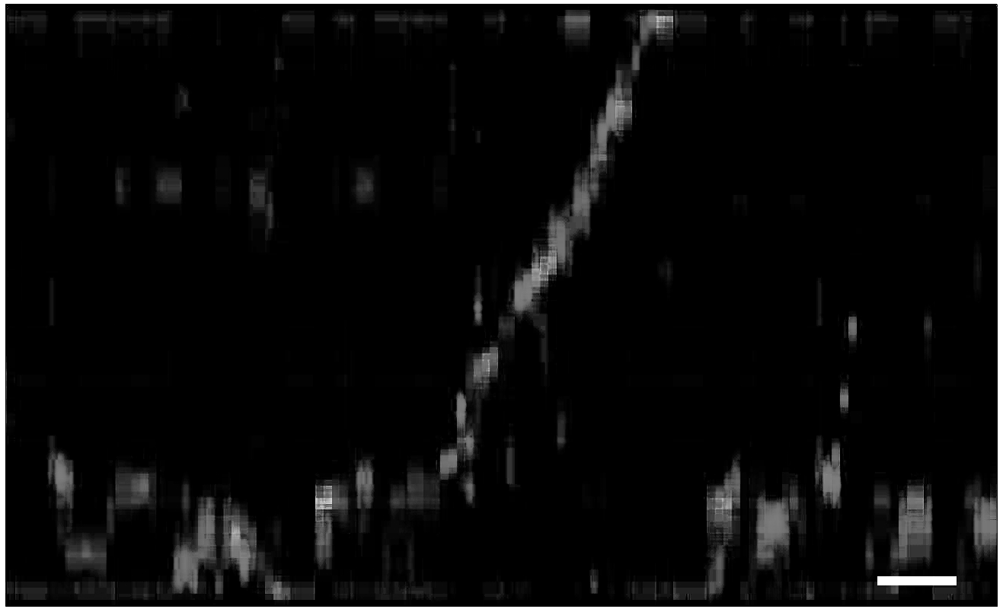
Place cell ensemble recordings
Study sequence replay during reward-consumption
3
Encoded Position (m)
2
1
Rat Position
0
100ms
Time

Slide 6
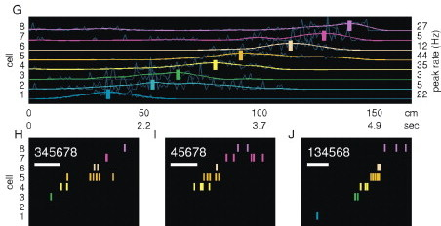
Place cell ensemble recordings
Study sequence replay during sleep
50ms

Slide 7
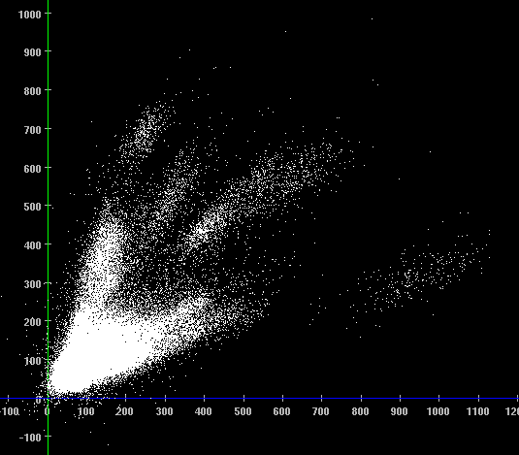
Place cell ensemble recordings
Needed for studying place coding and sequence replay:
  Lots of neurons
  Stability
Tetrodes
Real-time plots

Slide 8
Place cell ensemble recordings
Moving forward:
  Cortico-hippocampal interactions
  Functional studies

Slide 9
Place cell ensemble recordings
Moving forward, what we'll need:
  Cortico-hippocampal interactions → more tetrodes
  Functional studies → we'll see later

Slide 10
Place cell ensemble recordings
Moving forward, what we'll need:
  Cortico-hippocampal interactions → more tetrodes
  Functional studies → we'll see later
We need a new recording rig

Slide 11
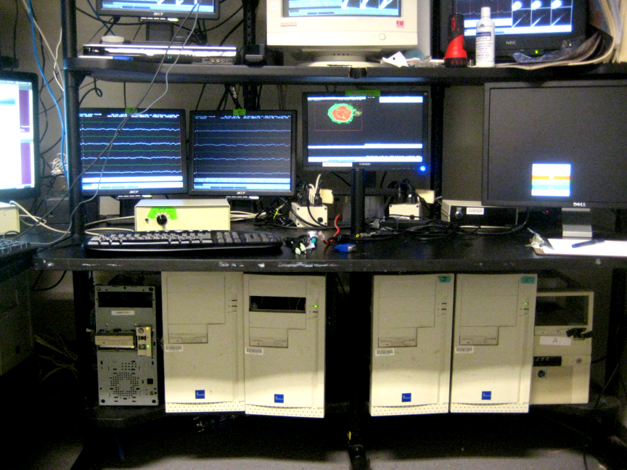
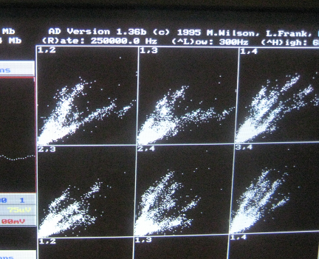
AD
Modern tetrode ephys system
  Record spikes, LFP, position in parallel
  Real-time spike and LFP display
  Fault-tolerant
  Flexible differential recording
Trapped in old man's body
  Relies on DOS, Pentium, < 2Gb disks
  2 tetrodes / computer

Slide 12
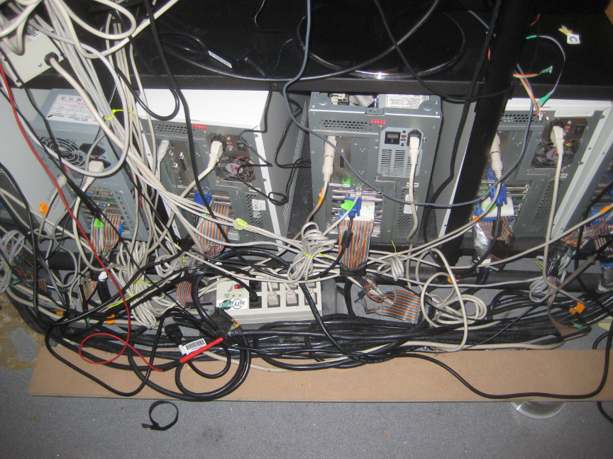
AD
Modern tetrode ephys system
  Record tetrodes, LFP, position in parallel
  Real-time spike and LFP display
  Fault-tolerant
  Flexible differential recording
Trapped in old man's body
  Relies on DOS, Pentium, < 2Gb disks
  Analog position tracking
  Analog neuralynx amps
  2 tetrodes / computer
Why not buy commercial replacement?
  Too closed-down, no control
“Perpetual triple-bypass”

Slide 13
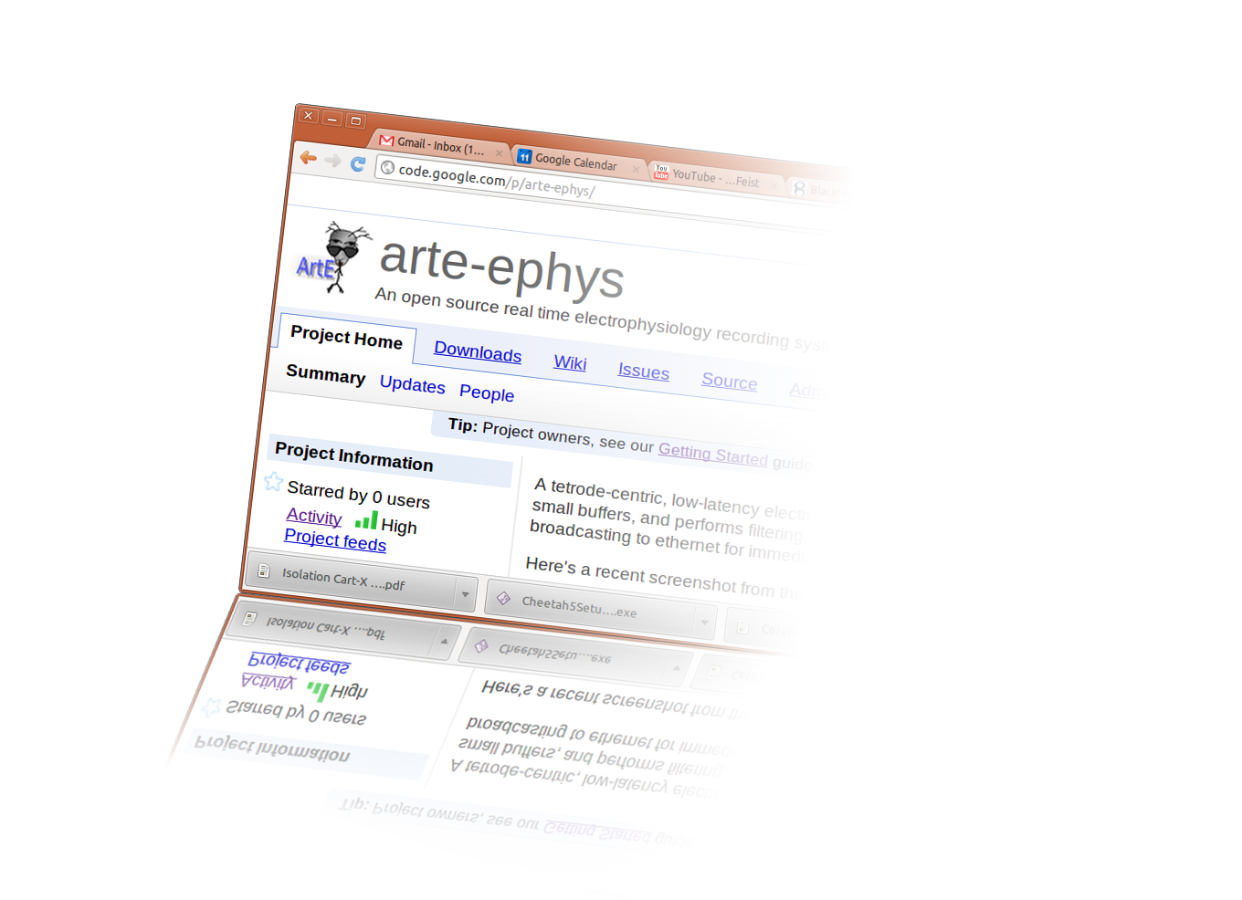
ArtE - our 'modernized AD' proposal
National Instruments Daq cards:
  32 channels (8 tetrodes) per card, 2 cards per computer
  4 computers for 64 tetrodes
Headless operation
No fancy hardware if possible, do most filtering in software
Fastest possible computers, smallest possible data packets, lowest real-time latency

Slide 14
ArtE - our 'modernized AD' proposal
National Instruments Daq cards:
  32 channels (8 tetrodes) per card, 2 cards per computer
  4 computers for 64 tetrodes
Headless operation
No fancy hardware if possible, do most filtering in software
Fastest possible computers, smallest possible data packets, lowest real-time latency

Slide 15
The streaming problem
Handling infinite data in fixed amount of memory
Digital filtering: history-dependent, multiple passes
Filtering a stream with batches of data: more tricky, hard to carry recent history & multiple passes over the 'gap'
Collecting data in big batches makes gaps rare – just ignore them, but
Big batches → big delay before data is available
Small batches → have to treat the gaps right

Slide 16
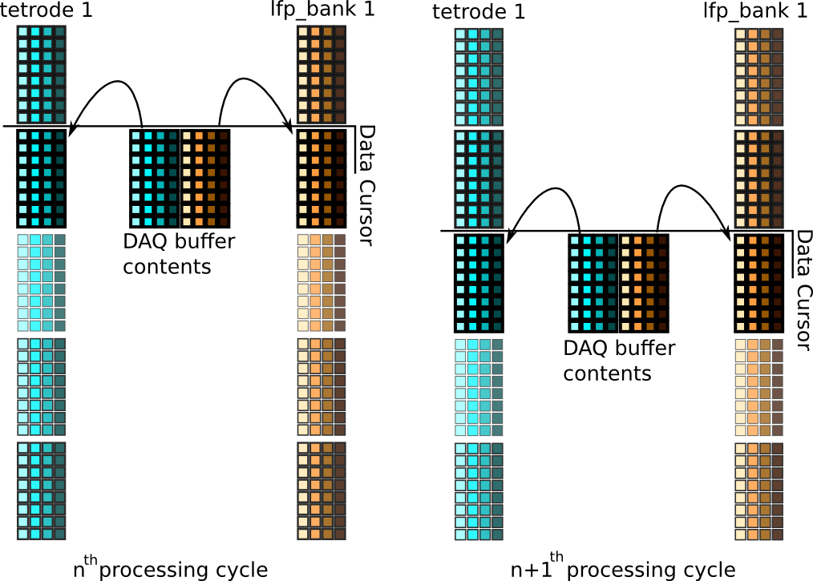
Filtering in a stream:
...
...
Copy to stream, filter to tip...
Copy to stream, filter to tip...

Slide 17
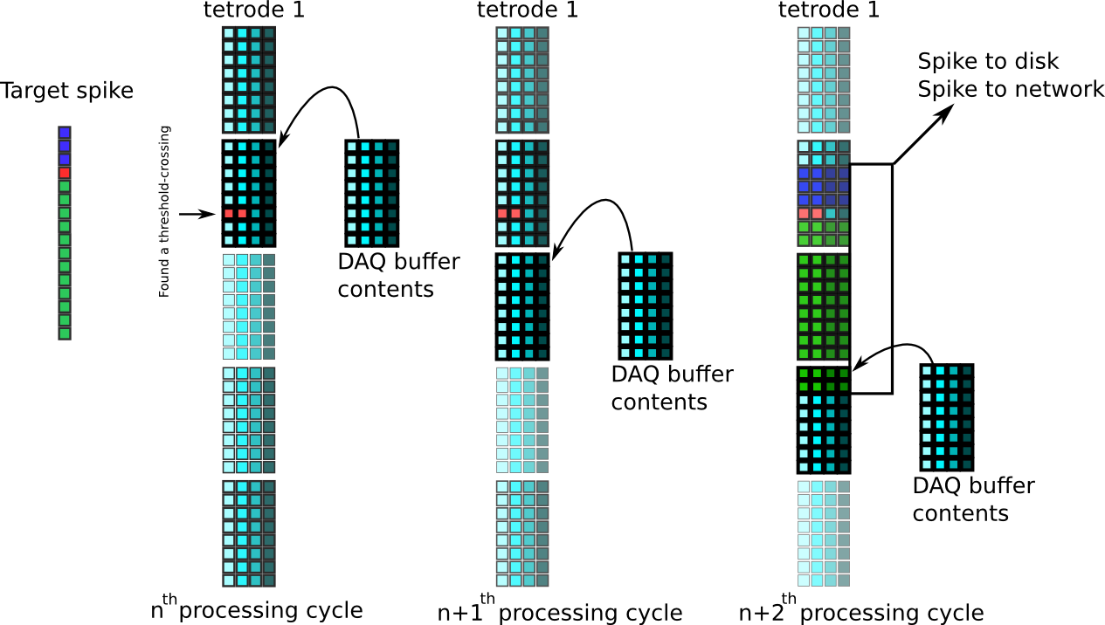
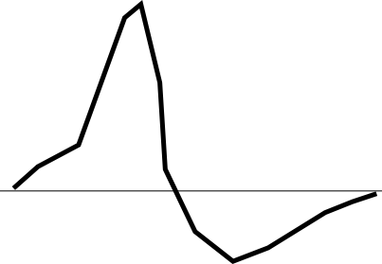
Sifting spikes from the stream

Slide 18
Several months later...
… after intense hacking on lots of ugly scientist-code...
(but with very elegant code contributions from Stuart Layton and Josh Siegle)
… ArtE begins producing reasonable-looking data.

Slide 19
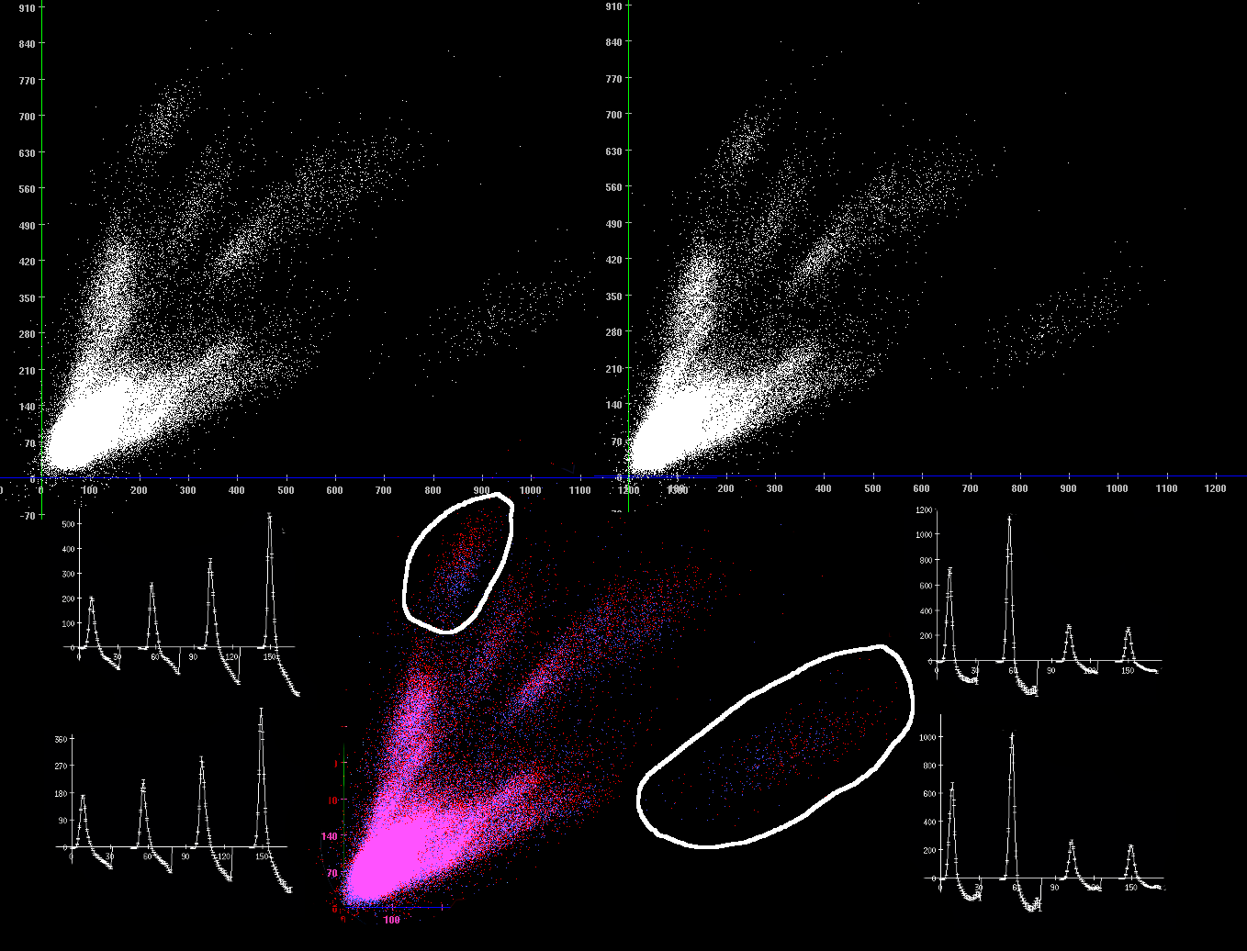
System Check: AD ↔ ArtE Comparison
AD
300-6000Hz
(hardware)
ArtE
300-6000Hz
(software)
Overlay
AD
ArtE

Slide 20
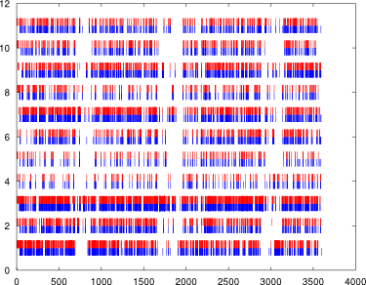
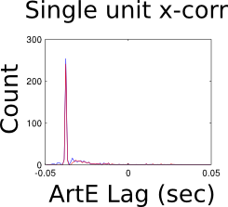
Timing check
Single unit rasters
Arte
AD
Unit #
Time (s)
An old timing bug – fixed by now
Another known bug – ArtE detects 90-95% of spikes seen by AD, not yet solved.

Slide 21
Future real-time goals
Position reconstruction
  In a T maze, reward rat for replaying left maze arm
  Can replay support opperant conditioning??
  If so, overdrive replay of the left maze arm
  What effect does this have on behavior? On place cells? On replay of the right arm?
Mixing ensemble coding questions w/ experimental intervention → function studies for replay

Slide 22
Solving the streaming problem for:
Position tracking
Place fields
Position reconstruction
Major technical challenges
  How to represent a track?
  How to represent place fields / comupte them fast
  Tons of concurrency → c/c++ hell

Slide 23
Getting into unfamiliar territory
Streaming confusion
  → Read a lot about “design patterns” for c++
    → Steve Yegge blogs, software advice and history
      → Ocaml, functional programming
        → Haskell
Switched from c/c++ to Haskell
Allowed me to think clearer thoughts about the program & solve trickier problems

Slide 24
A brief Haskell detour
How different are different programming languages?
  [] vs. {} vs. ()
  Semicolon or no semicolon
  Stops working once per licenese cycle or not...
Haskell is different
  No for-loops
  `a = a + 1` <- impossible. Variables never change

Slide 25
Why Haskell is different
An experiment in language design
Experiment was a success – giving up changing variables = gaining interesting features
  Never-changing values allow functions to be fixed relationships that you can manipulate, generate proofs on, like in math
  Large classes of bugs eliminated
  Awesome syntax for creating and applying functions (demo)

Slide 26
Run-length encoding problem
MATLAB
  34 Lines
  Ran 20 times to debug
  Split between two files
  Poor output format
  Hard to understand flow
  Felt gross to write
Haskell
  13 lines
  1 run to debug
  Output format mirrors meaning of the data
  Fun to write

Slide 27
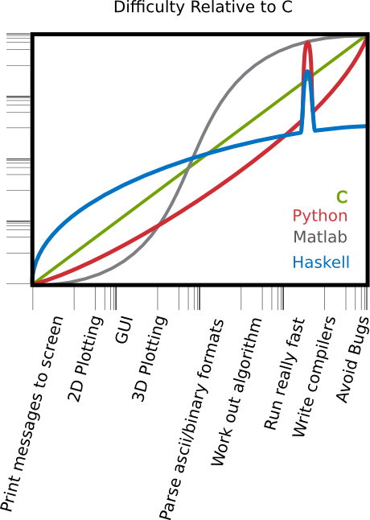

Slide 28
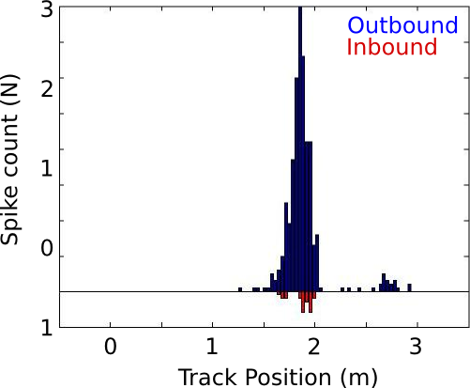
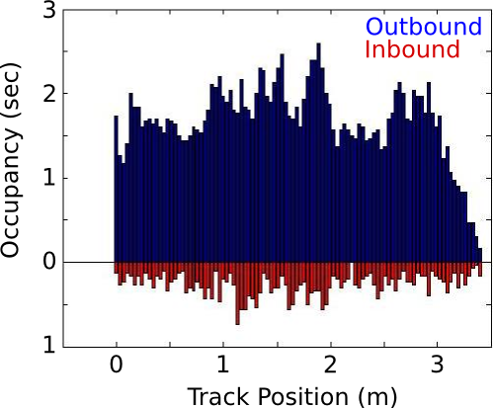
Place fields
Post-processing:
  Count spikes / count occupancy, in each bin
Real-time
  Update 'sufficient statistics' each event (new spike or position)

Slide 29

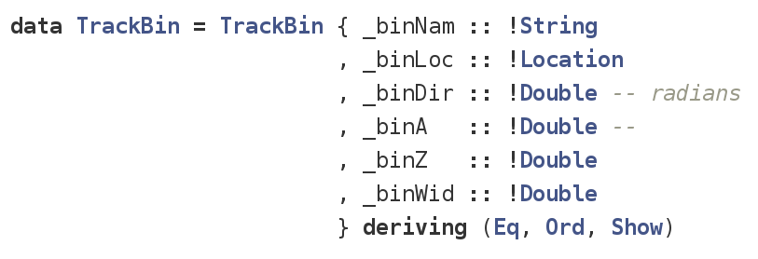
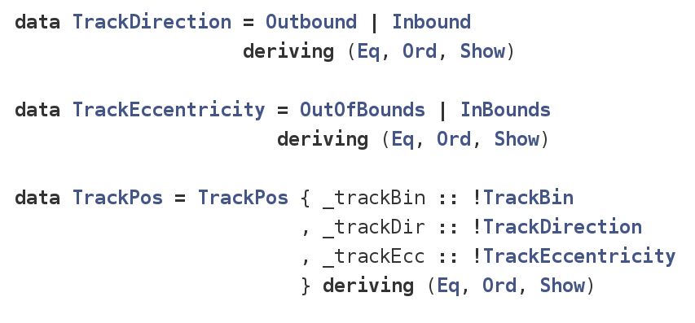
Place fields
Track: a list of physical bins
TrackBin: a small piece of track,
Its location and size, and the direction to call 'outbound'
TrackPos: An animal's relation to a track. Which bin is closest? Is the rat heading inbound or outbound? Feet & hands inside the car, or leaning over edge?
Field: Any variable that can take a different value for different TrackPos, like a place field, or occupancy map

Slide 30
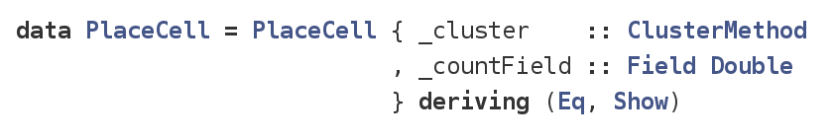
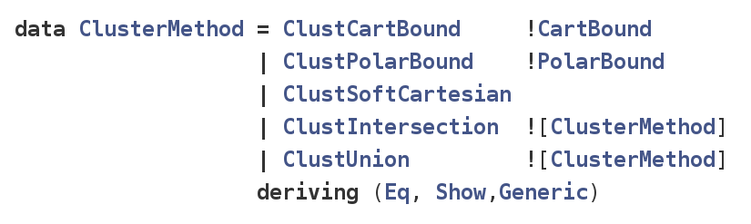
Place fields
Place cell: a way of sorting spikes, and running history of spike counts at different TrackPos's
ClusterMethod: A set of instructions for spike-sorting one cell from a tetrode

Slide 31
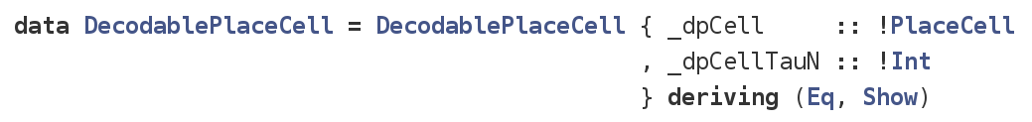
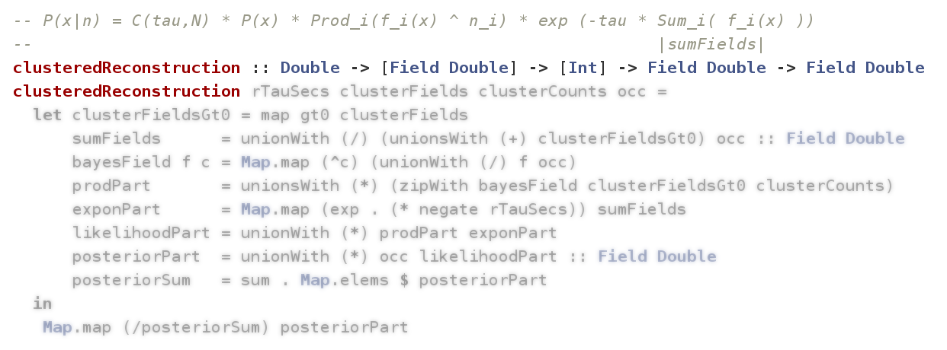
Position decoding
DecodablePlaceCell: A place cell along with its recent history – the number of spikes fired in the last 20ms. (demo)

Slide 32
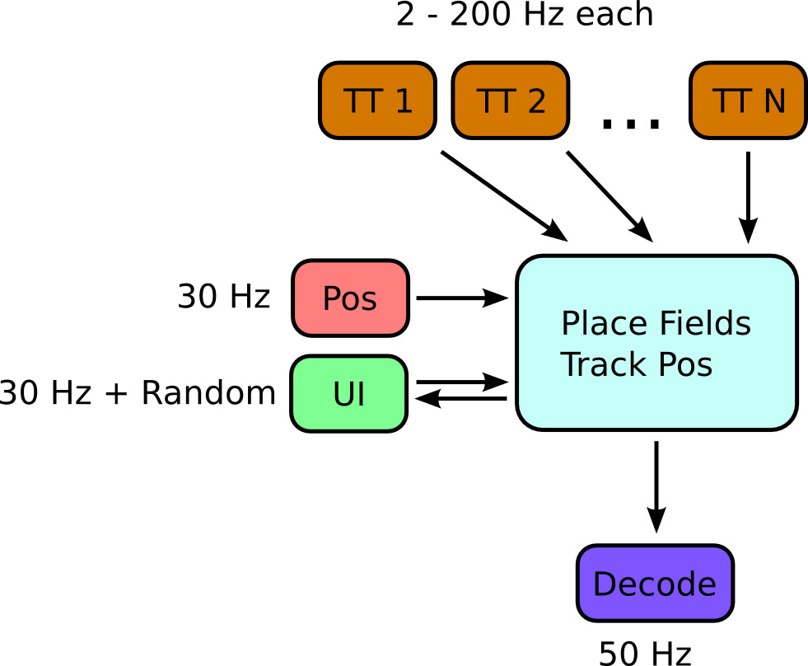
Position decoding

Slide 33
Real-time demo
Spikes read from disk, presented to ArtE in real time as though they were coming from the network
Raw (x,y) position data read from disk
Clusters bounds drawn post-hoc on this data read in and used
ArtE is
  Turning raw position data into TrackPos and heading
  Spike-sorting
  Tracking place fields
  Bayesian position decoding at replay timescale

Slide 34
Remaining challenges
Parts of ArtE work. Still need:
  User interface for defining cluster boundaraies mid-experiment
  Improvements in data → network
  ArtE camera control
  Debuged & improved c/c++ backend
  Recording hardware

Slide 35
Conclusion
Feature parity in sight, possible to go well beyond commercial systems and enable new experiments without an EECS degree
Haskell is a huge win for productivity

Slide 36
Acknowledgements
Stuart Layton
Josh Siegle
Fabian Kloosterman
Hector Penagos
Matt Wilson
See the code (and help out!) at
  github.com/ImAlsoGreg/haskell-tetrode-ephys
Get in touch! imalsogreg@gmail.com

Slide 37
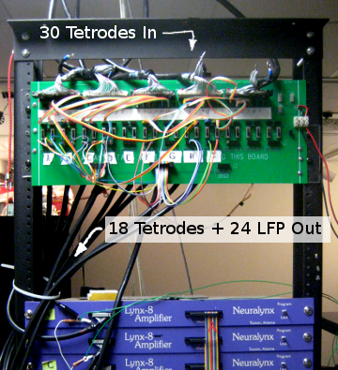
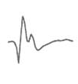
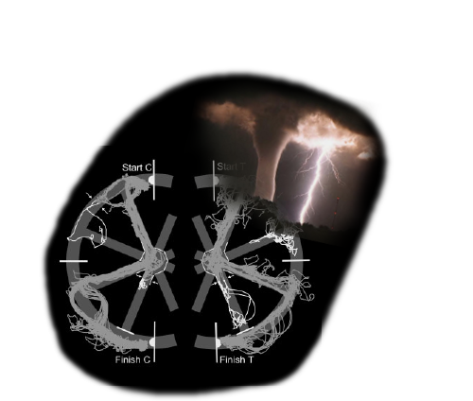
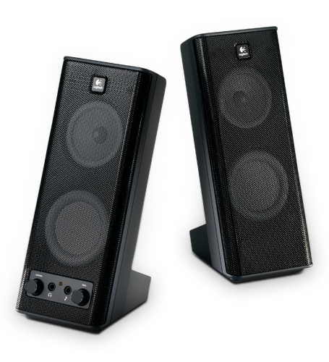

What features do we want from a setup?
Recording capacity
  More tetrodes
  Longer sessions
Recording flexibility
  Customizable waveform lengths
  Customizable visualization
Experimental control & synchronization
Closed-loop configurations
  Online readout of position
  Online readout of spikes
  Online analysis
    Realtime LFP features for triggered events
    Realtime position decoding, using clusterless, etc
Fungible hardware
Reliability & testing

Slide 38
Strategy and Goals for an AD Replacement
Replace by 'snatch method'
Run alongside AD, one variable change at a time
Compatible with our old amplifierss, but not reliant on them
Stay modular
  Expect to run headless on multiple computers
  Expect data to be shared over a network
Keep real-time in mind
  Small processing chunks
  Streaming?

Slide 39
Haskell is different
Normal program (c,python,java,matlab, ...not lisp):
  Function: series of actions to do, grouped together and named
  Functions do things according to their arguments; they often do things to their arguments.
  Program: series of actions to take: often tortuous
Haskell program
  Function: a mapping between sets
  Functions don't do things, they are things: they are relationships between sets
  Program: Set of facts that are all always true. There is no timeline.

Slide 40
Systems on the market
Pros
  Big channel counts
  Often come with multiplexing headstages
  Promise to customize
  Some serve spike & LFP data through network & offer an API for handling it
Cons
  Inflexible hardware referencing
  Software built on top of LabView
  Closed source
  Tetrode mode clunky or absent
  Slow, opaque development
  $$
Tucker-Davis
Blackrock
Ripple
Neuralynx
Pros
  Inherently tetrode-based
  (New?) API seems powerful
  Solid-state patch-box, nice reference flexibility
Cons
  Some software inflexibility
  Cheetah is buggy & counterintuitive
  Closed source
  $$

Slide 41
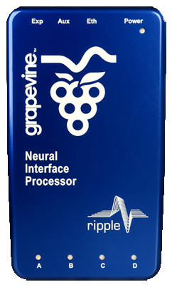
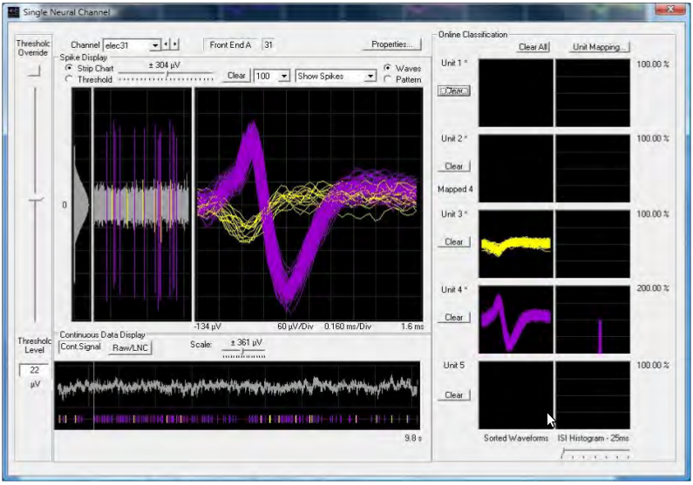
Systems on the market
Ripple's Grapevine
Electrical interface,
computer, and DSPs
In a small box.
Blackrock's 'Cerebrus' Software
Closed source, build on LabView
Data and configuration competing for
very limited space

Slide 42
Feasibility of building our own system
Cons
  Programming/maintaining software – time consuming
  No community support
  Slow development – may lag behind out-of-the-box options in terms of features
Pros
  We have the source code
  Understanding the software limitations, sources of artifacts, etc
  $$
  Features limited only by our technical competence
  Track-record
  Bragging rights

Slide 43
System development goals
Replicate AD on modern hardware, OS
  Use parts that can still be bought if they break
  Record more tetrodes
Add flexibility to the rig
  Longer waveforms, recording sessions
  Tetrode, stereotrode, n-trode
  Flexible visualization
Simplify front-end hardware & miniaturize the computer situation
  Filter in software, no programmable amplifiers
  Reduce the number of computers, cables
Close the loop
  Put data on the network, analyze it in real-time and use it in the experiment
    Online clusterless position decoding
    Online rat tracking
    Online ripple detection, theta phase detection; for triggering on those things
    Online replay decoding; trigger on that

Slide 44
Rationale for starting from scratch
AD philosophy
  Commodity parts
  Independent parallel processing
  UI geared toward the experiment (no unnecessary embellishment or customizability)
Room for improvement
  Low channel-count A/D cards → many computers
  Computation speed limits online processing
  Reliance on analog filtering

Slide 45
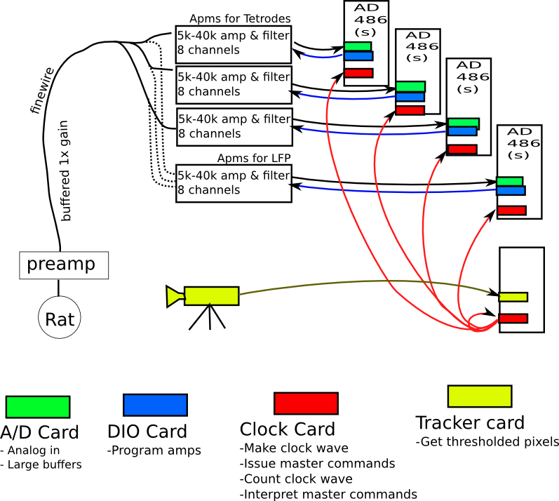
AD Overview
AD
486
(M)

Slide 46
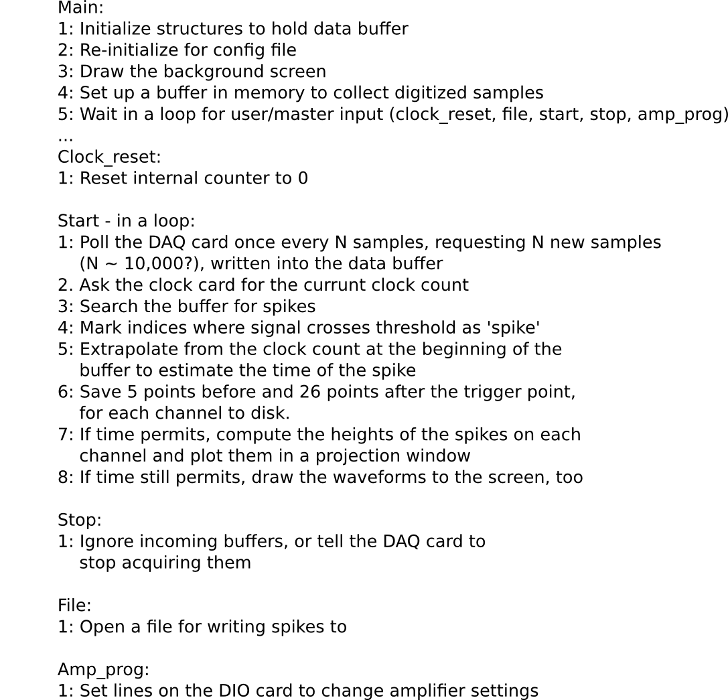
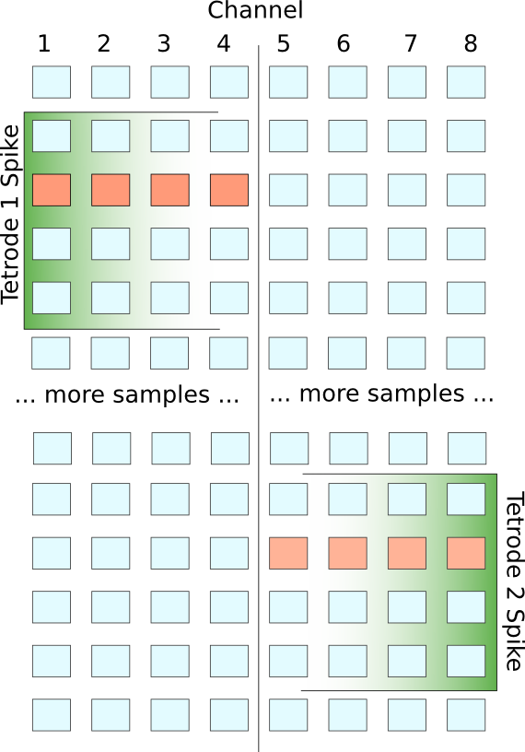
AD Overview

Slide 47
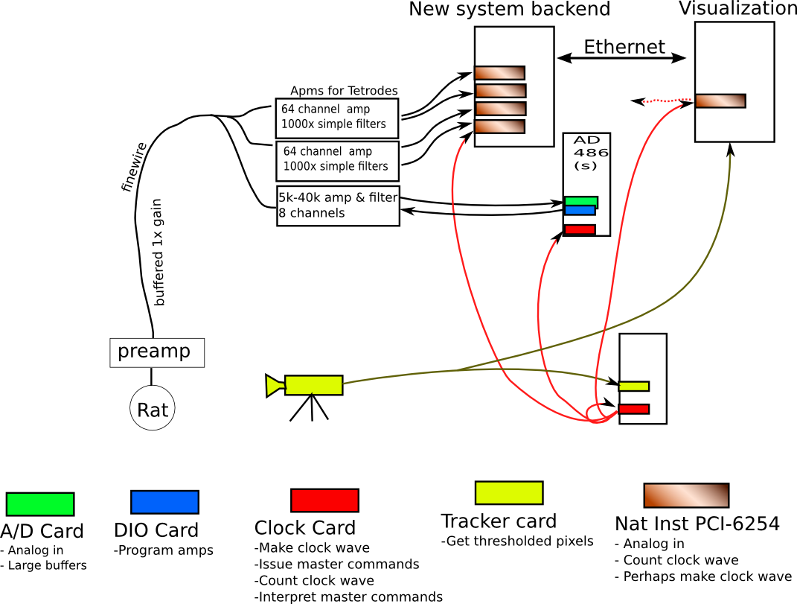
Proposed hybrid new+AD system
Main features:
  Simplified amps, not programmable
  Fewer computers
  Ethernet for live broadcasting of data
  New A/D cards
    More analog channels
    PCI interface
    c API & Linux drivers
  Split some signals to old AD computer and amp for signal & timing comparison
AD takes care of generating clock signal
AD takes care of animal tracking
AD
486
(M)

Slide 48
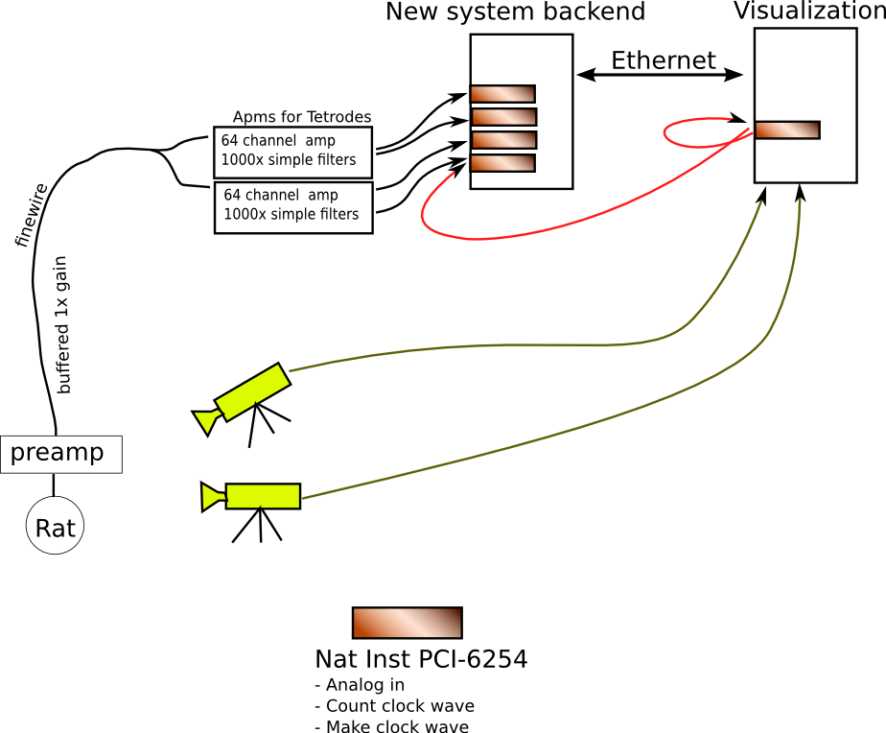
Proposed new standalone system
Main features:
  Simplified amps, not programmable
  Fewer computers
  Ethernet for live broadcasting of data
  New A/D cards
    More analog channels
    PCI interface
    c API & Linux drivers
  Animal tracking using new libraries, perhaps replace flickering LEDs with continuously powered ones
    Multi-camera
    Tracking safety by redundant samples
    3d possibilities

Slide 49
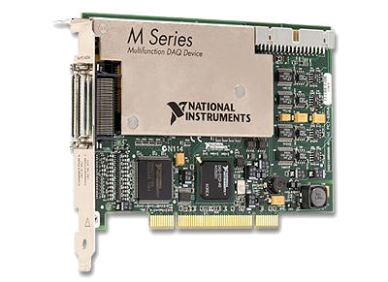
Feasibility of building our own system
32 analog inputs lines (32 samps/ms)
A digital edge counter (for clock signals)
48 digital IO lines (for experiment control)
National Instruments PCI-6254
PCI Interface
NiDAQmx Driver has nice c API

Slide 50
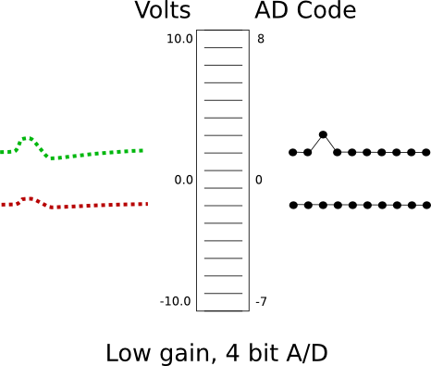
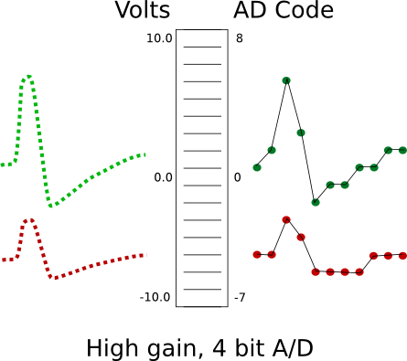
Can we dispense with programmable amps?
A/D sample bit width determines how finely the input voltage range is sampled
4 bits → 2⁴ levels → AD resolution = 20V/2⁴ = 1.25V
With 1000x gain, 10mV input is mapped to 10V output
Signal resolution is input resolution / gain: 1.25mV

Slide 51
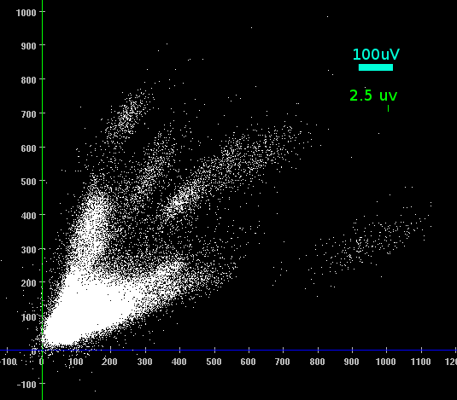
Can we dispense with programmable amps?
PCI-6254 card has 16 bit resolution and a +/- 10V input range
Resolution at DAQ card inputs: 20V / 2¹⁶ = 300uV
Resolution after 1000x gain: 0.3uV
Dynamic range after 1000x gain: 10mV
What is the required resolution?
CA1 example:
Here 1 pixel = 2.5uV

Slide 52
Can we dispense with programmable amps?
PCI-6254 card has 16 bit resolution and a +/- 10V input range
Resolution at DAQ card inputs: 20V / 2¹⁶ = 300uV
Resolution after 100x gain: 3uV
Dynamic range after 100x gain: +/- 100mV
Replace by table,
What is the required resolution?
CA1 example:
Here 1 pixel = 2.5uV

Slide 53
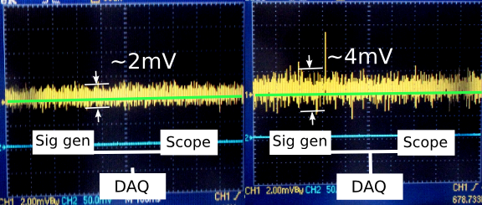
Can we dispense with programmable amps?
Due to ground loops, DAQ card noise floor is ~4mV (equivalent to 4uV of noise on top of spikes at 1000x gain)(2mV out of the 10 volt range)
Reaching for higher acquisition resolution → more accurately digitizing the noise floor,
Probably not much improvement on spike digitization
Increasing SNR above the DAQ input noise floor means increasing the amp gain & reducing the dynamic range

Slide 54
Can we dispense with programmable amps?
Serious caveat: Is (signal + noise) still limited to 10mV (10V after 1000x amp) in freely moving rat when filters are open?
Still need to do that test.

Slide 55
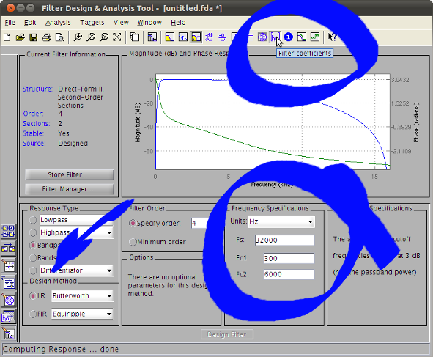
Fixed-gain amps – what about filtering?
Need at least anti-aliasing filter to be analog
Neuralynx docs specify frequency response of their analog filters
Matlab can provide parameters for creating a matching discrete-time IIR filter
We can use those parameters in our c code
Since filtering is done in software, don't need separate amps or DAQs for spikes & LFP
Filtering fast enough using the CPU possible in principle; spike-finding is done already. At this point, we're confident enough to experiment with code-writing.

Slide 56
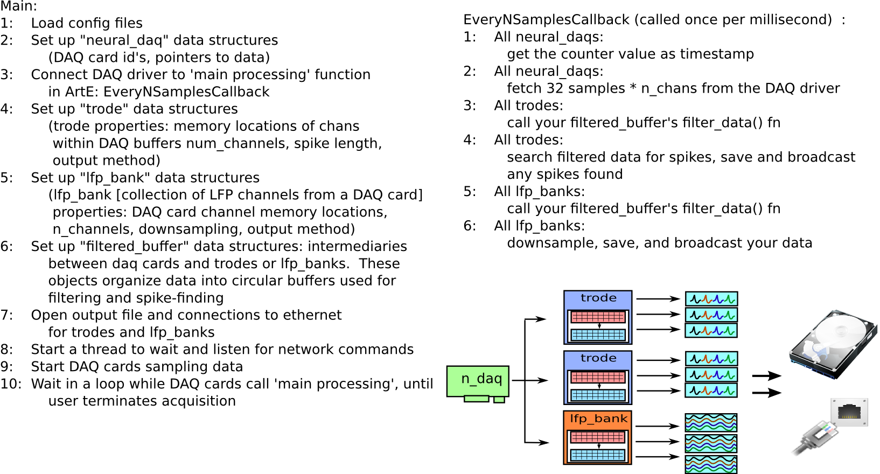
Rough sketch of program logic

Slide 57
Finding spikes

Slide 58
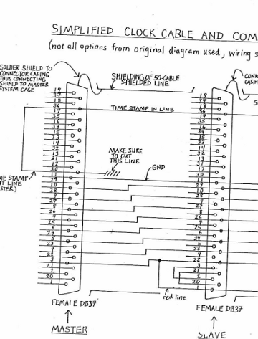
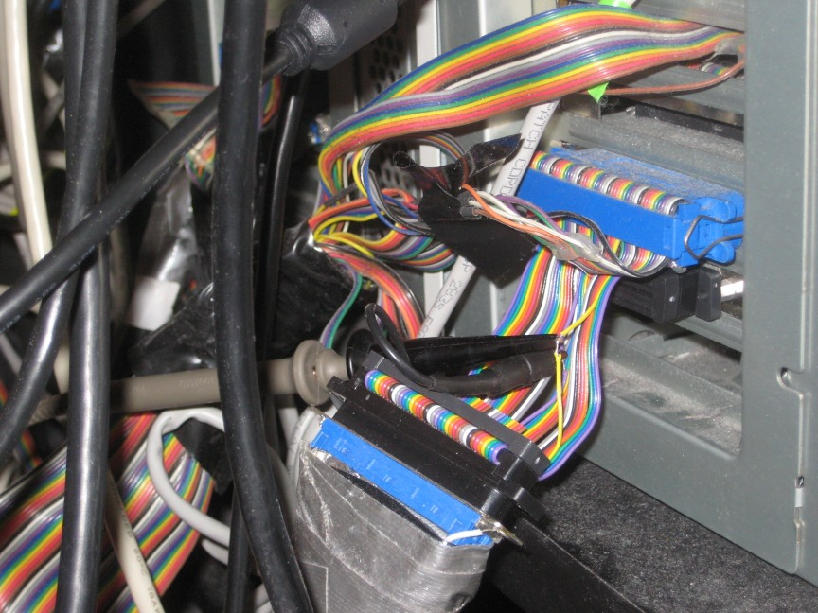
Integrating with AD

Slide 59
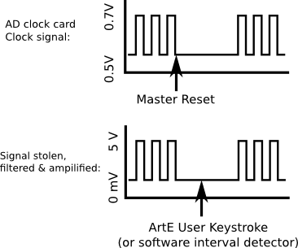
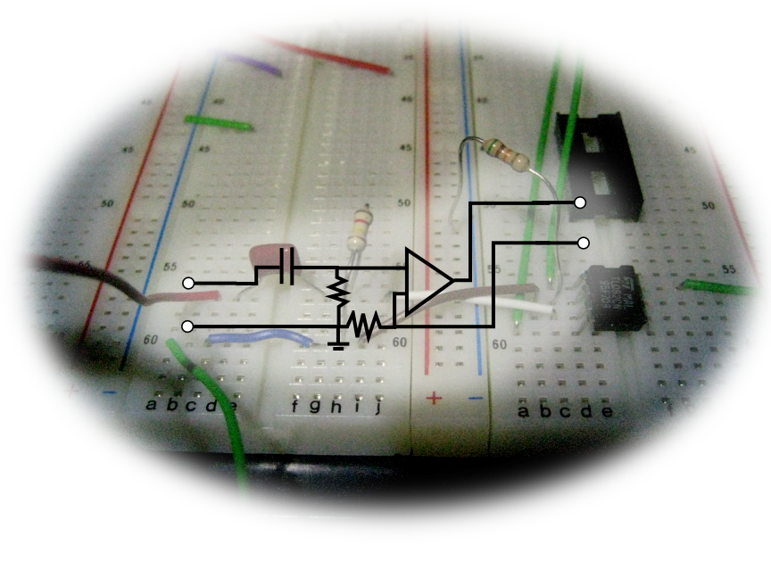
Integrating with AD

Slide 60
Current code situation
All major pieces are in place for the back-end; though some are still ugly, buggy, or missing functionality and sanity checks
  Trode, lfp_bank, filtered_buffer objects & functions all implemented
  Spike packet, LFP packet, network transmission and disk saving are working in a 'rough draft' state
  Some utilities are written for examining packets, visualizing spikes, converting file formats, and sending commands to a running ArtE
Please check out arte-ephys.googlecode.com
  Have a look at the code
  Make suggestions
  What's clear? What needs a re-write? What needs more documentation?
Demo time

Slide 61
Checking data, benchmarks, debugging
All data saved in variable-length buffer format to one file per computer [e.g. ./artedata_comp0.data]
arte_to_mwl takes the place of adextract (still very buggy)
arte_extract takes the place of tauto80
Extracted .tt files can be converted into standard .pxyabw by spikeparms2
the the rest of the checking can be done in xclust and matlab

Slide 62
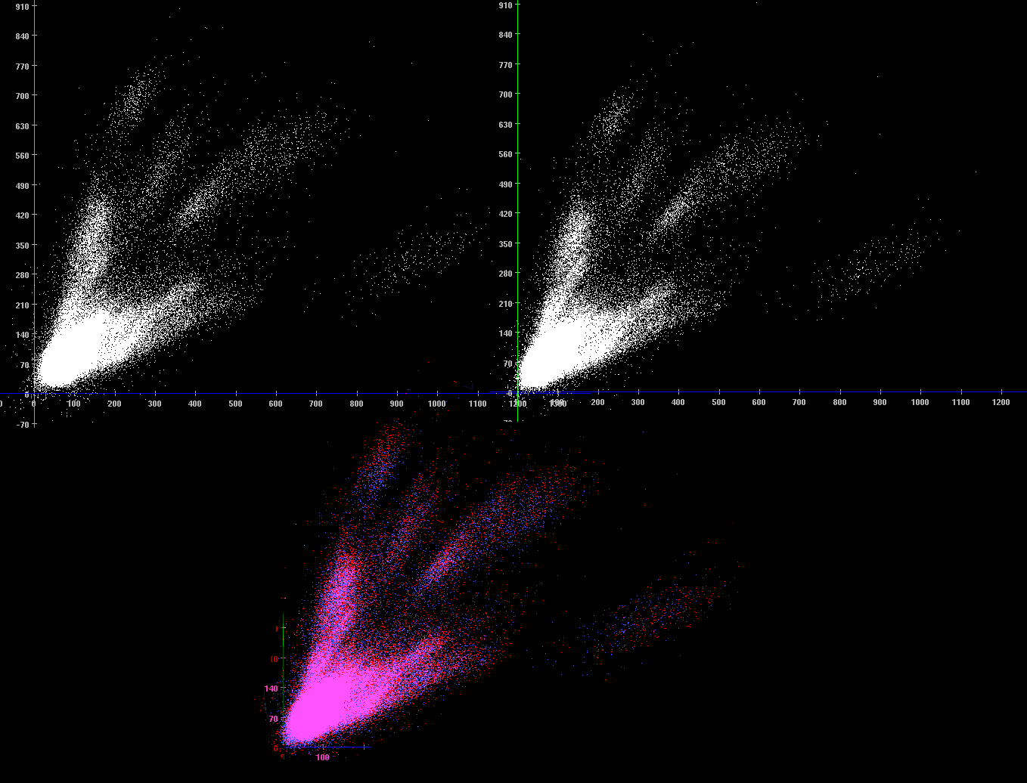
AD
300-6000Hz
(hardware)
ArtE
300-6000Hz
(software)
Overlay
AD
ArtE

Slide 63

Filtering strongly affects waveforms & amplitude
AD
ArtE
AD
300-6000 Hz
(hardware)
ArtE
300-6000 Hz
(hardware + software)
AD
ArtE

Slide 64
The near future
Finish implementing arte disk writing
  Lfp_bank writes buggy
  arte_to_mwl broken for lfp records
Continue debugging timestamps
Implement basic features
  e.g. Save eventstrings
GUI
Documentation
e.t.a. for a thoroughly debugged and benchmarked system with GUI suitable for running simple experiments: 2 months?
e.t.a. for standalone system with Lynx-8 amps at fixed gains: 6 months?
e.t.a. for standalone system with nonprogrammable (cheap) amps: 12 months?
Questions?

