Slide 1
Lab Meeting
July 1, 2013

Slide 2
Haskell
What it is
Why I like it
Why it's safe for us to use

Slide 3
Haskell
What it is – A purely functional programming language
Why I like it
Why it's safe for us to use

Slide 4
Functional Programming
Functions are 'first class citizens'
  Terse syntax for function application: f(a,b,c) => f a b c
  Functions are values: f a b c = λd.g; h (g d) = e
Functions are 'functions' in the math sense
  f a = b Calling a function with the same argument will always return the same result
  No side-effects. Functions don't read from the disk, read from memory, write to the disk, draw on the screen, etc. Just map input values to output values

Slide 5
Functional Consequences
a = a + 1 -> Crash (using algebra, for what value of 'a' would this statement hold?)
No for loops
  for( i = 0; i < n; i++ ){ } ← i = 0 and i++ side-effect
  for n = [1:10]; end; ← n change is a side-effect
Haskell has no variable assignment and no for loops – how can this possibly be good?

Slide 6
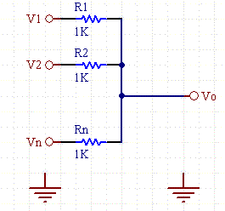

Analogy with the Static Discipline
Analog signal is represented as an analog voltage
Add two analog signals:
  very simple & accurate
Analog signal is approximated by a series of 1's and 0's
Add two digital signals:
  Approximate & tricky
Alternatively:
disallow values other than 0 and 1

Slide 7
Analogy with the Static Discipline
Analog circuits
  Small components
  High precision
  Fast computation
  Small errors compound across modules
Digital Circuits
  'Big' components
  Approximate encoding
  Arbitrary coding scheme
  Error-limited, arbitrarily composable modules
Not allowing ourselves to compute with analog values is costly. But composability is worth any cost. For big systems, Digital computation is the obvious right choice.

Slide 8
Functional Discipline Costs & Benefits
Costs
  Our programming intuition is based on side-effects
  A program with zero side-effects can't actually do anything
Benefits
  Abstraction
  Composability
  Safety
  Provability
  Testing
  Concurrency & Parallelism
  (to be explained soon)

Slide 9
Haskell
What it is
Why I like it
Why it's safe for us to use

Slide 10
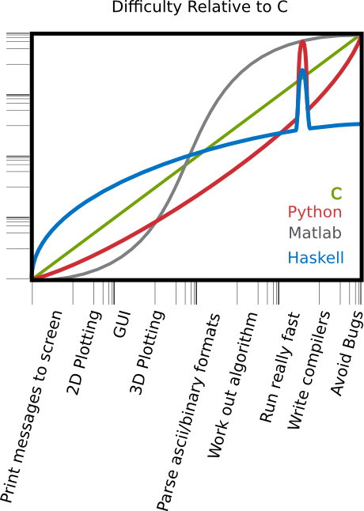
The Haskell learning curve
Difficulty (log scale)

Slide 11
Ripple bursts
How are they organized in time
How closely does MUA follow
How rhythmic are ripples in a burst
Do ripples modulate activity in retrosplenial cortex
Do bursts modulate it differently than ripples alone

Slide 12
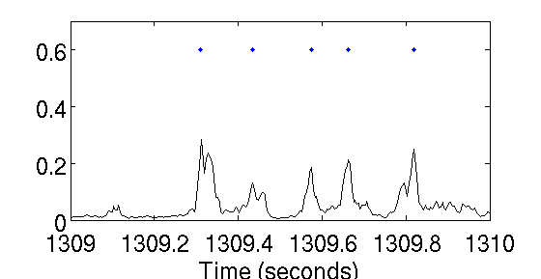
Ripple Bursts
Labeling ripples (LFP)
  Mean envelope > 100 µV
  Cutoff window at 50 µV
  At least 30 mS long
  Split in two if local minimum < 75 µV

Slide 13
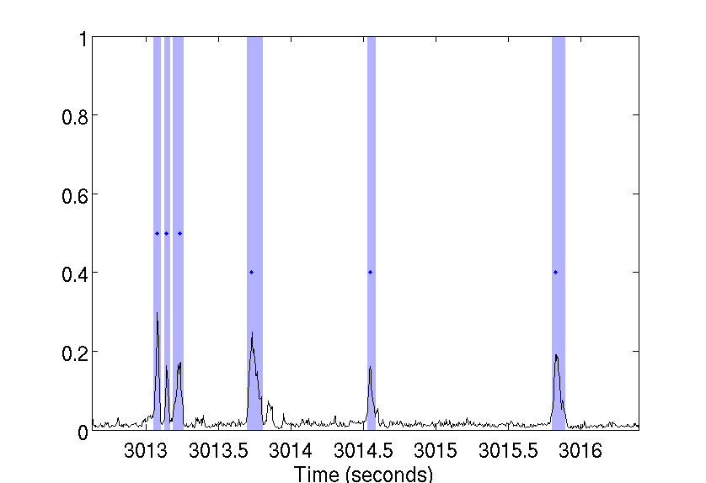
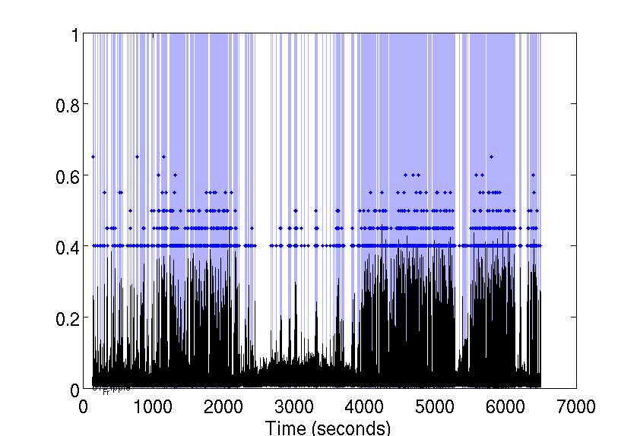
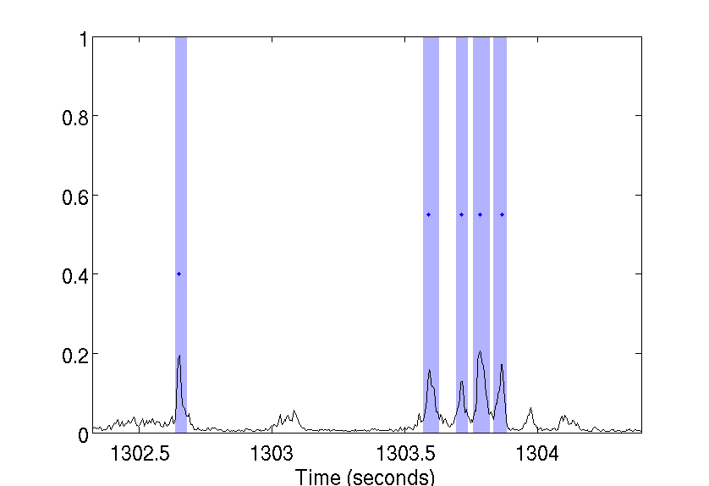
Ripple Bursts
Labeling Ripple Bursts
  Ripples with peaks < 250 mS apart are a ripple burst
Run
(Reward)
SWS
Sleep box
Track
Sleep box

Slide 14
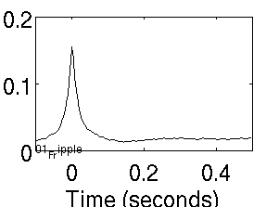
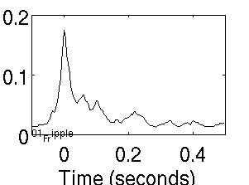
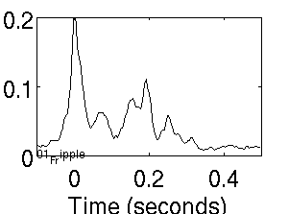
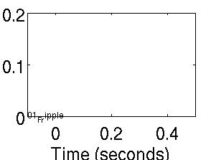
Bursts x-corr ripple LFP envelope
Singles
Doubles
Triples
Quads
Run (Reward)

Slide 15
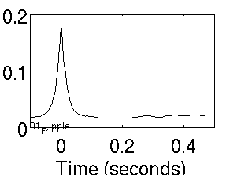
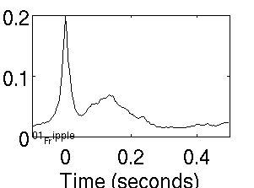
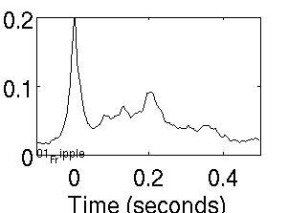
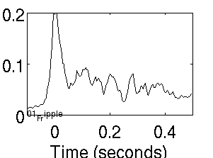
Bursts x-corr ripple LFP envelope
Singles
Doubles
Triples
Quads
SWS (Pre-sleep)

Slide 16
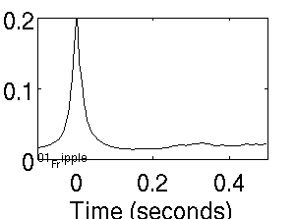

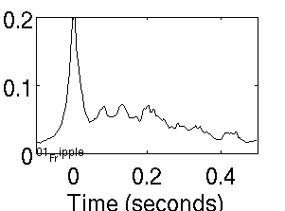
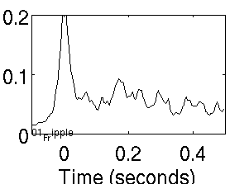
Bursts x-corr ripple LFP envelope
Singles
Doubles
Triples
Quads
SWS (Post-sleep)

Slide 17
Bursts x-corr ripple LFP envelope
Singles
Doubles
Triples
Quads
SWS (Post-sleep)

Slide 18
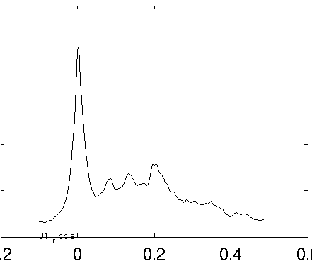
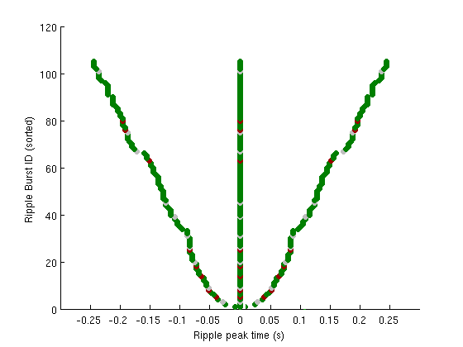
Intra-burst rhythmicity?
Weak rhythmicity =
  Ripples have preferred IRI
Strong rhythmicity =
  Within burst, one IRI predicts the next
(Fake data
For illustration)

Slide 19
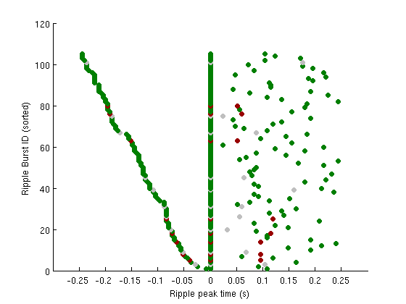
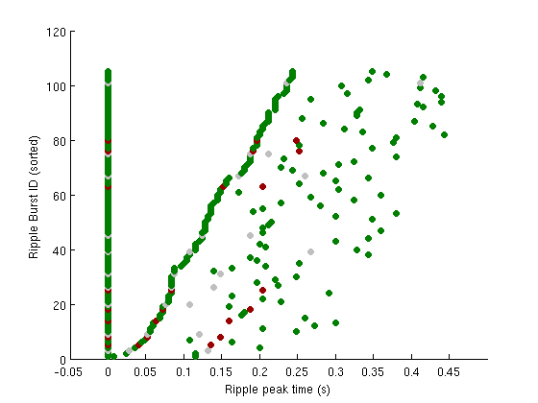
Intra-burst rhythmicity?
Ripple-triggered ripple peak times within three-ripple bursts
Run
SWS
Aligned to middle ripple
Aligned to first ripple

Slide 20
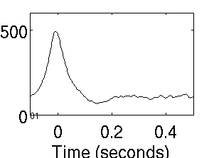
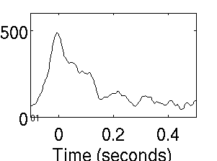
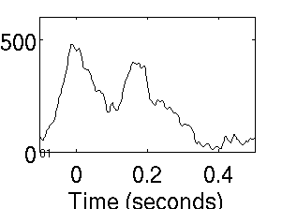
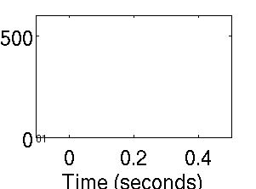
Relation to hippocampal MUA
Singles
Doubles
Triples
Quads
Run (Reward)

Slide 21
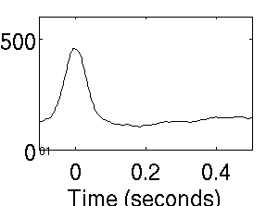
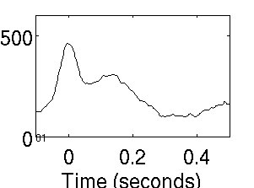
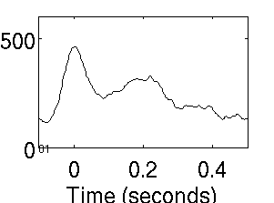
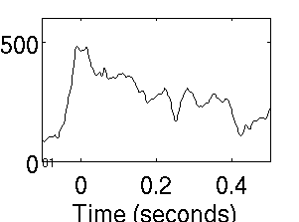
Relation to hippocampal MUA
Singles
Doubles
Triples
Quads
SWS (Pre-sleep)

Slide 22

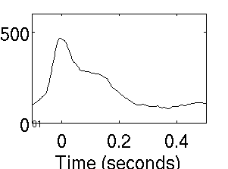
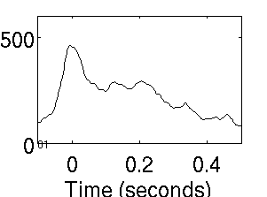
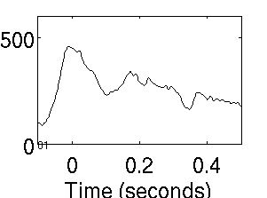
Relation to hippocampal MUA
Singles
Doubles
Triples
Quads
SWS (Post-sleep)

Slide 23
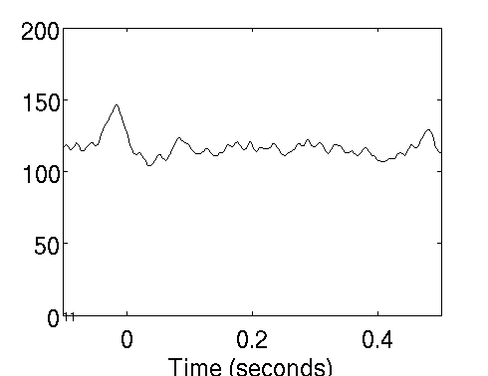
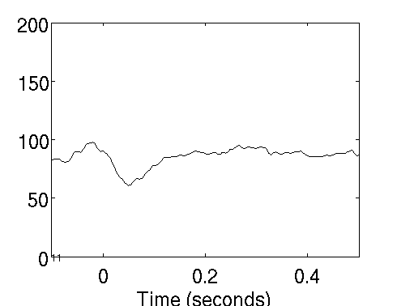
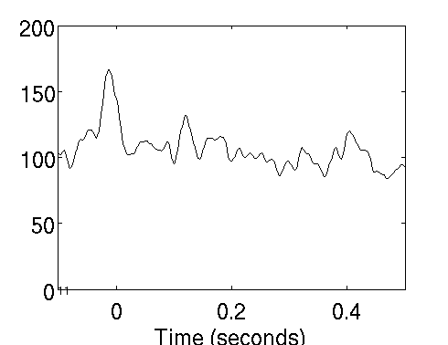
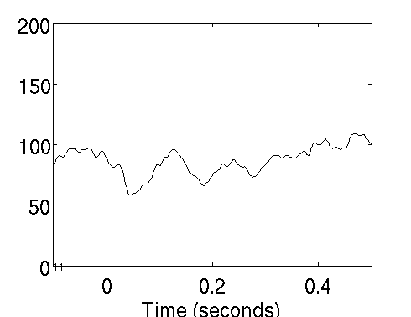
Relation to RSC MUA
Single
Single
Double
Double
Run (Reward)
SWS

Slide 24
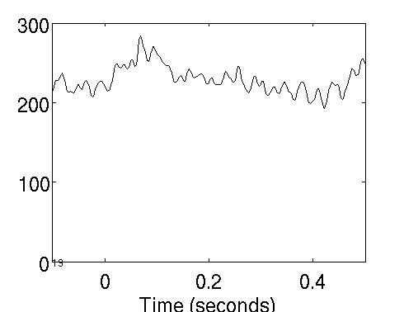
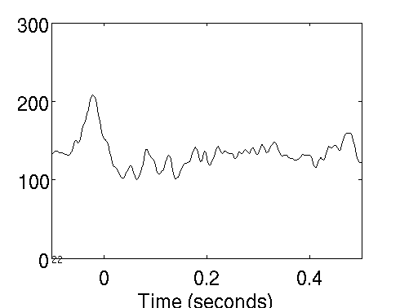
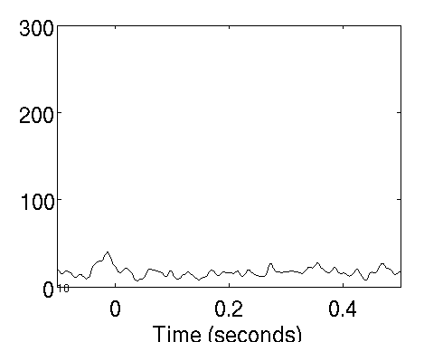
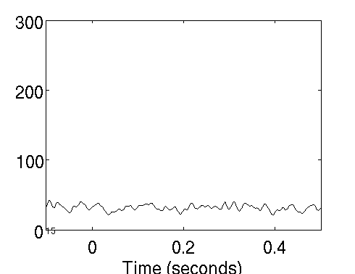
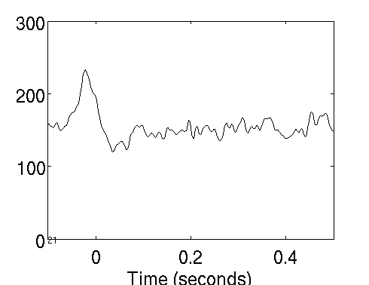
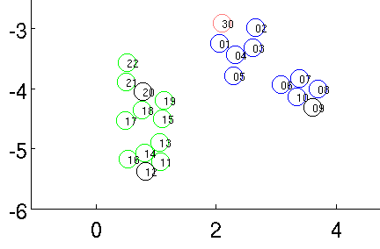
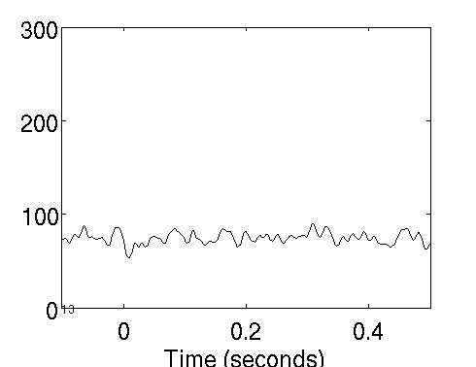
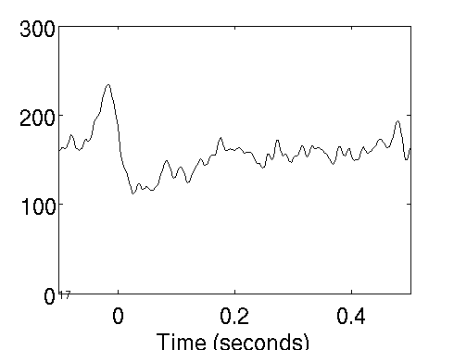
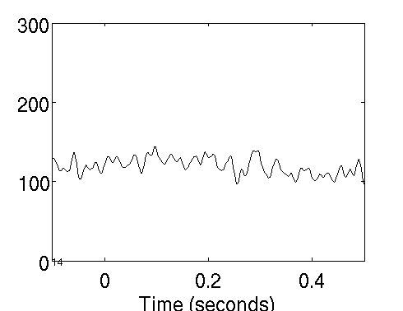
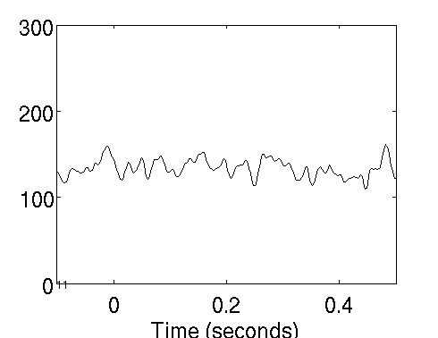
RSC single-ripple-triggered MUA
A/P
(mm)
M/L (mm)
Run (Reward)

Slide 25
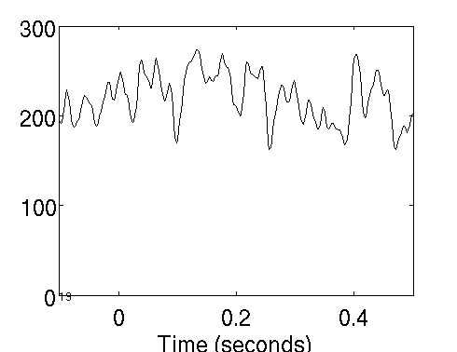
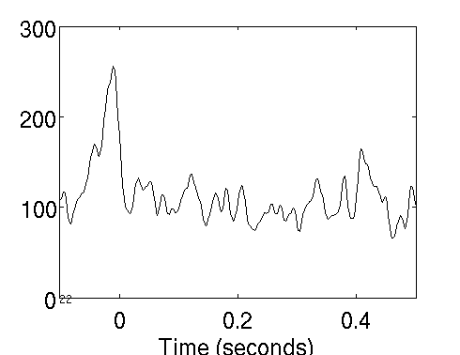
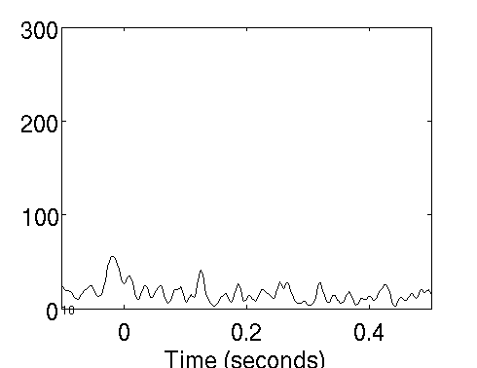
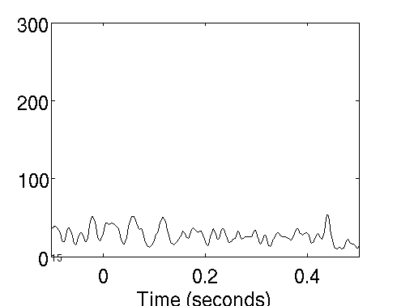





RSC doublet-triggered MUA
A/P
(mm)
M/L (mm)
Run (Reward)

Slide 26









RSC single-ripple-triggered MUA
A/P
(mm)
M/L (mm)
SWS

Slide 27









RSC doublet-triggered MUA
A/P
(mm)
M/L (mm)
SWS

Slide 28
Take-homes
Doublet/triplet labels in EEG don't map very well onto doublets/triplets in MUA
Preferred IRI for MUA in HPC ~100ms
Ripples have a preferred IRI across bursts
  Without extra within-burst rhythmicity
Bursts correlate with MUA peaks in RSC during wake, peak-troughs during sleep
  To different degrees on different RSC tetrodes
  Isolated ripples vs. doublets→modulated response in run, similar response in sleep

