Slide 1

Haskell Tales from the Lab
Greg Hale – Hac NYC - 2014

Slide 2
First
  What we do in the lab
  How Async and STM let us do it in real time
Second
  Pet project: reffit.com

Slide 3
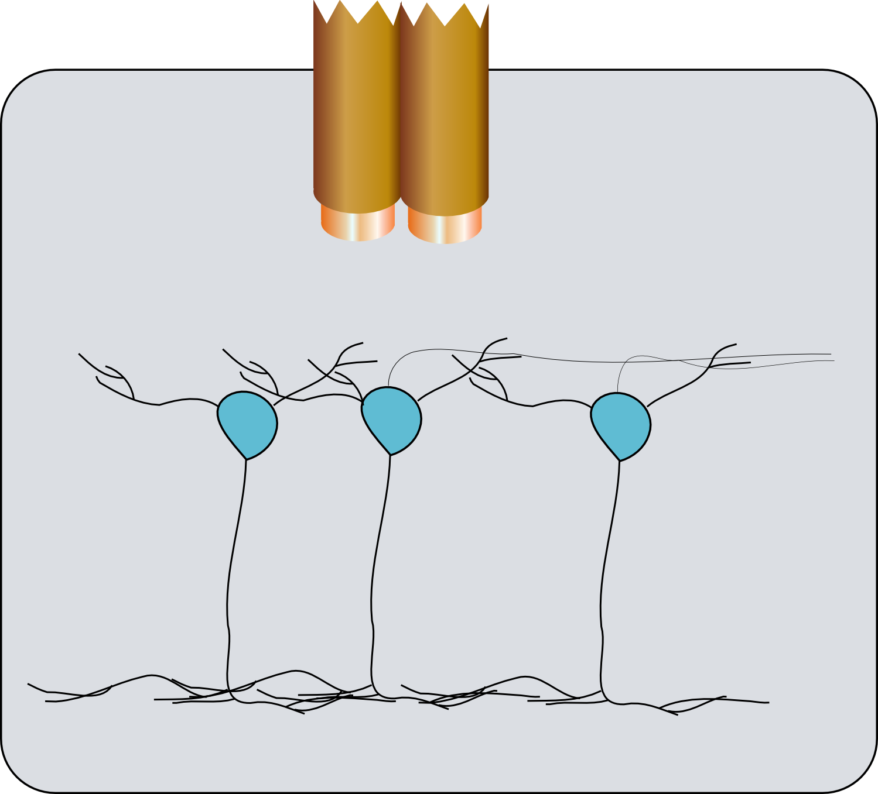

Recording neurons

Slide 4
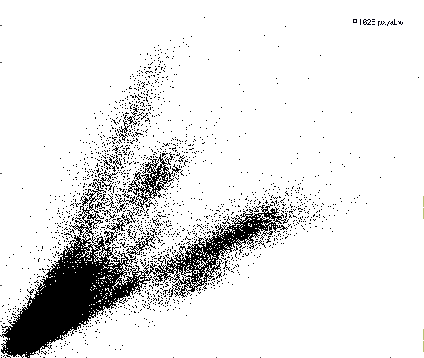
Recording neurons

Slide 5
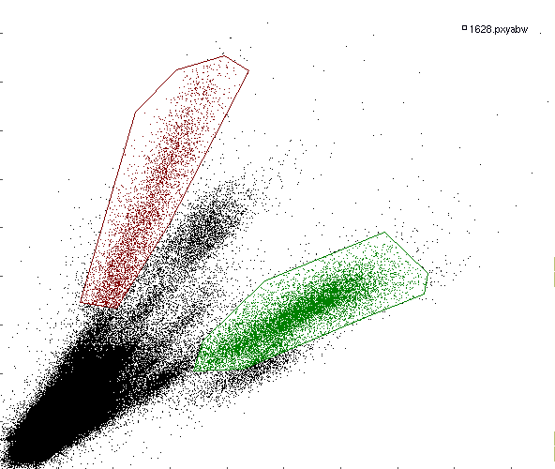
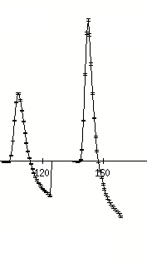
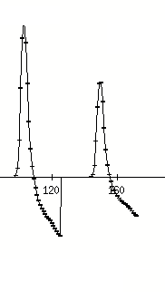
Recording neurons

Slide 6
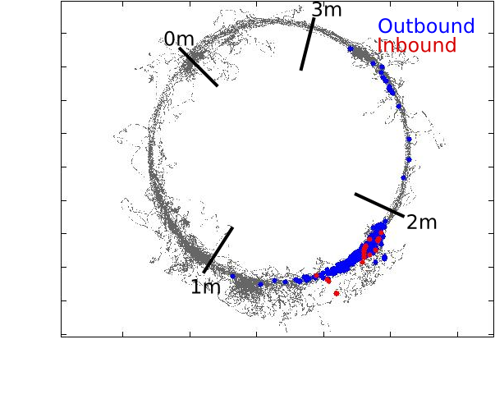
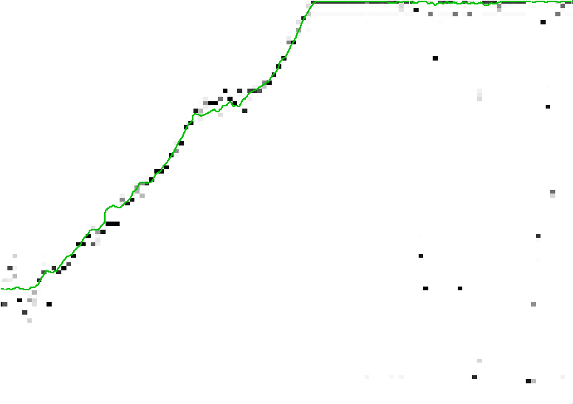
Estimating position
Track Position (m)
2 sec
Time
type PlaceField = map Position SpikeRate
(Spike data from t (0,now - Δ)
P ( Pos | Spikes ) = C π( PlaceField * e^nSpikes ) * Norm
(Spike data from t (now – Δ, now)

Slide 7
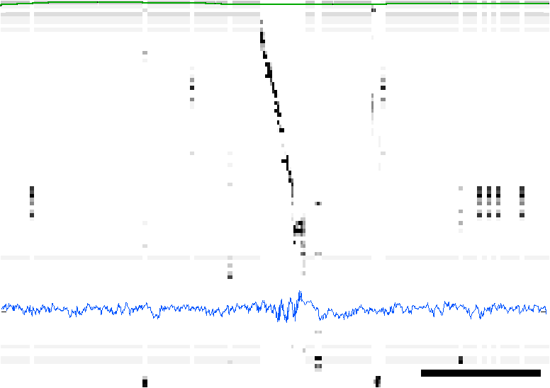
Hippocampus going rogue
Track Position (m)
0.5 sec
Time
type PlaceField = map Position SpikeRate
(Spike data from t (0,now - Δ)
P ( Pos | Spikes ) = C π( PlaceField * e^nSpikes ) * Norm
(Spike data from t (now – Δ, now)

Slide 8
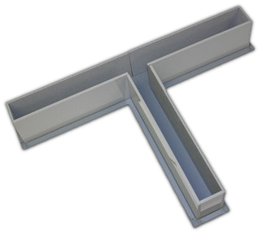
Real time decoding?
Reward rat for specific neural sequences (thought police)
Can they be trained?
Interrupt replay while it's happening
Impact on learning?

Slide 9
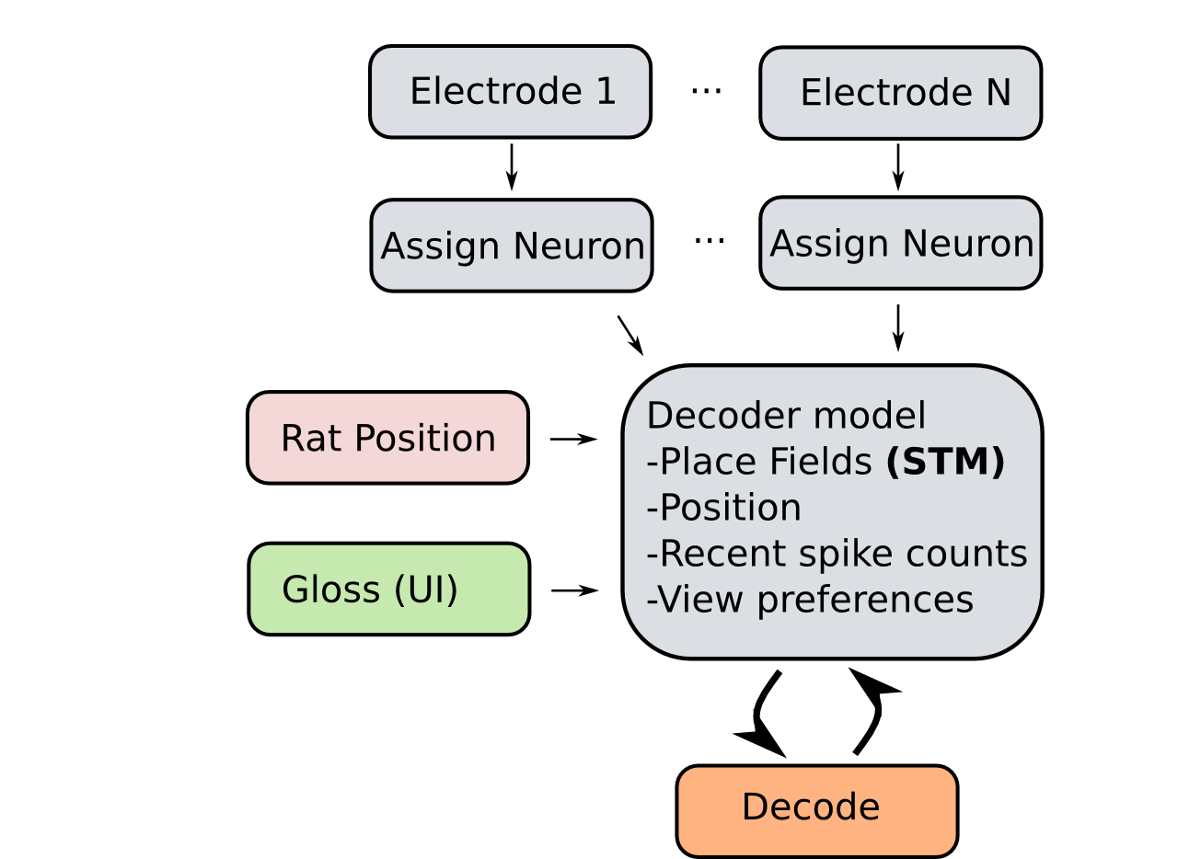
Real time decoding?

