Slide 1
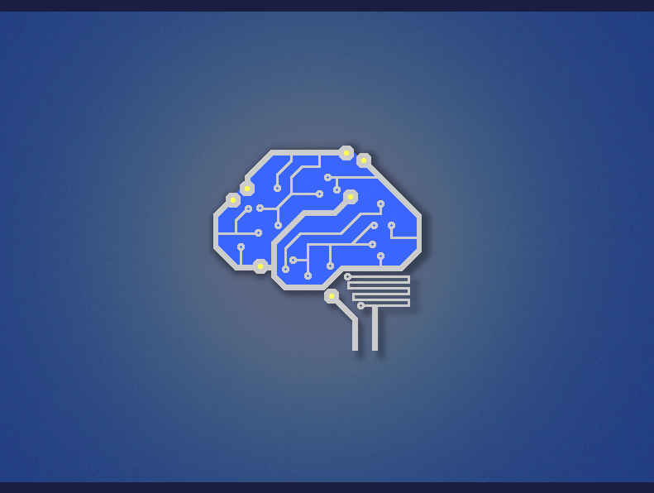
Haskell Tales from the Lab
Greg Hale – Hac NYC - 2014

Slide 2
First
  What we do in the lab
  How Async and STM let us do it in real time
Second
  Pet project: reffit.com

Slide 3
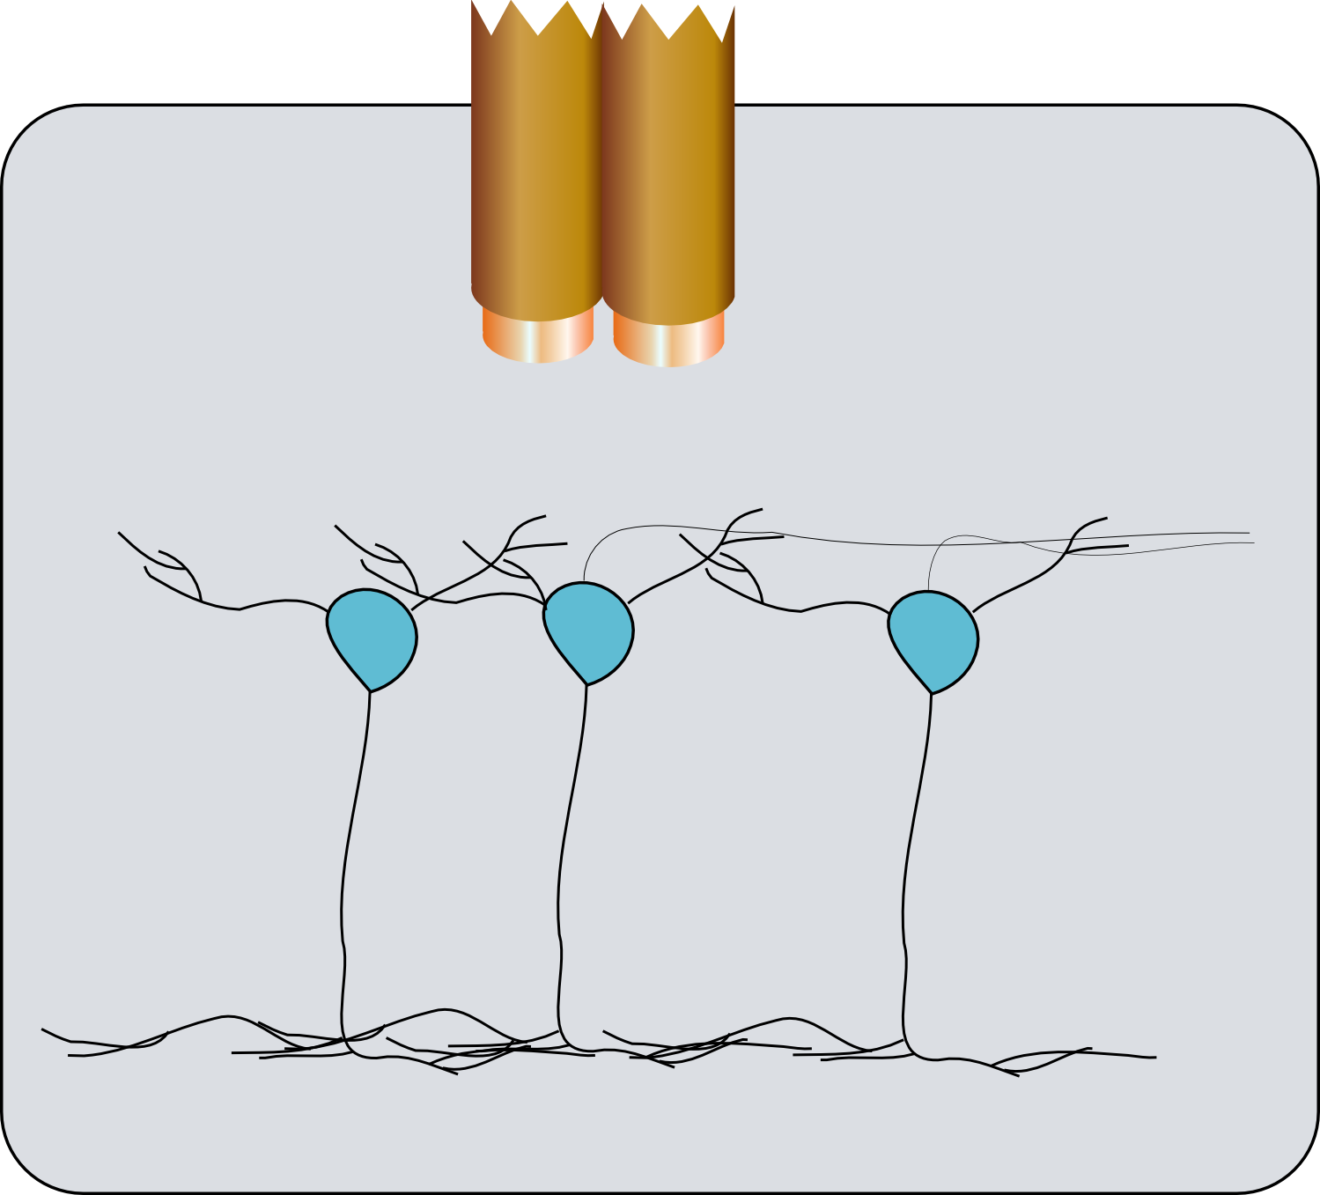

Recording neurons

Slide 4

Recording neurons

Slide 5
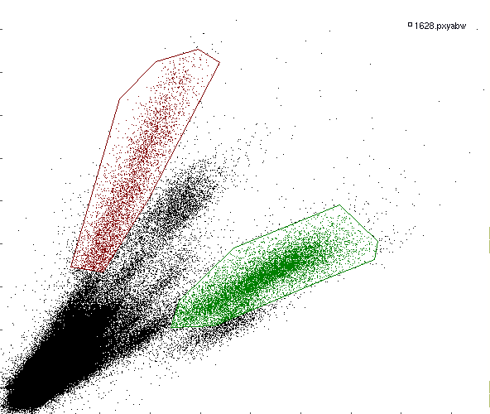
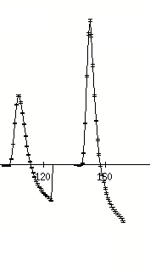
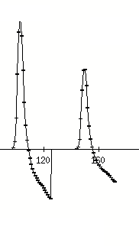
Recording neurons

