Slide 1
Supervised learning capstone Bank telemarketing analysis
By: Nusair Imam
Mentor: Ilyas Ustun
PROGRAM MANAGER: JOSEPHINE PIKE

Slide 2
Presentation Outline
Understanding the data
Data analysis, cleaning and preparation
Initial application of selected models
Feature engineering and parameter tuning
Conclusion and Future Considerations

Slide 3
The data - variables
Categorical (dtype = object) | Continuous (dtype = numerical)
Job | Age
Marital | Duration
Education | Campaign
Default | Pdays
Housing | Previous
Loan | Emp.var.rate
Contact | cons.price.idx
Month | Cons.conf.idx
Day_of_week | Euribor3m
Poutcome | Nr.employed

Slide 4
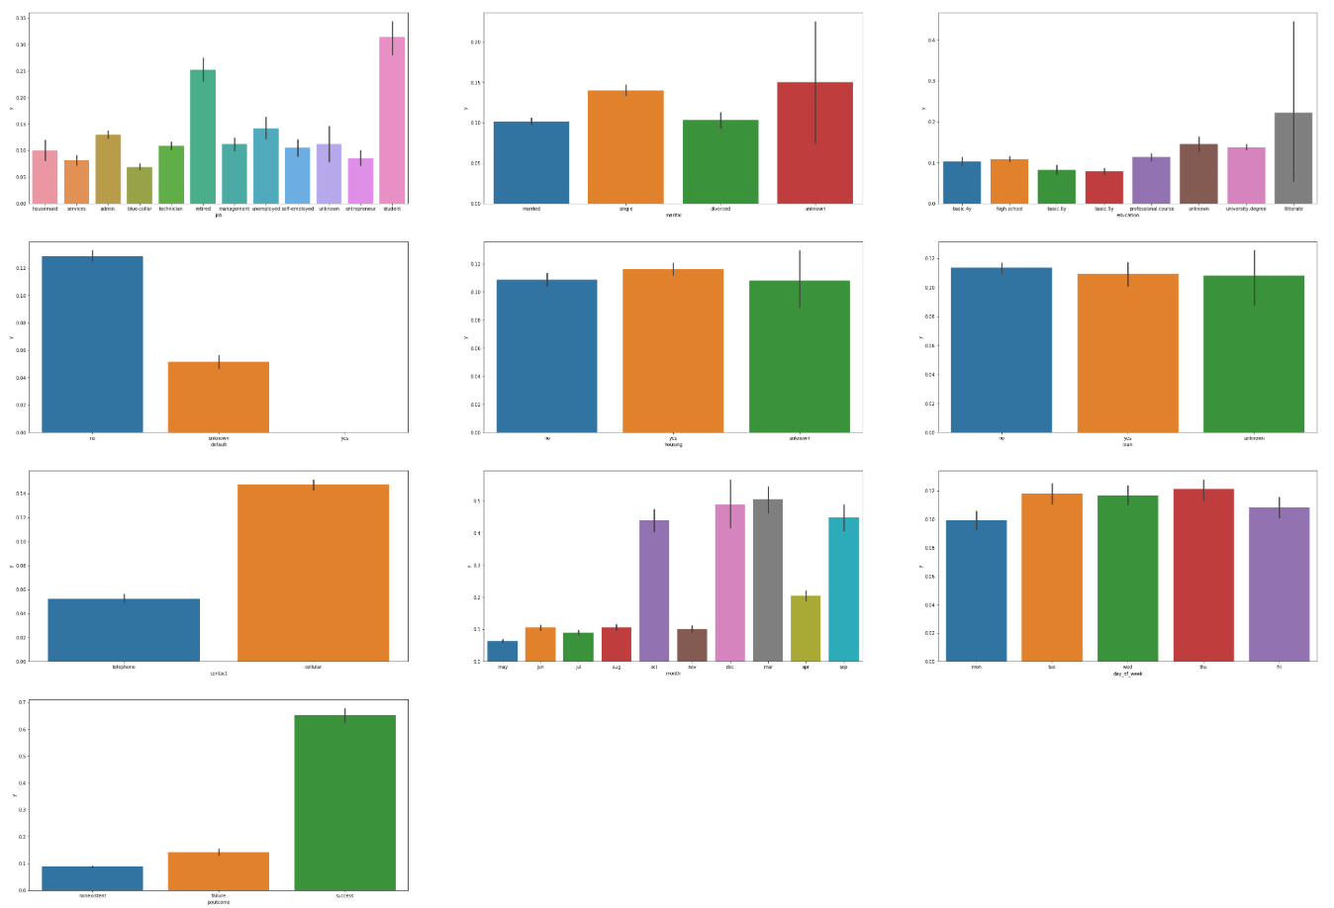
Object Variables
Job : Occupational information
Marital : Marital status
Education : Education level
Housing : Housing loan (Yes/No)
Default : Credit default (Yes/No)
Loan : Personal loan (Yes/No)
Contact : Method of contact (telephone/cellular)
Month : Month of the year (last contact)
Day_of_week: Day (last contact)
Poutcome: Outcome of previous campaign

Slide 5
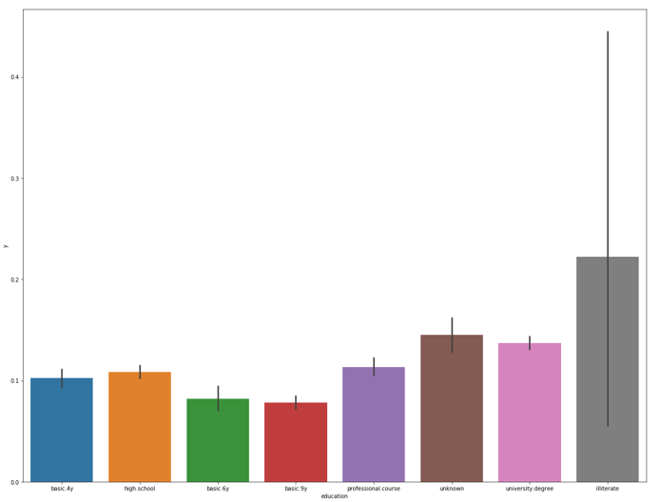
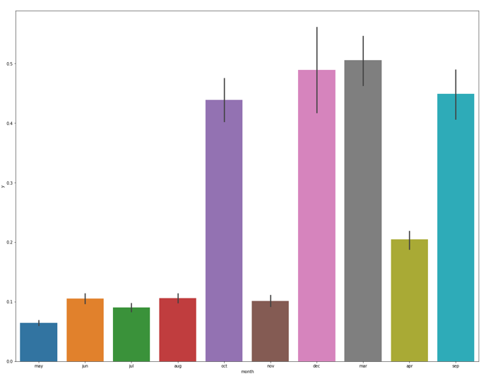
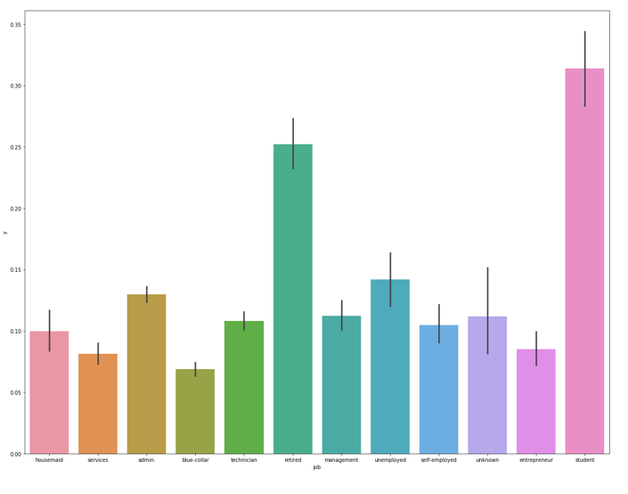
Object Variables Key Takeaways
Students and retired people have a greater chance of making a deposit
People who identified as illiterate have a higher chance of making a deposit ; large error bar indicates presence of outliers
Certain months have a higher success rate (March, April, Sept, Oct, Dec)
Class imbalance ; only 11% of participants made a deposit
Notes:
Subset of 3 pictures : y (yes/no) , job vs y, month vs y, education vs y

Slide 6
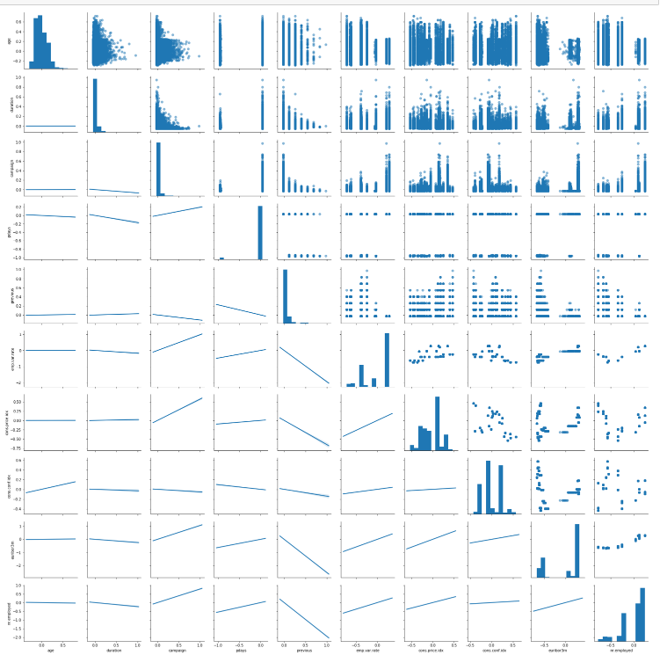
Numerical variables
Age : Age of client
Duration : Contact duration (seconds)
Campaign : Number of calls made to client
Pdays : Number of days since last contact (previous campaign)
Previous : Number of calls in previous campaign
Emp.var.rate : Employment variation rate (quarterly)
cons.price.idx : Consumer price index (monthly)
Cons.conf.idx : Consumer condfidence index (monthly)
Euribor3m : Euro interbank interest rate (daily)
Nr.employed : Number of employees (quarterly)
Notes:
Change image to reflect HUE

Slide 7
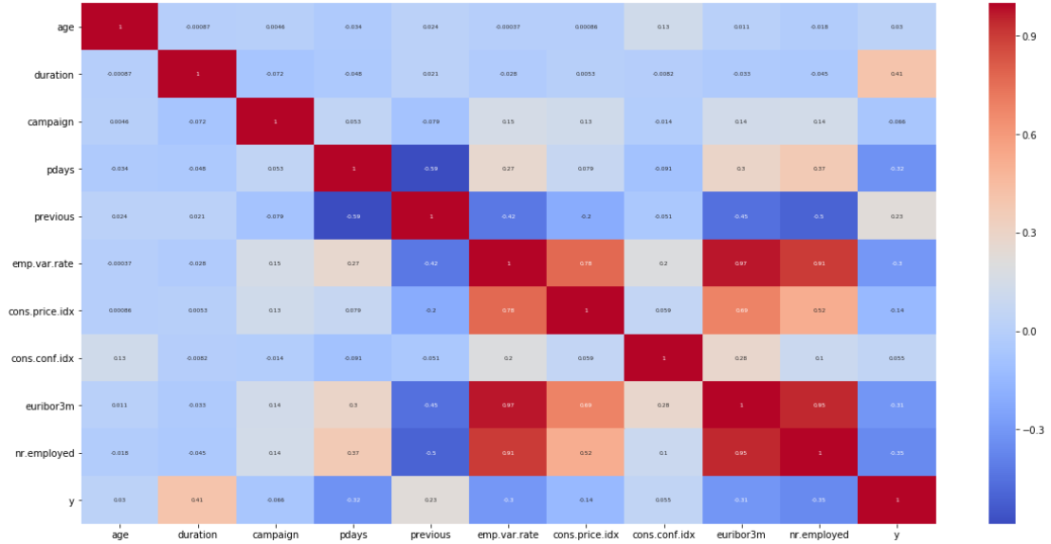
Numerical variables - heatmap
High correlations between the output and the following variables:
Nr.employed
Euribor3m
Duration
Emp.var.rate
Pdays
Previous (outcome)

Slide 8
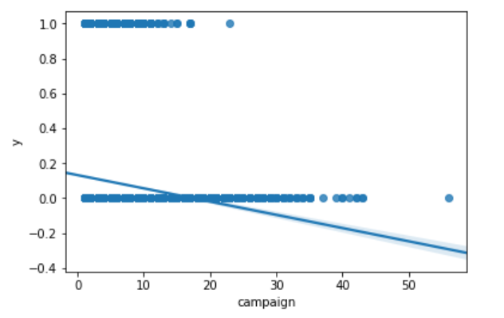
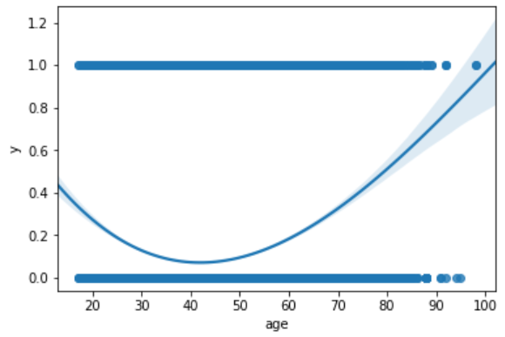
Numerical variables Key Takeaways
Rememeber – the variable ‘campaign’ is the number of calls rendered per client during the campaign
No person who was contacted more than 20 times subscribed to a fixed term deposit
People at the ends of the age spectrum are more likely to subscribe
High Correlations between fixed term deposits and
Notes:
Finish last bullet point – talk about high correlations from heatmap

Slide 9
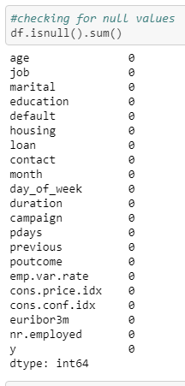
Data Cleaning
No NaN values, missing data
Converted output from Yes/No to numerical 1/0
Creating dummy variables for object variables in order to have a numerical dataset with all the variables.
Dealt with class imbalance (data skewed towards the negative outcome)
Oversampling via Sklearn’s SMOTE
Notes:
Add scre

Slide 10
Test, train methodology
Data split on an 80:20 basis using Sklearn’s train_test_split function
Models trained on train dataset and tested on both train and dataset
Initial modelling on Oversampled train dataset with 63 features
Final modelling on reduced set of features based on feature importance from RFC, LogR and feature engineering

Slide 11
Terms and definitions – in context of what it means in this application
Type 1 error: FP
Incorrectly identifying non-subscibers as subscribers
Type 2 error: FN
Not identifying those that are predicted to subscribe
Precision: TP/(TP+FP)
Out of those that we think will subscribe, what percentage actually did?
Recall: TP/(TP+FN)
Out of those that did subscribe, what percentage did we predict would?
Notes:
Precision needs to be optimized because

Slide 12
Terms and definitions – in context of what it means in this application
Precision: TP/(TP+FP)
Out of those that we think will subscribe, what percentage actually did?
Example Scenario : sending coupons to those that think are likely to subscribe – you do not want to waste coupons on those that will not subscribe!
Recall: TP/(TP+FN)
Out of those that did subscribe, what percentage did we predict would?
Bank telemarketing – this is the primary KPI for this application – we do not want to misclassify people who end up subscribing
Notes:
Precision needs to be optimized because

Slide 13
Models
Random Forest Classifier
K-nearest Classifier
Logistic Regression
SVM
SVC
Linear SVC
 | RFC | LogR | KNN | SVC | lSVC
Accuracy (%) | 99.3 | 91.0 | 93.1 | 95.9 | 88.4
Type 1 (%) | 0.04 | 3.26 | 2.46 | - | 0.16
Type 2 (%) | 0.63 | 6.65 | 4.41 | - | 10.99
Precision (%) | 99.7 | 66.46 | 73.7 | - | 67.08
Recall (%) | 94.45 | 41.23 | 61.0 | - | 2.90
*Initial Results : Trained and tested on entire dataset w/o oversampling

Slide 14
Models – Initial training on unbalanced data
Results biased towards dominant class ( client does NOT make deposit)
SVC left out due to computational constraints (# feat = 63)
Tendency to predict False negative ( Type 2)
This manifests itself in the Recall
 | RFC | LogR | KNN | SVC | lSVC
Accuracy (%) | 90.9 | 91.2 | 90.5 | 88.9 | 89.1
Type 1 (%) | 2.39 | 2.16 | 3.81 | - | 0.1
Type 2 (%) | 6.69 | 6.62 | 5.66 | - | 10.8
Precision (%) | 64.6 | 67.2 | 58.6 | - | 74.2
Recall (%) | 39.5 | 40.1 | 48.8 | - | 2.53
*Initial Results : Test subset (after test/train split)

Slide 15
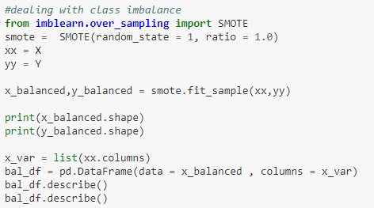
Oversampled data
SMOTE (Synthetic Minority Oversampling Technique)
Potentially important information may have been simulated (risk of overfitting)
Notes:
Add cross value score?

Slide 16
Models – Initial training on oversampled data (using SMOTE)
Linear SVC has an exceptional recall but much lower accuracy than the others
Reduction in type 2 errors and increase in Recall
 | RFC | LogR | KNN | SVC | lSVC
Accuracy (%) | 87.7 | 86.8 | 84.7 | - | 63.0
Type 1 (%) | 8.7 | 11.8 | 12.81 | - | 36.87
Type 2 (%) | 3.56 | 1.40 | 2.50 | - | 0.12
Precision (%) | 46.3 | 45.0 | 40.0 | - | 22.86
Recall (%) | 67.8 | 87.4 | 77.4 | - | 98.9
*Initial Results : Test subset (after test/train split)

Slide 17
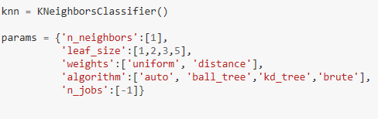
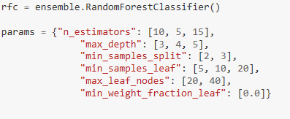
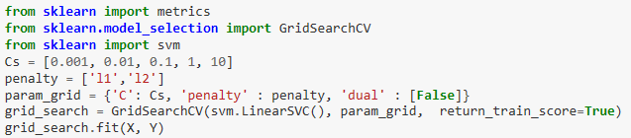
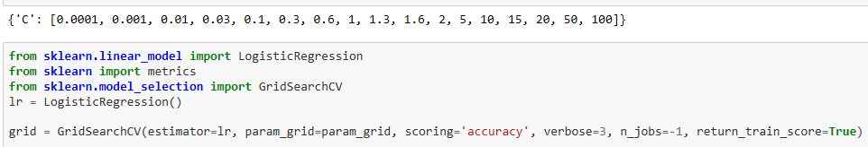
Parameter Tuning - GridSearchCV
Implemented on RFC, Logistic Regression
Other model’s left out due to computational constraints
Notes:
RESTART UPDATE HERE.

Slide 18

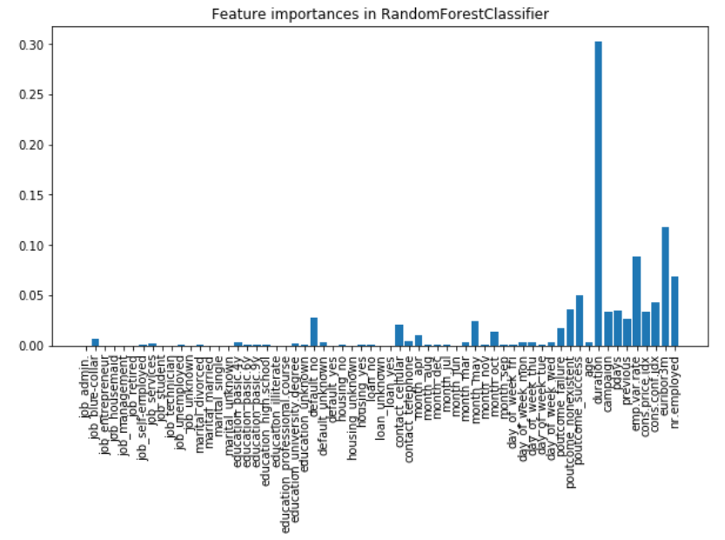
Feature engineering
Features shortlisted based on RFC importance diagram
Duration feature removed since this is not known until after the call (when the outcome is known)
Conversion rate feature added (# of calls divided by outcome)

Slide 19
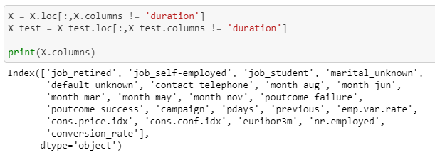
Feature engineering)
The reduced dataset exhibited overfitting
Only after removal of the ‘duration’ column did results become more realistic
22 features other than ‘duration’ column
 | RFC | LogR
Accuracy (%) | 98.6 | 99.9
Type 1 (%) | 1.36 | 0.02
Type 2 (%) | 0.05 | 0.02
Precision (%) | 89.0 | 99.78
Recall (%) | 99.6 | 99.78
Notes:
ADD SOME WACKY CV SCORES
ADD List of Final 23 features

Slide 20
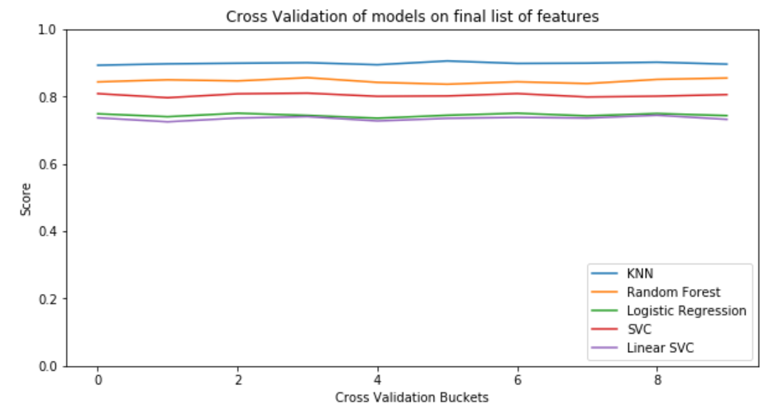
Results – without ‘duration’ column
Consistent cross validation scores
RFC is the best model despite KNN having better overall results
SMOTE method utilizes the same methodology (Euclidean distance) as KNN and therefore KNN is more prone to overfitting on SMOTE-oversampled dataset
 | RFC | LogR | KNN | lSVC
Accuracy (%) | 99.2 | 99.9 | 97.0 | 57.0
Type 1 (%) | 0.63 | 0.01 | 2.25 | 42.7
Type 2 (%) | 0.16 | 0.07 | 0.76 | 0.23
Precision (%) | 94.5 | 99.9 | 82.1 | 20.2
Recall (%) | 98.6 | 99.3 | 93.2 | 97.9
Notes:
UPDATE CROSS VALIDATION COLUMN

Slide 21
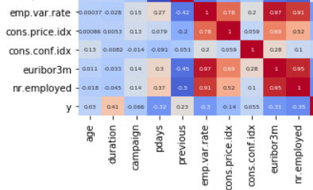
Final Recommendation - Observations
Despite good CV scores and model performance, it is unlikely that these model will perform well in real world situations due to high correlations between European socio-economic features.
Logistic Regression performed the best overall
No client should be called more than 20 times
Depending on industry standard hitrate, the number of calls should be optimized by putting a maximum limit.

Slide 22
Future considerations
Data treatment can be altered
PCA on highly correlated columns to reduce multicollinearity
Undersampling via numpy’s random choice function
Unsupervised techniques should be explored (Nueral networks)
More features should be added to model
Gross income
Registered residence location
Size of family

Slide 23
Next steps
Improve on current model performance
PCA of features
More iterations of tune, feature engineer, test process
Undersampling using functions other than np.random.choice
Try other ensemble models such a Xgboost, gradient boost
Map a neural network

