Slide 1
Build A Diet
By: Mike Schuler, Imamah Younus, Onyinyechi Asoluka
Notes:
Our project focused on the obesity epidemic in the United States and simple measures one can take to meet weight loss goals. First , we looked at obesity, how it is defined and then its negative health impacts. We then analyzed some data from the U.S. Center for Disease Control, looking at rates of obesity in the U.S. and, finally, we built an app using what we learned in class that can tackle this problem by helping people make better food choices.

Slide 2
What is Obesity?
#Fatstagram
Obesity is a disease.
Obesity is an epidemic.
Obesity is a public health crisis.
But, what is it really?

Slide 3
Obesity Definition:
A weight that is higher than what is considered as a healthy weight for a given height is described as overweight or obese.
Body Mass Index, or BMI, is used as a screening tool for overweight or obesity.
The CDC weight classificat ions are:
Underweight = BMI less than 18.5
Normal Weight = BMI between 18.5 - 24.9
Overweight = BMI between 25.0 - 29.9
Obese = BMI greater than 30.0
Severe Obesity = BMI greater than 40.0
*Source: U.S. Center for Disease Control and Prevention: https://www.cdc.gov/obesity/adult/defining.html
Notes:
BMI is calculated by measuring a person’s weight in kilograms divided by their height in meters squared (kg/m2).

Slide 4
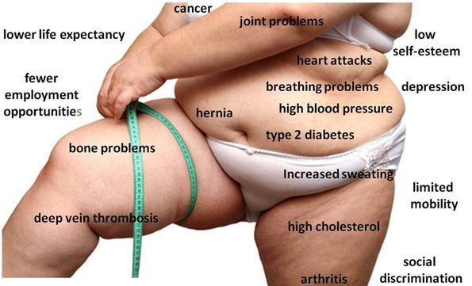
Obesity-Related Health Issues
Notes:
Obesity is a national epidemic and major contributor to some of the leading causes of death in the U.S., including heart disease, stroke, diabetes and some types of cancer.

Slide 5

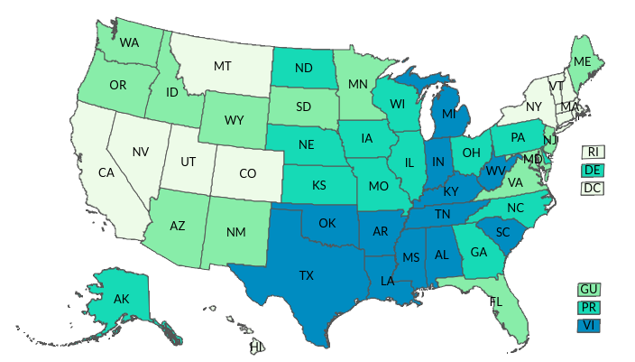
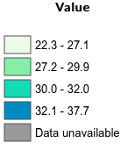
The Obesity Epidemic
*Center for Disease Control and Prevention https://www.cdc.gov/nchs/data/hestat/obesity_adult_15_16/obesity_adult_15_16.htm
Notes:
The CDC published a report tracking BMI data of the US showing percentages of US adults who are overweight or obese.
As you can see the Percent of adults aged 18 years and older who have obesity is about 22 percent or above in all states.

Slide 6
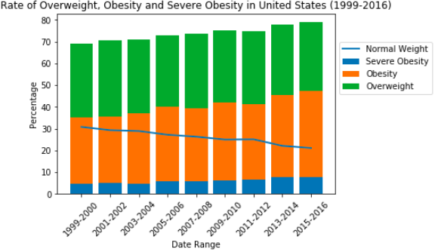
Normal Weight Decreasing Among U.S. Adults
U.S. Adults 2015 - 2016
Obesity: 39.8%
Severe Obesity: 7.6%
Overweight: 31.8%
Normal Weight: 21.1%
U.S. Adults 1999 - 2000
Obesity: 34.0%
Severe Obesity: 4.7%
Overweight: 30.5%
Normal Weight: 30.8%
*DATA SOURCE: U.S. National Center for Health Statistics and National Health Examination Surveys https://www.cdc.gov/nchs/data/hestat/obesity_adult_15_16/obesity_adult_15_16.htm
Notes:
According to results from the 2015-2016 National Health and Nutrition Examination Survey* (NHANES), an estimated 39.8% of U.S. adults aged 20 and over have obesity, including 7.6% with severe obesity, and another 31.8% are overweight. That leaves just 21.1% of U.S. adults with normal or healthy BMI, which is considerably lower than the more than 30% of U.S. adults from the 1999-2000 survey.

Slide 7
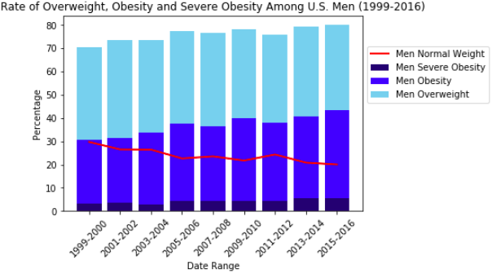
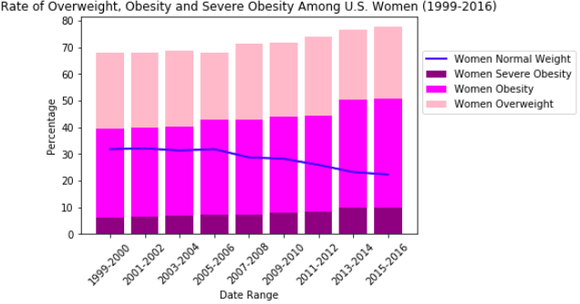
Gender Breakdown
Men in 2015-2016 (Change from 1999 - 2000)
Obesity: 37.9% (+10.4)
Severe Obesity: 3.6% (+0.5)
Overweight: 36.5% (-3.2)
Normal Weight: 29.7% (-9.7)
Women in 2015 - 2016 (Change from 1999 - 2000)
Obesity: 41.1% (+7.7)
Severe Obesity: 9.7% (+3.5)
Overweight: 26.9% (-6.3)
Normal Weight: 22.3% (-9.8)
Notes:
Looking by gender, we see a similarly alarming trend. For men in 2015-2016, 37.9% of those surveyed have obesity, including 3.6% with severe obesity, and 36.5% are overweight. For women, 41.1% have obesity, with 9.7% with severe obesity and 26.9% overweight. This 20% of men and 22.3% of women fall into the healthy weight category in 2015-2016, decreasing from 30.8% and 31.8%, respectively, from on the 1999-2000 survey.

Slide 8
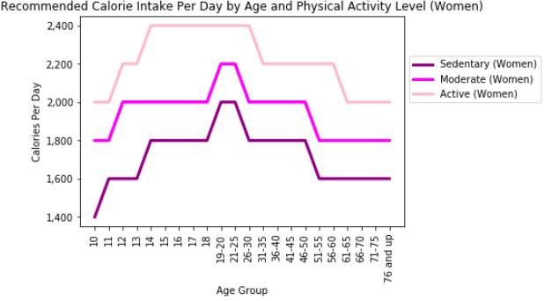
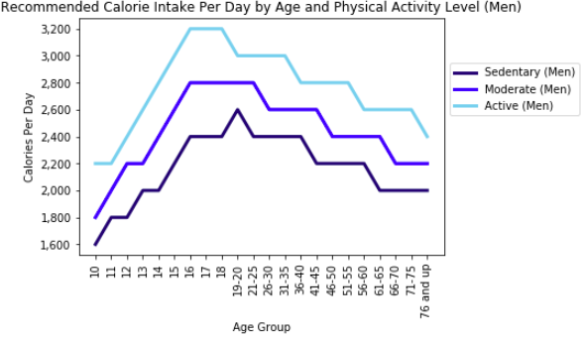
Recommended Calories Per Day
DATA SOURCE: Institute of Medicine. Dietary Guidelines 2015-2020 (https://health.gov/dietaryguidelines/2015/guidelines/appendix-2/)
Notes:
The number of calories a person needs per day varies based on several of factors, including the person’s age, sex, height, weight, and level of physical activity. Estimates range from 1,600 to 2,400 calories per day for adult women and 2,000 to 3,000 calories per day for adult men.

Slide 9
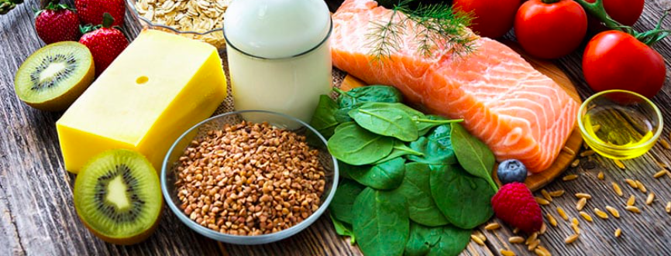
How do we solve this problem?
Build A Diet
Notes:
So having learned about Obesity rates and what we learned in class using APIs, we came up with this application that allows users to make better food choices. We called it “Build a Diet”.

Slide 10
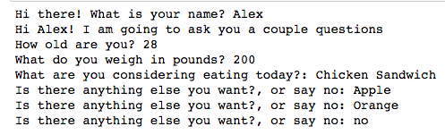
The app starts by asking:
Notes:
This app first asks for the user’s name, weight, and what they are going to/want to eat..

Slide 11
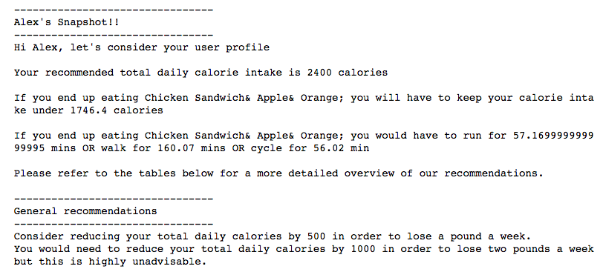
Notes:
Next, it gives you a snapshot and gives you a general recommendation for calorie intake to meet simple weight loss goals.

Slide 12
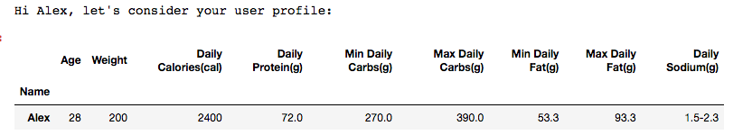
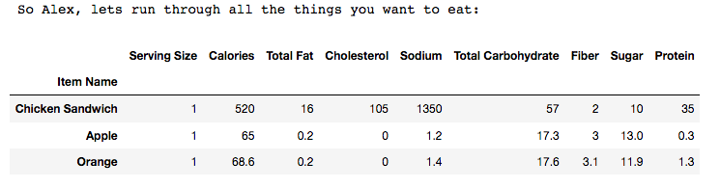
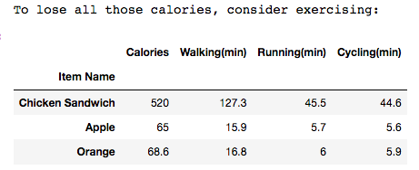
Notes:
Lastly, it gives you three tables with a little more detail information:
The first table gives you general information about the user.
The second table gives information about the food that you are about to eat
The last tabel gives you the amount of walking, running or cycling you will need to do to burn off those calories.

Slide 13
Now let’s run through an example in Jupyter Notebook

Slide 14
We hope you learned something about obesity. Thank you for your time!
Presentation By: Mike Schuler, Imamah Younus, Onyinyechi Asoluka

