Slide 1
Salesforce Process Mapping & Documentation
Week 1 | Process Audit Simulation
Three processes: Lead Management, Opportunity Tracking, Case Resolution
Focus: current-state mapping, risks, recommendations and measurable outcomes
Training simulation — validate all assumptions against the target Salesforce org

Slide 2
Scope & Method
Map triggers, inputs, activities, decisions, outputs and exception paths
Review data quality, ownership, automation, reporting and governance
Prioritize improvements by impact and feasibility
No live Salesforce org or operational dataset was accessed

Slide 3
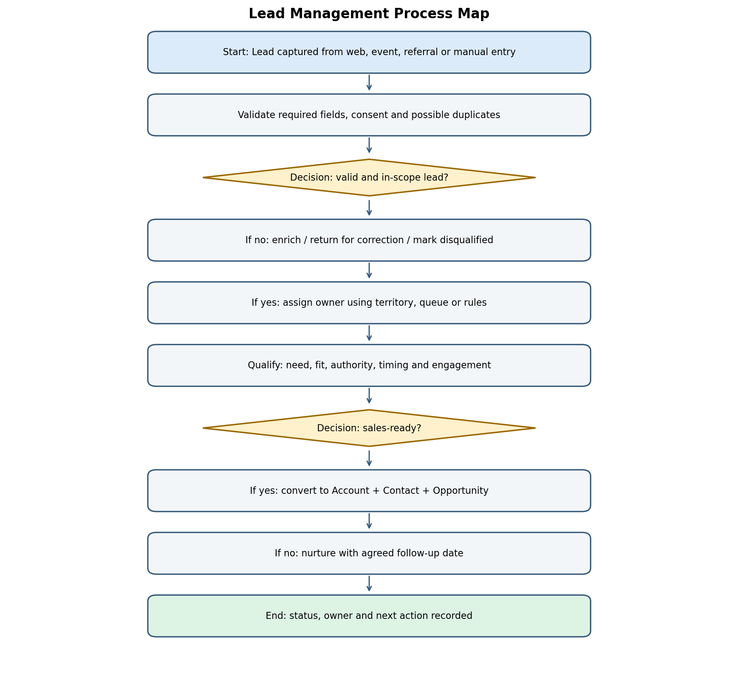
Lead Management
Capture and validate leads; check duplicates and consent
Assign by rules/queues; qualify consistently
Convert sales-ready leads; nurture or disqualify others
Priority fixes: data validation, assignment, next-step reminders

Slide 4
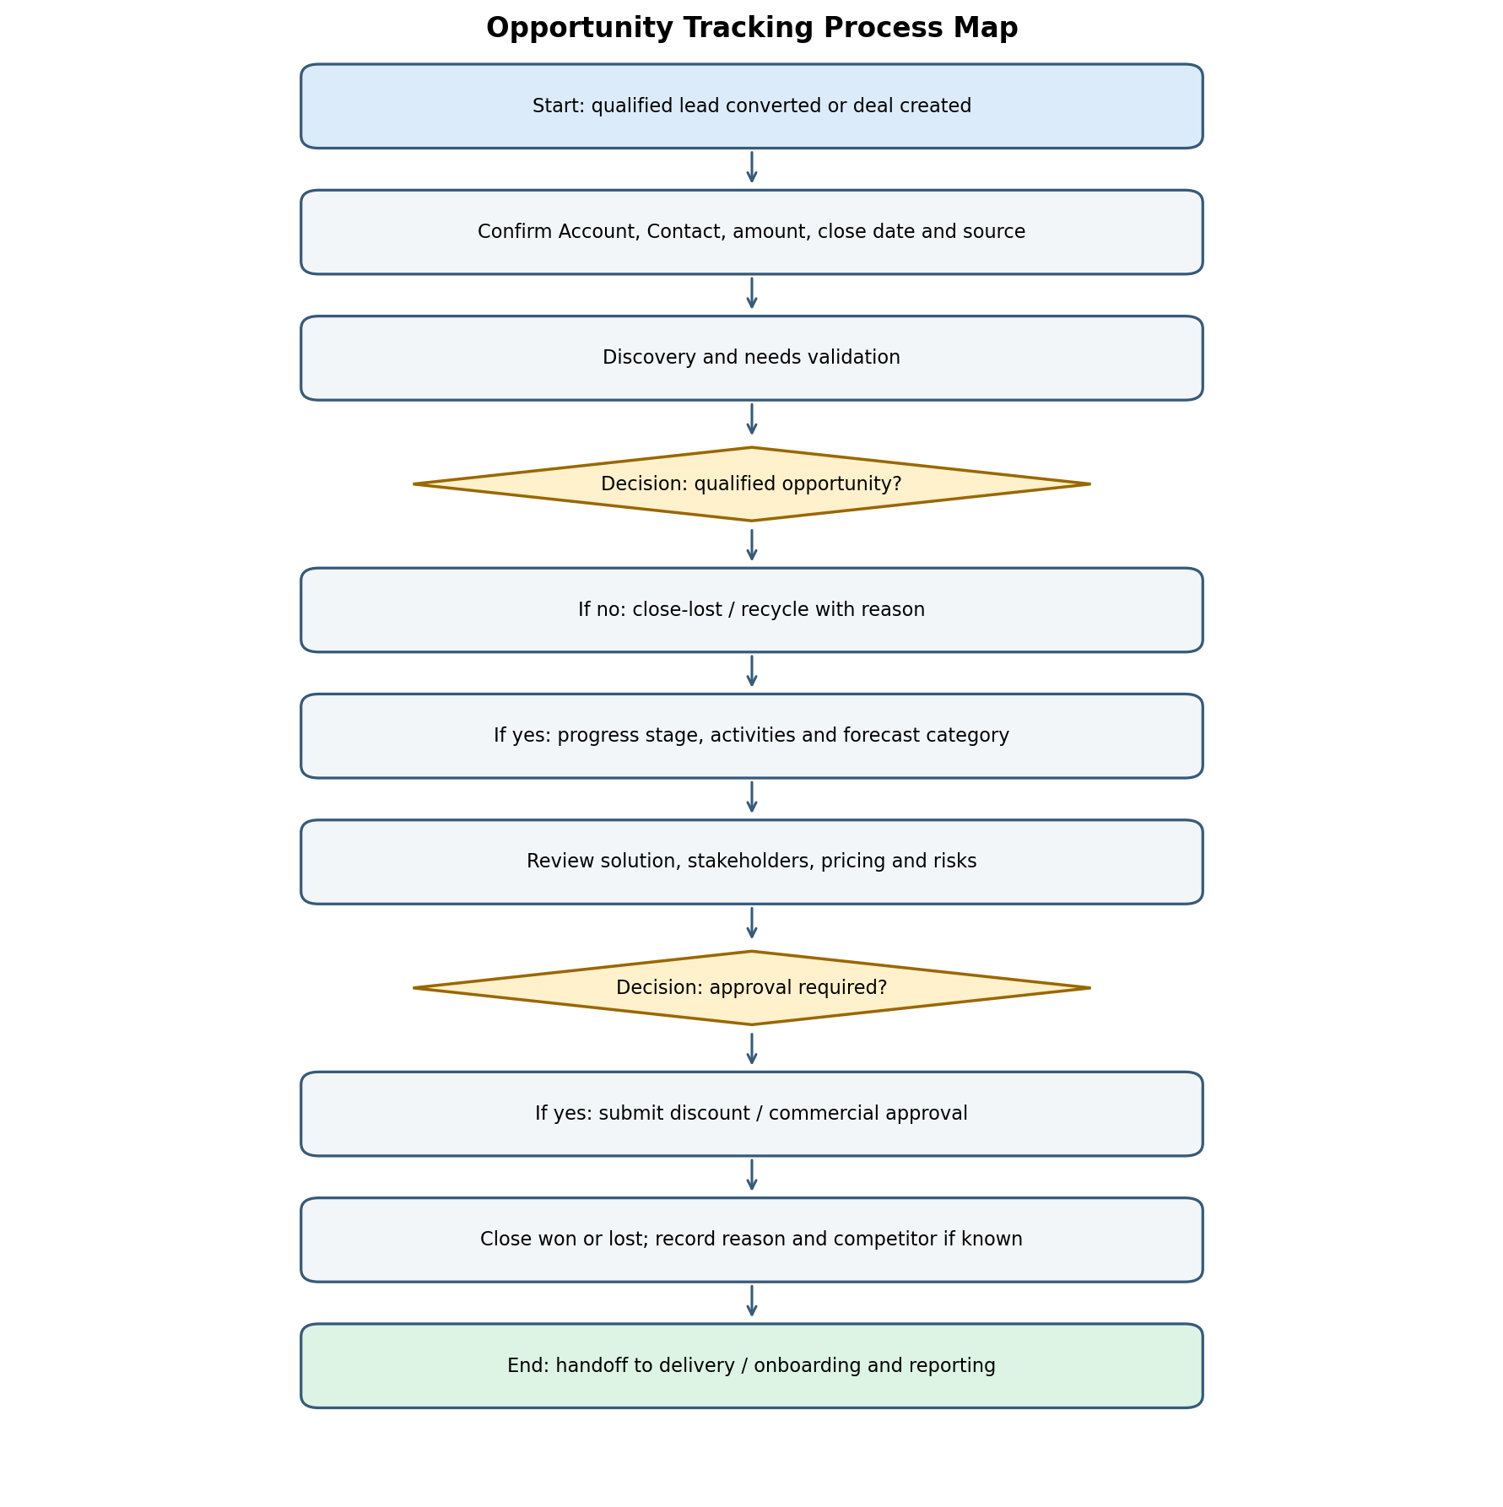
Opportunity Tracking
Qualify, discover, validate solution and commercial terms
Use stage exit criteria and approval history
Close won/lost and capture reason; hand off won deals
Priority fixes: stale-deal alerts, close-date monitoring, forecast hygiene

Slide 5
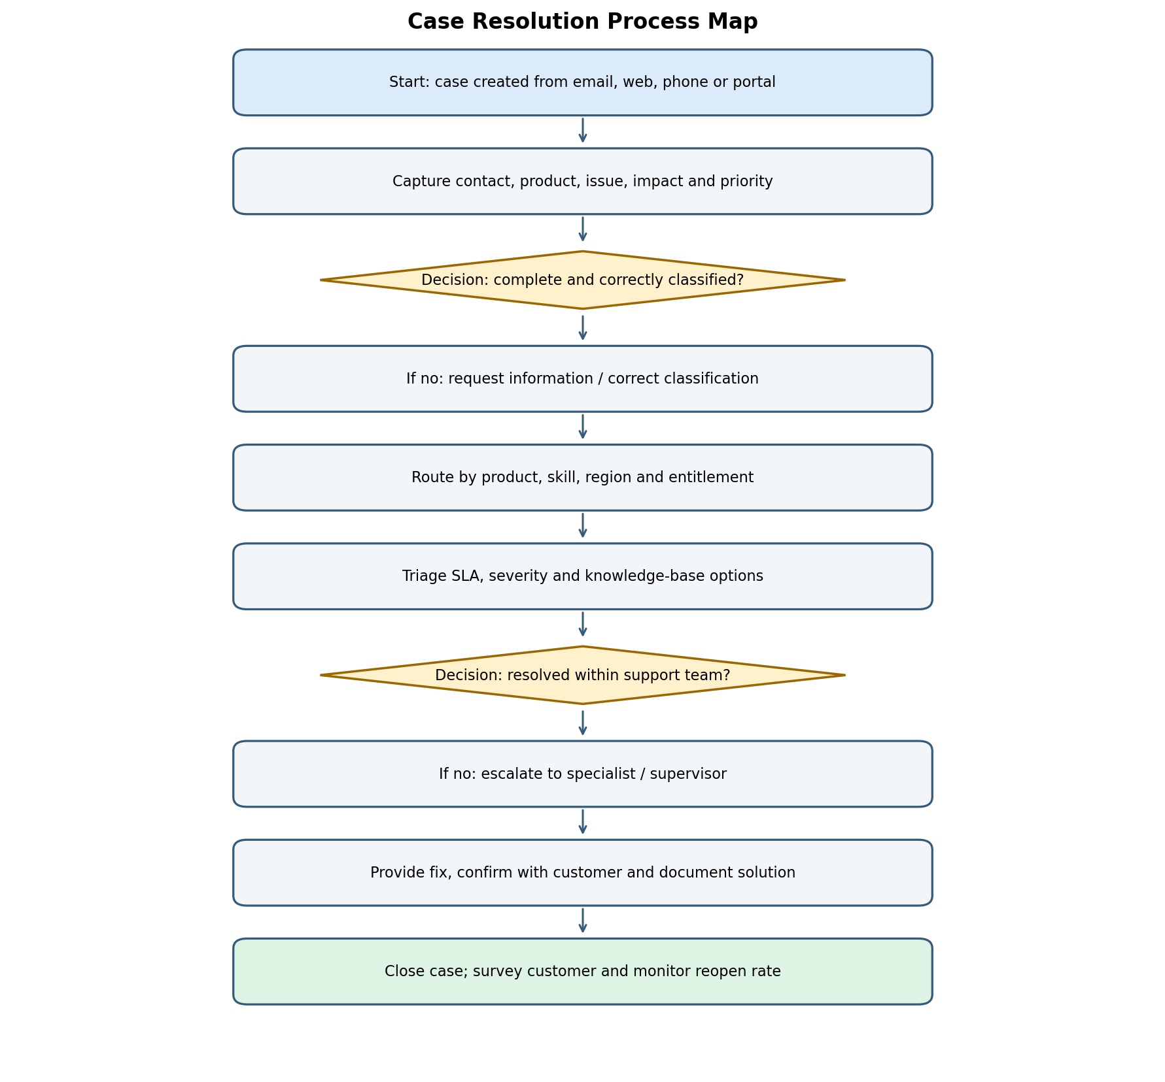
Case Resolution
Capture issue, classify priority and route to an agent/queue
Use knowledge and escalation paths; monitor response/resolution SLA
Document solution, close and monitor reopen/customer feedback
Priority fixes: guided intake, routing, SLA alerts, closure validation

Slide 6
Cross-Process Findings
Data quality: duplicates, missing fields and inconsistent picklists undermine trust
Ownership: unassigned/stale records delay response and follow-up
Automation: prioritize repeatable rules; test exception paths and alert on failures
Governance: sandbox, UAT, release notes, rollback and named process owners
Adoption: role-based training and clear guidance reduce workarounds

Slide 7
Recommended Roadmap
Week 1: validate maps, stakeholders and baseline KPIs
Weeks 2–3: quick wins — validation, duplicates, ownership fallbacks, alerts
Weeks 4–6: stage guidance, approvals, case routing and SLA escalation
Weeks 7–8: pilot, resolve defects and review adoption
Ongoing: monthly KPI review and quarterly process audit

Slide 8
KPIs & Controls
Leads: first-response time, lead-to-opportunity conversion, duplicate rate
Opportunities: stage conversion, forecast accuracy, stale-deal rate
Cases: first response, first-contact resolution, SLA attainment, reopen rate
Controls: least privilege, validation, approval trails, fallback queues, test evidence
Set targets after baseline measurement; agree metric definitions first

Slide 9
Conclusion & Next Steps
The biggest opportunities are data quality, clear ownership and consistent decision criteria
Validate representative workflows with Sales, Marketing, Support and platform owners
Pilot prioritized changes in a sandbox; test happy paths and exceptions
Track KPI trends and adjust through documented governance

