Slide 1
Fine-Grained Sentiment Analysis on PeduliLindungi Application Users with Multinomial Naive Bayes-SMOTE
9th International Conference on Electrical Engineering, Computer Science and Informatics
October 6-7, 2022
Imam Suyuti
Universitas Sebelas Maret, Indonesia | imamsuyuti00@student.uns.ac.id

Slide 2
INTRODUCTION
The increasing spread of the COVID-19 virus (Coronavirus Disease 2019) in Indonesia has prompted the government to issue a policy to control the spread of the virus by imposing large-scale restrictions which are often known as Large-Scale Social Restrictions (PSBB).
PT Telekomunikasi Indonesia Tbk (Telkom) and the Ministry of Communication and Information (Kominfo) have collaborated to create the PeduliLindungi application. This application was developed by the government to assist in tracking and stopping the spread of the Covid-19 virus.
In each application, there are user ratings and reviews regarding the services and features provided. Reviews can be in the form of suggestions, criticisms, or complaints.

Slide 3
INTRODUCTION
Sentiment analysis is computational research of textually expressed opinions, sentiments, and emotions. Sentiment analysis is generally used to analyze something in the future. In this case, sentiment analysis can be applied to mobile application reviews.
The problem that often arises in most sentiment analysis studies is that most of the review data tend to be unbalanced (imbalanced datasets) in terms of the number of each class.
In this research, the Synthetic Minority Oversampling Technique (SMOTE) method was used to handle the case of unbalanced data.

Slide 4
INTRODUCTION
Sentiment Analysis Online Transportation Services on Twitter Using Naive Bayes Classifier Method
Pintoko & Muslim, 2018
Community Sentiment Analysis on Quick Results 2019 Indonesian Presidential Election Count on Social Media Twitter Using Naive Bayes Classifier Method
Andika, Azizah, & Respatiwulan, 2019
Sentiment Analysis on Google Play Store Reviews Using the Naive Bayes Method
Daulay & Asror, 2020
1
3
5
2
4
Sentiment analysis research using the Naïve Bayes algorithm has been conducted on Tokopedia
Apriani & Gustian, 2019
Sentiment Analysis On E-Sports For
Education Curriculum Using Naive Bayes And Support Vector Machine
Ardianto, 2020

Slide 5
RESEARCH METHOD
Primary data was collected through a web scrapping process on the Google Play Store website and data was collected from September 14, 2021, to October 14, 2021, with as many as 9021 PeduliLindungi user reviews.
Web Scrapping method is a method used to collect or extract semi-structured information or data from websites.
Then the process of analyzing and exploring unstructured text data becomes structured to identify patterns in the form of new knowledge and meaningful or useful information with the help of a technology is called text mining.

Slide 6
RESEARCH METHOD
Text preprocessing proses is a prepared document text or raw data set proses to convert text data that was originally unstructured into structured data.
The steps for text processing are as follows:
Case Folding is a process of standardizing the form of letters so that there is no difference in meaning.
Tokenizing is a word-by-word separation process that does not affect each other from the document text.
Filtering is the process of filtering or selecting words in a document.
Stemming is changing affixed words into base words.
TF-IDF weighting is one of the models used to calculate word weights in a document using the term frequency model to count the words that appear in each document.

Slide 7
RESEARCH METHOD
In this research, Fine-Grained Sentiment Analysis is used which is often referred to as aspect-based opinion mining, and its basic tasks include aspect extraction, opinion identification, and sentiment classification.
This analysis includes a type of sentiment analysis that will group responses or opinions into several categories such as positive and negative.
VADER Lexicon is used to automatically label sentiment classes on English review data.
The data that has been labeled sentiment class will then be partitioned into training and testing with an 80:20 data split.
The Synthetic Minority Oversampling Technique (SMOTE) method is used to handle the case of unbalanced data.

Slide 8
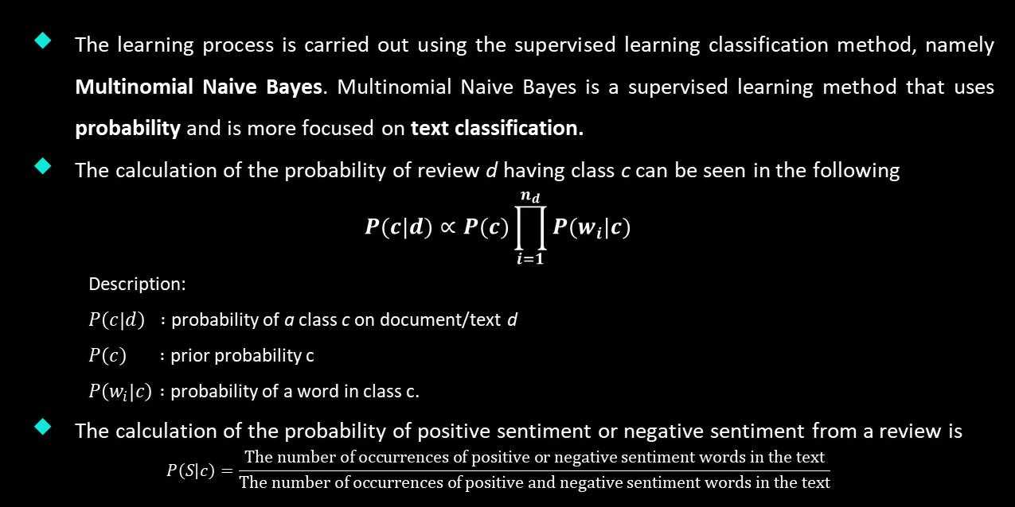
RESEARCH METHODS
The learning process is carried out using the supervised learning classification method, namely Multinomial Naive Bayes. Multinomial Naive Bayes is a supervised learning method that uses probability and is more focused on text classification.
The calculation of the probability of review d having class c can be seen in the following
$$P(c|d)∝P(c)\prod_{i=1}^{n_{d}}{P(w_{i}|c)}$$
Description:
$P\left(c | d\right) :$ probability of a class c on document/text d
$P\left(c\right) :$ prior probability c
$P\left(w_{i} | c\right) :$ probability of a word in class c.
The calculation of the probability of positive sentiment or negative sentiment from a review is
$$P\left(S | c\right)=\frac{\text{The} \text{number} \text{of} \text{occurrences} \text{of} \text{positive} \text{or} \text{negative} \text{sentiment} \text{words} \text{in} \text{the} \text{text}}{\text{The} \text{number} \text{of} \text{occurrences} \text{of} \text{positive} \text{and} \text{negative} \text{sentiment} \text{words} \text{in} \text{the} \text{text}}$$

Slide 9
RESEARCH METHODS
The number of each prediction class and actual class must be known when measuring the accuracy of the classification because this is done to see the performance of the classification that has been carried out. The following Table confusion matrix can be used to calculate classification accuracy.
If there is a data imbalance case, then choosing which model is best, it can be done by using the AUC (Area Under Curve) value.
Actual | Prediction | B
Yellow | Positive | Negative
Positive | True Positive | False Negative
Negative | False Positive | True Negative

Slide 10
RESEARCH METHOD
AUC is an evaluation criterion that uses sensitivity or specificity as the basis for measurement. The AUC value is generally in the interval 0.5 – 1.0. The following table description for each AUC value interval can be seen in Table below.
Wordcloud will be used to visualize the results of the classification analysis. Wordcloud is a representation of data that shows a set of important and frequently occurring words in a word.
AUC Value | Description
0,9 – 1,0 | Excellent
0,8 – 0,9 | Good
0,7 – 0,8 | Fair
0,6 – 0,7 | Poor
0,5 – 0,6 | Failure

Slide 11
RESEARCH RESULT

Slide 12
TEXT PREPROCESSING
Text preprocessing stage is needed to uniform the spelling of words and letter shapes, reduce vocabulary and eliminate characters other than letters so that the data text is more structured and informative. The results of text preprocessing are in Table below.
Review | Text Preprocessing Result
Worked as intended, however the notification about turning on locations is unnecessary when the app isn't even being used or when you're not checked in on a public space that requires you to scan. Also, one problem I find annoying is you can't pair your phone number with your e-mail account if you had accidentally registered an account for each of them. E-mail and phone number both became separate accounts. I hope there will be a fix for this. I trust the devs would improve the app overtime. | work intend howev notif turn locat unnecessari app isnt even use your check public space requir scan also one problem find annoy cant pair phone number email account accident regist account email phone number becam separ account hope fix trust dev would improv app overtim

Slide 13
FINE-GRAINED SENTIMENT ANALYSIS
This research uses the VADER lexicon library to carry out the process of labeling sentiment categories on English review data automatically.
The review data will only be labeled as two types of sentiment, namely positive sentiment, and negative sentiment.
Sentiment | PeduliLindungi
Positive | 2777
Negative | 6244
Total | 9021

Slide 14
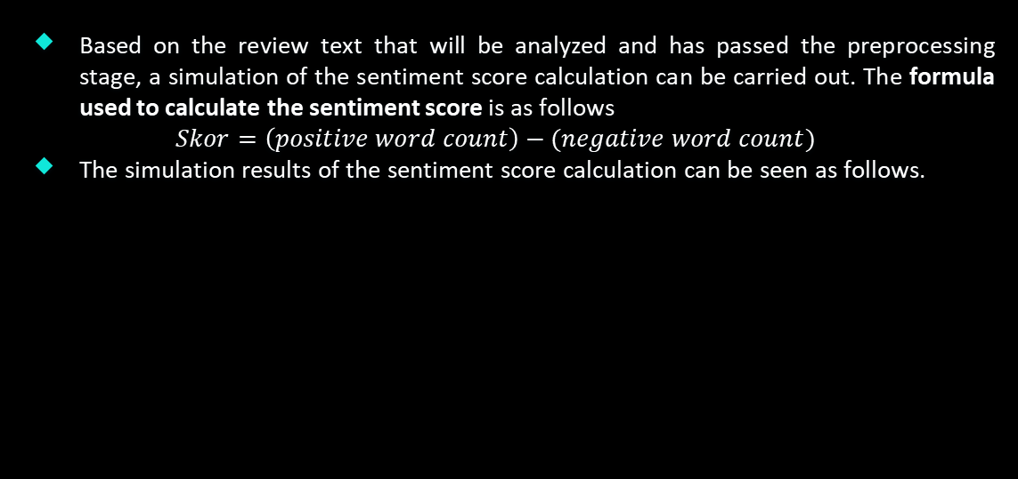
FINE-GRAINED SENTIMENT ANALYSIS
Based on the review text that will be analyzed and has passed the preprocessing stage, a simulation of the sentiment score calculation can be carried out. The formula used to calculate the sentiment score is as follows
$$Skor=\left(positive word count\right)−(negative word count)$$
The simulation results of the sentiment score calculation can be seen as follows.
Review Text | Score | Sentiment Label
The plot was good, but the characters are uncompelling and the dialog is not great. | 1 – 2 = -1 | Negative

Slide 15
CLASSIFICATION
This research will use SMOTE and non-SMOTE techniques which will later be used to compare the classification performance when applied to imbalanced datasets.
Classification predictions are made with a Multinomial Naïve Bayes algorithm. From the results of the classification method used, the AUC, recall, precision, and accuracy values are obtained.
This analysis will partition the dataset with a ratio of 80% as training data and 20% as test data.
Multinomial Naïve Bayes Method | AUC | Recall | Precision | Accuracy
Non-SMOTE | 0,8727 | 0,9890 | 0,8209 | 0,8404
SMOTE | 0,9061 | 0,8890 | 0,9025 | 0,8543

Slide 16
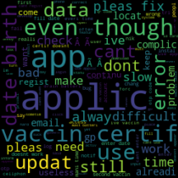

VISUALIZATION
Wordcloud will be used to visualize the results of the classification analysis. The purpose of the visualization is to extract information in the form of topics that are often discussed by PeduliLindungi users so that information that is considered important can be extracted from the many existing review texts.
PeduliLindungi Negative Sentiment PeduliLindungi Positive Sentiment
Wordcloud Wordcloud

Slide 17
SMOTE is proven to increase the accuracy of the model on unbalanced data (imbalance) seen from the AUC value in the model with SMOTE higher than the AUC value generated by the non-SMOTE model. The resulting AUC value is 0.9061, so the method is classified as having a very good classification performance and user reviews have more negative sentiments related to the error application system, while positive reviews relating to the benefits of using the application

Slide 18
THANKS!

