Slide 1

Objectives
- to develop an application that is easy to use(user-friendly).
- a system that reduces a lot of time for the complaint process.
- to develop a system where the admin (government departments) is able to track the complaints and manage them.
- to build a system where user can complaint, suggest, or enquiry depending on the cases.
- to build a system where all the government offices are combined in one place

Slide 2
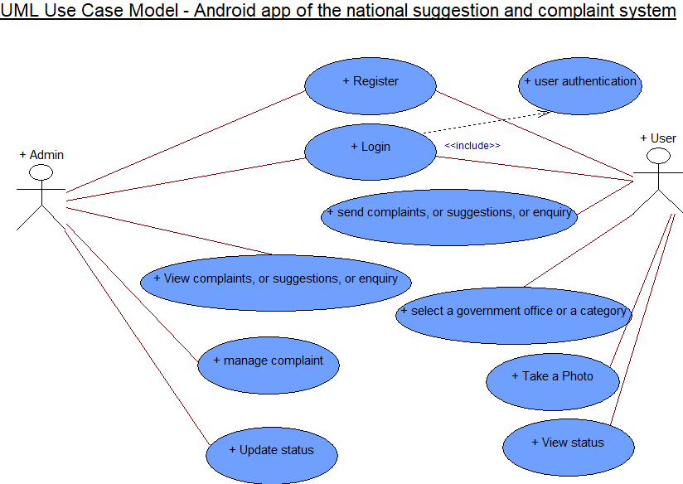
System Design

Slide 3
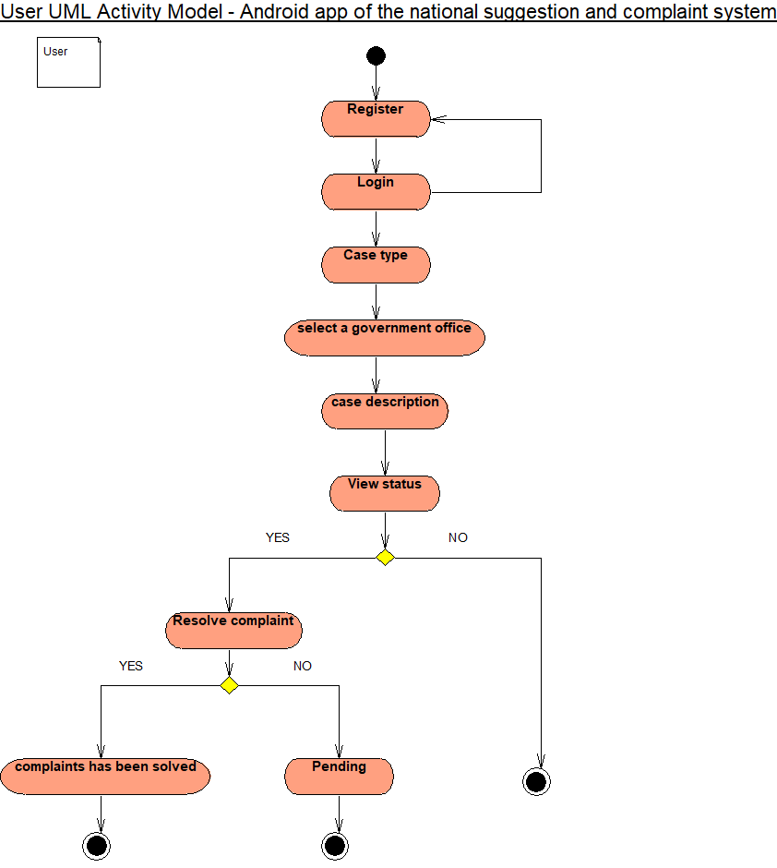
System Design

Slide 4
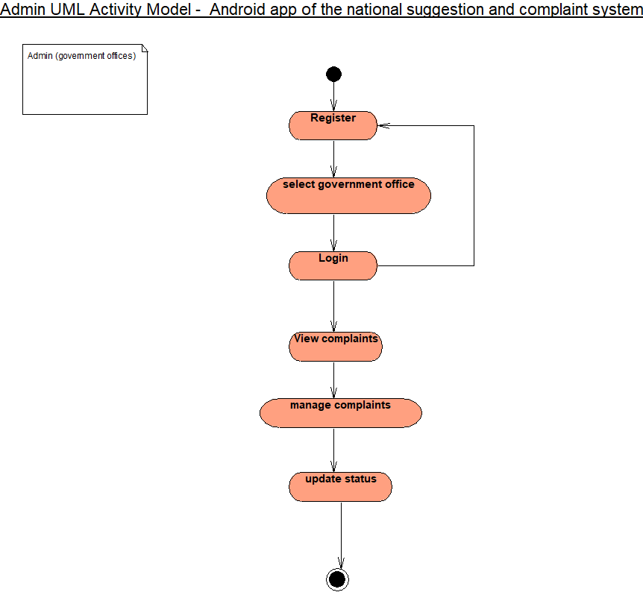
System Design

Slide 5
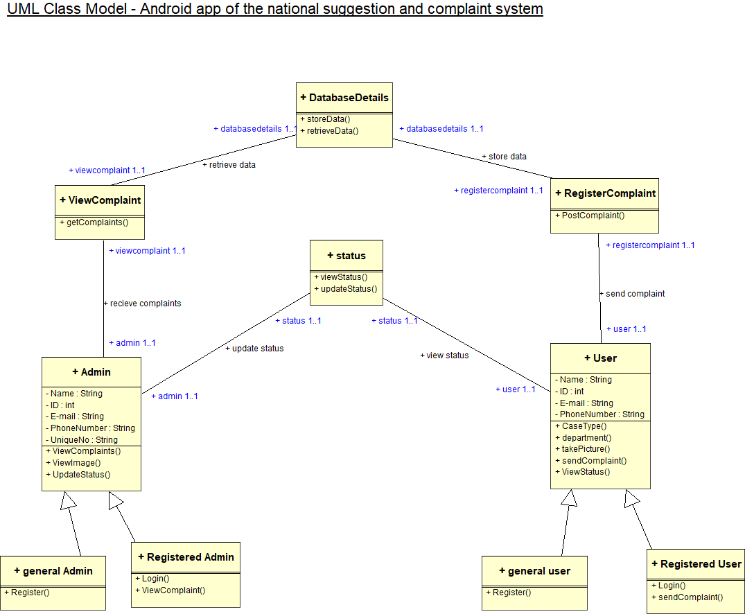
System Design

Slide 6
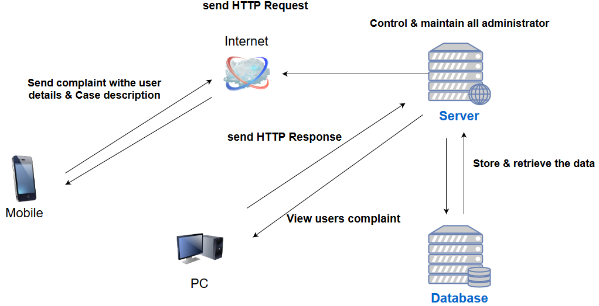
system architecture

Slide 7
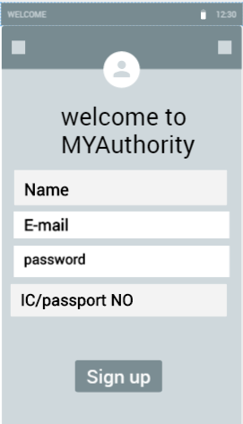
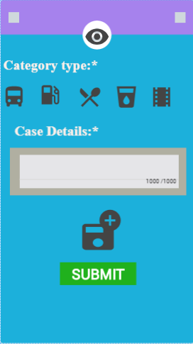
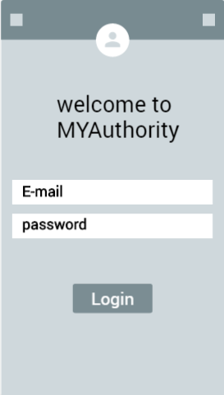
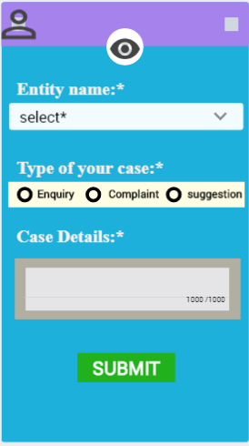
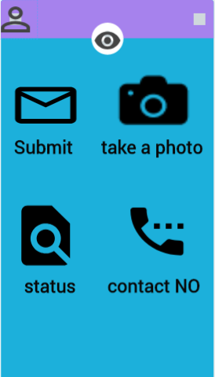
prototype

Slide 8
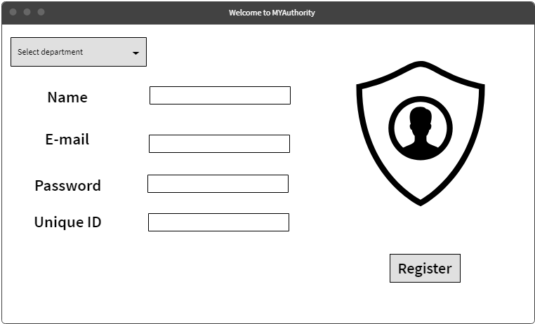
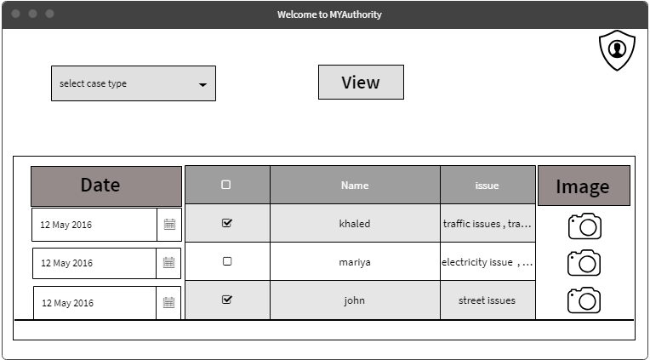
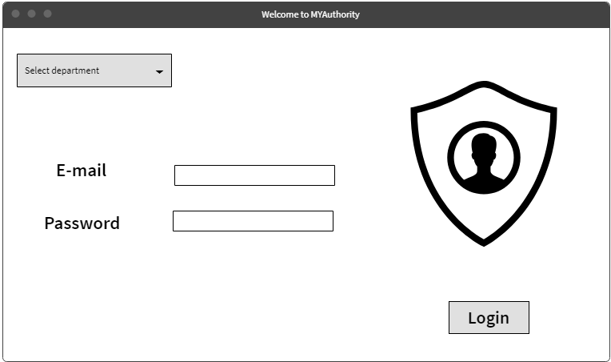
prototype

