Slide 1
Unified GTM & B2B Dashboard Concept
By: Iftekher Mamun
For: iHeartMedia

Slide 2
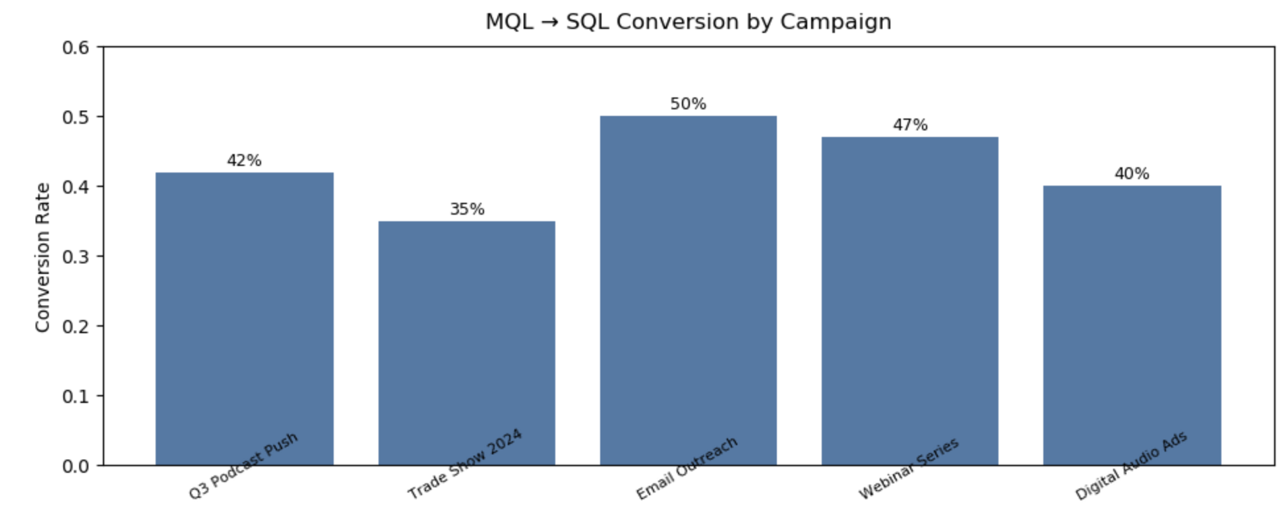
MQL → SQL Conversion by Campaign
Shows which campaigns are generating sales-ready leads, enabling the marketing and sales teams to focus budget and resources where they will yield the highest impact.
Supports campaign optimization and improves lead quality in alignment with revenue goals.

Slide 3
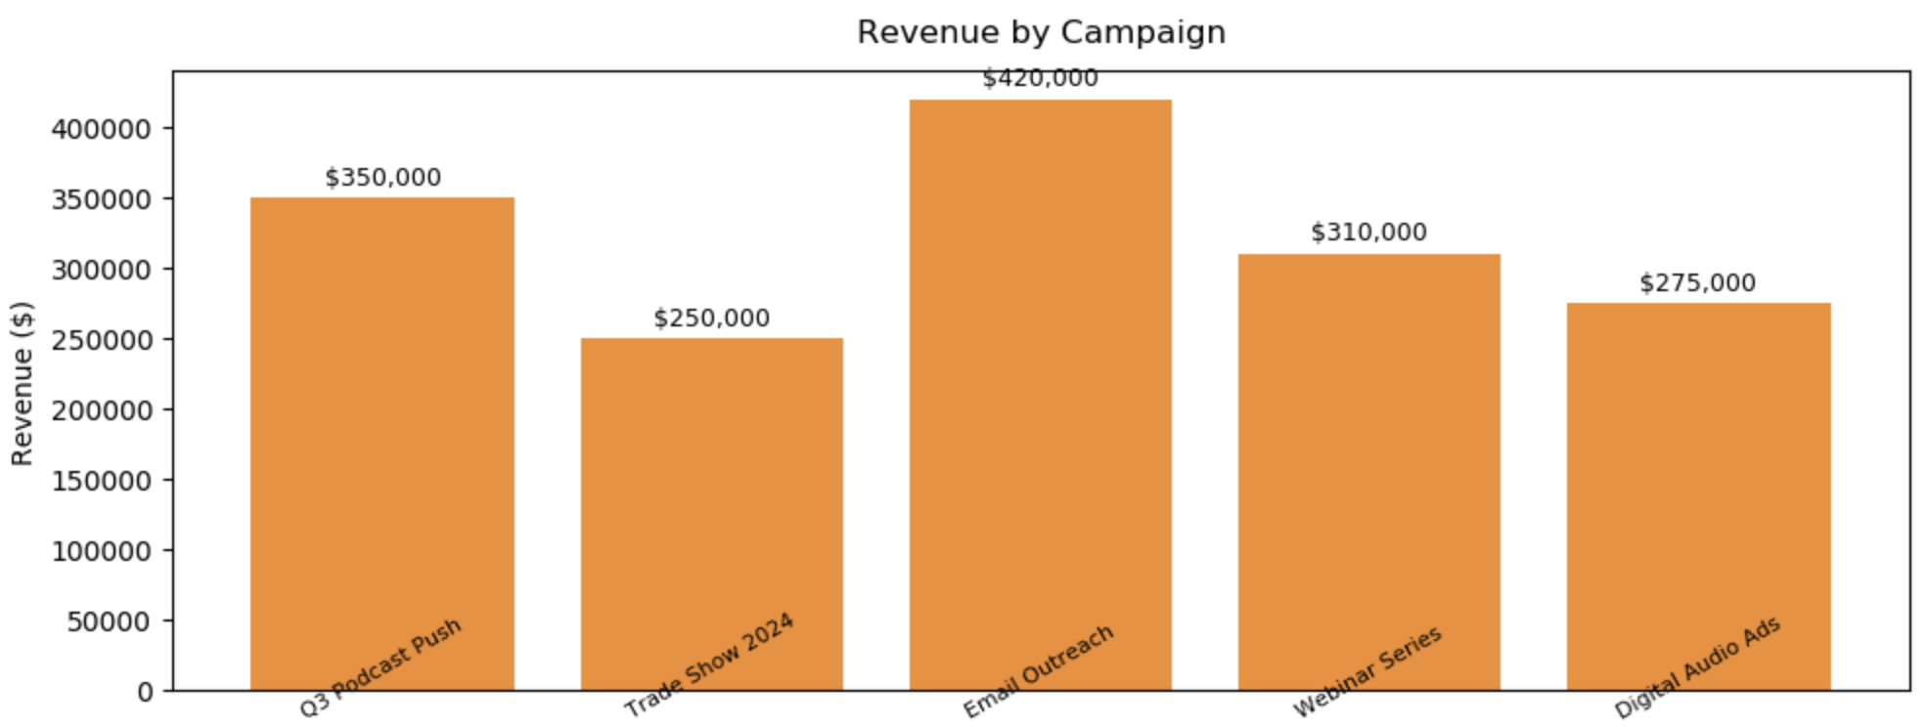
Revenue by Campaign
Connects marketing activities directly to revenue impact — a key motivator for sales teams. Enables prioritization of GTM initiatives that deliver the greatest ROI, making performance conversations more data-driven.

Slide 4
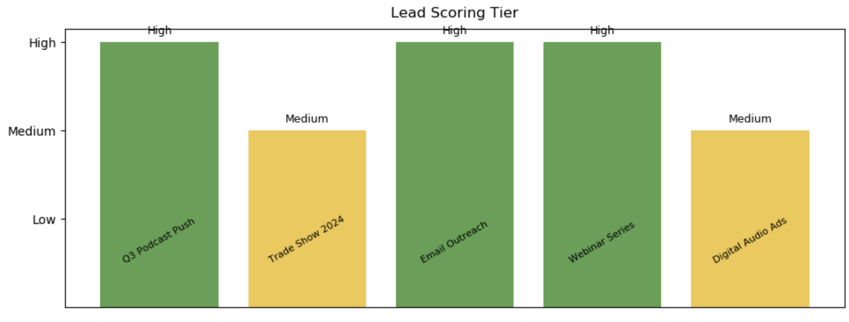
Lead Scoring Tier
Visualizes lead quality at a glance, allowing sales teams to prioritize outreach to high-potential prospects.
Supports consistent scoring models and fosters cross-team alignment on lead definitions and follow-up urgency.

Slide 5
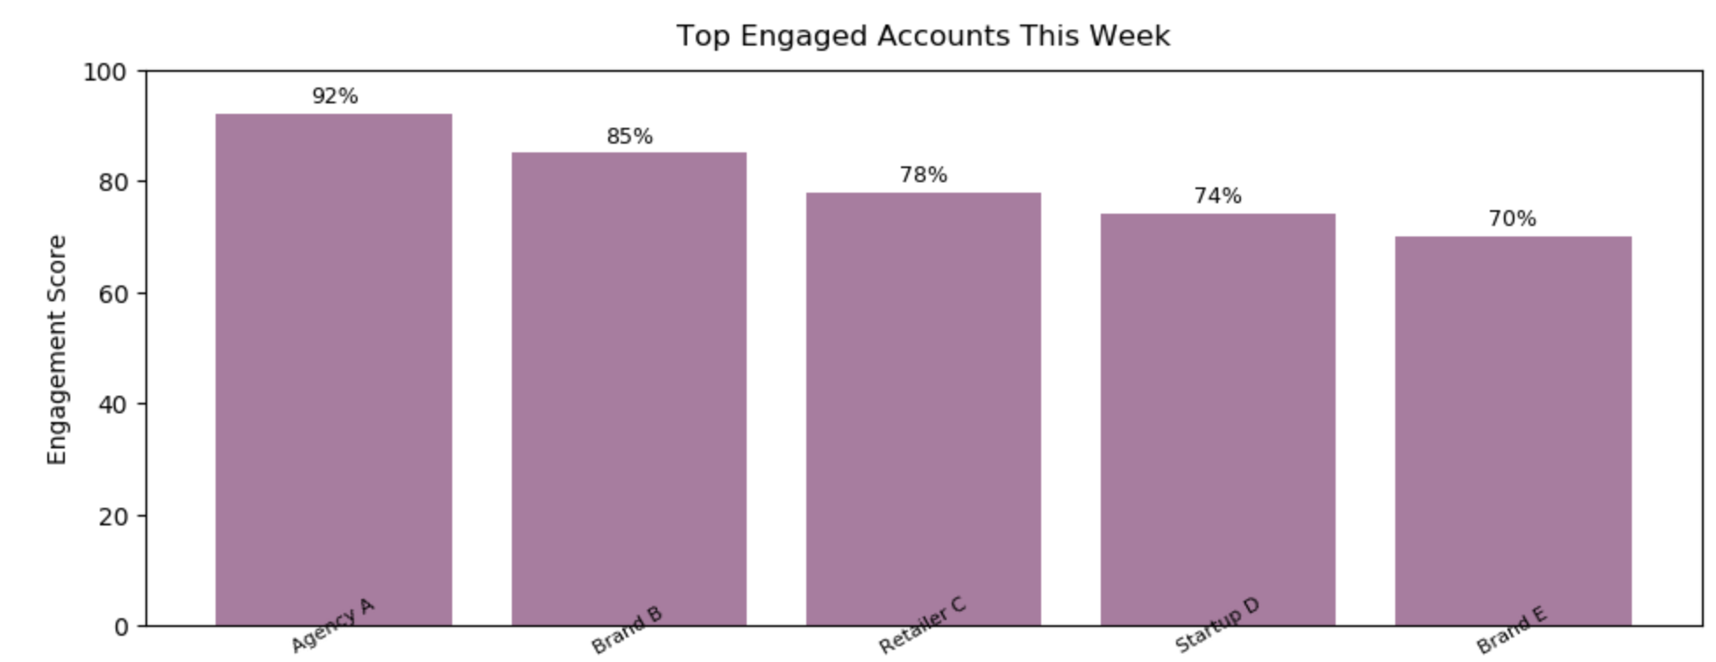
Top Engaged Accounts
Highlights the most engaged accounts in real time, providing a shortlist for immediate sales action. Improves funnel velocity and ensures sales efforts target the warmest opportunities.

