Slide 1
BIE 33103 DOTNET PROGRAMMING
Semester 1 Session 2023/2024
CHAPTER 4: GUI PROGRAMMING

Slide 2
OVERVIEW
GUI programming
Introduction to GUI
Learn about ASP.NET Web forms and server controls
Work with ASP.NET Web server controls
Validate user input with validation controls

Slide 3
Introduction to GUI
A graphical user interface (GUI) is an interface which allows a user to interact with electronic devices such as computer.
Through graphical icons
GUI program has the following structure:
Create the icons and widgets
Define functions that will process user and application events
Associate specific user events with specific functions
Start an infinite event-loop that processes user events. When a user event happens, the event-loop calls the function associated with that event.

Slide 4
GUI application in ASP.net
Window form application
Web page application

Slide 5
Introduction to Web Forms and Controls
ASP.NET provides features that allow you to quickly build Web Forms pages using ASP.NET controls
ASP.NET controls are similar to HTML elements for forms and controls

Slide 6
Understanding ASP.NET Web Forms and Server Controls
Web page forms are used primarily to submit user data to a server for processing
Data received by a form submission is usually a text string assigned to the Request.QueryString and Request.Form collections
JavaScript can be used to validate the form data before submission to a server-side program
JavaScript can be bypassed by appending a query directly to the URL

Slide 7


Request.QueryString
Example:
In default.aspx
In default2.aspx

Slide 8
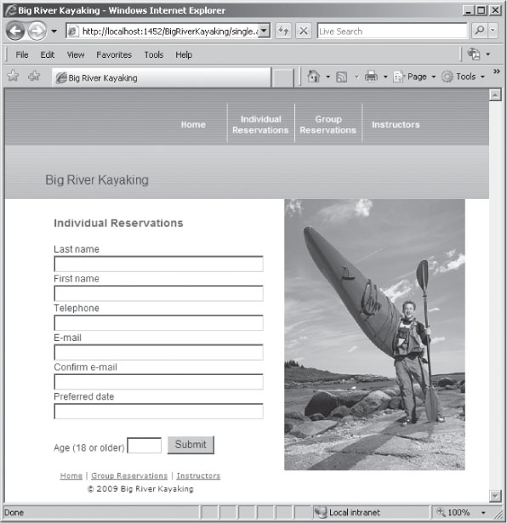
Figure 4-1: Big River Kayaking Individual Reservations page

Slide 9
Using a Single Page to Handle a Standard HTML Form
To process form data, you should first check to ensure that the form fields are not empty
Test the QueryString values for null or “ ”
Must convert the string data to numeric data types to do calculations
Use TryParse() method to ensure that the submitted form value can be safely converted to a numeric data type
Syntax: type.TryParse(string, out variable)
TryParse() returns false if there is no value
Eg:
int a;
bool result;
string myString = “23”;
result = int.TryParse(myString, out a);
Console.WriteLine(“String is numeric!” + result);

Slide 10
Using Web Forms
Web forms: used to build dynamic interfaces containing Web server controls to:
Access data sources
Validate user input
Handle site navigation
Manage security issues such as logins and password recovery
Perform other tasks
Web forms and their server controls can be controlled programmatically with ASP.NET

Slide 11
Using Web Forms (cont..)‏
default.aspx file contains a form element with this setting to specify that it is an ASP.NET Web form:
<form runat=“server”>
Web form only submits data to itself; you cannot submit a Web form to another page
By default, the form’s data will be posted back to the Web page itself – a process called post back
View state: determines whether or not data is posted back to a Web page
With post back and view state, you do not need to retrieve form data with Response.QueryString or Response.Form collections

Slide 12
Using Web Forms (cont..)‏
Web server TextBox control is equivalent to <input type=“text”> HTML element
Web server Button control is equivalent to the HTML button element
Web server controls can be programmatically accessed and manipulated on the server with an ASP.NET program
HTML elements can only be accessed and manipulated on the client with JavaScript
Web server controls all include runat=“server” attribute

Slide 13
Using Web Forms (cont..)‏
View state is maintained by assigning form values to the value attribute of a hidden form field called _VIEWSTATE
Values are encoded with Base64, which allows non-alphanumeric characters to be included
View state is enabled by default but can be disabled in the page directive:
<%@ Page Language=“C#” EnableViewState=“false” %>
Can also be disabled in the control element’s opening tag

Slide 14
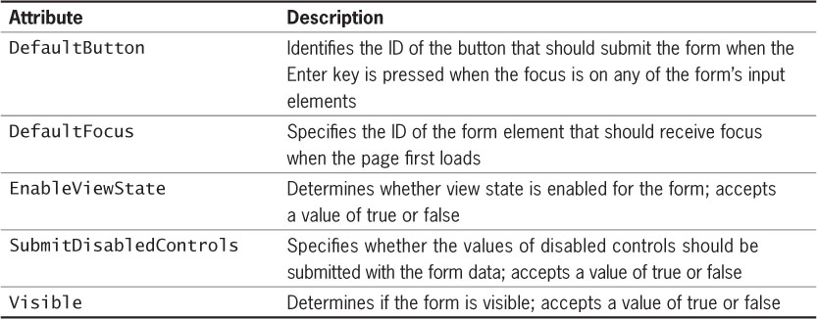
Using Web Forms (cont..)‏
Table 4-1 ASP.NET Web form attributes

Slide 15
Using Web Forms (cont..)‏
ASP.NET form attributes can be assigned on the <form> tag
Example: <form ID=“form1” runat=“server” DefaultButton=“submitOrder”>
ASP.NET attributes can be set programmatically with C# by appending the attribute name to the control’s ID value with a period
Example: creditCardNum.EnableViewState=“false”;

Slide 16
Using Web Forms (cont..)‏
Use the Text property of a Textbox’s ID to retrieve its current value
Example:
string shippingAddress = address.Text;
After the server-side program processes the data, it is returned to the same Web form page
Use the form’s Visible attribute to hide the form and display a message indicating successful submission
Use the Page class’s IsPostBack property to determine whether a Web form has already been submitted and determine if data must be validated

Slide 17
Understanding Events
Event: a specific circumstance, such as a user action, that is monitored by the browser
Example: when a user clicks a button, the Click event is generated, or raised
Three types of events are supported by ASP.Net:
Application events
Page events
Control events
An XHTML element can be associated with a specific event to trigger code written in JavaScript, VBScript, or other client-side scripting languages

Slide 18
Application and Session Events
The most important application events are:
Application_Start - It is raised when the application/website is started.
Application_End - It is raised when the application/website is stopped.
Similarly, the most used Session events are:
Session_Start - It is raised when a user first requests a page from the application.
Session_End - It is raised when the session ends.

Slide 19
Page and Control Events
Common page and control events are:
DataBinding - It is raised when a control binds to a data source.
Disposed - It is raised when the page or the control is released.
Error - It is a page event, occurs when an unhandled exception is thrown.
Init - It is raised when the page or the control is initialized.
Load - It is raised when the page or a control is loaded.
PreRender - It is raised when the page or the control is to be rendered.
Unload - It is raised when the page or control is unloaded from memory.

Slide 20
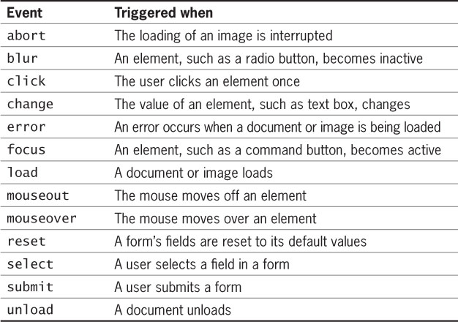
Understanding Events (cont..)‏
Table 4-2 JavaScript events

Slide 21

Understanding Events
Example of event-raised
Event handler

Slide 22
Writing Event Handlers
Event handler: a function or method that executes in response to a specific event
Default name for a page event handler is Page_eventname()
Example: Load event is Page_Load()
Event handler methods require two parameters:
An object argument representing the raised event
An EventArgs parameter used for passing data with an event
For page events, the parameters will not contain any values
Page events are contained in the Page class

Slide 23
Writing Event Handlers (cont..)‏
Code-behind page: preferred method for working with C# code
Is a separate class file containing properties for an associated page
Has a file extension of .cs
Example: the code-behind page for a Default.aspx file is Default.aspx.cs

Slide 24
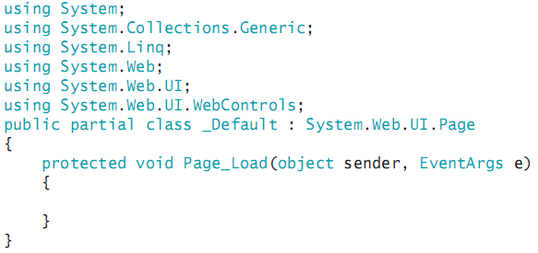
Writing Event Handlers (cont..)‏
Each code-behind page has the following code:

Slide 25
Writing Event Handlers (cont..)‏
Namespace: a container that manages identifiers in a C# program
Access specifier: determines the availability of a class’s methods and properties
Protected access specifier only allows the class to access the method or property
Specify the name of control events as function or method name, followed by event name
Example: calcShipping_Click

Slide 26
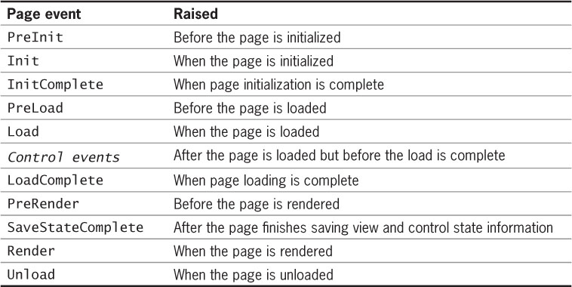
Writing Event Handlers (cont..)‏
Table 4-3 ASP.NET page events

Slide 27
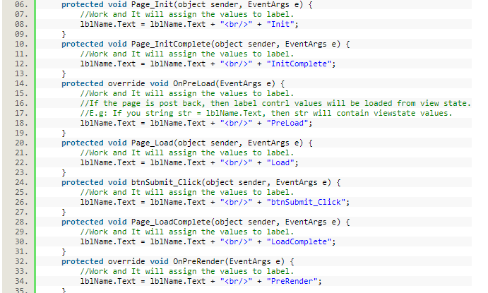
Writing Event Handlers (cont..)‏
Try it!
Table 4-3 ASP.NET page events

Slide 28
Working with Control Events
With ASP.NET server controls, post back occurs every time a server control event executes
The form is submitted every time a control event occurs
Page events therefore execute each time a response is returned to the client
May wish to use JavaScript for certain tasks to avoid this extra traffic to the server and back

Slide 29
What Are the Different Types of Controls?
ASP.NET supports three types of controls:
Server controls: special types of HTML controls that run on the server and can be programmatically accessed and manipulated by ASP.NET programs
User controls: customized types of controls consisting of multiple server controls and HTML elements
Web parts controls: allow users to directly control the behavior and appearance of an ASP.NET page from within the browser

Slide 30
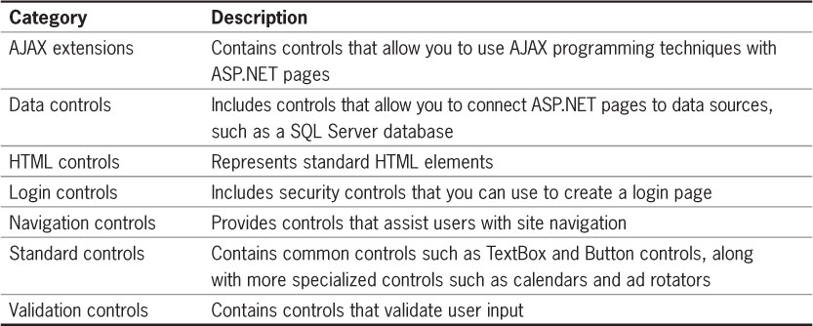
What Are the Different Types of Controls? (cont..)‏
Table 4-4 Server control categories

Slide 31
What Are the Different Types of Controls? (cont..)‏
Add ASP.NET controls to the form by dragging them from the Toolbox to the <form> element
Code will be added to the Web form when you drag a control onto it
A tag pair for the control is also added
Can also format some server controls as empty elements, with no ending tag

Slide 32
Using ASP.NET Standard Controls
Each server control has multiple methods, properties, and events
Methods, properties, and events that are common to more than one control are contained in the Control class
If a control will not need to be programmatically available to the ASP.NET program, use the equivalent HTML element instead

Slide 33
Text and Image Controls
Label control: equivalent to the HTML <label> element
Used to set and modify text appearing on a page
<label> HTML element: associated with and appears as a label for only one form control
accesskey attribute indicates the form control with which the label is associated
ASP.NET Label control:
AssociatedControlID property associates it with a control

Slide 34
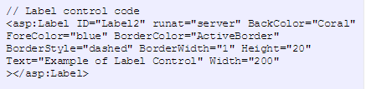

Text and Image Controls
Label control, example:

Slide 35
Text and Image Controls (cont..)‏
If the Label control has a tag pair, its contents are displayed as the label’s text
If the Label control is created as an empty element, use the Text property to specify the label’s text
Literal control: adds literal text that is not rendered in any HTML elements but can be created and manipulated programmatically on the server
Example: can modify the contents of a Label control by manipulating a Literal control’s value

Slide 36
Text and Image Controls (cont..)‏
Image control: adds an image that is rendered with the HTML <img> element
ImageURL property: used to identify the file associated with the image control
AlternateText property: equivalent to the alt HTML attribute of an <img> element
Height and Width properties: equivalent to the height and width attributes of an <img> element
Specify the height and width of an image to allow the browser to reserve space for the image and load the rest of the page while the image is being downloaded

Slide 37
Hyperlink Controls
HyperLink control: adds a hyperlink that is rendered with the HTML <a> element
NavigateURL property: specifies the link’s target URL
Text property: specifies the visible link text when using an empty element
ImageURL property: to use an image as a link anchor
Image map: allows users to click on an area of an image to navigate to another page
Hot spot: each region of an image associated with a URL

Slide 38
Hyperlink Controls (cont..)‏
ImageMap control: defines the image to be used for an image map
ImageURL property: specifies the image file to be used
To configure a hot spot within an image map, nest one of these controls within the ImageMap control:
<asp:circlehotspot> control: a circular hot spot
<asp:rectanglehotspot> control: a rectangular hot spot
<asp:polygonhotspot> control: a polygon hot spot
Must specify coordinates for the shapes

Slide 39
Hyperlink Controls (cont..)‏
HotSpotMode property: determines the behavior of a hot spot:
Inactive value: disables the hot spot
Navigate value: causes the page to navigate to the specified URL
NotSet value: each hot spot without a value assigned to its own HotSpotMode property navigates to its specified target URL
Postback value: the Web form will post back to itself

Slide 40

Figure 4-5 Medical research center image map hot spots

Slide 41
Hyperlink Controls (cont..)‏
When using Postback value for HotSpotMode property:
Must create a click event handler for the image map
Requires a second parameter defined with the ImageMapEventArgs parameter
ImageMapEventArgs parameter allows you to access the PostBackValue property to identify which hot spot was clicked

Slide 42
Form Controls
Standard HTML <input> element allows you to create several types of form controls:
Text boxes and password boxes
Radio buttons
Check boxes
Push buttons, submit buttons, and reset buttons
File boxes
Image submit buttons
ASP.NET provides separate controls for each of these, but each is rendered with the <input> element

Slide 43
TextBox and HiddenField Controls
TextBox control: equivalent to <input type = “text”> HTML element
TextMode property: determines the behavior of the TextBox control:
SingleLine: allows only one line of text
MultiLine: allows multiple lines of text
Password: text input is obscured
HiddenField control: creates a form field rendered with <input type = “hidden”>
Value property: manipulates the value in a hidden field

Slide 44
Button, ImageButton, and LinkButton Controls
Button control: creates two types of buttons
Submit button: causes a Web form to post back to itself (default functionality)
Push button: similar to OK and Cancel buttons in dialog boxes
UseSubmitBehavior:
True: specifies that this button is the submit button, rendered with <input type=“submit”> element
False: creates a push button, rendered with <input type=“button> element

Slide 45
Button, ImageButton, and LinkButton Controls (cont..)‏
ImageButton control: creates an image submit button with a graphical image
Renders with <input type=“image”> element
ImageURL property: specifies the image to use
LinkButton control: creates a hyperlink that posts the form to the server instead of navigating to another URL
Renders with <a> element

Slide 46
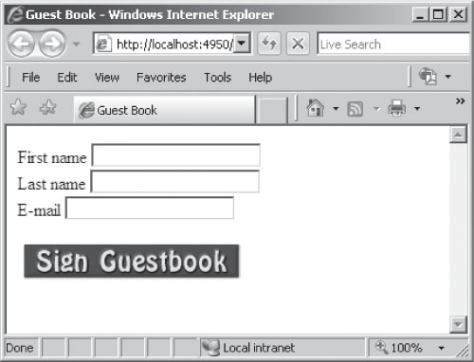
Button, ImageButton, and LinkButton Controls (cont..)‏
Figure 4-7 Form with an image button

Slide 47
RadioButton and RadioButtonList Controls
Radio buttons (or option buttons): groups of controls from which only one selection can be made
RadioButton or RadioButtonList controls:
Render with <input type=“radio”/> element
GroupName property: assigns a radio button to a specified group
Text property: unique value associated with the button
Checked property: indicates if the button was selected

Slide 48
RadioButton and RadioButtonList Controls (cont..)‏
RadioButtonList control: provides an easy way to organize individual radio buttons
Nest ListItem controls within each RadioButtonList control to represent individual radio buttons
SelectedItem property: used to determine which item was selected

Slide 49
CheckBox and CheckBoxList Controls
CheckBox control: allows multiple selections from a group of items
Renders with <input type=“checkbox”/>
Checked property: indicates if check box was selected
CheckedChanged event: executes when the user clicks the check box
By default, this does not cause post back
AutoPostBack property: value of true will cause post back to occur

Slide 50
CheckBox and CheckBoxList Controls (cont..)‏
CheckBoxList control: provides an easy way to organize multiple check boxes
Nest ListItem controls within the CheckBoxList control to represent individual check boxes
Items collection: used to iterate through the check boxes
Selected property: indicates if an item was selected
RepeatColumns property: how many columns are used to display the check boxes

Slide 51
CheckBox and CheckBoxList Controls (cont..)‏
CheckBoxList control (cont’d.):
RepeatDirection property: determines vertical or horizontal layout
RepeatLayout property: determines whether check box list is laid out in a table

Slide 52
ListBox and DropDownList Controls
HTML <select> element creates a fixed selection list of choices
ListBox control: creates a list of choices
DropDownList control: creates a drop-down style menu
Nest ListItem controls within these controls to represent each list item
Selected property: indicates which item was selected

Slide 53
ListBox and DropDownList Controls (cont..)‏
ListBox control properties include:
SelectionMode: determines whether multiple items can be selected
Rows: specifies how many list items to display

Slide 54
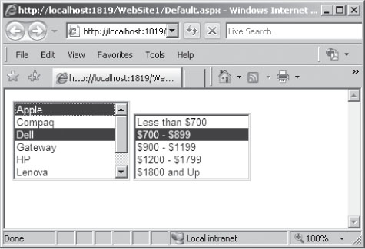
ListBox and DropDownList Controls (cont..)‏
Figure 4-8 Two selection lists

Slide 55
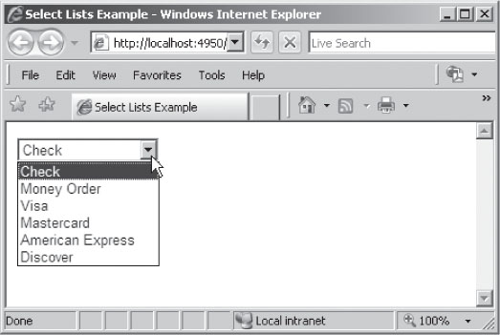
ListBox and DropDownList Controls (cont..)‏
Figure 4-9 Drop-down list

Slide 56
Common control events
Event | Attribute | Controls
Click | OnClick | Button, image button, link button, image map
Command | OnCommand | Button, image button, link button
TextChanged | OnTextChanged | Text box
SelectionIndexChanged | SelectionIndexChanged | Drop-down list, list box, radio button list, check box list
CheckedChanged | OnCheckedChanged | CheckBox , radio button

Slide 57
ListBox and DropDownList Controls (cont..)‏
Some events cause the form to be posted back to the server immediately, these are called the postback events.
For example, the click event such as, Button.Click.
Some events are not posted back to the server immediately, these are called non-postback events.
For example, the change events or selection events such as TextBox.TextChanged or CheckBox.CheckedChanged.
The non-postback events could be made to post back immediately by setting their AutoPostBack property to true.

Slide 58
Default Event
The default event for the Page object is Load event.
Similarly, every control has a default event. For example, default event for the button control is the Click event.
The default event handler could be created in Visual Studio, just by double clicking the control in design view. true.

Slide 59
Some default events for common control
Control | Default Event
AdRotator | AdCreated
BulletedList | Click
Button | Click
Calender | SelectionChanged
CheckBox | CheckedChanged
CheckBoxList | SelectionIndexChanged
DataGrid | SelectionIndexChanged
DataList | SelectionIndexChanged
DropDownList | SelectionIndexChanged
Hyperlink | Click

Slide 60
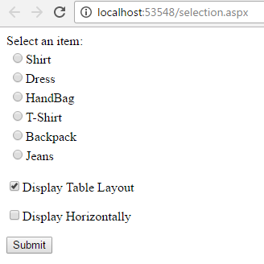
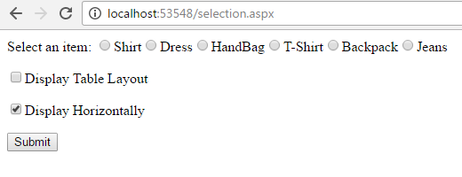
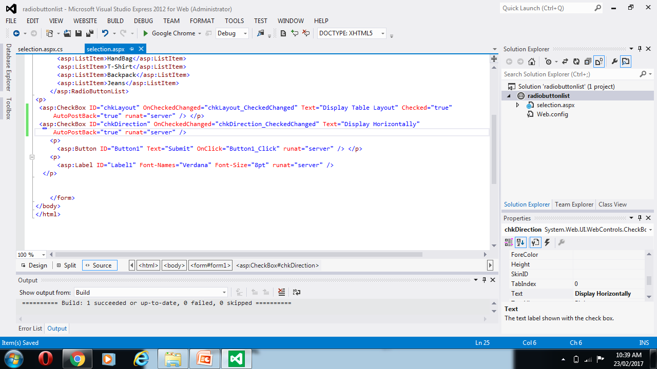
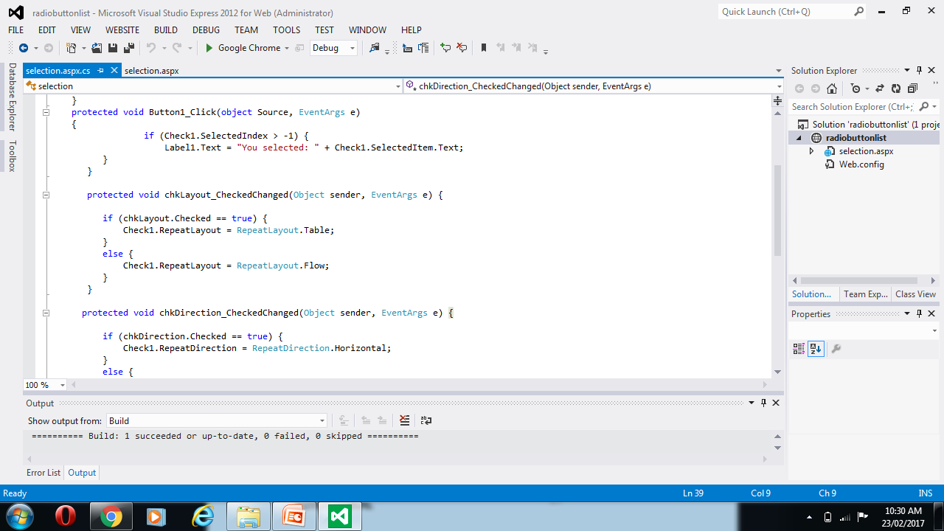
Example:
B
A

Slide 61
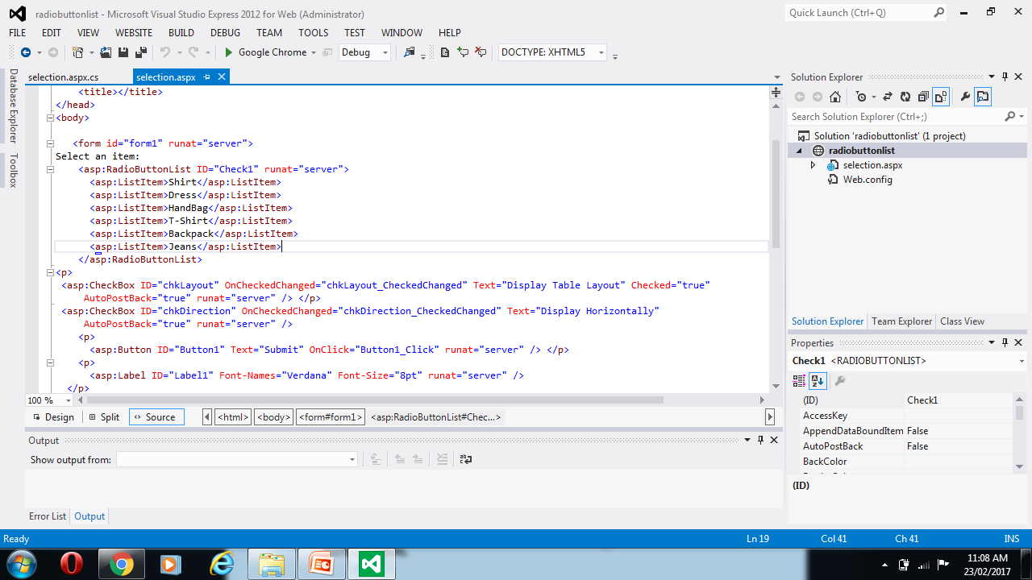
Example:

Slide 62
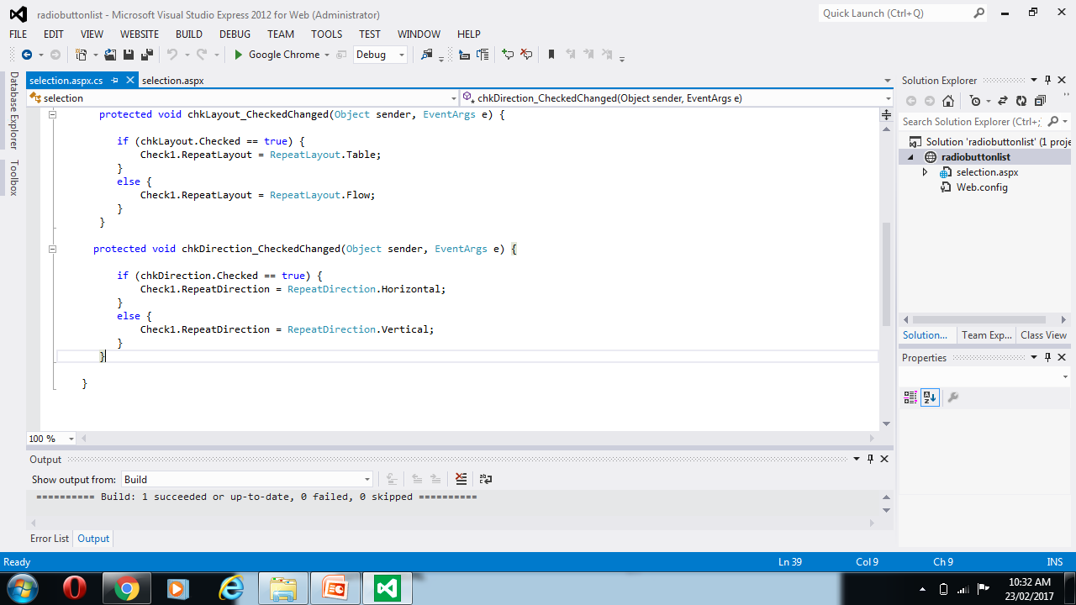

Slide 63
Validating User Input with Validation Controls
ASP.NET offers validation controls for validating user input
Two of the most commonly used validation controls:
RequiredFieldValidator control
CompareValidator control

Slide 64
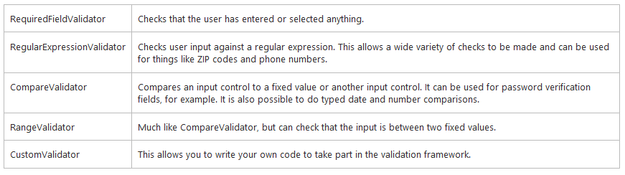
Validating User Input with Validation Controls

Slide 65
RequiredFieldValidator Control
RequiredFieldValidator control: ensures that a value is entered into a specified field on a Web form
Text property: contains the error message that will appear if the field is empty when the user tries to submit the form
ControlToValidate property: the field that is to be validated

Slide 66
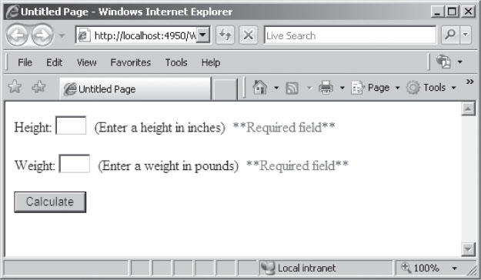
RequiredFieldValidator Control (cont..)‏
Figure 4-10 BMI program with RequiredFieldValidator controls

Slide 67
CompareValidator Control
CompareValidator control: verifies that the entered value is a specific data type
Text property: the message to appear if the data type of the entered value is incorrect
ControlToValidate property: the form field to be validated
ControlToCompare property: another field against which the field being validated is to be compared
Type property: the data type that must be used
Operator property: the comparison type to perform
ValueToCompare property: the value to be used in the comparison test

Slide 68
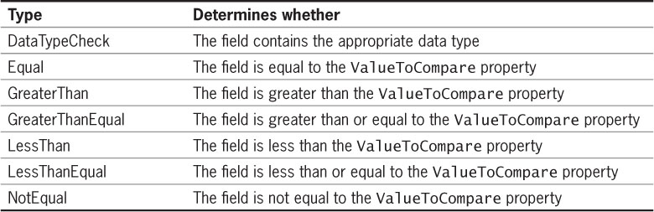
CompareValidator Control (cont..)‏
Table 4-5 Comparison types of the Operator property

Slide 69
Summary
Use a conditional expression to test if a submitted variable contains a null value
Use TryParse() method to convert a string variable to a numeric data type
Web Forms are used to quickly build dynamic interfaces using Web server controls
Post back is the process by which form data is posted back to the same page by a Web form
Use the Page class’s IsPostBack property to determine whether a Web form has already been submitted

Slide 70
Summary (cont..)‏
An event is a special circumstance monitored by the browser, to which your program can respond
A function or method that executes in response to a specific event is called an event handler
A code-behind page is a C# class file containing the C# methods and properties associated with an ASP.NET Web page
Post back occurs each time that a server control event is raised
Server controls are special types of HTML controls that can be programmatically manipulated

Slide 71
Summary (cont..)‏
A user control is a customized control containing multiple server controls and HTML elements
Web parts controls allow users to control the behavior and appearance of an ASP.NET page from within the browser
Image maps provide clickable areas on images for navigating to different Web pages
RequiredFieldValidator controls ensure that a value is entered into a specified field
CompareValidator control verifies that an entered value is of the specified data type

Slide 72
THANK
YOU

