Slide 1
CO203
Part-II

Slide 2
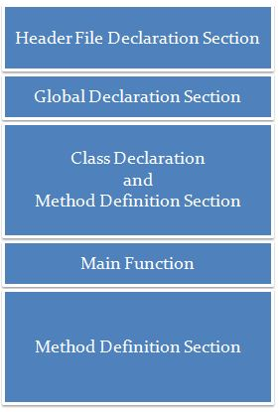
Basic Structure of C++ Programme

Slide 3
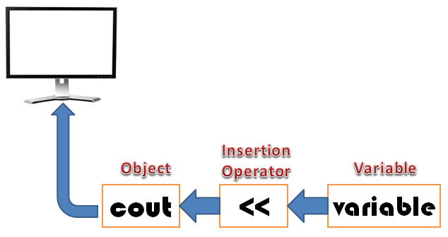
First Program
// my first program in C++
#include <iostream>
int main()
{
cout << "Hello World!";
}
Insertion Operator
Object

Slide 4
Classes
Data + Functions
Close to Built-in Data Type
Data Hiding
Inheritance
Revisit Structures in C and Compare
struct complex
{
float x;
float y;
};
struct complex c1,c2,c3;
Note: No data hiding

Slide 5
Define a Class (in C++)
Example
class Test
{
private:
int data1;
float data2;
public:
void function1()
{
data1 = 2;
}
float function2()
{
data2 = 3.5;
return data2;
}
};
class className
{
// some data
// some functions
};

Slide 6
Objects (in C++)
When class is defined, only the specification for the object is defined; no memory or storage is allocated.
To use the data and access functions defined in the class, you need to create objects
Syntax to Define Object in C++
Declaration similar to any built-in Data Type
className objectVariableName;
Example
class Test
{
private:
int data1;
float data2;
public:
void function1()
{
data1 = 2;
}
float function2()
{
data2 = 3.5;
return data2;
}
};
int main()
{
Test o1, o2;
}
Array of Objects
class item
{
----
----
}x,y,z;
item x[10];
Array of objects

Slide 7
Access Data Member And Member Function In C++
Data Members and Member Functions can be accessed by a . (dot) operator
o2.function1();
o1.data2 = 5.5;
This will call the function1() function inside the Test class for objects o2.
Access to Data Member

Slide 8
Defining Member Functions
Outside the class
Inside the class
return_type class_name::function_name(arg dec)
{
----
----
}
Treated as inline function

Slide 9
Abstract Classes & Interfaces
abstract methods = Methods that are declared, with no implementation
abstract class = A class with abstract methods, not meant to be instantiated
interface = A named collection of method definitions (without implementations)

Slide 10
Examples
Food is an abstract class. Can you make an instance of food? No, of course not. But you can make an instance of an apple or a steak or a peanut butter cup, which are types of food. Food is the abstract concept; it shouldn’t exist.
Skills are interfaces. Can you make an instance of a student, an athlete or a chef? No, but you can make an instance of a person, and have that person take on all these skills. Deep down, it’s still a person, but this person can also do other things, like study, sprint and cook.

Slide 11
Abstract Class
Superclasses are created through the process called "generalization"
Common features (methods or variables) are factored out of object classifications (ie. classes).
Those features are formalized in a class. This becomes the superclass
The classes from which the common features were taken become subclasses to the newly created super class
Often, the superclass does not have a "meaning" or does not directly relate to a "thing" in the real world
It is an artifact of the generalization process
Because of this, abstract classes cannot be instantiated
They act as place holders for abstraction

Slide 12
Abstract Class Example
In the following example, the subclasses represent objects taken from the problem domain.
The superclass represents an abstract concept that does not exist "as is" in the real world.
Abstract superclass:
Vehicle
- make: String
- model: String
- tireCount: int
Note: UML represents abstract
classes by displaying their name
in italics.
Car
- trunkCapacity: int
Truck
- bedCapacity: int

Slide 13
What Are Abstract Classes Used For?
Abstract classes are used heavily in Design Patterns
Creational Patterns: Abstract class provides interface for creating objects. The subclasses do the actual object creation
Structural Patterns: How objects are structured is handled by an abstract class. What the objects do is handled by the subclasses
Behavioural Patterns: Behavioural interface is declared in an abstract superclass. Implementation of the interface is provided by subclasses.
Be careful not to over use abstract classes
Every abstract class increases the complexity of your design
Every subclass increases the complexity of your design
Ensure that you receive acceptable return in terms of functionality given the added complexity.

Slide 14
Defining Abstract Classes
Inheritance is declared using the "extends" keyword
If inheritance is not defined, the class extends a class called Object
public abstract class Vehicle
{
private String make;
private String model;
private int tireCount;
[...]
Vehicle
- make: String
- model: String
- tireCount: int
public class Car extends Vehicle
{
private int trunkCapacity;
[...]
Car
- trunkCapacity: int
Truck
- bedCapacity: int
public class Truck extends Vehicle
{
private int bedCapacity;
[...]
Often referred to as "concrete" classes

Slide 15
What is an Interface?
An interface is similar to an abstract class with the following exceptions:
All methods defined in an interface are abstract. Interfaces can contain no implementation
Interfaces are more abstract than abstract classes
Interfaces are implemented by classes using the "implements" keyword.

Slide 16
Declaring an Interface
In Steerable.java:
public interface Steerable
{
public void turnLeft(int degrees);
public void turnRight(int degrees);
}
When a class "implements" an
interface, the compiler ensures that
it provides an implementation for
all methods defined within the
interface.
In Car.java:
public class Car extends Vehicle implements Steerable
{
public int turnLeft(int degrees)
{
[...]
}
public int turnRight(int degrees)
{
[...]
}

Slide 17
Abstract Classes Vs Interfaces
An interface cannot implement any methods, whereas an abstract class can
A class can implement many interfaces but can have only one superclass (abstract or not)
An interface is not part of the class hierarchy. Unrelated classes can implement the same interface

Slide 18
Syntax
abstract class:
public class Apple extends Food { … }
interface:
public class Person implements Student, Athlete, Chef { … }

Slide 19
Why they are useful…?
By leaving certain methods undefined, these methods can be implemented by several different classes, each in its own way.

Slide 20
An abstract class can’t inherit from more than one other class.
Interfaces can inherit from other interfaces, and a single interface can inherit from multiple other interfaces
Example:
interface Singer {
void sing();
void warmUpVoice();
}
interface Dancer {
void dance();
void stretchLegs();
}
interface Talented extends Singer, Dancer {
// can sing and dance. Wowwee.
}

Slide 21
Type Casting
static_cast<char>var1;
OR
(char)var1;
OR
Char(var1);

Slide 22
Abstract Classes (C++)
Abstract class cannot be instantiated, but pointers and references of Abstract class type can be created.
Abstract class can have normal functions and variables along with a pure virtual function.
Classes inheriting an Abstract Class must implement all pure virtual functions, or else they will become Abstract too.

Slide 23
Abstract classes (C++) Cont…
An abstract class contains at least one pure virtual function.
Example:
class AB {
public:
virtual void f() = 0;
};

Slide 24
Virtual function
A virtual function is a member function in base class that you expect to redefine in derived classes. (Virtual Function is overridden in derived class)
Tells the compiler to perform late binding (Function call resolve at run time i.e. Dynamic Binding or Runtime Binding)

Slide 25
Base pointer, when contains address of derived class, always executes the functions from base class.
Then, how the polymorphism can be achieved?
Virtual Function is the solution
Tells the compiler to perform late binding

Slide 26
class Base
{
public:
void show()
{
cout << "Base class";
}
};
class Derived:public Base
{
public:
void show()
{
cout << "Derived Class";
}
}
int main()
{
Base* b; //Base class pointer
Derived d; //Derived class object
b = &d;
b->show(); //Early Binding Ocuurs
}
Output : Base class
virtual void show()
Output : Base class

