Slide 1
Programming progression…
Programming has progressed through:
  machine code
  assembly language
  machine-independent programming languages
  procedures & functions
  objects

Slide 2
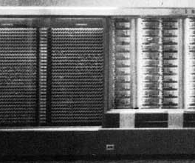
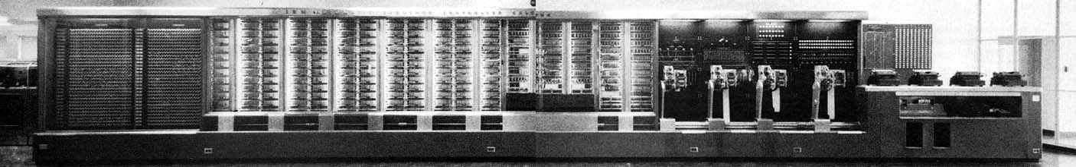
Machine language – Mark I

Slide 3
Machine Language
0000 1001 1100 0110 1010 1111 0101 1000
1010 1111 0101 1000 0000 1001 1100 0110
1100 0110 1010 1111 0101 1000 0000 1001
0101 1000 0000 1001 1100 0110 1010 1111

Slide 4
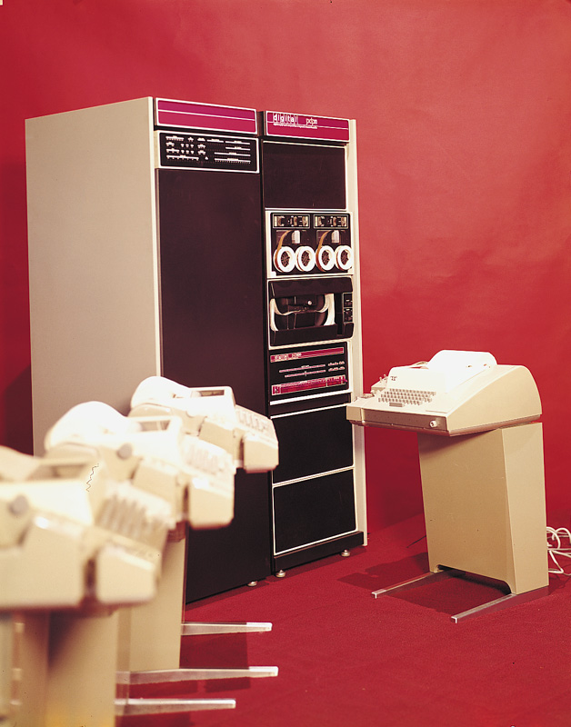
Assembly Language – PDP-11

Slide 5
Assembly Language – Macro-11
GCD: TST B
BEQ SIMPLE
MOV A, R5
SXT R4
DIV B, R4
MOV B, A
MOV R5, B
CALL GCD
SIMPLE: RETURN

Slide 6
Assembly Language – Macro-11
GCD: TST B
BEQ SIMPLE
MOV A, R5
SXT R4
DIV B, R4
MOV B, A
MOV R5, B
CALL GCD
SIMPLE: RETURN
20/20

Slide 7
Machine-Independent Programming Languages – Fortran
! This example program solves for roots of the quadratic equation,
! ax^2 +bx +c =0,for given values of a, b and c.
!
PROGRAM bisection
IMPLICIT NONE
INTEGER :: iteration
DOUBLE PRECISION :: CC, Er, xl, x0, x0_old, xr
! Set convergence criterion and guess for xl, xr.
CC = 1.d-4
xl = 8.d-1
xr = 11.d-1
! Bisection method.
Er =CC +1
iteration = 0
DO WHILE (Er > CC)
iteration = iteration + 1
! Compute x0 and the error.
x0_old = x0
x0 = (xl + xr) / 2.d0
Er = DABS((x0 - x0_old)/x0)*100.d0
WRITE (*,10) iteration, x0_old, x0, Er
10 FORMAT (1X,I4,3(2X,E10.4))
this is partial…

Slide 8
Procedures & Functions – Pascal
program ValueArg(output);
{Shows how to arrange for a procedure to have arguments.}
procedure PrintInitials(First, Last : char);
{Within this procedure, the names First and Last represent the argument values. We’ll call write to print them.}
begin
write(‘My initials are: ’);
write(First);
writeln(Last)
end; {PrintInitials}
begin
PrintInitials (‘D’, ‘C’); {Any two characters can be arguments.}
PrintInitials (‘Q’, ‘T’); {Like strings, characters are quoted.}
PrintInitials (‘&’, ‘#’)
end. {ValueArg}

Slide 9
Objects
(My examples will be from Java)
class Time {
private int hour, minute;
public Time (int h, int m) {
hour = h;
minute = m;
}
public void addMinutes (int m) {
int totalMinutes =
((60*hour) + minute + m) % (24*60);
if (totalMinutes<0)
totalMinutes = totalMinutes + (24*60);
hour = totalMinutes / 60;
minute = totalMinutes % 60;
}
}
this is partial…

Slide 10
Paradigm Shift in Programming
Programs: Data, Statements, Functions
Programming with flowchart
Program = Data Structure + Algorithms
Structured Programming
  Sequence Instructions
  Decision Making
  Looping

Slide 11
ALGORITHMS
An algorithm is a sequence of precise instructions for solving a problem in a finite amount of time.
Properties of an Algorithm:
It must be precise and unambiguous(accurate meaning)
It must give the correct solution in all cases
It must eventually end.

Slide 12
Understanding the Algorithm
Possibly the simplest and easiest method to understand the steps in an algorithm, is by using the flowchart method. This algorithm is composed of block symbols to represent each step in the solution process as well as the directed paths of each step. (Pictorial Representation of an Algorithm)

Slide 13
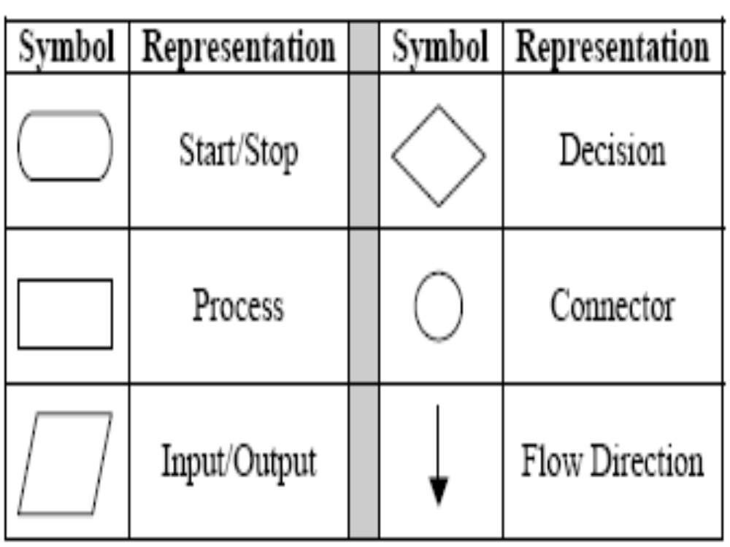
The most common block symbols are:

Slide 14
Problem for Flowchart
A variable is a symbolic name assigned to a computer memory which stores a particular value.
e.g. COUNTER, SUM, AVE
Calculate its Average ?

Slide 15
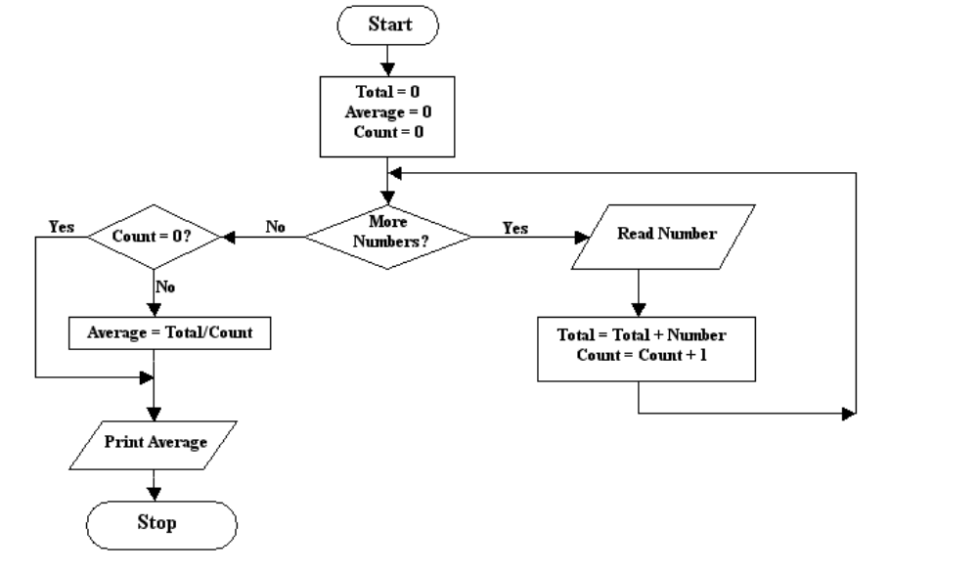
A flowchart representation of the algorithm for the above problem can be as follows:

Slide 16
History of Object-Oriented Programming
SIMULA I (1962-65) and SIMULA 67 (1967) were the first two object-oriented languages.
  Developed at the Norwegian Computing Center, Oslo, Norway by Ole-Johan Dahl and Kristen Nygaard .
  Simula 67 introduced most of the key concepts of object-oriented programming: objects and classes, subclasses (“inheritance”), virtual procedures.

Slide 17
Object-Oriented Programming
Programming for simulation
Software Crisis
Software Reuse
Software IC
Polymorphism,Inheritance and Encapsulation (PIE).
Classes as an Abstract Data Type(Abstraction)
Easy to debug and maintain
Mainstream in software development
Software components.

Slide 18
Object Oriented Languages
Eiffel (B. Meyer)
CLOS (D. Bobrow, G. Kiczales)
SELF (D. Ungar et al.)
Java (J. Gosling et al.)
BETA (B. Bruun-Kristensen, O. Lehrmann Madsen, B. Møller-Pedersen, K. Nygaard)
Other languages add object dialects, such as TurboPascal
C++ (Bjarne Stroustrup)

Slide 19
Structured Programming Concept(Modular Prog.)
Structured programming techniques assist the programmer in writing effective error free programs.
Top down approach
Overall program structure divided into separate subsections
This technique help to make isolated small pieces of code easier to understand without having to understand the whole program at once.
After a piece has been tested and studied in detail individually, it is than integrated into the overall program structure.
It is possible to write any computer program by using only three (3) basic control structures (logical concept’s) :
  Sequence instructions
  Decision Structure(if-else)
  Loop (While, Do While,…)
Ex. are Pascal , C, ADA

Slide 20
Procedural Programming
(Procedure oriented)
Top down approach
Procedures, also known as functions or methods simply contains a series of computational(Algorithmic) steps to be carried out.
procedural programming specify the syntax and procedure to write a program.
Big program is a divided into small pieces.
Functions are more important than data.
Input- arguments, output-return values.
Ex. are C, Algol etc.

Slide 21
Top down approach
A complex program divides into smaller pieces, makes efficient and easy to understand a program.
Begins from the top level.
Emphasize the planning and complete understanding of a program
No coding can begins until a sufficient level of module details has been reached.

Slide 22
Advantages of the Top-Down
Design Method
• It is easier to comprehend the solution of a smaller and less complicated problem than to grasp the solution of a large and complex problem.
• It is easier to test segments of solutions, rather than the entire solution at once. This method allows one to test the solution of each sub-problem separately until the entire solution has been tested.
• It is often possible to simplify the logical steps of each sub-problem, so that when taken as a whole, the entire solution has less complex logic and hence easier to develop.
• A simplified solution takes less time to develop and will be more readable.
• The program will be easier to maintain.

Slide 23
Bottom up approach
Reverse top down approach.
Lower level tasks are first carried out and are then integrated to provide the solution of a single program.
Lower level structures of the program are evolved first then higher level structures are created.
It promotes code reuse.
It may allow unit testing.

Slide 24
Concept of Class and Object
“Class” refers to a blueprint. It defines the variables and methods the objects support. It is the basic unit of Encapsulation. It also defines as the Collection of a similar types of objects.
“Object” is an instance(Properties) of a class. Each object has a class which defines its data and behavior.

Slide 25
Structure of a Class in C++
class name {
declarations
constructor definition(s)
method definitions
}
attributes and symbolic constants
how to create and initialize objects
how to manipulate the state of objects
These parts of a class can actually be in any order

Slide 26
Sample class
#include<iostream.h>
class Pencil
{
public String color = “red”;
public int length;
public float diameter;
setcolor(string);
  public void setColor (String newColor) {
  color = yellow;
  }
  }

Slide 27
Members of class
  private: private members are accessible
  only in the class itself. protected: protected members are
  accessible in classes in the
  same package, in subclasses of the class and inside the class.
  public: public members are
  accessible anywhere (outside the class).

Slide 28
Defining Abstraction
Abstraction – Specifying what to do but not how to do ; a flexible feature for having a overall view of an object’s functionality.
Abstraction is the process of extracting common features from specific examples
Abstraction is a process of defining the essential concepts while ignoring the inessential details
Notes:
ATS Application Programming: Java Programming
3.1 Encapsulation and Abstraction
© Accenture 2005 All Rights Reserved
Course Code # Z16325
One of the primary goals of a high level programming language is the simplification of unfriendly, complex, low level computing instructions using a structure that is easier to use, understand organize, maintain and extend.

Slide 29
Everything is an Object
Anything that you can describe can be represented as an object, and that representation can be created, manipulated and destroyed to represent how you use the real object that it models.
Notes:
ATS Application Programming: Java Programming
3.1 Encapsulation and Abstraction
© Accenture 2005 All Rights Reserved
Course Code # Z16325
So what is an object?
In our previous discussion, we said that an object embodies its own unique behavior, and each one models some object in the real world (and is therefore something that exists in time and space). A car or a book are examples of such objects. You can describe a car, repair it, drive it, and/or even sell it. You can buy a book, read a book, and/or even provide a review of the book.
But in the real world, tangible items are not the only kind of objects that are of interest to us during software development. A work assignment, for example, is not something you can touch but you can describe it, discuss it, assign it and/or complete it. Book borrowing is also not tangible but you can describe it, monitor it and/or report it.
Basically, anything that you can describe can be represented as an object, and that representation can be created, manipulated and destroyed to represent how you use the real object that it models.

Slide 30
Defining an Object
An object is a self-contained entity
with attributes and behaviors
information an object must know:
identity – uniqueness
attributes – structure
state – current condition
behavior an object must do:
methods – what it can do
events – what it responds to
Notes:
ATS Application Programming: Java Programming
3.1 Encapsulation and Abstraction
© Accenture 2005 All Rights Reserved
Course Code # Z16325
Each object defines three basic types of information that it must know:
1. An object has to describe the features that will allow its users to distinguish it from other objects. It needs to have an identity. Even if two objects share the same features, each object has a unique identity.
2. An object must be able to describe itself. This type of information is stored in an object’s attributes and which form the object’s structure.
3. An object must be able to describe its current condition, called its state. Object state is sometimes represented by the values of each of its attributes.
For example, a car can be brand new or worn out. Other times, the state is represented by the presence or absence of key relationships with other objects. For example, a book can be reserved or ordered. A reserved book has a relationship with the person who reserved it. An ordered book has a relationship with an order.

Slide 31



Class as Abstraction
A class is an abstraction of its instances. It defines all the attributes and methods that its instances must also have.
Person
name
sex
age
tellSex()
tellAge()
Notes:
ATS Application Programming: Java Programming
3.1 Encapsulation and Abstraction
© Accenture 2005 All Rights Reserved
Course Code # Z16325

Slide 32
Defining Encapsulation
Encapsulation is the process of hiding an object’s implementation from another object, while presenting only the interfaces that should be visible.
Encapsulation – Binding data and operations of data together in a single unit – A class adhere this feature
Notes:
ATS Application Programming: Java Programming
3.1 Encapsulation and Abstraction
© Accenture 2005 All Rights Reserved
Course Code # Z16325
Notes:
Encapsulation is the process of hiding details of an object or function. Implementation hiding is a powerful programming technique because it reduces complexity.
Encapsulation means to design, produce, and describe software so that it can be easily used without knowing the details of how it works.

Slide 33
Principles of Encapsulation
“Don’t ask how I do it, but this is what I can do”
- The encapsulated object
“I don’t care how, just do your job, and I’ll do mine”
- One encapsulated object to another
Notes:
ATS Application Programming: Java Programming
3.1 Encapsulation and Abstraction
© Accenture 2005 All Rights Reserved
Course Code # Z16325
Faculty Notes
Encapsulation means to design, produce, and describe software so that it can be easily used without knowing the details of how it works.
Programmers should only concern themselves with learning how to use an object, not how it works.

Slide 34
Features of OOP
Polymorphism
Inheritance
Encapsulation
(PIE)

Slide 35
Polymorphism
“Poly”= Many, “Morphism”= forms
For ex. We want to find out max. out of three no., We can pass integer, float etc.
Two types –
  Compile time polymorphism.
  Run time polymorphism.

Slide 36
Polymorphism
World
India
China
USA
Rajasthan
New delhi
Washington
New york

Slide 37
Inheritance
Mechanism of deriving a new class from an already existing class.
5 types of inheritance
  Single level
  Multilevel
  Multiple
  Hierarchical
  Hybrid

Slide 38
Base class
Flower
World
Rose
Derived class
India
Single level
Rajasthan
Parrot
Sparrow
Base class
Jaipur
Bird
Derived class
Multi level
Multiple

Slide 39
Class A
{
};
Class B:public A
{
};
Class C:public B
{
};
Class D: public C
{
};
Multi level
Class base
{
Data members and Functions;
};
Class derived:public base
{
Data members and functions;
};
Single Level
Class A
{
};
Class B
{
};
Class C:public A, Public B
{
};
Multiple

Slide 40
Hierarchical Inheritance
A
B
C
D
E
F
G
H
I
J

Slide 41
I Half(Hierarchical)
Hybrid = Hierarchical + Multiple
Class A
Class A
Class B
Class C
Class B
Class C
Class D
Class A
Hybrid
Class B
Class C
Class B
Class C
Class D
Class D
II Half (Multiple )
Hybrid = Multi level+ Multiple

Slide 42
Ex. of Inheritance
UNIVERSITY
Parent class
Engg. college
Child class
CS Deptt.
EE Deptt.
ECE Deptt.
Civil Deptt.
Sub classes of child class

Slide 43
PPP INHERITANCE
(CLASS MEMBERS)
PUBLIC :
Class B: public A
{
};
** the line class B: public A tells the compiler that we are inheriting class A in class B in public mode. In public mode inheritance note the followings:
all the public members of class A becomes public members of class b
All the protected members of class A becomes protected members of class B
Private members are never inherited.

Slide 44
Encapsulation
Encapsulation is the mechanism that binds the data & function in one form known as class. The data & function may be private or public.

Slide 45
Objects binds together in form of a Class…
Animal
Dog
Cat
Fish
Mutt
Poodle
Gold
Beta

Slide 46
“Bjarne Stroustrup”
develops C++ (1980’s)
  Brings object oriented concepts into the C programming language

Slide 47
Why Reading Language C++ ?
As a better C
As an Object-Oriented Programming Language
Faster than other OO Languages
It derives using the increment (++) operator of C, because it have some advanced features of C.

Slide 48
Using C++
File | New…
Projects | Win32 Console Application
  Project Name, Location
  Files | C++ Source File
  File, Location
Edit Program
Build | Compile ***.cpp
Build | Build ***.exe
Build | Execute ***.exe
Execute and stop the program

Slide 49
C++ Character set
A – Z= 26 = 65 to 90
a – z = 26 = 97 to 122
0 – 9 = 10 = 48 to 57
Symbols = 34= other values
TOTAL = 96
ASCII Values

Slide 50
C++ Data types
S. No | DATA TYPE | Size (in bytes) | RANGE
1 | Short int | 2 | -32768 to +32767
2 | Unsigned short int | 2 | 0 to 65535
3 | long int | 4 | -2147483648 to 2147483647
4 | Float | 4 | 3.4e-38 to 3.4e+38
5 | Char | 1 | -128 to 127
6 | Unsigned char | 1 | 0 to 255
7 | Unsigned long int | 4 | 0 to 4294967295
8 | Double | 8 | 1.7e-308 to 1.7e+308
9 | Long double | 10 | 1.7e-308 to 1.7e+308

Slide 51
C++ Tokens
Keywords (63)
Identifiers
Constants (2)
Strings
Operators (18)
Special Symbols

Slide 52
C++ Constants
Numeric Constants
Non Numeric constants
Integer Constants
Character Constants
Real Constants
String Constants
Decimal, Octal, Hex

Slide 53
C++ Operators
S. No | OPERATORS | SYMBOLS
1. | Arithmetic | +,-,/,*,%
2. | Logical | &&,||,!
3. | Relational | <,>,>=,<=,==,!=
4. | Assignment | =
5. | Increment | ++
6. | Decrement | --
7. | Comma | ,
8. | Conditional (Ternary) | ?:
9. | Bitwise | &,|,^,!,>>,<<
10. | Special Operator | Sizeof
11. | Extraction | >>
12. | Insertion | <<
13. | Dynamic Memory Allocator | New
14. | Dynamic memory De-allocator | Delete

Slide 54
Some streams in<iostream.h>
cout
cin
Operator << (Insertion)
Operator >> (Extraction)
endl

Slide 55
C vs C++
C Program
#include<stdio.h>
void main()
{
int a;
printf (“ Enter the value ”);
scanf(“%d”, &a);
printf(“\n a=%d”,a);
}
C++ Program
#include<iostream.h>
void main()
{
int a;
cout<<“Enter the value”;
cin>>a;
cout<<endl<<“a=”<<a;
}

Slide 56
Program Hello
// This program outputs the message
// Hello! to the screen
#include <iostream.h>
void main()
{
cout <<"Hello!"<< endl;
}

Slide 57
Stream Input/Output
Stream Input
Keyboard
INDIA
Stream Output
INDIA
Console Unit

Slide 58
Program Average
#include <iostream.h>
void main() {
int x;
int y;
cout <<"Enter two numbers \n";
cin >> x >> y;
cout <<"Their average is: ";
cout << (x + y)/2.0 << endl;
}

Slide 59
Structures
#include<iostream.h>
Void main() {
struct book{
int page_no;
char name[15];
};
book b1;
b1.page_no=125;
b1.name =“oops”;
cout <<“Book Name"<< b1.name <<“Book page no"<< b1.page_no <<endl; }

Slide 60
Call by Reference
#include <iostream.h>
#include<conio.h>
void swap(int *, int *);
void main() {
int i=7, j=-3;
Clrscr();
swap(&i,&j);
cout <<"i = "<< i << endl
<<"j = "<< j << endl;
getch();
}
void swap(int *a, int *b) {
int t;
t = *a;
*a = *b;
*b = t;
}

Slide 61
Return by reference
Example
int val1() {
//……
return i;
}
//……
j = val1();
Temporary
storage
i
8
8
j
8

Slide 62
Matrix Multiplication
#include<iostream.h>
#include<conio.h>
void main()
{
int row1,col1,row2,col2;
int i,j,k;
int mat1[5][5],mat2[5][5],multi[5][5];
clrscr();
cout<<"enter the row for first matrix\n";

Slide 63
cin>>row1;
cout<<"enter column for first matrix\n";
cin>>col1;
cout<<"enter elements of first matrix\n";
for(i=0;i<row1;i++)
{
for(j=0;j<col1;j++)
{
cin>>mat1[i][j];
}
}
cout<<"enter the row of second matrix\n";
cin>>row2;
cout<<"enter column for second matrix\n";
cin>>col2;
cout<<"enter elements of second matrix\n";

Slide 64
for(i=0;i<row2;i++)
{
for(j=0;j<col2;j++)
{
cin>>mat2[i][j];
}
}
if(col1==row2)
{
cout<<"multiplication of matrices is\n";
for(i=0;i<row1;i++)
{
for(j=0;j<col1;j++)
{

Slide 65
multi[i][j]=0;
for(k=0;k<col1;k++)
{
multi[i][j]+=mat1[i][k]*mat2[k][j];
}
cout<<multi[i][j];
}
cout<<endl;
}
}
else
cout<<"multiplication is not compatible";
getch();
}

Slide 66
Inline Functions
#include <iostream.h>
inline void swap(int&, int&);
int main() {
int i=7, j=-3;
swap(i,j);
cout <<"i = "<< i << endl
<<"j = "<< j << endl;
return 0;
}
void swap(int& a, int& b) {
int t;
t = a;
a = b;
b = t;
}

Slide 67
Overloading
A class can have more than one method with the same name as long as they have different parameter list.
public class Pencil
{
  public void setPrice (float newPrice) {
  price = newPrice;
  }
  public void setPrice (Pencil p) {
  price = p.getPrice(); }

Slide 68
“HAVE A NICE DAY”

