Slide 1
Automotive Hacking
A M I R B Athauda
IT21049354

Slide 2
01
Content
ABSTRACT
02
INTRODUCTION
03
EVOLUTION OF AUTOMOTIVE HACKING
04
FUTURE DEVELOPMENTS OF AUTOMOTIVE HACKING
05
CONCLUSION
06
Q&A

Slide 3
In today's cars, information systems work together symbiotically. This poll is based on the Automotive Cyber Security projects research into network security. This study provides a general overview of authenticating the vehicle's security features, protecting millions of people from dangerous cyberattacks.
ABSTRACT

Slide 4
INTRODUCTION

Slide 5
What is mean by Automotive Hacking?
Automotive Hacking is the practice of exploiting weaknesses in a vehicle's product, equipment, and communication frameworks. An attack on the software or hardware that drives a vehicle is known as automotive hacking. An attacker can take benefit of weaknesses in the vehicle's software and communication systems

Slide 6
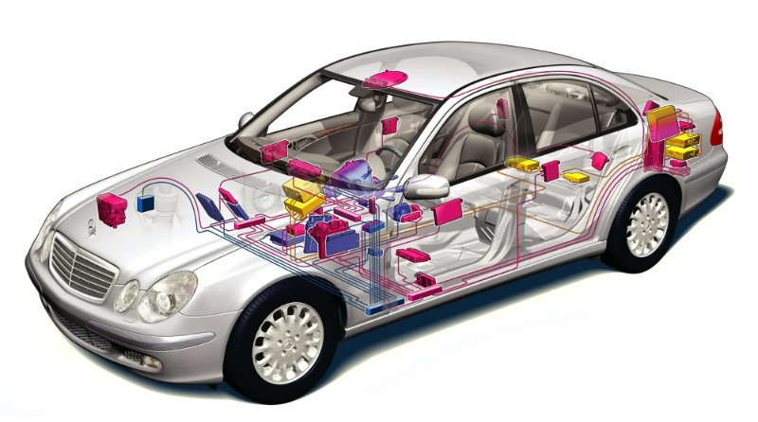
The Interconnected Car
- Physical Control Components
Vehicle which can communicate with other devices outside its cabin.
Other devices can use the car's internet and data.
Done by using a dedicated short-range radio or cellular radio
A network of wires runs throughout the car to link all its components.
- Safety Components
- Entertainment & Convenience Components

Slide 7
Types of Hacking
Key Fob Hacks
Mobile App Hacks
Server Hacks
General Motors OnStar App
SECURITY

Slide 8
EVOLUTION OF AUTOMOTIVE HACKING

Slide 9

1. The CAN Bus Architecture
2. ECU Hacking
3. TCU Hacking
4. Various Techniques for Unlocking an Automobile
5. History of Automobile Hacks in Past Decade

Slide 10
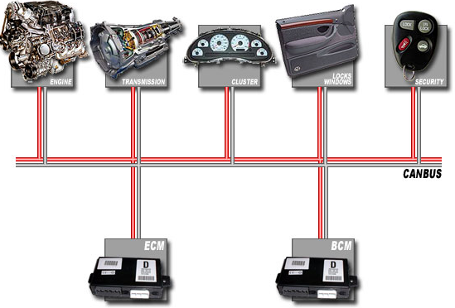
The CAN Bus Architecture
Introduced in 1986
CAN bus is the main part of today's vehicles' network of interconnected systems
Increased efficiency and reduced complexity, as well as lower wiring costs.

Slide 11
ECU Hacking
There are several electronic controllers in an automobile that communicate with each other.
Electronic control unit (ECU), transmission control unit (TCU), and transmission control module (TCM) are just a few of the names given to these computerized systems (TCM).
Front Door Attacks
ECUs are vulnerable to three different types of Attacks
Back Door Attacks
Exploits

Slide 12
TCU Hacking
Telematic control units (TCUs) are embedded systems in automobiles that allow them to communicate with other connected automobiles and the cloud.
Various subsystems receive and process data from the vehicle's telemetry through this device.

Slide 13
Various Techniques for Unlocking
an Automobile
RF Transceiver Based on Arduino
60 Second Hijack using HiTag2 and a Radio
Using Roll Jam Devices
Using a USB Killer

Slide 14

History of Automobile Hacks in Past Decade
2010 – Disabling Vehicles at a Remote using a web app
2010 & 2011 – Ecperimental Analysis of CAESS
2015 – Remote Hack of Miller & Valasek

Slide 15
FUTURE DEVELOPMENT OF AUTOMOTIVE HACKING

Slide 16
Securing the Automobile from Hackers
Encryption
Device Authorization
Two – way Authentication method

Slide 17
Internet Of Things and Connected Vehicles
Integrity and authenticity are major issues for the connected car, and the Internet of Things
in generally
Security concerns would influence customers' buying decisions for IoT goods, according to 66% of car industry responses
can be overcome by applying established software development best practices (including mobile and IoT) to the automotive industry’s specialized needs.
SECURITY

Slide 18
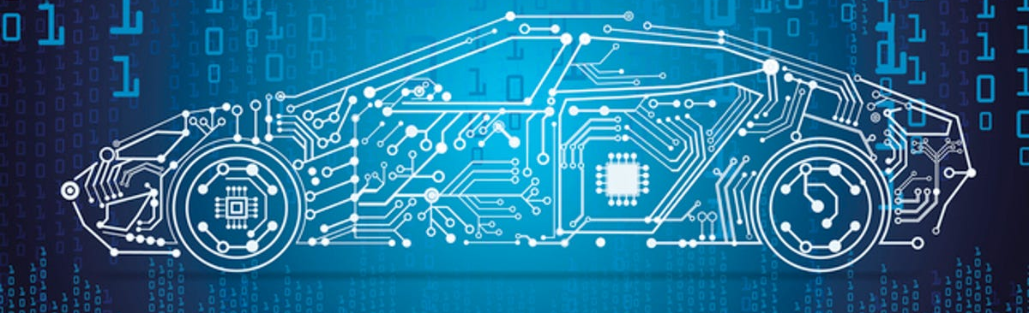
Perfomance Tuning
Performance tuning involves modifying an engine's operating parameters to improve vehicle performance. Even mechanical changes need changing an engine computer. The Performance Racing Industry estimates that roughly half a million individuals race cars annually in the US. In addition, thousands of modified automobiles compete in amateur races globally. To attain goals other than the original design, most performance tuning involves modifying engine operating conditions. Most engines may be modified to produce greater power or consume less fuel if safety is compromised or a different fuel is used.

Slide 19

CONCLUSION
The world is changing. Automobile hacking is a hot topic in Cyber Security. Because car hacking is on the rise. Today's environment protects us from both external and internal manipulation. Improve vehicle safety, reliability, and dependability.

Slide 20
Q & A

Slide 21
THANK YOU

