Slide 1
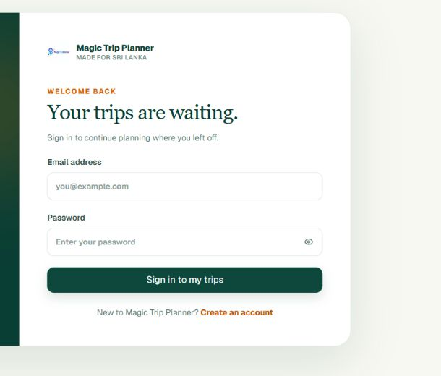
IDEALIZE 2026 / SEMI-FINALS
Magic Trip
Planner
Less planning.
More going.
AI-assisted Sri Lanka itineraries that connect places, routes, stays, and costs in one restorable plan.
FALCON CODE / UNIVERSITY OF MORATUWA
Notes:
Open with the promise: the product reduces planning effort while increasing confidence that the itinerary works in the real world.
[Sources]
- D:/IDEALIZE 2026 - SEMI FINALS - SUBMISSION GUIDELINES.pdf - pitch deck requirement
- Local product capture from http://localhost:3000/login on 2026-09-01
- D:/GitHub/Magic-Trip-Planner-Idealize/README.md - product description
- D:/Falcon_Code_Proposal.pdf - Falcon Code team identity and University of Moratuwa affiliation (pp. 2-5)
[/Sources]

Slide 2
PROBLEM
Static itineraries fail when real-world travel conditions change.
Travelers compare weather, routes, stays, attractions, transport, and reviews across disconnected tools—then resolve every conflict manually.
01
Fragmented planning
Weather, routes, stays, transport, and attractions live in separate tools.
02
Experience blind spots
THE CONSEQUENCE
Shortest-route tools miss timing, weather, closures, availability, and safety.
Decision fatigue, inefficient planning, and unexpected disruptions before and during the journey.
03
Static & stale guidance
Fixed itineraries and outdated reviews fail to reflect current conditions.
02
Notes:
Frame the problem as a real-world adaptability gap: travelers must coordinate disconnected information themselves, while static itineraries and stale reviews do not keep pace with changing conditions.
[Sources]
- D:/Falcon_Code_Proposal.pdf - Problem Statement (p. 6)
- D:/GitHub/Magic-Trip-Planner-Idealize/README.md - product problem and workflow framing
- D:/GitHub/Magic-Trip-Planner-Idealize/Frontend/src/app/page.tsx - user-facing value proposition
[/Sources]

Slide 3
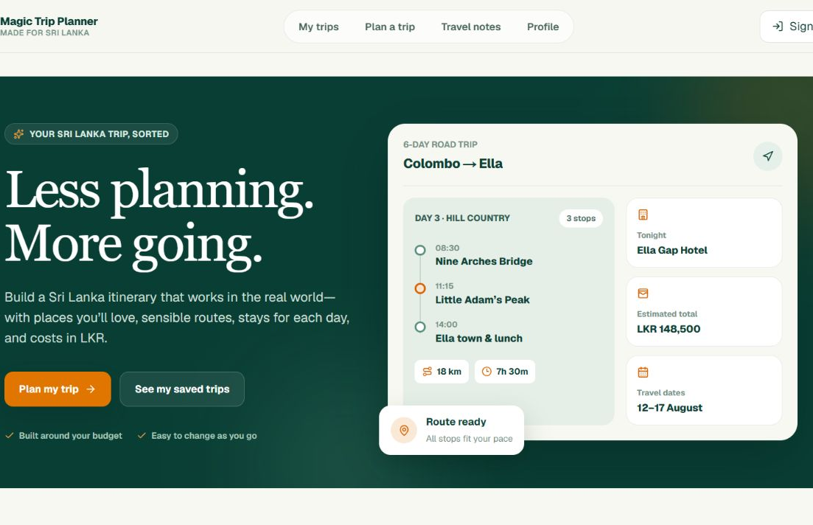
SOLUTION
One trip record connects every decision from idea to itinerary.
MAGIC TRIP PLANNER
A guided workspace turns traveler inputs into a map-verified, editable plan that can be saved, shared, restored, and exported.
AI-matched Sri Lanka destinations
Day-by-day road routes and timing
Daily stays near route endpoints
Practical LKR budget estimates
Share, print, calendar, and offline outputs
03
Notes:
Move from the promise to the evidence: this is the implemented product interface, not a conceptual mock-up.
[Sources]
- Local product capture from http://localhost:3000 on 2026-09-01
- D:/GitHub/Magic-Trip-Planner-Idealize/README.md - implemented product capabilities
[/Sources]

Slide 4
PRODUCT FLOW
Five connected stages turn preferences into a usable travel plan.
The system combines structured AI output with deterministic routing, pricing, persistence, and provider fallbacks.
01
02
03
04
05
Set intent
Discover
Verify
Build
Complete
Dates, budget, travelers, transport, pace, interests
Gemini returns schema-validated destination ideas
Geocoding keeps only map-backed places
Daily road routes and stays are sequenced
LKR budget, exports, sharing, and versions
Every stage saves state so the traveler can edit manually, retry, cancel, or restore an earlier plan.
04
Notes:
Emphasize that AI is used where it adds judgment, while routes, validation, budgets, and orchestration remain explicit application logic.
[Sources]
- D:/GitHub/Magic-Trip-Planner-Idealize/README.md - How the AI workflow works
- D:/GitHub/Magic-Trip-Planner-Idealize/Backend/app/workers/planning_worker.py - durable planning sequence
- D:/GitHub/Magic-Trip-Planner-Idealize/Backend/app/agents/route_agent.py - deterministic route planning
[/Sources]

Slide 5
PRODUCT PROOF
The MVP is built for real planning, not a one-shot demo.
The current web application combines guided manual planning with a recoverable one-click workflow.
8
4
2
guided stages
takeaway paths
collaboration roles
Preferences through final summary
Print/PDF, calendar, share, offline HTML
Viewer and editor access
Also implemented: background-job progress, cancel/retry, checkpoints, provider caching, quota controls, security headers, and responsive PWA metadata.
05
Notes:
Use these counts as proof of implemented breadth, then mention reliability features as the reason the app can support real trips.
[Sources]
- D:/GitHub/Magic-Trip-Planner-Idealize/Frontend/src/components/planner/PlannerWorkspace.tsx - eight-stage workspace
- D:/GitHub/Magic-Trip-Planner-Idealize/Frontend/src/components/planner/budget.tsx - print, calendar, and share outputs
- D:/GitHub/Magic-Trip-Planner-Idealize/Frontend/src/components/planner/TravelerToolkit.tsx - offline HTML export
- D:/GitHub/Magic-Trip-Planner-Idealize/Frontend/src/components/planner/ShareTrip.tsx - viewer/editor roles
[/Sources]

Slide 6
DIFFERENTIATION
The advantage is continuity across the whole journey.
Instead of adding another discovery screen, Magic Trip Planner keeps the same decisions connected and editable.
CAPABILITY
MANUAL TABS
GENERIC AI CHAT
MAGIC TRIP PLANNER
Sri Lanka-specific context
User assembles
Prompt dependent
Built in
Map-verified places
Manual checks
Not guaranteed
Coordinate-backed
Daily route + overnight stays
Separate tools
Text suggestion
Connected workflow
LKR budget by saved route
Manual estimate
Generic estimate
Deterministic pricing
Persistent, restorable plan
Scattered links
Conversation only
Jobs + versions
06
Notes:
Frame the comparison around workflow continuity rather than claiming that every alternative lacks useful discovery or booking features.
[Sources]
- D:/GitHub/Magic-Trip-Planner-Idealize/README.md - implemented product capabilities and current limitations
- Comparison is qualitative and category-level; no named competitor claims are made.
[/Sources]

Slide 7
MARKET FEASIBILITY
Sri Lanka's tourism recovery creates a timely digital planning opportunity.
Tourist arrivals
2.36M
tourist arrivals in 2025
+15.1%
growth versus 2024
US$3.2B
tourism earnings in 2025
SLTDA's tourism strategy explicitly prioritizes technology-based visitor services and a stronger digital footprint.
07
Notes:
Use the market data as evidence of opportunity, then connect it to the official policy signal for technology-enabled visitor services.
[Sources]
- https://sltda.gov.lk/en/monthly-tourist-arrivals-reports-2025 - 2024 and 2025 tourist arrivals and 15.1% growth
- https://www.cbsl.gov.lk/sites/default/files/cbslweb_documents/publications/aer/2025/en/25_Featured_Chart_08.pdf - 2025 tourism earnings of US$3.219 billion
- https://www.sltda.gov.lk/storage/common_media/Sri_Lanka-Final_V6_Edited850147500.pdf - technology-based tourism sector priority
[/Sources]

Slide 8
GO TO MARKET
Start focused, then expand with the travel ecosystem.
The first objective is repeatable planning adoption; monetization follows once traveler intent and partner value are validated.
01
02
03
Independent visitors
Groups and diaspora
Travel partners
International travelers who want a Sri Lanka-specific route, stays, and costs before arrival.
Friends, families, and returning Sri Lankans coordinating shared decisions and realistic budgets.
Hotels, guides, and operators who benefit from higher-intent, better-prepared travelers.
Reach: SEO, creator itineraries, university and travel communities
Reach: referrals, collaborative planning, community partnerships
Reach: pilot integrations and curated local inventory
COMMERCIAL MODEL TO VALIDATE: freemium planning + affiliate referrals + B2B white-label/API
08
Notes:
Be explicit that the commercial model is the validation plan, not current revenue. The near-term KPI is completed, shared, or exported itineraries.
[Sources]
- Commercial model and acquisition channels are team hypotheses for validation; no current revenue or traction is claimed.
- D:/GitHub/Magic-Trip-Planner-Idealize/README.md - implemented sharing, collaboration, and export surfaces
[/Sources]

Slide 9
FUTURE SCALABILITY
A durable architecture supports reliability today and scale tomorrow.
The system separates the fast user interface from long-running planning work, persistent state, and external providers.
NEXT.JS PWA
FASTAPI
POSTGRESQL
PLANNING WORKER
Responsive traveler experience
Cookie-authenticated JSON API
Trips, jobs, versions, caches
Durable background orchestration
GEMINI + MAP / WEATHER / MEDIA / FARE PROVIDERS
Structured AI output • provider cache • fallbacks • quota controls
09
Notes:
Explain the scaling logic: web requests stay responsive, the worker can scale independently, and PostgreSQL keeps jobs and plans durable across process restarts.
[Sources]
- D:/GitHub/Magic-Trip-Planner-Idealize/README.md - architecture and production topology
- D:/GitHub/Magic-Trip-Planner-Idealize/DEPLOYMENT.md - Vercel, Azure, worker, and PostgreSQL deployment model
- D:/GitHub/Magic-Trip-Planner-Idealize/Backend/app/workers/planning_worker.py - durable worker orchestration
[/Sources]

Slide 10
ROADMAP
Scale through trust, reach, and transaction depth.
The product can grow without changing its core promise: one reliable plan that stays useful before and during the trip.
NOW
NEXT
SCALE
Strengthen trust
Grow planning value
Deepen transactions
Public deployment
provider monitoring
real-user usability tests
Live availability signals
community travel intelligence
multilingual experience
Transport + hotel integrations
verified guide marketplace
international expansion
Current code already provides the foundations: modular providers, persistent data, role-based collaboration, and export surfaces.
10
Notes:
Treat this as a sequence of validation gates. Trust and deployment quality come before transaction features or geographic expansion.
[Sources]
- D:/GitHub/Magic-Trip-Planner-Idealize/README.md - current capabilities and limitations
- Roadmap items are planned future work, not currently implemented features.
- D:/Falcon_Code_Proposal.pdf - community intelligence, transport/hotel collaboration, verified guides, and international expansion (pp. 7, 11)
[/Sources]

Slide 11
MAGIC TRIP PLANNER
Make every Sri Lanka trip easier to plan - and easier to trust.
Working web application
READY FOR THE LIVE DEMO
Market-aligned Sri Lanka focus
Public hosted link submitted separately
Scalable full-stack foundation
IDEALIZE 2026 / SEMI-FINALS
Notes:
Close by resolving the opening promise, then transition immediately into the live product demonstration.
[Sources]
- D:/IDEALIZE 2026 - SEMI FINALS - SUBMISSION GUIDELINES.pdf - working public web application and pitch-deck requirements
- D:/GitHub/Magic-Trip-Planner-Idealize/README.md - product and architecture summary
[/Sources]

