Slide 1
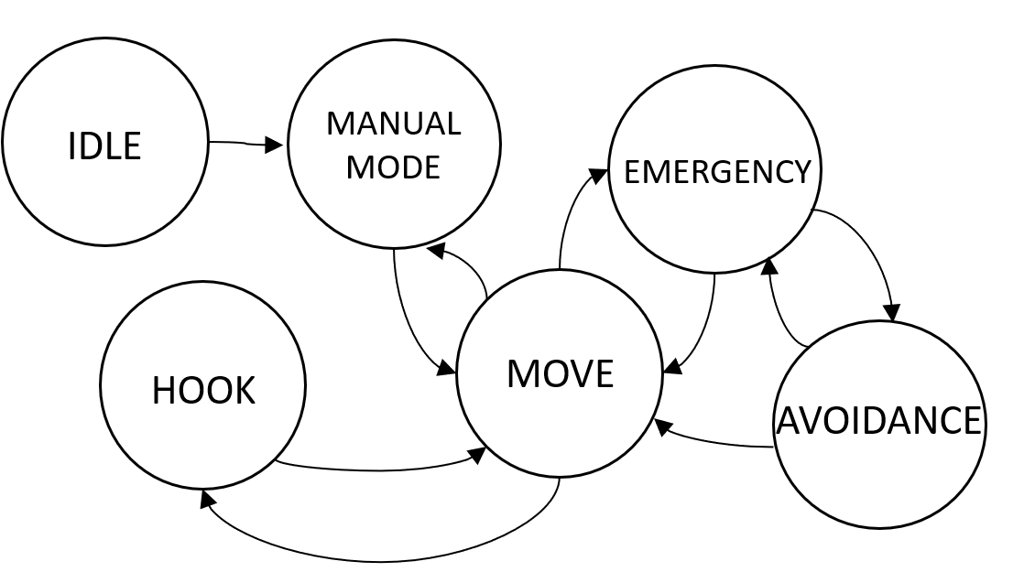
Tow Mater 5SIEC 2022-2023 / By Team Benny
THE DEMONSTRATION
THE MANEUVER
With U-turn
(≠ directions)
Without U-turn
(= directions)
STUDENTS
Léonie Hatte - Imane El Khamlichi - Alexis Pierre Dit Lambert -Martin Cheliz - Samantha Gorrin-Ascanio - Laura Mendes
TUTORS
Sébastien Delautier - Didier Le Botlan
Move backwards
Move forward
The aim of this project is to tow a damaged vehicle with an autonomous vehicle. The goal is to make safety our priority! The vehicle has to approach the damaged vehicle slowly, taking into account its environment. It has to detect and avoid obstacles on its way towards the damaged vehicle. Then it should park and maneuver to reach the towing device of the damaged car.
THE AVOIDANCE OF OBSTACLES
Avoid through the side without obstacles
Go through the side where there is the most space
Avoid a small (≃ 10cm) or big (≃ 30cm) obstacle
THE TOWING CAR ARCHITECTURE
THE TOWING CAR STATE MACHINE
Nucléo F103RB
MOTORS
Jetson Nano – ROS 2 Humble (Docker)
Ethernet
Raspberry Pi 3 – ROS 2 Humble
US
CAMERA
CAN
HOOK
LIDAR
Nucléo
L476RG
IMU
GPS
Obstacles detected by the Ultrasonic Sensors
Obstacles detected by the LiDAR

Slide 2
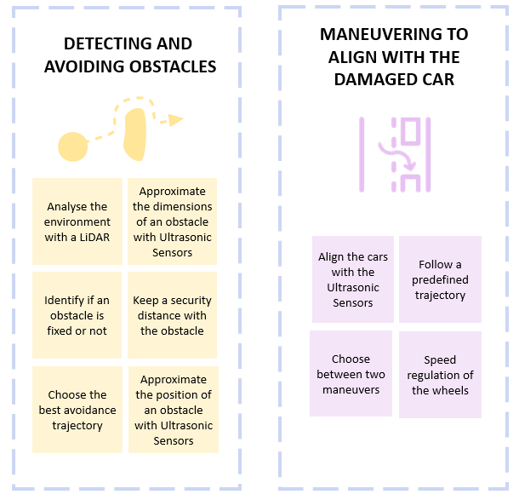
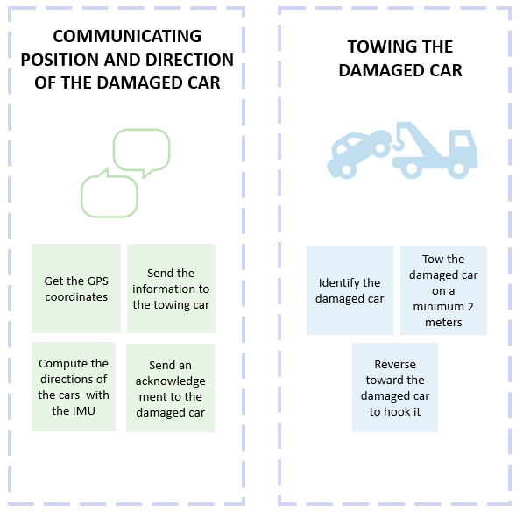
OUR FEATURES
THE TESTS
Safety distance of 15 cm during avoidance
Maximum 20 cm drift from its trajectory
Alignment of maximum 5 cm interval
Identify a fixed obstacle after 5s
Maneuvering in a 5m radius
Stops 75 cm +/- 5 cm away from obstacle
Avoids obstacles with a width of less than 30cm
Maximum 10 m gap
Autonomous towing
GPS coordinates +/- 50 cm
Tow at least 2 meters on a straight line
Maximum 10 s after receive the coordinates
Detect the QR code at a distance between 20cm and 100cm

Slide 3
Tow Mater 5SIEC 2022-2023 / By Team Benny
THE DEMONSTRATION
THE MANEUVER
With U-turn: ≠ direction
STUDENTS
Léonie Hatte - Imane El Khamlichi - Alexis Pierre Dit Lambert -Martin Cheliz - Samantha Gorrin-Ascanio - Laura Mendes
TUTORS
Sébastien Delautier - Didier Le Botlan
Without U-turn: =direction
The aim of this project is to tow a damaged vehicle with an autonomous vehicle. The goal is to make safety our priority! The vehicle has to approach the damaged vehicle slowly, taking into account its environment. It has to detect and avoid obstacles on its way towards the damaged vehicle. Then it should park and maneuver to reach the towing device of the damaged car.
THE AVOIDANCE OF OBSTACLES
Avoid through the side without obstacles
Go through the side where there is the most space
Avoid a small (≃ 10cm) or big (≃ 30cm) obstacle
THE TOWING CAR ARCHITECTURE
THE TOWING CAR STATE MACHINE
Nucléo F103RB
MOTORS
Jetson Nano – ROS 2 Humble (Docker)
Ethernet
Raspberry Pi 3 – ROS 2 Humble
US
CAMERA
CAN
HOOK
LIDAR
Nucléo
L476RG
IMU
GPS
Obstacles detected by the Ultrasonic Sensors
Obstacles detected by the LiDAR

Slide 4
OUR FEATURES
THE TESTS
Safety distance of 15 cm during avoidance
Maximum 20 cm drift from its trajectory
Alignment of maximum 5 cm interval
Identify a fixed obstacle after 5s
Maneuvering in a 5m radius
Stops 75 cm +/- 5 cm away from obstacle
Avoids obstacles with a width of less than 30cm
Maximum 10 m gap
Autonomous towing
GPS coordinates +/- 50 cm
Tow at least 2 meters on a straight line
Maximum 10 s after receive the coordinates
Detect the QR code at a distance between 20cm and 100cm

