Slide 1
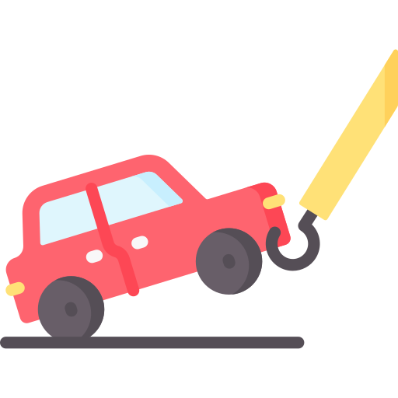

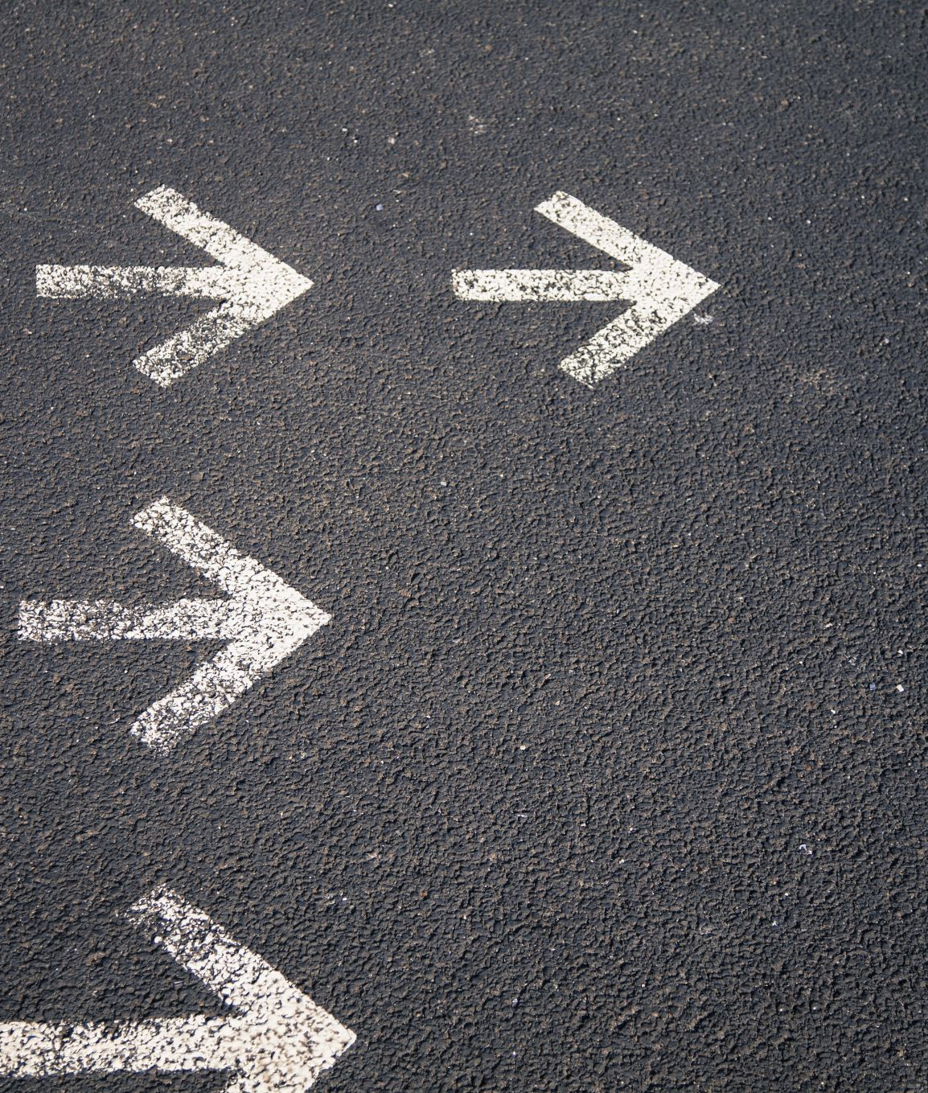
Tow Mater
Project plan
Keywords:
Team:
Autonomous car
Towing
No human implication
Safety
Maneuver
Autonomy
Obstacle detection
Martin Chéliz
Laura Mendes
Samantha Gorrin
Alexis Pierre Dit Lambert
Imane El Khamlichi
Léonie Hatte

Slide 2




Our project plan
Product description
Features
Release vision
Validation plan
Project Planning
Backlog
Sprint 1
Risks

Slide 3


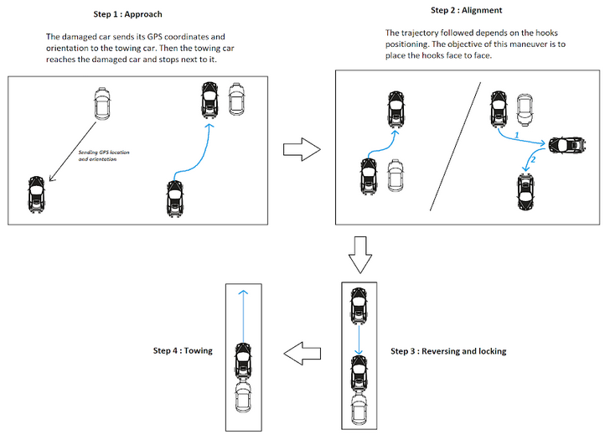

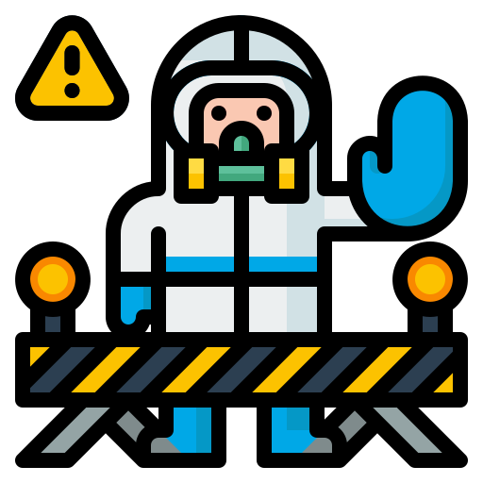


Product description
PROBLEM
SOLUTION
Needing help out of service hours
Step 1: The damaged car sends its GPS coordinates and orientation to the towing car. Then, the towing car reaches the damaged car then stops next to it
Step 4: Towing
Areas with no human access
Access to hazardous areas
The User does not know his current location
Good localization accuracy
A tedious waiting
A fast
response
Step 2: The trajectory followed depends on the hooks’ position. The objective of this maneuver is to place the hooks face to face
Step 3: Reversing and locking

Slide 4
Features
Priority | Categories | Name
1 | Vision Speed Regulation Trajectory | Performing the alignment maneuver and towing the car
2 | Obstacle detection Trajectory | Detecting and avoiding obstacles
3 | Network | Communicating with damaged car
4 | Speed regulation Trajectory | Reaching the damaged car

Slide 5
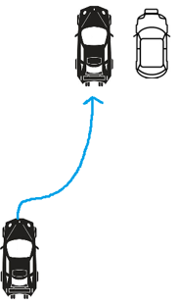
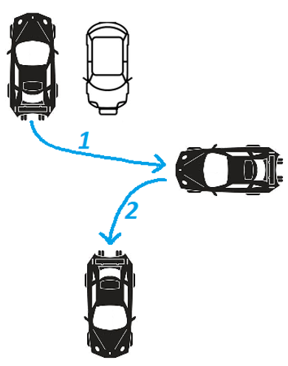
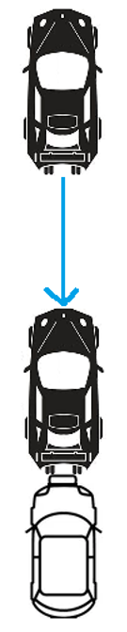
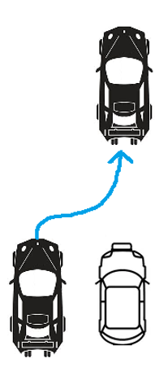
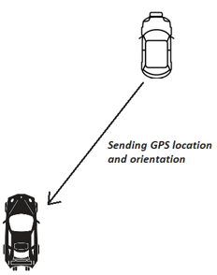
Release vision
Reverses in a straight line
Locks the hook
Tows in a straight line
Differentiate obstacle / hook
Detection of large obstacles (>30cm) → stops
Sprint 4
Sprint 2 (No U-turn)
Avoid fixed obstacles during alignment maneuver
Vehicles communicate → GPS positioning + orientation data
Aligns itself with the damaged car
Detection of small obstacles (<30cm) → stops
U-turn to align with the other vehicle
Identification of moving obstacles
Reach the damaged car
Perform the alignment
Hook locking
Towing in a straight line
Avoids fixed obstacles
Stops when moving obstacles
Sprint 1
Sprint 3 (with U-turn)
Sprint 5

Slide 6
Validation plan (1/5)
The towing car can follow a minimum 5m straight line.
The towing car stops at a minimum distance of 50cm from a big obstacle.
The towing car signals if the identified obstacle is the damaged car 5s after detecting it.
The hook can be done at a distance interval from 10cm to 20cm.
The towing car can tow on a minimum 5m straight line.
Sprint 1
Notes:
6

Slide 7
Validation plan (2/5)
Sprint 2
The towing car does not derive more than 5cm from a predefined trajectory.
The towing car stops at a minimum distance of 30cm from a small obstacle.
Notes:
7

Slide 8
Validation plan (3/5)
Sprint 3
The towing car signals well if the identified obstacle is fixed or not 5s after detecting it.
Notes:
8

Slide 9
Validation plan (4/5)
The towing car sends the acknowledgement after a maximum of 10 seconds after receiving the GPS information.
The communication between the two cars can be done when they are at a minimum distance of 10m one from the other.
The towing car avoids an obstacle with a minimum distance of 30cm.
Sprint 4
Notes:
9

Slide 10
Validation plan (5/5)
Sprint 5
The towing car can stop next to the damaged car with a distance of more or less 10cm to 30cm.
Sprint 4
The damaged car determines its orientation in less than 5s .
Notes:
10

Slide 11
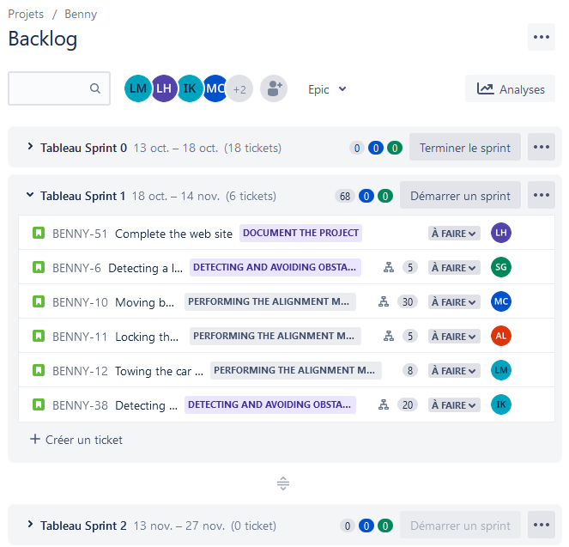
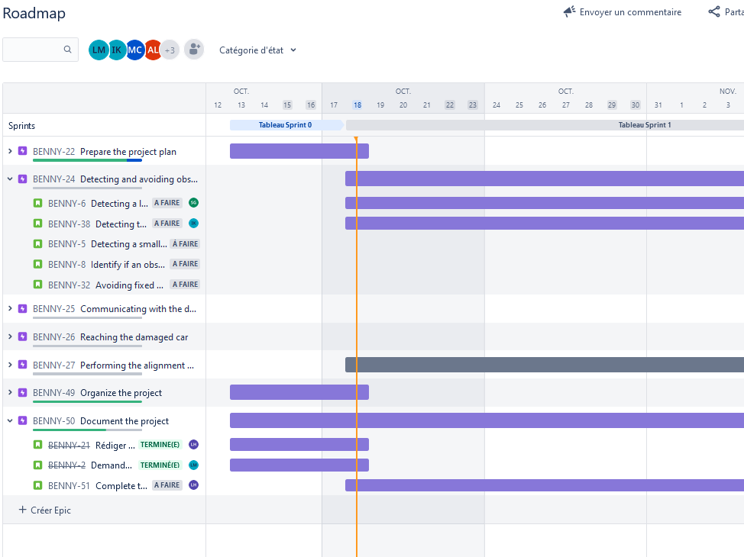
Project planning
Time organization
Tasks repartition

Slide 12
Backlog
Priority | Name | Feature
1 | Follow a predefined trajectory | Performing the alignment maneuver and towing the car
2 | Maneuver to line up with the damaged vehicle (without U-turn) | Performing the alignment maneuver and towing the car
3 | Detect a small obstacle (<30cm) and stop | Detecting and avoiding obstacles
4 | Maneuver to line up with the damaged vehicle (with U-turn) | Performing the alignment maneuver and towing the car
5 | Identify if an obstacle is fixed or mobile | Detecting and avoiding obstacles
6 | Avoid fixed obstacles | Detecting and avoiding obstacles
7 | Transmit the GPS position and the orientation of the damaged car to the towing vehicle | Communicating with damaged car
8 | Send acknoledgement of GPS and orientation data reception | Communicating with damaged car
9 | Reach the damaged vehicle and stop next to it | Reaching the damaged car
10 | Identify the position/orientation relative to the damaged car | Reaching the damaged car

Slide 13
Sprint 1
Samantha
Laura
Martin
Imane
Alexis
Léonie
Teams
Detecting a large obstacle then stop
Locking the towing hook
Detecting the hook of the broken car
Detection of obstacles by Ultrasonic Sensors
Sending a stop command to the motor
Transmit the lock request
Actuate and lock the hook
Add a camera to the back of the car
Detect the car hook by camera image
5
5
20
Priority
Moving backwards in a straight line to place the tow hook
Towing the car on a straight line
Speed Control
Steering Control
30
8

Slide 14
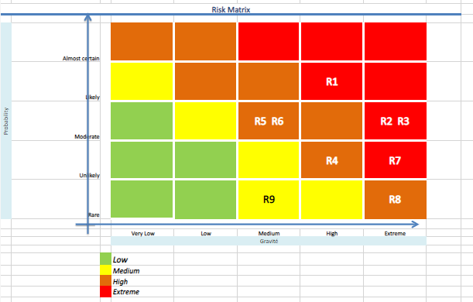
Risks
R1 | Team issues (miscommunication, knowledges centralization, sick-leave)
R2 | Components shortage
R3 | Lack of components
R4 | Bad weather (rain, snow, etc.) : can lead to recurring malfunctions
R5 | Modules incompatibility
R6 | Lack of skills
R7 | Cybersecurity risks
R8 | Pandemic
R9 | Budget

Slide 15
Risks
R1 | Team issues (miscommunication, knowledges centralization, sick-leave)
R2 | Components shortage
R3 | Lack of components
R4 | Bad weather (rain, snow, etc.) : can lead to recurring malfunctions
R5 | Modules incompatibility
R6 | Lack of skills
R7 | Cybersecurity risks
R8 | Pandemic
R9 | Budget
Always write documentation on what we did and share it with the other members, ask the other members to be sure they have understood
Always have spare parts
Order early
Maneuver to line up with the damaged vehicle (with U-turn)
Use Github to manage the files and use ROS to make the compatibility simpler.
Organize the tasks depending on the skills of the members and follow training when nobody has
AI component security assessments should be performed regularly throughout their lifecycle
Possibility of teleworking.
Estimate the costs

Slide 16
Questions ?

