Slide 1
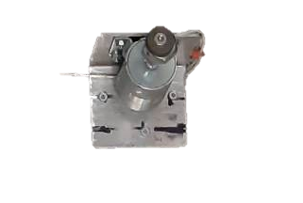

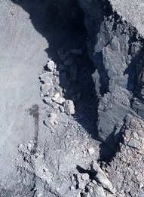

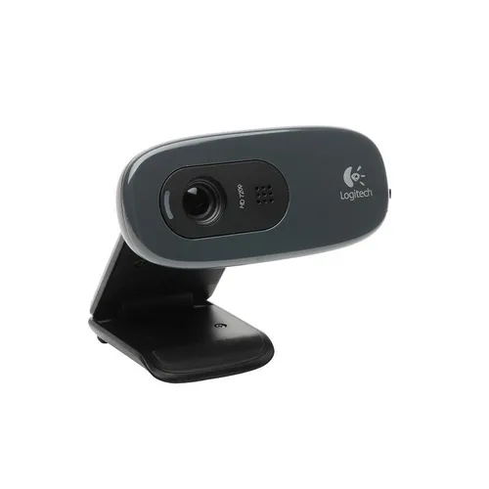
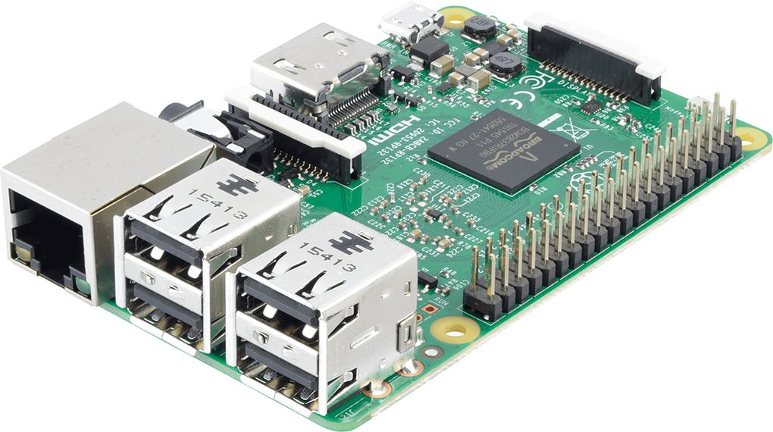
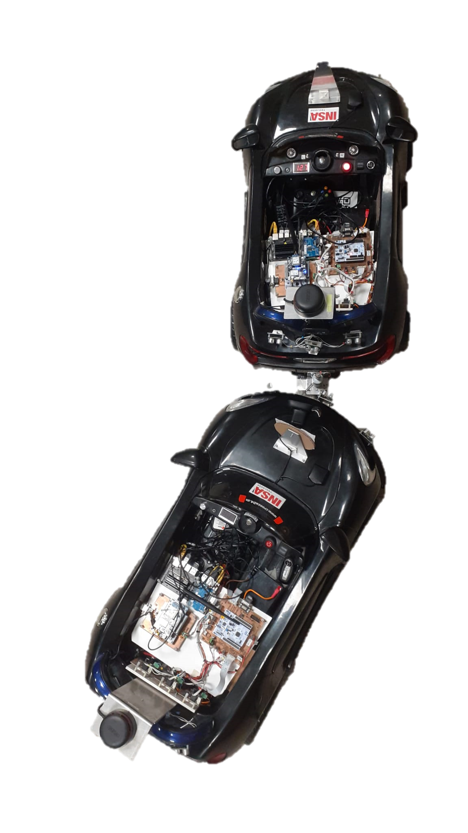
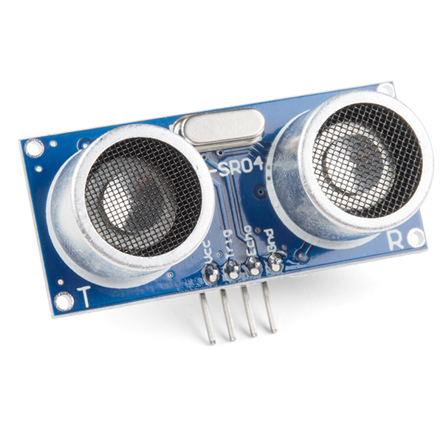
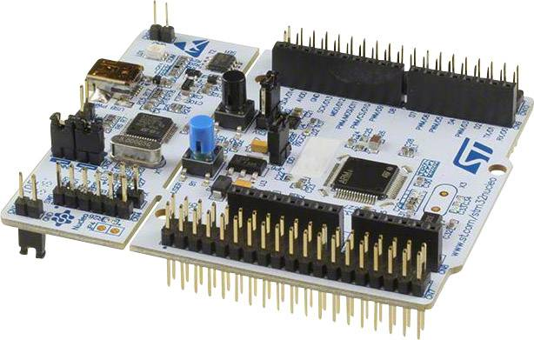
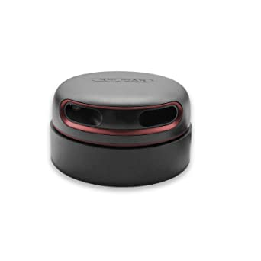
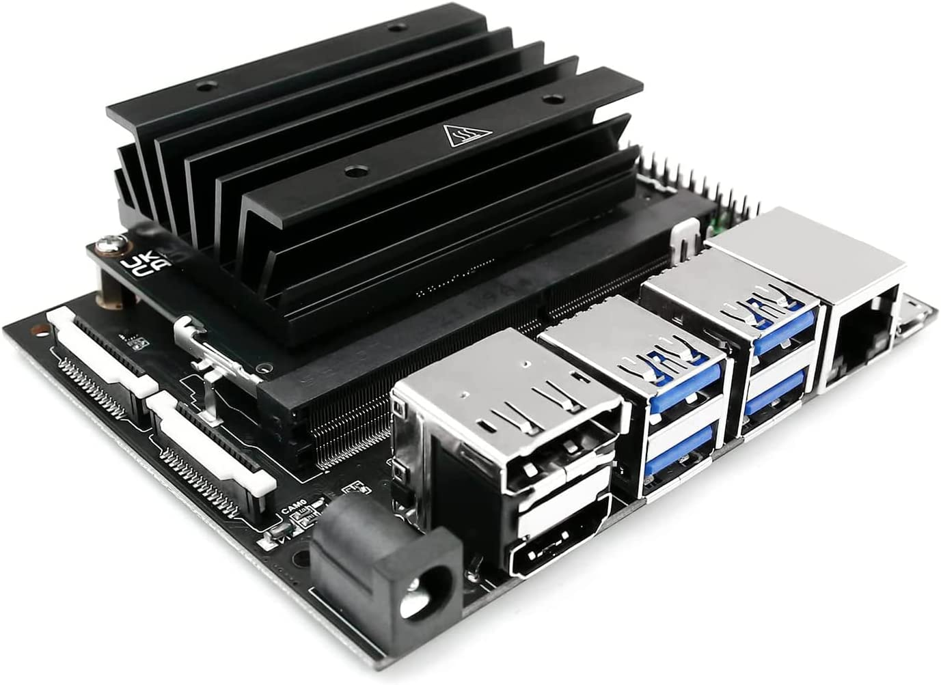
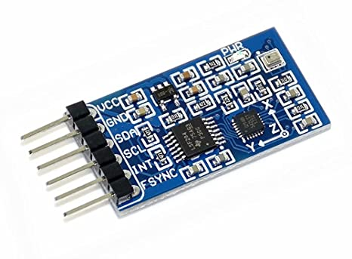
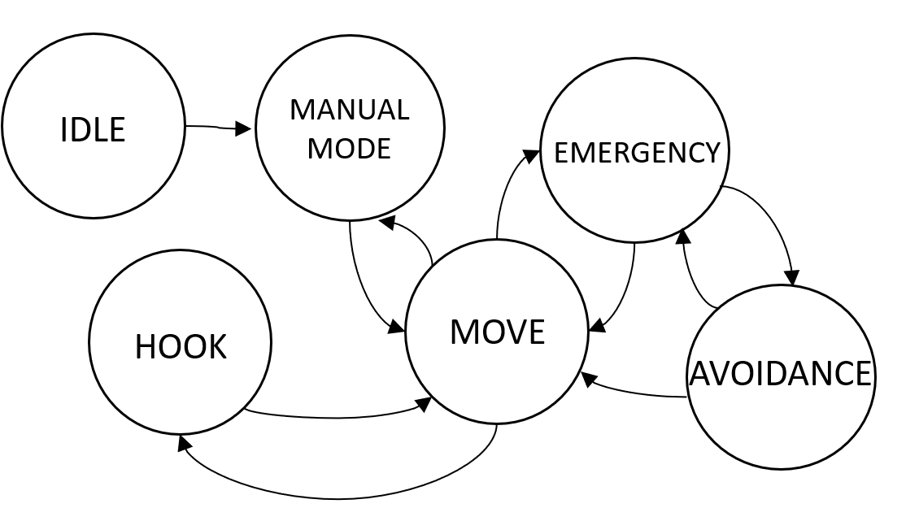



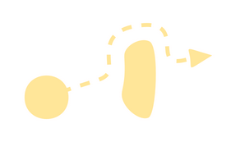


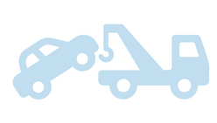

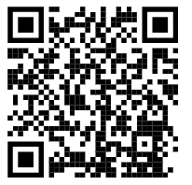
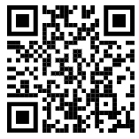


Tow Mater 5SIEC 2022-2023 / By Team Benny
STUDENTS
Léonie Hatte - Imane El Khamlichi - Alexis Pierre Dit Lambert -Martin Cheliz - Samantha Gorrin-Ascanio - Laura Mendes
TUTORS
Sébastien Delautier - Didier Le Botlan
THE PRODUCT AND ITS ARCHITECTURE
The aim of this project is to tow a damaged vehicle with an autonomous vehicle. The goal is to make safety our priority! The vehicle has to approach the damaged vehicle slowly, taking into account its environment. It has to detect and avoid obstacles on its way towards the damaged vehicle. Then it should park and maneuver to reach the towing device of the damaged car.
Robot Operating System is a set of software libraries and tools. It provides an operating system-like environment for robots.
HOOK
CAMERA
Raspberry Pi 3
ULTRASONIC SENSORS
LIDAR
LIght Detection and Ranging is a method for determining ranges by targeting a surface with a laser and measuring the time for the reflected light to return to the receiver.
Nucléo
MOTORS
IMU
Inertial Measurement Unit measures a body's angular rate and orientation, using a combination of accelerometers, gyroscopes and magnetometers.
Jetson Nano
THE TOWING CAR ARCHITECTURE
THE TOWING CAR STATE MACHINE
Nucléo F103RB
MOTORS
Jetson Nano – ROS 2 Humble (Docker)
Raspberry Pi 3 – ROS 2 Humble
ULTRASONIC SENSORS
CAMERA
Ethernet
CAN
HOOK
LIDAR
Nucléo
L476RG
IMU
GPS
OUR FEATURES
: Harder tasks
: Favorite tasks
: To improve
DETECTING AND
AVOIDING OBSTACLES
MANEUVERING TO ALIGN WITH THE DAMAGED CAR
COMMUNICATING
POSITION AND DIRECTION OF THE DAMAGED CAR
TOWING THE
DAMAGED CAR
Analyse the environment with a LiDAR
Approximate the dimensions of an obstacle with Ultrasonic Sensors
Align the cars with the Ultrasonic Sensors
Follow a predefined trajectory
Get the GPS coordinates
Send the information to the towing car
Identify the damaged car
Tow the damaged car on a minimum 2 meters
Identify if an obstacle is fixed or not
Keep a security distance with the obstacle
Choose between two maneuvers
Speed regulation of the wheels
Compute the directions of the cars with the IMU
Send an acknowledgement to the damaged car
Reverse toward the damaged car to hook it
Choose the best avoidance trajectory
Approximate the position of an obstacle with Ultrasonic Sensors
FUTUR FEATURE
Calculate the route to the damaged car
Go next to the damaged car
REACHING THE DAMAGED CAR
lmendes@insa-toulouse.fr
About us
Git project

