Slide 1

MalTwin
AI-based malware variant detection for Industrial IoT using Digital Twins and visual analysis
60% Implementation Evaluation
Iman Fatima CIIT/SP23-BCT-021/ISB
Maaz Malik CIIT/SP23-BCT-025/ISB
Supervisor: Ms. Najla Raza
BS Cyber Security · COMSATS University Islamabad

Slide 2

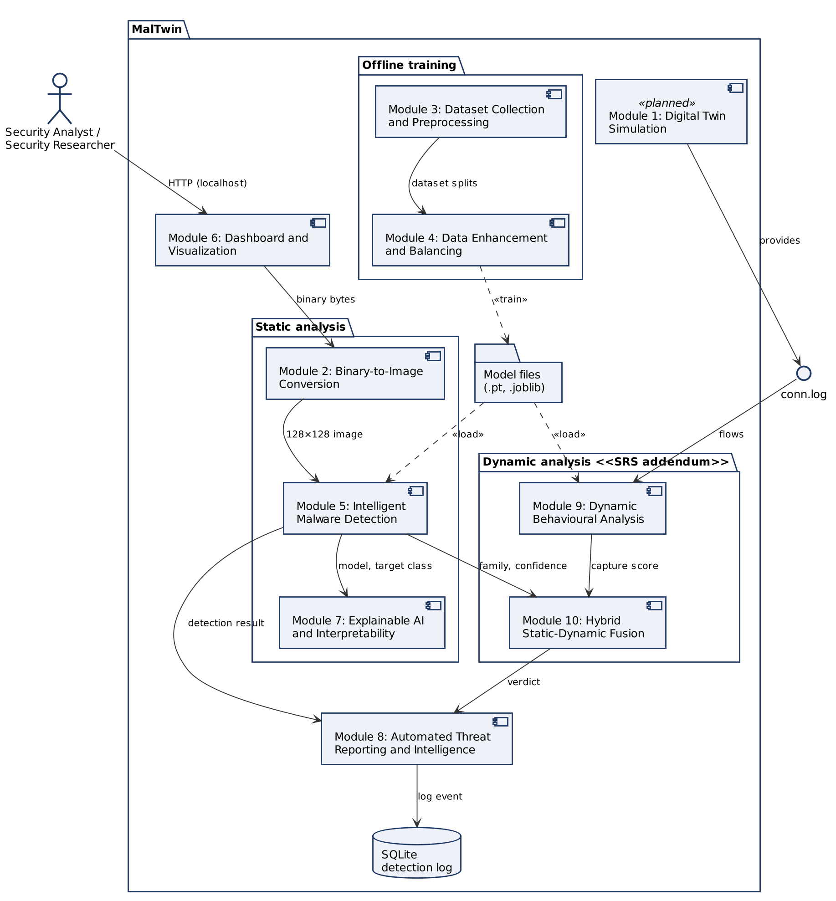

Problem and proposed solution
The problem
IIoT malware mutates into variants that signatures miss
Running malware on real PLCs risks stopping production
Detectors rarely explain their verdict
Our solution
Static: binary → image → CNN family
Dynamic: network behaviour → model
Fusion + Grad-CAM + MITRE: one explained verdict
UML component diagram: ten modules, static and dynamic paths

Slide 3
Changes since the 30% evaluation

Slide 4
SRS evaluation comments and our response
# | Committee comment | Action taken | Where
S1 | Revise the use case diagram; not comprehensible | Redrawn in UML as two diagrams; every use case has an ID; Researcher specialises Analyst (generalisation) | Ch. 2.1.1
S2 | Use case symbols joined: not a proper use case diagram | No use case joined by plain lines; only «include» / «extend» dependencies | Ch. 2.1.1
S3 | Use case descriptions do not match the diagram | One full description per use case, same ID and name: 15 of 15; old-to-new mapping table | Ch. 2.1.2–2.1.3
S4 | FRs are too few for an FYP | FRs expanded from 24 to 59, every module covered, each a testable "shall" statement traced to tests | Ch. 2.2, RTM
S5 | Formatting: justify text; improve TOC | All text and lists justified; TOC, list of figures and list of tables generated from styles | Whole report

Slide 5
30% evaluation comments and our response
# | Committee comment | Action taken | Where
D1–D2 | Comments and actions not in SDS; SRS comments not corrected | Response table at the front of Document 4 covering all 15 comments | p. 8–9
D3 | First two chapters missing | Chapter 1 Introduction and Chapter 2 Requirements added | Ch. 1–2
D4 | Use case diagram is not a design diagram | Moved to the requirements chapter | Ch. 2
D5 | Only one activity and one sequence diagram | 10 sequence + 9 activity diagrams, one per major use case | Ch. 3.4.1
D6 | Use the standard database icon in DFDs | Open-ended data store symbol (D1–D3); Levels 0–2 balanced | Ch. 3.4.2.1
D7 | Schema is neither a schema nor an ERD | Crow's-foot ERD + relational schema with PK/FK/CHECK; FK now enforced in the code | Ch. 3.4.2.3, 3.5
D8 | Caption all tables and figures | Every table and figure numbered and captioned | Whole report
D9 | Results on the balanced dataset | Balanced training + new class-balanced test evaluation (10 draws, mean ± std) | Ch. 4.2
D10 | Diagrams did not follow SE notation (verbal) | All diagrams in UML / Yourdon–DeMarco / crow's foot, with a notation key | Table 3.4

Slide 6
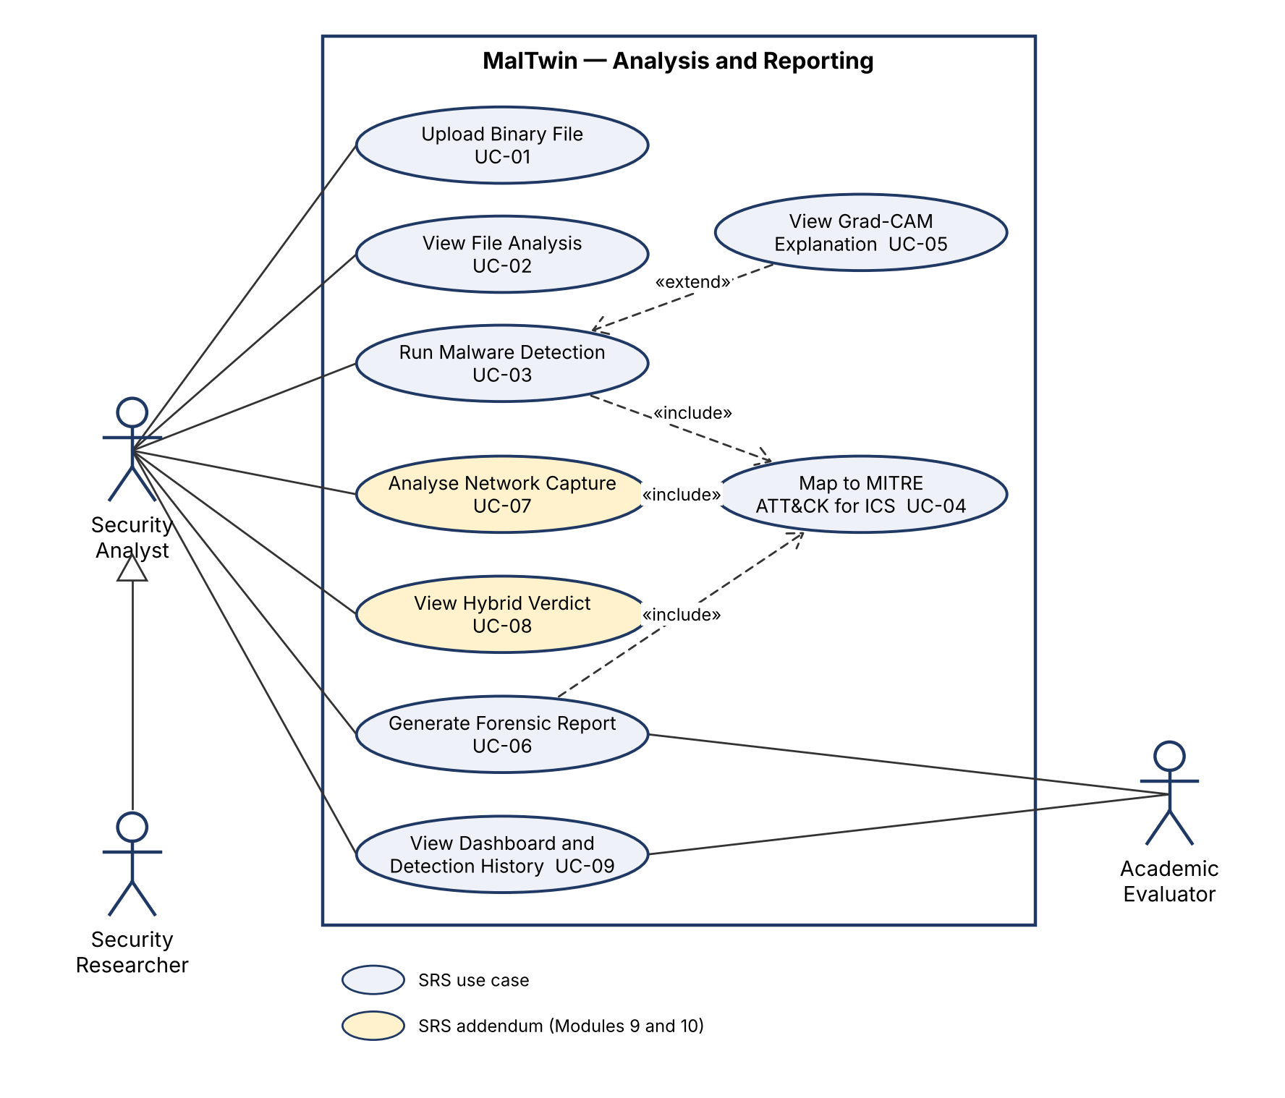
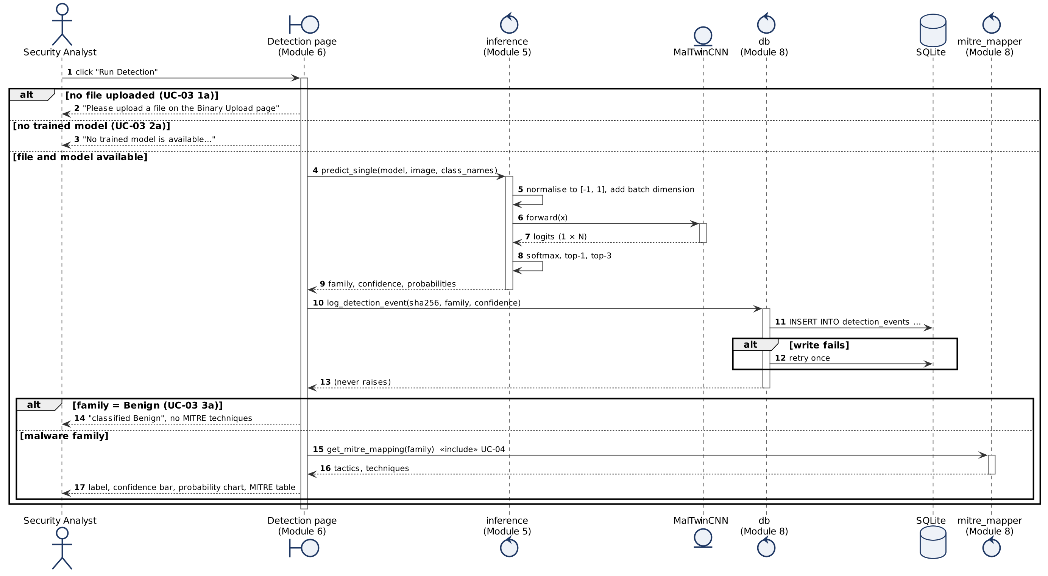
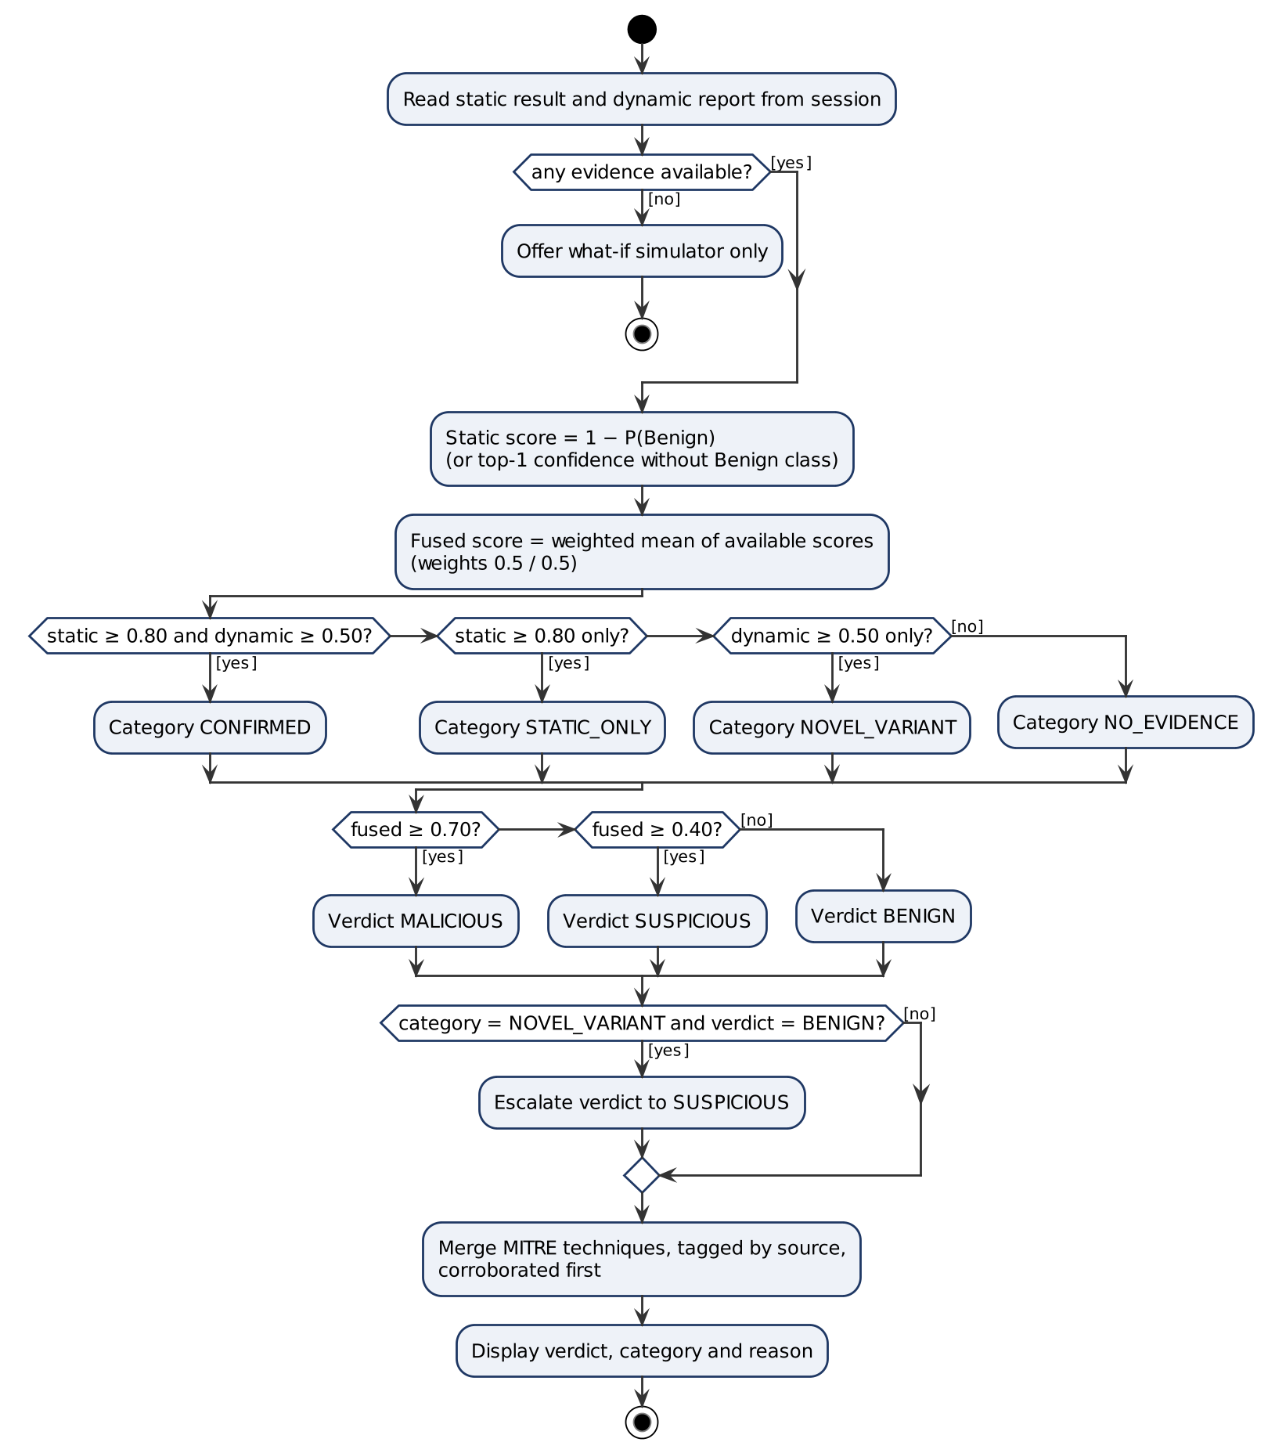
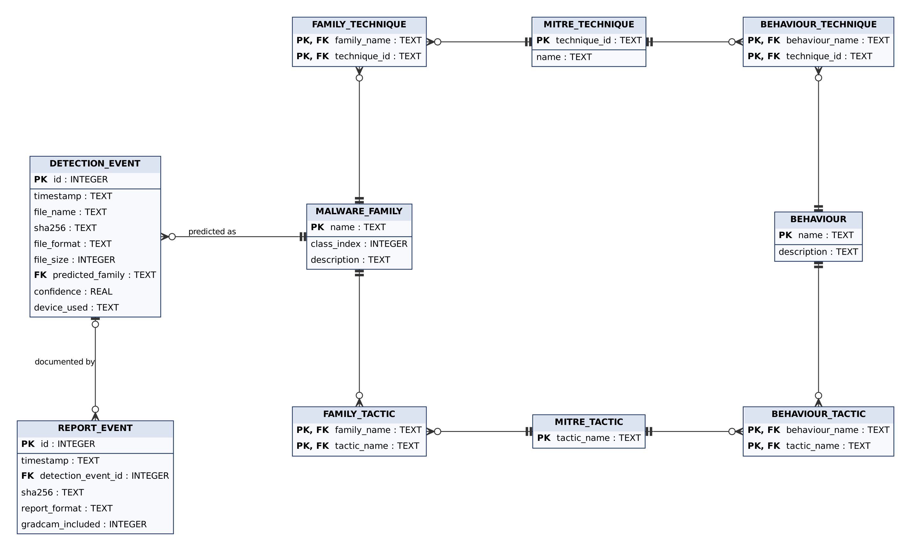
Redrawn models: use cases, behaviour, data
Sequence: UC-03 Run Detection (1 of 10)
Use cases (UML)
Activity: fusion decision (1 of 9)
ERD (crow's foot)

Slide 7






Major technical changes
Dynamic analysis + fusion
Benign class
Network-behaviour model (IoT-23) and a hybrid verdict that flags possible new variants
Clean files were always called malware: Malimg has no benign class. Added one from clean system binaries
Upload matches training
17 defects fixed
Uploads now use the same byte layout as the Malimg training images (Nataraj width table)
Crash after every upload, lost navigation clicks, reports never linked to their detection, a slow history query, and more
Deeper evaluation
Automated testing + RTM
Results on a class-balanced test set, ROC-AUC, false positive rate, unseen-family test
357 automated tests, all passing; 79 tagged tests cover 57 / 57 testable requirements

Slide 8
Implemented modules
8 of 10 modules complete · fusion logic complete · Digital Twin designed

Slide 9



Iman — implemented modules
M2 Binary-to-image
M5 CNN + Benign class
M7 Grad-CAM
M8 Reporting
PE/ELF magic-byte validation, 50 MB cap
SHA-256 computed locally
Malimg width table → 128×128
3 conv blocks, 1.35 M parameters
25 families + Benign
Oversampling for 36:1 imbalance
Captum on last conv layer
Heatmap shows which bytes drove the decision
0.5 s worst case on CPU
MITRE ATT&CK for ICS, all 25 families
PDF + JSON forensic reports
SQLite log (WAL, 0600)

Slide 10
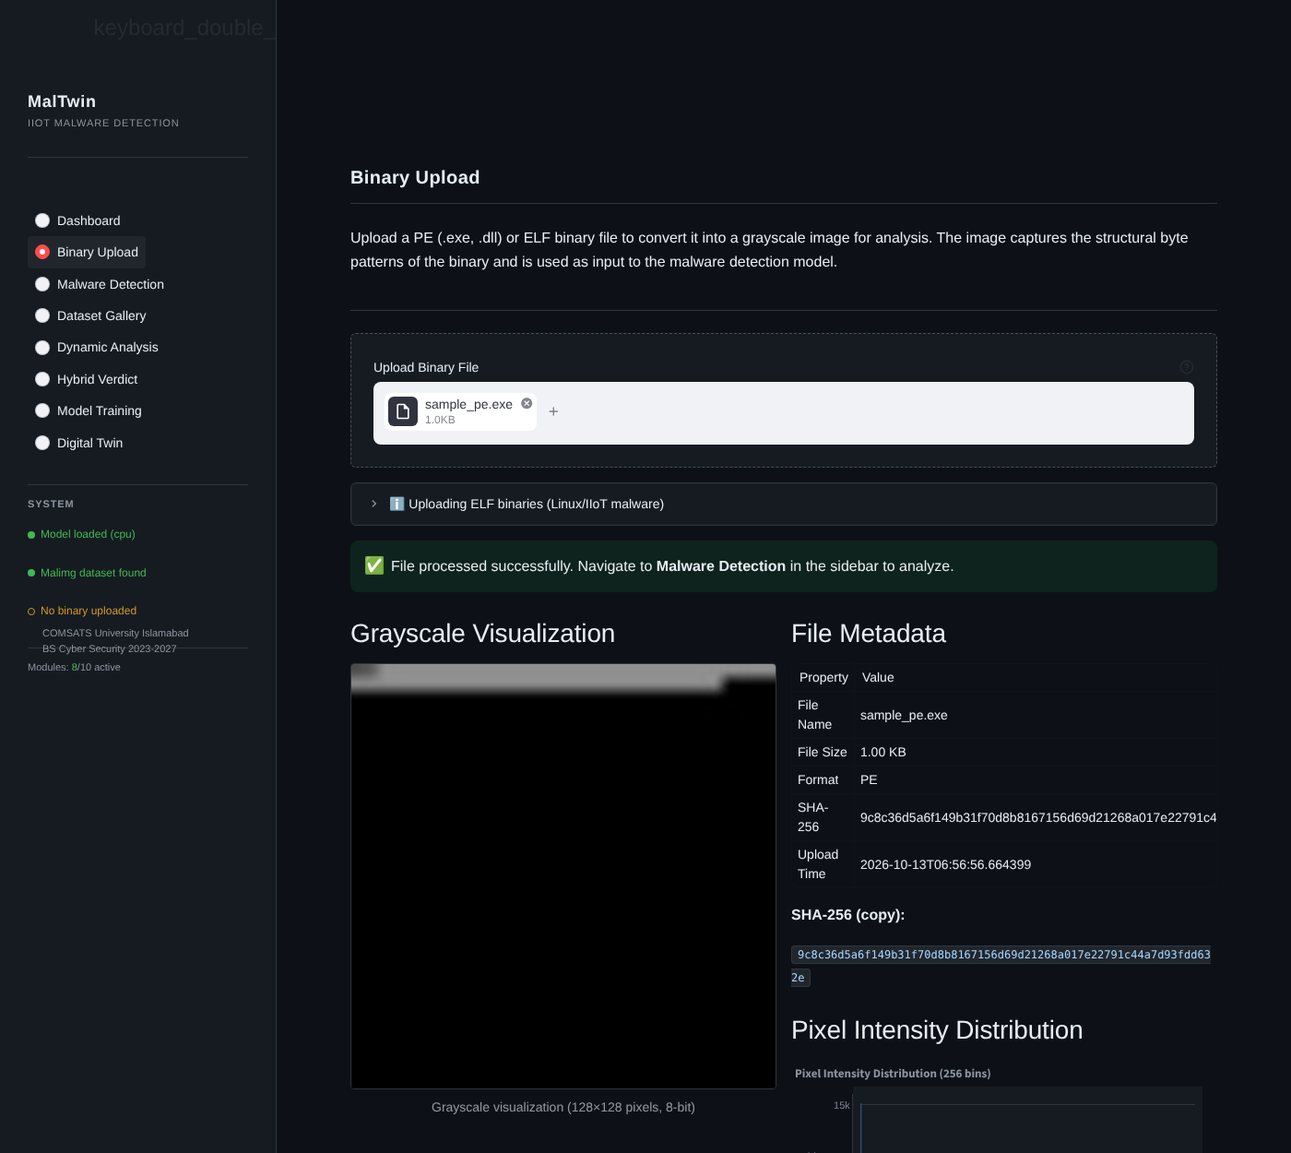

Iman — from binary to explained verdict
How it fits the system
Every static result starts here: the image is the CNN's only input
Confidence colour (green / amber / red) tells the analyst when to trust it
Grad-CAM + MITRE turn a label into evidence an analyst can act on
The family confidence is the static half of the hybrid verdict
LIVE DEMO Upload a binary → Run Detection → Grad-CAM → download the PDF report

Slide 11




Maaz — implemented modules
M3 / M4 Dataset & balancing
M6 Dashboard
M9 Dynamic analysis
M10 Hybrid fusion
Stratified 70/15/15 split
Augmentation built, off by default (ablation)
Weighted random oversampling
8 pages, Streamlit
Health status of all 10 modules
History, filters, CSV export
Zeek conn.log / IoT-23 parser
61 IP-free flow features
Random forest, 7-behaviour taxonomy
Weighted static + dynamic score
Agreement categories
Novel-variant escalation rule

Slide 12
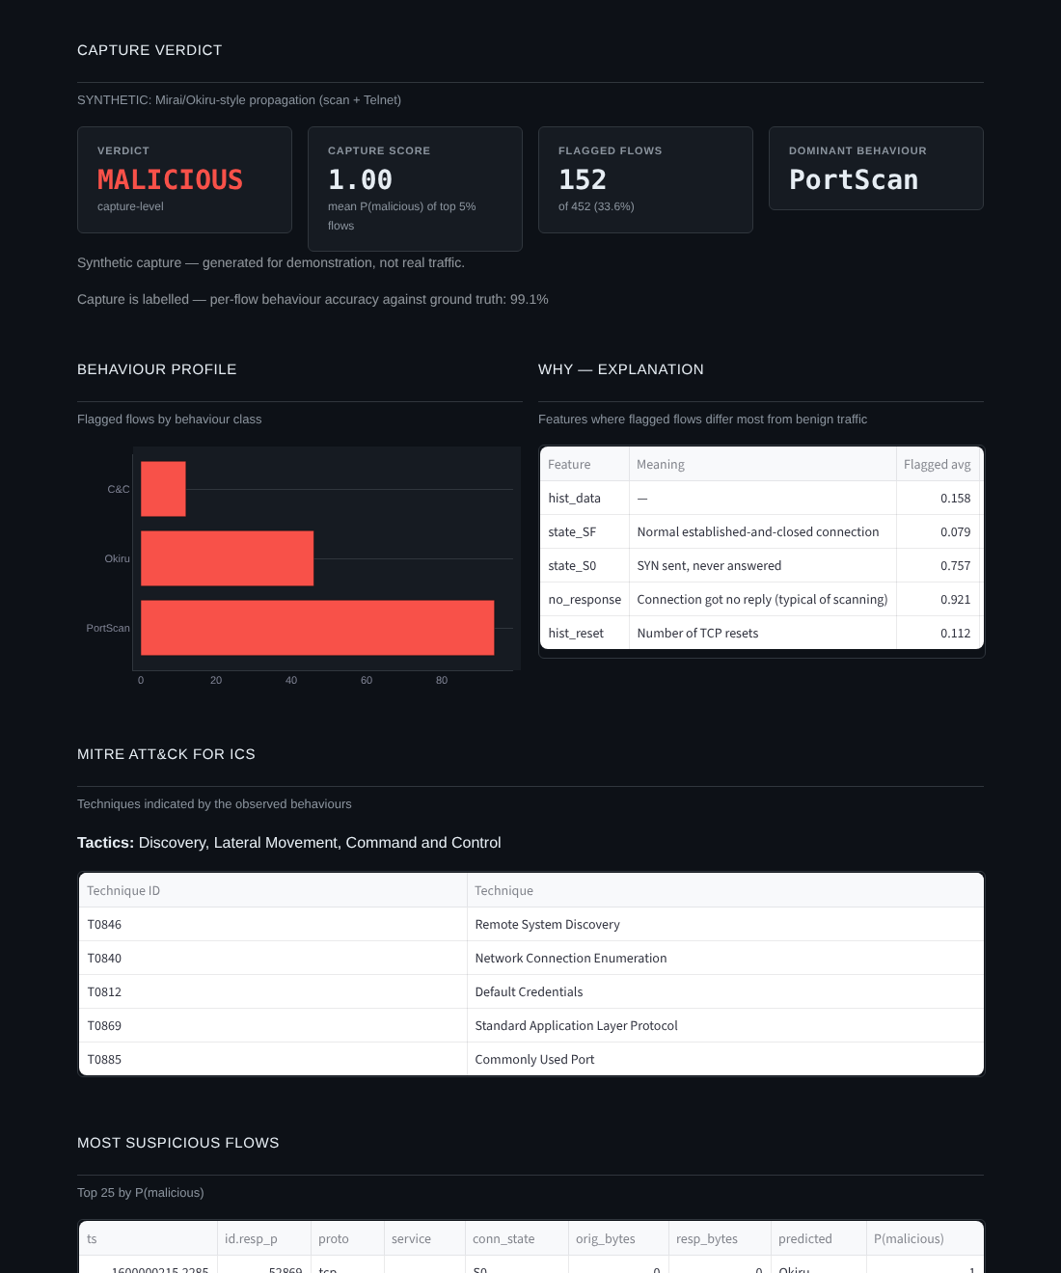
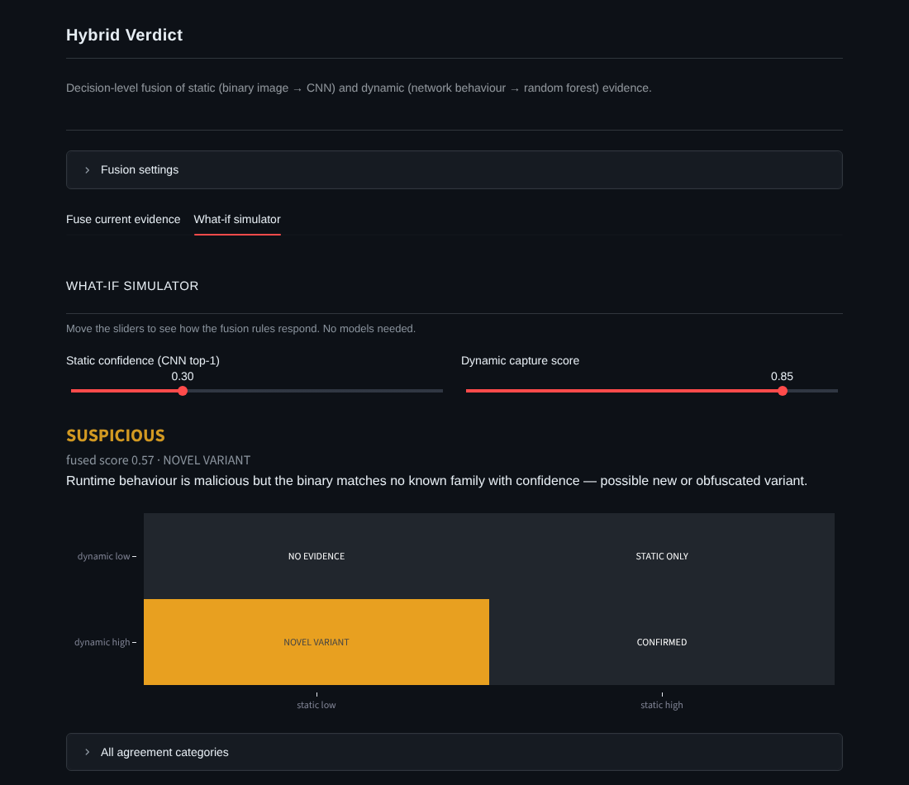
Maaz — behaviour and the hybrid verdict
LIVE DEMO Analyse an IoT-23 capture → open Hybrid Verdict → what-if: static low + dynamic high = NOVEL VARIANT

Slide 13
The fusion rule in one picture
Verdict
fused = (static + dynamic) / 2
MALICIOUS ≥ 0.70
SUSPICIOUS ≥ 0.40
Novel variant is never reported BENIGN
Weights adjustable on the dashboard
NO EVIDENCE
STATIC ONLY
dynamic < 0.50
Neither view finds malware
Known family, quiet at runtime: dormant or evasive
NOVEL VARIANT
CONFIRMED
dynamic ≥ 0.50
Behaves maliciously but matches no family: the case MalTwin exists for
Known family and malicious behaviour
static < 0.80
static ≥ 0.80

Slide 14
Testing

Slide 15




Four testing techniques, each for a reason
344
35
16
20
Unit
Functional
Business rules
Integration
Every function in isolation, on synthetic data: no dataset or GPU needed, so it runs on any laptop
13 automated UI tests (AppTest) on every run + 22 browser tests (Playwright): uploads, buttons, errors
Decision tables for rules that decide outcomes: upload acceptance, confidence colours, fusion
9 module hand-offs + 11 automated tests on the real dataset and trained model

Slide 16
Results: 17 defects found, all fixed
Test type | Cases | Passed | Failed
Unit (automated) | 344 | 344 | 0
UI (automated, AppTest) | 13 | 13 | 0
Functional (browser) | 22 | 22 | 0
Business rules | 16 | 16 | 0
Integration (manual) | 9 | 9 | 0
Integration (real dataset)* | 11 | 5 | 6
Performance (SRS targets)* | 7 | 6 | 1
Failed cases → status
D1 Upload page crashed after every upload → fixed
D2 Navigation click lost after upload → fixed
D4 Training crashed on new PyTorch → fixed
D5 Upload image layout ≠ training layout → fixed
D9 Detection result wiped on revisiting Upload → fixed
D10 Clean files always called malware → Benign class added
D11 Reports never linked to their detection → FK enforced
D14 Two C2LOP families had no MITRE mapping → added
D15 Tests overwrote the real class list → isolated
D16 History query 737 ms > 500 ms → covering index, < 10 ms
Full list in report Table 5.31
* First run on the laptop; all causes fixed, re-run before the demo

Slide 17
Automated testing

Slide 18




Strategy and tools
pytest
Core use cases automated
UC-01 Upload binary file
UC-03 Run malware detection
UC-06 Generate forensic report
UC-07 Analyse network capture
UC-08 View hybrid verdict
UC-09 Dashboard and history
Not automated yet: UC-13 / UC-14 Digital Twin (not built), so no tests are claimed for them.
Core logic: conversion, CNN, Grad-CAM, reports, dynamic model, fusion, database
Streamlit AppTest
Dashboard runs headless: clicks Run Detection, checks label, chart, MITRE, DB log
Playwright
Real browser runs of upload → detect → dynamic → hybrid
@pytest.mark.rtm
Every automated test ID is a tag on a real test, so the RTM is generated from code

Slide 19
Example automated tests: positive and negative
Test ID | Type | What it checks | Requirement | Result
AT-UI-04 | positive | Run Detection end-to-end: label, chart, MITRE, logged to SQLite | FR5.1–5.3, FR5.5, FR-B3 | PASS
AT-M2-04 | negative | Non-PE/ELF file rejected with a format error | FR3.1, FR3.5, REL-2 | PASS
AT-M2-08 | positive | Upload conversion is pixel-identical to the Malimg layout | FR-B1 | PASS
AT-M7-03 | negative | Invalid Grad-CAM target returns None, no crash | FR-B6, REL-2 | PASS
AT-M10-01 | positive | Six fusion decision-table cases | FR7.1 | PASS
AT-M9-02 | negative | Empty / non-Zeek log rejected | FR6.1 | PASS
AT-M5-09 | negative | Without a Benign class every clean file is flagged (proves the fix is needed) | FR4.14 | PASS
AT-DB-06 | positive | Database file permission is 600 | SEC-3 | PASS

Slide 20
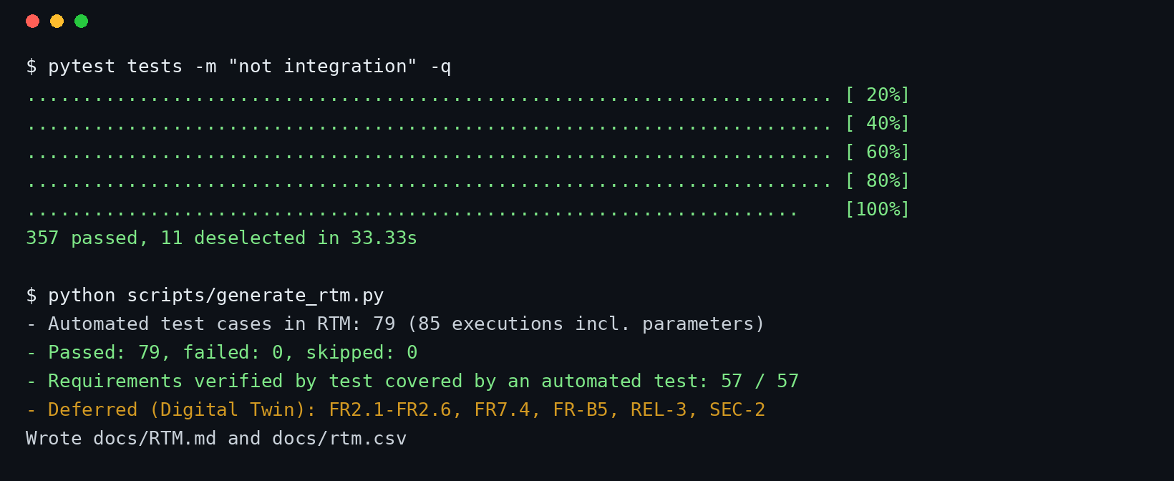
Execution evidence
357
tests executed
0
failed
57 / 57
testable requirements traced
LIVE DEMO python scripts/generate_rtm.py (runs every test and regenerates the RTM)

Slide 21
Requirement Traceability Matrix (excerpt)
Requirement | Description | Automated tests | Result
FR1.1 | Module status on dashboard | AT-M6-01, AT-M6-02, AT-UI-02 | PASS
FR1.3 | Sidebar navigation | AT-UI-01 | PASS
FR3.1 | Upload with validation | AT-M2-03, AT-M2-04 | PASS
FR5.1 | Run detection | AT-M5-02, AT-UI-03, AT-UI-04 | PASS
FR5.6 | PDF / JSON report | AT-M8-03, AT-M8-04, AT-M8-05, AT-UI-05 | PASS
FR4.12 | Results on balanced test set | AT-M5-12, AT-M5-13 | PASS
FR7.1 | Fusion decision rules | AT-M10-01, AT-M10-02 | PASS
FR2.1–2.6 | Digital Twin controls | — (deferred, not built) | —
Full matrix: docs/RTM.md, generated from the test run; every ID is a real test in tests/

Slide 22
AI / ML techniques

Slide 23
Three techniques, chosen for the data
CNN on byte images
Random forest on flows
Decision-level fusion
Malimg: 9,339 images, 25 families + Benign class
IoT-23: labelled IoT botnet traffic (Mirai, Okiru, Torii…)
Outputs of both models
Why
Byte layout preserves file structure; variants of one family look alike
Small network trains on a laptop; Grad-CAM stays readable
Why
Tabular, heavy-tailed features with extreme imbalance
Feature importance explains each verdict
Why
Works with either source alone
Raises behaviour-only detections as possible new variants

Slide 24
Results
97.6% ± 0.5
98.7%
94.2 → 98.7%
Accuracy on the class-balanced test set
Test accuracy · macro F1 97.1% · ROC-AUC 0.9997
Ablation: accuracy without byte-scrambling augmentation
10.2%
0.80
99.997%
Clean apps flagged as malware (6.4% confident) — mostly Visual Basic
Unseen-family AUROC — confidence alone misses new variants
IoT-23 malicious flows detected · 0.18% FPR (random split)
Measured on the demo laptop (8-core CPU, no GPU): inference 28 ms · Grad-CAM 0.51 s · report 38 ms · 10k-flow capture 0.32 s · all within SRS limits

Slide 25
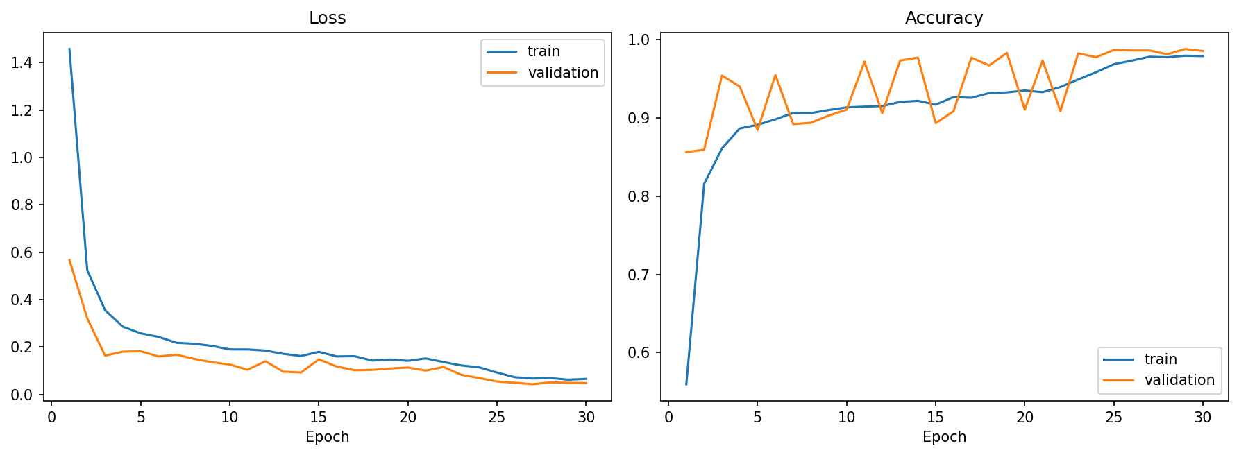
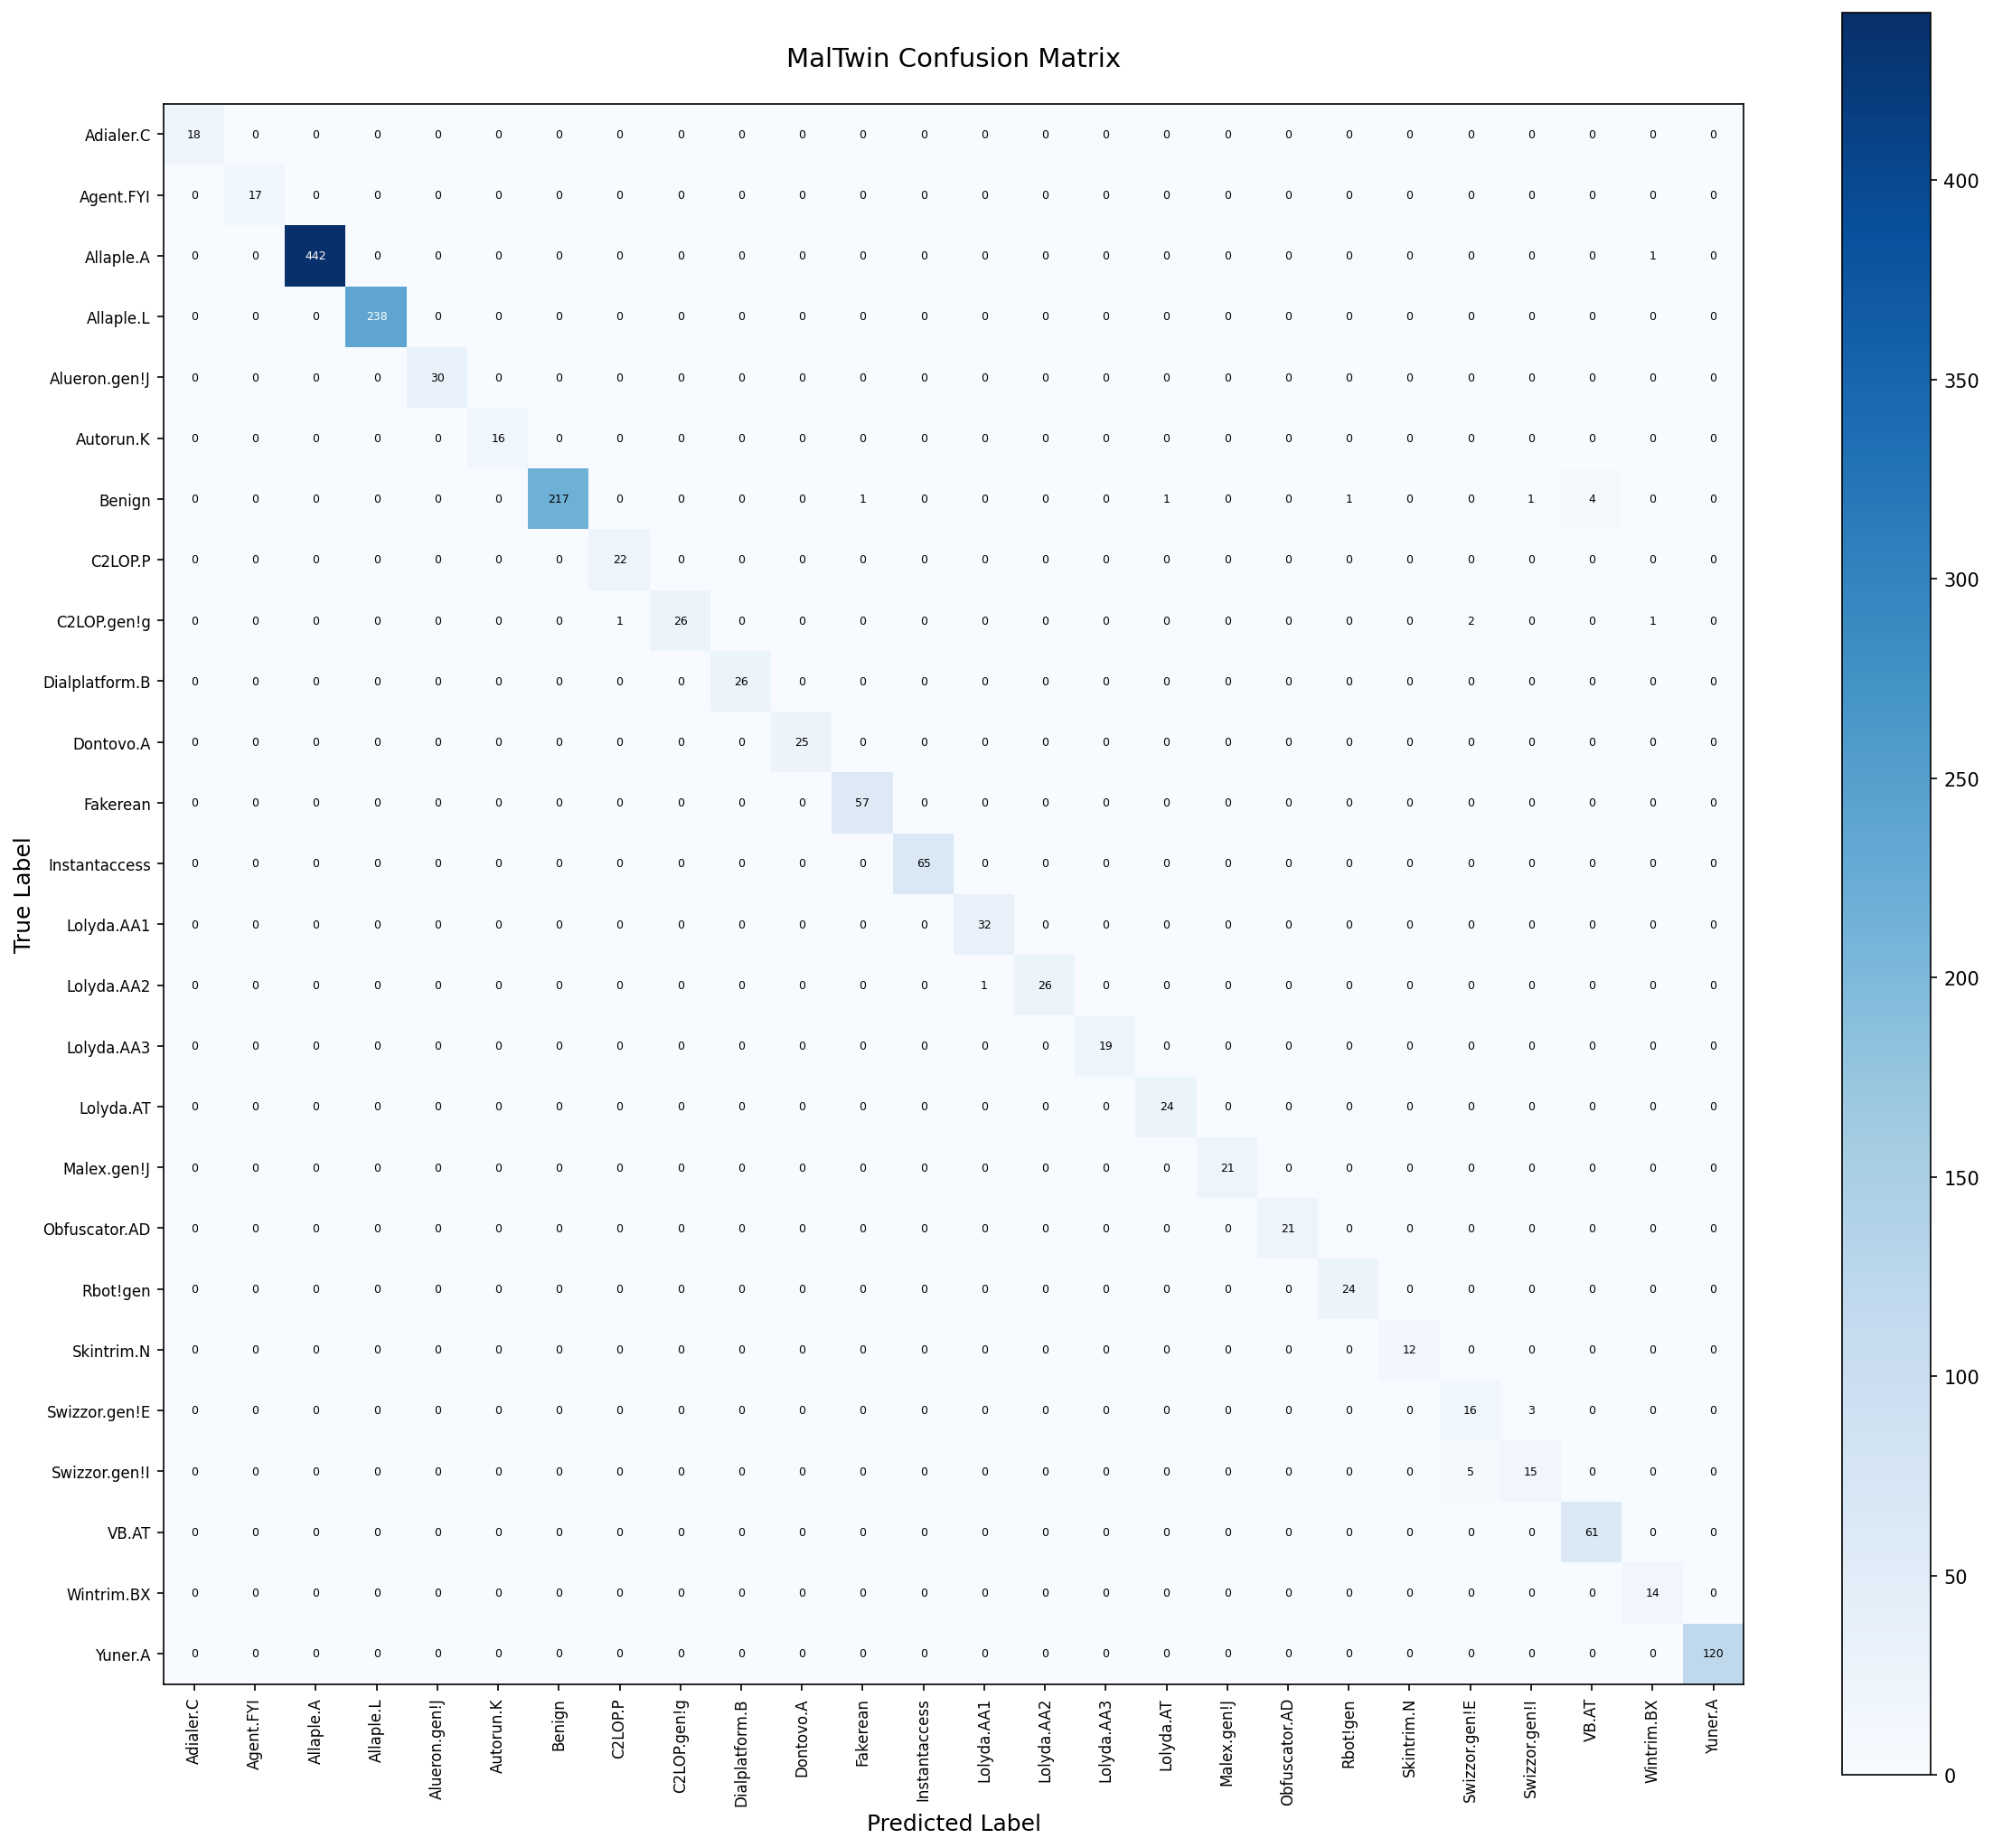
Static model: training and errors
Training curves — 30 epochs, no augmentation, best at epoch 29
Trained on a balanced dataset: every family drawn equally often
Balanced test set: 97.6% ± 0.5 (10 draws, 12 images × 26 classes)
No test-set malware was classified as Benign (precision 1.00)
Main confusion: Swizzor.gen!E vs Swizzor.gen!I — near-identical variants
Confusion matrix, 26 classes

Slide 26
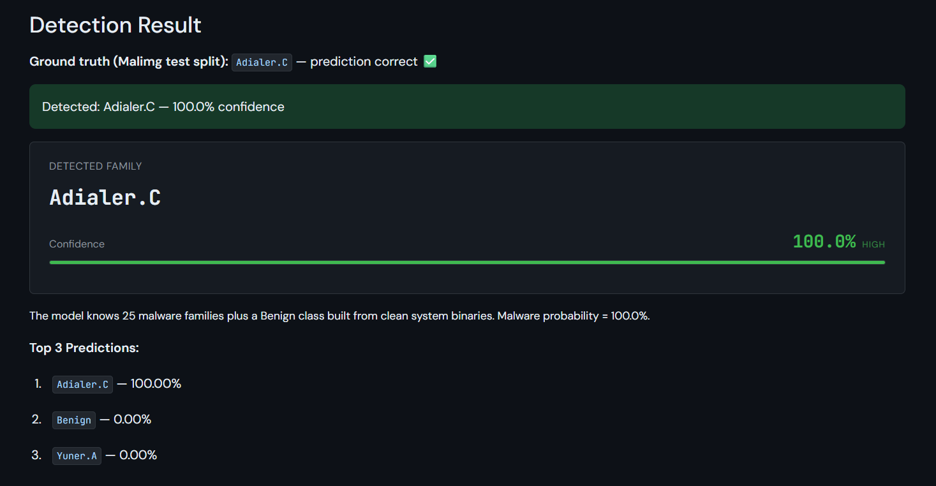
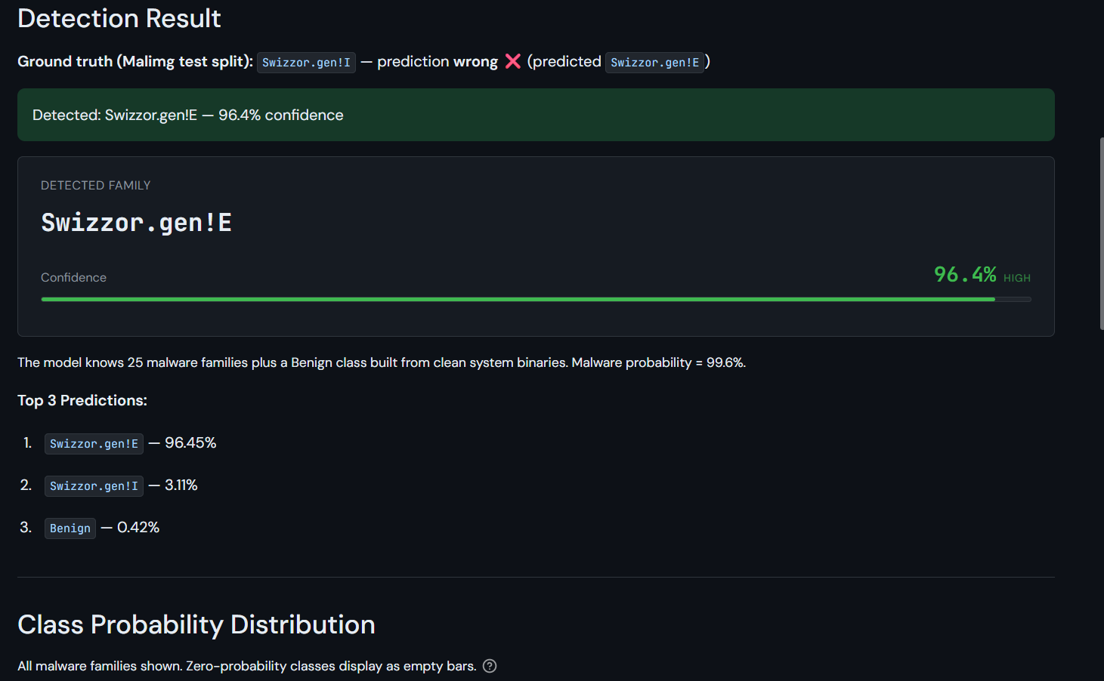
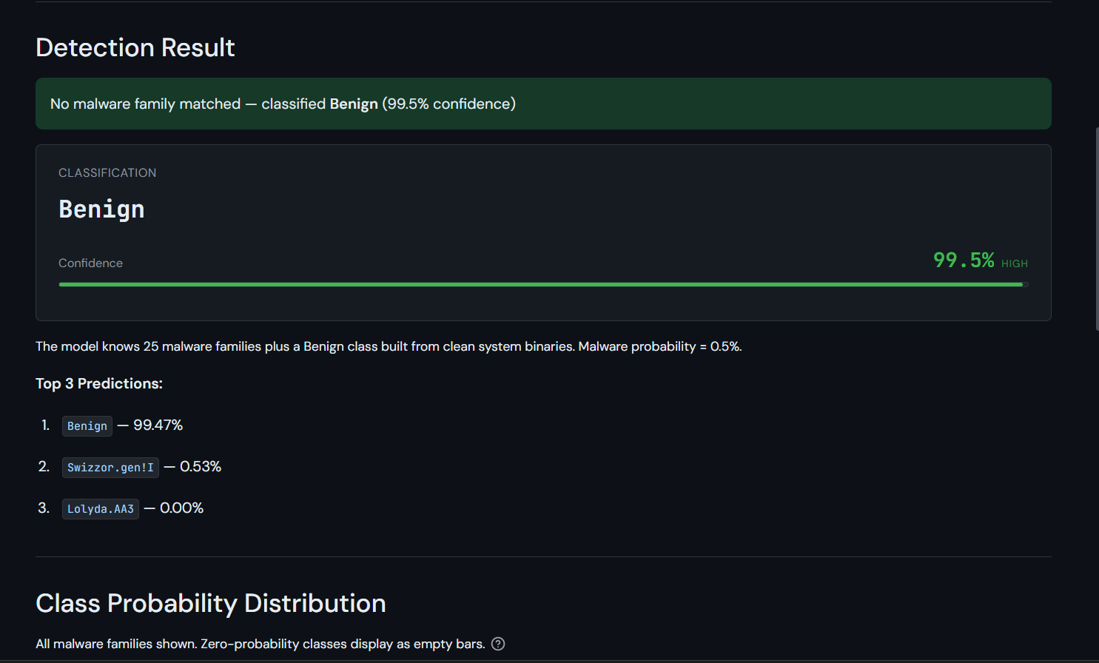
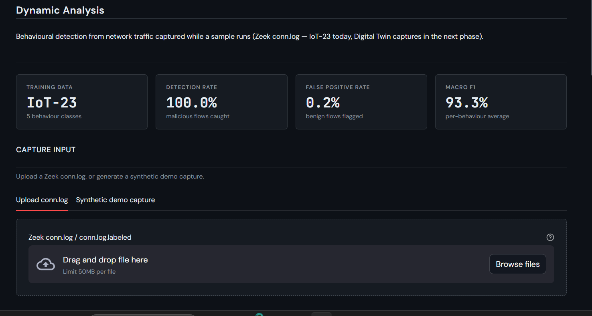
On the dashboard: right, wrong and clean
Held-out Adialer.C test image → correct, 100%
Swizzor.gen!I → called Swizzor.gen!E (right family, wrong variant)
Clean clang64.exe → Benign, 99.5%
Dynamic model on IoT-23: 100% detection, 0.2% FPR
LIVE DEMO Binary Upload → "Malimg test-set sample" tab → Load → Run Detection (ground truth shown)

Slide 27
Next steps

Slide 28
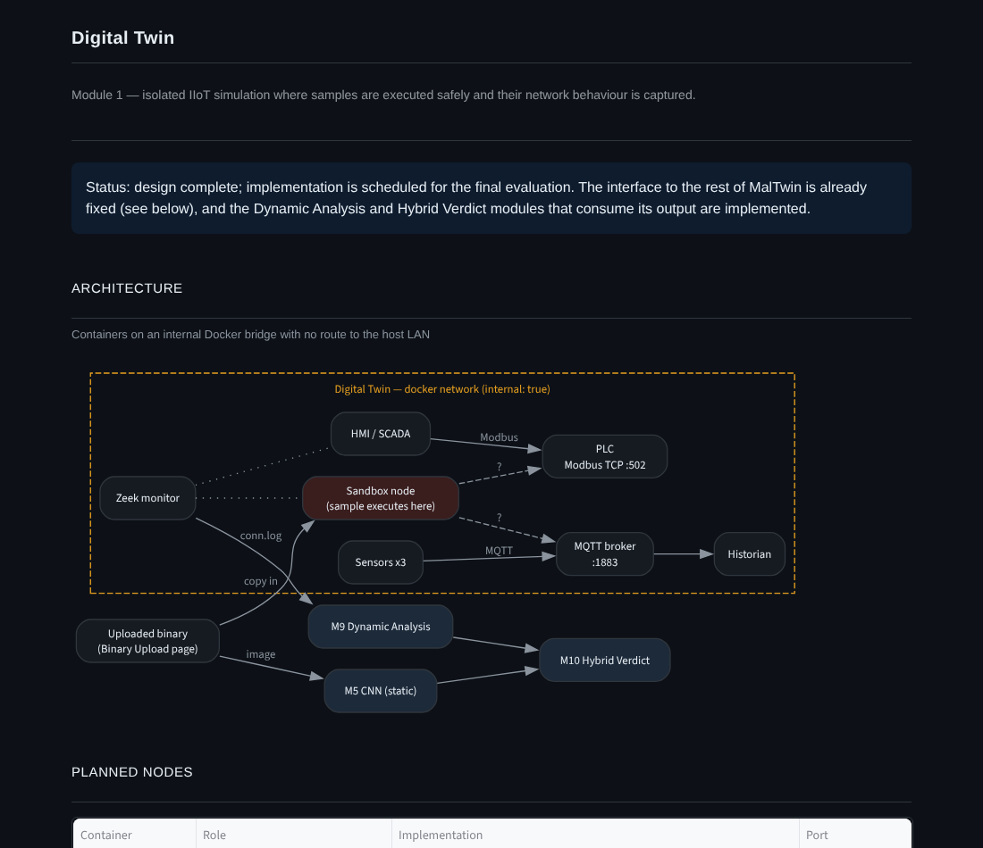
Remaining 40% and how we will handle it
1
Build the Digital Twin
Docker IIoT network: PLC, HMI, sensors, MQTT, sandbox, Zeek
Risk: Mininet needs native Linux → Docker networking, runs on WSL2 too
2
Paired evaluation
Same sample, image + traffic; tune fusion weights
Risk: few IIoT samples → Mirai / Gafgyt families
3
Broader benign set
Engineering and HMI software, Linux firmware
Risk: false alarms on industrial tools
4
Final testing
Usability trial (USE-1), twin tests, RTM to 100%

Slide 29
Thank you
Questions and live demo
github.com/imanfatimadocx/MalTwin

