Slide 1

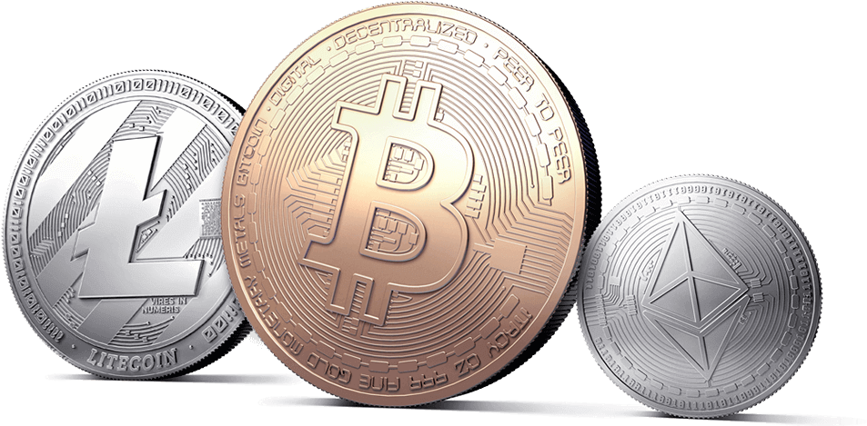
Dab 103 Cryptocurrencies: An Infographic
Group: 002
SUBMITTED BY:
AASHUTOSH SEHGAL
IMAN FATIMA
JASMINE RUBALDEEP KAUR UMAIR NABEEL

Slide 2
Introduction
Over the last decade, an increasing number of people from all over the world are investing in cryptocurrency. Cryptocurrency is a type of decentralized, distributed currency that is used to make transactions over the internet, same as you would with normal currency but without any intermediary bank.
The most commonly used Cryptocurrency is powered by the “Blockchain” technology which first came to light in 2008. Blockchain is essentially a digital ledger that keeps record of transactions and helps tracking assets. The legitimacy of every transaction is verified through the distributed peer-to-peer system and then added to the ledger and once added, it is immutable, which accounts for security. Blockchain facilitates an entirely different perspective, which is that no one is a trusted user.

Slide 3
Bitcoin was blockchain's first trial run that made out into this world in 2009, as of May 2021, 10,115 different cryptocurrencies exist according to Google and the number is still on the rise. A money system with nobody in control, no laws, and no regulations. That was rather a wild experiment which turned into a revolution. Businesses began creating their own cryptocurrencies and selling the coins as a way to raise money, like shares on a stock market. And people treated cryptocurrencies like a stock market too, investing in different ones, trying to buy low and sell high. [6]
Cryptocurrencies are generally measured in “COINS” and new ones are added to the system through “MINING” which is a process of solving complex mathematical problems with help of computer programs. Mining requires lots of hardware and processing power.

Slide 4
Inspiration
The force that motivated us to pursue this amazing journey of understanding the world of Cryptocurrency is to analyze the investment opportunities for both short term and long term investments.
Even though the nature of this market is agile, it is safe to say that cryptocurrency’s market is rapidly increasing, as the market capitalization briefly reached more than 1,000 billion USD. Even though, it may seem like an elusive subject to potential buyers or amateur crypto enthusiasts, with this project we hope to provide some insights into the crypto-world to get them started. [4]
We aim to provide a detailed descriptive analysis of some major cryptocurrencies in the market today namely Bitcoin, Ethereum and Dogecoin, over the period of 2017-21.

Slide 5
Problem Statement
Cryptocurrencies like Bitcoin, Ethereum and others gained a lot of attention in 2017 when they reached new heights, Whereas Dogecoin gained attention in 2021. Cryptocurrencies are volatile as there is speculation whether they are good investment or not. Given the high variance in prices, can data and statistical analytics methods can be used to provide better investment opportunities to general public?

Slide 6
High Level Project Goal
Analyze the trading data of cryptocurrencies using traditional and statistical metrics.
Compare cryptocurrency with other markets and check volatility between the two.
Analyze dependency of cryptocurrencies on Bitcoin.

Slide 7
Questions Our Project Would Answer
1) Why bitcoin became famous and what heights did it reached during its peak?
2) Are other Cryptocurrencies prices dependent on Bitcoin, are the major peaks and crashes co-related?
3) What is expected ROI (Return on Investment) when investing in Cryptocurrencies for a long term? How did Dogecoin which started as joke and ended up being worth half billion dollars? Did Twitter influence it?
4) How volatile is Bitcoin compared to gold? Does investing in volatile cryptocurrency really good investment?

Slide 8
dataset
Our dataset is collected from a Cryptocurrency exchange known as Gemini and for Dogecoin and gold dataset we have used Yahoo Finance. [3]
Gemini Exchange Link
DogeCoin Data By Yahoo Finance
Banks Market capital by relbanks
Cryptocurrency market capital by yahoo finance
Gold Market Dataset By Yahoo Finance

Slide 9
Description
In this project, our focus is on two major cryptocurrencies and a meme coin, we will through our data cleaning and transformation and with the analysis of data answer the questions in our proposal. Data cleaning/transformation includes finding and removing missing values if any, transforming columns to make them compatible for analysis.
Later while answering questions, we will take individual question explain its' key points through appropriate plots also we will see the volatility of the cryptocurrency as compared to gold and based on all these analysis we will provide our audience with suggestions giving them a brief and thorough idea about cryptocurrencies before entering into its world.

Slide 10
Exploratory Data Analysis
We have used 4 datasets in our project, from which 3 are related to cryptocurrencies, namely Bitcoin, Ethereum and Dogecoin from year 2017 to 2021.
Vol. column of btc, eth and doge have “K”, “M”, “B” which makes the values invalid for analysis, Market Cap column in banks data is in Billions and needs correction which we will do in later stage. Date of information column is irrelevant and region should be converted to category data type to reduce space.

Slide 11
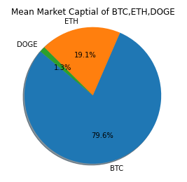
Market Share
The pie chart explains the obvious fact that bitcoin being the oldest has the maximum share in market capital of 79.6%, whereas Ethereum has 19.1% and the most recent dogecoin has 1.3% which is still quite significant despite been in market for shorter span of time.

Slide 12
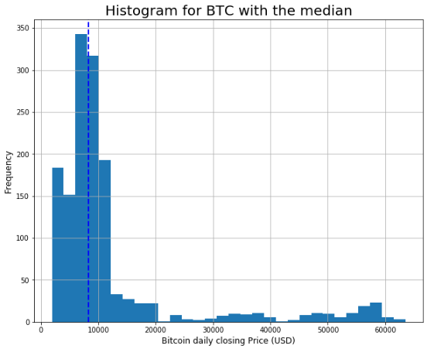
Histogram with median for Bitcoin
The closing price was noticed to be below 20000 for many days, the plot is right skewed as we can see a tail at the right side of the plot. The dashed line shows the median representing half of the time closing prices were under $8300.

Slide 13
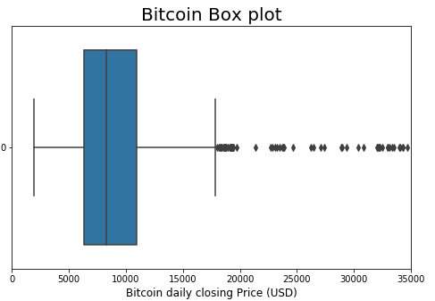
Boxplot for btc
On the box plot below, we see that bitcoin closing price was most of the time between 7000 and 11000 in the last 3 years. All values over 18000 are outliers (using IQR). Outliers are specific to this data sample.

Slide 14
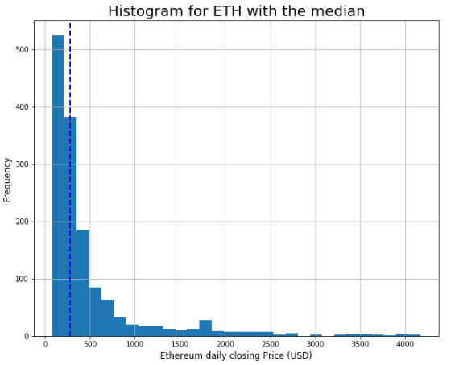
Histogram with median for eth
The closing price was noticed to be below 1000 for most days, the plot is right skewed as we can see a tail at the right side of the plot. The dashed line shows the median representing half of the closing prices were under 278.4.

Slide 15
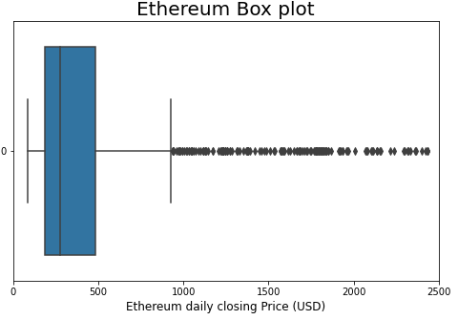
Boxplot for eth
The below box plot depicts that the closing price was mostly in between 300 and 500 in the last 3 years. All values that lies above 900 are outliers as per the box plot.

Slide 16
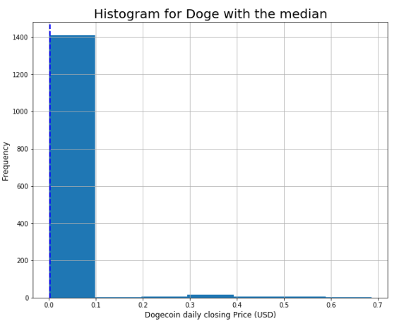
Histogram with median for doge
The closing price was noticed to be below 0.1 for many days, the plot is unimodal as there is only one peak and most of the time price were 0.1 dollars or less. The dashed line shows the median representing half of the closing prices were under 0.003.

Slide 17
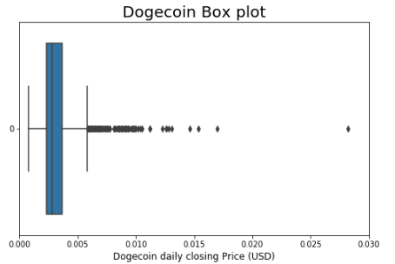
Boxplot for doge
On the box plot below, we see that Dogecoin closing price was most of the time between 0.002 and 0.004 in the last 3 years. All values over 0.006 are outliers (using IQR). Outliers are specific to this data sample of 2017 to 2021.

Slide 18
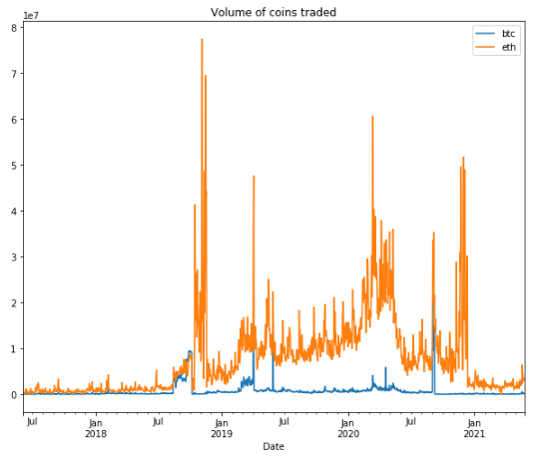
Volume of coins traded
Volume indicates how many shares or currencies are bought and sold during given period of time. Volume of Ethereum traded on daily basis is much higher than the bitcoin as shown in the graph. Moreover, the bitcoin is more expensive so this explains why on same scale it shows less movement than Ethereum.

Slide 19
DATA CLEANING/TRANSFORMATION AND DATA ANALYSIS

Slide 20
Data Cleaning
1. There are no missing value in the cryptocurrencies datasets, therefore, we need not to perform any data cleaning.
We can check any available null values in the dataset using isnull() method present in Python.
2. When combining the dataset of bitcoin and gold for analysis there are some missing values which were removed. The reason that gold prices are "NaN" is because bitcoin market never sleeps. Crypto markets work 24/7 while gold is traded on stock exchanges which are closed on weekends and holidays.

Slide 21
Data Transformation
1. The volume column in datasets is of type character and data is in millions(M). So it was converted from character to float and millions were converted to zeros to compare the coins traded on daily basis.
2. Suffix was added in header of dogecoin dataset as all the datasets have same header names.
3. All the cryptocurrencies dataset were merged into single dataset and further suffixes were added in headers of Bitcoin and Ethereum dataset.
4. For comparing bitcoin and gold few columns were dropped and the remaining columns were renamed.

Slide 22
Answers to questions

Slide 23
1) Why bitcoin became famous and what heights did it reached during its peak?
For this we will use Candlestick charts which provide an easy-to-interpret picture of price action.
The filled portion of the candlestick is called the body. The lines above and below the body represent the high/low range and are called shadows (or “wicks” or “tails”). The high is marked by the top of the upper shadow and the low by the bottom of the lower shadow.

Slide 24
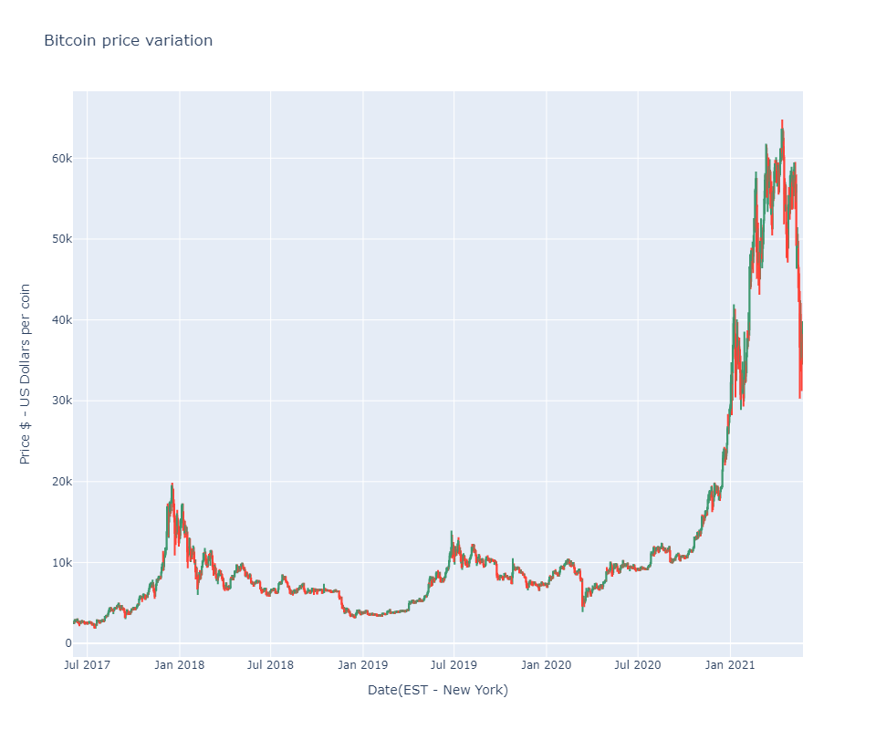
As can be seen from the chart there are two distinguished peaks first in Dec 2017 where price surged close to 20K dollars and next one is recent where price surged to more than 60K dollars per coin.

Slide 25
Even the most casual observer of the digital currency scene will be aware that 2017 was a record year in terms of price movement. Bitcoin was the marquee attraction for new giant investors and corporations given its incredible rise from 900 dollars in January 2017 to 20,000 dollars by December 2017. [8]
In early 2021 Recently, there has been a trend where public companies are converting their cash treasuries into cryptocurrency. Square, an American payments company, bought 50 million dollar worth of Bitcoins. Following this, Microstrategy- a public listed company in the US, converted 425 million dollars worth of cash reserves into Bitcoin, considering it to be a better store of value. Many companies have since followed this trend. The confidence of corporate giants on cryptocurrencies has added more merit to it as a currency and value store.[10]

Slide 26
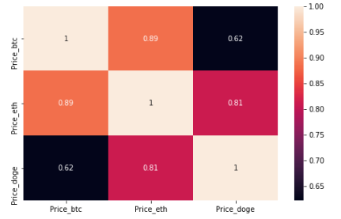
2) Are other Cryptocurrencies prices dependent on Bitcoin, are the major peaks and crashes co-related?
Next we will look at dependency of Ethereum and Dogecoin on Bitcoin. Also as dogecoin is called Meme coin because it was started as a joke and to mock the bitcoin.

Slide 27
We calculate the Pearson correlation between the closing prices of BTC, ETH, and LTC. Pearson correlation is a measure of the linear correlation between two variables X and Y. It has a value between +1 and −1, where 1 is the total positive linear correlation, 0 is no linear correlation, and −1 is the total negative linear correlation.
(BTC, ETH) and (ETH,DOGE) were highly correlated as per the data. This means, when BTC closing price increased, ETH prices followed. Similarly is it safe to say that when prices of ETH increased DOGE followed.
BTC and Doge have high positive relationship correlated with 0.62 Pearson correlation coefficient.
The knowledge of the correlation coefficient helps to determine percentage the influence of Bitcoin over Dogecoin. The share of BTC price affecting trend in Dogecoin is the most important factor. The other part covers all the other things, such as media, events or regulations.

Slide 28
3) What is expected ROI (Return on Investment) when investing in Cryptocurrencies for a long term? How did Dogecoin which started as joke and ended up being worth half billion dollars?
Buy and hold is a passive investment strategy in which an investor buys a cryptocurrency and holds it for a long period, regardless of fluctuations in the market. Let’s analyze returns using the Buy and hold strategy for the past 3 years. We calculate the return percentage, where t represents a certain period and price0 is the initial closing price.[7]
return(t,0) = price(t)-price(0)/price(0)
or
ROI = (Present Value of Investment - Initial value of investment) / Initial Value of Investment

Slide 29
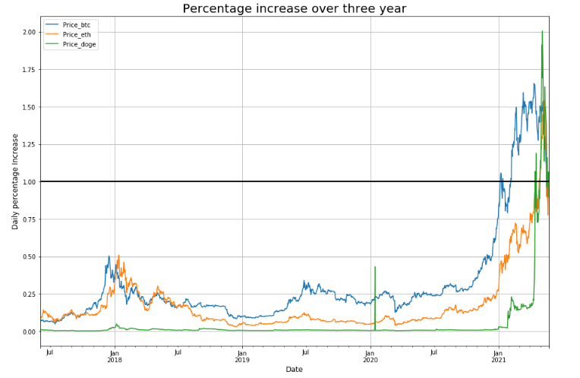
We can see that DOGE was the most profitable for the month of Apr'21. Other two currencies also returned high amount during the same period. All three cryptocurrencies fluctuated a lot but all gained if compared to year 2017.

Slide 30
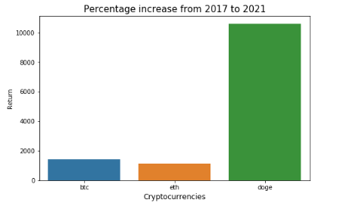
Dogecoin have the highest return of the three cryptocurrencies with return of more than 10000% in three years whereas bitcoin return is 1400% and of Ethereum is close 1150%. So if one wants to invest in cryptocurrencies dogecoin is the best one for long term investment.

Slide 31
4) How volatile is Bitcoin compared to gold? Does investing in volatile cryptocurrency really good investment?
The question that we are going to answer here is "How volatile is Bitcoin compared to gold? And which one of them is a better investment?". Since both are assets that people regularly invest in, we thought it would be interesting to perform an analysis and see which one has more returns and less risks or vice versa.
Based on the time-frame we selected the annual return of gold is 9.5% while that of bitcoin is 66.8%. While bitcoin has a higher return, it has more risks which can be visualized through volatility, which represents the degree of variability in returns of our assets.

Slide 32
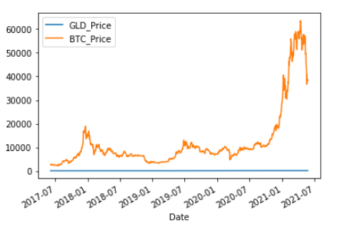
Compared to Bitcoin, gold prices are a flat line! Are gold price returns really that far from bitcoin? Gold is steady compared to bitcoin because gold is an $11 trillion dollar regularized market while cryptocurrency market is only 600 billion dollars that relies heavily on technology and 'word-of-mouth'. Let's explore this further with volatility.

Slide 33
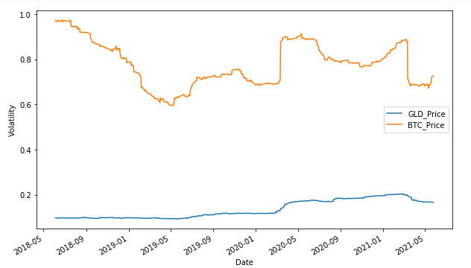
The formula for volatility is
volatility = standard deviation(sum(return)) * Square root(trading days)
While gold has smaller returns , it does not have high risks like bitcoin whose volatility is never a straight line.[9]

Slide 34
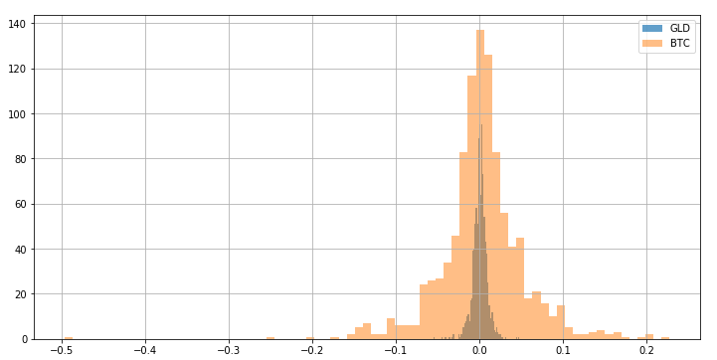
Bitcoin is way more distributed along the x-axis than gold. And wider the distribution, the more the price fluctuates.

Slide 35
Conclusion
We found out that cryptocurrencies are trend creators and trend followers their prices are highly influenced by trends on social media and competition amongst major companies.
(BTC, ETH) and (ETH,DOGE) were highly correlated as per the data. This means, when BTC closing price increased, ETH prices followed. Similarly is it safe to say that when prices of ETH increased DOGE followed.
Dogecoin have the highest return of the three cryptocurrencies with return of more than 10000% in three years whereas bitcoin return is 1400% and of ethereum is close 1150%. So if one wants to invest in cryptocurrencies dogecoin is the best one for long term investment.

Slide 36
Conclusion (Contd.)
Compared to Bitcoin, gold prices are a flat line! Are gold price returns really that far from bitcoin? Gold is steady compared to bitcoin because gold is an $11 trillion dollar regularized market while cryptocurrency market is only 600 billion dollars that relies heavily on technology and 'word-of-mouth'. it is clear now that while gold has smaller returns , it does not have high risks like bitcoin whose volatility.

Slide 37
Recommendation
Our suggestion for crypto enthusiasts is that instead of reading a few positive or negative articles or tweets about crypto-world, they should look for resources that elaborates trends not just stating them. From our thorough analysis we found the following:
For long term investment cryptocurrencies is a safe bet but not for short term, gold on the other hand is a safer investment for both short and long term because gold's volatility is more or less a straight line meaning it is a steady market which includes fewer risks and fewer jumps but has lesser return as well.
The price of bitcoin is largely derived by trends, so you are at more risk of losing your investment for short term investment and that is evident by the high volatility. So short term investment should not be made in cryptocurrencies.

Slide 38
References and Resources
https://www.nyse.com/market-data/historical
https://www.nasdaq.com/market-activity/quotes/historical
https://finance.yahoo.com/quote/%5EGSPC/history?period1=1221404400&period2=1230649200&interval=1d&filter=history&frequency=1d
https://opendata.stackexchange.com/questions/11955/total-cryptocurrency-market-cap-over-time
https://www.blockchain.com/charts/market-cap
https://cbeci.org/
https://allstarcharts.com/u-s-stock-market-bottomed-2008-march-2009/

Slide 39
References and Resources
Formula for Volatility was taken from [http://techflare.blog/how-to-calculate-historical-volatility-and-sharpe-ratio-in-python/ ]
https://www.investopedia.com/articles/technical/02/010702.asp
https://quantivity.wordpress.com/2011/02/21/why-log-returns/
https://economictimes.indiatimes.com/markets/stocks/news/5-reasons-why-bitcoin-cryptocurrency-prices-are-on-the-rise/articleshow/80764149.cms?from=mdr

Slide 40
Thank You

