Slide 1
Book1
File created on: 11/12/2024 1:03:30 AM

Slide 2
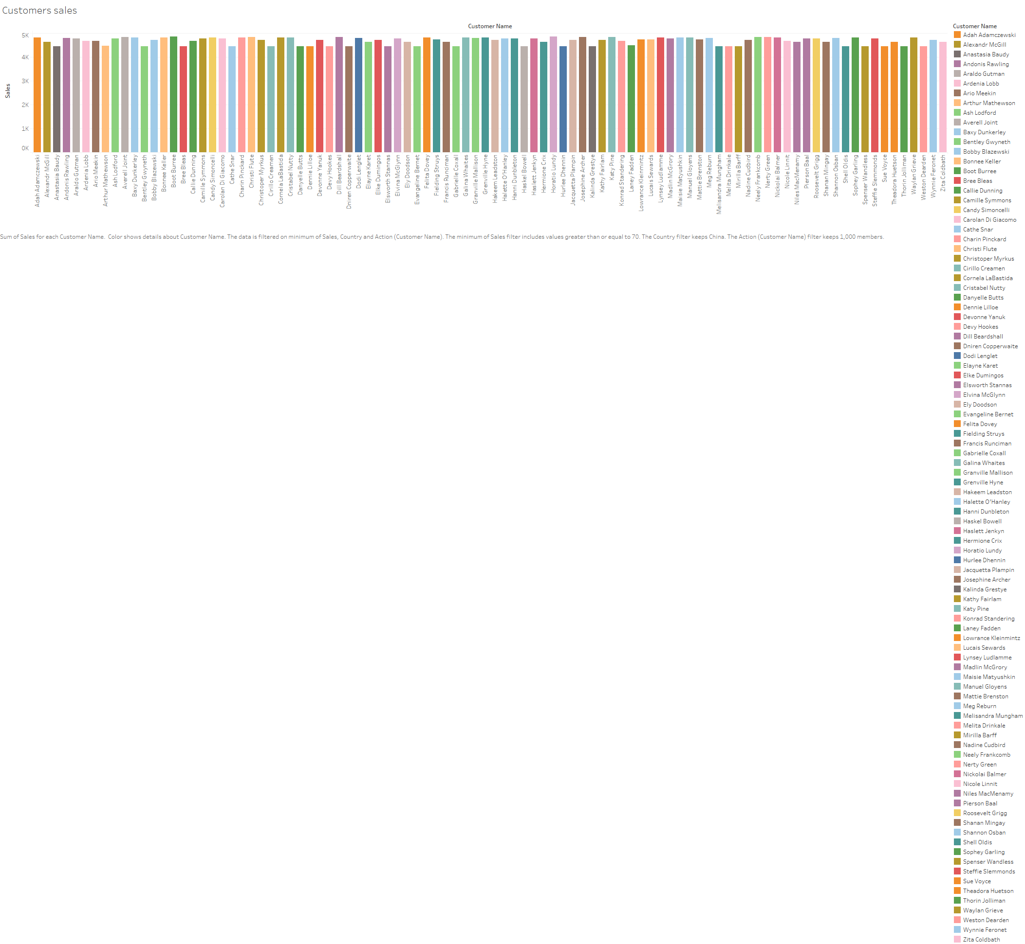

Slide 3
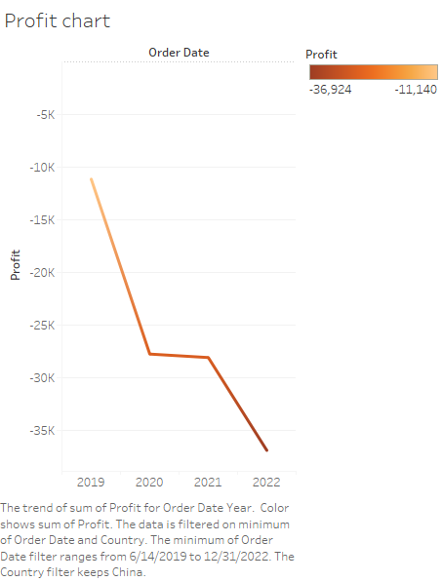

Slide 4


Slide 5
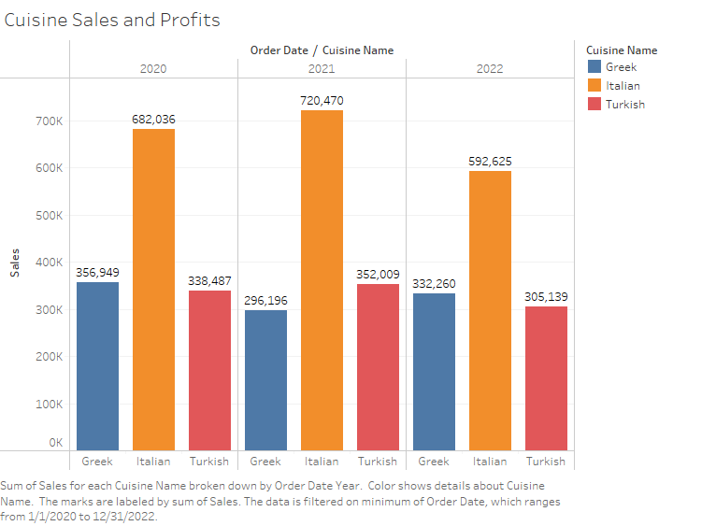

Slide 6
