Slide 1

SMART LAUNDRY LOGISTICS — A DSA-DRIVEN PLATFORM
LaundryConnect
Smart Laundry Pickup & Delivery Management Platform, built on hand-implemented
Tries, Heaps, Interval Scheduling, and Dijkstra's Algorithm.
Aniket Singh Rajput
B.Tech CSE Reg. No. 12417064
Lovely Professional University

Slide 2





OVERVIEW
What We'll Cover
Problem & Objectives
Tech Stack & Architecture
Why LaundryConnect exists and what it set out to solve
MERN stack, system design, and data flow
Core DSA Implementation
Live Features
Trie, Priority Queue, Interval Scheduling, Dijkstra
Real-time tracking, payments, reviews
7-Day Build Timeline
Deployment & Results
How the project was executed end-to-end
Live on Vercel + Render, challenges solved
2

Slide 3

THE PROBLEM
Laundry logistics is harder
than it looks
Result
Wasted delivery time, unfair order processing, frustrated customers, and a business that can't scale past a handful of manual daily orders.
Most small-scale laundry operators coordinate pickups, deliveries, and order status manually — or through basic CRUD apps that store data without any logic to optimize operations.
Delivery partners get double-booked for overlapping time slots
Express orders and long-waiting orders compete unfairly for priority
Multi-stop deliveries are routed with no real optimization
Customers have no visibility into live order status
3

Slide 4


GOALS
Objectives & Outcomes
Secure, role-based authentication
JWT + bcrypt across customer, partner, and admin roles
Instant, scalable service search
Custom Trie — O(prefix length), independent of catalog size
Fair, starvation-free order processing
Custom max-heap priority queue with wait-time aging
Zero delivery-slot conflicts
Interval scheduling with automatic free-slot suggestions
Optimized multi-stop delivery routes
Dijkstra + greedy nearest-neighbor over live coordinates
Real-time order tracking
Socket.io push updates — no polling required
4

Slide 5





UNDER THE HOOD
Technology Stack
Frontend
Backend
Database
React (Vite), Tailwind CSS, React Router, Axios, Socket.io Client
Node.js, Express.js, Socket.io Server
MongoDB Atlas (Cloud) with Mongoose ODM
Auth & Security
Version Control
Deployment
JSON Web Tokens (JWT), bcrypt password hashing
Git + GitHub, MIT Licensed, public repository
Vercel (Frontend) + Render (Backend)
5

Slide 6
DESIGN
System Architecture
React Client (Vite)
DSA Utility Layer — What Lives Here
Customer / Partner / Admin UI
Trie.js
REST (Axios) + WebSocket (Socket.io)
Prefix search over service catalog
Express + Socket.io Server
PriorityQueue.js
REST API + real-time events
Max-heap for order processing order
Controllers invoke DSA utils
intervalScheduler.js
DSA Utility Layer
Sorted-sweep slot conflict detection
Trie · Heap · Scheduler · Dijkstra
dijkstra.js + routeOptimizer.js
Shortest-path delivery routing
Mongoose ODM
MongoDB Atlas
User · Order · Service · Partner · Slot
6

Slide 7
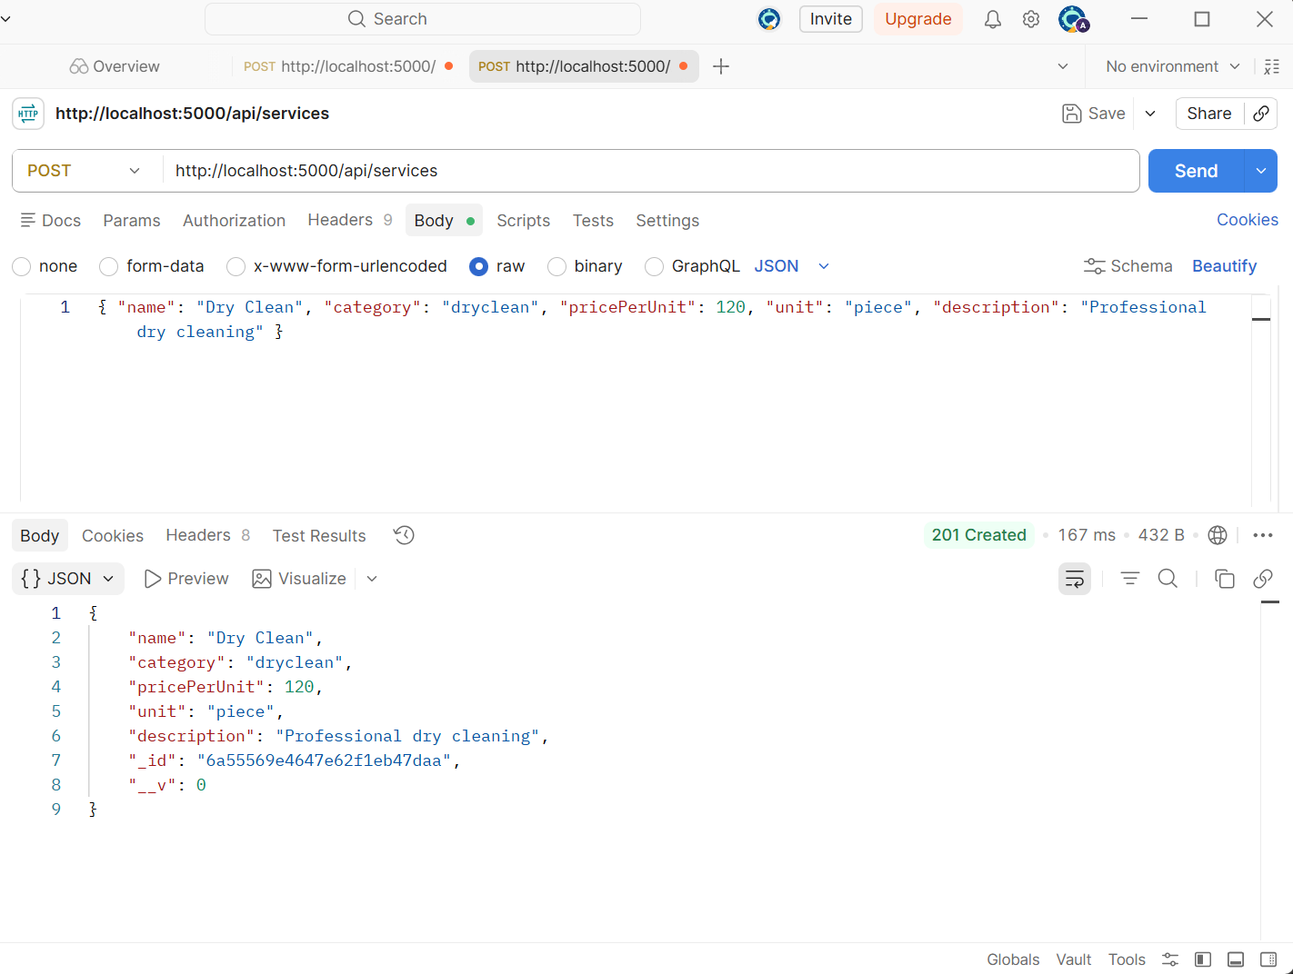
DSA CONCEPT 01
Trie — Instant Service Search
Each node stores a Set of matching service IDs at every character along the insertion path — search resolves in O(k) time, k = prefix length, independent of total catalog size.
search(prefix) {
let node = this.root;
for (const char of prefix) {
if (!node.children[char])
return [];
node = node.children[char];
}
return Array.from(node.serviceIds);
}
7

Slide 8
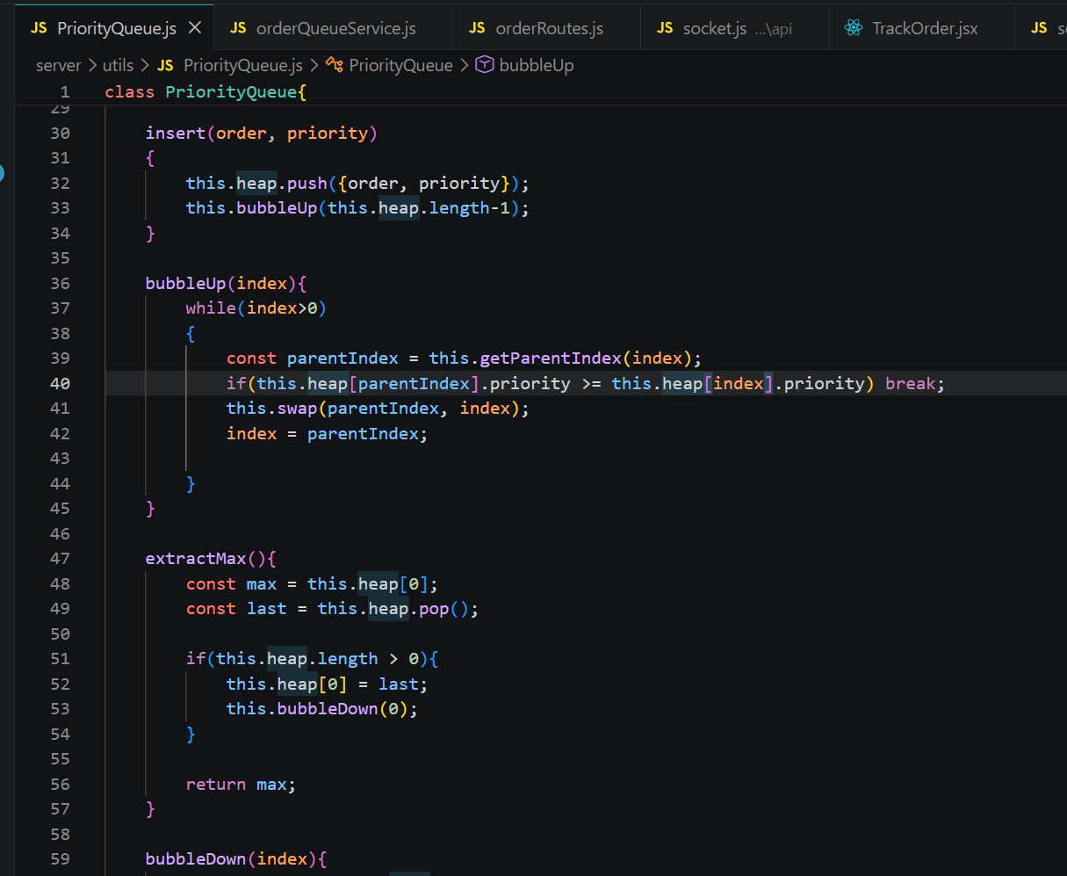
DSA CONCEPT 02
Max-Heap — Fair Order Processing
A binary max-heap stored as a flat array. Priority combines an express-flag base score with a wait-time bonus — preventing older standard orders from being starved by a constant stream of new express orders.
O(log n)
Array-based
Anti-starvation
insert / extractMax
no pointer overhead
wait-time aging
priorityScore = (isExpress ? 100 : 10) + minutesWaiting
Recomputed dynamically at every queue read, so wait-time aging is always current.
8

Slide 9
DSA CONCEPT 03
Interval Scheduling — Zero Slot Conflicts
Delivery partner slots for a date are sorted by start time; a running cursor sweeps forward to detect overlaps or free gaps — the classic sorted-sweep interval scheduling pattern.
Slot Timeline Example
09:00 11:00 13:00 15:00
hasConflict(existingSlots, newStart, newEnd) {
for (const slot of existingSlots) {
if (doesOverlap(slot.startTime,
slot.endTime, newStart, newEnd))
return true;
}
return false;
}
// O(n log n) sort + linear sweep
// vs. O(n²) naive pairwise checks
Booked
New Request — CONFLICT
✗ Overlaps existing slot 09:00–10:30
Suggested Free Slot
✓ Auto-suggested next available: 10:30–12:00
9

Slide 10
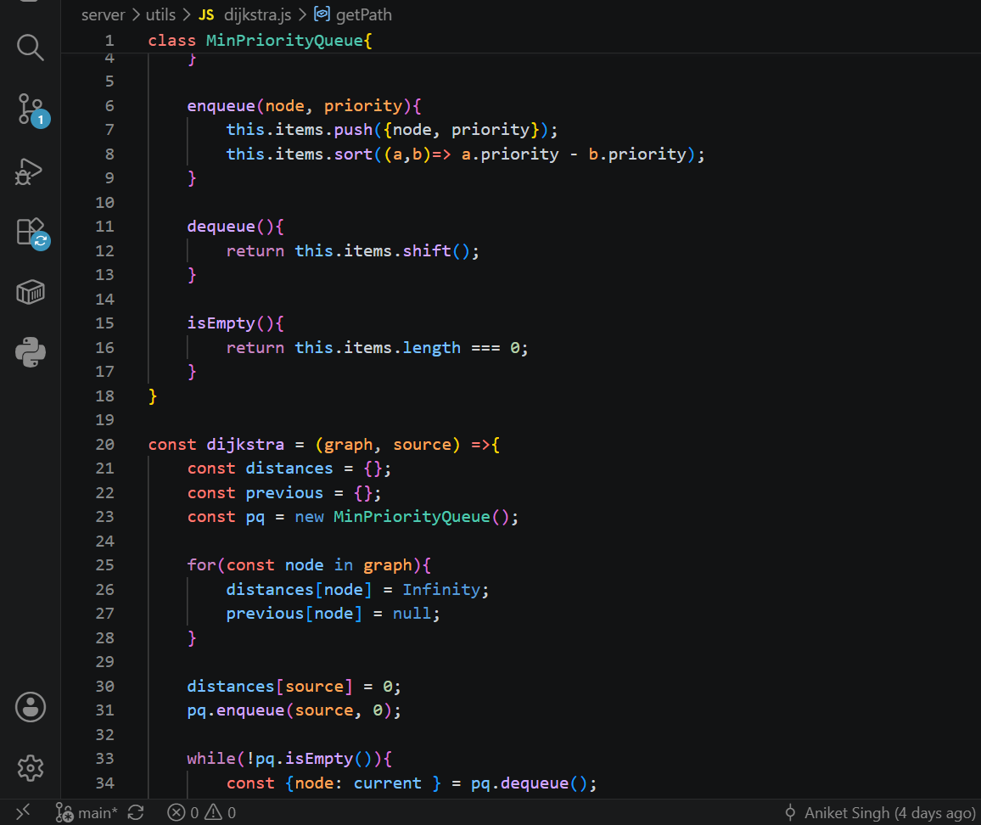
DSA CONCEPT 04
Dijkstra — Optimized Delivery Routes
Delivery stops form a complete graph with edge weights from the Haversine great-circle distance formula. Dijkstra's shortest-path algorithm, combined with a greedy nearest-neighbor heuristic, sequences a partner's multiple stops efficiently.
Why not exact TSP?
Exact multi-stop route optimization is NP-hard — greedy nearest-neighbor is the standard, practical approximation for realistic stop counts.
while (!pq.isEmpty()) {
const { node } = pq.dequeue();
for (const nb of graph[node]) {
const d = distances[node] + nb.weight;
if (d < distances[nb.node])
pq.enqueue(nb.node, d);
}
}
10

Slide 11
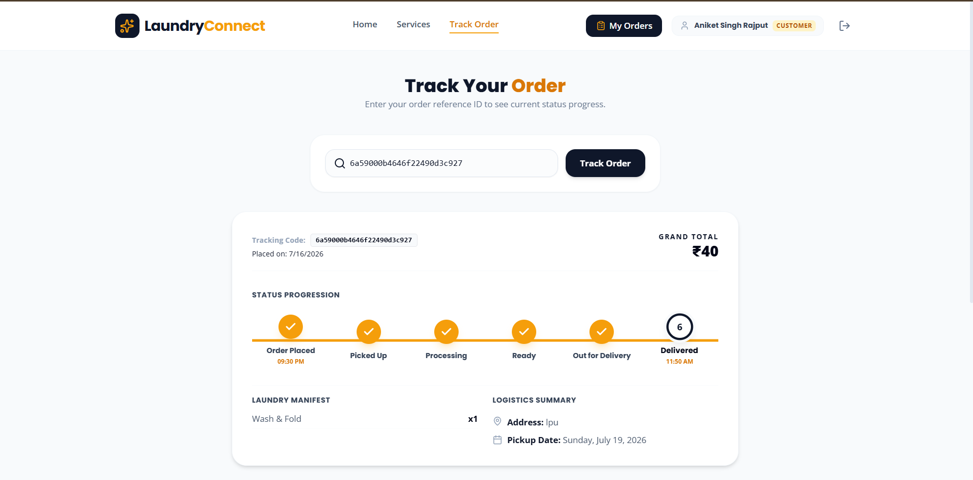
LIVE FEATURE
Real-Time Order Tracking
Every status change emits a room-scoped Socket.io event. The customer's Track Order page listens and updates instantly — no page refresh, no polling.
1
Partner updates status
2
PATCH /orders/:id/status
3
Server emits Socket.io event
4
Customer's screen updates live
11

Slide 12
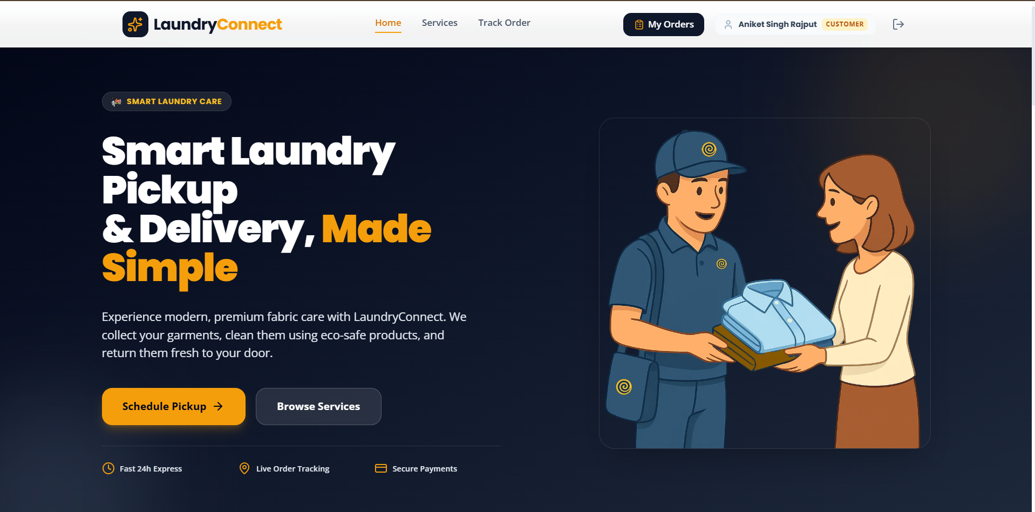

PRODUCT WALKTHROUGH
Customer Experience
Trie-powered live search across all services
Schedule pickups with express priority option
Live status tracking from pickup to delivery
Secure payment + itemized invoice, plus reviews
12

Slide 13
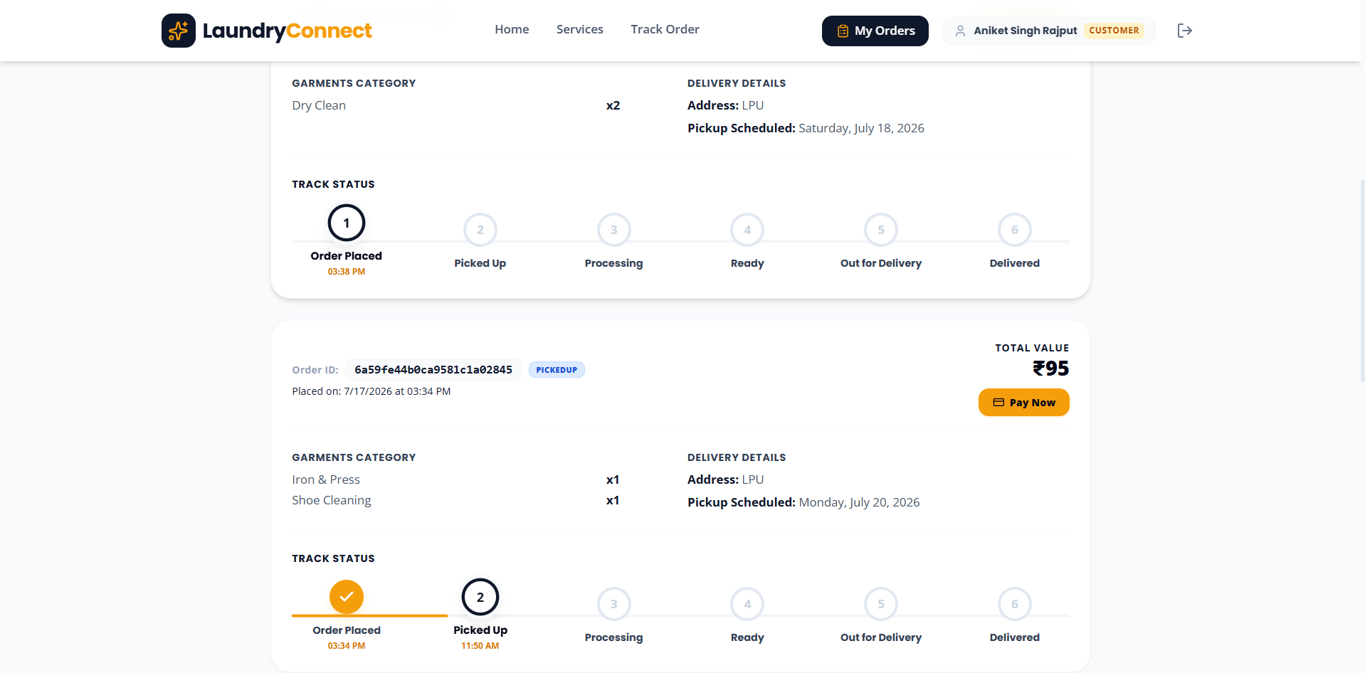


PRODUCT WALKTHROUGH
Admin & Partner Control
Live priority queue with real DSA scores
Partner & service management (CRUD)
Conflict-checked slot booking
One-click optimized delivery routing
13

Slide 14

TRANSACTION LAYER
Payments, Invoicing & Reviews
Mock Payment Flow
Itemized Invoice
Ratings & Reviews
UPI / Card / Cash selection with confirmation modal and live order-status update on success.
Structured, printable invoice generated per order — service breakdown, totals, and payment method.
5-star rating restricted to delivered orders, feeding into a running average partner rating.
14

Slide 15
EXECUTION
7-Day Development Timeline
Day 1
Day 2
Day 3
Day 4
Day 5
Day 6
Day 7
Setup & Auth
Services & Trie
Priority Queue
Scheduling & Routing
Frontend Build
Payments & Live Tracking
Test, Fix & Deploy
Schemas, MongoDB Atlas, JWT auth
Service CRUD, Trie search
Max-heap order processing
Interval scheduling, Dijkstra
React, all customer/admin pages
Invoicing, reviews, Socket.io
GitHub, Render, Vercel
15

Slide 16

REAL DEBUGGING LOG
Challenges Faced & Solutions
Emoji icons made the UI look like a template
Replaced with real, category-mapped image assets
Review text silently dropped after submission
Fixed a field-name mismatch: “review” vs “reviewComment”
Optimized route never rendered despite a 200 OK
Found a one-character key mismatch in the API response
Category filters returned “No Services Found”
Rebuilt label-to-category mapping to match real DB data
Initial GitHub push rejected (unrelated histories)
Recreated repo with no auto-generated files, clean push
16

Slide 17
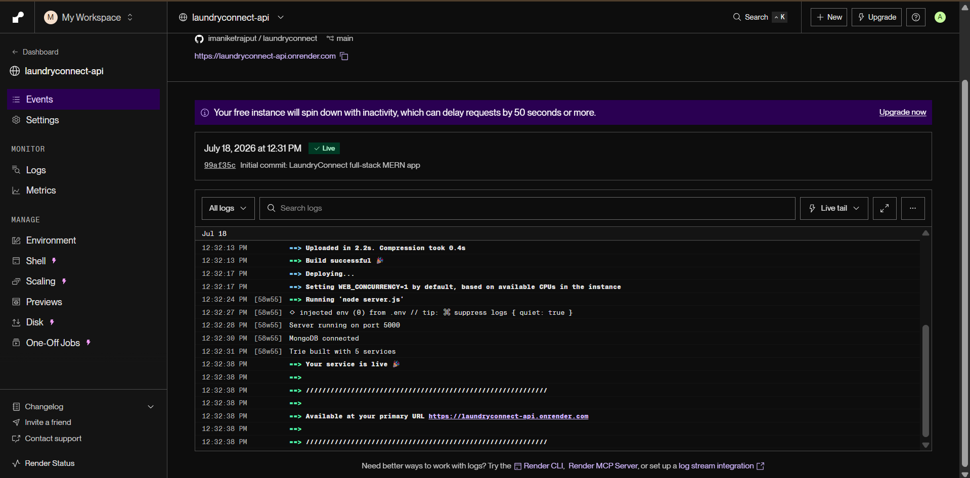
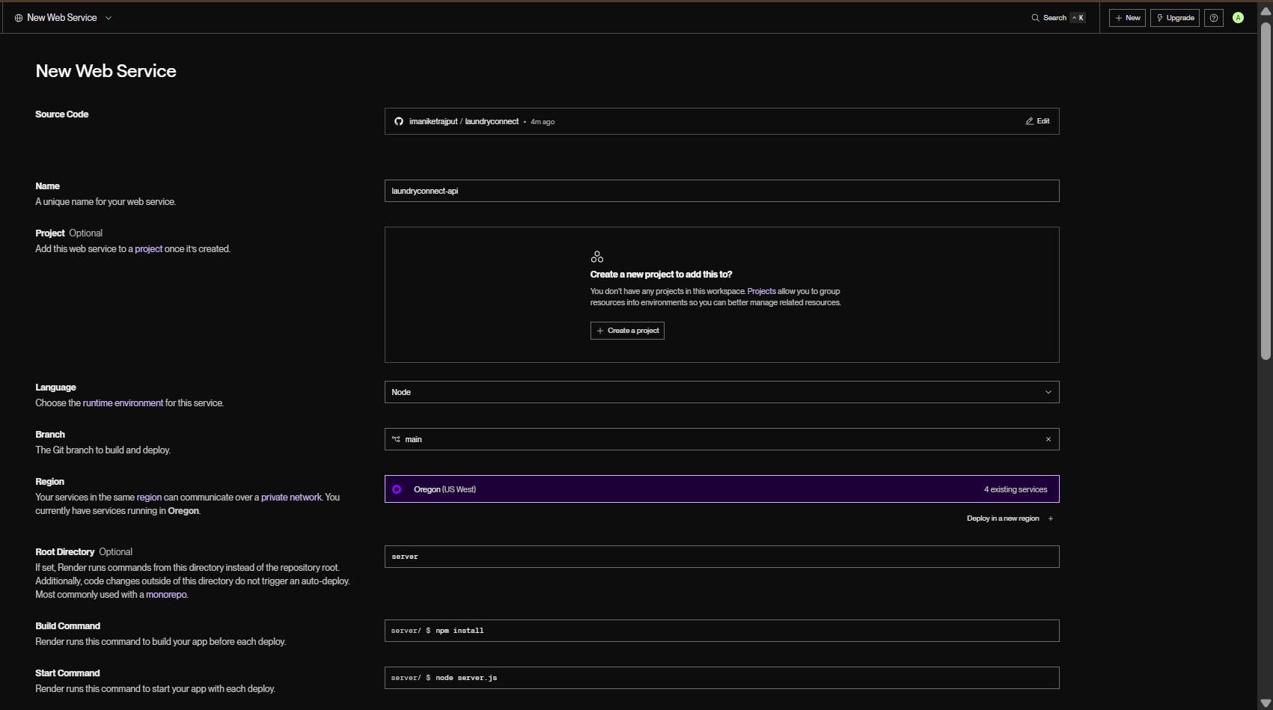
SHIP IT
Live Deployment
Source Code
github.com/imaniketrajput/laundryconnect — MIT Licensed
Backend
Deployed on Render (free tier), auto-deploy from main
Frontend
Deployed on Vercel, auto-deploy from main
Render — live backend deploy log
Free-tier note
Render's free instance spins down after inactivity — first request may take 30–50s to wake.
17

Slide 18
CONCLUSION
Real DSA. Real product.
Actually deployed.
LaundryConnect proves that Trie, Heap, Interval Scheduling, and Dijkstra aren't just whiteboard exercises — they solve real operational problems in a live, publicly deployed full-stack application.
Future Scope
• Real payment gateway integration
• Redis-backed distributed priority queue
• Push notifications for status changes
Thank You
• Automated partner-to-order assignment
18

