Slide 1
WENMEET
CUJ Wireframes
Nebula scheduling: core journeys, variations, and v2 breakouts
open
locked
rescheduling
Notes:
Overview of every critical user journey for wenmeet, from core scheduling through v2 breakout rooms.

Slide 2
PART 1
Core journeys
Six journeys, one row each. Color is semantic only: teal = open/uncertain, gold = locked, amber = rescheduling. Nebula density ∝ certainty throughout.
Notes:
Six journeys, one row each. Color is semantic only: teal = open/uncertain, gold = locked, amber = rescheduling. Nebula density ∝ certainty throughout.

Slide 3
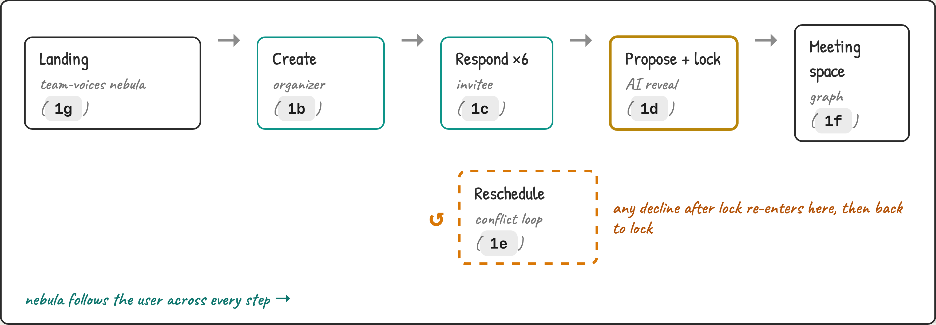
1a
Journey map
how the CUJs connect
Notes:
Journey map

Slide 4
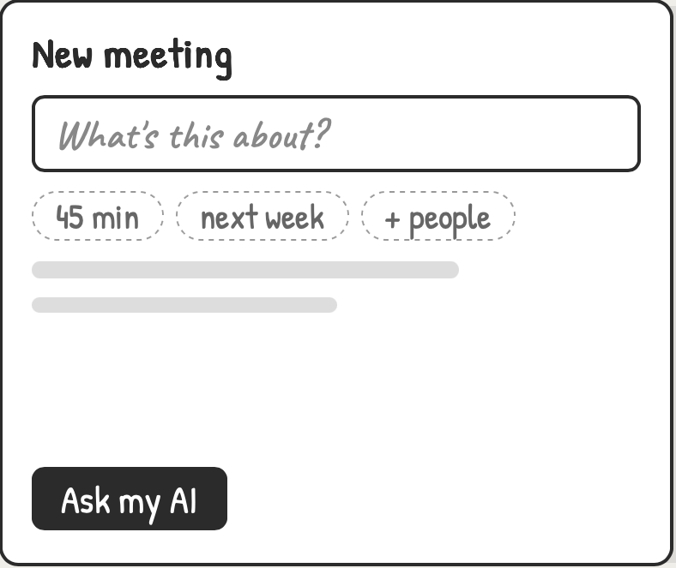
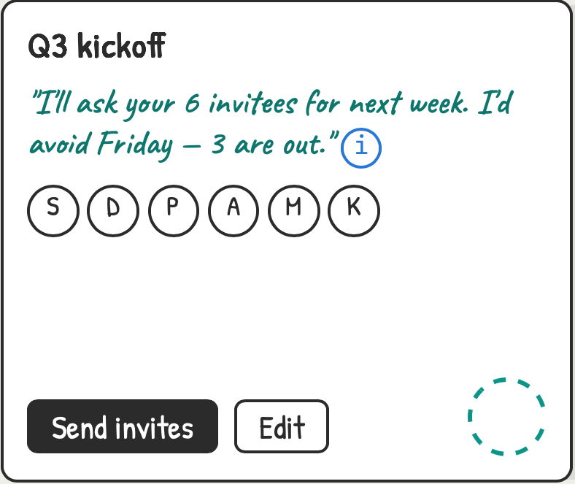
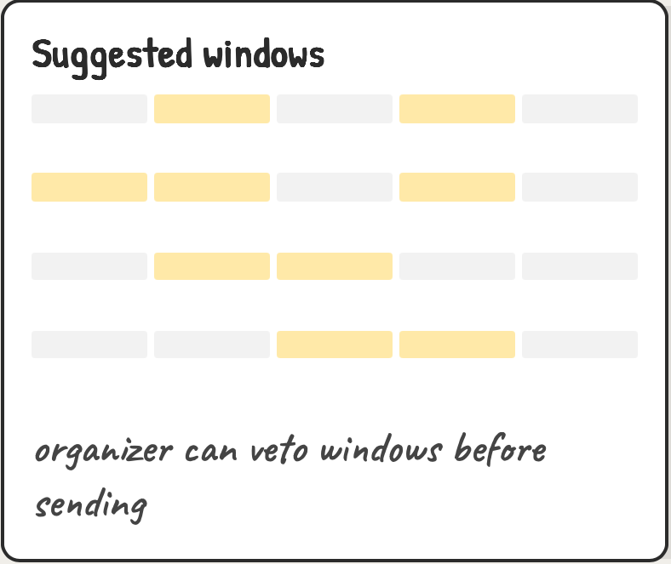
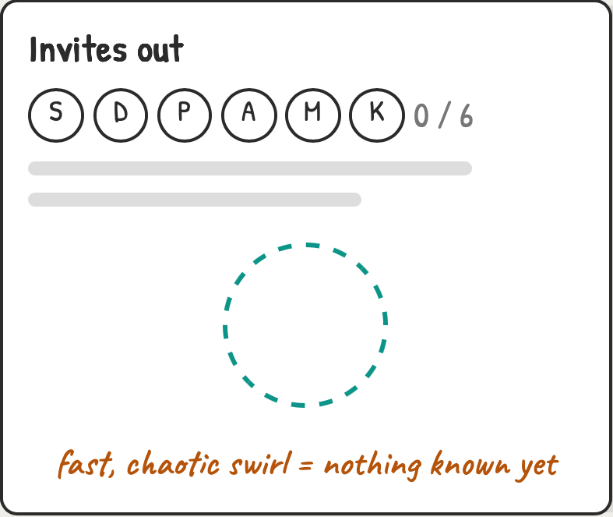
1b
CUJ 1 · Organizer creates a meeting
nebula is born chaotic
→
→
→
1B-1
1B-2
1B-3
1B-4
Blank slate. One field, constraint chips — no grid yet.
AI drafts the ask in first person; ⓘ hides reasoning. Tiny orb appears — fast, scattered.
Week grid with AI-suggested windows (gold tint). Tap to veto.
Waiting state. Corner orb grows into the empty space — motion is the status indicator, no spinner.
Notes:
Blank slate. One field, constraint chips — no grid yet. AI drafts the ask in first person; ⓘ hides reasoning. Tiny orb appears — fast, scattered. Week grid with AI-suggested windows (gold tint). Tap to veto. Waiting state. Corner orb grows into the empty space — motion is the status indicator, no spinner.

Slide 5
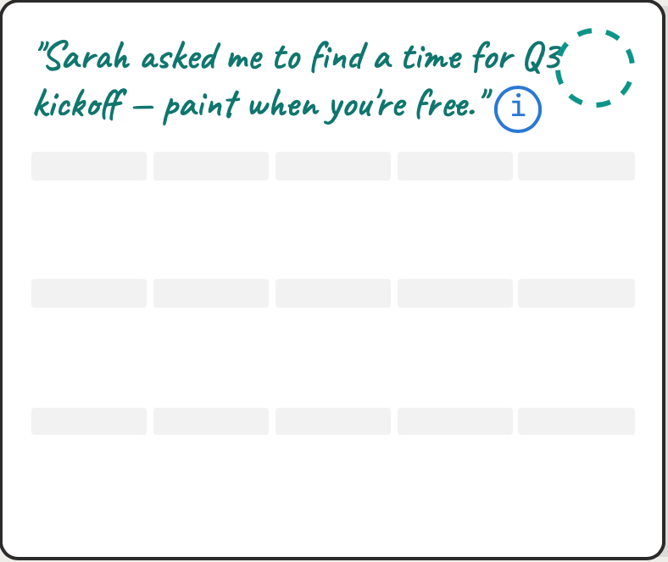
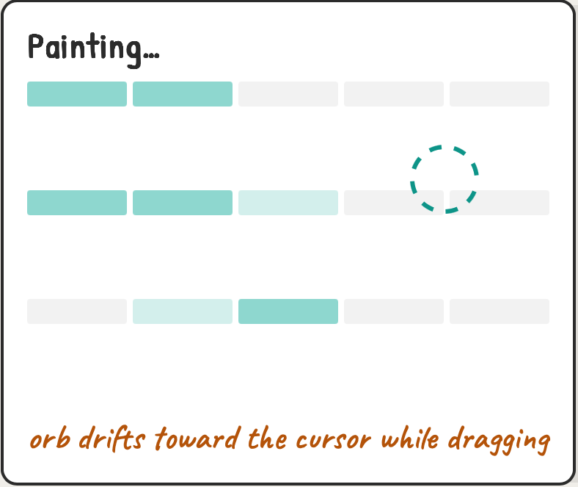
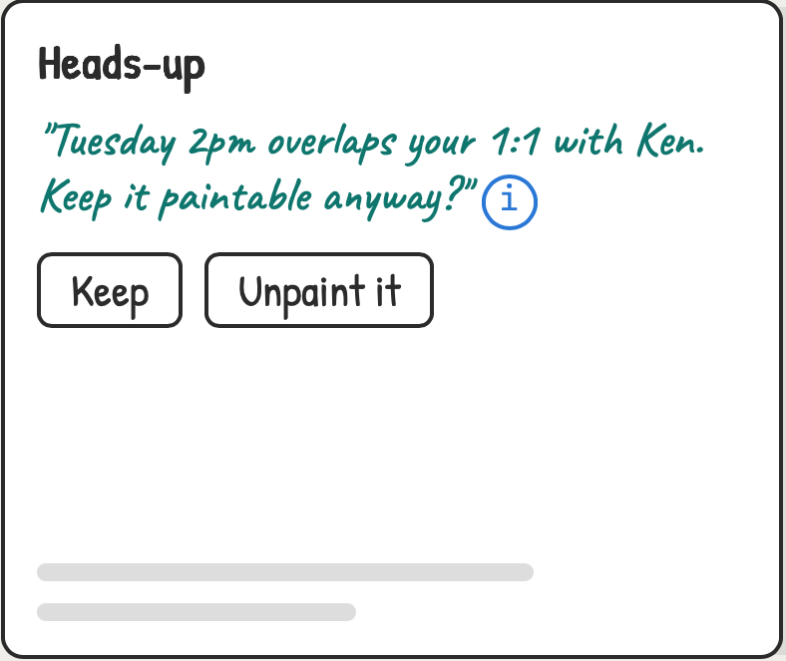
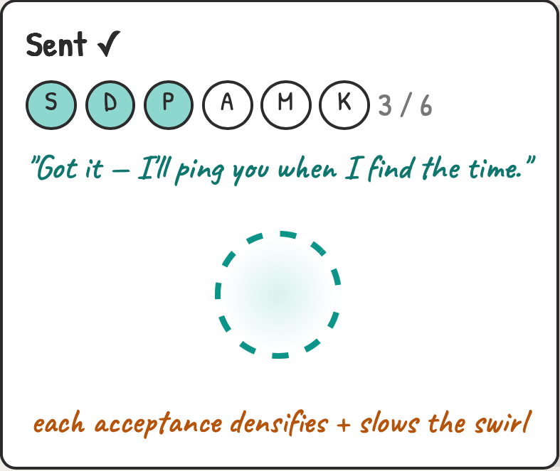
1c
CUJ 2 · Invitee responds
painting availability calms the orb
→
→
→
1C-1
1C-2
1C-3
1C-4
Invite landing: no account needed, grid front and center.
Drag-paint free / if-need-be (half tint). Orb shadows the gesture.
Calendar-aware nudge — AI flags a clash but never edits your paint.
Submit = visible effect on the shared orb. Your response literally adds mass.
Notes:
Invite landing: no account needed, grid front and center. Drag-paint free / if-need-be (half tint). Orb shadows the gesture. Calendar-aware nudge — AI flags a clash but never edits your paint. Submit = visible effect on the shared orb. Your response literally adds mass.

Slide 6
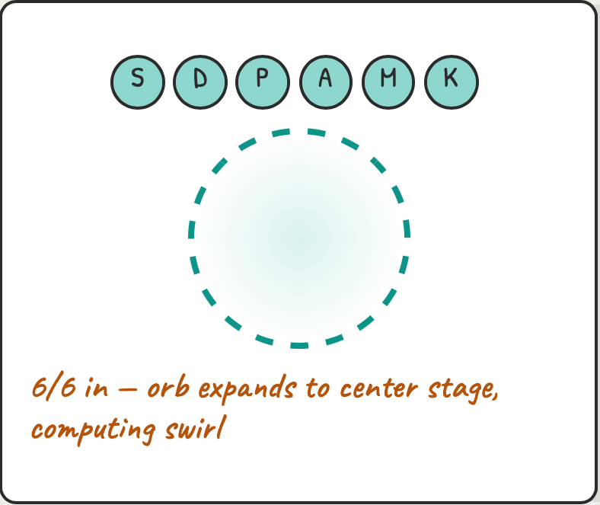
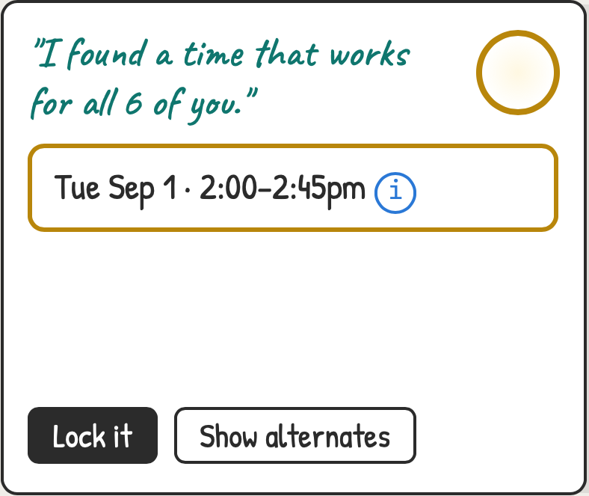
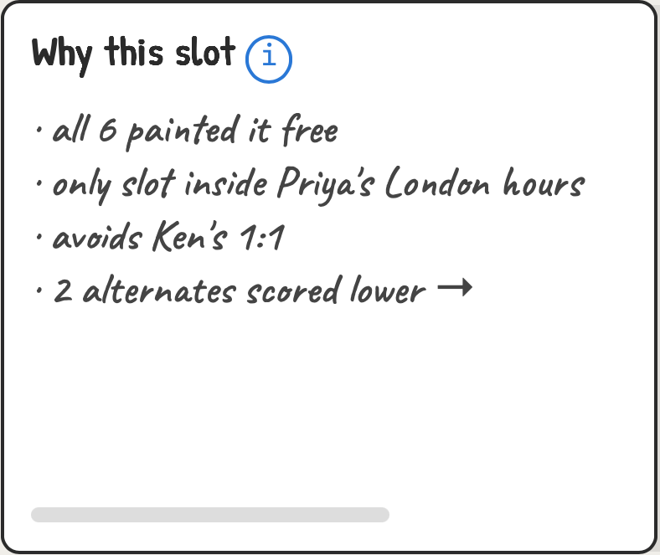
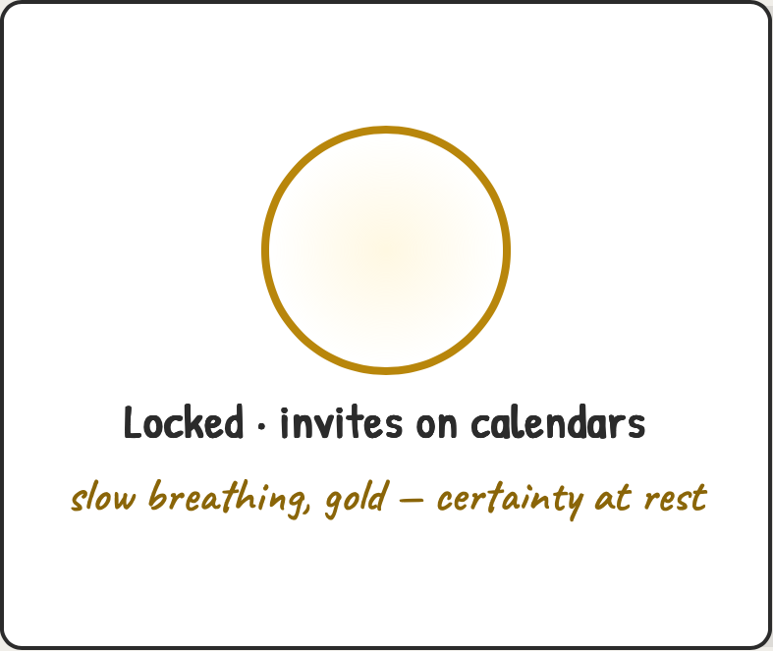
1d
CUJ 3 · AI proposes & locks
swirl → reveal → gold breathing
→
→
→
1D-1
1D-2
1D-3
1D-4
Threshold moment. The orb takes over the grid for ~2s — the "thinking" beat from the motion comp.
Reveal. One proposal, first person, alternates behind a button — not a ranked wall.
Reasoning on ⓘ tap only — trust without chatter.
Locked end-state. Motion nearly stops; the nebula becomes a quiet confirmation object.
Notes:
Threshold moment. The orb takes over the grid for ~2s — the "thinking" beat from the motion comp. Reveal. One proposal, first person, alternates behind a button — not a ranked wall. Reasoning on ⓘ tap only — trust without chatter. Locked end-state. Motion nearly stops; the nebula becomes a quiet confirmation object.

Slide 7
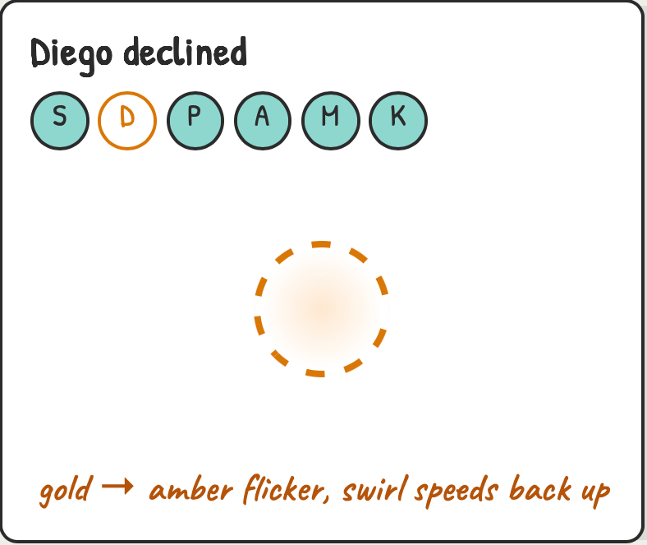
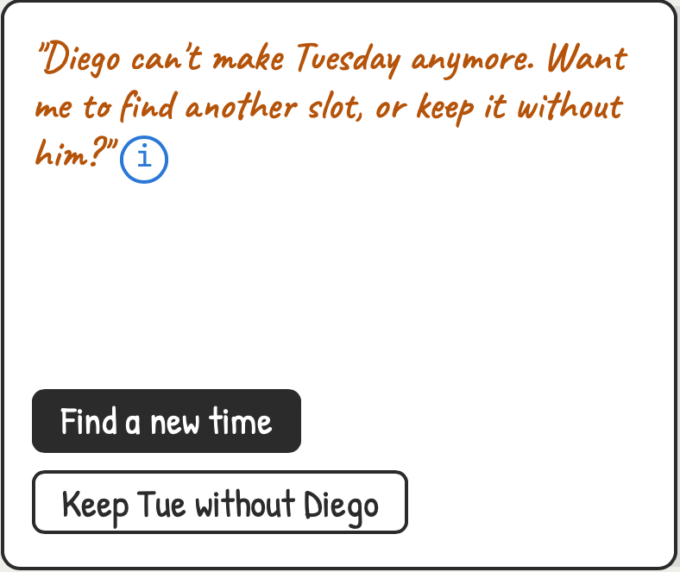
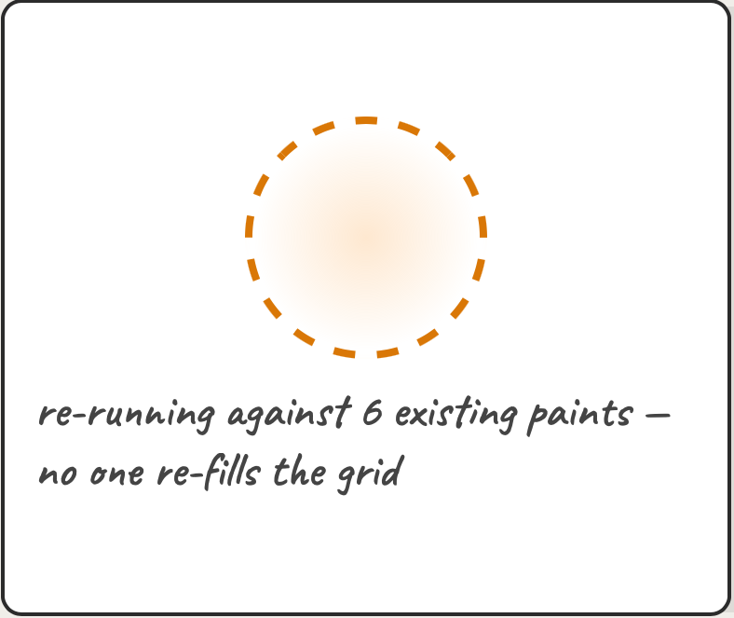
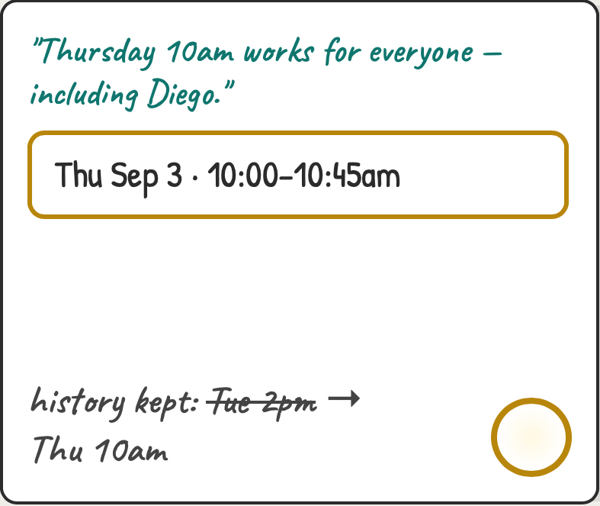
1e
CUJ 4 · Reschedule loop
gold flickers amber, then re-locks
→
→
→
1E-1
1E-2
1E-3
1E-4
Conflict detected. The locked orb visibly destabilizes before any words appear.
Organizer chooses; AI never re-books on its own.
Re-compute reuses everyone's availability. Amber swirl = working, not broken.
Re-lock with visible history — the strikethrough keeps trust in what changed.
Notes:
Conflict detected. The locked orb visibly destabilizes before any words appear. Organizer chooses; AI never re-books on its own. Re-compute reuses everyone's availability. Amber swirl = working, not broken. Re-lock with visible history — the strikethrough keeps trust in what changed.

Slide 8
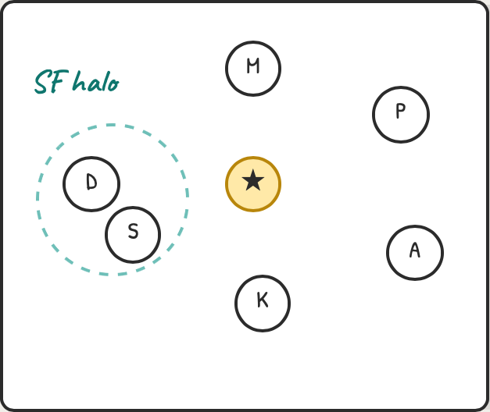
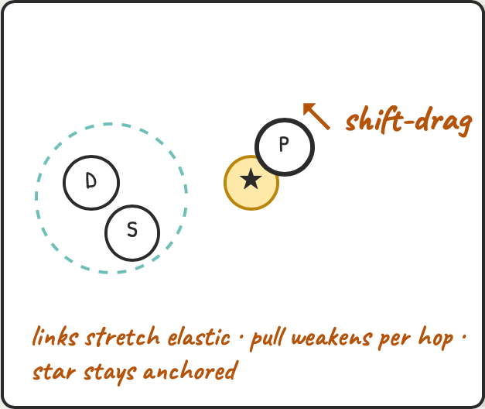
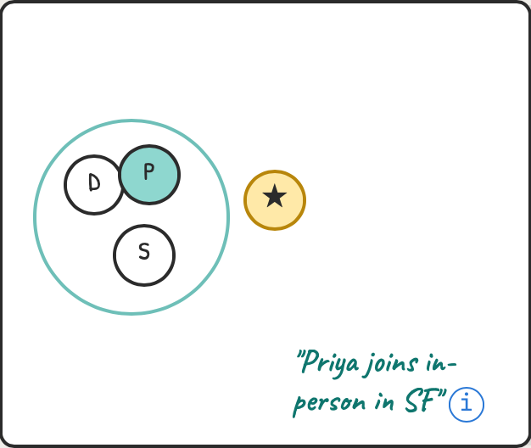
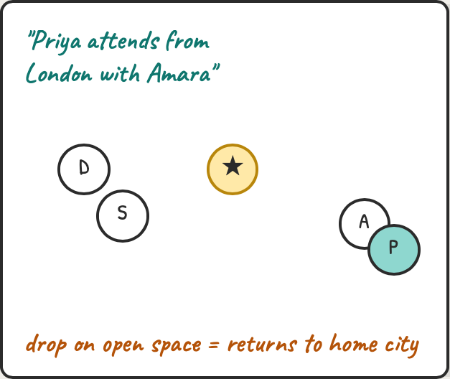
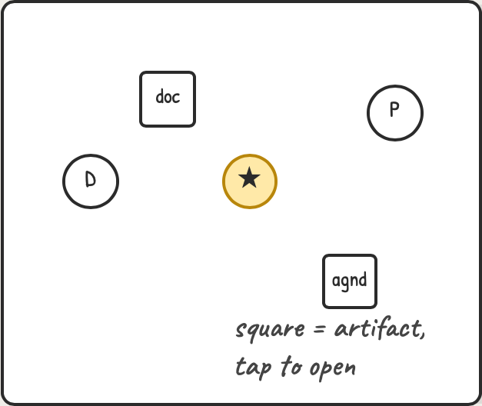
1f
CUJ 5 · Meeting space graph
drag Priya, drop-zone semantics
→
→
→
→
1F-1
1F-2
1F-3
1F-4
1F-5
Graph overview: meeting star center, 6 attendee nodes, teal halo = Diego + Sana co-located in SF.
Dragging Priya: swirl intensifies, neighbors get tugged along their links.
Drop inside SF halo → she joins that cluster. Halo firms up solid; copy confirms the meaning.
Alt drop targets: onto Amara's node = pair remotely; open space = re-settle home (speed-7 ease).
Artifacts (agenda, docs) attach as square nodes — the meeting accretes knowledge before it happens.
Notes:
Graph overview: meeting star center, 6 attendee nodes, teal halo = Diego + Sana co-located in SF. Dragging Priya: swirl intensifies, neighbors get tugged along their links. Drop inside SF halo → she joins that cluster. Halo firms up solid; copy confirms the meaning. Alt drop targets: onto Amara's node = pair remotely; open space = re-settle home (speed-7 ease). Artifacts (agenda, docs) attach as square nodes — the meeting accretes knowledge before it happens.

Slide 9
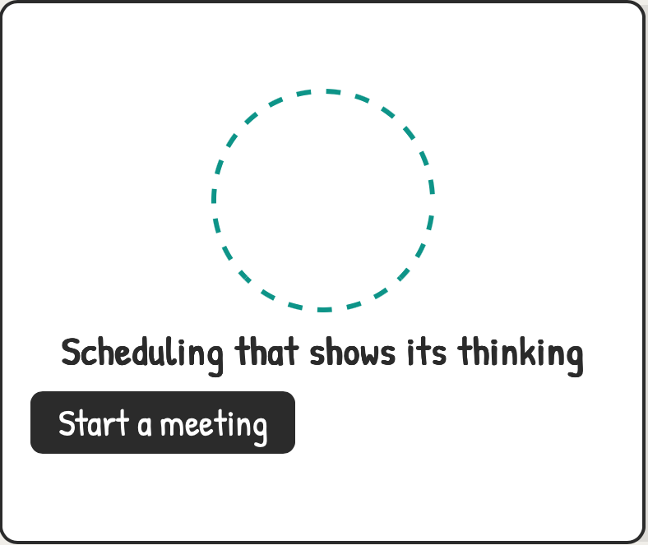
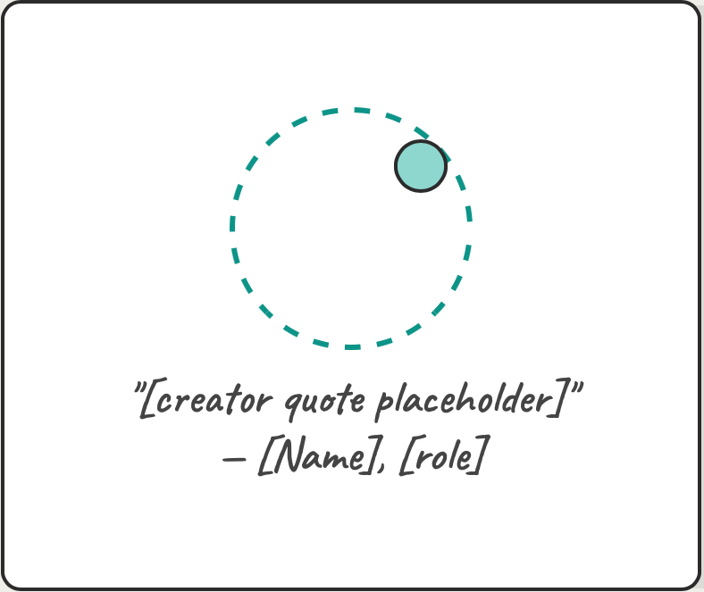
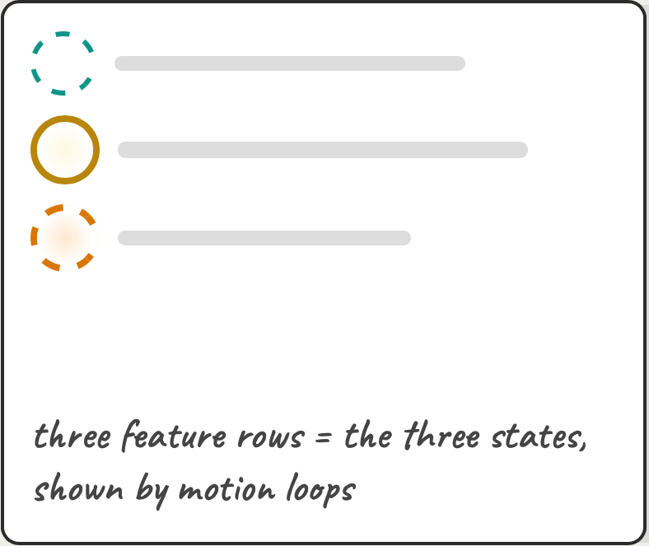
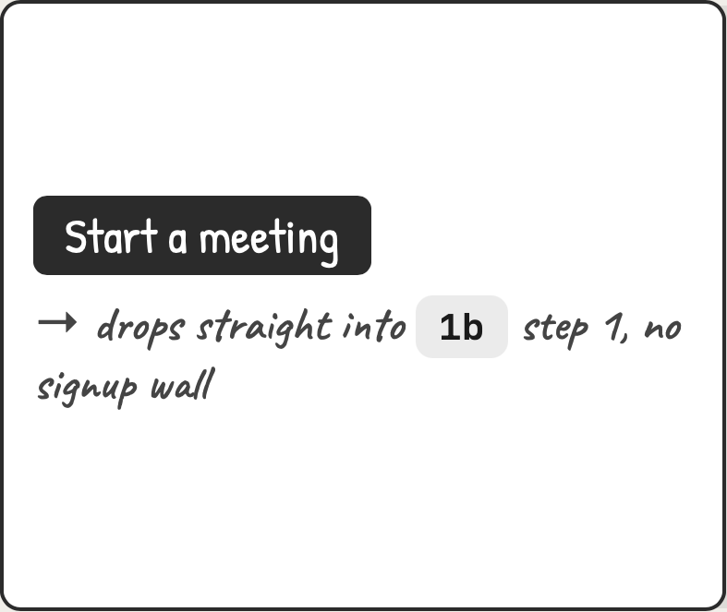
1g
CUJ 6 · Landing
team-voices nebula → first meeting
→
→
→
1G-1
1G-2
1G-3
1G-4
Hero: the nebula IS the hero image — particles are team voices.
Hover a particle → a creator quote surfaces. Names/quotes still placeholder.
Scroll: features told as states, not bullet lists.
CTA closes the loop into the create CUJ.
Notes:
Hero: the nebula IS the hero image — particles are team voices. Hover a particle → a creator quote surfaces. Names/quotes still placeholder. Scroll: features told as states, not bullet lists. CTA closes the loop into the create CUJ.

Slide 10
PART 2
Riffs, mobile & new journeys
Three layouts for the reveal beat in 1d · mobile 1c · keep-partial branch of 1e · three CUJs the map didn't cover.
Notes:
Three layouts for the reveal beat in 1d · mobile 1c · keep-partial branch of 1e · three CUJs the map didn't cover.

Slide 11
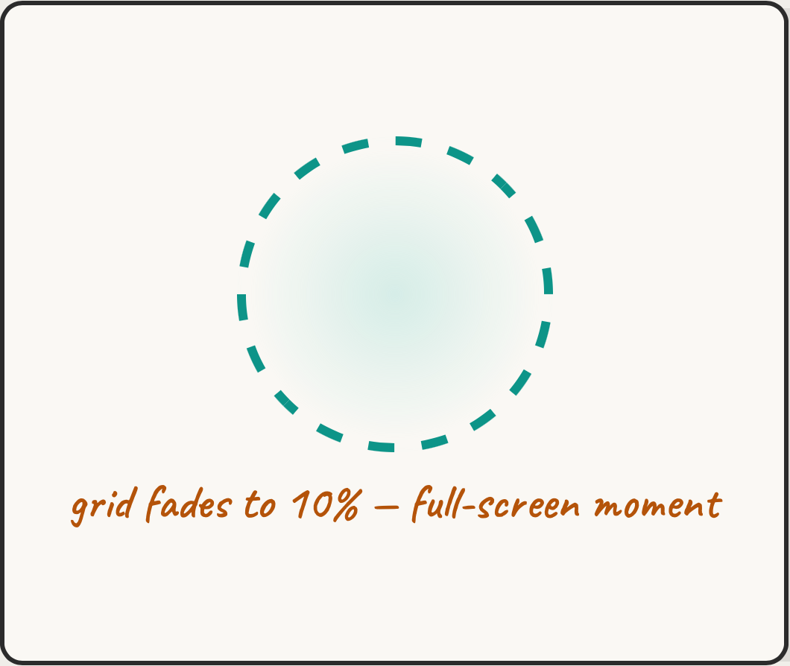
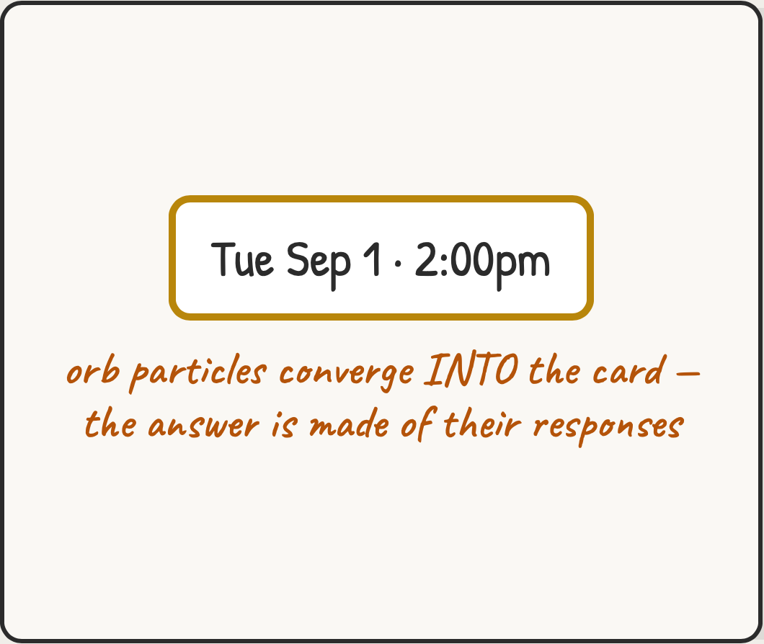
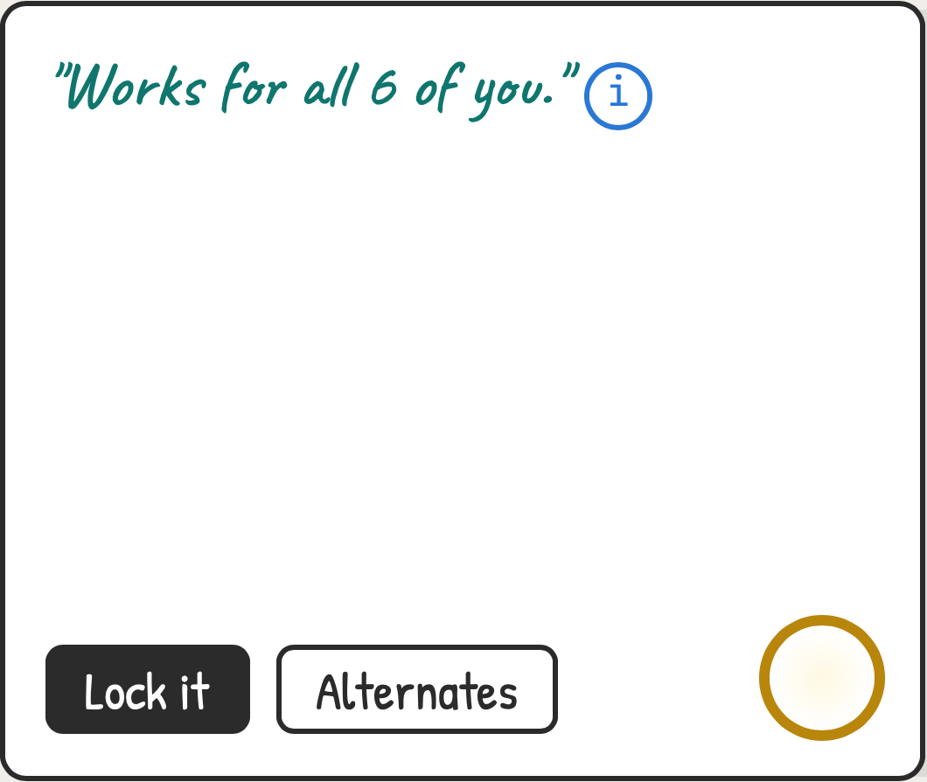
2a
Reveal riff A · Cinematic takeover
nebula collapses into the answer
→
→
2A-1
2A-2
2A-3
Everything else recedes; the orb is the only object.
Collapse animation: 6 voices condense into one slot.
Copy arrives after the motion. Best for the marketing/video moment; heaviest in daily use.
Notes:
Everything else recedes; the orb is the only object. Collapse animation: 6 voices condense into one slot. Copy arrives after the motion. Best for the marketing/video moment; heaviest in daily use.

Slide 12
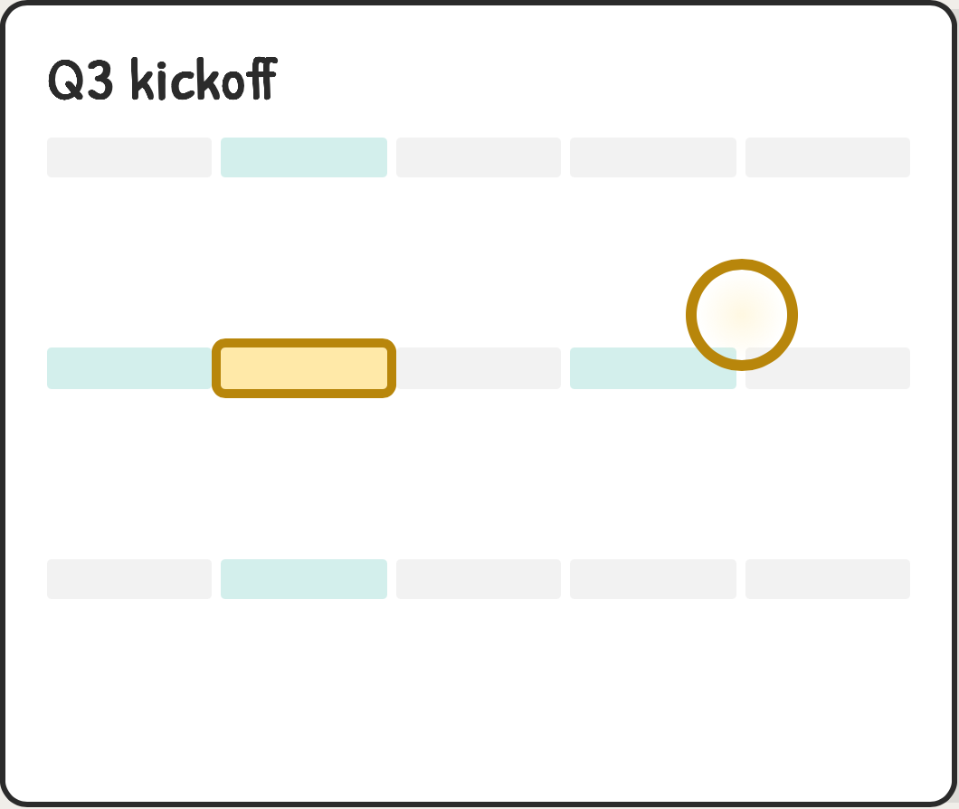
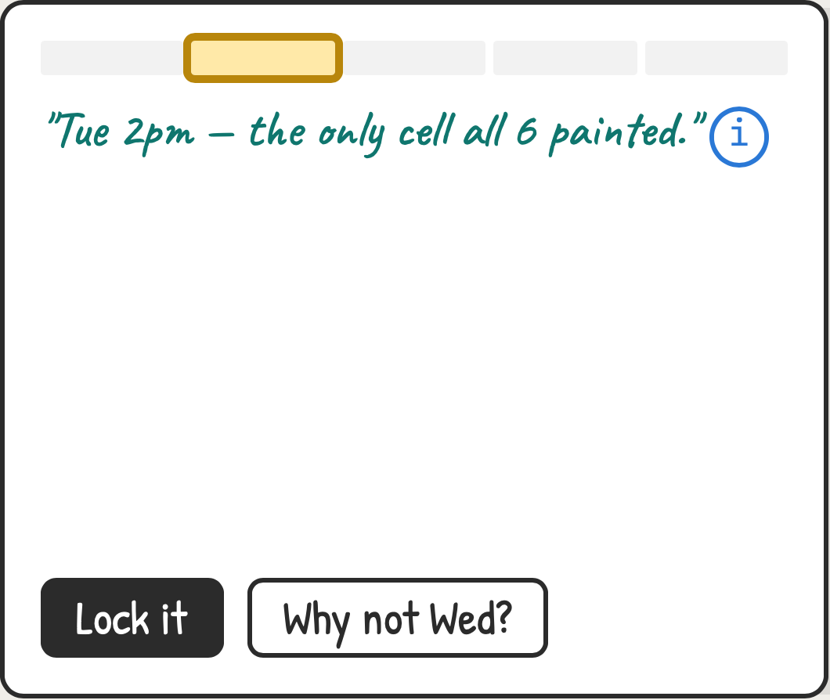
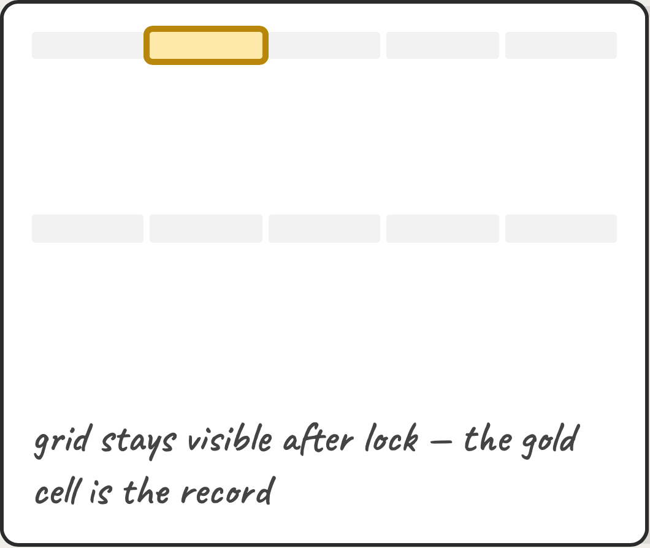
2b
Reveal riff B · Grid-anchored
the answer lands in place
→
→
2B-1
2B-2
2B-3
Orb shrinks and docks onto the winning cell — context never leaves the grid.
Popover on the cell; "Why not Wed?" invites interrogating any other slot.
Calmest option; the grid itself becomes the confirmation. Best for daily use.
Notes:
Orb shrinks and docks onto the winning cell — context never leaves the grid. Popover on the cell; "Why not Wed?" invites interrogating any other slot. Calmest option; the grid itself becomes the confirmation. Best for daily use.

Slide 13
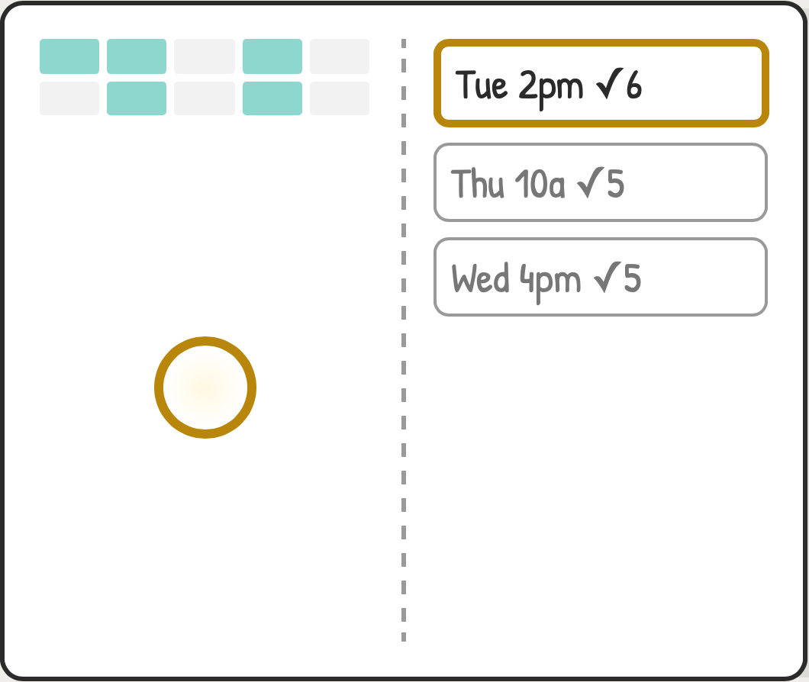
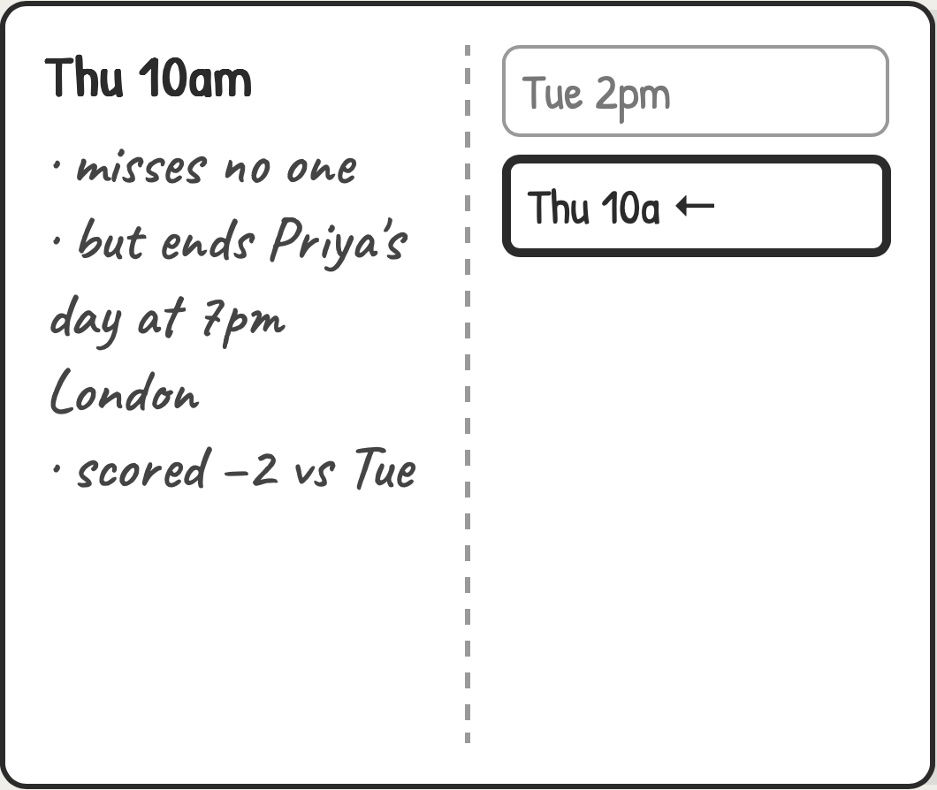
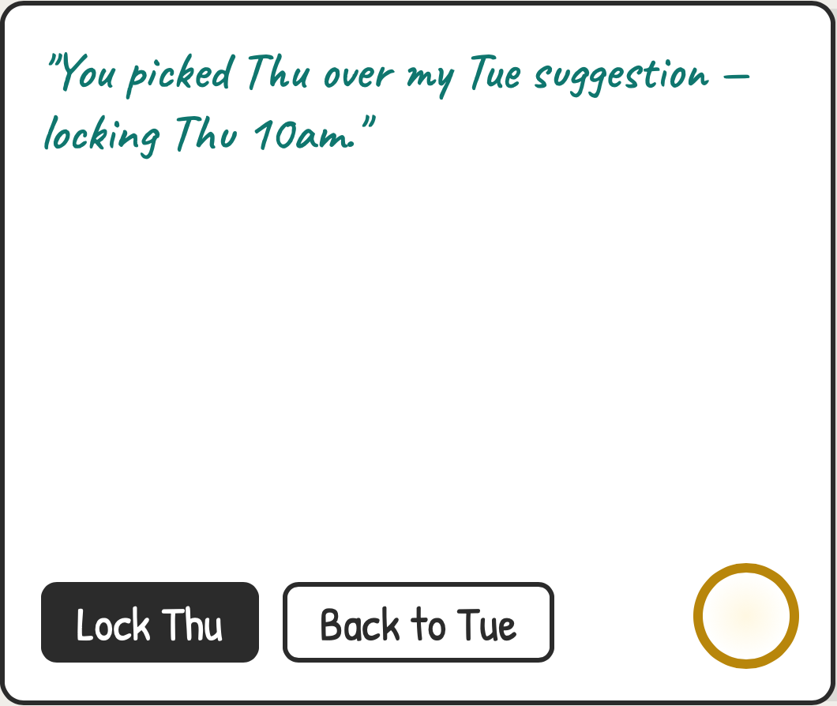
2c
Reveal riff C · Ledger panel
proposal + reasoning side by side
→
→
2C-1
2C-2
2C-3
Ranked ledger always visible — top pick bold, runners-up honest about who they miss.
Tap any alternate to see its tradeoffs — reasoning is browsable, not just a ⓘ.
Organizer can overrule the AI; it acknowledges without arguing. Most control, most chrome.
Notes:
Ranked ledger always visible — top pick bold, runners-up honest about who they miss. Tap any alternate to see its tradeoffs — reasoning is browsable, not just a ⓘ. Organizer can overrule the AI; it acknowledges without arguing. Most control, most chrome.

Slide 14
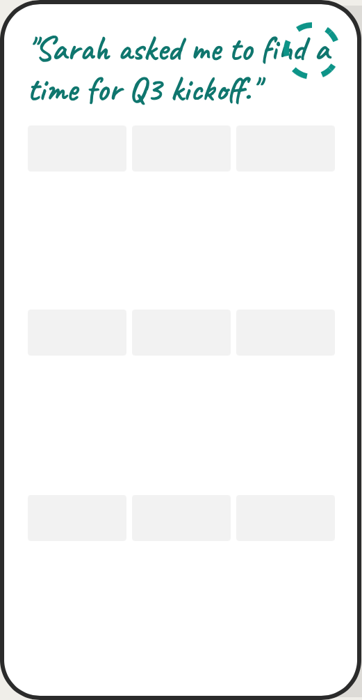
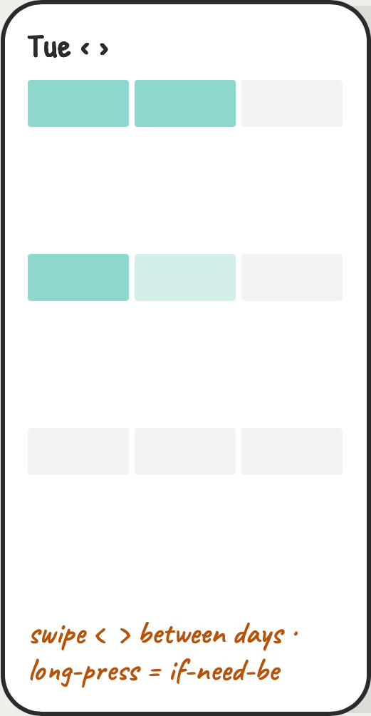
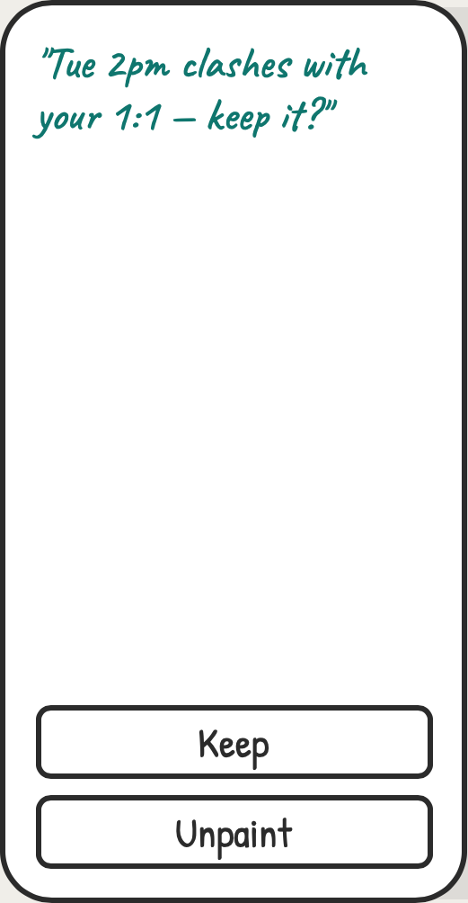
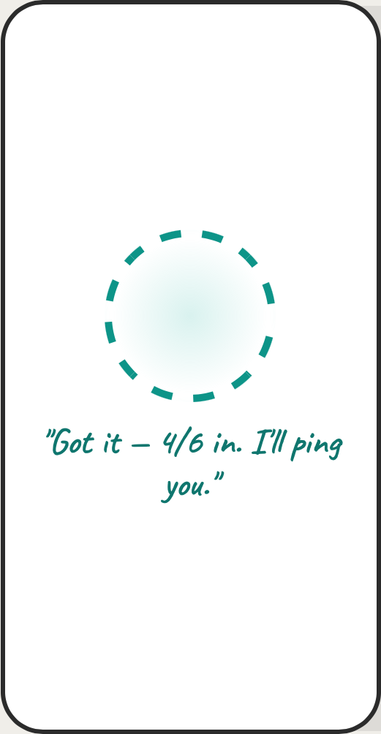
2d
Mobile invitee view of 1c
thumb-first paint
→
→
→
2D-1
2D-2
2D-3
2D-4
One day per screen, 3 columns — cells ≥44px tall for thumbs.
Thumb-paint; long-press toggles the half-state instead of a mode switch.
Nudge as a bottom sheet — full-width tap targets.
Done state fits one screen; orb is the receipt.
Notes:
One day per screen, 3 columns — cells ≥44px tall for thumbs. Thumb-paint; long-press toggles the half-state instead of a mode switch. Nudge as a bottom sheet — full-width tap targets. Done state fits one screen; orb is the receipt.

Slide 15
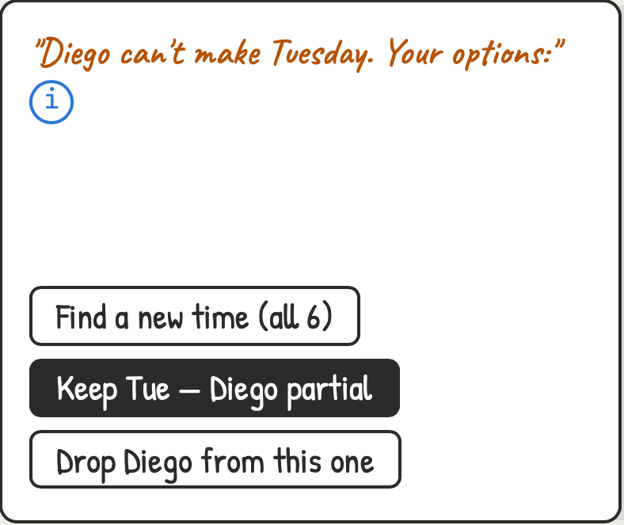
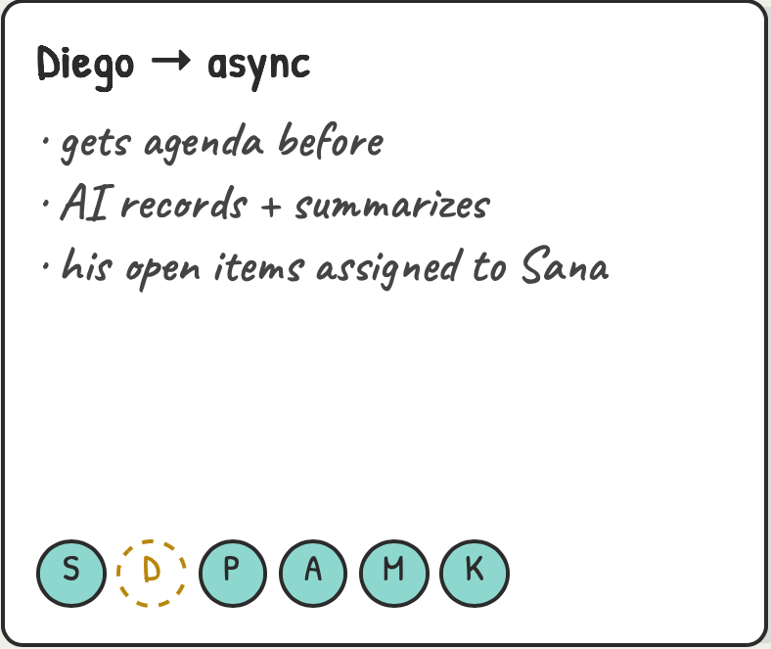
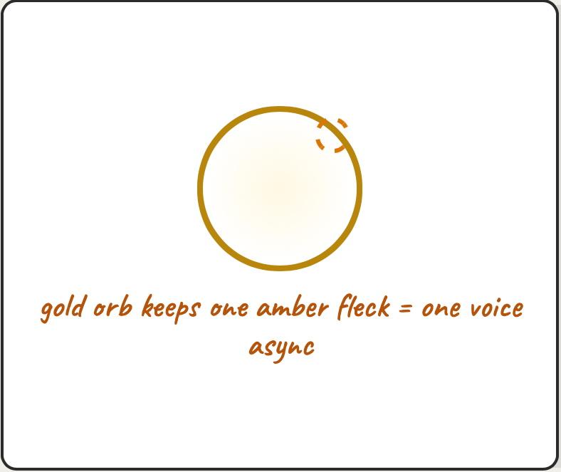
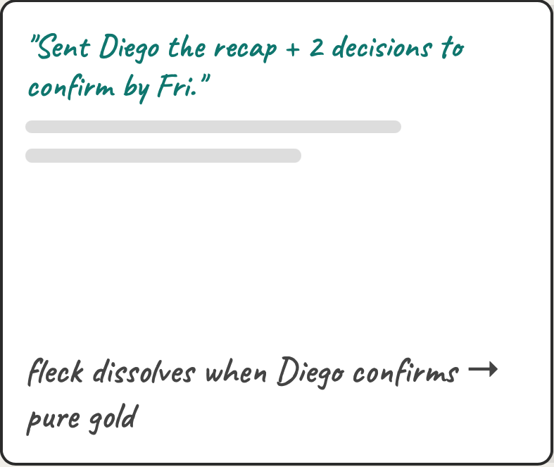
2e
Reschedule 1e expanded
the keep-partial path
→
→
→
2E-1
2E-2
2E-3
2E-4
Third path added: keep the slot, keep Diego — just not live.
Partial = a defined contract, not a shrug. Dashed-gold avatar marks async attendance.
The lock state honestly shows it's 5-live-1-async — certainty with an asterisk.
Loop closes post-meeting; the orb only fully settles when the async voice lands.
Notes:
Third path added: keep the slot, keep Diego — just not live. Partial = a defined contract, not a shrug. Dashed-gold avatar marks async attendance. The lock state honestly shows it's 5-live-1-async — certainty with an asterisk. Loop closes post-meeting; the orb only fully settles when the async voice lands.

Slide 16
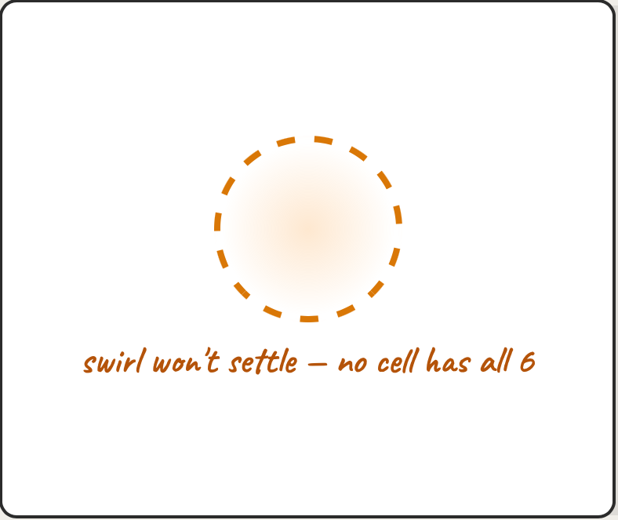
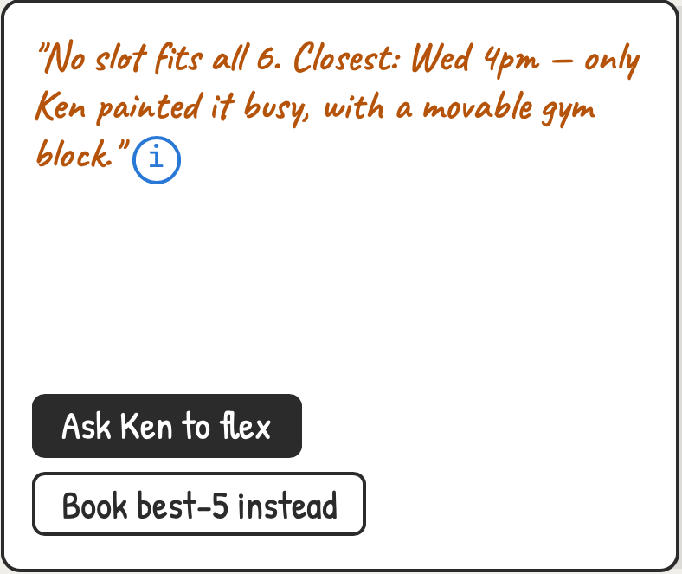
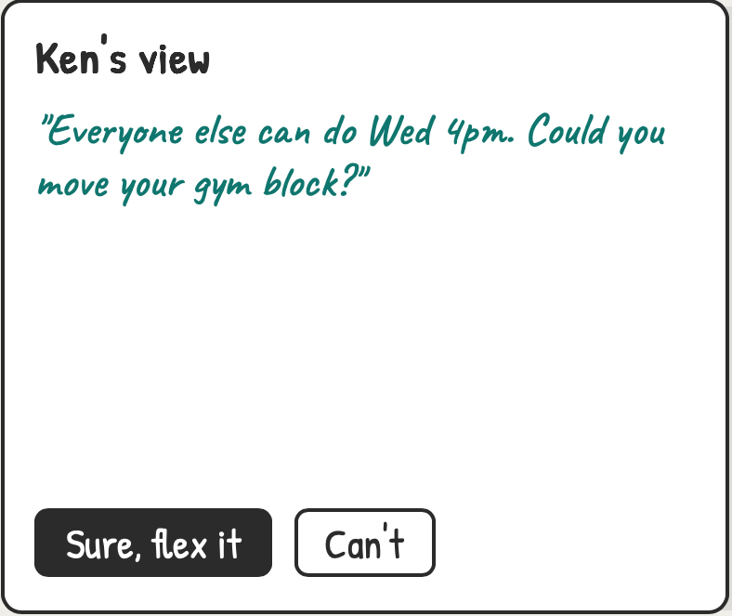
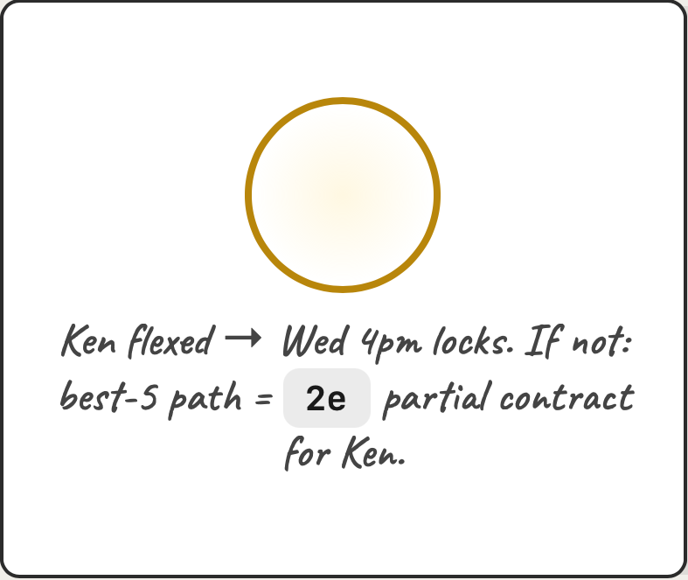
2f
New CUJ · No common slot
AI negotiates a flex
→
→
→
2F-1
2F-2
2F-3
2F-4
Failure state has its own motion: the orb visibly can't converge.
AI names the cheapest ask, but the human sends it — no auto-nagging.
One-tap flex request on the invitee side; "Can't" is a first-class answer.
Both exits converge on known states — negotiate or degrade gracefully.
Notes:
Failure state has its own motion: the orb visibly can't converge. AI names the cheapest ask, but the human sends it — no auto-nagging. One-tap flex request on the invitee side; "Can't" is a first-class answer. Both exits converge on known states — negotiate or degrade gracefully.

Slide 17
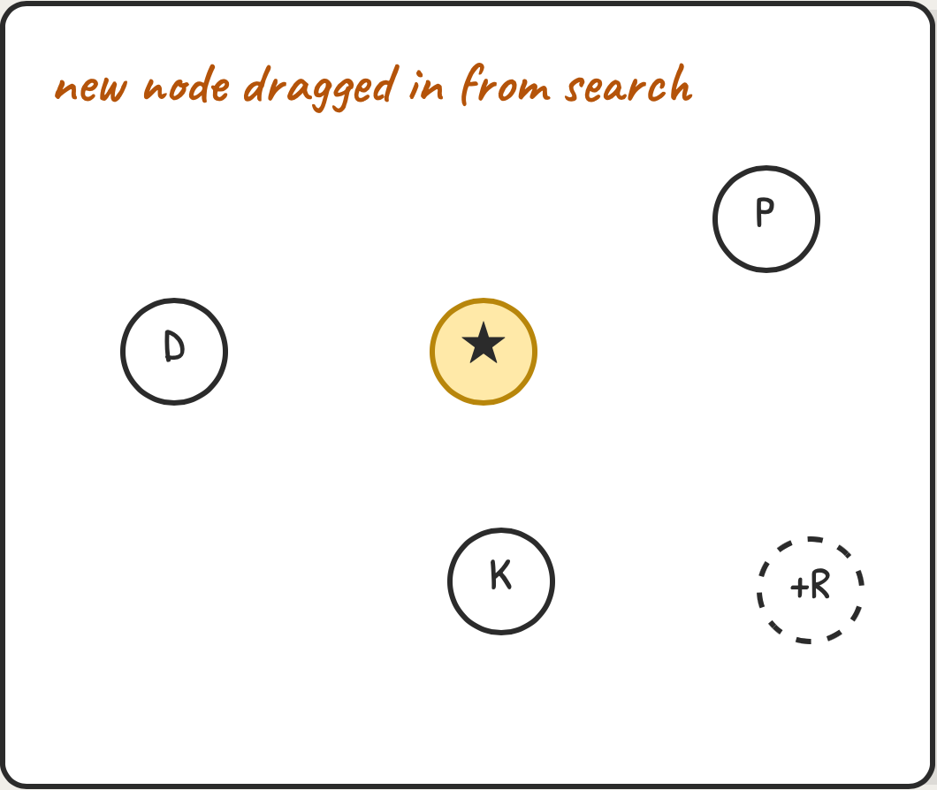
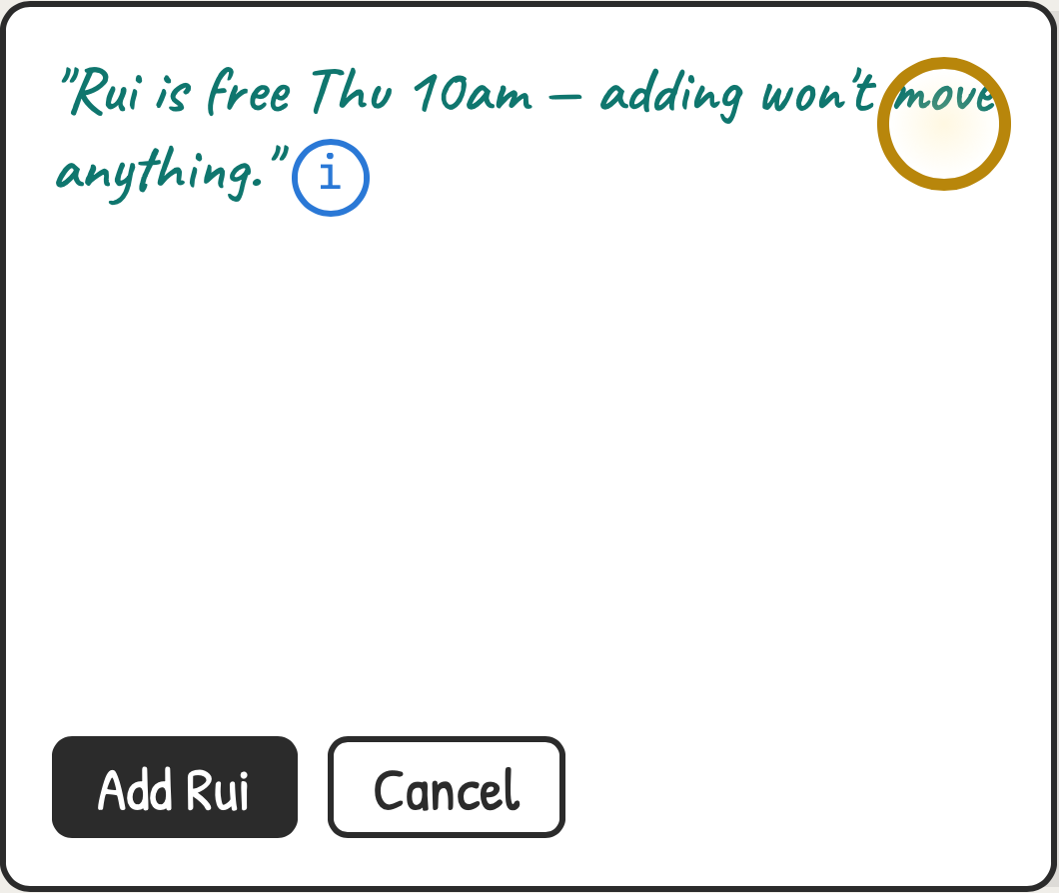
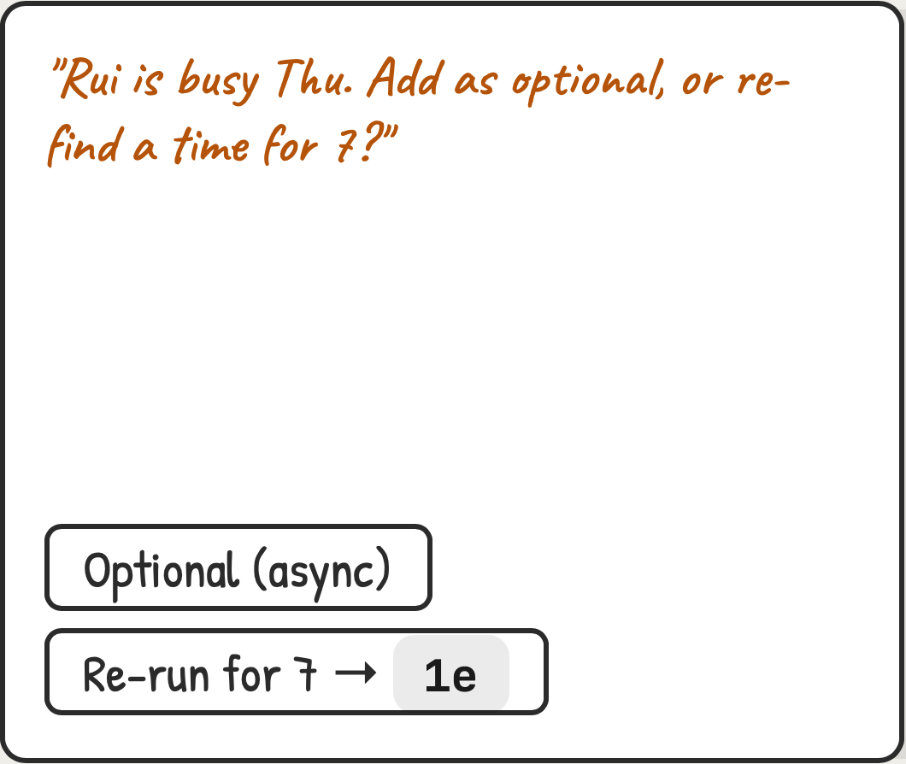
2g
New CUJ · Add attendee after lock
drag onto the star
→
→
2G-1
2G-2
2G-3
In the meeting graph, adding = dragging a person onto the locked star.
Happy path: calendar check passes, gold stays gold.
Conflict path routes into existing loops — optional uses the 2e contract, re-run enters 1e.
Notes:
In the meeting graph, adding = dragging a person onto the locked star. Happy path: calendar check passes, gold stays gold. Conflict path routes into existing loops — optional uses the 2e contract, re-run enters 1e.

Slide 18



2h
New CUJ · Recurring series
one nebula per occurrence
→
→
2H-1
2H-2
2H-3
Series offer only after a successful single lock — cadence is earned, not default.
Each occurrence carries its own state; the amber one needs attention.
Per-occurrence repair without touching the series — reuses the 1e loop scoped to one orb.
Notes:
Series offer only after a successful single lock — cadence is earned, not default. Each occurrence carries its own state; the amber one needs attention. Per-occurrence repair without touching the series — reuses the 1e loop scoped to one orb.

Slide 19
PART 3
v2 · Breakout blobs
Extends the 1f graph: drag multiple nodes into a new cluster → it becomes a persistent blob → a live room anyone enters by dragging their node in. Blobs stay until clicked or closed (×). Flagged v2 — wireframed now so the graph physics are built for it.
Notes:
Extends the 1f graph: drag multiple nodes into a new cluster → it becomes a persistent blob → a live room anyone enters by dragging their node in. Blobs stay until clicked or closed (×). Flagged v2 — wireframed now so the graph physics are built for it.

Slide 20




3a
CUJ v2-1 · Break out
two nodes dragged together spawn a blob
→
→
→
3A-1
3A-2
3A-3
3A-4
Inside any meeting graph: pull two+ nodes together — same gesture as the 1f drop-zones.
Proximity + hold spawns a proto-blob — a new mini-nebula, teal and swirling (uncertain: not live yet).
Confirm beat — accidental drags cost nothing. "Blob for later" parks it on the canvas.
Live blob: solid teal ring, filled member nodes, name label, × in the corner. Rest of graph untouched.
Notes:
Inside any meeting graph: pull two+ nodes together — same gesture as the 1f drop-zones. Proximity + hold spawns a proto-blob — a new mini-nebula, teal and swirling (uncertain: not live yet). Confirm beat — accidental drags cost nothing. "Blob for later" parks it on the canvas. Live blob: solid teal ring, filled member nodes, name label, × in the corner. Rest of graph untouched.

Slide 21




3b
CUJ v2-2 · Join & leave
your node is the door
→
→
→
3B-1
3B-2
3B-3
3B-4
Anyone drags their OWN node toward a live blob — the ring brightens as you approach (magnetic).
Crossing the ring = entering the room. Video tiles, no join-link ceremony; the graph stays one tap away.
Leaving is the reverse gesture — no "Leave meeting?" dialog. Your node re-settles in the main graph.
Presence is ambient: the blob shows its occupants live, so joining is informed, never a blind link.
Notes:
Anyone drags their OWN node toward a live blob — the ring brightens as you approach (magnetic). Crossing the ring = entering the room. Video tiles, no join-link ceremony; the graph stays one tap away. Leaving is the reverse gesture — no "Leave meeting?" dialog. Your node re-settles in the main graph. Presence is ambient: the blob shows its occupants live, so joining is informed, never a blind link.

Slide 22




3c
CUJ v2-3 · Blob lifecycle
persists until clicked or ×
→
→
→
3C-1
3C-2
3C-3
3C-4
Empty blobs idle (dashed, slow swirl) but STAY on the canvas — standing rooms, not ephemeral calls.
Click = peek card, never auto-join. "Schedule" converts the blob into a full nebula meet (routes to 1b with members pre-filled).
× closes a blob. If it ever went live, its artifacts fold back into the parent meeting's graph ( 1f squares) — nothing lost.
After close: canvas returns to 1f state plus the artifact — the breakout leaves a trace, not clutter.
Notes:
Empty blobs idle (dashed, slow swirl) but STAY on the canvas — standing rooms, not ephemeral calls. Click = peek card, never auto-join. "Schedule" converts the blob into a full nebula meet (routes to 1b with members pre-filled). × closes a blob. If it ever went live, its artifacts fold back into the parent meeting's graph (1f squares) — nothing lost. After close: canvas returns to 1f state plus the artifact — the breakout leaves a trace, not clutter.

Slide 23

3d
v1 setup
what we build NOW so blobs slot in later
Notes:
v1 setup

