Slide 1
WIREFRAMES · OCT 2026
asap.tools
From "when?" to "we're in" — the scheduling page and the meeting room.
Notes:
Wireframes for asap.tools across three rounds: PRD site tabs, entry flow, and the product screens from PRD v2.

Slide 2
OVERVIEW
Two screens, three routes
/
/s/:token
/m/:id
Scheduling page
Invitee paint
Meeting room
→
→
Organizer creates, paints, locks. Opens directly at www.asap.tools.
Same page from the invite email; aggregate heatmap only.
Attendees, location, add person, reschedule.
OPEN
→
COMPUTING
→
PROPOSED
→
LOCKED
→
DESTABILIZED
Notes:
Three routes, one bundle. Everyone lands on the scheduling page; after lock, the meeting opens into the room.

Slide 3
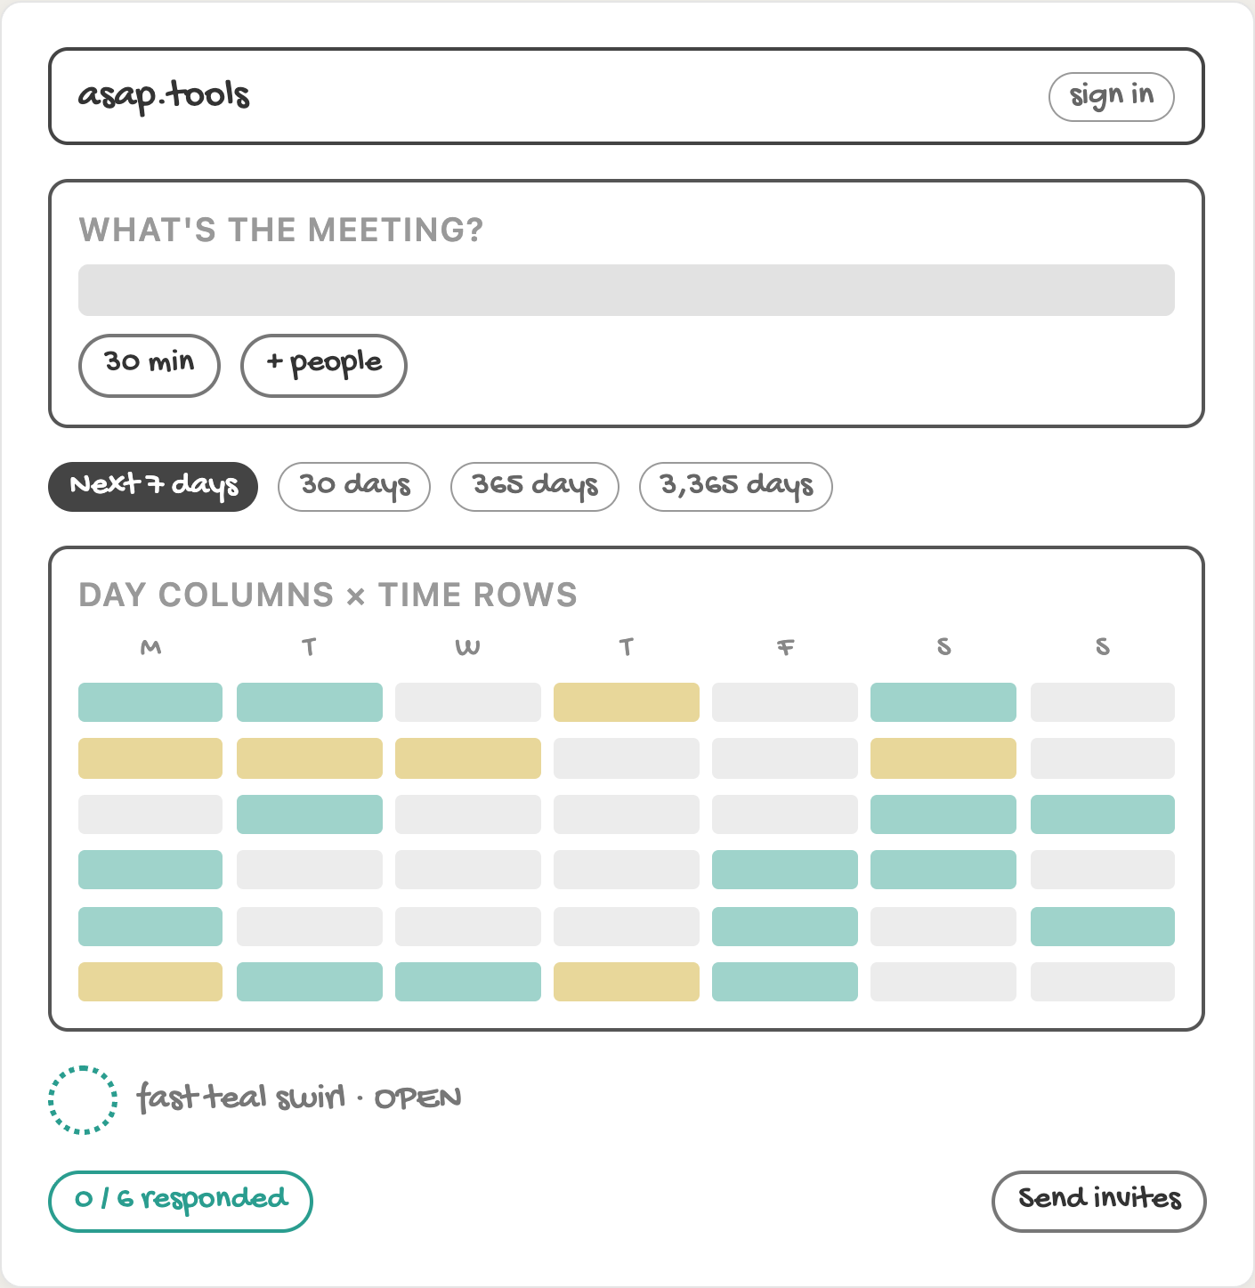
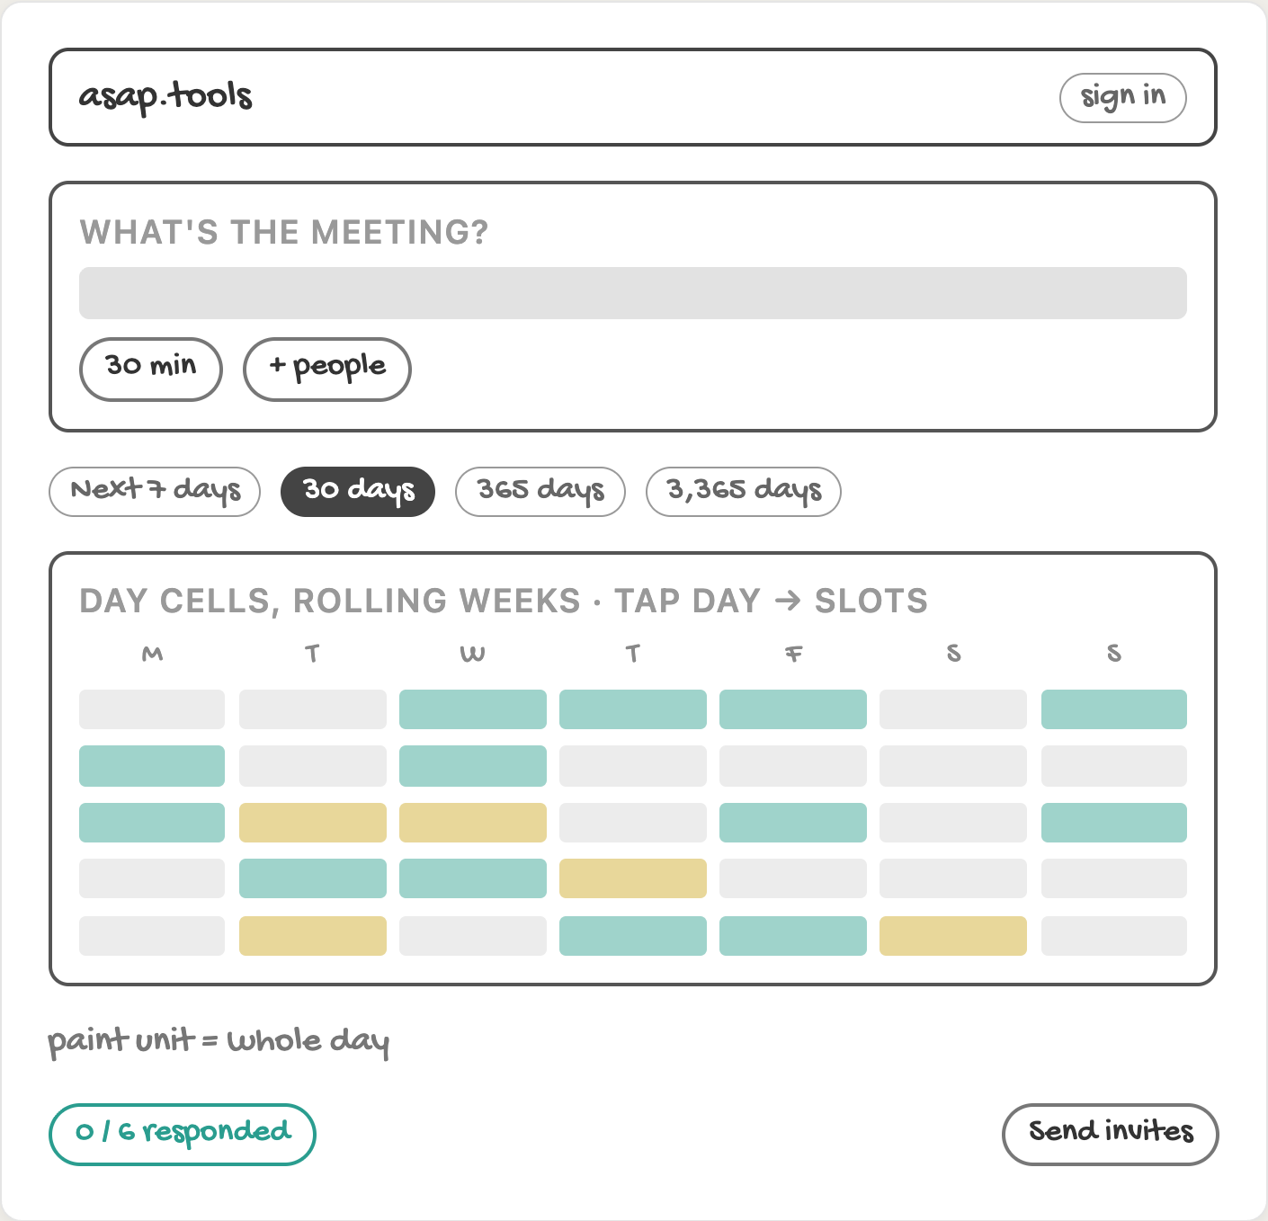
ROUND 3 · SCHEDULING PAGE
Calendar views: 7 and 30 days
3a
/ · Next 7 days (default, create)
3b
/ · Next 30 days
Notes:
The view sets the scheduling window. 7 days is the default and paints time slots; 30 days paints whole days.

Slide 4
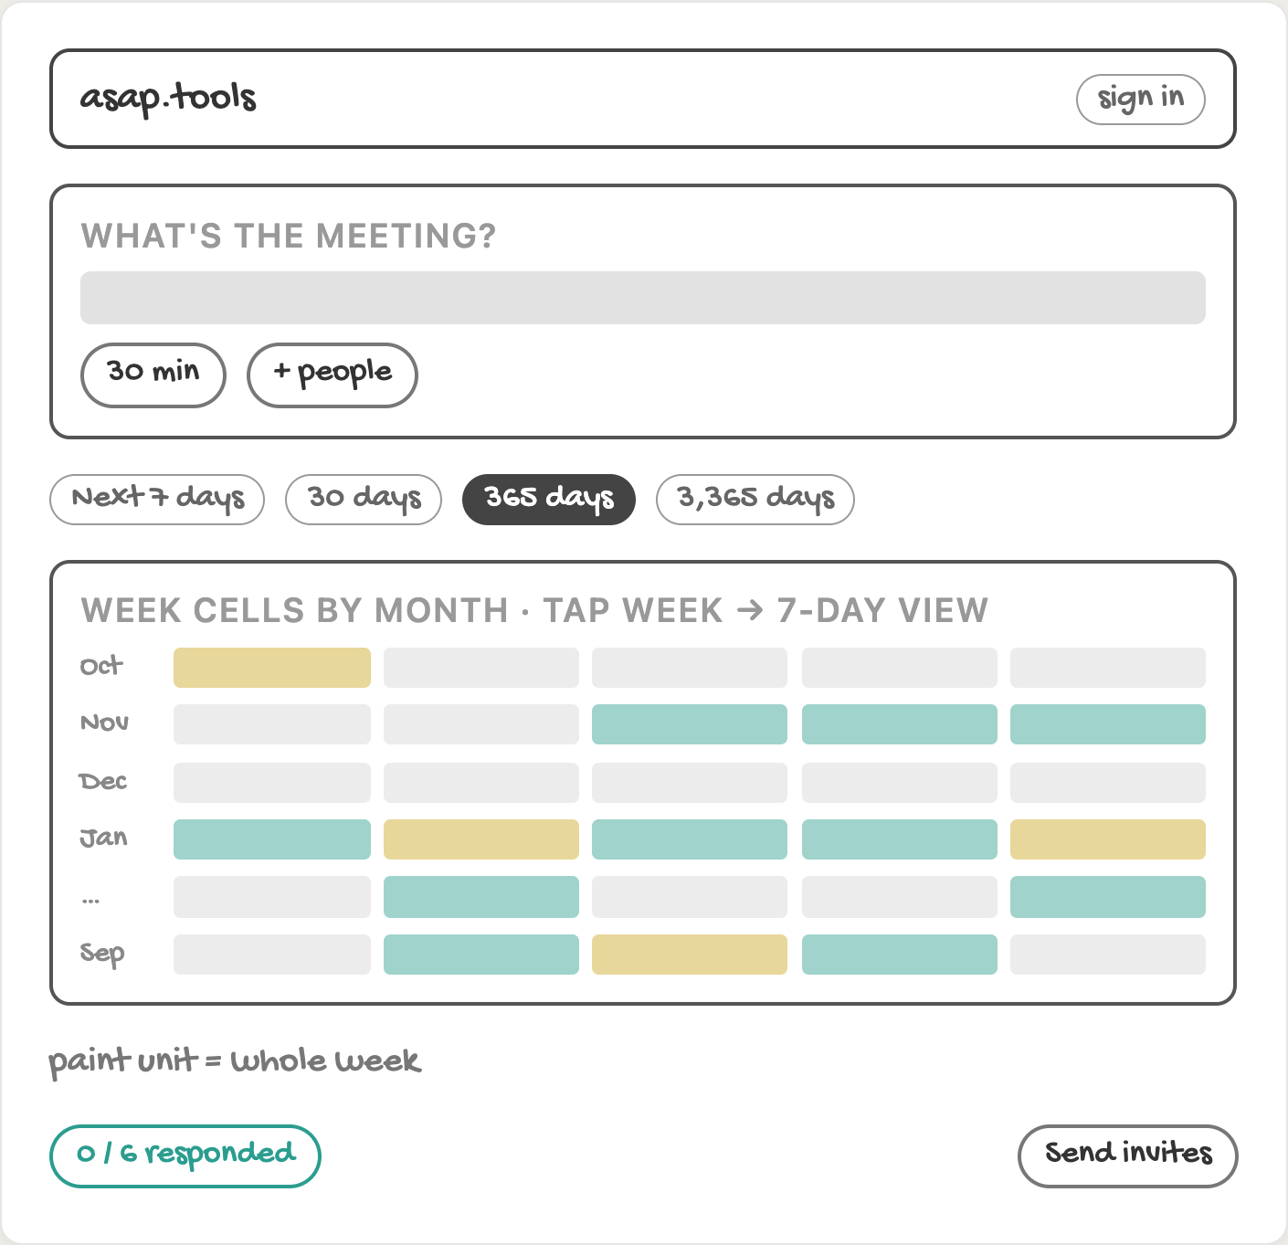
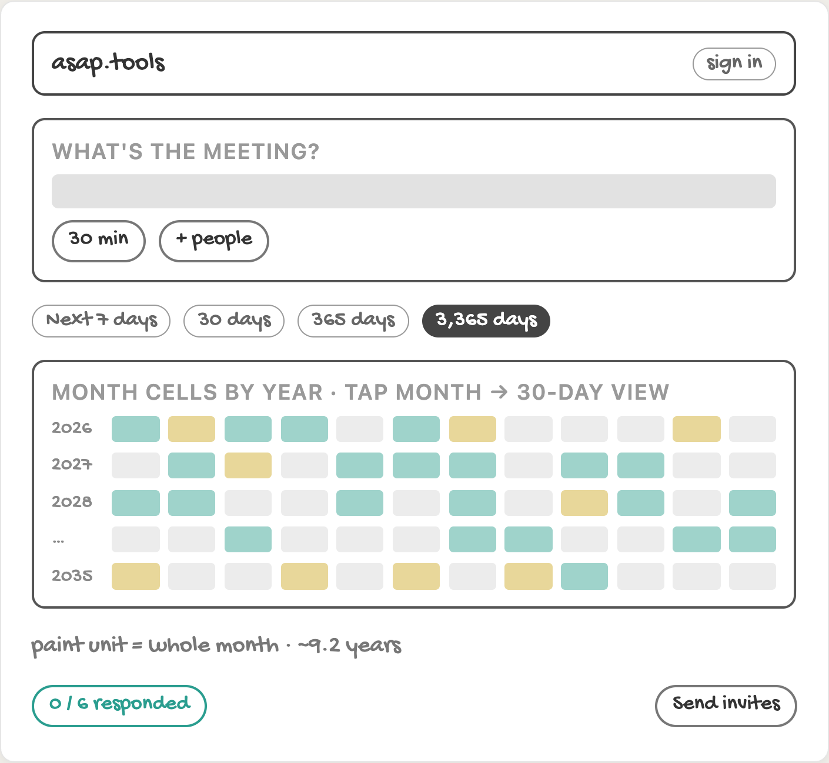
ROUND 3 · SCHEDULING PAGE
Calendar views: 365 and 3,365 days
3c
/ · Next 365 days
3d
/ · Next 3,365 days
Notes:
365 days paints whole weeks; 3,365 days paints whole months. Tapping drills down a level.

Slide 5
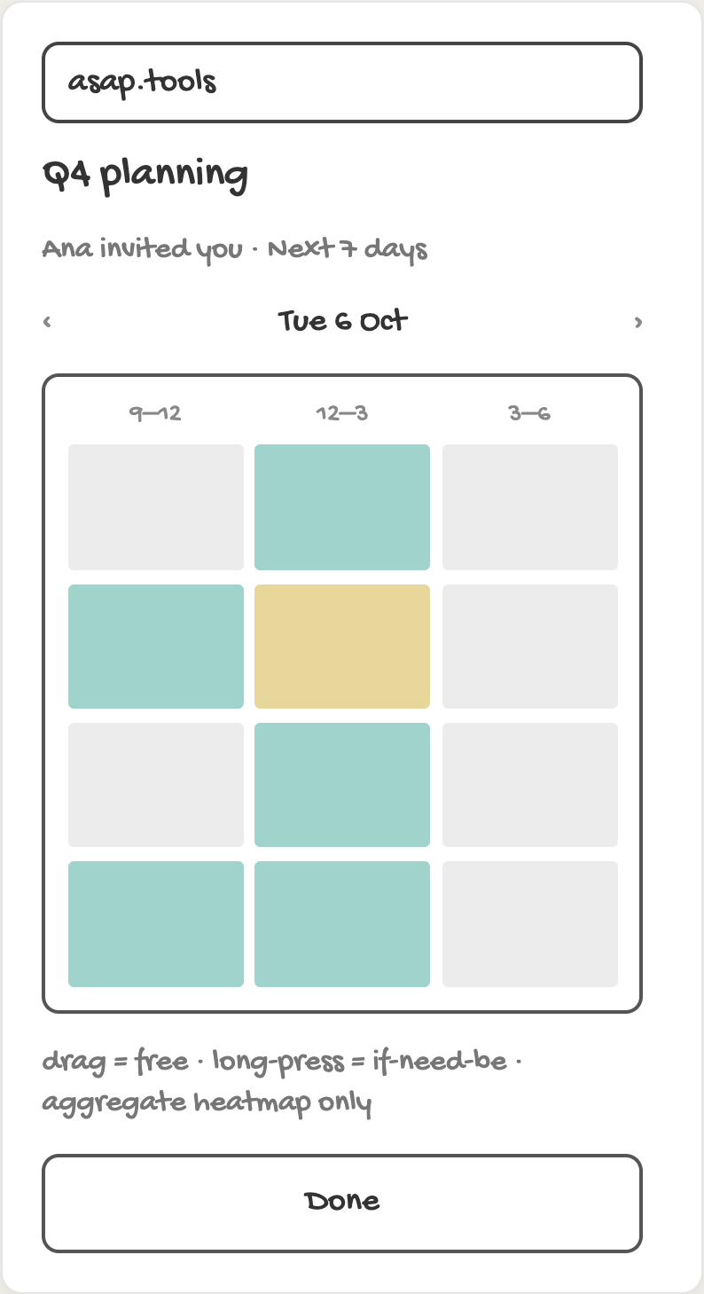
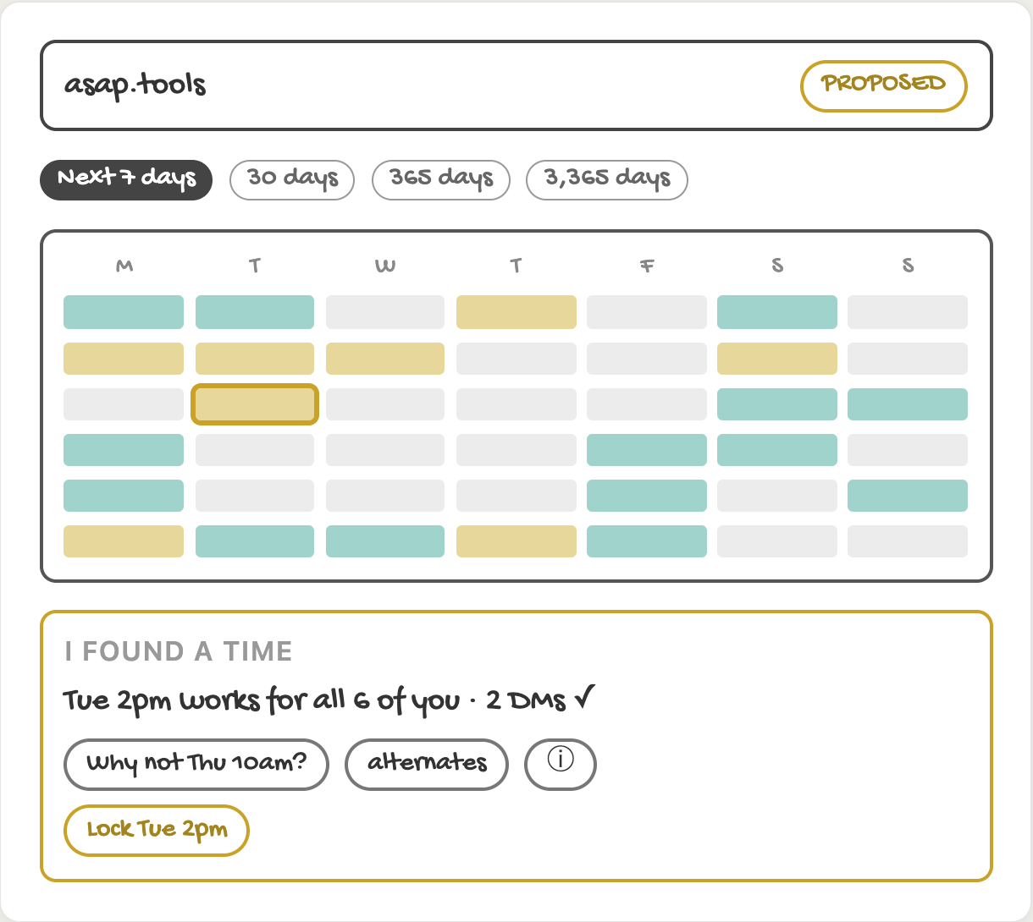
ROUND 3 · SCHEDULING PAGE
Invitee paint and reveal
3e
/s/:token · invitee paint, mobile
3f
/ · PROPOSED — grid-anchored reveal
Notes:
Invitees paint on mobile from the invite link. When responses are in, the orb docks on the winning cell with one proposal.

Slide 6
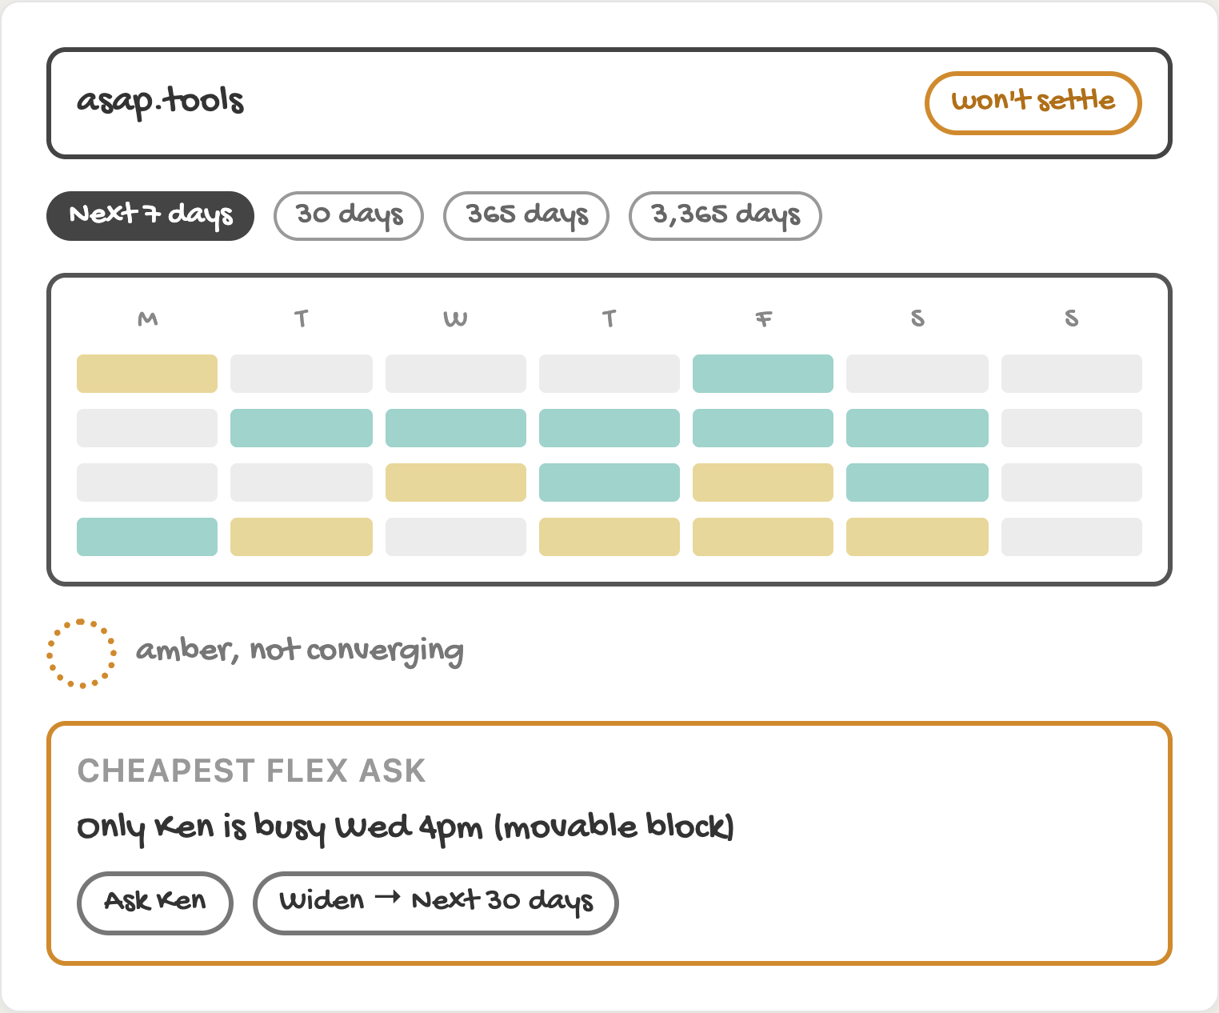
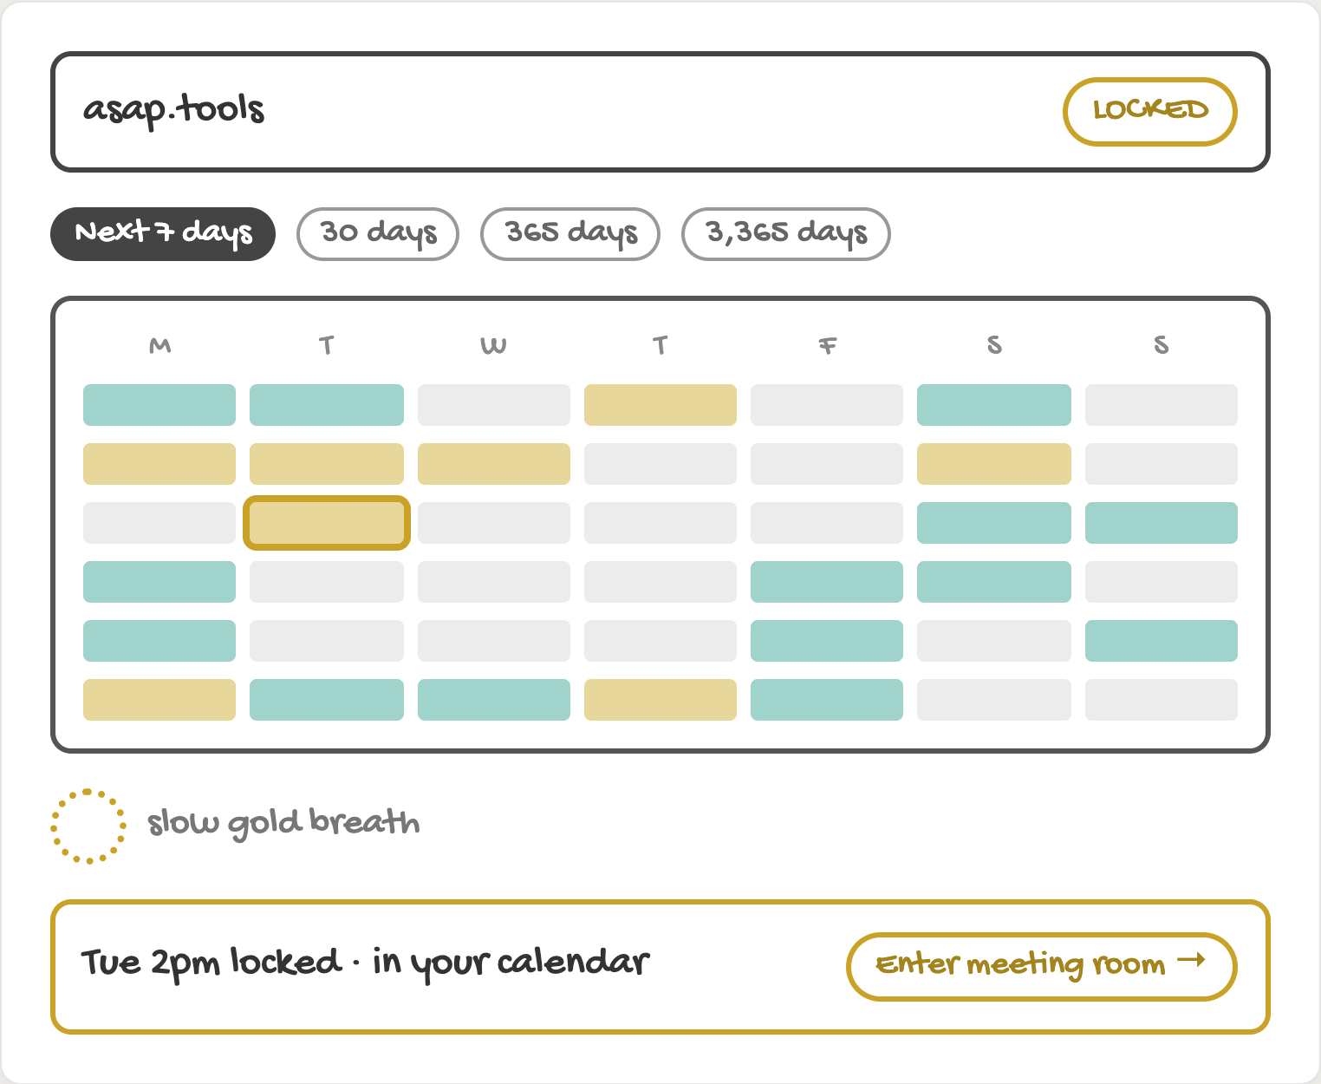
ROUND 3 · SCHEDULING PAGE
No common slot, then lock
3g
/ · no common slot
3h
/ · LOCKED
Notes:
If nothing works, the cheapest flex ask is named; failing that, widen to the next view. Lock shows the Enter meeting room bar.

Slide 7
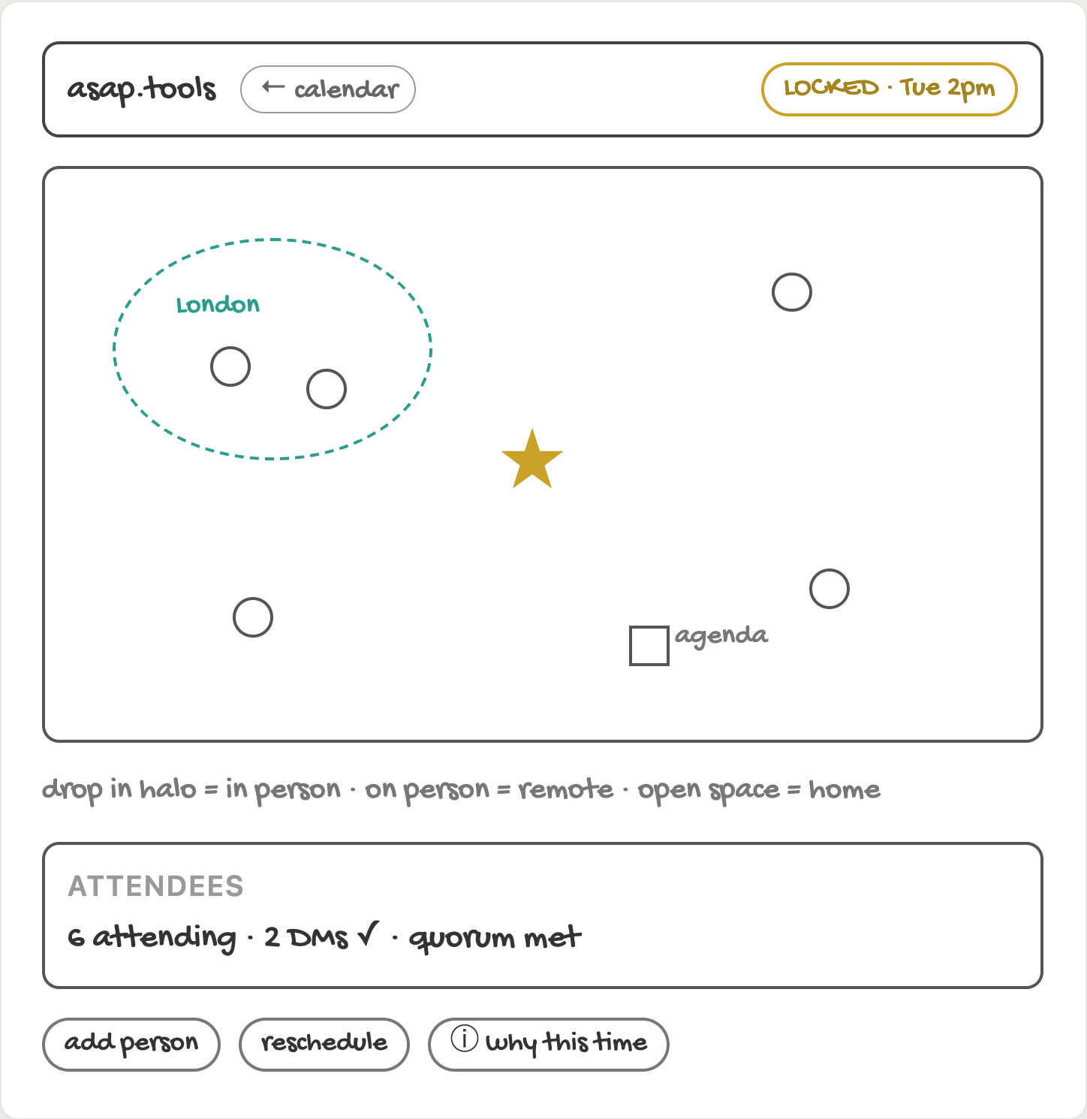
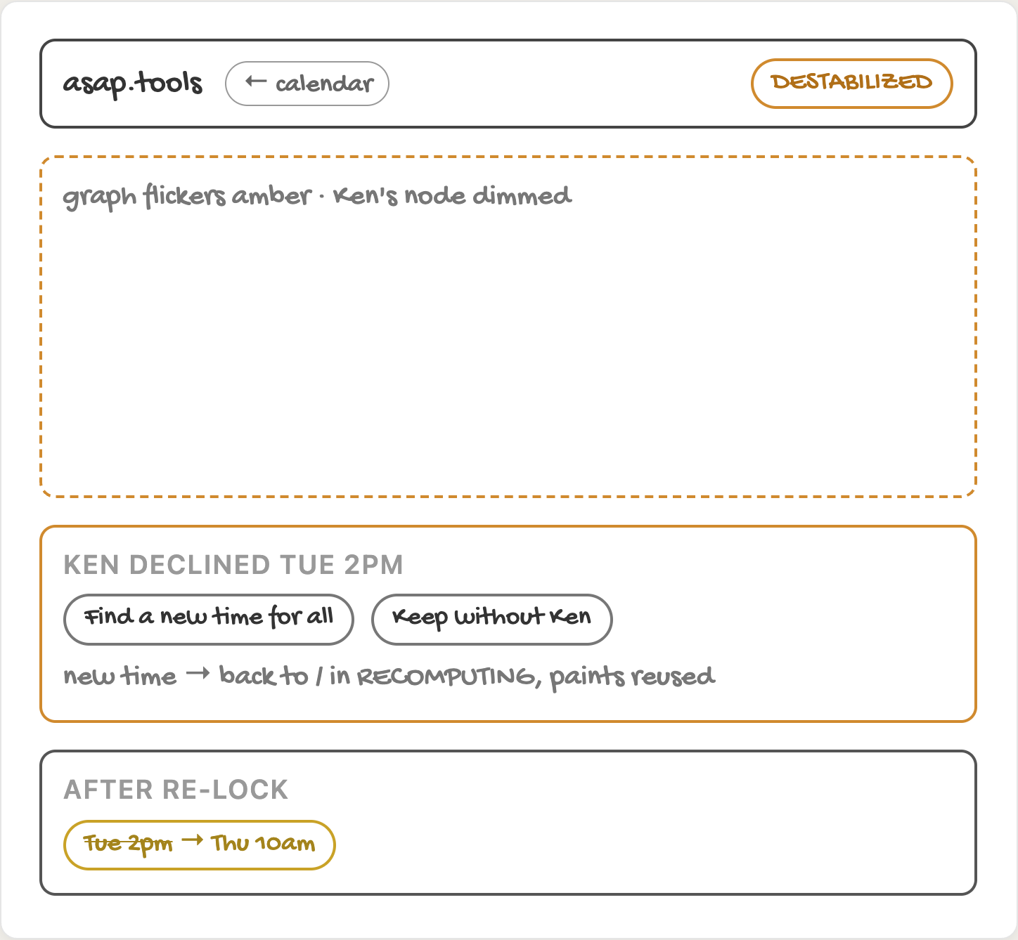
ROUND 3 · MEETING ROOM
Room and reschedule
3i
/m/:id · meeting room
3j
/m/:id · DESTABILIZED → reschedule
Notes:
The room shows attendees by city; drag to join in person or remote. A decline flips it amber and routes back to the calendar.

Slide 8
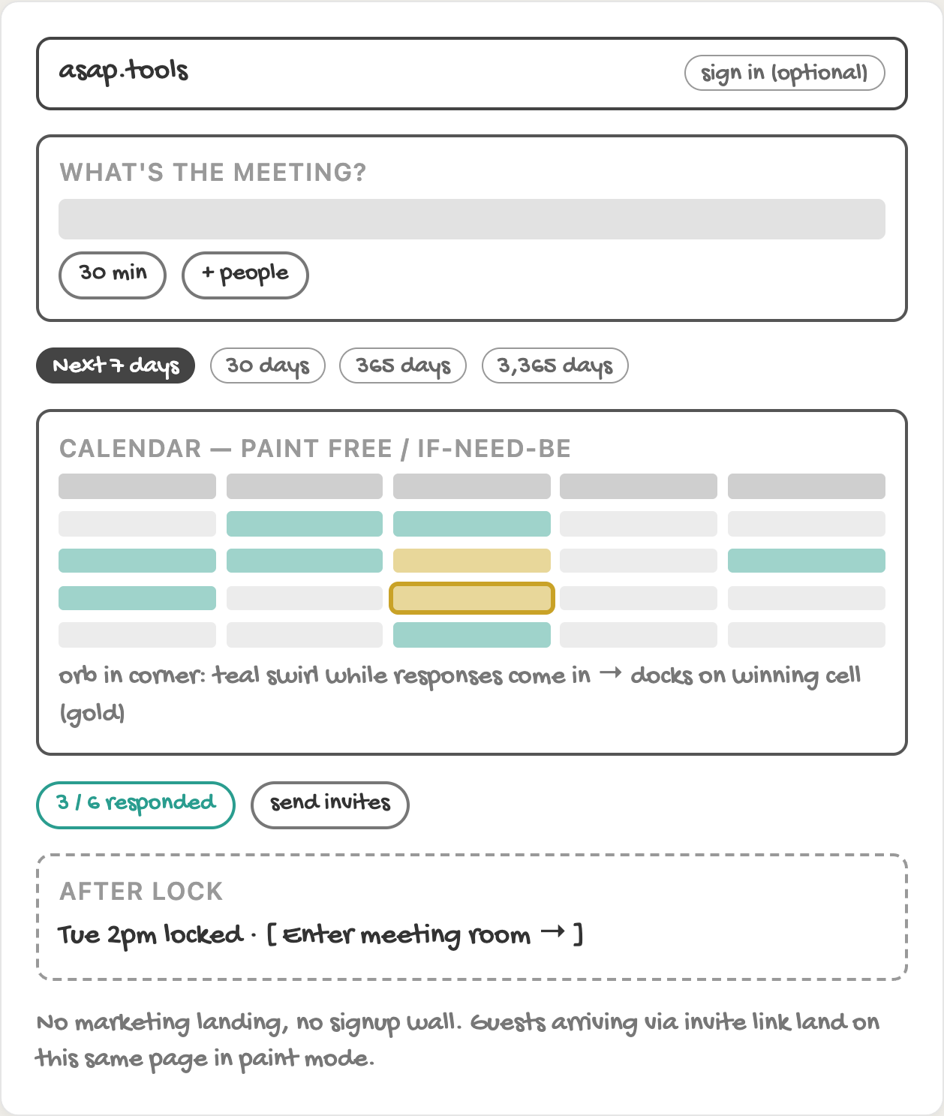
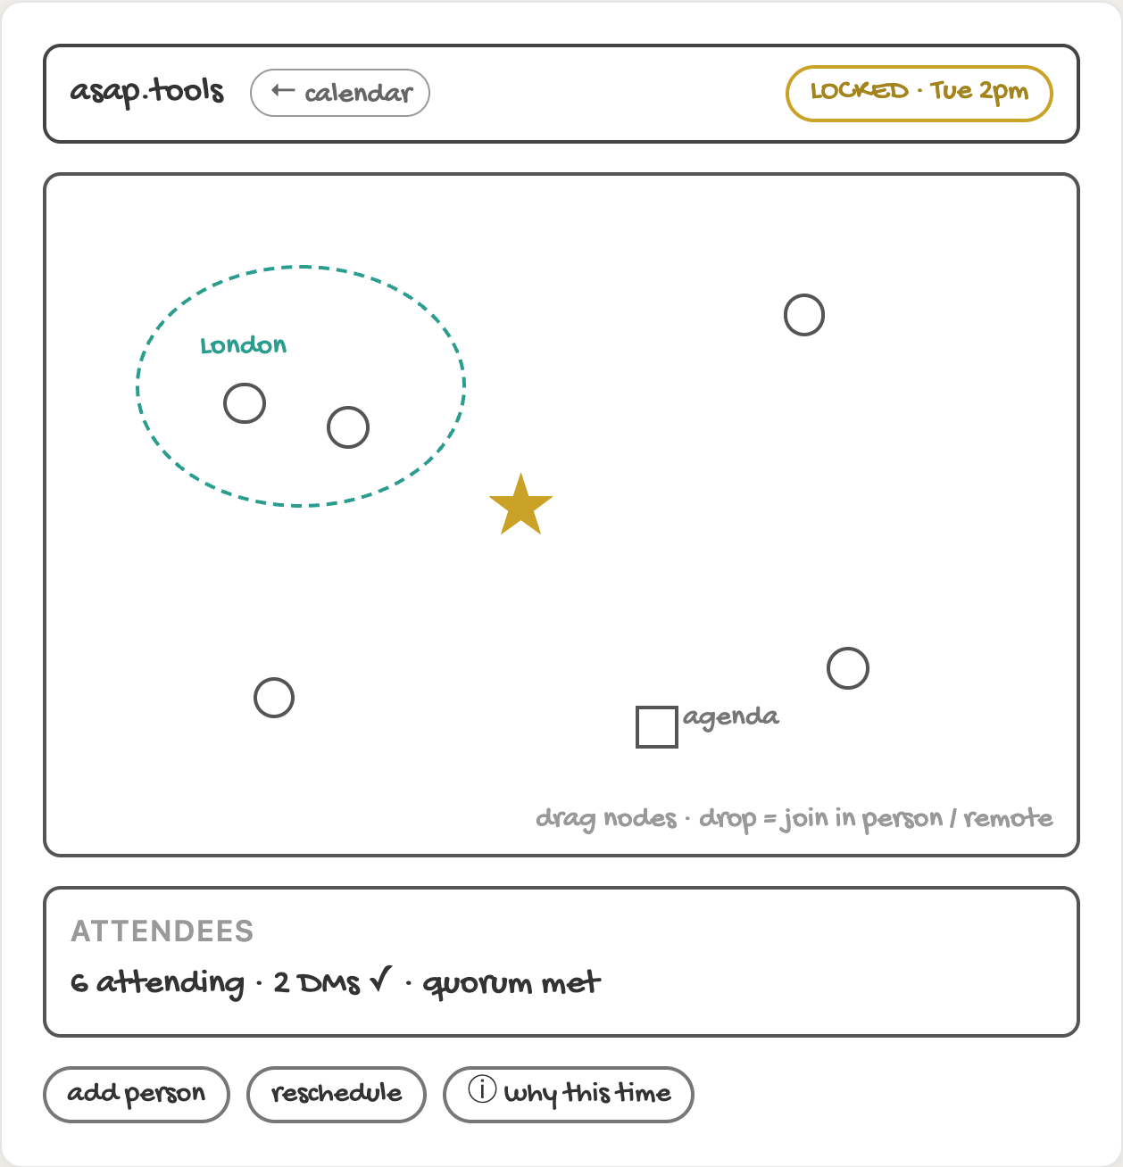
ROUND 2
Entry flow
2a
www.asap.tools → Scheduling page
2b
Meeting room (asap.tools/m/:id)
Notes:
The first sketch of the root route: www.asap.tools opens the calendar, then the meeting room.

Slide 9
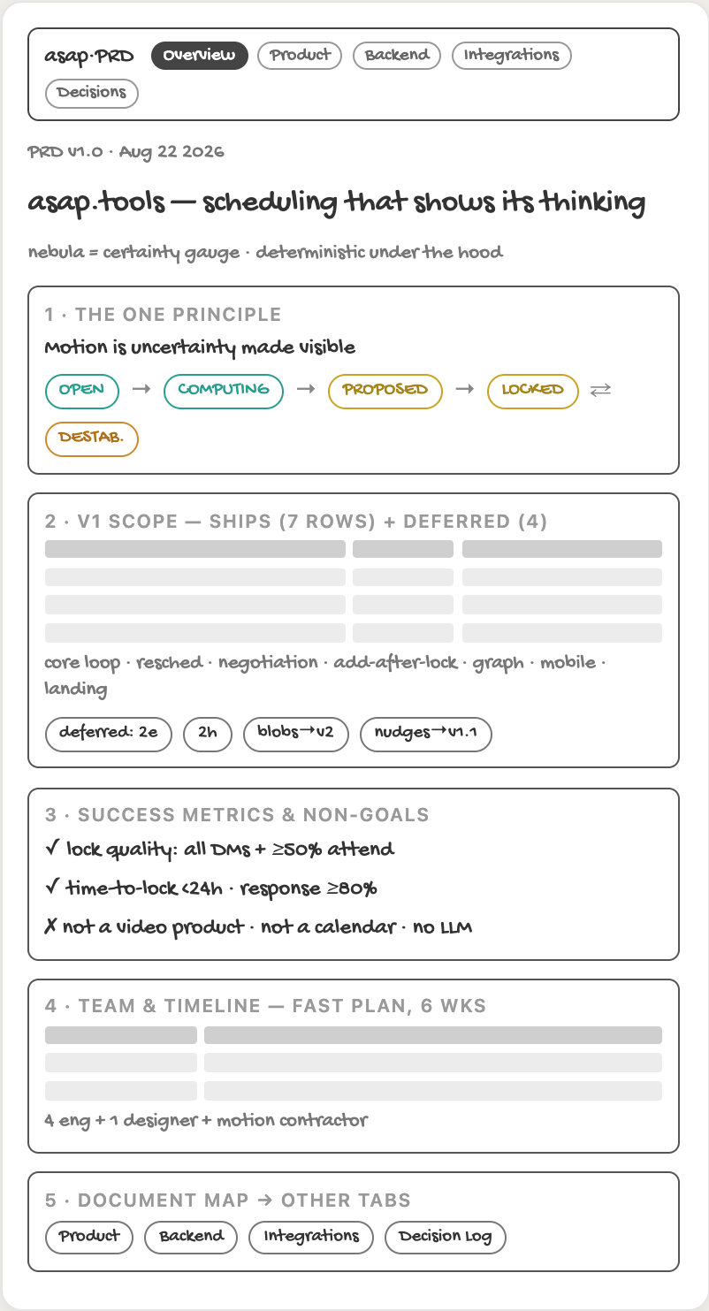
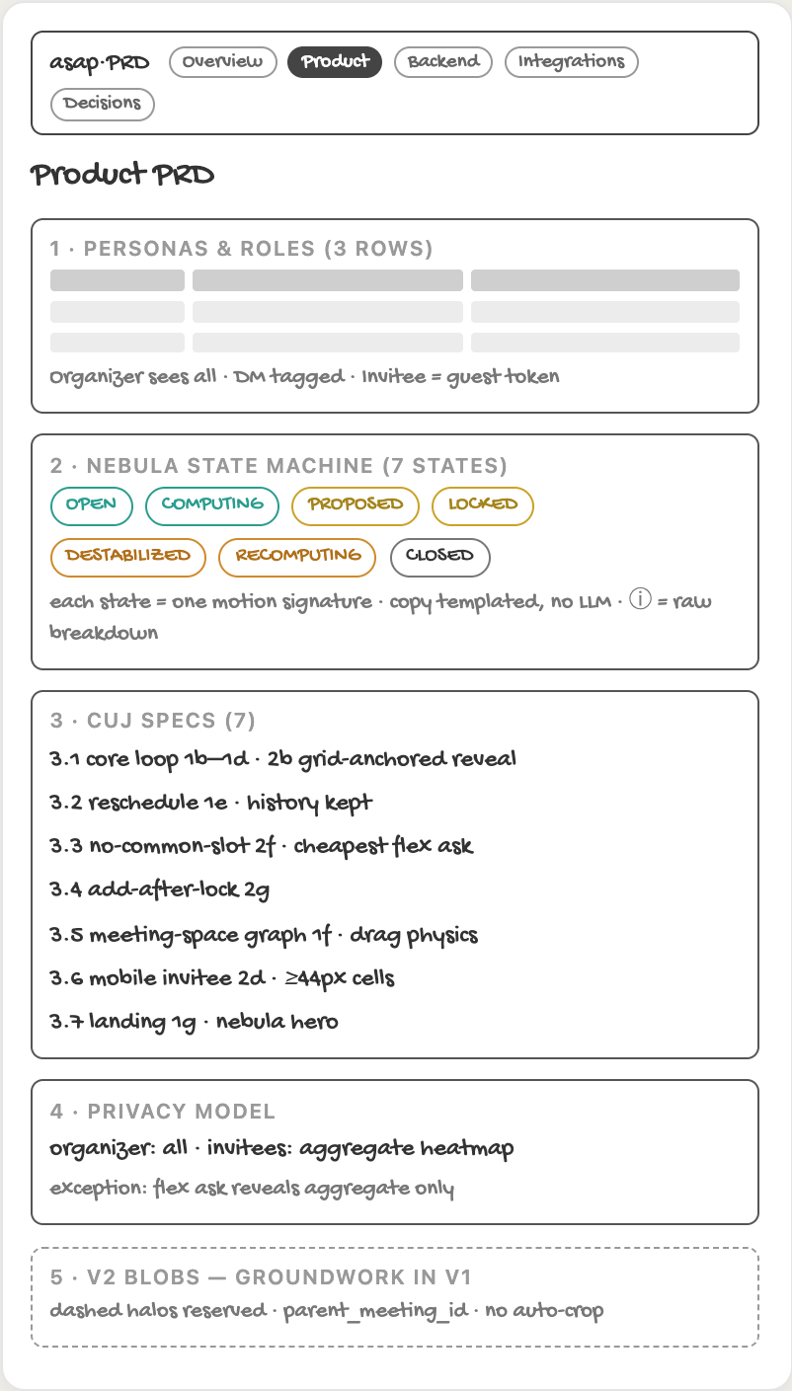
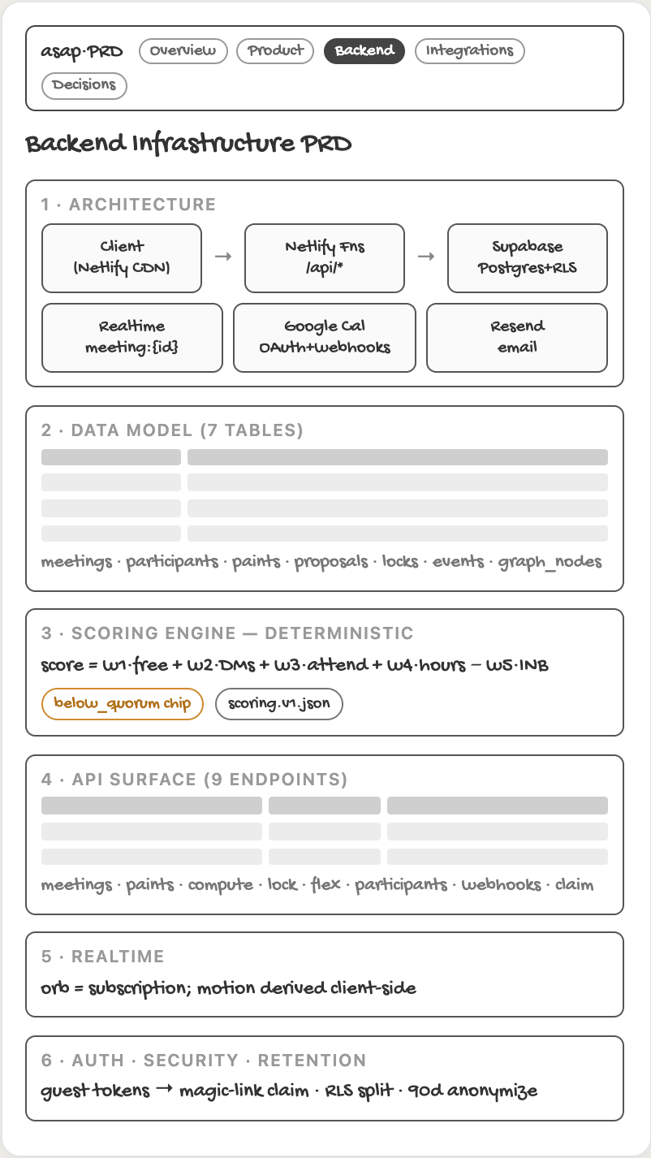
ROUND 1 · PRD SITE
Overview, Product, Backend
1a
Tab 1 · Overview
1b
Tab 2 · Product PRD
1c
Tab 3 · Backend PRD
Notes:
One wireframe per tab of the original PRD site.

Slide 10
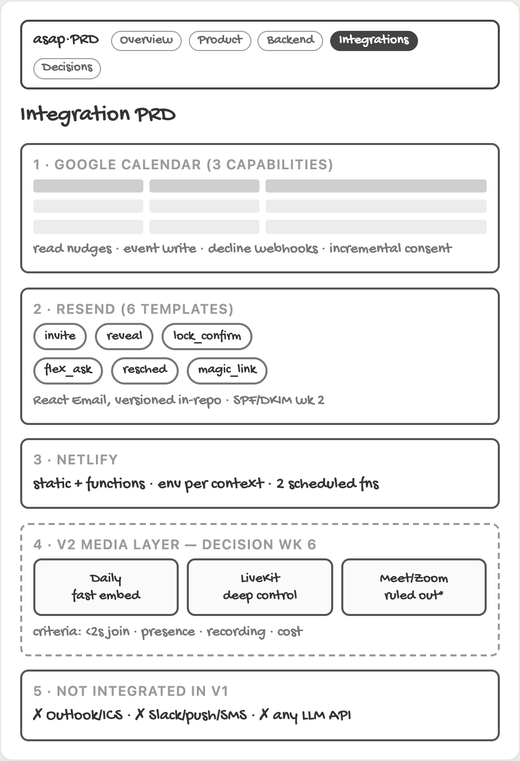
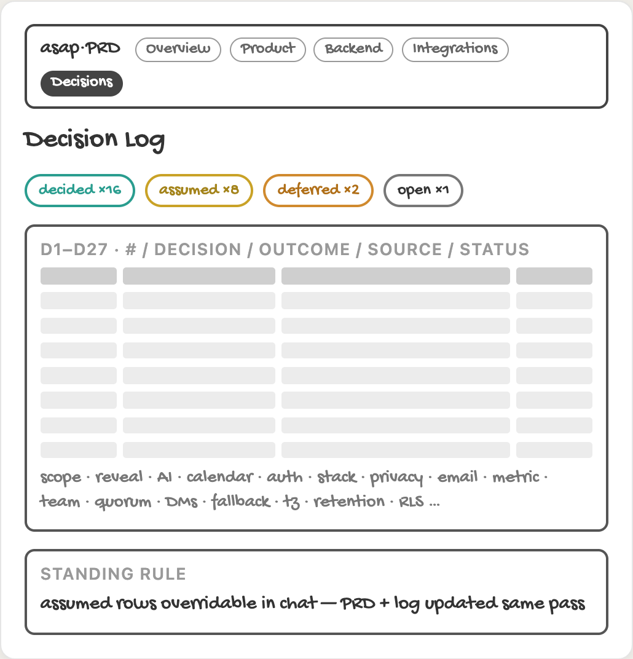
ROUND 1 · PRD SITE
Integrations, Decision Log
1d
Tab 4 · Integration PRD
1e
Tab 5 · Decision Log
Notes:
One wireframe per tab of the original PRD site.

