Slide 1
IMS project
Iman Kassim

Slide 2
Introduction
Agile project
Create an Inventory Management System that contains:
Customers
Items
Orders

Slide 3
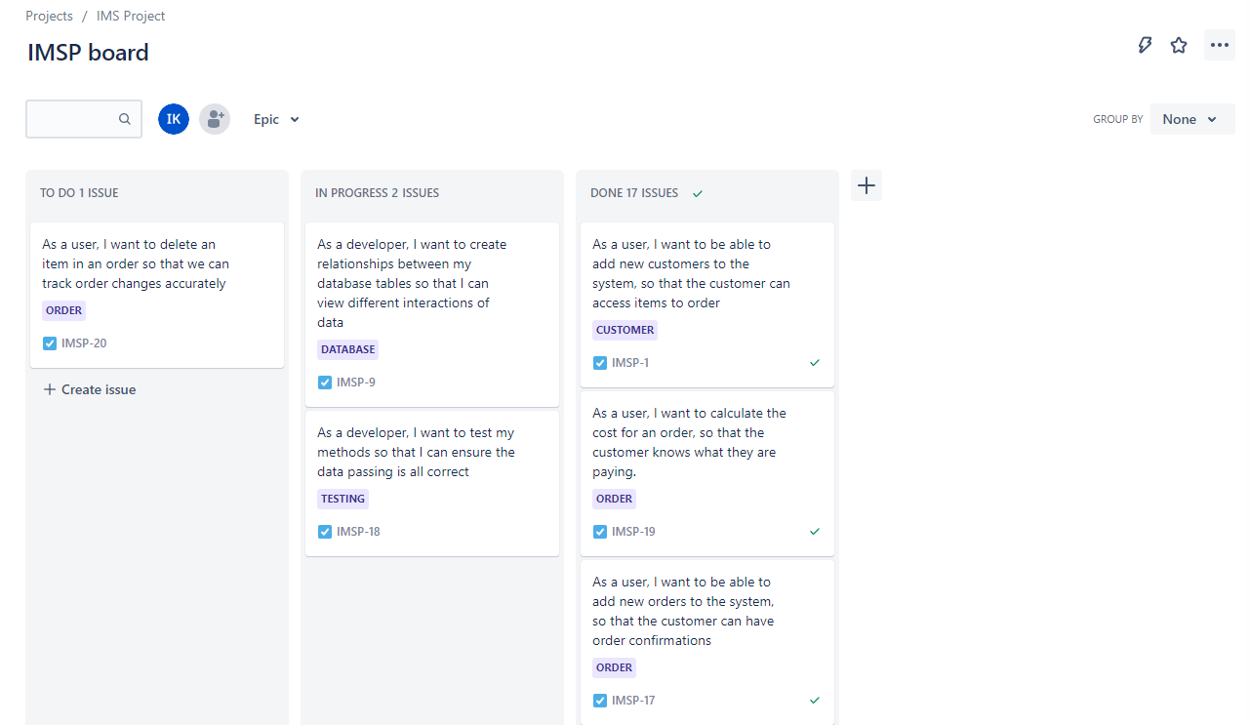
JIRA

Slide 4
MVP
Create application that can be used from the command line
Customer | Item | Order
Add a customer to the system View all customers in the system Update a customer in the system Delete a customer in the system | Add an item to the system View all items in the system Update an item in the system Delete an item in the system | Create an order in the system. View all orders in the system. Delete an order in the system Add an item to an order. Calculate a cost for an order. Delete an item in an order

Slide 5
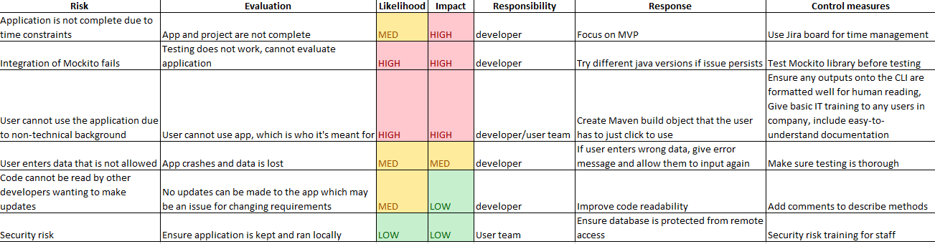
Risk assessment

Slide 6
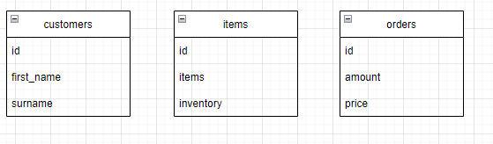
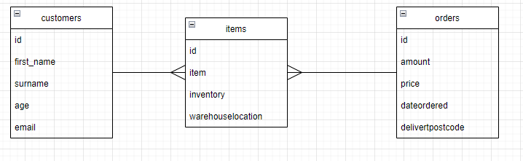
ERD + users (tables)
<- Current
Next Sprint ->
Notes:
Not currently implemented, will be moved to the next sprint

Slide 7
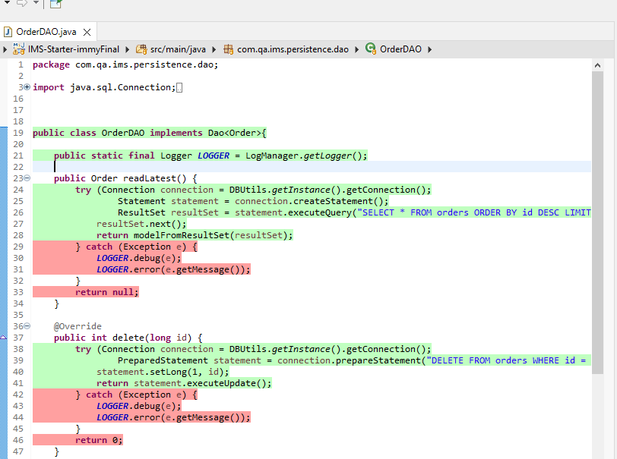
Code functionality

Slide 8
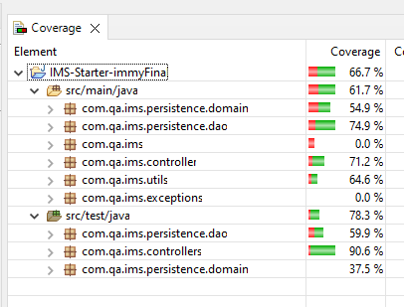
Test functionality
JUnit + Mockito testing

Slide 9
Reflections
WHAT WENT WELL MVP achieved Gives user another chance to input if they enter the wrong thing in the CLI |  | WHAT DIDN’T GO WELL Ran out of time due to illness Relationships between tables not established Issues with some tests Work is pushed to dev but not master because of merge conflicts |  | IMPROVEMENTS Account for time better Improve Jira setup – add more detail Revise over GitHub and commands to avoid further conflicts

