Slide 1
IMS project
Iman Kassim

Slide 2
Introduction
Agile project
Create an Inventory Management System that contains:
Customers
Items
Orders

Slide 3
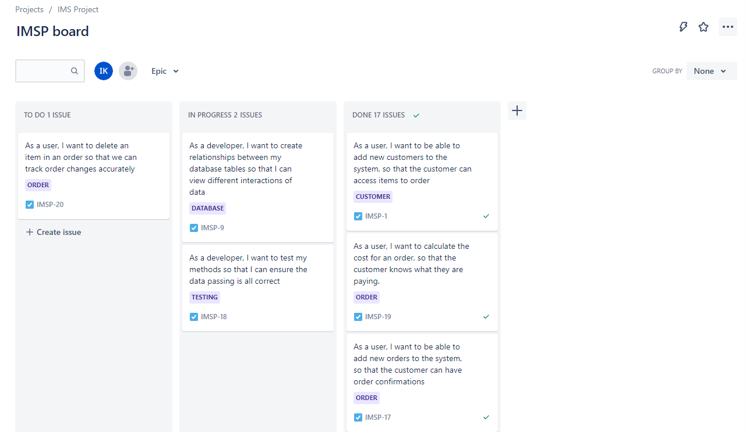
JIRA

Slide 4
MVP
Create application that can be used from the command line
Customer | Item | Order
Add a customer to the system View all customers in the system Update a customer in the system Delete a customer in the system | Add an item to the system View all items in the system Update an item in the system Delete an item in the system | Create an order in the system. View all orders in the system. Delete an order in the system Add an item to an order. Calculate a cost for an order. Delete an item in an order

Slide 5
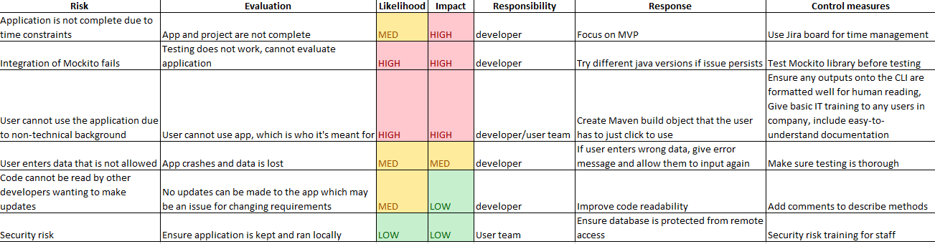
Risk assessment

Slide 6
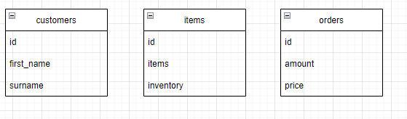
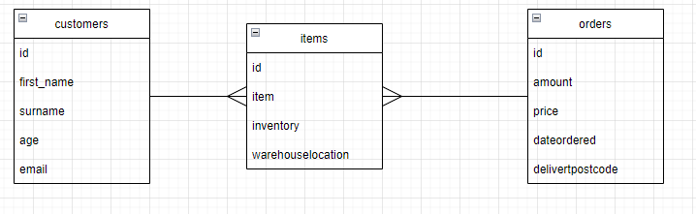
ERD + users (tables)
<- Current
Next Sprint ->
Notes:
Not currently implemented, will be moved to the next sprint

Slide 7
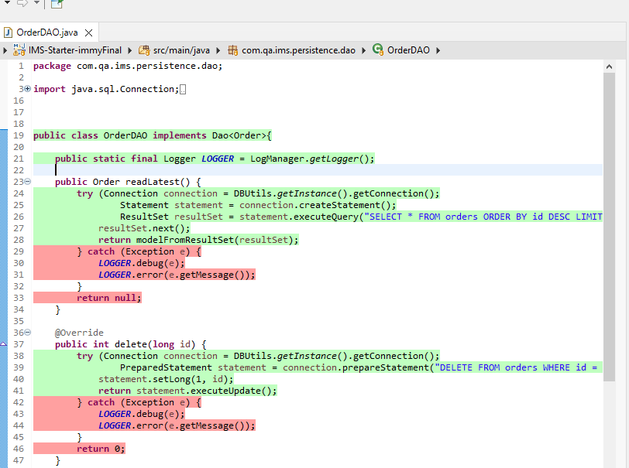
Code functionality

Slide 8
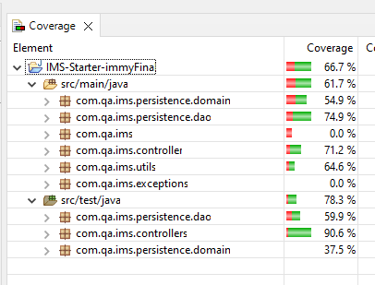
Test functionality
JUnit + Mockito testing

